Slide 1

Lecture 16 More problems on the Greedy Method
CS 161 Design and Analysis of Algorithms
Ioannis Panageas

Slide 2
Greedy method
The greedy method is a general algorithm design technique, in which given:
configurations: different choices we need to make
objective function: a score assigned to all configurations, which we want to either maximize or minimize
We should make choices greedily: We can find a globally-optimal solution by a series of local improvements from a starting configuration.

Slide 3
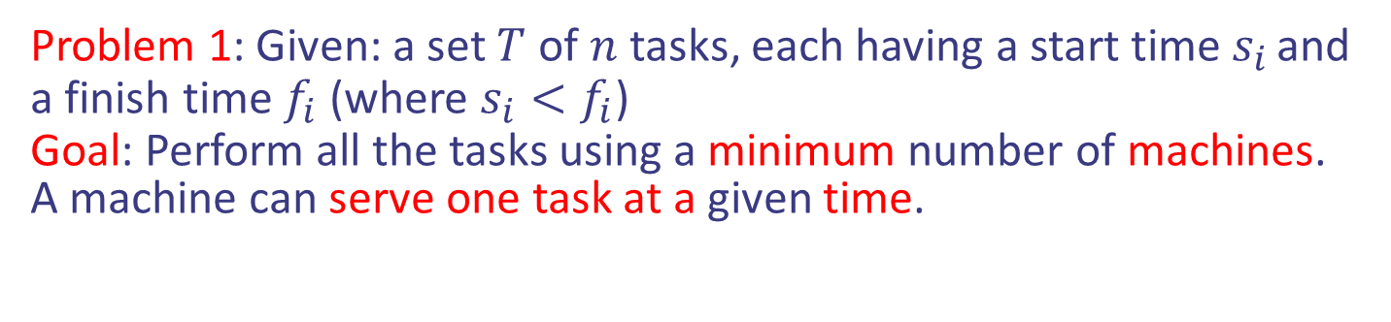
Scheduling jobs/tasks
Problem 1: Given: a set $T$ of $n$ tasks, each having a start time $s_{i}$ and a finish time $f_{i}$ (where $s_{i}<f_{i}$)
Goal: Perform all the tasks using a minimum number of machines.
A machine can serve one task at a given time.

Slide 4
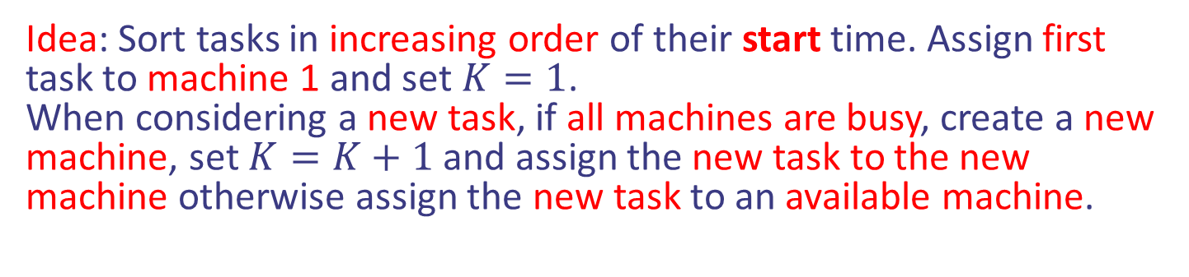
Scheduling jobs/tasks
Problem 1: Given: a set $T$ of $n$ tasks, each having a start time $s_{i}$ and a finish time $f_{i}$ (where $s_{i}<f_{i}$)
Goal: Perform all the tasks using a minimum number of machines.
A machine can serve one task at a given time.
Idea: Sort tasks in increasing order of their start time. Assign first task to machine 1 and set $K=1$.
When considering a new task, if all machines are busy, create a new machine, set $K=K+1$ and assign the new task to the new machine otherwise assign the new task to an available machine.

Slide 5
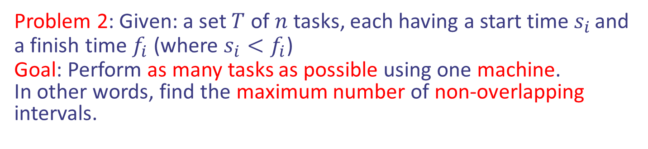
Scheduling jobs/tasks
Problem 2: Given: a set $T$ of $n$ tasks, each having a start time $s_{i}$ and a finish time $f_{i}$ (where $s_{i}<f_{i}$)
Goal: Perform as many tasks as possible using one machine.
In other words, find the maximum number of non-overlapping intervals.

Slide 6
Scheduling jobs/tasks
Problem 2: Given: a set $T$ of $n$ tasks, each having a start time $s_{i}$ and a finish time $f_{i}$ (where $s_{i}<f_{i}$)
Goal: Perform as many tasks as possible using one machine.
In other words, find the maximum number of non-overlapping intervals.
Idea: Sort tasks in increasing order of their finish time. Perform first task and remove all overlapping tasks with first task. Repeat the same process to the remaining tasks.

Slide 7
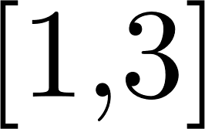
Scheduling jobs/tasks
Problem 2: Given: a set $T$ of $n$ tasks, each having a start time $s_{i}$ and a finish time $f_{i}$ (where $s_{i}<f_{i}$)
Goal: Perform as many tasks as possible using one machine.
In other words, find the maximum number of non-overlapping intervals.
Idea: Sort tasks in increasing order of their finish time. Perform first task and remove all overlapping tasks with first task. Repeat the same process to the remaining tasks.

Slide 8
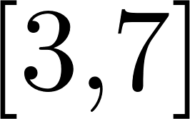
Scheduling jobs/tasks
Problem 2: Given: a set $T$ of $n$ tasks, each having a start time $s_{i}$ and a finish time $f_{i}$ (where $s_{i}<f_{i}$)
Goal: Perform as many tasks as possible using one machine.
In other words, find the maximum number of non-overlapping intervals.
Idea: Sort tasks in increasing order of their finish time. Perform first task and remove all overlapping tasks with first task. Repeat the same process to the remaining tasks.

Slide 9
Scheduling jobs/tasks
Problem 2: Given: a set $T$ of $n$ tasks, each having a start time $s_{i}$ and a finish time $f_{i}$ (where $s_{i}<f_{i}$)
Goal: Perform as many tasks as possible using one machine.
In other words, find the maximum number of non-overlapping intervals.
Idea: Sort tasks in increasing order of their finish time. Perform first task and remove all overlapping tasks with first task. Repeat the same process to the remaining tasks.

Slide 10
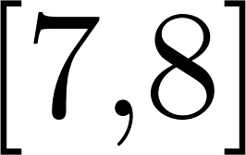
Scheduling jobs/tasks
Problem 2: Given: a set $T$ of $n$ tasks, each having a start time $s_{i}$ and a finish time $f_{i}$ (where $s_{i}<f_{i}$)
Goal: Perform as many tasks as possible using one machine.
In other words, find the maximum number of non-overlapping intervals.
Idea: Sort tasks in increasing order of their finish time. Perform first task and remove all overlapping tasks with first task. Repeat the same process to the remaining tasks.

Slide 11
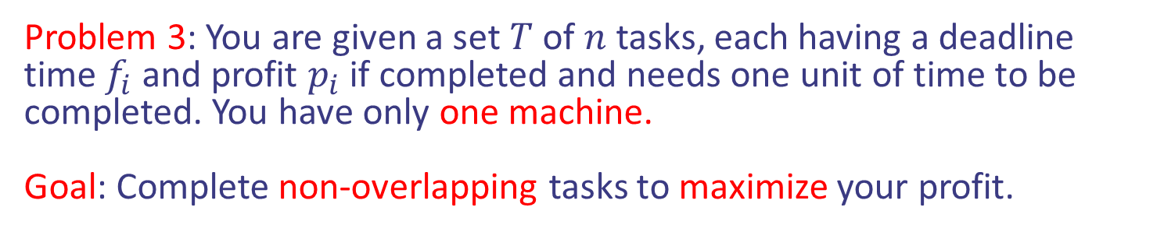
Scheduling jobs/tasks
Problem 3: You are given a set $T$ of $n$ tasks, each having a deadline time $f_{i}$ and profit $p_{i}$ if completed and needs one unit of time to be completed. You have only one machine.
Goal: Complete non-overlapping tasks to maximize your profit.

Slide 12
Scheduling jobs/tasks
Problem 3: You are given a set $T$ of $n$ tasks, each having a deadline time $f_{i}$ and profit $p_{i}$ if completed and needs one unit of time to be completed. You have only one machine.
Goal: Complete non-overlapping tasks to maximize your profit.

Slide 13
Scheduling jobs/tasks
Problem 3: You are given a set $T$ of $n$ tasks, each having a deadline time $f_{i}$ and profit $p_{i}$ if completed and needs one unit of time to be completed. You have only one machine.
Goal: Complete non-overlapping tasks to maximize your profit.
Idea: Sort tasks in decreasing order of their profit. Repeat the following until run out of tasks: Choose first task and schedule it at the latest time possible without exceeding deadline. If not possible, discard the task.

Slide 14
Scheduling jobs/tasks
Problem 3: You are given a set $T$ of $n$ tasks, each having a deadline time $f_{i}$ and profit $p_{i}$ if completed and needs one unit of time to be completed. You have only one machine.
Goal: Complete non-overlapping tasks to maximize your profit.
Idea: Sort tasks in decreasing order of their profit. Repeat the following until run out of tasks: Choose first task and schedule it at the latest time possible without exceeding deadline. If not possible, discard the task.

Slide 15
Scheduling jobs/tasks
Problem 3: You are given a set $T$ of $n$ tasks, each having a deadline time $f_{i}$ and profit $p_{i}$ if completed and needs one unit of time to be completed. You have only one machine.
Goal: Complete non-overlapping tasks to maximize your profit.
Idea: Sort tasks in decreasing order of their profit. Repeat the following until run out of tasks: Choose first task and schedule it at the latest time possible without exceeding deadline. If not possible, discard the task.

Slide 16
Scheduling jobs/tasks
Problem 3: You are given a set $T$ of $n$ tasks, each having a deadline time $f_{i}$ and profit $p_{i}$ if completed and needs one unit of time to be completed. You have only one machine.
Goal: Complete non-overlapping tasks to maximize your profit.
Idea: Sort tasks in decreasing order of their profit. Repeat the following until run out of tasks: Choose first task and schedule it at the latest time possible without exceeding deadline. If not possible, discard the task.

Slide 17
Scheduling jobs/tasks
Problem 3: You are given a set $T$ of $n$ tasks, each having a deadline time $f_{i}$ and profit $p_{i}$ if completed and needs one unit of time to be completed. You have only one machine.
Goal: Complete non-overlapping tasks to maximize your profit.
Idea: Sort tasks in decreasing order of their profit. Repeat the following until run out of tasks: Choose first task and schedule it at the latest time possible without exceeding deadline. If not possible, discard the task.

Slide 18
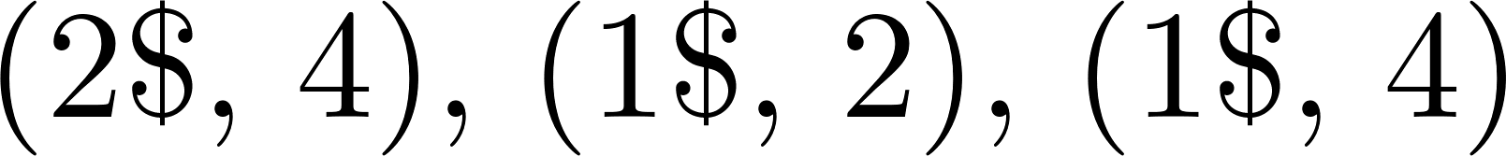
Scheduling jobs/tasks
Problem 3: You are given a set $T$ of $n$ tasks, each having a deadline time $f_{i}$ and profit $p_{i}$ if completed and needs one unit of time to be completed. You have only one machine.
Goal: Complete non-overlapping tasks to maximize your profit.
Idea: Sort tasks in decreasing order of their profit. Repeat the following until run out of tasks: Choose first task and schedule it at the latest time possible without exceeding deadline. If not possible, discard the task.

Slide 19

Problems on trees using Greedy
Definition: Given a graph $G$, a matching is a collection of edges that do not share a vertex.
Notes:
Exercise: guess merge sort

Slide 20


Problems on trees using Greedy
Definition: Given a graph $G$, a matching is a collection of edges that do not share a vertex.
Notes:
Exercise: guess merge sort

Slide 21


Problems on trees using Greedy
Definition: Given a graph $G$, a matching is a collection of edges that do not share a vertex.
Notes:
Exercise: guess merge sort

Slide 22

Problems on trees using Greedy
Definition: Given a graph $G$, a matching is a collection of edges that do not share a vertex.
Problem: Given a tree graph, compute/find a maximum matching.
Notes:
Exercise: guess merge sort

Slide 23






Problems on trees using Greedy
Definition: Given a graph $G$, a matching is a collection of edges that do not share a vertex.
Problem: Given a tree graph, compute/find a maximum matching. We know how to do it for bipartite graphs via maxflow!!
Notes:
Exercise: guess merge sort

Slide 24
Problems on trees using Greedy
Definition: Given a graph $G$, a matching is a collection of edges that do not share a vertex.
Problem: Given a tree graph, compute/find a maximum matching. We know how to do it for bipartite graphs via maxflow!!
Trees are bipartite!
Notes:
Exercise: guess merge sort

Slide 25
Maximum Matching on trees
Problem: Given a tree graph, compute/find a maximum matching.
Do not use Maxflow, but directly Greedy.
Question: The green edge has a leaf as an endpoint. Should it be in the matching?
Design and Analysis of Algorithms

Slide 26
Maximum Matching on trees
Problem: Given a tree graph, compute/find a maximum matching.
Do not use Maxflow, but directly Greedy.
Idea: Choose an edge with one endpoint being a leaf and put it in the matching. Remove all other incident edges. The new graph is a union of trees. Repeat until run out of edges.
Design and Analysis of Algorithms

Slide 27
Maximum Matching on trees
Problem: Given a tree graph, compute/find a maximum matching.
Do not use Maxflow, but directly Greedy.
Idea: Choose an edge with one endpoint being a leaf and put it in the matching. Remove all other incident edges. The new graph is a union of trees. Repeat until run out of edges.
Design and Analysis of Algorithms

Slide 28

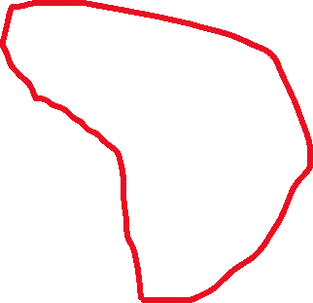
Maximum Matching on trees
Problem: Given a tree graph, compute/find a maximum matching.
Do not use Maxflow, but directly Greedy.
Idea: Choose an edge with one endpoint being a leaf and put it in the matching. Remove all other incident edges. The new graph is a union of trees. Repeat until run out of edges.
Design and Analysis of Algorithms

Slide 29
Maximum Matching on trees
Problem: Given a tree graph, compute/find a maximum matching.
Do not use Maxflow, but directly Greedy.
Idea: Choose an edge with one endpoint being a leaf and put it in the matching. Remove all other incident edges. The new graph is a union of trees. Repeat until run out of edges.
Design and Analysis of Algorithms

Slide 30
Maximum Matching on trees
Problem: Given a tree graph, compute/find a maximum matching.
Do not use Maxflow, but directly Greedy.
Idea: Choose an edge with one endpoint being a leaf and put it in the matching. Remove all other incident edges. The new graph is a union of trees. Repeat until run out of edges.
Design and Analysis of Algorithms

Slide 31
Maximum Matching on trees
Problem: Given a tree graph, compute/find a maximum matching.
Do not use Maxflow, but directly Greedy.
Idea: Choose an edge with one endpoint being a leaf and put it in the matching. Remove all other incident edges. The new graph is a union of trees. Repeat until run out of edges.
Design and Analysis of Algorithms

Slide 32
Maximum Matching on trees
Problem: Given a tree graph, compute/find a maximum matching.
Do not use Maxflow, but directly Greedy.
Idea: Choose an edge with one endpoint being a leaf and put it in the matching. Remove all other incident edges. The new graph is a union of trees. Repeat until run out of edges.
Design and Analysis of Algorithms

Slide 33
Maximum Matching on trees
Problem: Given a tree graph, compute/find a maximum matching.
Do not use Maxflow, but directly Greedy.
Idea: Choose an edge with one endpoint being a leaf and put it in the matching. Remove all other incident edges. The new graph is a union of trees. Repeat until run out of edges.
Design and Analysis of Algorithms

Slide 34
Maximum Matching on trees
Problem: Given a tree graph, compute/find a maximum matching.
Do not use Maxflow, but directly Greedy.
Idea: Choose an edge with one endpoint being a leaf and put it in the matching. Remove all other incident edges. The new graph is a union of trees. Repeat until run out of edges.
Design and Analysis of Algorithms

Slide 35
Maximum Matching on trees
Problem: Given a tree graph, compute/find a maximum matching.
Do not use Maxflow, but directly Greedy.
Idea: Choose an edge with one endpoint being a leaf and put it in the matching. Remove all other incident edges. The new graph is a union of trees. Repeat until run out of edges.
Design and Analysis of Algorithms

Slide 36
Maximum Matching on trees
Problem: Given a tree graph, compute/find a maximum matching.
Do not use Maxflow, but directly Greedy.
Idea: Choose an edge with one endpoint being a leaf and put it in the matching. Remove all other incident edges. The new graph is a union of trees. Repeat until run out of edges.
Design and Analysis of Algorithms

Slide 37
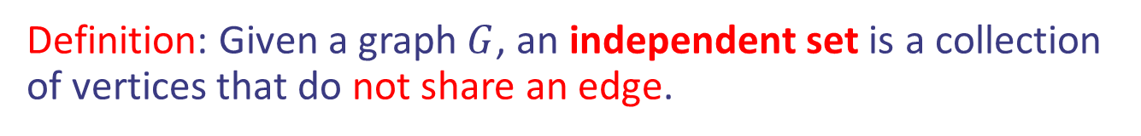
Problems on trees using Greedy
Definition: Given a graph $G$, an independent set is a collection of vertices that do not share an edge.
Notes:
Exercise: guess merge sort

Slide 38

Problems on trees using Greedy
Definition: Given a graph $G$, an independent set is a collection of vertices that do not share an edge.
Notes:
Exercise: guess merge sort

Slide 39
Problems on trees using Greedy
Definition: Given a graph $G$, an independent set is a collection of vertices that do not share an edge.
Notes:
Exercise: guess merge sort

Slide 40
Problems on trees using Greedy
Definition: Given a graph $G$, an independent set is a collection of vertices that do not share an edge.
Problem: Given a tree graph, compute/find a maximum independent set.
Notes:
Exercise: guess merge sort

Slide 41
Maximum Independent set on trees
Problem: Given a tree graph, compute/find a maximum independent set.
Question: Should a leaf be part of the independent set?
Notes:
Exercise: guess merge sort

Slide 42
Maximum Independent set on trees
Problem: Given a tree graph, compute/find a maximum independent set.
Idea: Choose a leaf (or isolated vertex) and put it in the independent set. Remove the neighboring vertex (and incident edges). The new graph is a union of trees. Repeat until run out of vertices.
Notes:
Exercise: guess merge sort

Slide 43
Maximum Independent set on trees
Problem: Given a tree graph, compute/find a maximum independent set.
Idea: Choose a leaf (or isolated vertex) and put it in the independent set. Remove the neighboring vertex (and incident edges). The new graph is a union of trees. Repeat until run out of vertices.
Notes:
Exercise: guess merge sort

Slide 44
Maximum Independent set on trees
Problem: Given a tree graph, compute/find a maximum independent set.
Idea: Choose a leaf (or isolated vertex) and put it in the independent set. Remove the neighboring vertex (and incident edges). The new graph is a union of trees. Repeat until run out of vertices.
Notes:
Exercise: guess merge sort

Slide 45
Maximum Independent set on trees
Problem: Given a tree graph, compute/find a maximum independent set.
Idea: Choose a leaf (or isolated vertex) and put it in the independent set. Remove the neighboring vertex (and incident edges). The new graph is a union of trees. Repeat until run out of vertices.
Notes:
Exercise: guess merge sort

Slide 46
Maximum Independent set on trees
Problem: Given a tree graph, compute/find a maximum independent set.
Idea: Choose a leaf (or isolated vertex) and put it in the independent set. Remove the neighboring vertex (and incident edges). The new graph is a union of trees. Repeat until run out of vertices.
Notes:
Exercise: guess merge sort

Slide 47
Maximum Independent set on trees
Problem: Given a tree graph, compute/find a maximum independent set.
Idea: Choose a leaf (or isolated vertex) and put it in the independent set. Remove the neighboring vertex (and incident edges). The new graph is a union of trees. Repeat until run out of vertices.
Notes:
Exercise: guess merge sort

Slide 48
Maximum Independent set on trees
Problem: Given a tree graph, compute/find a maximum independent set.
Idea: Choose a leaf (or isolated vertex) and put it in the independent set. Remove the neighboring vertex (and incident edges). The new graph is a union of trees. Repeat until run out of vertices.
Design and Analysis of Algorithms

Slide 49
Maximum Independent set on trees
Problem: Given a tree graph, compute/find a maximum independent set.
Idea: Choose a leaf (or isolated vertex) and put it in the independent set. Remove the neighboring vertex (and incident edges). The new graph is a union of trees. Repeat until run out of vertices.
Design and Analysis of Algorithms

Slide 50
Maximum Independent set on trees
Problem: Given a tree graph, compute/find a maximum independent set.
Idea: Choose a leaf (or isolated vertex) and put it in the independent set. Remove the neighboring vertex (and incident edges). The new graph is a union of trees. Repeat until run out of vertices.
Design and Analysis of Algorithms

Slide 51
Maximum Independent set on trees
Problem: Given a tree graph, compute/find a maximum independent set.
Idea: Choose a leaf (or isolated vertex) and put it in the independent set. Remove the neighboring vertex (and incident edges). The new graph is a union of trees. Repeat until run out of vertices.
Design and Analysis of Algorithms

Slide 52
Maximum Independent set on trees
Problem: Given a tree graph, compute/find a maximum independent set.
Idea: Choose a leaf (or isolated vertex) and put it in the independent set. Remove the neighboring vertex (and incident edges). The new graph is a union of trees. Repeat until run out of vertices.
Design and Analysis of Algorithms

Slide 53
Maximum Independent set on trees
Problem: Given a tree graph, compute/find a maximum independent set.
Idea: Choose a leaf (or isolated vertex) and put it in the independent set. Remove the neighboring vertex (and incident edges). The new graph is a union of trees. Repeat until run out of vertices.
Design and Analysis of Algorithms

Slide 54
Maximum Independent set on trees
Problem: Given a tree graph, compute/find a maximum independent set.
Idea: Choose a leaf (or isolated vertex) and put it in the independent set. Remove the neighboring vertex (and incident edges). The new graph is a union of trees. Repeat until run out of vertices.
Design and Analysis of Algorithms

Slide 55
Maximum Independent set on trees
Problem: Given a tree graph, compute/find a maximum independent set.
Idea: Choose a leaf (or isolated vertex) and put it in the independent set. Remove the neighboring vertex (and incident edges). The new graph is a union of trees. Repeat until run out of vertices.
Design and Analysis of Algorithms

Slide 56
Maximum Independent set on trees
Problem: Given a tree graph, compute/find a maximum independent set.
Idea: Choose a leaf (or isolated vertex) and put it in the independent set. Remove the neighboring vertex (and incident edges). The new graph is a union of trees. Repeat until run out of vertices.
Design and Analysis of Algorithms

Slide 57
Maximum Independent set on trees
Problem: Given a tree graph, compute/find a maximum independent set.
Idea: Choose a leaf (or isolated vertex) and put it in the independent set. Remove the neighboring vertex (and incident edges). The new graph is a union of trees. Repeat until run out of vertices.
Design and Analysis of Algorithms

Slide 58
Maximum Independent set on trees
Problem: Given a tree graph, compute/find a maximum independent set.
Idea: Choose a leaf (or isolated vertex) and put it in the independent set. Remove the neighboring vertex (and incident edges). The new graph is a union of trees. Repeat until run out of vertices.
Design and Analysis of Algorithms

