Slide 1

Lecture 20 Recap part B
CS 161 Design and Analysis of Algorithms
Ioannis Panageas

Slide 2
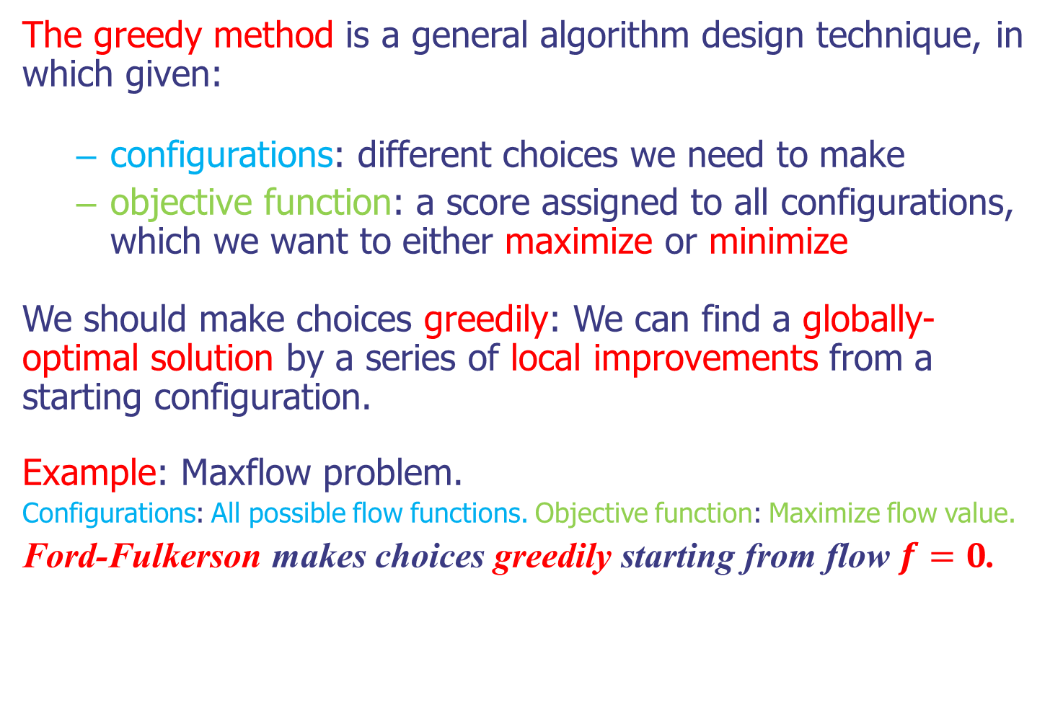
Greedy method
The greedy method is a general algorithm design technique, in which given:
configurations: different choices we need to make
objective function: a score assigned to all configurations, which we want to either maximize or minimize
We should make choices greedily: We can find a globally-optimal solution by a series of local improvements from a starting configuration.
Example: Maxflow problem.
Configurations: All possible flow functions. Objective function: Maximize flow value.
Ford-Fulkerson makes choices greedily starting from flow $f=0$.
Notes:
Exercise: guess merge sort

Slide 3
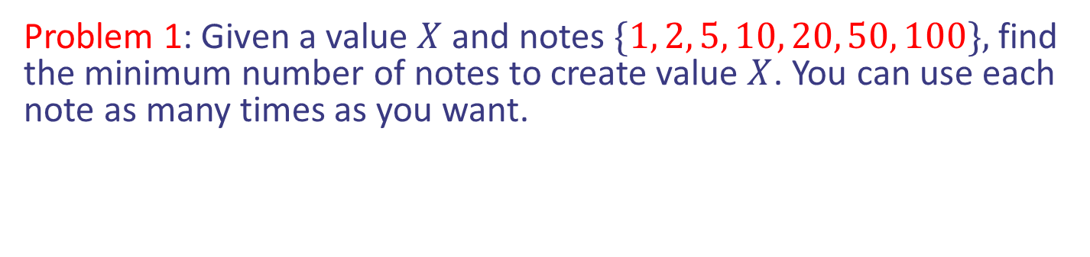
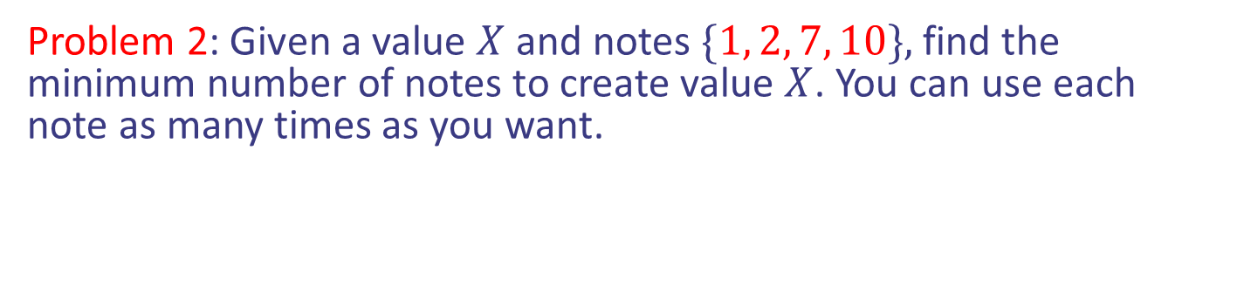
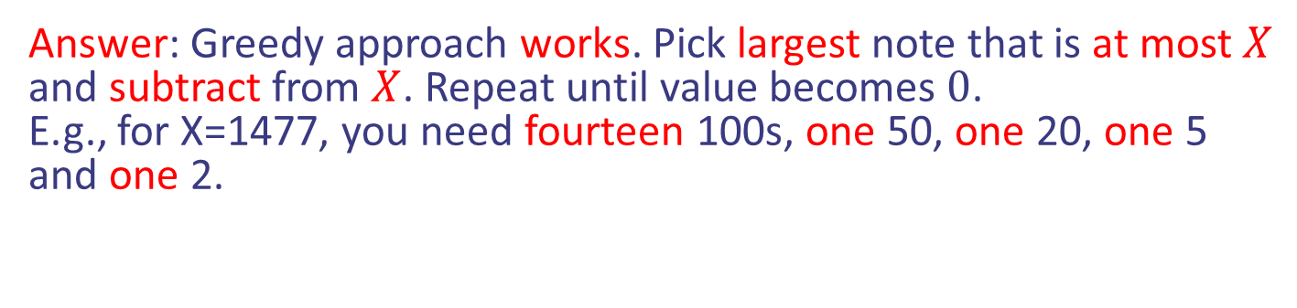
Greedy does not always work
Problem 1: Given a value $X$ and notes $\{1, 2, 5, 10, 20, 50, 100\},$ find the minimum number of notes to create value $X$. You can use each note as many times as you want.
Answer: Greedy approach works. Pick largest note that is at most $X$ and subtract from $X$. Repeat until value becomes $0$.
E.g., for X=1477, you need fourteen 100s, one 50, one 20, one 5 and one 2.
Problem 2: Given a value $X$ and notes $\{1, 2, 7, 10\},$ find the minimum number of notes to create value $X$. You can use each note as many times as you want.
Answer: Greedy approach does not work as before.
E.g., for X=14, you need two 7s, but greedy will give one 10, two 2s.
Greedy does not work always
Notes:
Exercise: guess merge sort

Slide 4

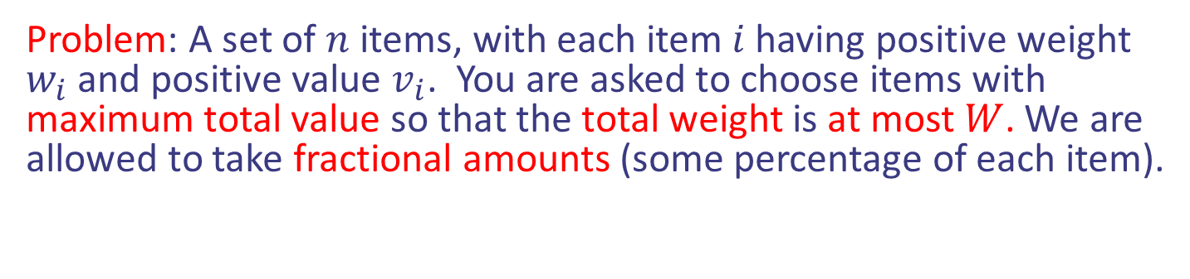
Fractional Knapsack
Problem: A set of $n$ items, with each item $i$ having positive weight $w_{i}$ and positive value $v_{i}$. You are asked to choose items with maximum total value so that the total weight is at most $W$. We are allowed to take fractional amounts (some percentage of each item).
Items:
1
2
3
4
5
Weight:
4 ml
8 ml
2 ml
6 ml
1 ml
Value:
$12
$32
$40
$30
$50
“knapsack”
with 10ml
Value:
$3
$4
$20
$5
$50
($ per ml)
Notes:
Exercise: guess merge sort

Slide 5
Fractional Knapsack
Problem: A set of $n$ items, with each item $i$ having positive weight $w_{i}$ and positive value $v_{i}$. You are asked to choose items with maximum total value so that the total weight is at most $W$. We are allowed to take fractional amounts (some percentage of each item).
Solution:
1 ml of 5
2 ml of 3
6 ml of 4
1 ml of 2
Total Value: $124
Items:
1
2
3
4
5
Weight:
4 ml
8 ml
2 ml
6 ml
1 ml
Value:
$12
$32
$40
$30
$50
“knapsack”
with 10ml
Value:
$3
$4
$20
$5
$50
($ per ml)
Notes:
Exercise: guess merge sort

Slide 6

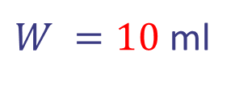
Fractional Knapsack
Idea: Greedy approach. Keep taking item with highest value to weight ratio until knapsack is full or run out of items.
Items:
1
2
3
4
5
Weight:
4 ml
8 ml
2 ml
6 ml
1 ml
Value:
$12
$32
$40
$30
$50
$W =10$ ml
Value:
$3
$4
$20
$5
$50
$value =$ $0
Notes:
Exercise: guess merge sort

Slide 7
Fractional Knapsack
Idea: Greedy approach. Keep taking item with highest value to weight ratio until knapsack is full or run out of items.
Items:
1
2
3
4
5
Weight:
4 ml
8 ml
2 ml
6 ml
1 ml
Value:
$12
$32
$40
$30
$50
$W =10$ ml
Value:
$3
$4
$20
$5
$50
$value =$ $0
Notes:
Exercise: guess merge sort

Slide 8

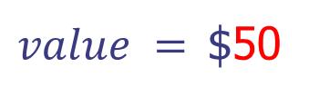
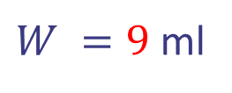
Fractional Knapsack
Idea: Greedy approach. Keep taking item with highest value to weight ratio until knapsack is full or run out of items.
Items:
1
2
3
4
Weight:
4 ml
8 ml
2 ml
6 ml
Value:
$12
$32
$40
$30
$W =9$ ml
Value:
$3
$4
$20
$5
$value =$ $50
Notes:
Exercise: guess merge sort

Slide 9
Fractional Knapsack
Idea: Greedy approach. Keep taking item with highest value to weight ratio until knapsack is full or run out of items.
Items:
1
2
3
4
Weight:
4 ml
8 ml
2 ml
6 ml
Value:
$12
$32
$40
$30
$W =9$ ml
Value:
$3
$4
$20
$5
$value =$ $50
Notes:
Exercise: guess merge sort

Slide 10

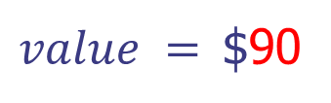
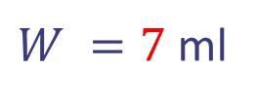
Fractional Knapsack
Idea: Greedy approach. Keep taking item with highest value to weight ratio until knapsack is full or run out of items.
Items:
1
2
4
Weight:
4 ml
8 ml
6 ml
Value:
$12
$32
$30
$W =7$ ml
Value:
$3
$4
$5
$value =$ $90
Notes:
Exercise: guess merge sort

Slide 11
Fractional Knapsack
Idea: Greedy approach. Keep taking item with highest value to weight ratio until knapsack is full or run out of items.
Items:
1
2
4
Weight:
4 ml
8 ml
6 ml
Value:
$12
$32
$30
$W =7$ ml
Value:
$3
$4
$5
$value =$ $90
Notes:
Exercise: guess merge sort

Slide 12

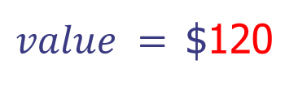
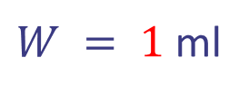
Fractional Knapsack
Idea: Greedy approach. Keep taking item with highest value to weight ratio until knapsack is full or run out of items.
Items:
1
2
Weight:
4 ml
8 ml
Value:
$12
$32
$W = 1$ ml
Value:
$3
$4
$value =$ $120
Notes:
Exercise: guess merge sort

Slide 13
Fractional Knapsack
Idea: Greedy approach. Keep taking item with highest value to weight ratio until knapsack is full or run out of items.
Items:
1
2
Weight:
4 ml
8 ml
Value:
$12
$32
$W = 1$ ml
Value:
$3
$4
$value =$ $120
Notes:
Exercise: guess merge sort

Slide 14

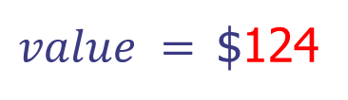
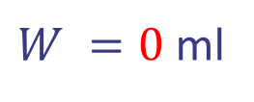
Fractional Knapsack
Idea: Greedy approach. Keep taking item with highest value to weight ratio until knapsack is full or run out of items.
Items:
1
2
Weight:
4 ml
7 ml
Value:
$12
$32
$W =0$ ml
Value:
$3
$4
$value =$ $124
Running time: ?
Notes:
Exercise: guess merge sort

Slide 15
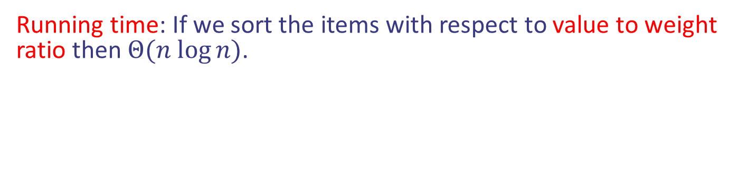
Fractional Knapsack
Idea: Greedy approach. Keep taking item with highest value to weight ratio until knapsack is full or run out of items.
Items:
1
2
Weight:
4 ml
7 ml
Value:
$12
$32
$W =0$ ml
Value:
$3
$4
$value =$ $124
Running time: If we sort the items with respect to value to weight ratio then $Θ(n log⁡n)$.
Notes:
Exercise: guess merge sort

Slide 16


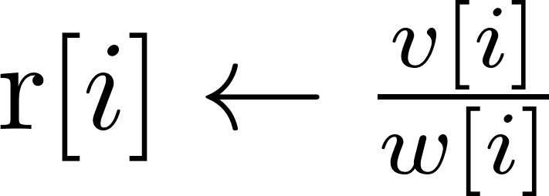
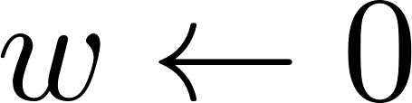
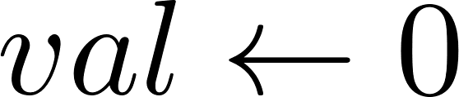
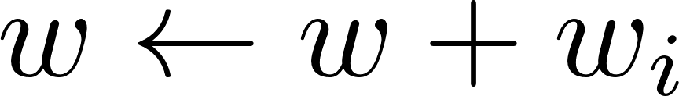
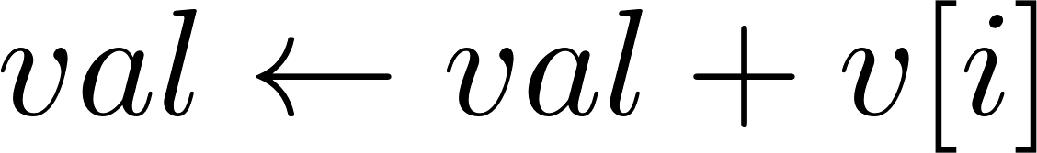


Fractional Knapsack
Pseudocode:
Compute the ratios
Initialization
While knapsack not full
If whole item fits
Notes:
Exercise: guess merge sort

Slide 17
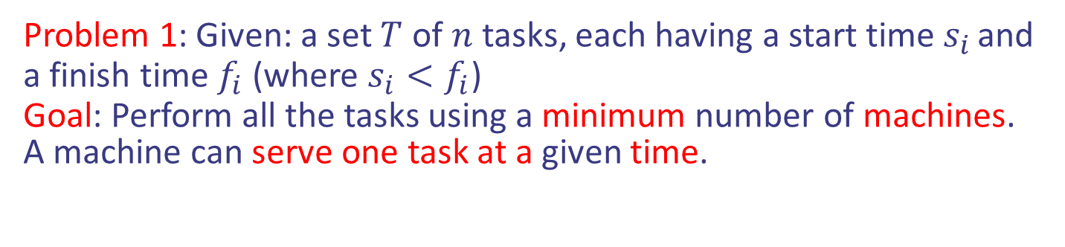
Scheduling jobs/tasks
Problem 1: Given: a set $T$ of $n$ tasks, each having a start time $s_{i}$ and a finish time $f_{i}$ (where $s_{i}<f_{i}$)
Goal: Perform all the tasks using a minimum number of machines.
A machine can serve one task at a given time.

Slide 18
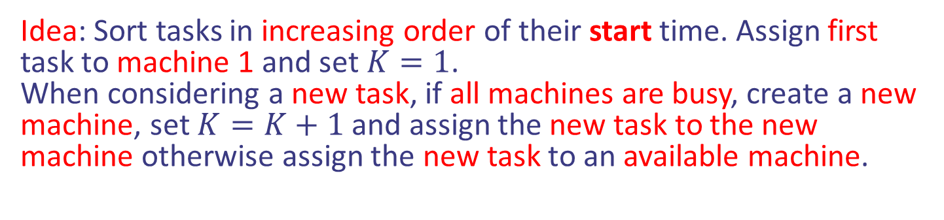
Scheduling jobs/tasks
Problem 1: Given: a set $T$ of $n$ tasks, each having a start time $s_{i}$ and a finish time $f_{i}$ (where $s_{i}<f_{i}$)
Goal: Perform all the tasks using a minimum number of machines.
A machine can serve one task at a given time.
Idea: Sort tasks in increasing order of their start time. Assign first task to machine 1 and set $K=1$.
When considering a new task, if all machines are busy, create a new machine, set $K=K+1$ and assign the new task to the new machine otherwise assign the new task to an available machine.

Slide 19
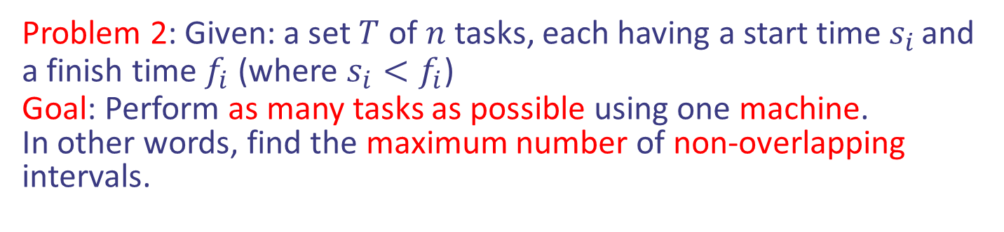
Scheduling jobs/tasks
Problem 2: Given: a set $T$ of $n$ tasks, each having a start time $s_{i}$ and a finish time $f_{i}$ (where $s_{i}<f_{i}$)
Goal: Perform as many tasks as possible using one machine.
In other words, find the maximum number of non-overlapping intervals.

Slide 20
Scheduling jobs/tasks
Problem 2: Given: a set $T$ of $n$ tasks, each having a start time $s_{i}$ and a finish time $f_{i}$ (where $s_{i}<f_{i}$)
Goal: Perform as many tasks as possible using one machine.
In other words, find the maximum number of non-overlapping intervals.
Idea: Sort tasks in increasing order of their finish time. Perform first task and remove all overlapping tasks with first task. Repeat the same process to the remaining tasks.

Slide 21

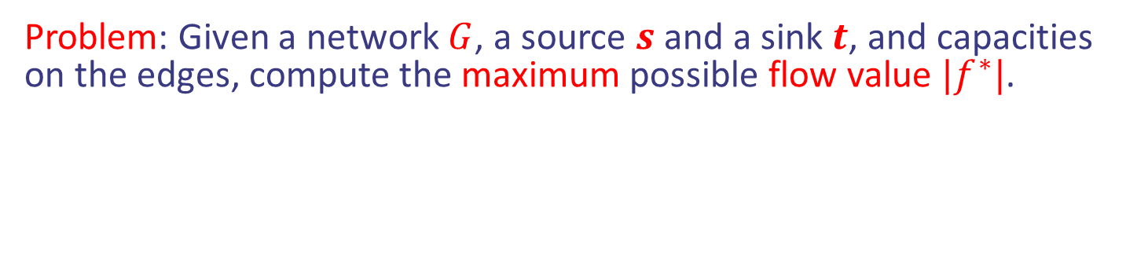
Maxflow Problem
Problem: Given a network $G$, a source $s$ and a sink $t$, and capacities on the edges, compute the maximum possible flow value $|f^{∗}|$.
v
$/3
$/6
$/1
$/7
t
s
$/3
w
$/1
$/9
$/5
$/5
u
$/2
z
Find the $ to get maxflow $|f^{∗}|$
Design and Analysis of Algorithms

Slide 22
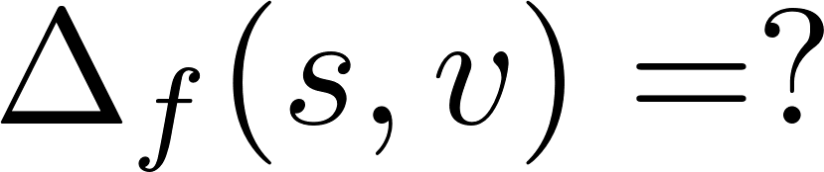
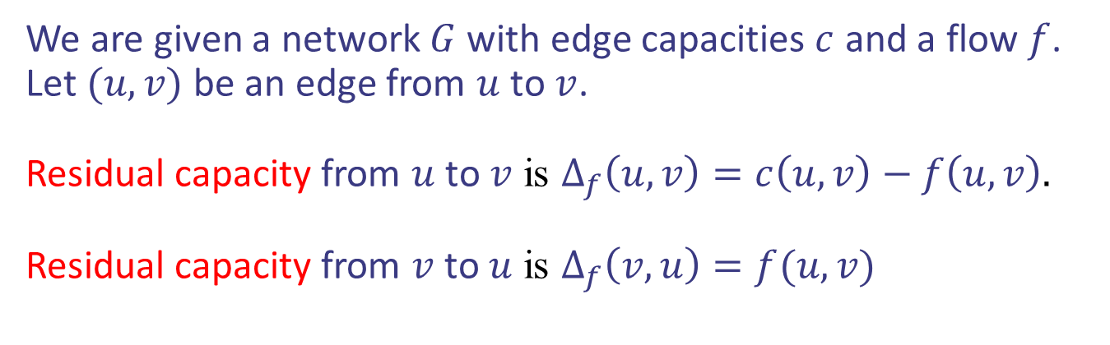
Augmenting paths
We are given a network $G$ with edge capacities $c$ and a flow $f$. Let $(u,v)$ be an edge from $u$ to $v$.
Residual capacity from $u$ to $v$ is $Δ_{f}\left(u,v\right)=c\left(u,v\right)−f\left(u,v\right).$
Residual capacity from $v$ to $u$ is $Δ_{f}\left(v,u\right)=f(u,v)$
v
1/3
2/6
1/1
3/7
t
s
3/3
w
1/1
2/9
4/5
3/5
u
2/2
z
Design and Analysis of Algorithms

Slide 23
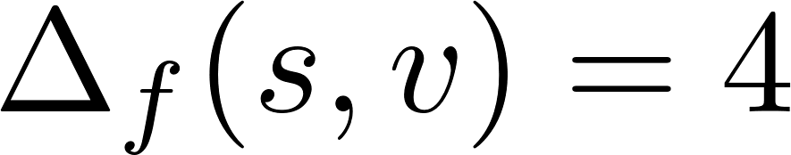
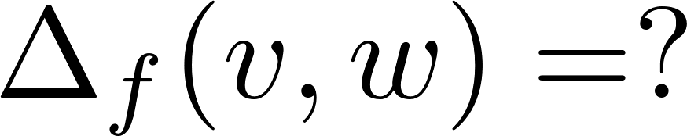
Augmenting paths
We are given a network $G$ with edge capacities $c$ and a flow $f$. Let $(u,v)$ be an edge from $u$ to $v$.
Residual capacity from $u$ to $v$ is $Δ_{f}\left(u,v\right)=c\left(u,v\right)−f\left(u,v\right).$
Residual capacity from $v$ to $u$ is $Δ_{f}\left(v,u\right)=f(u,v)$
v
1/3
2/6
1/1
3/7
t
s
3/3
w
1/1
2/9
4/5
3/5
u
2/2
z
Design and Analysis of Algorithms

Slide 24
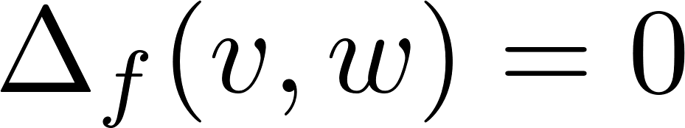
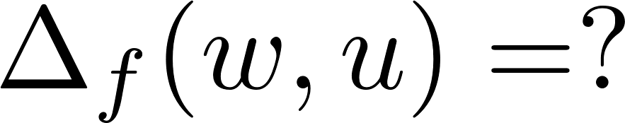
Augmenting paths
We are given a network $G$ with edge capacities $c$ and a flow $f$. Let $(u,v)$ be an edge from $u$ to $v$.
Residual capacity from $u$ to $v$ is $Δ_{f}\left(u,v\right)=c\left(u,v\right)−f\left(u,v\right).$
Residual capacity from $v$ to $u$ is $Δ_{f}\left(v,u\right)=f(u,v)$
v
1/3
2/6
1/1
3/7
t
s
3/3
w
1/1
2/9
4/5
3/5
u
2/2
z
Design and Analysis of Algorithms

Slide 25
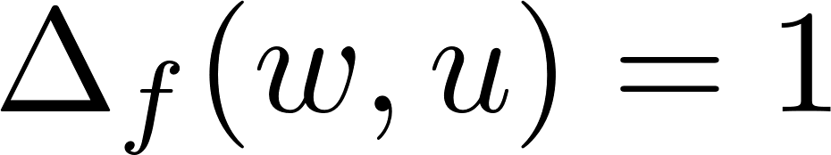
Augmenting paths
We are given a network $G$ with edge capacities $c$ and a flow $f$. Let $(u,v)$ be an edge from $u$ to $v$.
Residual capacity from $u$ to $v$ is $Δ_{f}\left(u,v\right)=c\left(u,v\right)−f\left(u,v\right).$
Residual capacity from $v$ to $u$ is $Δ_{f}\left(v,u\right)=f(u,v)$
v
1/3
2/6
1/1
3/7
t
s
3/3
w
1/1
2/9
4/5
3/5
u
2/2
z
Design and Analysis of Algorithms

Slide 26
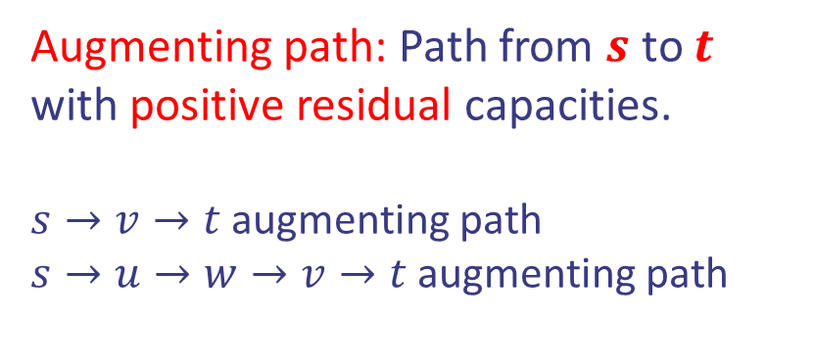
Augmenting paths
We are given a network $G$ with edge capacities $c$ and a flow $f$. Let $(u,v)$ be an edge from $u$ to $v$.
Residual capacity from $u$ to $v$ is $Δ_{f}\left(u,v\right)=c\left(u,v\right)−f\left(u,v\right).$
Residual capacity from $v$ to $u$ is $Δ_{f}\left(v,u\right)=f(u,v)$
Augmenting path: Path from $s$ to $t$ with positive residual capacities.
$s→v→t$ augmenting path
$s→u→w→v→t$ augmenting path
v
1/3
2/6
1/1
3/7
t
s
3/3
w
0/1
2/9
4/5
2/5
u
2/2
z
Design and Analysis of Algorithms

Slide 27
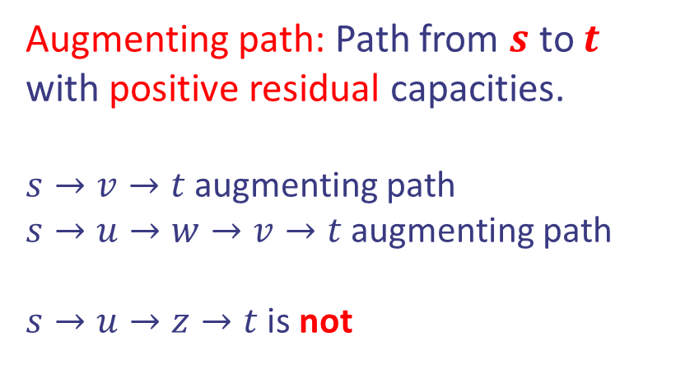
Augmenting paths
We are given a network $G$ with edge capacities $c$ and a flow $f$. Let $(u,v)$ be an edge from $u$ to $v$.
Residual capacity from $u$ to $v$ is $Δ_{f}\left(u,v\right)=c\left(u,v\right)−f\left(u,v\right).$
Residual capacity from $v$ to $u$ is $Δ_{f}\left(v,u\right)=f(u,v)$
Augmenting path: Path from $s$ to $t$ with positive residual capacities.
$s→v→t$ augmenting path
$s→u→w→v→t$ augmenting path
$s→u→z→t$ is not
v
1/3
2/6
1/1
3/7
t
s
3/3
w
0/1
2/9
4/5
2/5
u
2/2
z
Design and Analysis of Algorithms

Slide 28
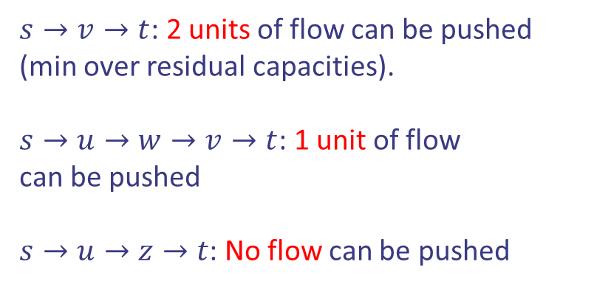
Augmenting paths
We are given a network $G$ with edge capacities $c$ and a flow $f$. Let $(u,v)$ be an edge from $u$ to $v$.
Residual capacity from $u$ to $v$ is $Δ_{f}\left(u,v\right)=c\left(u,v\right)−f\left(u,v\right).$
Residual capacity from $v$ to $u$ is $Δ_{f}\left(v,u\right)=f(u,v)$
$s→v→t$: 2 units of flow can be pushed
(min over residual capacities).
$s→u→w→v→t$: 1 unit of flow
can be pushed
$s→u→z→t$: No flow can be pushed
v
1/3
2/6
1/1
3/7
t
s
3/3
w
0/1
2/9
4/5
2/5
u
2/2
z
Design and Analysis of Algorithms

Slide 29
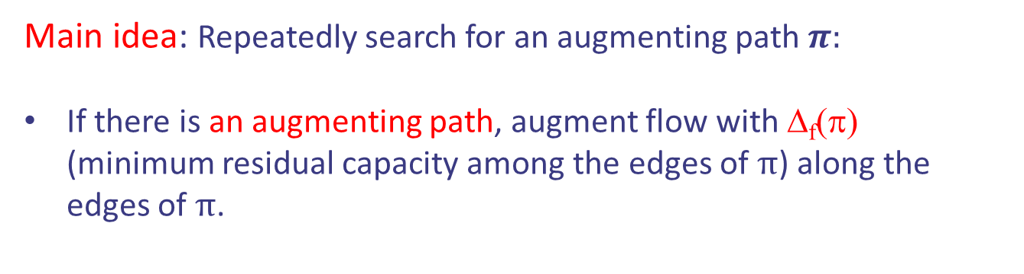
The Ford-Fulkerson Algorithm
Main idea: Repeatedly search for an augmenting path $π:$
If there is an augmenting path, augment flow with Δ_{f}(π) (minimum residual capacity among the edges of $π$) along the edges of $π$.
Design and Analysis of Algorithms

Slide 30
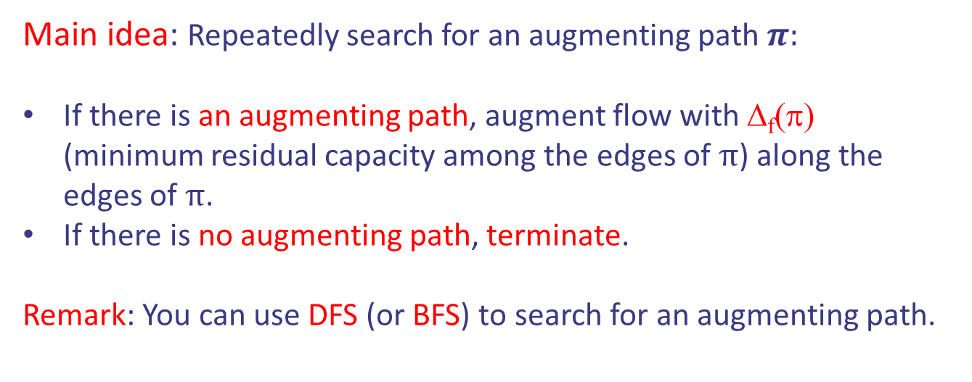
The Ford-Fulkerson Algorithm
Main idea: Repeatedly search for an augmenting path $π:$
If there is an augmenting path, augment flow with Δ_{f}(π) (minimum residual capacity among the edges of $π$) along the edges of $π$.
If there is no augmenting path, terminate.
Remark: You can use DFS (or BFS) to search for an augmenting path.
Running time: ?
Design and Analysis of Algorithms

Slide 31

The Ford-Fulkerson Algorithm
Main idea: Repeatedly search for an augmenting path $π:$
If there is an augmenting path, augment flow with Δ_{f}(π) (minimum residual capacity among the edges of $π$) along the edges of $π$.
If there is no augmenting path, terminate.
Remark: You can use DFS (or BFS) to search for an augmenting path.
Running time:
Time to search for an augmenting path $×$ number of updates.
Design and Analysis of Algorithms

Slide 32

The Ford-Fulkerson Algorithm
Main idea: Repeatedly search for an augmenting path $π:$
If there is an augmenting path, augment flow with Δ_{f}(π) (minimum residual capacity among the edges of $π$) along the edges of $π$.
If there is no augmenting path, terminate.
Remark: You can use DFS (or BFS) to search for an augmenting path.
Running time:
Time to search for an augmenting path $×$ number of updates.
$$Θ\left(|V|+|E|\right)⋅|f^{∗}|$$
Running time of DFS or BFS
Updates increase flow by 1 unit only
Design and Analysis of Algorithms

Slide 33
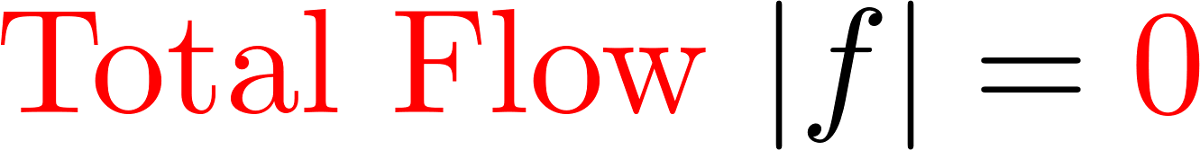
The Ford-Fulkerson Algorithm
v
0/3
0/6
0/1
0/7
t
s
0/3
w
0/1
0/9
0/5
0/5
u
z
0/2
Design and Analysis of Algorithms

Slide 34
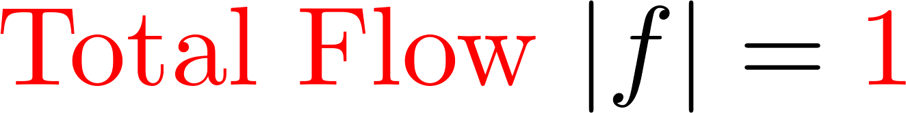
The Ford-Fulkerson Algorithm
v
0/3
0/6
0/1
1/7
t
s
0/3
w
1/1
0/9
0/5
1/5
u
z
0/2
Design and Analysis of Algorithms

Slide 35
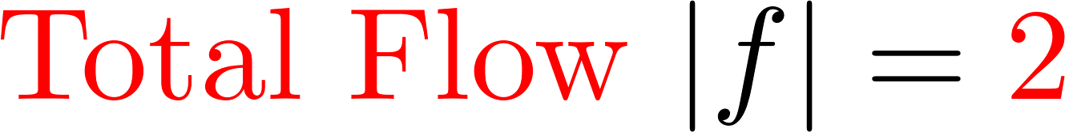
The Ford-Fulkerson Algorithm
v
0/3
0/6
0/1
1/7
t
s
1/3
w
0/1
0/9
1/5
1/5
u
z
1/2
Design and Analysis of Algorithms

Slide 36
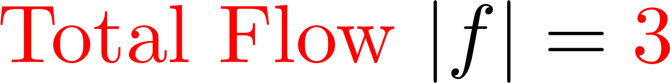
The Ford-Fulkerson Algorithm
v
0/3
1/6
1/1
2/7
t
s
1/3
w
0/1
0/9
1/5
1/5
u
z
1/2
Design and Analysis of Algorithms

Slide 37
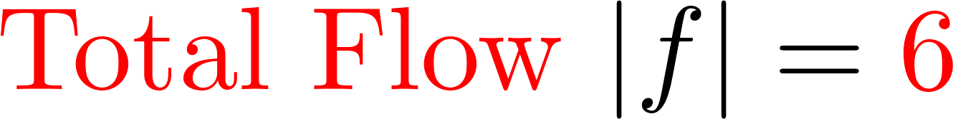
The Ford-Fulkerson Algorithm
v
3/3
4/6
1/1
2/7
t
s
1/3
w
0/1
0/9
1/5
1/5
u
z
1/2
Design and Analysis of Algorithms

Slide 38
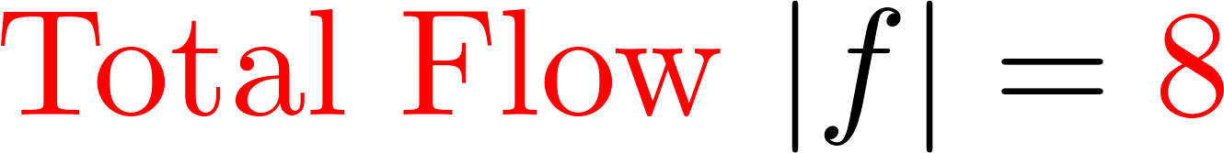
The Ford-Fulkerson Algorithm
v
3/3
4/6
1/1
4/7
t
s
3/3
w
0/1
0/9
1/5
1/5
u
z
1/2
Design and Analysis of Algorithms

Slide 39
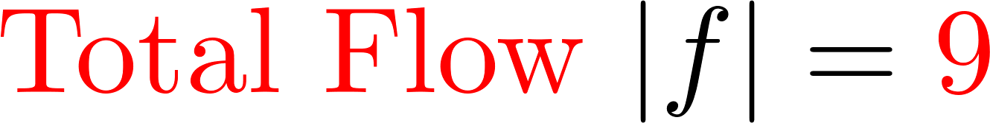
The Ford-Fulkerson Algorithm
v
3/3
4/6
1/1
4/7
t
s
3/3
w
1/1
1/9
2/5
2/5
u
z
1/2
Design and Analysis of Algorithms

Slide 40

The Ford-Fulkerson Algorithm
v
3/3
4/6
1/1
4/7
t
s
3/3
w
1/1
1/9
3/5
3/5
u
z
2/2
Design and Analysis of Algorithms

Slide 41
The Ford-Fulkerson Algorithm
v
3/3
4/6
1/1
4/7
t
s
3/3
w
1/1
1/9
3/5
3/5
u
z
2/2
No more augmenting paths!
Design and Analysis of Algorithms

Slide 42
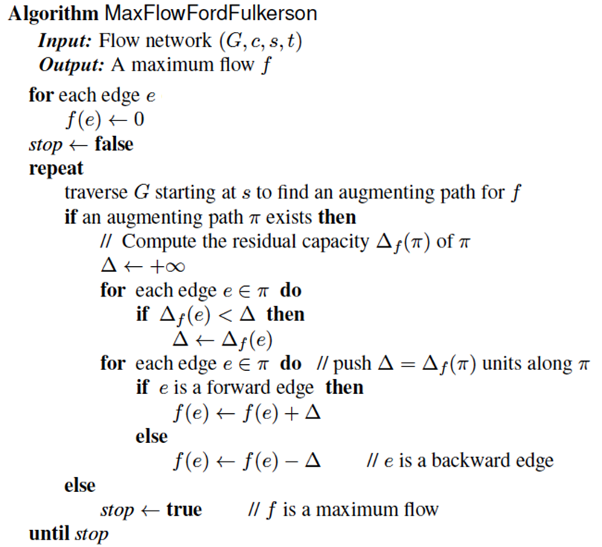




The Ford-Fulkerson Algorithm
Pseudocode:
Initialization $f=0$
$$Δ:min residual capacity on aug. path$$
$$Update flow on aug. path$$
$$No more aug. paths$$
Design and Analysis of Algorithms

Slide 43


Application: Maximum Matching
Definition: Given a bipartite graph, a matching is just a collection of edges that do not share a vertex.
Design and Analysis of Algorithms

Slide 44

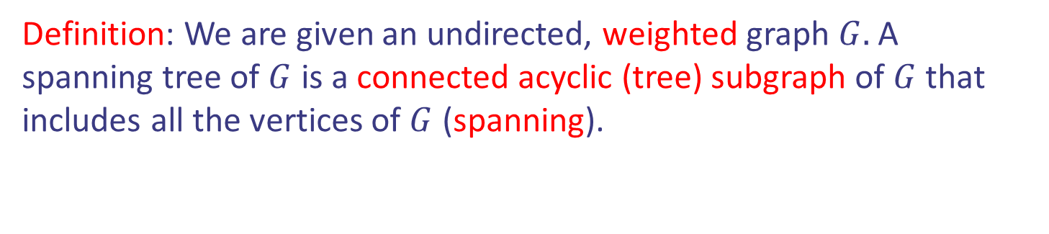
Spanning Tree
Definition: We are given an undirected, weighted graph $G.$ A spanning tree of $G$ is a connected acyclic (tree) subgraph of $G$ that includes all the vertices of $G$ (spanning).
OAK
10
1
MIA
LA
6
7
9
3
BOS
4
NYC
8
5
2
DC
ATL
Design and Analysis of Algorithms

Slide 45
Spanning Tree
Definition: We are given an undirected, weighted graph $G.$ A spanning tree of $G$ is a connected acyclic (tree) subgraph of $G$ that includes all the vertices of $G$ (spanning).
OAK
10
1
MIA
LA
6
7
9
3
BOS
4
NYC
8
5
2
DC
ATL
Design and Analysis of Algorithms

Slide 46
Kruskal’s Algorithm for MSTs
Idea 1: Greedy approach. Consider the edges from smaller weight to larger. Include each edge in the current solution as long as it does not create a cycle, otherwise discard it.
B
8
G
E
4
5
9
F
1
C
3
6
11
7
2
D
H
12
A
10
Design and Analysis of Algorithms

Slide 47
Kruskal’s Algorithm for MSTs
Idea 1: Greedy approach. Consider the edges from smaller weight to larger. Include each edge in the current solution as long as it does not create a cycle, otherwise discard it.
B
8
G
E
4
5
9
F
1
C
3
6
11
7
2
D
H
12
A
10
Design and Analysis of Algorithms

Slide 48
Kruskal’s Algorithm for MSTs
Idea 1: Greedy approach. Consider the edges from smaller weight to larger. Include each edge in the current solution as long as it does not create a cycle, otherwise discard it.
B
8
G
E
4
5
9
F
1
C
3
6
11
7
2
D
H
12
A
10
Design and Analysis of Algorithms

Slide 49
Kruskal’s Algorithm for MSTs
Idea 1: Greedy approach. Consider the edges from smaller weight to larger. Include each edge in the current solution as long as it does not create a cycle, otherwise discard it.
B
8
G
E
4
5
9
F
1
C
3
6
11
7
2
D
H
12
A
10
Design and Analysis of Algorithms

Slide 50
Kruskal’s Algorithm for MSTs
Idea 1: Greedy approach. Consider the edges from smaller weight to larger. Include each edge in the current solution as long as it does not create a cycle, otherwise discard it.
B
8
G
E
4
5
9
F
1
C
3
6
11
7
2
D
H
12
A
10
Design and Analysis of Algorithms

Slide 51
Kruskal’s Algorithm for MSTs
Idea 1: Greedy approach. Consider the edges from smaller weight to larger. Include each edge in the current solution as long as it does not create a cycle, otherwise discard it.
B
8
G
E
4
5
9
F
1
C
3
6
11
7
2
D
H
12
A
10
Design and Analysis of Algorithms

Slide 52
Kruskal’s Algorithm for MSTs
Idea 1: Greedy approach. Consider the edges from smaller weight to larger. Include each edge in the current solution as long as it does not create a cycle, otherwise discard it.
B
8
G
E
4
5
9
F
1
C
3
6
11
7
2
D
H
12
A
10
Design and Analysis of Algorithms

Slide 53
Kruskal’s Algorithm for MSTs
Idea 1: Greedy approach. Consider the edges from smaller weight to larger. Include each edge in the current solution as long as it does not create a cycle, otherwise discard it.
B
8
G
E
4
5
9
F
1
C
3
6
11
7
2
D
H
12
A
10
Design and Analysis of Algorithms

Slide 54
Kruskal’s Algorithm for MSTs
Idea 1: Greedy approach. Consider the edges from smaller weight to larger. Include each edge in the current solution as long as it does not create a cycle, otherwise discard it.
B
8
G
E
4
5
9
F
1
C
3
6
11
7
2
D
H
12
A
10
Design and Analysis of Algorithms

Slide 55
Kruskal’s Algorithm for MSTs
Idea 1: Greedy approach. Consider the edges from smaller weight to larger. Include each edge in the current solution as long as it does not create a cycle, otherwise discard it.
B
8
G
E
4
5
9
F
1
C
3
6
11
7
2
D
H
12
A
10
Design and Analysis of Algorithms

Slide 56
Kruskal’s Algorithm for MSTs
Idea 1: Greedy approach. Consider the edges from smaller weight to larger. Include each edge in the current solution as long as it does not create a cycle, otherwise discard it.
B
8
G
E
4
5
9
F
1
C
3
6
11
7
2
D
H
12
A
10
Design and Analysis of Algorithms

Slide 57
Kruskal’s Algorithm for MSTs
Idea 1: Greedy approach. Consider the edges from smaller weight to larger. Include each edge in the current solution as long as it does not create a cycle, otherwise discard it.
B
8
G
E
4
5
9
F
1
C
3
6
11
7
2
D
H
12
A
10
Design and Analysis of Algorithms

Slide 58
Kruskal’s Algorithm for MSTs
Idea 1: Greedy approach. Consider the edges from smaller weight to larger. Include each edge in the current solution as long as it does not create a cycle, otherwise discard it.
B
8
G
E
4
5
9
F
1
C
3
6
11
7
2
D
H
12
A
10
Design and Analysis of Algorithms

Slide 59
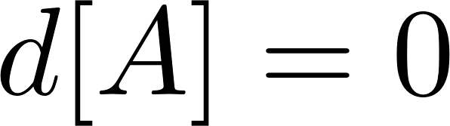
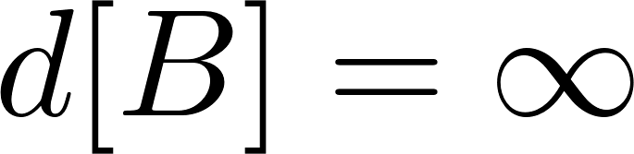
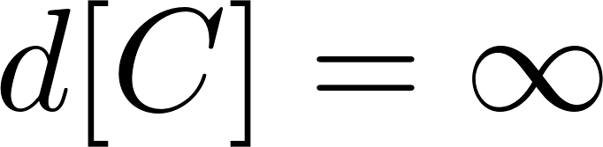
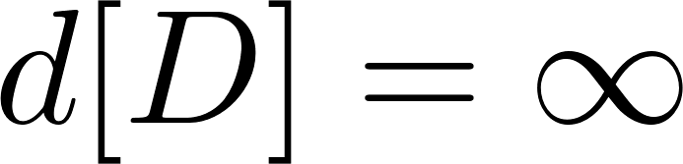
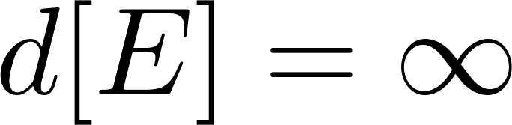




Prim’s Algorithm for MSTs
Idea 2: Similar to Dijkstra’s algorithm. We pick an arbitrary vertex $s$.
At each step:
We add to the current tree the vertex $u$ with the smallest $d[u]$ and the corresponding incident to $u$ edge.
We update the labels of the vertices adjacent to $u$.
B
8
G
E
4
5
9
F
1
C
3
6
11
7
2
D
H
12
A
10
Design and Analysis of Algorithms

Slide 60




Prim’s Algorithm for MSTs
Idea 2: Similar to Dijkstra’s algorithm. We pick an arbitrary vertex $s$.
At each step:
We add to the current tree the vertex $u$ with the smallest $d[u]$ and the corresponding incident to $u$ edge.
We update the labels of the vertices adjacent to $u$.
B
8
G
E
4
5
9
F
1
C
3
6
11
7
2
D
H
12
A
10
Design and Analysis of Algorithms

Slide 61




Prim’s Algorithm for MSTs
Idea 2: Similar to Dijkstra’s algorithm. We pick an arbitrary vertex $s$.
At each step:
We add to the current tree the vertex $u$ with the smallest $d[u]$ and the corresponding incident to $u$ edge.
We update the labels of the vertices adjacent to $u$.
B
8
G
E
4
5
9
F
1
C
3
6
11
7
2
D
H
12
A
10
Design and Analysis of Algorithms

Slide 62


Prim’s Algorithm for MSTs
Idea 2: Similar to Dijkstra’s algorithm. We pick an arbitrary vertex $s$.
At each step:
We add to the current tree the vertex $u$ with the smallest $d[u]$ and the corresponding incident to $u$ edge.
We update the labels of the vertices adjacent to $u$.
B
8
G
E
4
5
9
F
1
C
3
6
11
7
2
D
H
12
A
10
Design and Analysis of Algorithms

Slide 63


Prim’s Algorithm for MSTs
Idea 2: Similar to Dijkstra’s algorithm. We pick an arbitrary vertex $s$.
At each step:
We add to the current tree the vertex $u$ with the smallest $d[u]$ and the corresponding incident to $u$ edge.
We update the labels of the vertices adjacent to $u$.
B
8
G
E
4
5
9
F
1
C
3
6
11
7
2
D
H
12
A
10
Design and Analysis of Algorithms

Slide 64


Prim’s Algorithm for MSTs
Idea 2: Similar to Dijkstra’s algorithm. We pick an arbitrary vertex $s$.
At each step:
We add to the current tree the vertex $u$ with the smallest $d[u]$ and the corresponding incident to $u$ edge.
We update the labels of the vertices adjacent to $u$.
B
8
G
E
4
5
9
F
1
C
3
6
11
7
2
D
H
12
A
10
Design and Analysis of Algorithms

Slide 65



Prim’s Algorithm for MSTs
Idea 2: Similar to Dijkstra’s algorithm. We pick an arbitrary vertex $s$.
At each step:
We add to the current tree the vertex $u$ with the smallest $d[u]$ and the corresponding incident to $u$ edge.
We update the labels of the vertices adjacent to $u$.
B
8
G
E
4
5
9
F
1
C
3
6
11
7
2
D
H
12
A
10
Design and Analysis of Algorithms

Slide 66


Prim’s Algorithm for MSTs
Idea 2: Similar to Dijkstra’s algorithm. We pick an arbitrary vertex $s$.
At each step:
We add to the current tree the vertex $u$ with the smallest $d[u]$ and the corresponding incident to $u$ edge.
We update the labels of the vertices adjacent to $u$.
B
8
G
E
4
5
9
F
1
C
3
6
11
7
2
D
H
12
A
10
Design and Analysis of Algorithms

Slide 67

Prim’s Algorithm for MSTs
Idea 2: Similar to Dijkstra’s algorithm. We pick an arbitrary vertex $s$.
At each step:
We add to the current tree the vertex $u$ with the smallest $d[u]$ and the corresponding incident to $u$ edge.
We update the labels of the vertices adjacent to $u$.
B
8
G
E
4
5
9
F
1
C
3
6
11
7
2
D
H
12
A
10
Design and Analysis of Algorithms

