Slide 1

Lecture 3 Divide and Conquer I: Introduction, Merge-sort and Master Theorem
CS 161 Design and Analysis of Algorithms
Ioannis Panageas

Slide 2
Recursion
Definition:
Solving a task where the solution depends on solutions to smaller instances of the same problem, by using functions/algorithms that call themselves.
Notes:
Exercise: guess merge sort

Slide 3
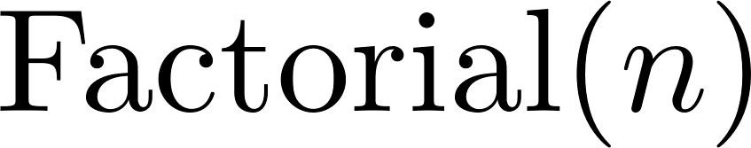
Recursion
Definition:
Solving a task where the solution depends on solutions to smaller instances of the same problem, by using functions/algorithms that call themselves.
Example:
Notes:
Exercise: guess merge sort

Slide 4
Recursion
Definition:
Solving a task where the solution depends on solutions to smaller instances of the same problem, by using functions/algorithms that call themselves.
Example:
Base case
Recursion
Notes:
Exercise: guess merge sort

Slide 5
Recursion
Definition:
Solving a task where the solution depends on solutions to smaller instances of the same problem, by using functions/algorithms that call themselves.
Running time:
Example:
Base case
Recursion
Notes:
Exercise: guess merge sort

Slide 6

Recursion
Notes:
Exercise: guess merge sort

Slide 7


Recursion
Notes:
Exercise: guess merge sort

Slide 8

Recursion
Notes:
Exercise: guess merge sort

Slide 9

Recursion
Notes:
Exercise: guess merge sort

Slide 10
Recursion
Notes:
Exercise: guess merge sort

Slide 11

Mergesort - A fast sorting recursive Algorithm
Have seen algorithms like insertion sort that have running time (worst case) $Θ(n^{2})$.
Key idea:
Divide input into two parts of equal size
Sort each part recursively
Merge the two sorted parts to obtain the solution.

Slide 12
Mergesort - A fast sorting recursive Algorithm
Key idea:
Divide input into two parts of equal size
Sort each part recursively
Merge the two sorted parts to obtain the solution.
Example: Sort the following 11 numbers
Divide
Recursion
Merge

Slide 13
Mergesort - A fast sorting recursive Algorithm
Key idea:
Divide input into two parts of equal size
Sort each part recursively
Merge the two sorted parts to obtain the solution.
Example: Sort the following 11 numbers
Divide
Recursion
Merge

Slide 14
Mergesort - A fast sorting recursive Algorithm
Key idea:
Divide input into two parts of equal size
Sort each part recursively
Merge the two sorted parts to obtain the solution.
Example: Sort the following 11 numbers
Divide
Recursion
Merge

Slide 15
Mergesort - A fast sorting recursive Algorithm
Key idea:
Divide input into two parts of equal size
Sort each part recursively
Merge the two sorted parts to obtain the solution.
Example: Sort the following 11 numbers
Divide
Recursion
Merge

Slide 16


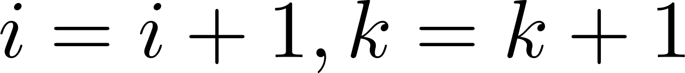


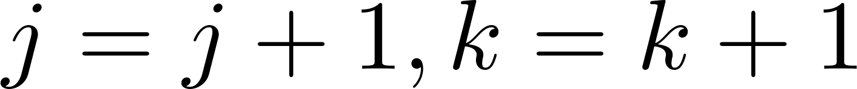
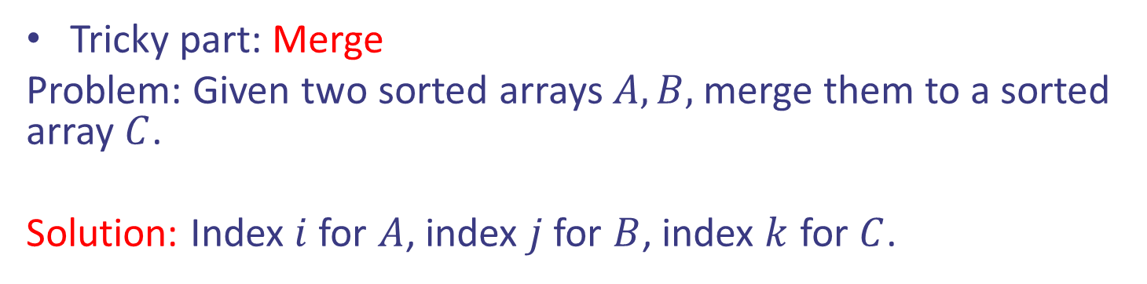
Mergesort - A fast sorting recursive Algorithm
Tricky part: Merge
Problem: Given two sorted arrays $A,B,$ merge them to a sorted array $C$.
Solution: Index $i$ for $A$, index $j$ for $B$, index $k$ for $C$.

Slide 17





Mergesort - A fast sorting recursive Algorithm
Tricky part: Merge
Problem: Given two sorted arrays $A,B,$ merge them to a sorted array $C$.
Solution: Index $i$ for $A$, index $j$ for $B$, index $k$ for $C$.

Slide 18

Mergesort - A fast sorting recursive Algorithm
Tricky part: Merge
Problem: Given two sorted arrays $A,B,$ merge them to a sorted array $C$.
Solution: Index $i$ for $A$, index $j$ for $B$, index $k$ for $C$.

Slide 19

Mergesort - A fast sorting recursive Algorithm
Tricky part: Merge
Problem: Given two sorted arrays $A,B,$ merge them to a sorted array $C$.
Solution: Index $i$ for $A$, index $j$ for $B$, index $k$ for $C$.

Slide 20

Mergesort - A fast sorting recursive Algorithm
Tricky part: Merge
Problem: Given two sorted arrays $A,B,$ merge them to a sorted array $C$.
Solution: Index $i$ for $A$, index $j$ for $B$, index $k$ for $C$.

Slide 21

Mergesort - A fast sorting recursive Algorithm
Tricky part: Merge
Problem: Given two sorted arrays $A,B,$ merge them to a sorted array $C$.
Solution: Index $i$ for $A$, index $j$ for $B$, index $k$ for $C$.

Slide 22

Mergesort - A fast sorting recursive Algorithm
Tricky part: Merge
Problem: Given two sorted arrays $A,B,$ merge them to a sorted array $C$.
Solution: Index $i$ for $A$, index $j$ for $B$, index $k$ for $C$.

Slide 23

Mergesort - A fast sorting recursive Algorithm
Tricky part: Merge
Problem: Given two sorted arrays $A,B,$ merge them to a sorted array $C$.
Solution: Index $i$ for $A$, index $j$ for $B$, index $k$ for $C$.

Slide 24

Mergesort - A fast sorting recursive Algorithm
Tricky part: Merge
Problem: Given two sorted arrays $A,B,$ merge them to a sorted array $C$.
Solution: Index $i$ for $A$, index $j$ for $B$, index $k$ for $C$.

Slide 25
Mergesort - A fast sorting recursive Algorithm
Tricky part: Merge
Problem: Given two sorted arrays $A,B,$ merge them to a sorted array $C$.
Solution: Index $i$ for $A$, index $j$ for $B$, index $k$ for $C$.

Slide 26
Mergesort - A fast sorting recursive Algorithm
Tricky part: Merge
Problem: Given two sorted arrays $A,B,$ merge them to a sorted array $C$.
Solution: Index $i$ for $A$, index $j$ for $B$, index $k$ for $C$.

Slide 27
Mergesort - A fast sorting recursive Algorithm
Tricky part: Merge
Problem: Given two sorted arrays $A,B,$ merge them to a sorted array $C$.
Solution: Index $i$ for $A$, index $j$ for $B$, index $k$ for $C$.

Slide 28
Mergesort - A fast sorting recursive Algorithm
Tricky part: Merge
Problem: Given two sorted arrays $A,B,$ merge them to a sorted array $C$.
Solution: Index $i$ for $A$, index $j$ for $B$, index $k$ for $C$.

Slide 29

Mergesort - A fast sorting recursive Algorithm
Tricky part: Merge
Problem: Given two sorted arrays $A,B,$ merge them to a sorted array $C$.
Solution: Index $i$ for $A$, index $j$ for $B$, index $k$ for $C$.
Running time: $Θ(n)$

Slide 30






Mergesort
Pseudocode:
Notes:
Exercise: guess merge sort

Slide 31
Mergesort (Example)
Example: Sort 7 2 9 4 3 8 6 1
7 2 9 4 ⏐ 3 8 6 1 → 1 2 3 4 6 7 8 9
7 2 9 4 → 2 4 7 9
3 8 6 1 → 1 3 8 6
7 2 → 2 7
9 4 → 4 9
3 8 → 3 8
6 1 → 1 6
7 → 7
2 → 2
9 → 9
4 → 4
3 → 3
8 → 8
6 → 6
1 → 1

Slide 32
Mergesort (Example)
Recursive call, left part
7 2 9 4 ⏐ 3 8 6 1 → 1 2 3 4 6 7 8 9
7 2 ⏐ 9 4 → 2 4 7 9
3 8 6 1 → 1 3 8 6
7 2 → 2 7
9 4 → 4 9
3 8 → 3 8
6 1 → 1 6
7 → 7
2 → 2
9 → 9
4 → 4
3 → 3
8 → 8
6 → 6
1 → 1

Slide 33
Mergesort (Example)
Recursive call, left part
7 2 9 4 ⏐ 3 8 6 1 → 1 2 3 4 6 7 8 9
7 2 ⏐ 9 4 → 2 4 7 9
3 8 6 1 → 1 3 8 6
7 ⏐ 2 → 2 7
9 4 → 4 9
3 8 → 3 8
6 1 → 1 6
7 → 7
2 → 2
9 → 9
4 → 4
3 → 3
8 → 8
6 → 6
1 → 1

Slide 34
Mergesort (Example)
Recursive call, base case
7 2 9 4 ⏐ 3 8 6 1 → 1 2 3 4 6 7 8 9
7 2 ⏐ 9 4 → 2 4 7 9
3 8 6 1 → 1 3 8 6
7 ⏐ 2 → 2 7
9 4 → 4 9
3 8 → 3 8
6 1 → 1 6
7 → 7
2 → 2
9 → 9
4 → 4
3 → 3
8 → 8
6 → 6
1 → 1

Slide 35
Mergesort (Example)
Recursive call, base case
7 2 9 4 ⏐ 3 8 6 1 → 1 2 3 4 6 7 8 9
7 2 ⏐ 9 4 → 2 4 7 9
3 8 6 1 → 1 3 8 6
7 ⏐ 2 → 2 7
9 4 → 4 9
3 8 → 3 8
6 1 → 1 6
7 → 7
2 → 2
9 → 9
4 → 4
3 → 3
8 → 8
6 → 6
1 → 1

Slide 36
Mergesort (Example)
Merge
7 2 9 4 ⏐ 3 8 6 1 → 1 2 3 4 6 7 8 9
7 2 ⏐ 9 4 → 2 4 7 9
3 8 6 1 → 1 3 8 6
7 ⏐ 2 → 2 7
9 4 → 4 9
3 8 → 3 8
6 1 → 1 6
7 → 7
2 → 2
9 → 9
4 → 4
3 → 3
8 → 8
6 → 6
1 → 1

Slide 37
Mergesort (Example)
Similarly
7 2 9 4 ⏐ 3 8 6 1 → 1 2 3 4 6 7 8 9
7 2 ⏐ 9 4 → 2 4 7 9
3 8 6 1 → 1 3 8 6
7 ⏐ 2 → 2 7
9 4 → 4 9
3 8 → 3 8
6 1 → 1 6
7 → 7
2 → 2
9 → 9
4 → 4
3 → 3
8 → 8
6 → 6
1 → 1

Slide 38
Mergesort (Example)
Merge
7 2 9 4 ⏐ 3 8 6 1 → 1 2 3 4 6 7 8 9
7 2 ⏐ 9 4 → 2 4 7 9
3 8 6 1 → 1 3 8 6
7 ⏐ 2 → 2 7
9 4 → 4 9
3 8 → 3 8
6 1 → 1 6
7 → 7
2 → 2
9 → 9
4 → 4
3 → 3
8 → 8
6 → 6
1 → 1

Slide 39
Mergesort (Example)
7 2 9 4 ⏐ 3 8 6 1 → 1 2 3 4 6 7 8 9
7 2 ⏐ 9 4 → 2 4 7 9
3 8 6 1 → 1 3 6 8
7 ⏐ 2 → 2 7
9 4 → 4 9
3 8 → 3 8
6 1 → 1 6
7 → 7
2 → 2
9 → 9
4 → 4
3 → 3
8 → 8
6 → 6
1 → 1

Slide 40
Mergesort (Example)
Merge
7 2 9 4 ⏐ 3 8 6 1 → 1 2 3 4 6 7 8 9
7 2 ⏐ 9 4 → 2 4 7 9
3 8 6 1 → 1 3 6 8
7 ⏐ 2 → 2 7
9 4 → 4 9
3 8 → 3 8
6 1 → 1 6
7 → 7
2 → 2
9 → 9
4 → 4
3 → 3
8 → 8
6 → 6
1 → 1

Slide 41

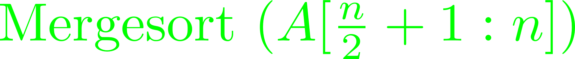
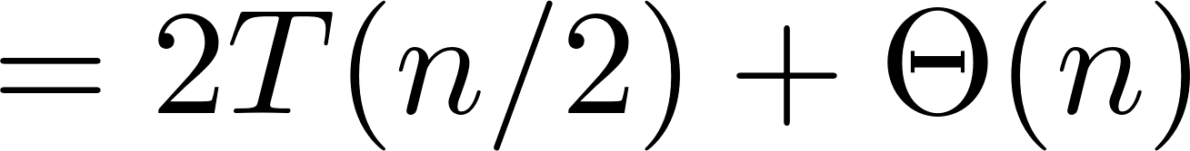
Mergesort
Pseudocode:
Running time:
Notes:
Exercise: guess merge sort

Slide 42
Mergesort
Pseudocode:
Running time:
How to analyze?
Notes:
Exercise: guess merge sort

Slide 43



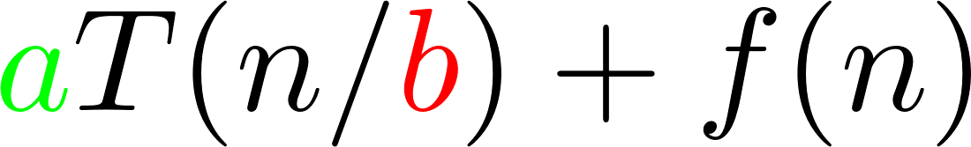

Master theorem
The Master Theorem can find the order of $T(n)$
which is defined recursively.

Slide 44
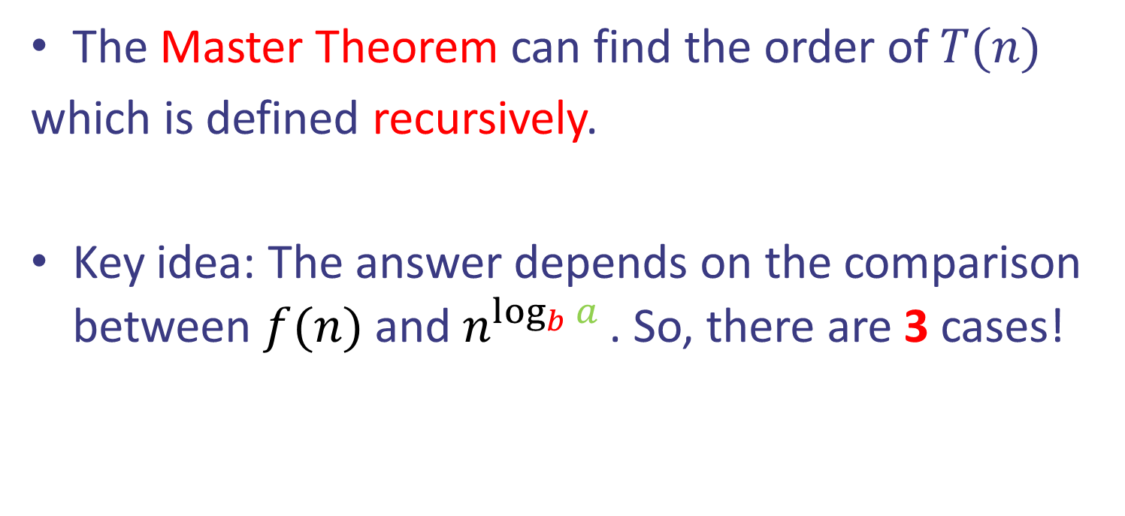
Master theorem
The Master Theorem can find the order of $T(n)$
which is defined recursively.
Key idea: The answer depends on the comparison between $f(n)$ and $n^{\log_{b}{a} }$. So, there are 3 cases!

Slide 45
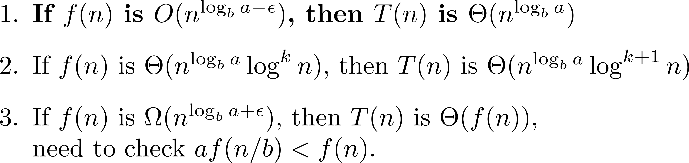
Master theorem
Case 1: $n^{\log_{b}{a}}$ dominates $f(n)$

Slide 46
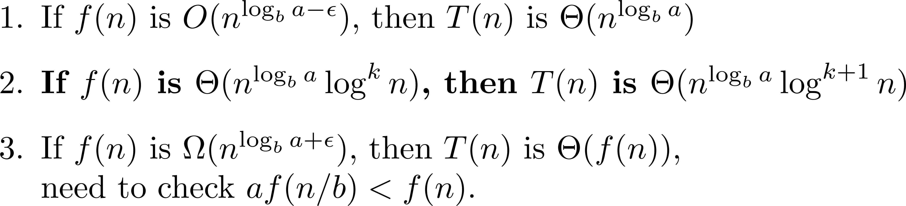
Master theorem
Case 2: $n^{\log_{b}{a}}$ have same order as $f(n)$ (up to $\log^{k}{n}$)

Slide 47
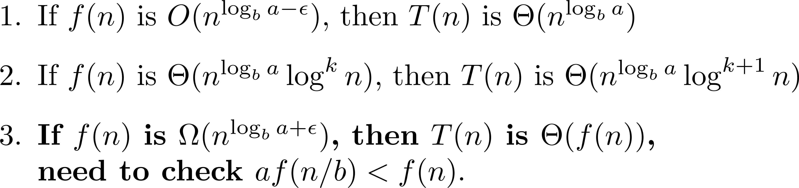
Master theorem
Case 3: $n^{\log_{b}{a}}$ is dominated by $f(n)$ (+ another condition)

Slide 48
Master Theorem (Examples)

Slide 49
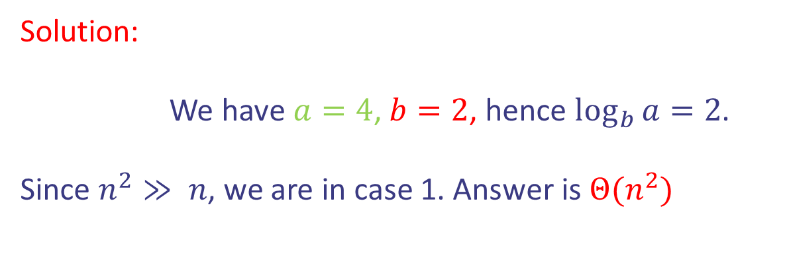
Master Theorem (Examples)
Solution:
We have $a=4$, $b=2$, hence $\log_{b}{a}=2$.
Since $n^{2}≫ n$, we are in case 1. Answer is $Θ(n^{2})$

Slide 50
Master Theorem (Examples)
Mergesort running time

Slide 51
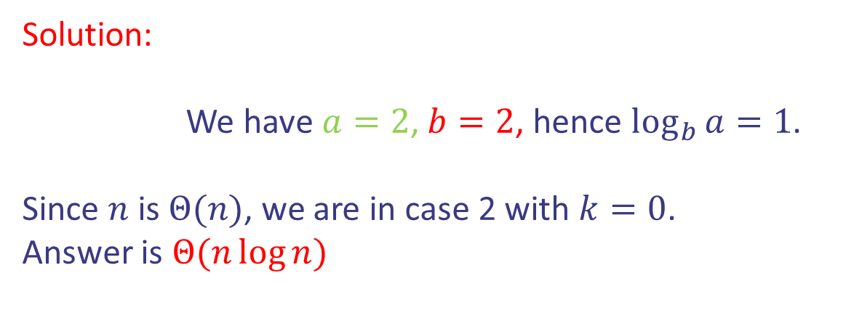
Master Theorem (Examples)
Mergesort running time
Solution:
We have $a=2$, $b=2$, hence $\log_{b}{a}=1$.
Since $n$ is $Θ(n)$, we are in case 2 with $k=0$.
Answer is $Θ(n\log{n})$

Slide 52
Master Theorem (Examples)

Slide 53
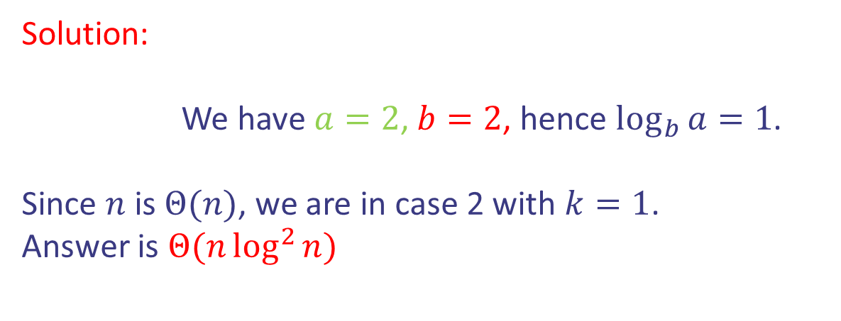
Master Theorem (Examples)
Solution:
We have $a=2$, $b=2$, hence $\log_{b}{a}=1$.
Since $n$ is $Θ(n)$, we are in case 2 with $k=1$.
Answer is $Θ(n\log^{2}{n})$

Slide 54
Master Theorem (Examples)

Slide 55
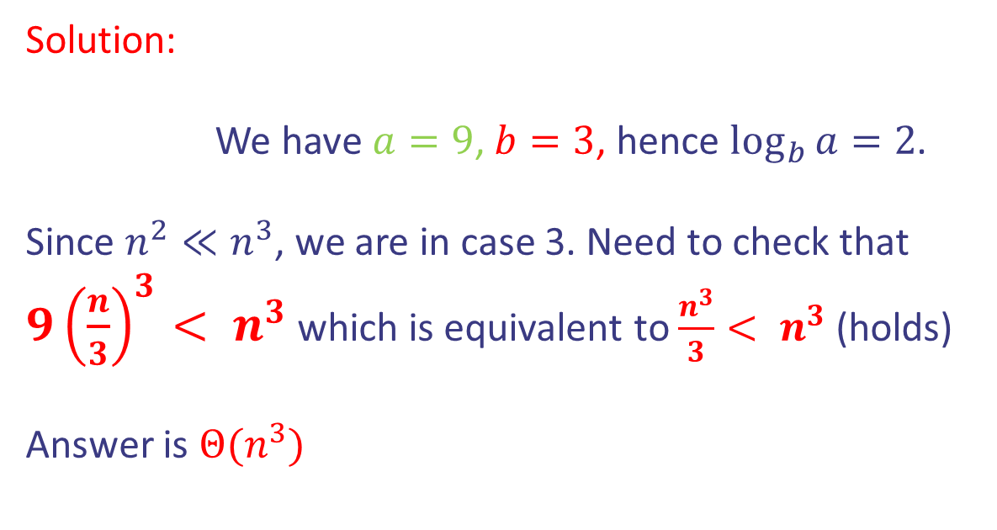
Master Theorem (Examples)
Solution:
We have $a=9$, $b=3$, hence $\log_{b}{a}=2$.
Since $n^{2}≪n^{3}$, we are in case 3. Need to check that
$9{\left(\frac{n}{3}\right)}^{3}< n^{3}$ which is equivalent to $\frac{n^{3}}{3}< n^{3}$ (holds)
Answer is $Θ(n^{3})$

Slide 56

Master Theorem (Examples)
Binary search running time

Slide 57
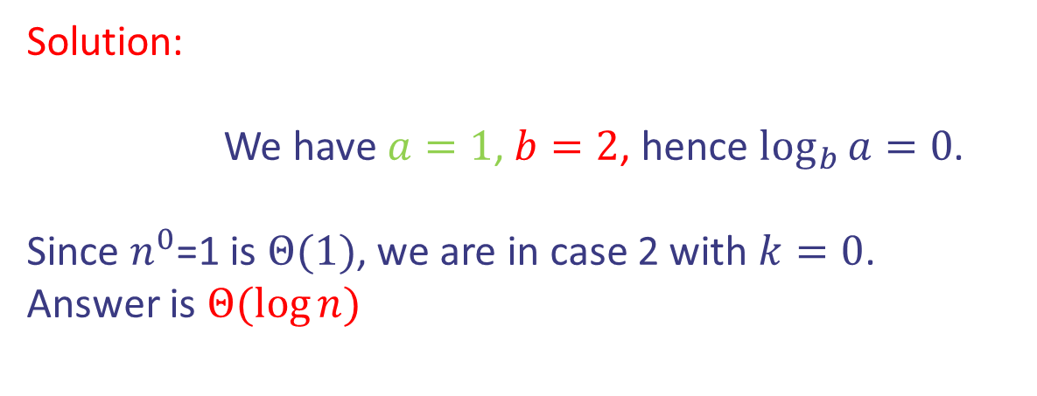
Master Theorem (Examples)
Binary search running time
Solution:
We have $a=1$, $b=2$, hence $\log_{b}{a}=0$.
Since $n^{0}$=1 is $Θ(1)$, we are in case 2 with $k=0$.
Answer is $Θ(\log{n})$

Slide 58
Divide and conquer method
Steps of method:
Divide input into parts (smaller problems)
Conquer (solve) each part recursively
Combine results to obtain solution of original
Notes:
Exercise: guess merge sort

Slide 59
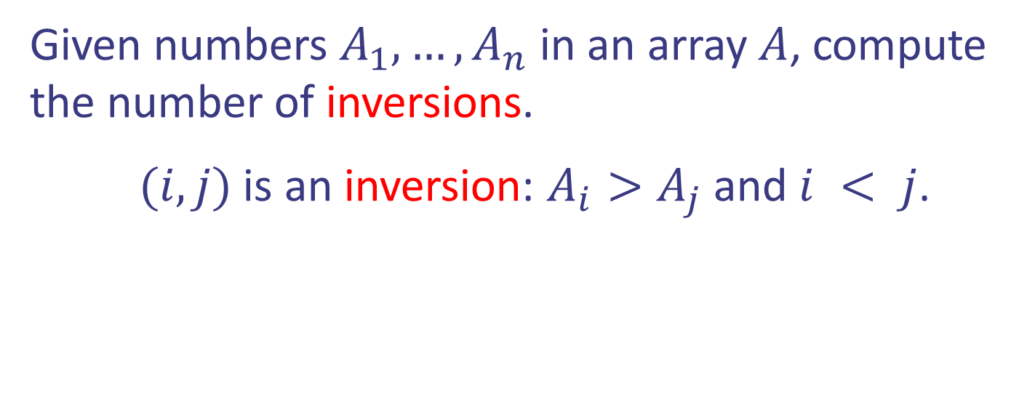
Case study I: Counting inversions
Given numbers $A_{1},…,A_{n}$ in an array $A$, compute the number of inversions.
$(i,j)$ is an inversion: $A_{i}>A_{j}$ and $i < j$.
Design and Analysis of Algorithms

Slide 60
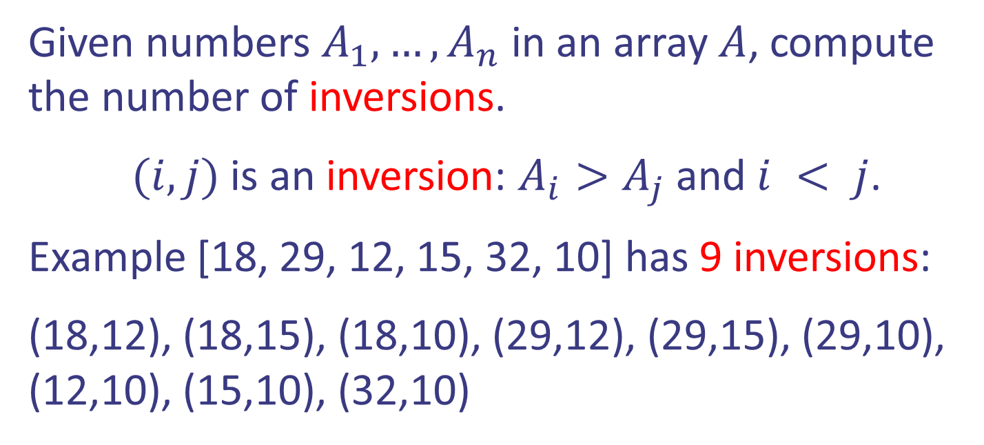
Case study I: Counting inversions
Given numbers $A_{1},…,A_{n}$ in an array $A$, compute the number of inversions.
$(i,j)$ is an inversion: $A_{i}>A_{j}$ and $i < j$.
Example [18, 29, 12, 15, 32, 10] has 9 inversions:
(18,12), (18,15), (18,10), (29,12), (29,15), (29,10), (12,10), (15,10), (32,10)
Design and Analysis of Algorithms

Slide 61
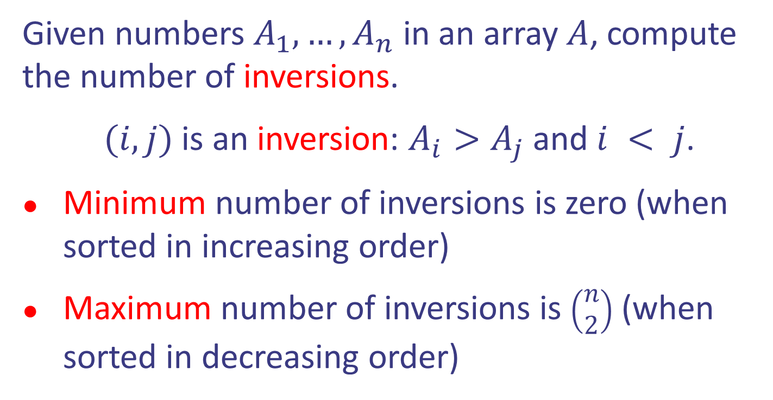
Case study I: Counting inversions
Given numbers $A_{1},…,A_{n}$ in an array $A$, compute the number of inversions.
$(i,j)$ is an inversion: $A_{i}>A_{j}$ and $i < j$.
Minimum number of inversions is zero (when sorted in increasing order)
Maximum number of inversions is $\left(\begin{matrix}n \\ 2\end{matrix}\right)$ (when sorted in decreasing order)
Design and Analysis of Algorithms

Slide 62
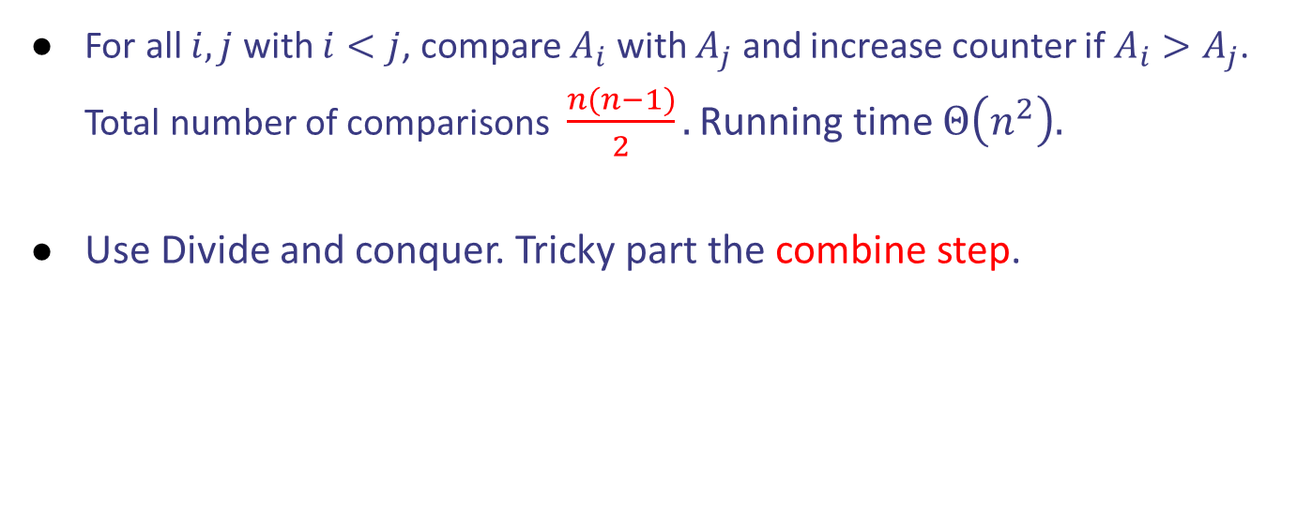
Case study I: Counting inversions
For all $i,j$ with $i<j$, compare $A_{i}$ with $A_{j}$ and increase counter if $A_{i}>A_{j}$. Total number of comparisons $\frac{n(n−1)}{2}.$ Running time $Θ\left(n^{2}\right).$
Use Divide and conquer. Tricky part the combine step.
Design and Analysis of Algorithms

Slide 63
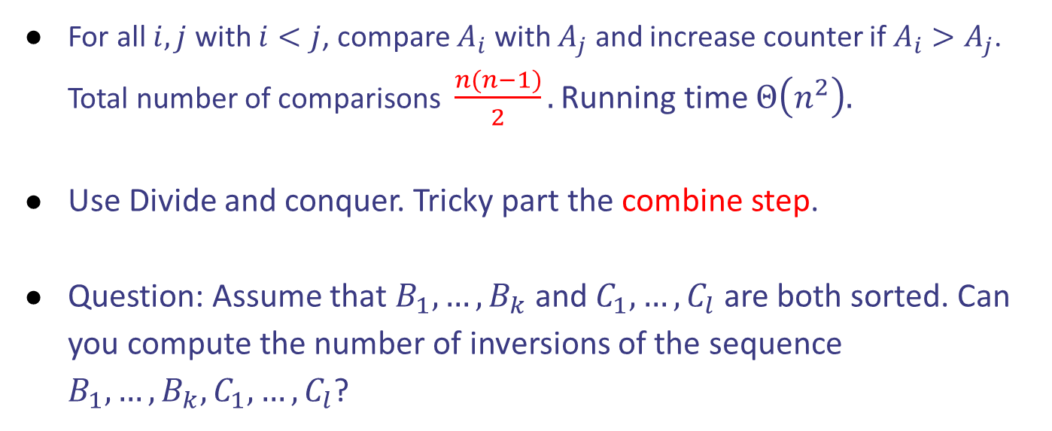
Case study I: Counting inversions
For all $i,j$ with $i<j$, compare $A_{i}$ with $A_{j}$ and increase counter if $A_{i}>A_{j}$. Total number of comparisons $\frac{n(n−1)}{2}.$ Running time $Θ\left(n^{2}\right).$
Use Divide and conquer. Tricky part the combine step.
Question: Assume that $B_{1},…,B_{k}$ and $C_{1},…,C_{l}$ are both sorted. Can you compute the number of inversions of the sequence $B_{1},…,B_{k}, C_{1},…, C_{l}$?
Design and Analysis of Algorithms

Slide 64


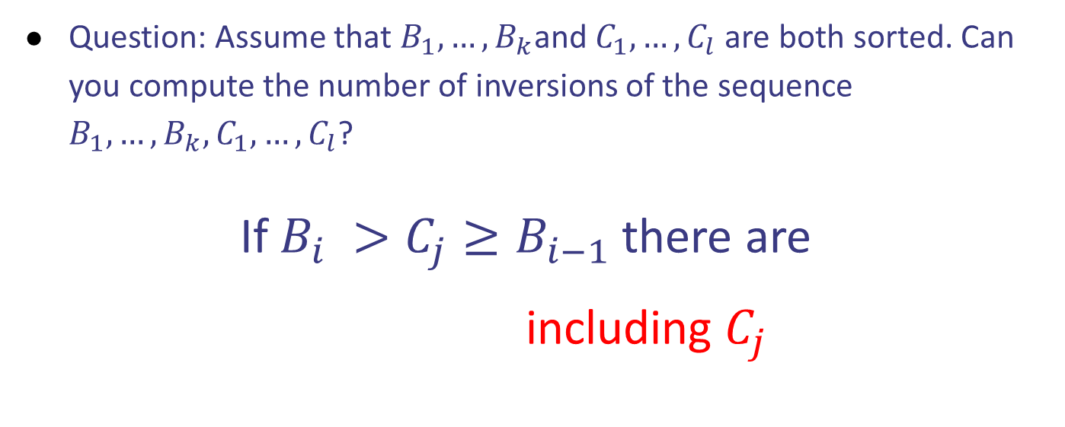
Case study I: Counting inversions
Question: Assume that $B_{1},…,B_{k}$and $C_{1},…,C_{l}$ are both sorted. Can you compute the number of inversions of the sequence $B_{1},…,B_{k}, C_{1},…, C_{l}$?
If $B_{i} >C_{j}≥B_{i−1}$ there are
$k−i+1$ including $C_{j}$
$$B_{1},…,B_{i},…,B_{k}$$
$$C_{1},…,C_{j},…,C_{l}$$
Design and Analysis of Algorithms

Slide 65
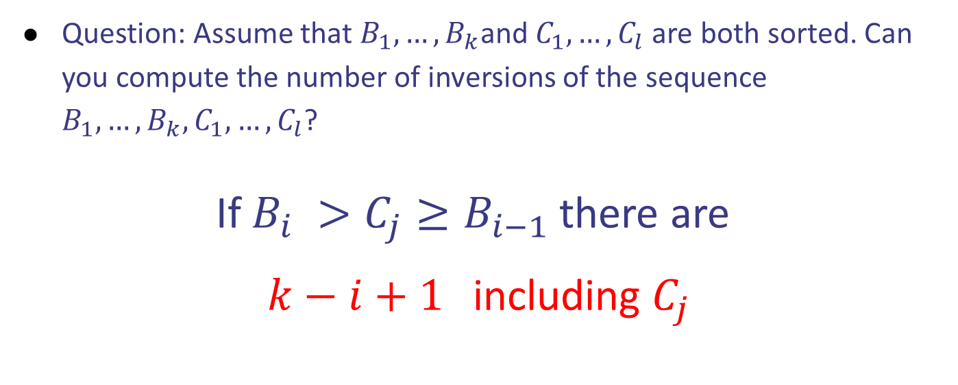
Case study I: Counting inversions
Question: Assume that $B_{1},…,B_{k}$and $C_{1},…,C_{l}$ are both sorted. Can you compute the number of inversions of the sequence $B_{1},…,B_{k}, C_{1},…, C_{l}$?
If $B_{i} >C_{j}≥B_{i−1}$ there are
$k−i+1$ including $C_{j}$
$$B_{1},…,B_{i},…,B_{k}$$
$$C_{1},…,C_{j},…,C_{l}$$
Design and Analysis of Algorithms

Slide 66




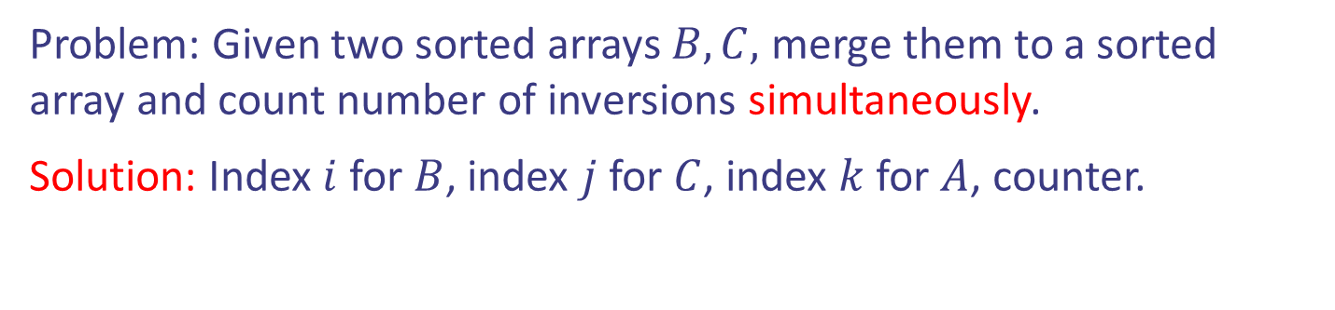
Case study I: Counting inversions
Problem: Given two sorted arrays $B,C,$ merge them to a sorted array and count number of inversions simultaneously.
Solution: Index $i$ for $B$, index $j$ for $C$, index $k$ for $A$, counter.

Slide 67

Case study I: Counting inversions
Problem: Given two sorted arrays $B,C,$ merge them to a sorted array and count number of inversions simultaneously.
Solution: Index $i$ for $B$, index $j$ for $C$, index $k$ for $A$, counter.

Slide 68


Case study I: Counting inversions
Problem: Given two sorted arrays $B,C,$ merge them to a sorted array and count number of inversions simultaneously.
Solution: Index $i$ for $B$, index $j$ for $C$, index $k$ for $A$, counter.

Slide 69

Case study I: Counting inversions
Problem: Given two sorted arrays $B,C,$ merge them to a sorted array and count number of inversions simultaneously.
Solution: Index $i$ for $B$, index $j$ for $C$, index $k$ for $A$, counter.

Slide 70


Case study I: Counting inversions
Problem: Given two sorted arrays $B,C,$ merge them to a sorted array and count number of inversions simultaneously.
Solution: Index $i$ for $B$, index $j$ for $C$, index $k$ for $A$, counter.

Slide 71

Case study I: Counting inversions
Problem: Given two sorted arrays $B,C,$ merge them to a sorted array and count number of inversions simultaneously.
Solution: Index $i$ for $B$, index $j$ for $C$, index $k$ for $A$, counter.

Slide 72


Case study I: Counting inversions
Problem: Given two sorted arrays $B,C,$ merge them to a sorted array and count number of inversions simultaneously.
Solution: Index $i$ for $B$, index $j$ for $C$, index $k$ for $A$, counter.

Slide 73


Case study I: Counting inversions
Problem: Given two sorted arrays $B,C,$ merge them to a sorted array and count number of inversions simultaneously.
Solution: Index $i$ for $B$, index $j$ for $C$, index $k$ for $A$, counter.

Slide 74

Case study I: Counting inversions
Problem: Given two sorted arrays $B,C,$ merge them to a sorted array and count number of inversions simultaneously.
Solution: Index $i$ for $B$, index $j$ for $C$, index $k$ for $A$, counter.

Slide 75
Case study I: Counting inversions
Problem: Given two sorted arrays $B,C,$ merge them to a sorted array and count number of inversions simultaneously.
Solution: Index $i$ for $B$, index $j$ for $C$, index $k$ for $A$, counter.

Slide 76

Case study I: Counting inversions
Problem: Given two sorted arrays $B,C,$ merge them to a sorted array and count number of inversions simultaneously.
Solution: Index $i$ for $B$, index $j$ for $C$, index $k$ for $A$, counter.

Slide 77
Case study I: Counting inversions
Problem: Given two sorted arrays $B,C,$ merge them to a sorted array and count number of inversions simultaneously.
Solution: Index $i$ for $B$, index $j$ for $C$, index $k$ for $A$, counter.

Slide 78
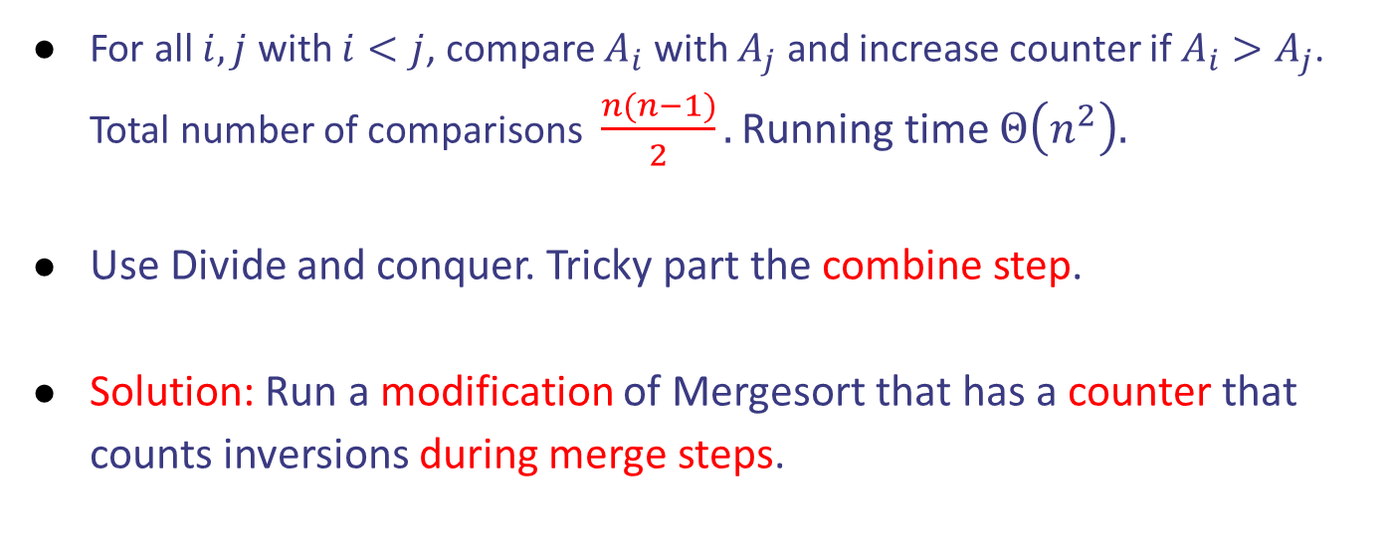
Case study I: Counting inversions
For all $i,j$ with $i<j$, compare $A_{i}$ with $A_{j}$ and increase counter if $A_{i}>A_{j}$. Total number of comparisons $\frac{n(n−1)}{2}.$ Running time $Θ\left(n^{2}\right).$
Use Divide and conquer. Tricky part the combine step.
Solution: Run a modification of Mergesort that has a counter that counts inversions during merge steps.
Design and Analysis of Algorithms

Slide 79


Case study I: Counting inversions
Pseudocode:

