Slide 1

Lecture 15 Minimum Spanning Trees
CS 161 Design and Analysis of Algorithms
Ioannis Panageas

Slide 2

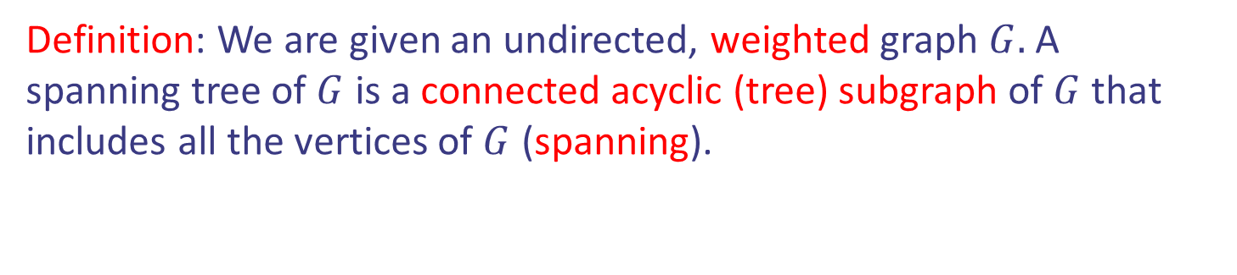
Spanning Tree
Definition: We are given an undirected, weighted graph $G.$ A spanning tree of $G$ is a connected acyclic (tree) subgraph of $G$ that includes all the vertices of $G$ (spanning).
OAK
10
1
MIA
LA
6
7
9
3
BOS
4
NYC
8
5
2
DC
ATL
Design and Analysis of Algorithms

Slide 3

Spanning Tree
Definition: We are given an undirected, weighted graph $G.$ A spanning tree of $G$ is a connected acyclic (tree) subgraph of $G$ that includes all the vertices of $G$ (spanning).
OAK
10
1
MIA
LA
6
7
9
3
BOS
4
NYC
8
5
2
DC
ATL
Design and Analysis of Algorithms

Slide 4
Spanning Tree
Definition: We are given an undirected, weighted graph $G.$ A spanning tree of $G$ is a connected acyclic (tree) subgraph of $G$ that includes all the vertices of $G$ (spanning).
OAK
10
1
MIA
LA
6
7
9
3
BOS
4
NYC
8
5
2
DC
ATL
Design and Analysis of Algorithms

Slide 5
Spanning Tree
Definition: We are given an undirected, weighted graph $G.$ A spanning tree of $G$ is a connected acyclic (tree) subgraph of $G$ that includes all the vertices of $G$ (spanning).
OAK
10
1
MIA
LA
6
7
9
3
BOS
Not a spanning tree.
It is not spanning (MIA).
NYC
4
8
5
2
DC
ATL
Design and Analysis of Algorithms

Slide 6
Spanning Tree
Definition: We are given an undirected, weighted graph $G.$ A spanning tree of $G$ is a connected acyclic (tree) subgraph of $G$ that includes all the vertices of $G$ (spanning).
OAK
10
1
MIA
LA
6
7
9
3
BOS
Not a spanning tree.
It is not a tree (cycle).
NYC
4
8
5
2
DC
ATL
Design and Analysis of Algorithms

Slide 7
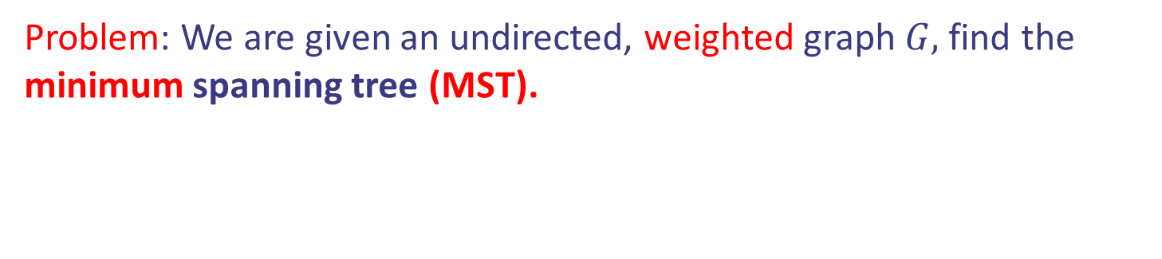
Minimum Spanning Tree
Problem: We are given an undirected, weighted graph $G,$ find the minimum spanning tree (MST).
OAK
10
1
MIA
LA
6
7
9
3
BOS
4
NYC
8
5
2
DC
ATL
Design and Analysis of Algorithms

Slide 8
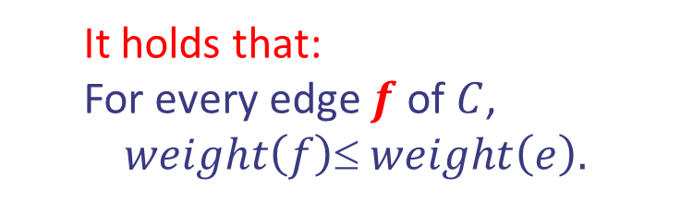
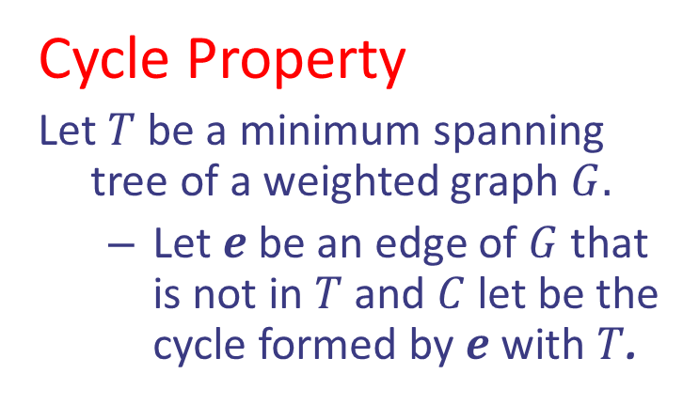
Minimum Spanning Tree
Cycle Property
Let $T$ be a minimum spanning tree of a weighted graph $G.$
Let $e$ be an edge of $G$ that is not in $T$ and $C$ let be the cycle formed by $e$ with $T$.
OAK
10
1
MIA
LA
6
7
9
3
BOS
It holds that:
For every edge $f$ of $C$,
$$weight\left(f\right)≤ weight\left(e\right).$$
4
NYC
8
5
2
DC
ATL
Design and Analysis of Algorithms

Slide 9
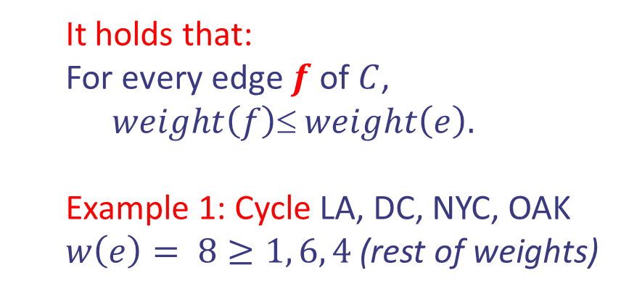
Minimum Spanning Tree
Cycle Property
Let $T$ be a minimum spanning tree of a weighted graph $G.$
Let $e$ be an edge of $G$ that is not in $T$ and $C$ let be the cycle formed by $e$ with $T$.
OAK
10
1
MIA
LA
6
7
9
3
BOS
It holds that:
For every edge $f$ of $C$,
$$weight\left(f\right)≤ weight\left(e\right).$$
Example 1: Cycle LA, DC, NYC, OAK
$w\left(e\right)= 8≥1, 6, 4$ (rest of weights)
4
NYC
8
5
2
$$e$$
DC
ATL
Design and Analysis of Algorithms

Slide 10
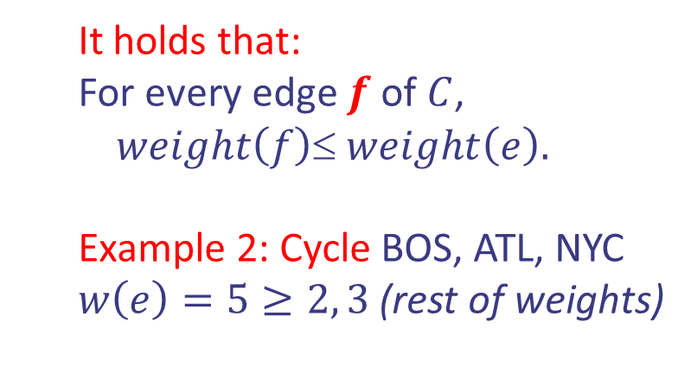
Minimum Spanning Tree
Cycle Property
Let $T$ be a minimum spanning tree of a weighted graph $G.$
Let $e$ be an edge of $G$ that is not in $T$ and $C$ let be the cycle formed by $e$ with $T$.
OAK
10
1
MIA
LA
6
7
9
3
BOS
It holds that:
For every edge $f$ of $C$,
$$weight\left(f\right)≤ weight\left(e\right).$$
Example 2: Cycle BOS, ATL, NYC
$w\left(e\right)=5≥2, 3$ (rest of weights)
4
NYC
8
5
2
DC
ATL
Design and Analysis of Algorithms

Slide 11
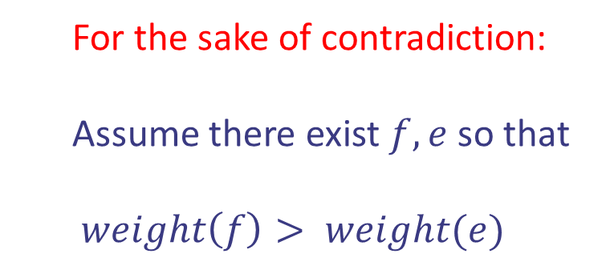

Minimum Spanning Tree
Cycle Property
f
8
For the sake of contradiction:
Assume there exist $f, e$ so that
$weight\left(f\right)> weight(e)$
4
9
2
6
3
e
8
7
7
Replacing $f$ with $e$ yields a better spanning tree
f
8
4
9
2
6
3
e
8
7
7
Design and Analysis of Algorithms

Slide 12
Kruskal’s Algorithm for MSTs
Idea 1: Greedy approach. Consider the edges from smaller weight to larger. Include each edge in the current solution as long as it does not create a cycle, otherwise discard it.
B
8
G
E
4
5
9
F
1
C
3
6
11
7
2
D
H
12
A
10
Design and Analysis of Algorithms

Slide 13
Kruskal’s Algorithm for MSTs
Idea 1: Greedy approach. Consider the edges from smaller weight to larger. Include each edge in the current solution as long as it does not create a cycle, otherwise discard it.
B
8
G
E
4
5
9
F
1
C
3
6
11
7
2
D
H
12
A
10
Design and Analysis of Algorithms

Slide 14
Kruskal’s Algorithm for MSTs
Idea 1: Greedy approach. Consider the edges from smaller weight to larger. Include each edge in the current solution as long as it does not create a cycle, otherwise discard it.
B
8
G
E
4
5
9
F
1
C
3
6
11
7
2
D
H
12
A
10
Design and Analysis of Algorithms

Slide 15
Kruskal’s Algorithm for MSTs
Idea 1: Greedy approach. Consider the edges from smaller weight to larger. Include each edge in the current solution as long as it does not create a cycle, otherwise discard it.
B
8
G
E
4
5
9
F
1
C
3
6
11
7
2
D
H
12
A
10
Design and Analysis of Algorithms

Slide 16
Kruskal’s Algorithm for MSTs
Idea 1: Greedy approach. Consider the edges from smaller weight to larger. Include each edge in the current solution as long as it does not create a cycle, otherwise discard it.
B
8
G
E
4
5
9
F
1
C
3
6
11
7
2
D
H
12
A
10
Design and Analysis of Algorithms

Slide 17
Kruskal’s Algorithm for MSTs
Idea 1: Greedy approach. Consider the edges from smaller weight to larger. Include each edge in the current solution as long as it does not create a cycle, otherwise discard it.
B
8
G
E
4
5
9
F
1
C
3
6
11
7
2
D
H
12
A
10
Design and Analysis of Algorithms

Slide 18
Kruskal’s Algorithm for MSTs
Idea 1: Greedy approach. Consider the edges from smaller weight to larger. Include each edge in the current solution as long as it does not create a cycle, otherwise discard it.
B
8
G
E
4
5
9
F
1
C
3
6
11
7
2
D
H
12
A
10
Design and Analysis of Algorithms

Slide 19
Kruskal’s Algorithm for MSTs
Idea 1: Greedy approach. Consider the edges from smaller weight to larger. Include each edge in the current solution as long as it does not create a cycle, otherwise discard it.
B
8
G
E
4
5
9
F
1
C
3
6
11
7
2
D
H
12
A
10
Design and Analysis of Algorithms

Slide 20
Kruskal’s Algorithm for MSTs
Idea 1: Greedy approach. Consider the edges from smaller weight to larger. Include each edge in the current solution as long as it does not create a cycle, otherwise discard it.
B
8
G
E
4
5
9
F
1
C
3
6
11
7
2
D
H
12
A
10
Design and Analysis of Algorithms

Slide 21
Kruskal’s Algorithm for MSTs
Idea 1: Greedy approach. Consider the edges from smaller weight to larger. Include each edge in the current solution as long as it does not create a cycle, otherwise discard it.
B
8
G
E
4
5
9
F
1
C
3
6
11
7
2
D
H
12
A
10
Design and Analysis of Algorithms

Slide 22
Kruskal’s Algorithm for MSTs
Idea 1: Greedy approach. Consider the edges from smaller weight to larger. Include each edge in the current solution as long as it does not create a cycle, otherwise discard it.
B
8
G
E
4
5
9
F
1
C
3
6
11
7
2
D
H
12
A
10
Design and Analysis of Algorithms

Slide 23
Kruskal’s Algorithm for MSTs
Idea 1: Greedy approach. Consider the edges from smaller weight to larger. Include each edge in the current solution as long as it does not create a cycle, otherwise discard it.
B
8
G
E
4
5
9
F
1
C
3
6
11
7
2
D
H
12
A
10
Design and Analysis of Algorithms

Slide 24
Kruskal’s Algorithm for MSTs
Idea 1: Greedy approach. Consider the edges from smaller weight to larger. Include each edge in the current solution as long as it does not create a cycle, otherwise discard it.
B
8
G
E
4
5
9
F
1
C
3
6
11
7
2
D
H
12
A
10
Design and Analysis of Algorithms

Slide 25
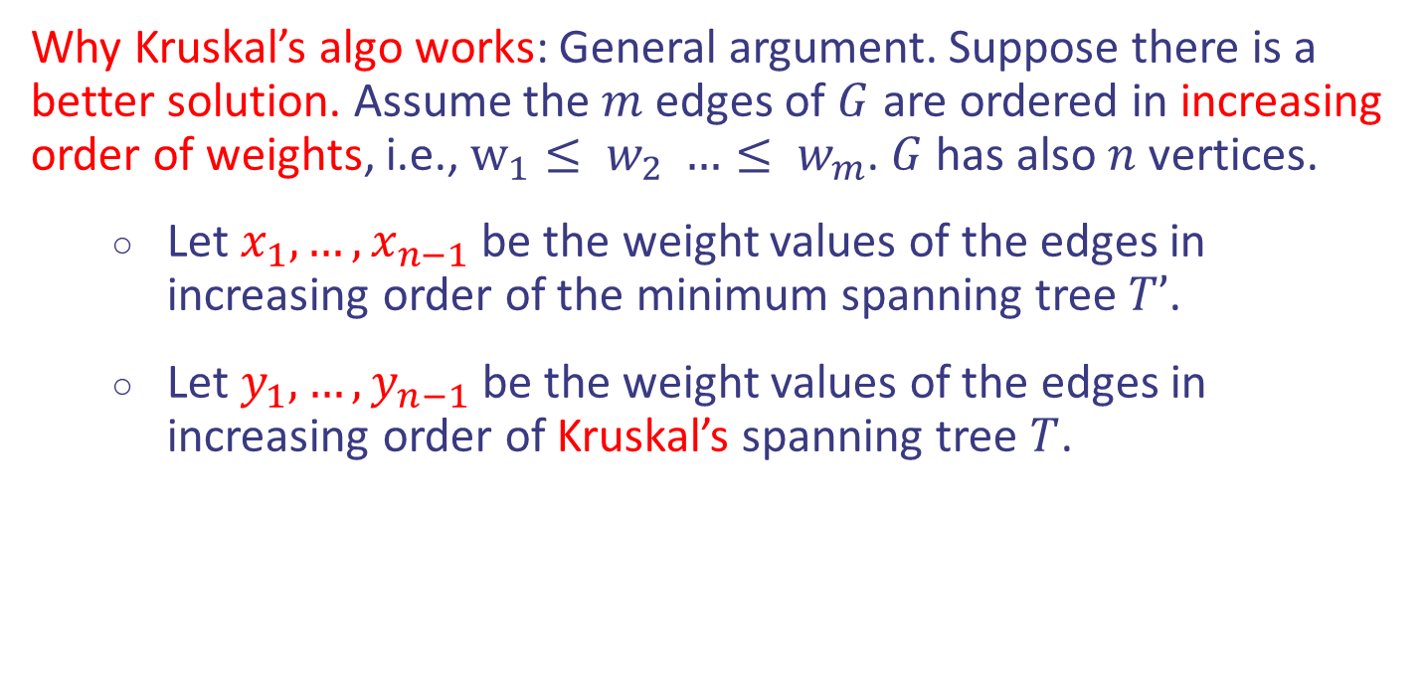
Kruskal’s Algorithm for MSTs
Why Kruskal’s algo works: General argument. Suppose there is a better solution. Assume the $m$ edges of $G$ are ordered in increasing order of weights, i.e., $w_{1}≤ w_{2} …≤ w_{m}$. $G$ has also $n$ vertices.
Let $x_{1},…,x_{n−1}$ be the weight values of the edges in increasing order of the minimum spanning tree $T’$.
Let $y_{1},…,y_{n−1}$be the weight values of the edges in increasing order of Kruskal’s spanning tree $T$.
Design and Analysis of Algorithms

Slide 26
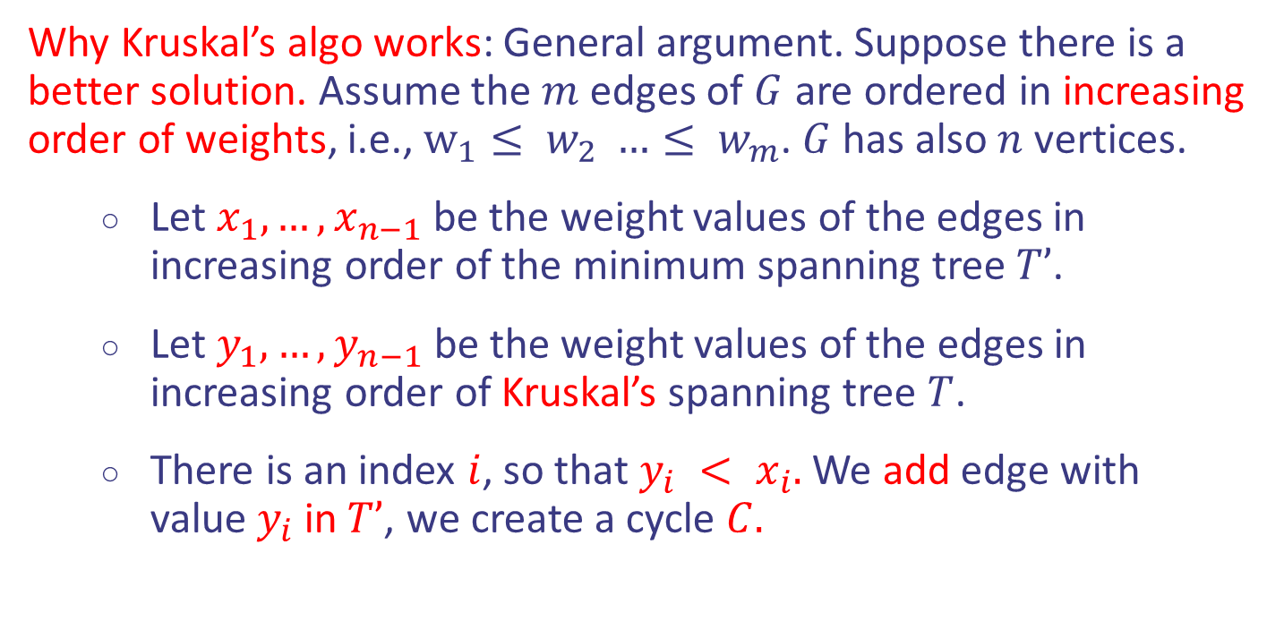
Kruskal’s Algorithm for MSTs
Why Kruskal’s algo works: General argument. Suppose there is a better solution. Assume the $m$ edges of $G$ are ordered in increasing order of weights, i.e., $w_{1}≤ w_{2} …≤ w_{m}$. $G$ has also $n$ vertices.
Let $x_{1},…,x_{n−1}$ be the weight values of the edges in increasing order of the minimum spanning tree $T’$.
Let $y_{1},…,y_{n−1}$be the weight values of the edges in increasing order of Kruskal’s spanning tree $T$.
There is an index $i$, so that $y_{i} < x_{i}.$ We add edge with value$y_{i}$in$T’$, we create a cycle $C.$
Design and Analysis of Algorithms

Slide 27
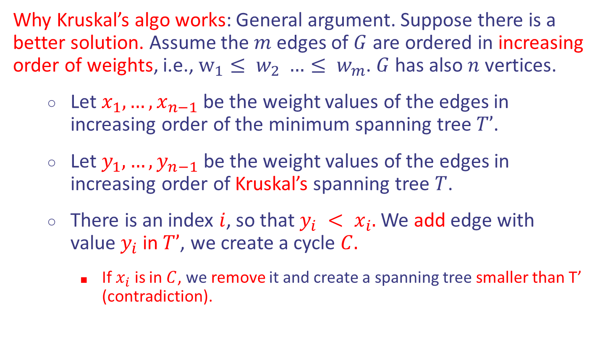
Kruskal’s Algorithm for MSTs
Why Kruskal’s algo works: General argument. Suppose there is a better solution. Assume the $m$ edges of $G$ are ordered in increasing order of weights, i.e., $w_{1}≤ w_{2} …≤ w_{m}$. $G$ has also $n$ vertices.
Let $x_{1},…,x_{n−1}$ be the weight values of the edges in increasing order of the minimum spanning tree $T’$.
Let $y_{1},…,y_{n−1}$be the weight values of the edges in increasing order of Kruskal’s spanning tree $T$.
There is an index $i$, so that $y_{i} < x_{i}.$ We add edge with value$y_{i}$in$T’$, we create a cycle $C.$
If $x_{i}$ is in $C$, we remove it and create a spanning tree smaller than T’ (contradiction).
Design and Analysis of Algorithms

Slide 28
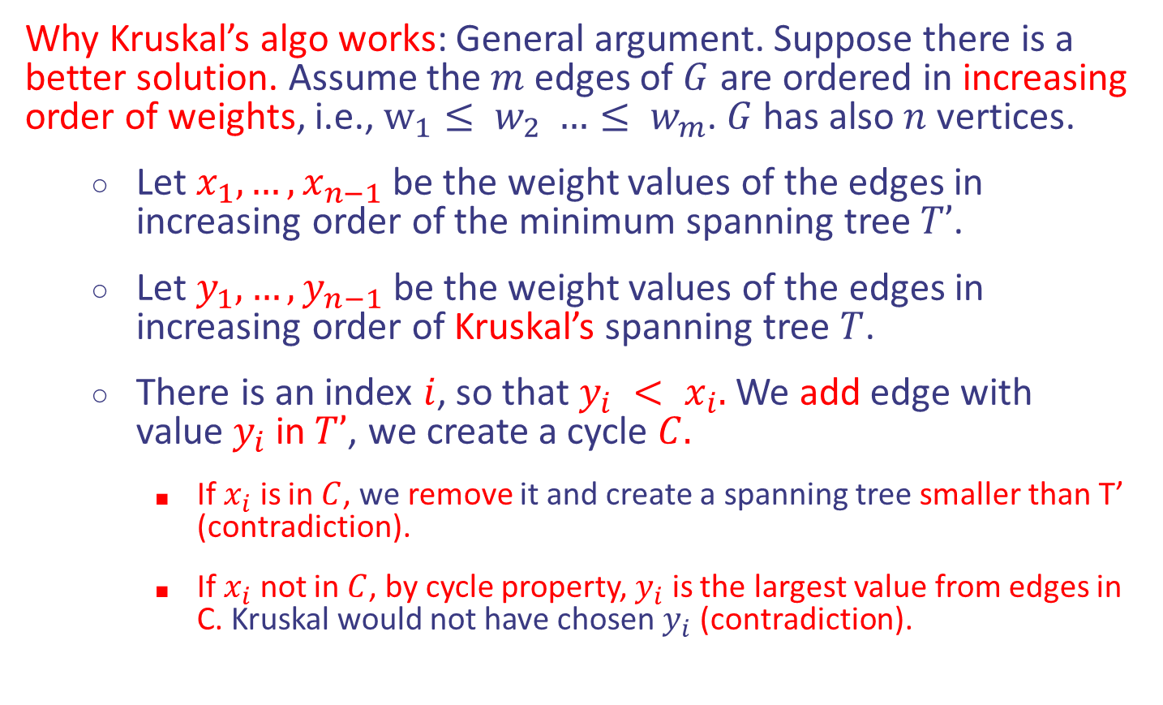
Kruskal’s Algorithm for MSTs
Why Kruskal’s algo works: General argument. Suppose there is a better solution. Assume the $m$ edges of $G$ are ordered in increasing order of weights, i.e., $w_{1}≤ w_{2} …≤ w_{m}$. $G$ has also $n$ vertices.
Let $x_{1},…,x_{n−1}$ be the weight values of the edges in increasing order of the minimum spanning tree $T’$.
Let $y_{1},…,y_{n−1}$be the weight values of the edges in increasing order of Kruskal’s spanning tree $T$.
There is an index $i$, so that $y_{i} < x_{i}.$ We add edge with value$y_{i}$in$T’$, we create a cycle $C.$
If $x_{i}$ is in $C$, we remove it and create a spanning tree smaller than T’ (contradiction).
If $x_{i}$ not in $C$, by cycle property, $y_{i}$ is the largest value from edges in C. Kruskal would not have chosen $y_{i}$ (contradiction).
Design and Analysis of Algorithms

Slide 29
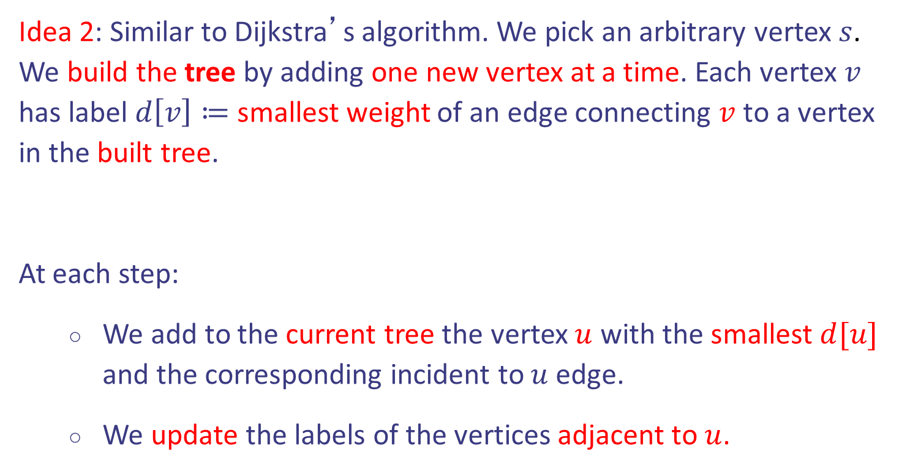
Prim’s Algorithm for MSTs
Idea 2: Similar to Dijkstra’s algorithm. We pick an arbitrary vertex $s$. We build the tree by adding one new vertex at a time. Each vertex $v$ has label $d\left[v\right]≔$ smallest weight of an edge connecting $v$ to a vertex in the built tree.
At each step:
We add to the current tree the vertex $u$ with the smallest $d[u]$ and the corresponding incident to $u$ edge.
We update the labels of the vertices adjacent to $u$.
Design and Analysis of Algorithms

Slide 30
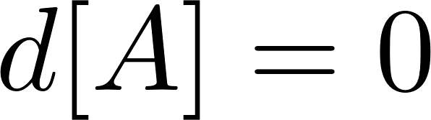
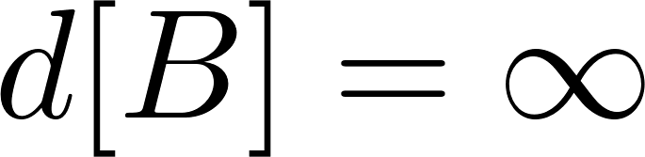
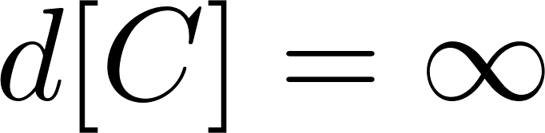
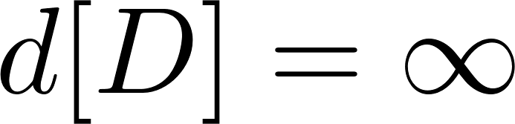
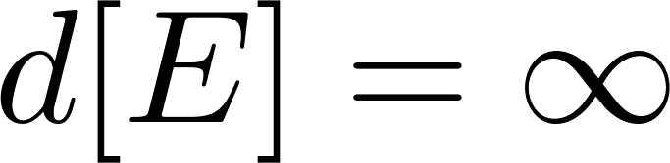
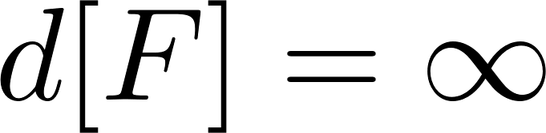
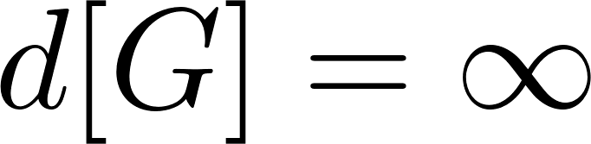
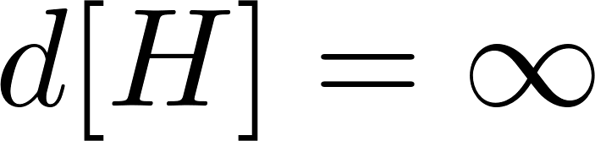
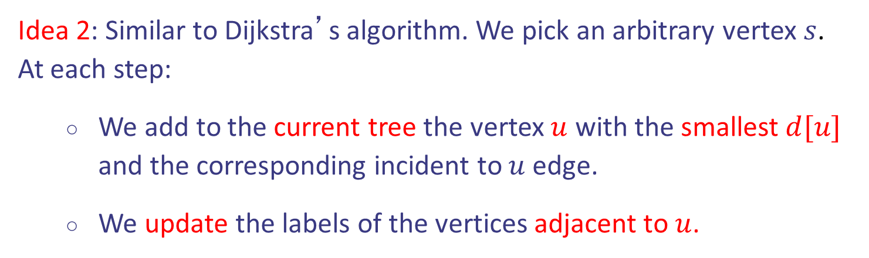
Prim’s Algorithm for MSTs
Idea 2: Similar to Dijkstra’s algorithm. We pick an arbitrary vertex $s$.
At each step:
We add to the current tree the vertex $u$ with the smallest $d[u]$ and the corresponding incident to $u$ edge.
We update the labels of the vertices adjacent to $u$.
B
8
G
E
4
5
9
F
1
C
3
6
11
7
2
D
H
12
A
10
Design and Analysis of Algorithms

Slide 31
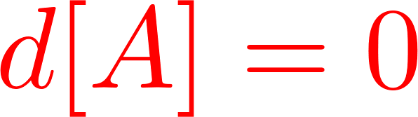
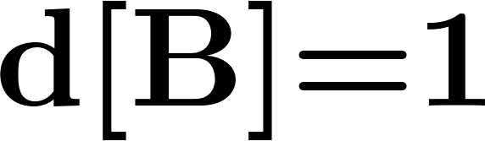
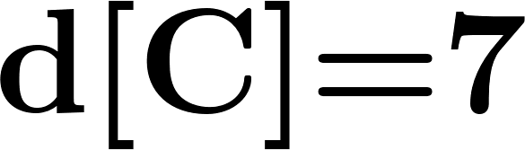
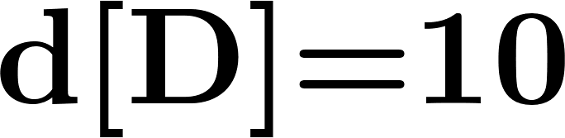
Prim’s Algorithm for MSTs
Idea 2: Similar to Dijkstra’s algorithm. We pick an arbitrary vertex $s$.
At each step:
We add to the current tree the vertex $u$ with the smallest $d[u]$ and the corresponding incident to $u$ edge.
We update the labels of the vertices adjacent to $u$.
B
8
G
E
4
5
9
F
1
C
3
6
11
7
2
D
H
12
A
10
Design and Analysis of Algorithms

Slide 32
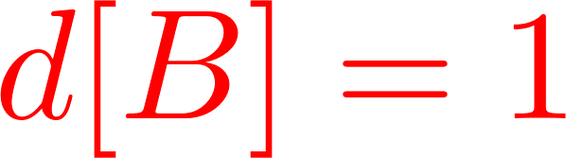
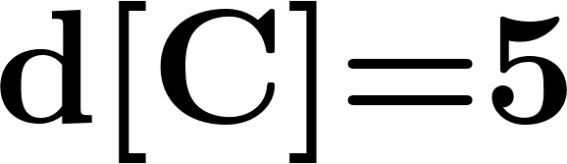
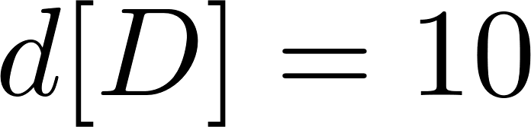
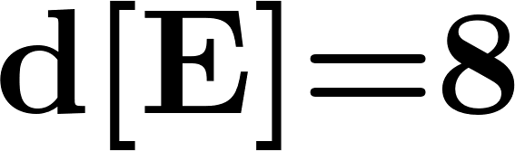
Prim’s Algorithm for MSTs
Idea 2: Similar to Dijkstra’s algorithm. We pick an arbitrary vertex $s$.
At each step:
We add to the current tree the vertex $u$ with the smallest $d[u]$ and the corresponding incident to $u$ edge.
We update the labels of the vertices adjacent to $u$.
B
8
G
E
4
5
9
F
1
C
3
6
11
7
2
D
H
12
A
10
Design and Analysis of Algorithms

Slide 33
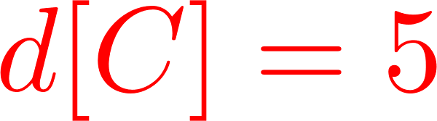
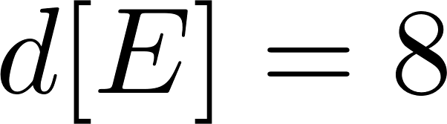
Prim’s Algorithm for MSTs
Idea 2: Similar to Dijkstra’s algorithm. We pick an arbitrary vertex $s$.
At each step:
We add to the current tree the vertex $u$ with the smallest $d[u]$ and the corresponding incident to $u$ edge.
We update the labels of the vertices adjacent to $u$.
B
8
G
E
4
5
9
F
1
C
3
6
11
7
2
D
H
12
A
10
Design and Analysis of Algorithms

Slide 34
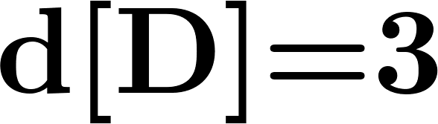
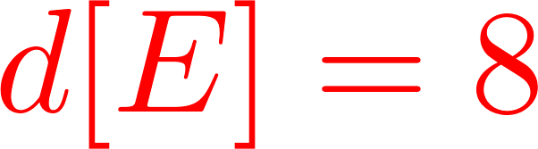
Prim’s Algorithm for MSTs
Idea 2: Similar to Dijkstra’s algorithm. We pick an arbitrary vertex $s$.
At each step:
We add to the current tree the vertex $u$ with the smallest $d[u]$ and the corresponding incident to $u$ edge.
We update the labels of the vertices adjacent to $u$.
B
8
G
E
4
5
9
F
1
C
3
6
11
7
2
D
H
12
A
10
Design and Analysis of Algorithms

Slide 35
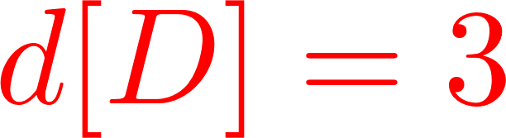
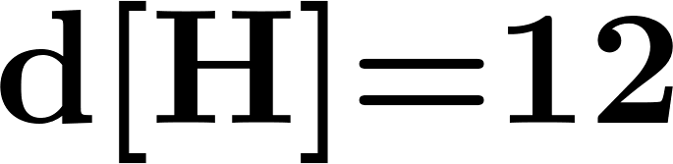
Prim’s Algorithm for MSTs
Idea 2: Similar to Dijkstra’s algorithm. We pick an arbitrary vertex $s$.
At each step:
We add to the current tree the vertex $u$ with the smallest $d[u]$ and the corresponding incident to $u$ edge.
We update the labels of the vertices adjacent to $u$.
B
8
G
E
4
5
9
F
1
C
3
6
11
7
2
D
H
12
A
10
Design and Analysis of Algorithms

Slide 36
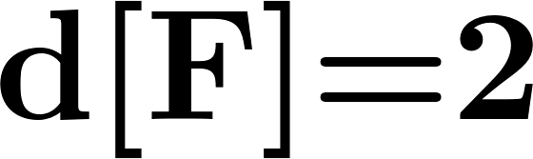
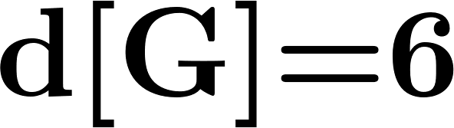
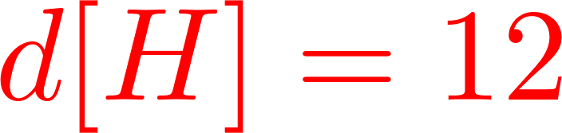
Prim’s Algorithm for MSTs
Idea 2: Similar to Dijkstra’s algorithm. We pick an arbitrary vertex $s$.
At each step:
We add to the current tree the vertex $u$ with the smallest $d[u]$ and the corresponding incident to $u$ edge.
We update the labels of the vertices adjacent to $u$.
B
8
G
E
4
5
9
F
1
C
3
6
11
7
2
D
H
12
A
10
Design and Analysis of Algorithms

Slide 37
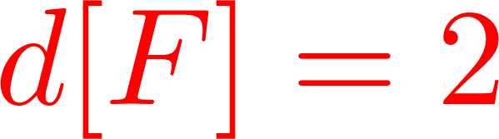
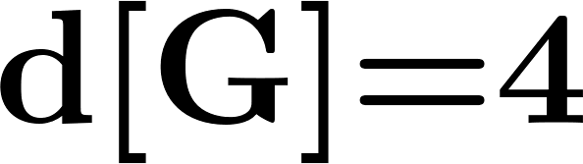
Prim’s Algorithm for MSTs
Idea 2: Similar to Dijkstra’s algorithm. We pick an arbitrary vertex $s$.
At each step:
We add to the current tree the vertex $u$ with the smallest $d[u]$ and the corresponding incident to $u$ edge.
We update the labels of the vertices adjacent to $u$.
B
8
G
E
4
5
9
F
1
C
3
6
11
7
2
D
H
12
A
10
Design and Analysis of Algorithms

Slide 38
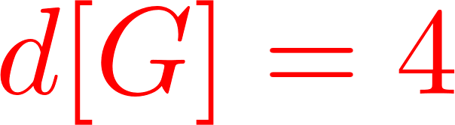
Prim’s Algorithm for MSTs
Idea 2: Similar to Dijkstra’s algorithm. We pick an arbitrary vertex $s$.
At each step:
We add to the current tree the vertex $u$ with the smallest $d[u]$ and the corresponding incident to $u$ edge.
We update the labels of the vertices adjacent to $u$.
B
8
G
E
4
5
9
F
1
C
3
6
11
7
2
D
H
12
A
10
Design and Analysis of Algorithms

Slide 39
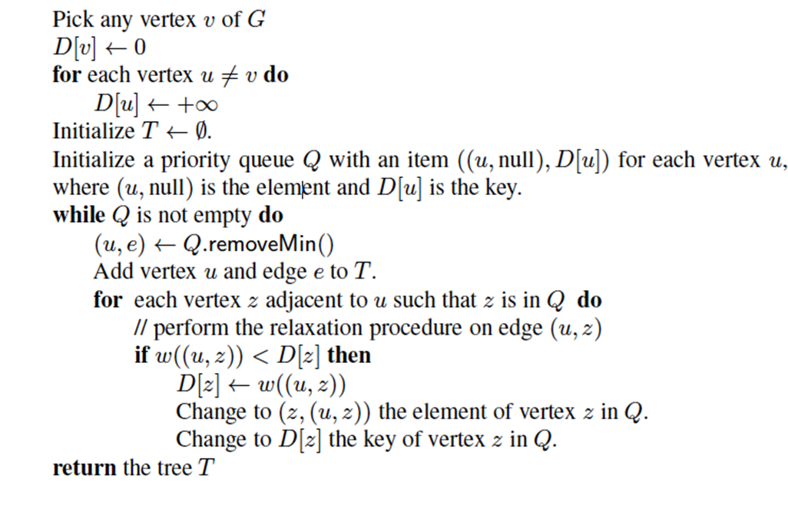
Prim’s Algorithm for MSTs
Pseudocode:
Starting vertex
Initialization
Relaxation
Design and Analysis of Algorithms

Slide 40
Prim’s Algorithm for MSTs
Pseudocode:
Starting vertex
Initialization
Relaxation
Design and Analysis of Algorithms

Slide 41

Prim’s Algorithm for MSTs
Pseudocode:
Starting vertex
Initialization
Relaxation
$$Θ({\left|V\right|}^{2})$$
Design and Analysis of Algorithms

Slide 42
Prim’s Algorithm for MSTs
Pseudocode:
Starting vertex
Initialization
Relaxation
Design and Analysis of Algorithms

