Slide 1

Lecture 9 Dynamic Programming II: Knapsack, Interval Scheduling, Bellman-Ford
CS 161 Design and Analysis of Algorithms
Ioannis Panageas

Slide 2
Dynamic Programming
Technique for solving optimization problems.
Solve problem by solving sub-problems and combine:
This is called Optimal substructure property.
Similar to divide-and-conquer: recursion (for solving sub-problems)
Sub-problems overlap: solve them only once!
DP = recursion + re-use (Memoization)

Slide 3


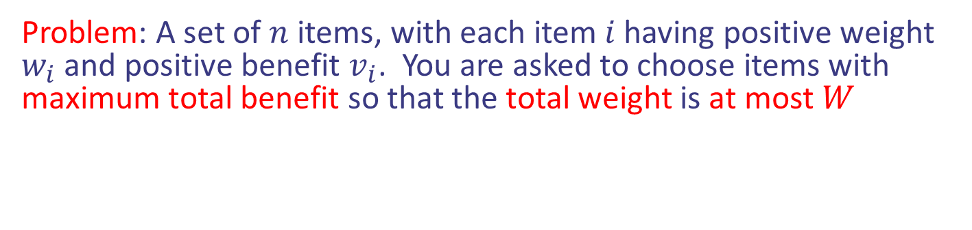
Case study II: 0/1 Knapsack
Problem: A set of $n$ items, with each item $i$ having positive weight $w_{i}$ and positive benefit $v_{i}$. You are asked to choose items with maximum total benefit so that the total weight is at most $W$
“knapsack” with 9 lbs capacity
Items:
Weight:
4 lbs
2 lbs
2 lbs
6 lbs
2 lbs
Solution:
item 5 ($80, 2 lbs)
item 3 ($6, 2lbs)
item 1 ($20, 4lbs)
Benefit:
$20
$3
$6
$25
$80
Design and Analysis of Algorithms

Slide 4

Case study II: 0/1 Knapsack
Idea: Dynamic Programming.
Step 1: Define the problem and subproblems.
Answer: Let $DP[k,j]$ be the maximum value I can get from items $\{1,…,k\}$ without exceeding $j$.
Design and Analysis of Algorithms

Slide 5

Case study II: 0/1 Knapsack
Idea: Dynamic Programming.
Step 1: Define the problem and subproblems.
Answer: Let $DP[k,j]$ be the maximum value I can get from items $\{1,…,k\}$ without exceeding $j$.
Step 2: Define the goal/output given Step 1.
It is $DP[n,W]$.
Design and Analysis of Algorithms

Slide 6
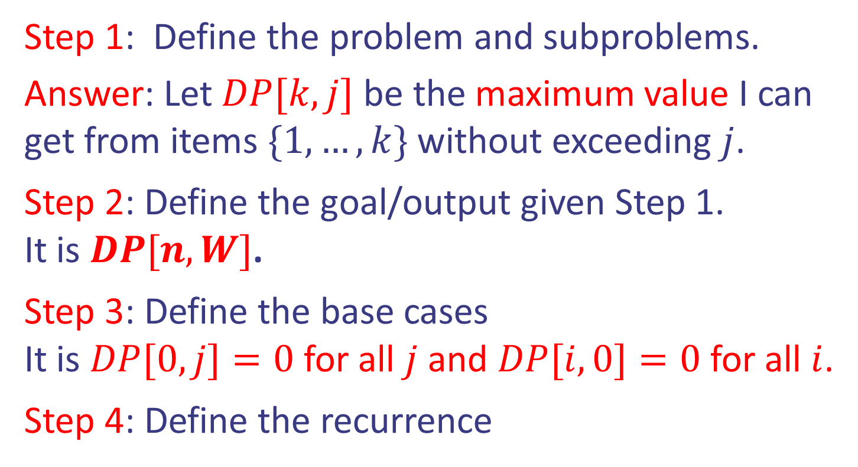
Case study II: 0/1 Knapsack
Idea: Dynamic Programming.
Step 1: Define the problem and subproblems.
Answer: Let $DP[k,j]$ be the maximum value I can get from items $\{1,…,k\}$ without exceeding $j$.
Step 2: Define the goal/output given Step 1.
It is $DP[n,W]$.
Step 3: Define the base cases
It is $DP[0,j]=0$ for all $j$ and $DP[i,0]=0$ for all $i$.
Step 4: Define the recurrence
Design and Analysis of Algorithms

Slide 7

Case study II: 0/1 Knapsack
Idea: Dynamic Programming.
Item $k$ will be used or not.
$DP[k,j] = max⁡(DP[k−1,j−w_{k}]+v_{k},DP[k−1,j])$
Step 4: Define the recurrence
Design and Analysis of Algorithms

Slide 8
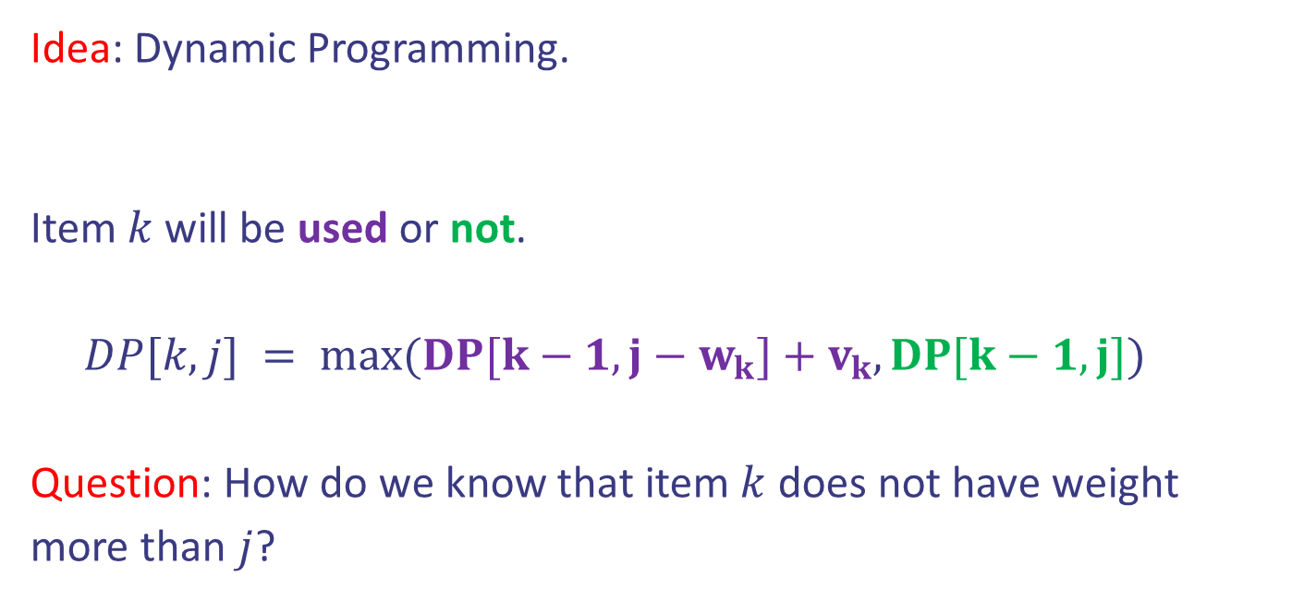
Case study II: 0/1 Knapsack
Idea: Dynamic Programming.
Item $k$ will be used or not.
$DP[k,j] = max⁡(DP[k−1,j−w_{k}]+v_{k},DP[k−1,j])$
Question: How do we know that item $k$ does not have weight more than $j$?
Step 4: Define the recurrence
Design and Analysis of Algorithms

Slide 9
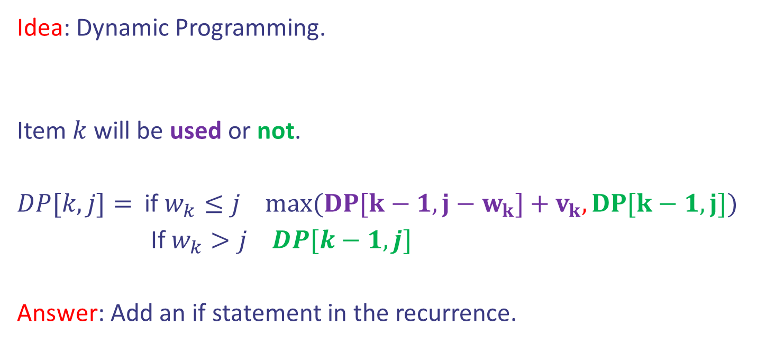
Case study II: 0/1 Knapsack
Idea: Dynamic Programming.
Item $k$ will be used or not.
$DP[k,j]=$ if $w_{k}≤j$ $max⁡(DP[k−1,j−w_{k}]+v_{k},DP[k−1,j])$
If $w_{k}>j$ $DP[k−1,j]$
Answer: Add an if statement in the recurrence.
Step 4: Define the recurrence
Design and Analysis of Algorithms

Slide 10
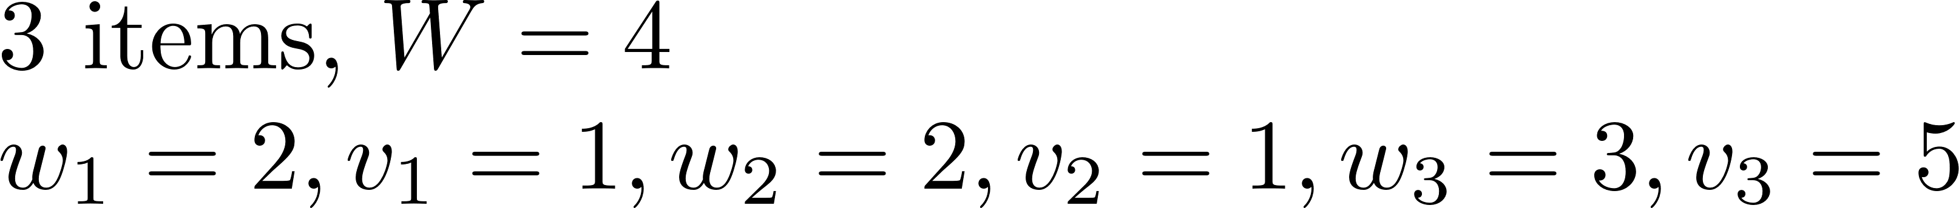

Case study II: 0/1 Knapsack
 | j=0 | 1 | 2 | 3 | 4
i=0 | 0 | 0 | 0 | 0 | 0
1 | 0
2 | 0
3 | 0
Design and Analysis of Algorithms

Slide 11
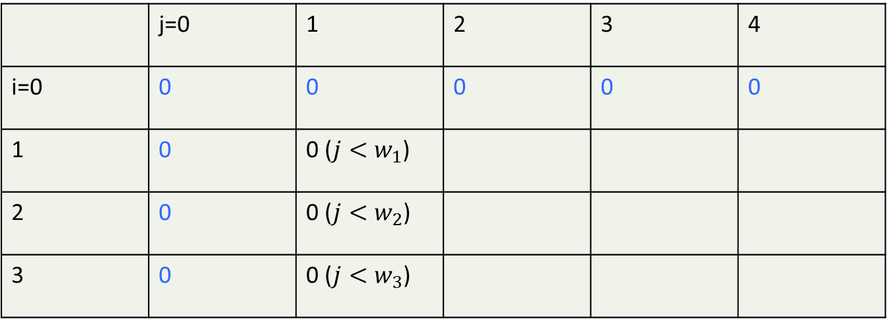
Case study II: 0/1 Knapsack
 | j=0 | 1 | 2 | 3 | 4
i=0 | 0 | 0 | 0 | 0 | 0
1 | 0 | 0 ($j<w_{1}$)
2 | 0 | 0 ($j<w_{2}$)
3 | 0 | 0 ($j<w_{3}$)
Design and Analysis of Algorithms

Slide 12


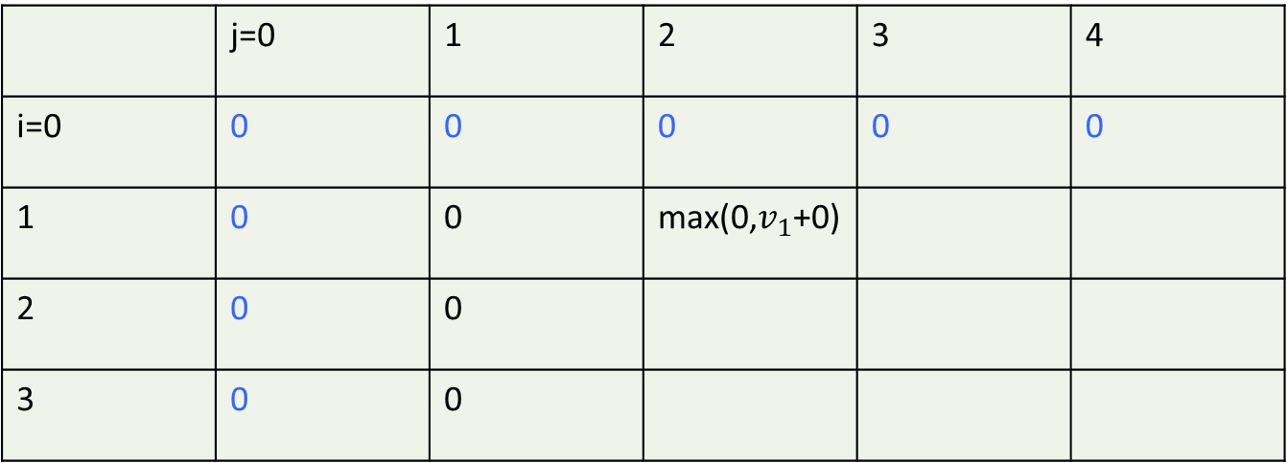
Case study II: 0/1 Knapsack
 | j=0 | 1 | 2 | 3 | 4
i=0 | 0 | 0 | 0 | 0 | 0
1 | 0 | 0 | max(0,$v_{1}$+0)
2 | 0 | 0
3 | 0 | 0
Design and Analysis of Algorithms

Slide 13


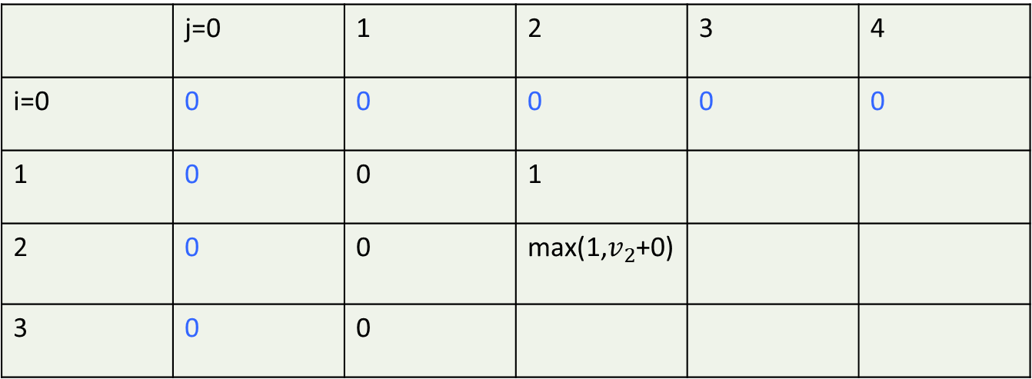
Case study II: 0/1 Knapsack
 | j=0 | 1 | 2 | 3 | 4
i=0 | 0 | 0 | 0 | 0 | 0
1 | 0 | 0 | 1
2 | 0 | 0 | max(1,$v_{2}$+0)
3 | 0 | 0
Design and Analysis of Algorithms

Slide 14
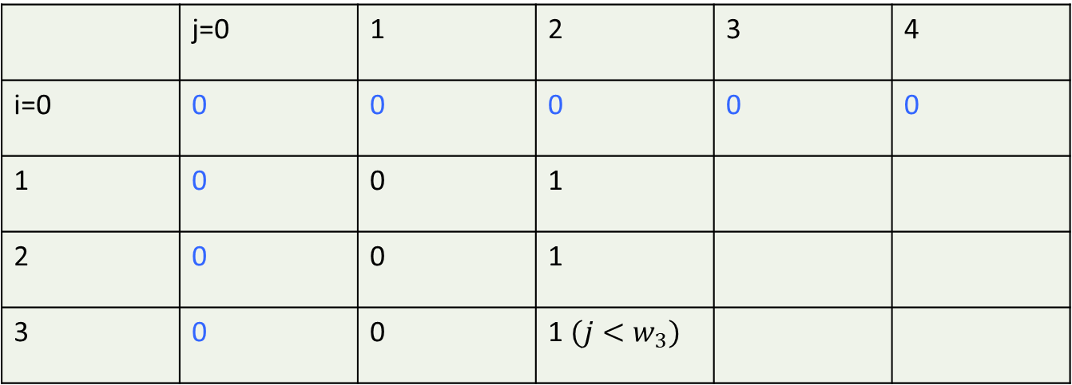
Case study II: 0/1 Knapsack
 | j=0 | 1 | 2 | 3 | 4
i=0 | 0 | 0 | 0 | 0 | 0
1 | 0 | 0 | 1
2 | 0 | 0 | 1
3 | 0 | 0 | 1 $(j<w_{3})$
Design and Analysis of Algorithms

Slide 15


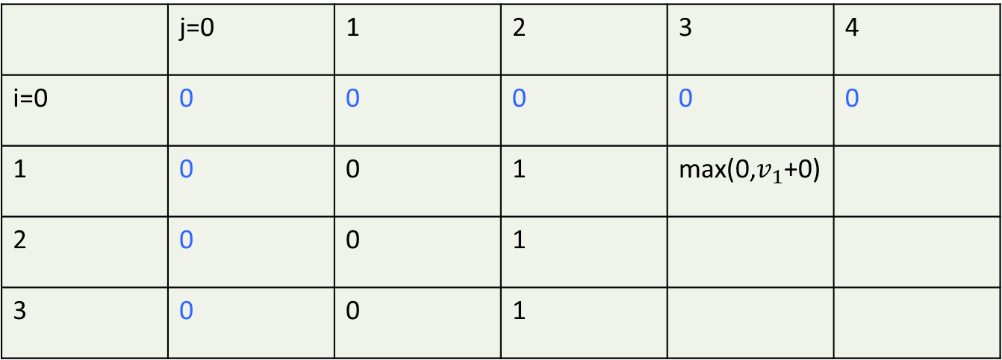
Case study II: 0/1 Knapsack
 | j=0 | 1 | 2 | 3 | 4
i=0 | 0 | 0 | 0 | 0 | 0
1 | 0 | 0 | 1 | max(0,$v_{1}$+0)
2 | 0 | 0 | 1
3 | 0 | 0 | 1
Design and Analysis of Algorithms

Slide 16
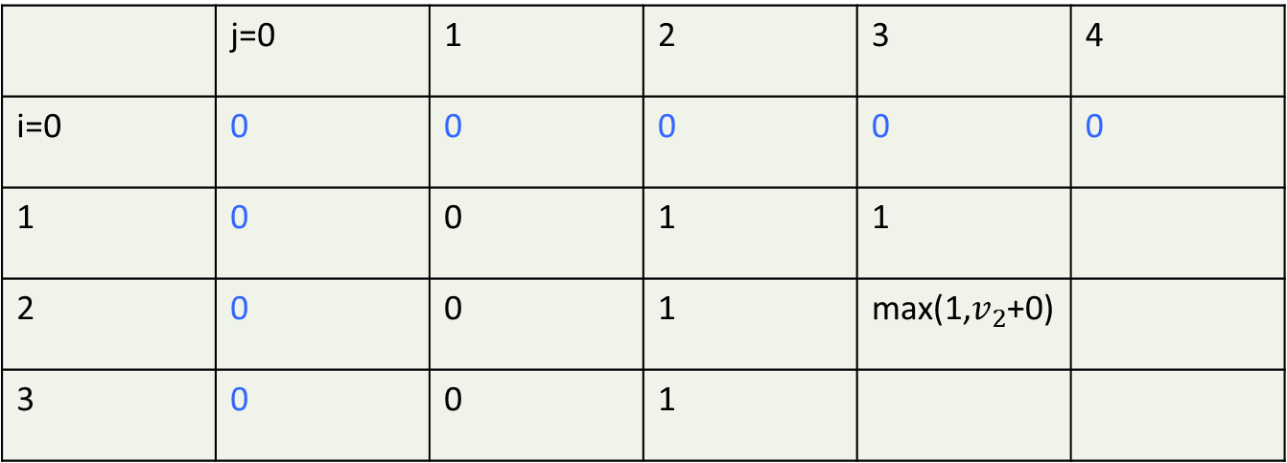
Case study II: 0/1 Knapsack
 | j=0 | 1 | 2 | 3 | 4
i=0 | 0 | 0 | 0 | 0 | 0
1 | 0 | 0 | 1 | 1
2 | 0 | 0 | 1 | max(1,$v_{2}$+0)
3 | 0 | 0 | 1
Design and Analysis of Algorithms

Slide 17
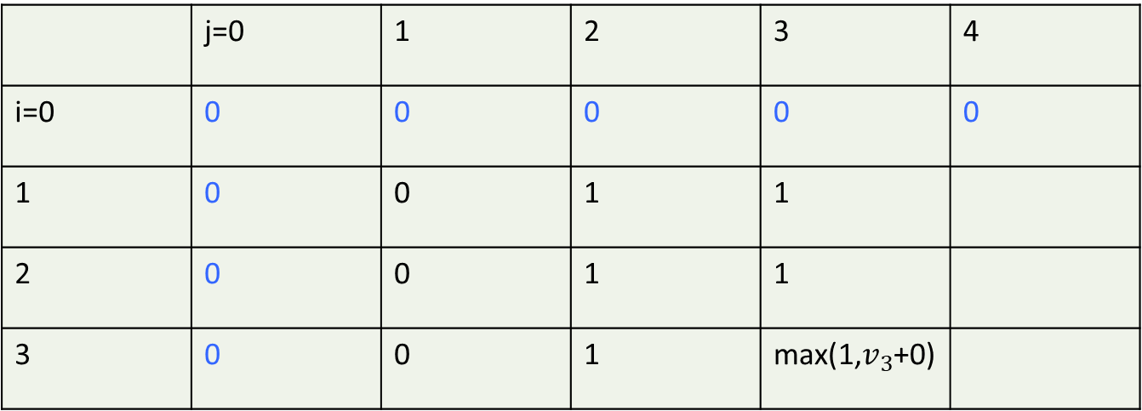
Case study II: 0/1 Knapsack
 | j=0 | 1 | 2 | 3 | 4
i=0 | 0 | 0 | 0 | 0 | 0
1 | 0 | 0 | 1 | 1
2 | 0 | 0 | 1 | 1
3 | 0 | 0 | 1 | max(1,$v_{3}$+0)
Design and Analysis of Algorithms

Slide 18
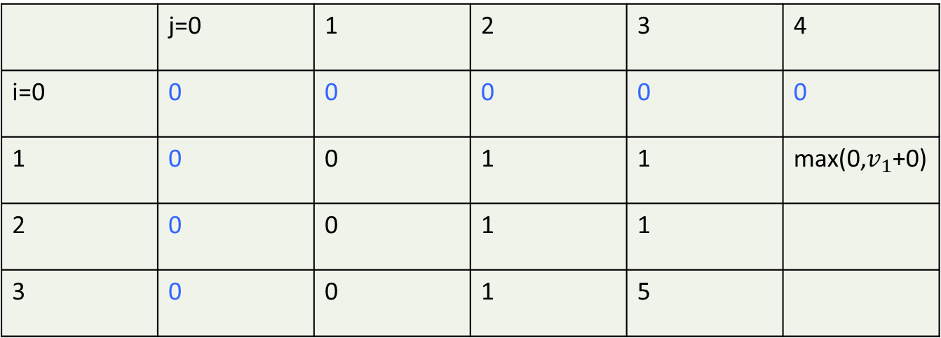
Case study II: 0/1 Knapsack
 | j=0 | 1 | 2 | 3 | 4
i=0 | 0 | 0 | 0 | 0 | 0
1 | 0 | 0 | 1 | 1 | max(0,$v_{1}$+0)
2 | 0 | 0 | 1 | 1
3 | 0 | 0 | 1 | 5
Design and Analysis of Algorithms

Slide 19
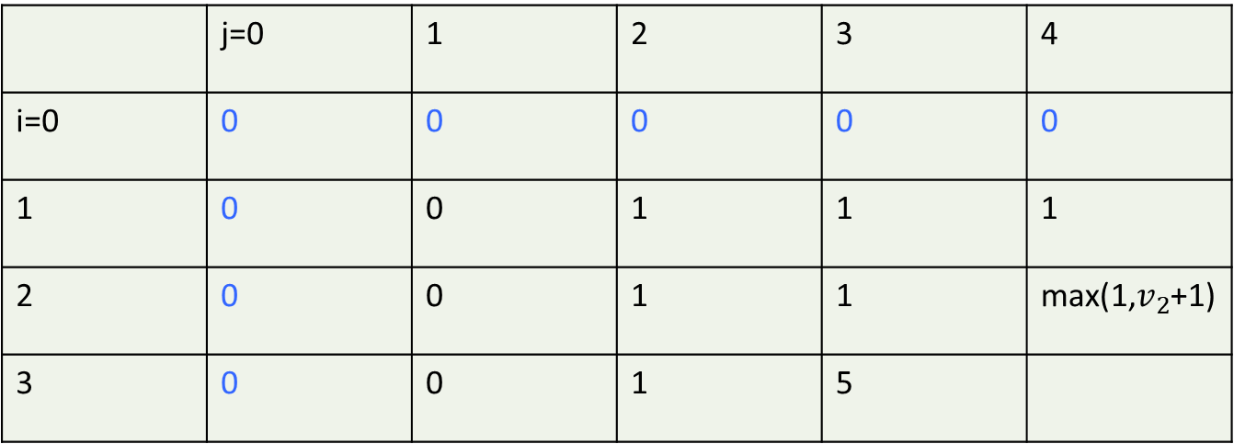
Case study II: 0/1 Knapsack
 | j=0 | 1 | 2 | 3 | 4
i=0 | 0 | 0 | 0 | 0 | 0
1 | 0 | 0 | 1 | 1 | 1
2 | 0 | 0 | 1 | 1 | max(1,$v_{2}$+1)
3 | 0 | 0 | 1 | 5
Design and Analysis of Algorithms

Slide 20
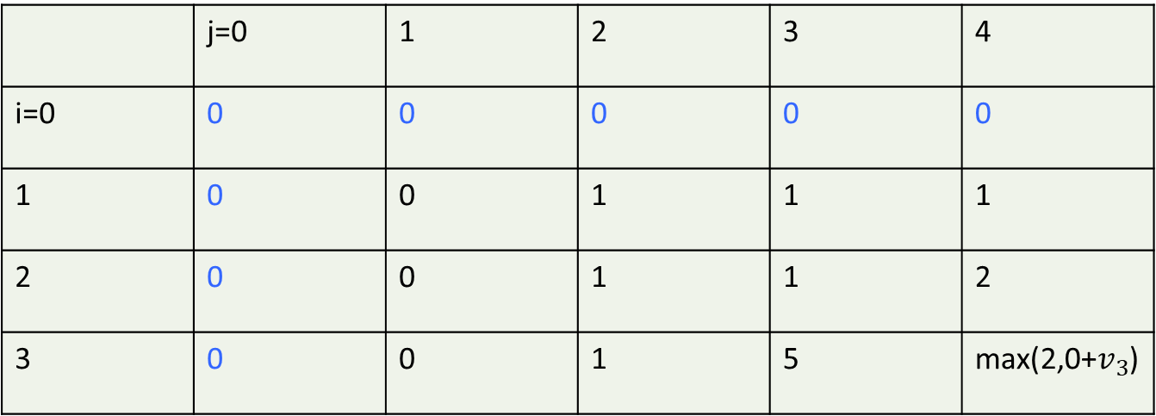
Case study II: 0/1 Knapsack
 | j=0 | 1 | 2 | 3 | 4
i=0 | 0 | 0 | 0 | 0 | 0
1 | 0 | 0 | 1 | 1 | 1
2 | 0 | 0 | 1 | 1 | 2
3 | 0 | 0 | 1 | 5 | max(2,0+$v_{3}$)
Design and Analysis of Algorithms

Slide 21
Case study II: 0/1 Knapsack
 | j=0 | 1 | 2 | 3 | 4
i=0 | 0 | 0 | 0 | 0 | 0
1 | 0 | 0 | 1 | 1 | 1
2 | 0 | 0 | 1 | 1 | 2
3 | 0 | 0 | 1 | 5 | 5
Design and Analysis of Algorithms

Slide 22

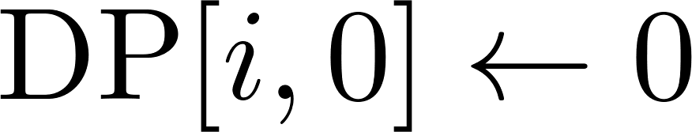

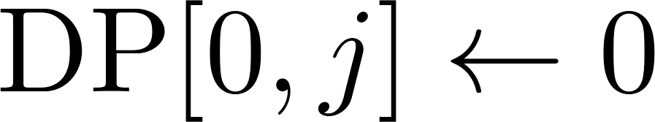



Case study II: 0/1 Knapsack
Pseudocode:
Initialization
Bottom up filliing DP
Goal
Design and Analysis of Algorithms

Slide 23

Case study II: 0/1 Knapsack
Pseudocode:
Initialization
Bottom up filliing DP
Goal
Design and Analysis of Algorithms

Slide 24
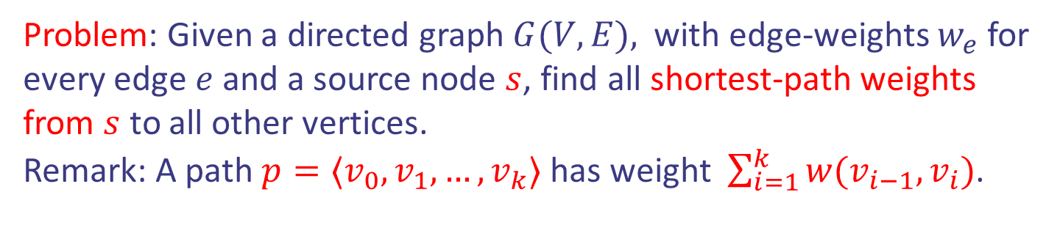
Case study III: Bellman-Ford
Problem: Given a directed graph $G(V, E),$with edge-weights $w_{e}$for every edge $e$ and a source node $s$, find all shortest-path weights from $s$ to all other vertices.
Remark: A path $p=⟨v_{0},v_{1},…,v_{k}⟩$ has weight $\sum_{i=1}^{k}{w(v_{i−1},v_{i})}$.
a
2
5
s
c
2
-1
6
5
b
Design and Analysis of Algorithms

Slide 25

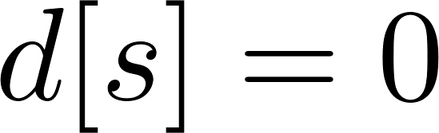
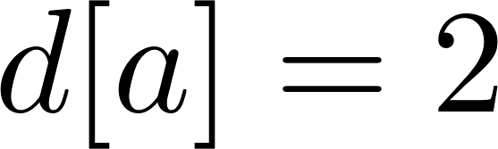
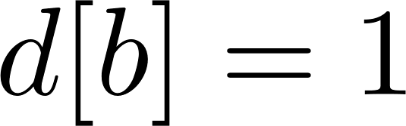
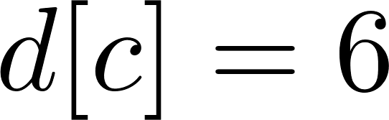
Case study III: Bellman-Ford
Problem: Given a directed graph $G(V, E),$with edge-weights $w_{e}$for every edge $e$ and a source node $s$, find all shortest-path weights from $s$ to all other vertices.
Remark: A path $p=⟨v_{0},v_{1},…,v_{k}⟩$ has weight $\sum_{i=1}^{k}{w(v_{i−1},v_{i})}$.
a
2
5
s
c
2
-1
6
5
b
Design and Analysis of Algorithms

Slide 26
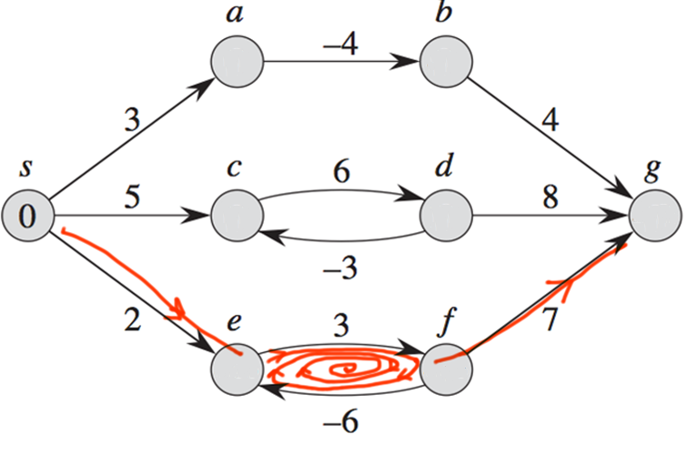
Case study III: Bellman-Ford
Assumption: There are no negative cycles. Otherwise, the question of shortest-path is ill-posed. Why?
Design and Analysis of Algorithms

Slide 27

Case study III: Bellman-Ford
Assumption: There are no negative cycles. Otherwise, the question of shortest-path is ill-posed. Why?
Shortest path $−∞$!
Design and Analysis of Algorithms

Slide 28

Case study III: Bellman-Ford
Idea: Dynamic Programming.
Step 1: Define the problem and subproblems.
Answer: Let $d\left[v,k\right]$ be the shortest weight from
$s$ to $v$ using at most $k$ edges.
Design and Analysis of Algorithms

Slide 29

Case study III: Bellman-Ford
Idea: Dynamic Programming.
Step 1: Define the problem and subproblems.
Answer: Let $d\left[v,k\right]$ be the shortest weight from
$s$ to $v$ using at most $k$ edges.
Step 2: Define the goal/output given Step 1.
It is $d[w,n−1]$ for shortest weight from $s$ to $w$.
Design and Analysis of Algorithms

Slide 30
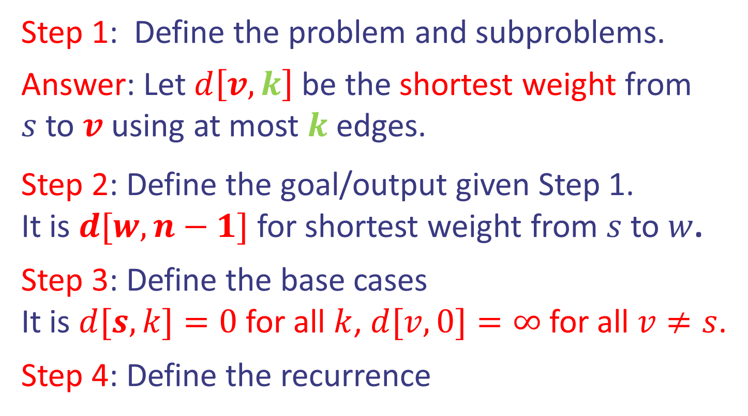
Case study III: Bellman-Ford
Idea: Dynamic Programming.
Step 1: Define the problem and subproblems.
Answer: Let $d\left[v,k\right]$ be the shortest weight from
$s$ to $v$ using at most $k$ edges.
Step 2: Define the goal/output given Step 1.
It is $d[w,n−1]$ for shortest weight from $s$ to $w$.
Step 3: Define the base cases
It is $d[s,k]=0$ for all $k$, $d[v,0]=∞$ for all $v≠s$.
Step 4: Define the recurrence
Design and Analysis of Algorithms

Slide 31



Case study III: Bellman-Ford
Idea: Dynamic Programming.
Shortest path from $s$ to $v$ uses $k$ edges via an intermediate edge $(u,v)$ or at most $k−1$ edges.
Step 4: Define the recurrence
Shortest path uses
at most $k−1$ edges
s
v
Shortest Path uses
via $u$ at most $k$ edges
u
Design and Analysis of Algorithms

Slide 32
Case study III: Bellman-Ford
Idea: Dynamic Programming.
Shortest path from $s$ to $v$ uses $k$ edges via an intermediate edge $(u,v)$ or at most $k−1$ edges.
Step 4: Define the recurrence
Shortest path uses
at most $k−1$ edges
s
v
Shortest Path uses
via $u$ at most $k$ edges
u
$$d[v,k]=min(\min_{u}{\{d[u,k−1]+w\left(u,v\right)\},{d[v,k−1]})}$$
Design and Analysis of Algorithms

Slide 33

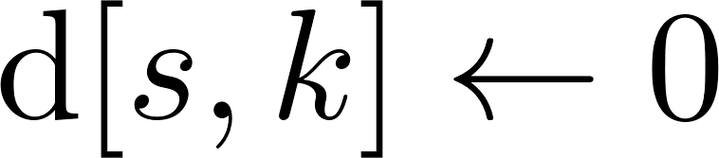
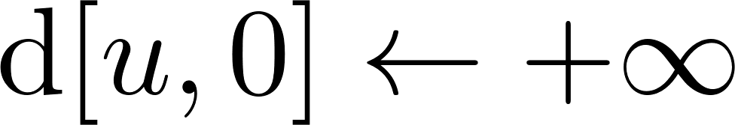


Case study III: Bellman-Ford
Pseudocode:
Initialization
Bottom up filliing DP
Goal (shortest path
from $s$ to $w$)
Design and Analysis of Algorithms

Slide 34
Case study III: Bellman-Ford
Pseudocode: Why 2D? We can use less memory.
Initialization
Bottom up filliing DP
Goal (shortest path
from $s$ to $w$)
Design and Analysis of Algorithms

Slide 35

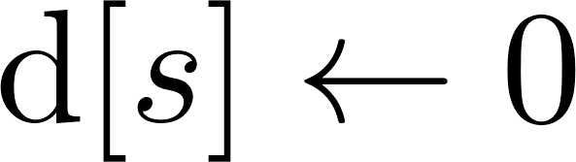
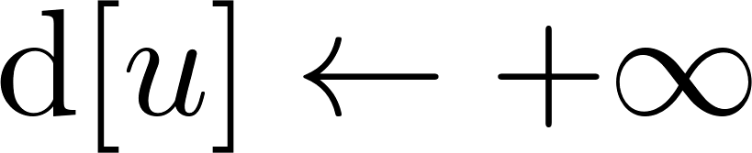
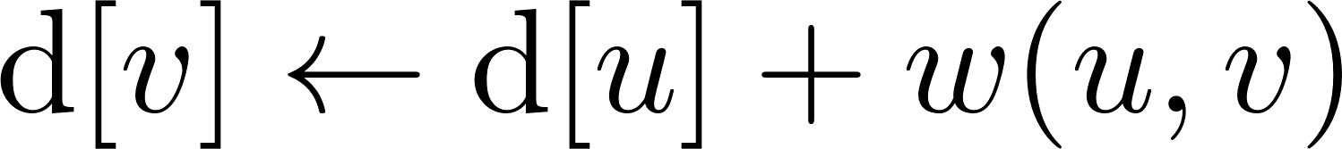

Case study III: Bellman-Ford
Pseudocode: Algorithm to know.
Initialization
Bottom up filliing DP
Goal (shortest path
from $s$ to $w$)
Design and Analysis of Algorithms

Slide 36


Case study III: Bellman-Ford
Pseudocode: Algorithm to know.
Initialization
Bottom up filliing DP
Goal (shortest path
from $s$ to $w$)
Design and Analysis of Algorithms

Slide 37

Case study III: Bellman-Ford
In words: $d[s]=0, d[u]=+∞$ for $u≠s.$
For $n−1$ times, relax all the edges $(u,v)$.
Design and Analysis of Algorithms

Slide 38
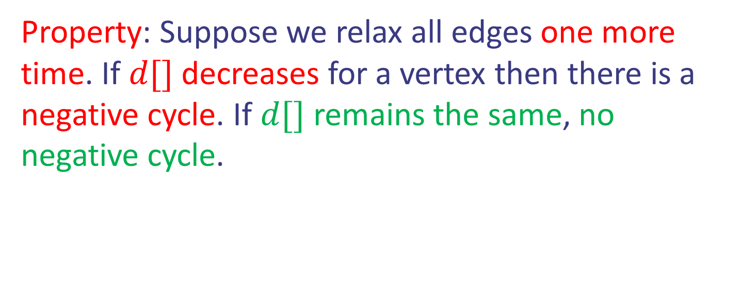
Case study III: Bellman-Ford
In words: $d[s]=0, d[u]=+∞$ for $u≠s.$
For $n−1$ times, relax all the edges $(u,v)$.
Property: Suppose we relax all edges one more time. If $d[]$decreases for a vertex then there is a negative cycle. If $d[]$ remains the same, no negative cycle.
Design and Analysis of Algorithms

Slide 39
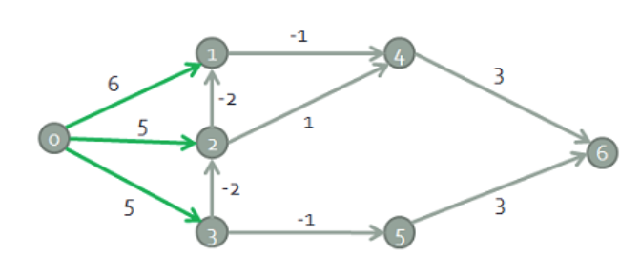
Case study III: Bellman-Ford
Find the shortest weight path from node 0.
Design and Analysis of Algorithms

Slide 40
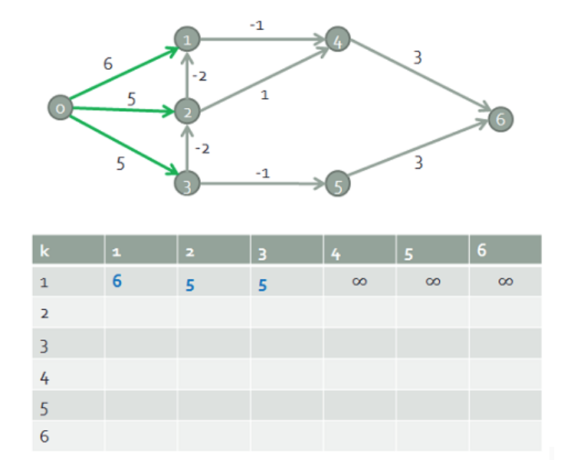
Case study III: Bellman-Ford
6
5
5
Design and Analysis of Algorithms

Slide 41
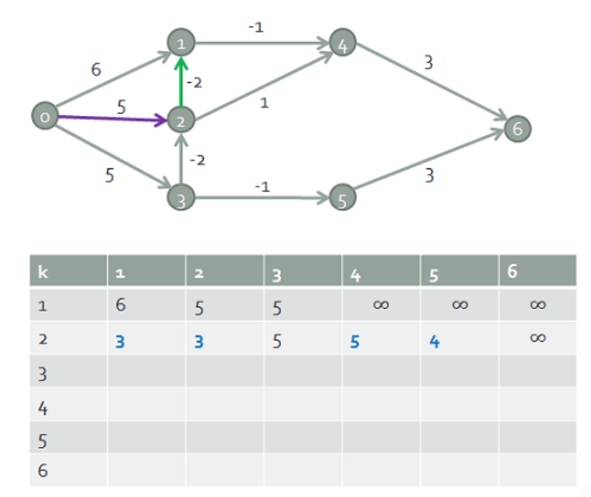
Case study III: Bellman-Ford
3
5
3
5
4
Design and Analysis of Algorithms

Slide 42
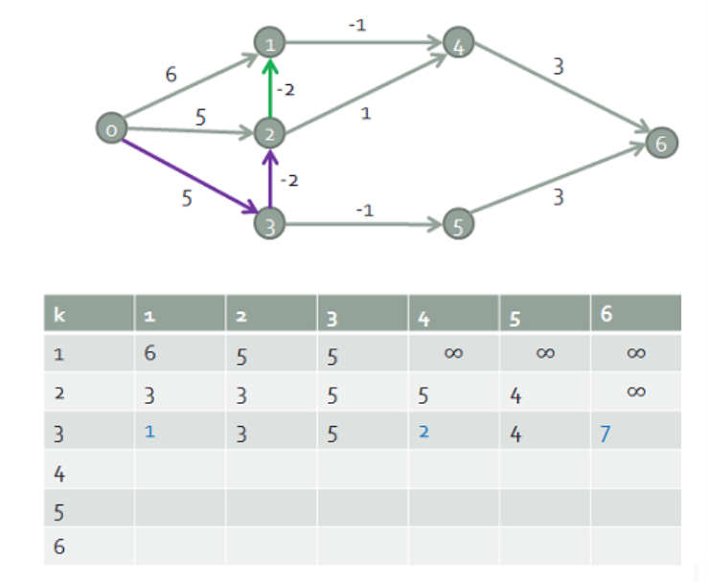
Case study III: Bellman-Ford
1
2
3
7
5
4
Design and Analysis of Algorithms

Slide 43
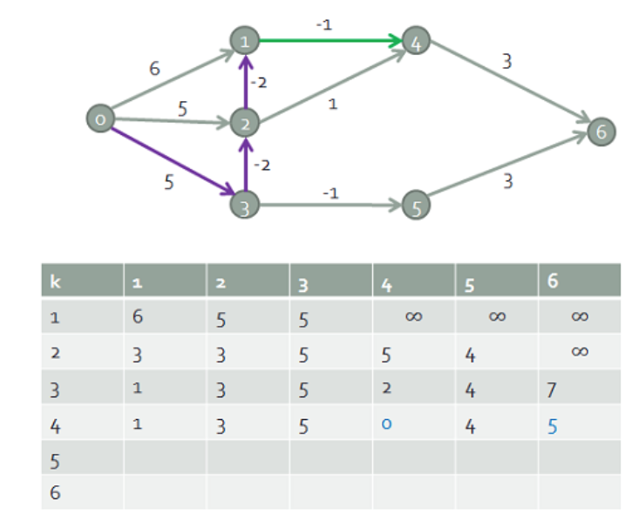
Case study III: Bellman-Ford
1
0
3
5
5
4
Design and Analysis of Algorithms

Slide 44
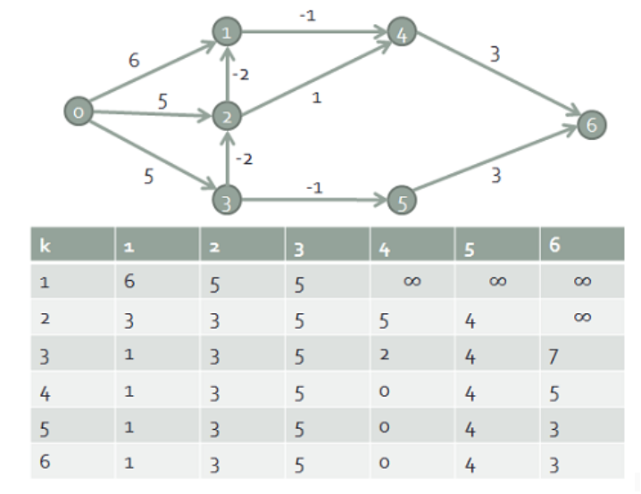
Case study III: Bellman-Ford
1
0
3
3
5
4
Design and Analysis of Algorithms

Slide 45
Case study III: Bellman-Ford
Find the shortest weight path from node 0.
8
0
4
-2
∞
7
∞
1
∞
3
9
-2
∞
∞
5
Design and Analysis of Algorithms

Slide 46
Case study III: Bellman-Ford
8
0
4
8
0
4
-2
-2
7
1
8
7
-2
1
4
∞
∞
∞
∞
∞
∞
3
9
3
9
-2
∞
∞
5
-2
∞
∞
5
Design and Analysis of Algorithms

Slide 47
Case study III: Bellman-Ford
8
0
4
8
0
4
-2
-2
7
1
8
7
-2
1
4
∞
∞
∞
∞
∞
∞
3
9
3
9
-2
∞
∞
5
-2
∞
∞
5
8
0
4
-2
5
8
7
-2
1
4
-1
1
3
9
-2
6
9
5
∞
∞
Design and Analysis of Algorithms

Slide 48
Case study III: Bellman-Ford
8
0
4
8
0
4
-2
-2
7
1
8
7
-2
1
4
∞
∞
∞
∞
∞
∞
3
9
3
9
-2
∞
∞
5
-2
∞
∞
5
8
0
4
8
0
4
-2
-2
5
8
7
-2
1
4
-1
5
7
-2
1
-1
1
3
9
3
9
-2
6
9
5
-2
4
5
∞
∞
1
9
Design and Analysis of Algorithms

Slide 49
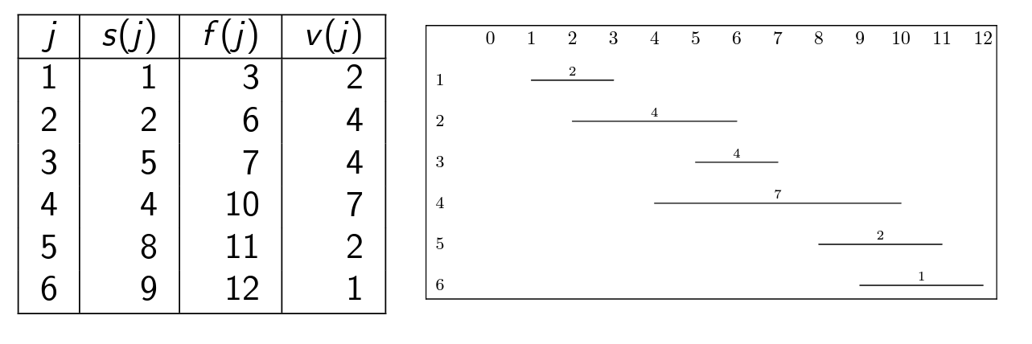
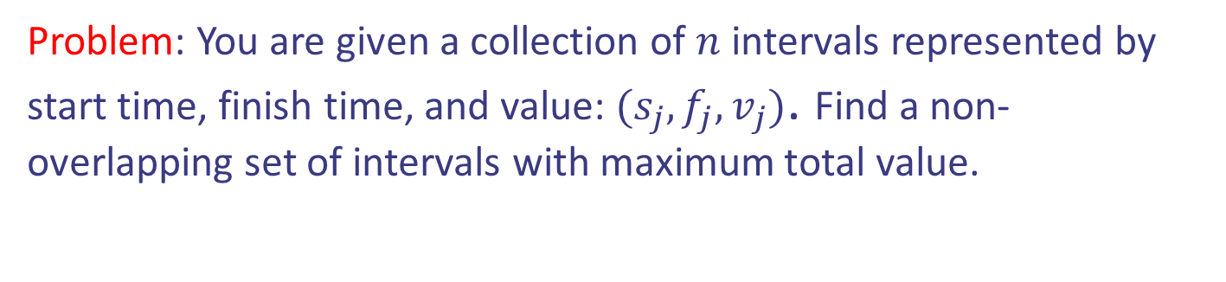
Case study IV: Interval Scheduling
Problem: You are given a collection of $n$ intervals represented by start time, finish time, and value: $(s_{j},f_{j},v_{j})$. Find a non-overlapping set of intervals with maximum total value.
Design and Analysis of Algorithms

Slide 50


Case study IV: Interval Scheduling
Problem: You are given a collection of $n$ intervals represented by start time, finish time, and value: $(s_{j},f_{j},v_{j})$. Find a non-overlapping set of intervals with maximum total value.
Design and Analysis of Algorithms

Slide 51

Case study IV: Interval Scheduling
Step 1: Define the problem and subproblems.
Answer: Let $DP[j]$ be the maximum value that can be obtained from a set of non-overlapping intervals with indices in the range $\{1,…,j\}$
Design and Analysis of Algorithms

Slide 52
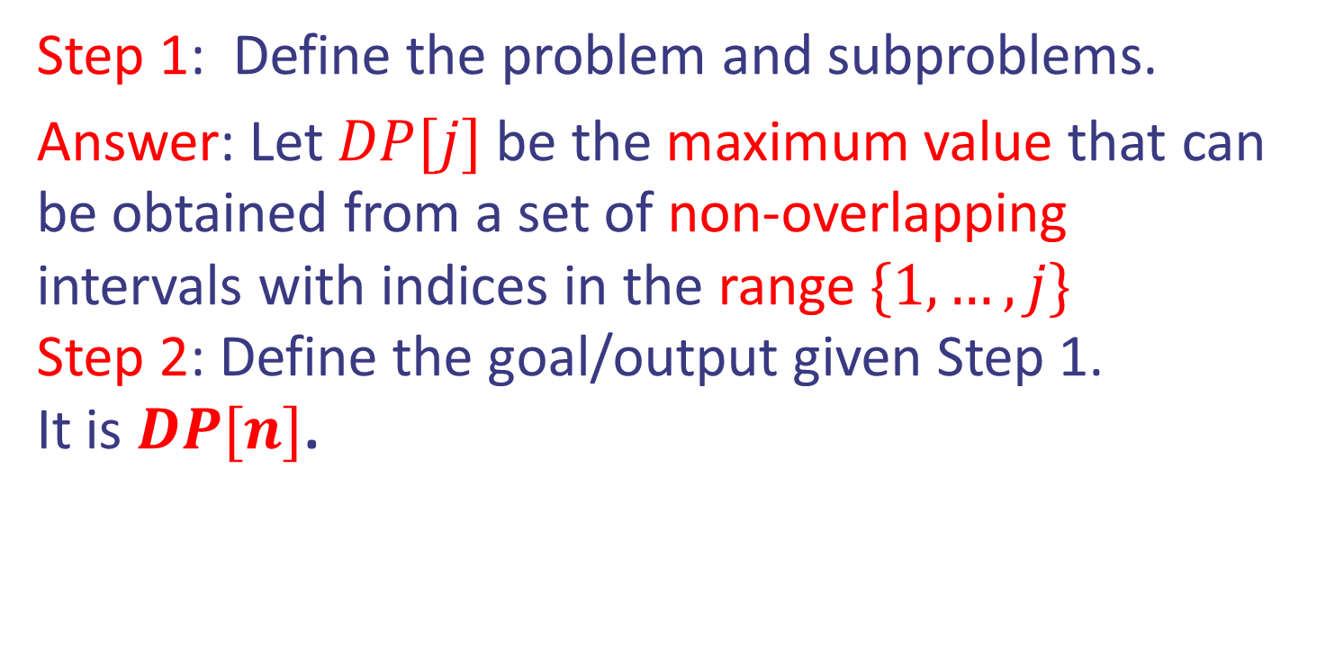
Case study IV: Interval Scheduling
Step 1: Define the problem and subproblems.
Answer: Let $DP[j]$ be the maximum value that can be obtained from a set of non-overlapping intervals with indices in the range $\{1,…,j\}$
Step 2: Define the goal/output given Step 1.
It is $DP[n]$.
Design and Analysis of Algorithms

Slide 53
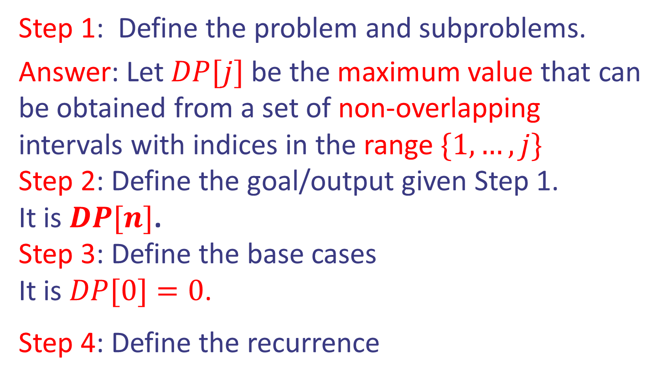
Case study IV: Interval Scheduling
Step 1: Define the problem and subproblems.
Answer: Let $DP[j]$ be the maximum value that can be obtained from a set of non-overlapping intervals with indices in the range $\{1,…,j\}$
Step 2: Define the goal/output given Step 1.
It is $DP[n]$.
Step 3: Define the base cases
It is $DP[0]=0$.
Step 4: Define the recurrence
Design and Analysis of Algorithms

Slide 54

Case study IV: Interval Scheduling
Step 4: Define the recurrence
Interval $j$ belongs to the optimal solution or not.
$DP[j] = max⁡(DP[\$]+v_{j},DP[j−1])$
What is $ ?
Design and Analysis of Algorithms

Slide 55
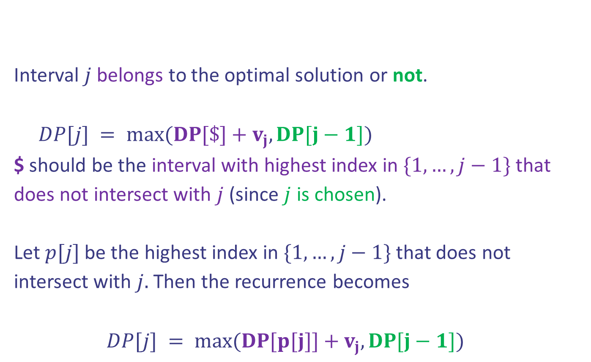
Case study IV: Interval Scheduling
Step 4: Define the recurrence
Interval $j$ belongs to the optimal solution or not.
$DP[j] = max⁡(DP[\$]+v_{j},DP[j−1])$
$ should be the interval with highest index in $\{1,…,j−1\}$ that does not intersect with $j$ (since $j$ is chosen).
Let $p[j]$ be the highest index in $\{1,…,j−1\}$ that does not intersect with $j.$ Then the recurrence becomes
$DP[j] = max⁡(DP[p[j]]+v_{j},DP[j−1])$
Design and Analysis of Algorithms

Slide 56



Case study IV: Interval Scheduling
Pseudocode:
Initialization
Bottom up filliing DP
Goal
Design and Analysis of Algorithms

Slide 57

Case study IV: Interval Scheduling
Pseudocode:
Initialization
Bottom up filliing DP
Goal
Question: How can we compute $p[j]$ for $1≤j≤n$
in $Θ(n\log{n)}$ time?
Design and Analysis of Algorithms

Slide 58

Case study IV: Interval Scheduling
Question: How can we compute $p[j]$ for $1≤j≤n$
in $Θ(n\log{n)}$ time?
Answer:
Sort first the intervals in increasing order of finishing times.
Design and Analysis of Algorithms

Slide 59

Case study IV: Interval Scheduling
Question: How can we compute $p[j]$ for $1≤j≤n$
in $Θ(n\log{n)}$ time?
Answer:
Sort first the intervals in increasing order of finishing times.
For every $j$, do binary search to find the interval before $j$ with finishing time at most $s_{j}$
Design and Analysis of Algorithms

