Slide 1

Lecture 19 Recap part A
CS 161 Design and Analysis of Algorithms
Ioannis Panageas

Slide 2
Divide and conquer method
Steps of method:
Divide input into parts (smaller problems)
Conquer (solve) each part recursively
Combine results to obtain solution of original
Notes:
Exercise: guess merge sort

Slide 3
Mergesort - A fast sorting recursive Algorithm
Key idea:
Divide input into two parts of equal size
Sort each part recursively
Merge the two sorted parts to obtain the solution.
Example: Sort the following 11 numbers
Divide
Recursion
Merge

Slide 4
Mergesort - A fast sorting recursive Algorithm
Key idea:
Divide input into two parts of equal size
Sort each part recursively
Merge the two sorted parts to obtain the solution.
Example: Sort the following 11 numbers
Divide
Recursion
Merge

Slide 5
Mergesort - A fast sorting recursive Algorithm
Key idea:
Divide input into two parts of equal size
Sort each part recursively
Merge the two sorted parts to obtain the solution.
Example: Sort the following 11 numbers
Divide
Recursion
Merge

Slide 6
Mergesort - A fast sorting recursive Algorithm
Key idea:
Divide input into two parts of equal size
Sort each part recursively
Merge the two sorted parts to obtain the solution.
Example: Sort the following 11 numbers
Divide
Recursion
Merge

Slide 7
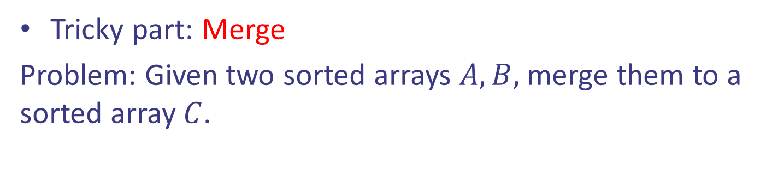
Mergesort - A fast sorting recursive Algorithm
Tricky part: Merge
Problem: Given two sorted arrays $A,B,$ merge them to a sorted array $C$.

Slide 8





Mergesort - A fast sorting recursive Algorithm
Tricky part: Merge
Problem: Given two sorted arrays $A,B,$ merge them to a sorted array $C$.

Slide 9

Mergesort - A fast sorting recursive Algorithm
Tricky part: Merge
Problem: Given two sorted arrays $A,B,$ merge them to a sorted array $C$.

Slide 10

Mergesort - A fast sorting recursive Algorithm
Tricky part: Merge
Problem: Given two sorted arrays $A,B,$ merge them to a sorted array $C$.

Slide 11

Mergesort - A fast sorting recursive Algorithm
Tricky part: Merge
Problem: Given two sorted arrays $A,B,$ merge them to a sorted array $C$.

Slide 12

Mergesort - A fast sorting recursive Algorithm
Tricky part: Merge
Problem: Given two sorted arrays $A,B,$ merge them to a sorted array $C$.

Slide 13

Mergesort - A fast sorting recursive Algorithm
Tricky part: Merge
Problem: Given two sorted arrays $A,B,$ merge them to a sorted array $C$.

Slide 14

Mergesort - A fast sorting recursive Algorithm
Tricky part: Merge
Problem: Given two sorted arrays $A,B,$ merge them to a sorted array $C$.

Slide 15

Mergesort - A fast sorting recursive Algorithm
Tricky part: Merge
Problem: Given two sorted arrays $A,B,$ merge them to a sorted array $C$.

Slide 16
Mergesort - A fast sorting recursive Algorithm
Tricky part: Merge
Problem: Given two sorted arrays $A,B,$ merge them to a sorted array $C$.

Slide 17
Mergesort - A fast sorting recursive Algorithm
Tricky part: Merge
Problem: Given two sorted arrays $A,B,$ merge them to a sorted array $C$.

Slide 18
Mergesort - A fast sorting recursive Algorithm
Tricky part: Merge
Problem: Given two sorted arrays $A,B,$ merge them to a sorted array $C$.

Slide 19

Mergesort - A fast sorting recursive Algorithm
Tricky part: Merge
Problem: Given two sorted arrays $A,B,$ merge them to a sorted array $C$.
Running time: $Θ(n)$

Slide 20
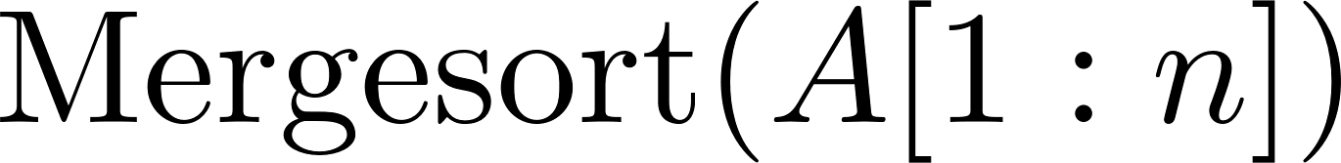



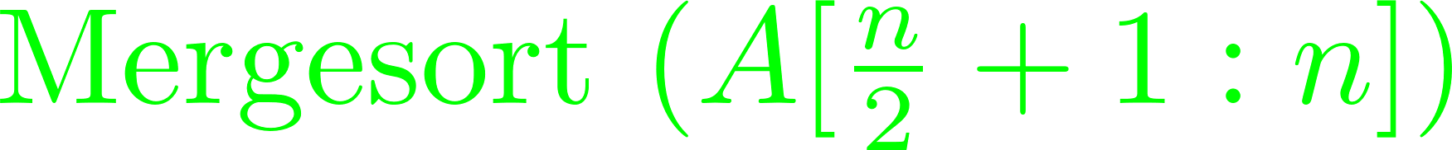

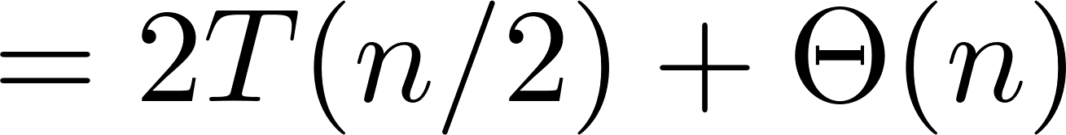
Mergesort
Pseudocode:
Running time:
How to analyze?
Notes:
Exercise: guess merge sort

Slide 21



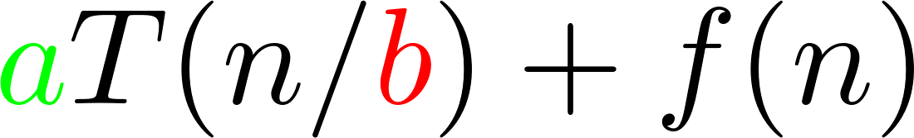

Master theorem
The Master Theorem can find the order of $T(n)$
which is defined recursively.

Slide 22
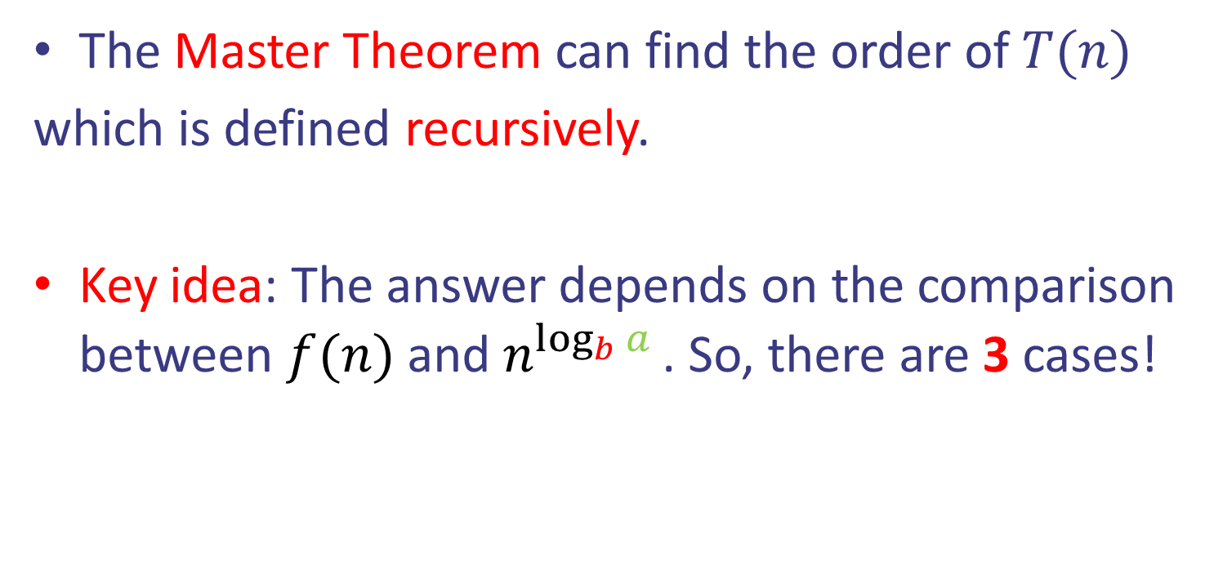
Master theorem
The Master Theorem can find the order of $T(n)$
which is defined recursively.
Key idea: The answer depends on the comparison between $f(n)$ and $n^{\log_{b}{a} }$. So, there are 3 cases!

Slide 23
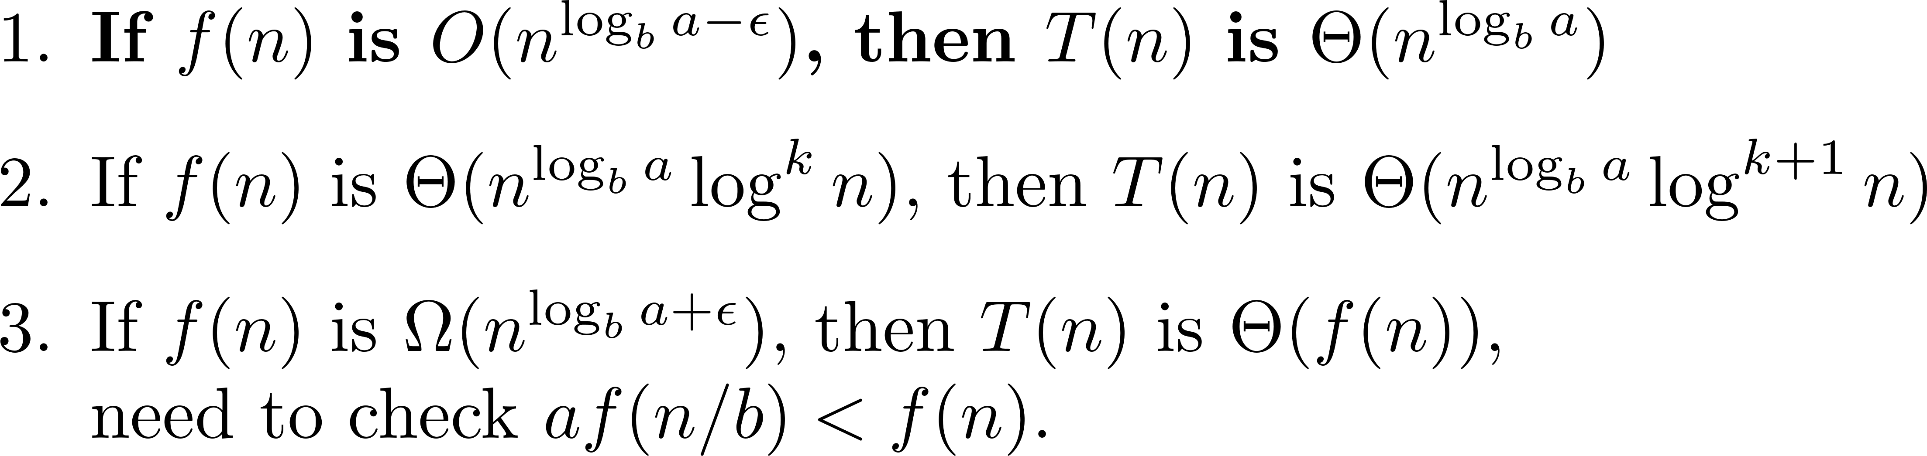
Master theorem
Case 1: $n^{\log_{b}{a}}$ dominates $f(n)$

Slide 24
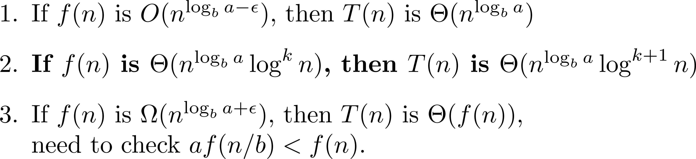
Master theorem
Case 2: $n^{\log_{b}{a}}$ have same order as $f(n)$ (up to $\log^{k}{n}$)

Slide 25
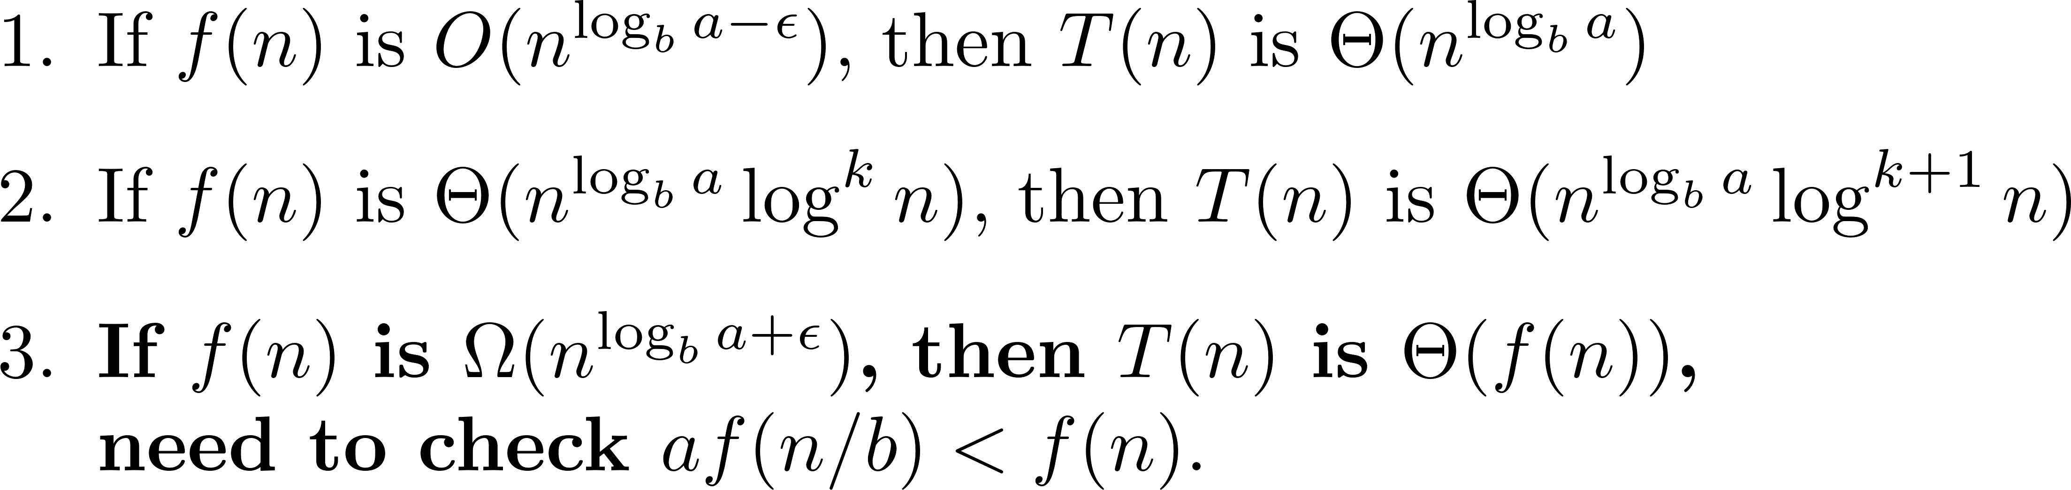
Master theorem
Case 3: $n^{\log_{b}{a}}$ is dominated by $f(n)$ (+ another condition)

Slide 26
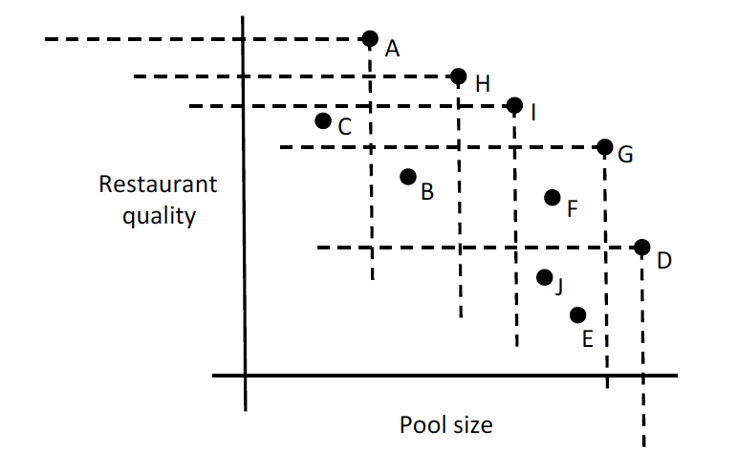
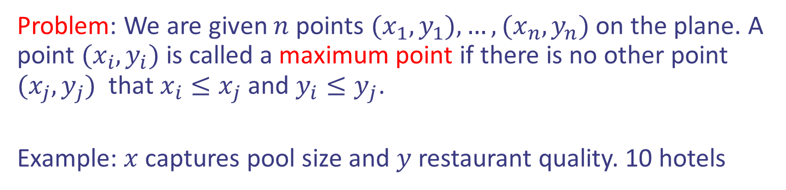
Case study: Maxima Set
Problem: We are given $n$ points $(x_{1},y_{1}),…,(x_{n},y_{n})$ on the plane. A point $(x_{i},y_{i})$ is called a maximum point if there is no other point $(x_{j}, y_{j})$ that $x_{i}≤x_{j}$ and $y_{i}≤y_{j}$.
Example: $x$ captures pool size and $y$ restaurant quality. 10 hotels

Slide 27
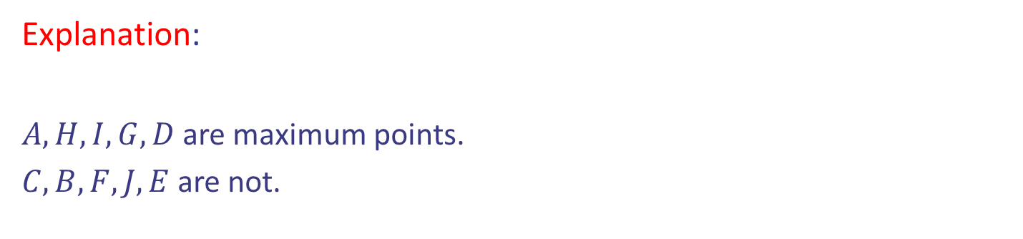
Case study: Maxima Set
Problem: We are given $n$ points $(x_{1},y_{1}),…,(x_{n},y_{n})$ on the plane. A point $(x_{i},y_{i})$ is called a maximum point if there is no other point $(x_{j}, y_{j})$ that $x_{i}≤x_{j}$ and $y_{i}≤y_{j}$.
Example: $x$ captures pool size and $y$ restaurant quality. 10 hotels
Explanation:
$A, H, I, G, D$are maximum points.
$C, B, F, J, E$are not.

Slide 28
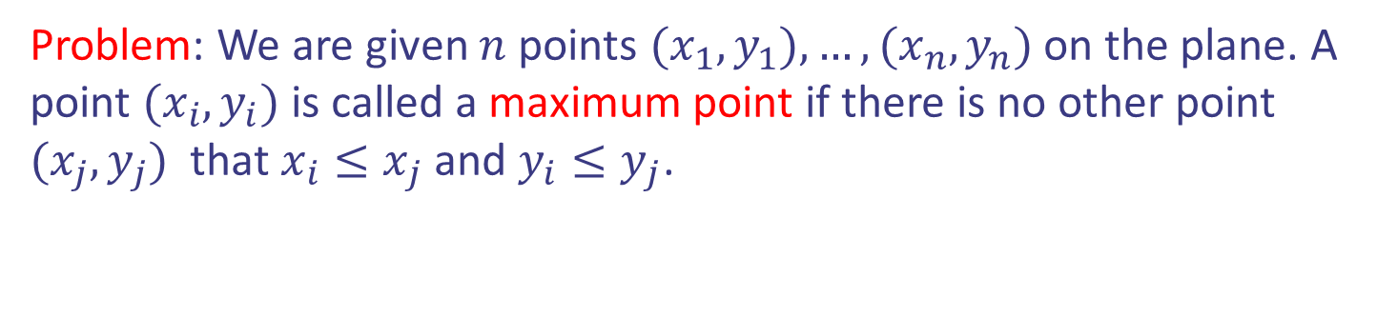
Case study: Maxima Set
Problem: We are given $n$ points $(x_{1},y_{1}),…,(x_{n},y_{n})$ on the plane. A point $(x_{i},y_{i})$ is called a maximum point if there is no other point $(x_{j}, y_{j})$ that $x_{i}≤x_{j}$ and $y_{i}≤y_{j}$.
Idea: Divide and conquer. Divide step and Combine step is challenging.

Slide 29
Case study: Maxima Set
Divide step: It should split the points in two parts of equal size.
How?

Slide 30




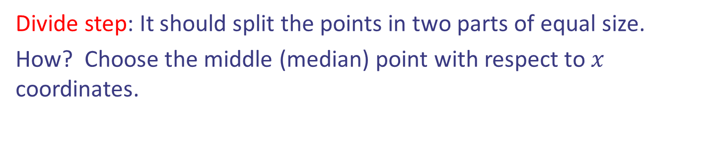


Case study: Maxima Set
Divide step: It should split the points in two parts of equal size.
How? Choose the middle (median) point with respect to $x$ coordinates.

Slide 31
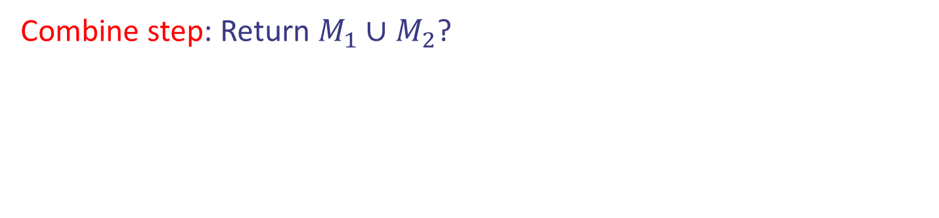
Case study: Maxima Set
Divide step: It should split the points in two parts of equal size.
How? Choose the middle (median) point with respect to $x$ coordinates.
Combine step: Return $M_{1}∪M_{2}$?

Slide 32
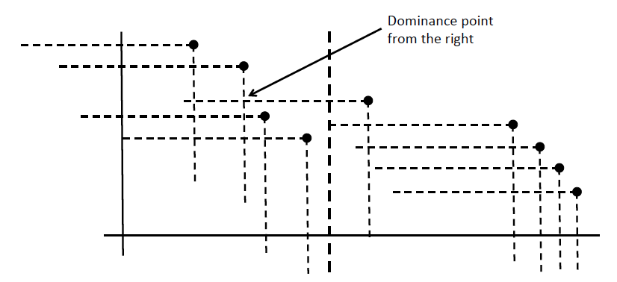



Case study: Maxima Set
Combine step: Return $M_{1}∪M_{2}$? Wrong: blue points below of $M_{1}$ are not part of the solution

Slide 33
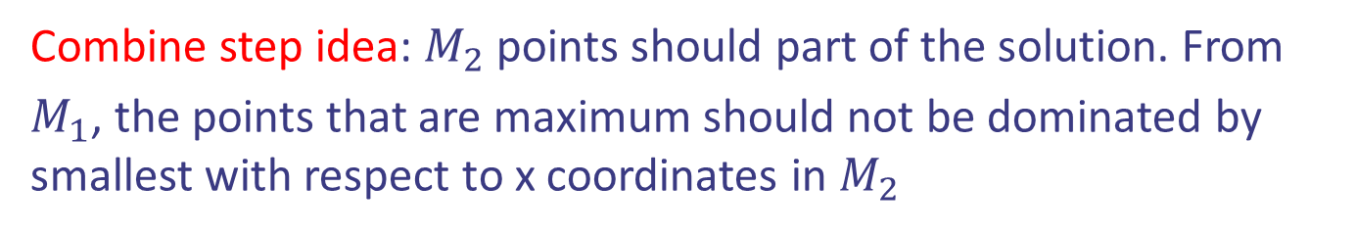



Case study: Maxima Set
Combine step idea: $M_{2}$ points should part of the solution. From
$M_{1}$, the points that are maximum should not be dominated by smallest with respect to x coordinates in $M_{2}$

Slide 34
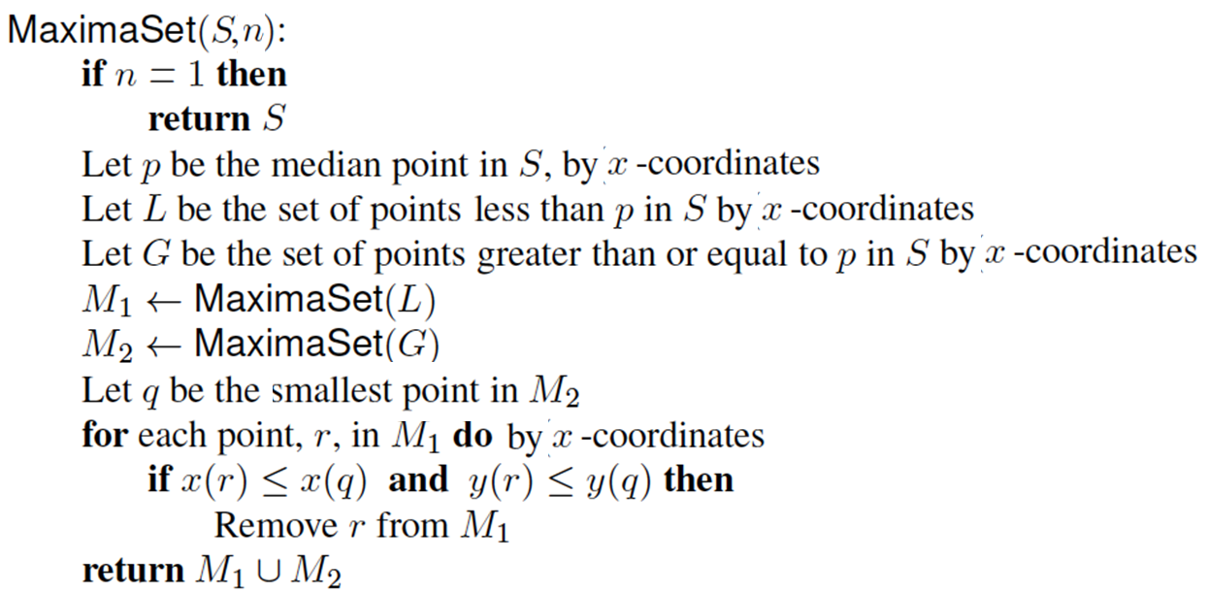
Case study: Maxima Set
Pseudocode:
Running time??

Slide 35
Dynamic Programming
Technique for solving optimization problems.
Solve problem by solving sub-problems and combine:
This is called Optimal substructure property.

Slide 36
Dynamic Programming
Technique for solving optimization problems.
Solve problem by solving sub-problems and combine:
This is called Optimal substructure property.
Similar to divide-and-conquer: recursion (for solving sub-problems)
Sub-problems overlap: solve them only once!
DP = recursion + re-use (Memoization)

Slide 37

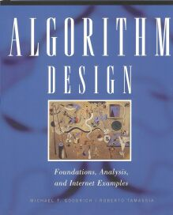
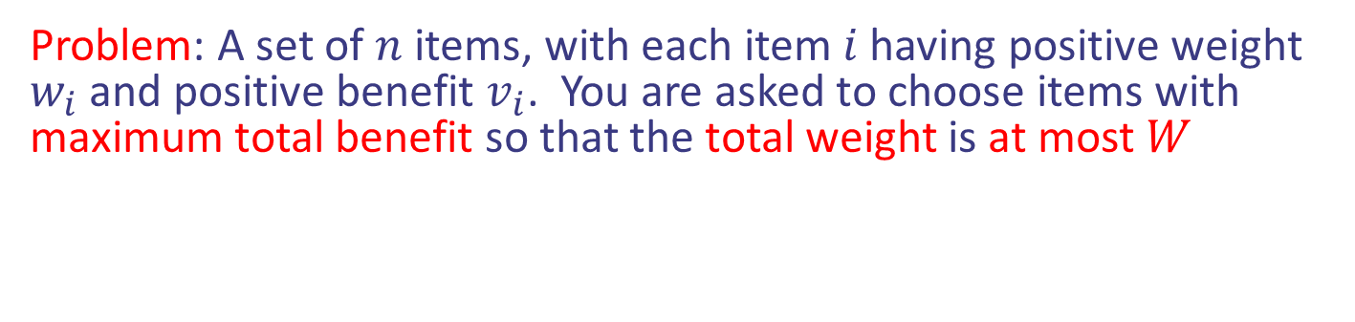
Case study II: 0/1 Knapsack
Problem: A set of $n$ items, with each item $i$ having positive weight $w_{i}$ and positive benefit $v_{i}$. You are asked to choose items with maximum total benefit so that the total weight is at most $W$
“knapsack” with 9 lbs capacity
Items:
Weight:
4 lbs
2 lbs
2 lbs
6 lbs
2 lbs
Solution:
item 5 ($80, 2 lbs)
item 3 ($6, 2lbs)
item 1 ($20, 4lbs)
Benefit:
$20
$3
$6
$25
$80
Design and Analysis of Algorithms

Slide 38
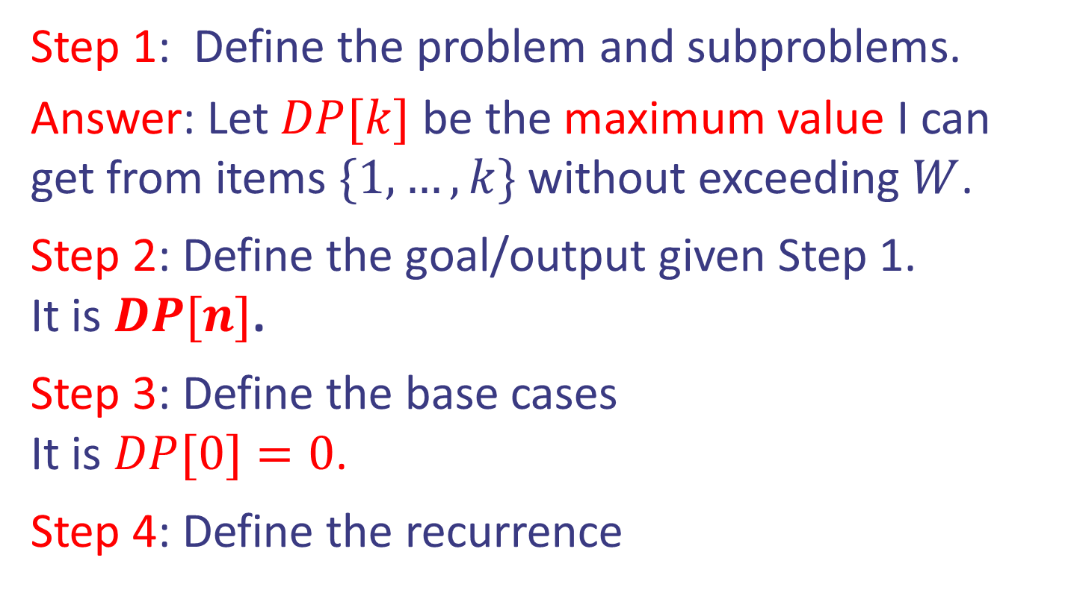
Case study II: 0/1 Knapsack
Idea: Dynamic Programming (first attempt).
Step 1: Define the problem and subproblems.
Answer: Let $DP[k]$ be the maximum value I can get from items $\{1,…,k\}$ without exceeding $W$.
Step 2: Define the goal/output given Step 1.
It is $DP[n]$.
Step 3: Define the base cases
It is $DP[0]=0$.
Step 4: Define the recurrence
Design and Analysis of Algorithms

Slide 39
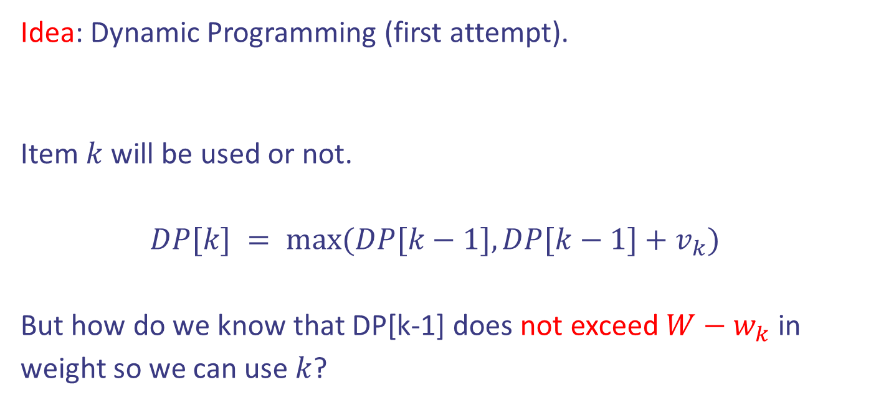
Case study II: 0/1 Knapsack
Idea: Dynamic Programming (first attempt).
Item $k$ will be used or not.
$DP[k] = max⁡(DP[k−1], DP[k−1]+v_{k})$
But how do we know that DP[k-1] does not exceed $W−w_{k}$ in weight so we can use $k$?
Step 4: Define the recurrence
Design and Analysis of Algorithms

Slide 40

Case study II: 0/1 Knapsack
Idea: Dynamic Programming (correct attempt).
Step 1: Define the problem and subproblems.
Answer: Let $DP[k,j]$ be the maximum value I can get from items $\{1,…,k\}$ without exceeding $j$.
Design and Analysis of Algorithms

Slide 41

Case study II: 0/1 Knapsack
Idea: Dynamic Programming (correct attempt).
Step 1: Define the problem and subproblems.
Answer: Let $DP[k,j]$ be the maximum value I can get from items $\{1,…,k\}$ without exceeding $j$.
Step 2: Define the goal/output given Step 1.
It is $DP[n,W]$.
Design and Analysis of Algorithms

Slide 42
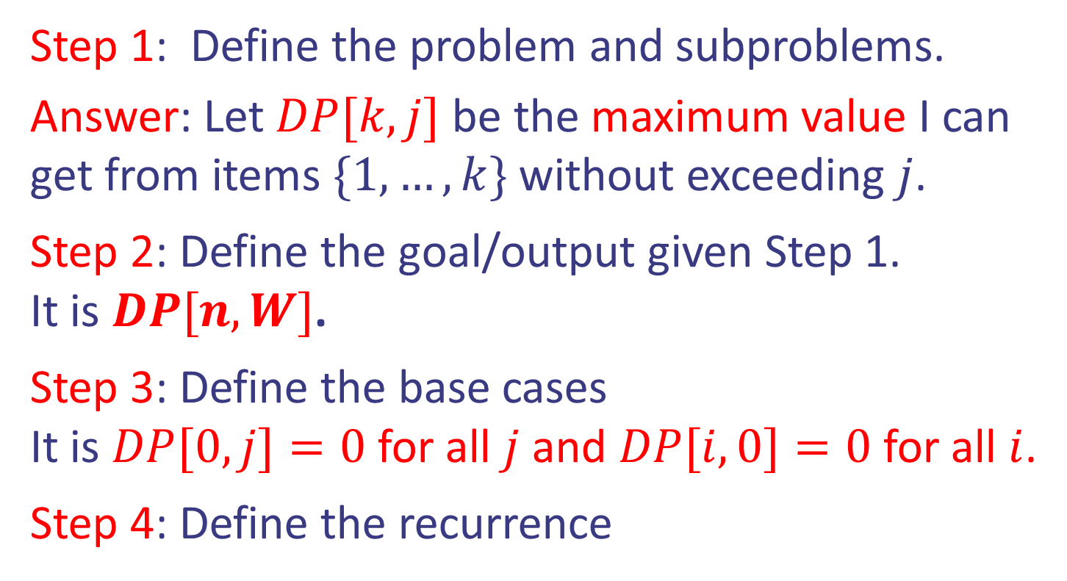
Case study II: 0/1 Knapsack
Idea: Dynamic Programming (correct attempt).
Step 1: Define the problem and subproblems.
Answer: Let $DP[k,j]$ be the maximum value I can get from items $\{1,…,k\}$ without exceeding $j$.
Step 2: Define the goal/output given Step 1.
It is $DP[n,W]$.
Step 3: Define the base cases
It is $DP[0,j]=0$ for all $j$ and $DP[i,0]=0$ for all $i$.
Step 4: Define the recurrence
Design and Analysis of Algorithms

Slide 43

Case study II: 0/1 Knapsack
Idea: Dynamic Programming (correct attempt).
Item $k$ will be used or not.
$DP\left[k\right][j] = max⁡(DP[k−1][j−w_{k}]+v_{k},DP[k−1][j])$
Step 4: Define the recurrence
Design and Analysis of Algorithms

Slide 44
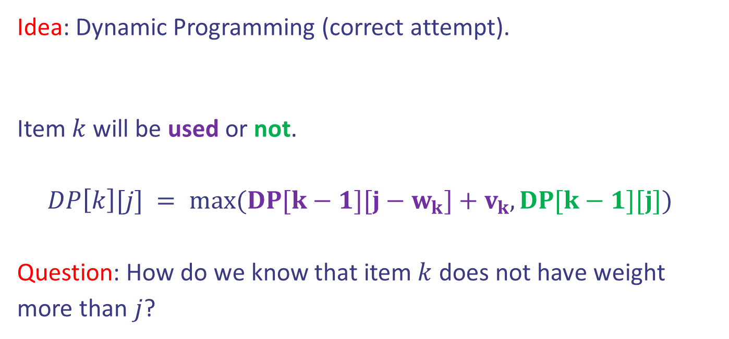
Case study II: 0/1 Knapsack
Idea: Dynamic Programming (correct attempt).
Item $k$ will be used or not.
$DP\left[k\right][j] = max⁡(DP[k−1][j−w_{k}]+v_{k},DP[k−1][j])$
Question: How do we know that item $k$ does not have weight more than $j$?
Step 4: Define the recurrence
Design and Analysis of Algorithms

Slide 45
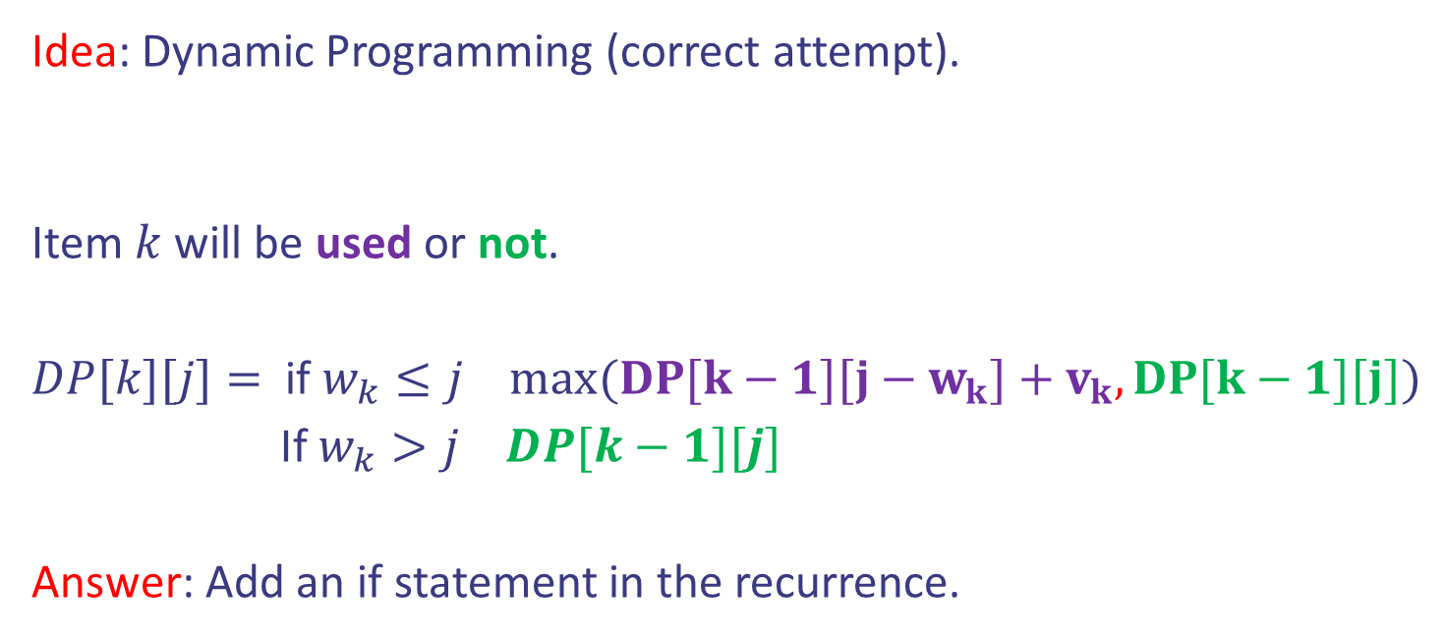
Case study II: 0/1 Knapsack
Idea: Dynamic Programming (correct attempt).
Item $k$ will be used or not.
$DP[k][j]=$ if $w_{k}≤j$ $max⁡(DP[k−1][j−w_{k}]+v_{k},DP[k−1][j])$
If $w_{k}>j$ $DP[k−1][j]$
Answer: Add an if statement in the recurrence.
Step 4: Define the recurrence
Design and Analysis of Algorithms

Slide 46
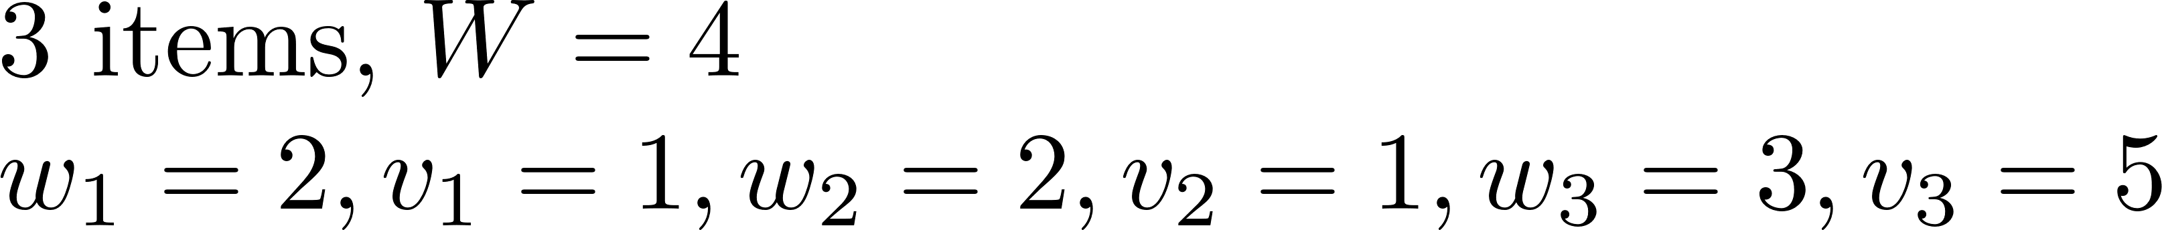

Case study II: 0/1 Knapsack
 | j=0 | 1 | 2 | 3 | 4
i=0 | 0 | 0 | 0 | 0 | 0
1 | 0
2 | 0
3 | 0

Slide 47
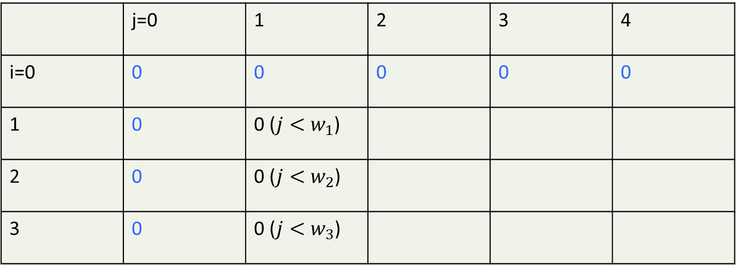
Case study II: 0/1 Knapsack
 | j=0 | 1 | 2 | 3 | 4
i=0 | 0 | 0 | 0 | 0 | 0
1 | 0 | 0 ($j<w_{1}$)
2 | 0 | 0 ($j<w_{2}$)
3 | 0 | 0 ($j<w_{3}$)

Slide 48


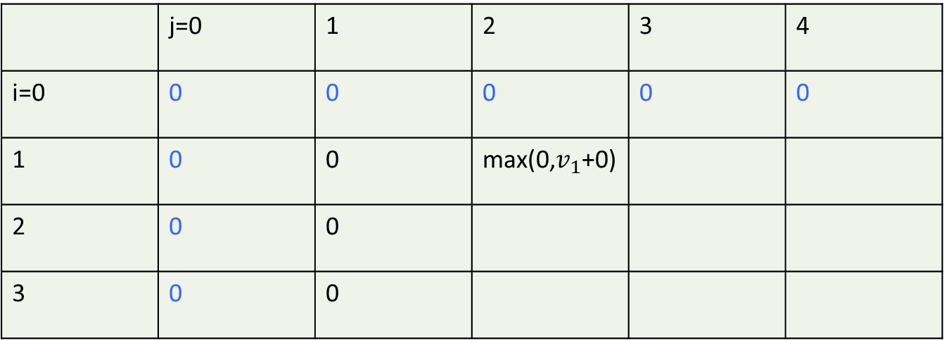
Case study II: 0/1 Knapsack
 | j=0 | 1 | 2 | 3 | 4
i=0 | 0 | 0 | 0 | 0 | 0
1 | 0 | 0 | max(0,$v_{1}$+0)
2 | 0 | 0
3 | 0 | 0

Slide 49


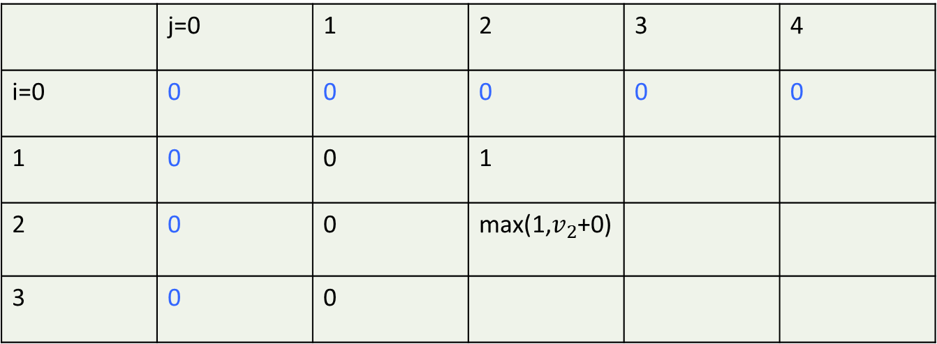
Case study II: 0/1 Knapsack
 | j=0 | 1 | 2 | 3 | 4
i=0 | 0 | 0 | 0 | 0 | 0
1 | 0 | 0 | 1
2 | 0 | 0 | max(1,$v_{2}$+0)
3 | 0 | 0

Slide 50
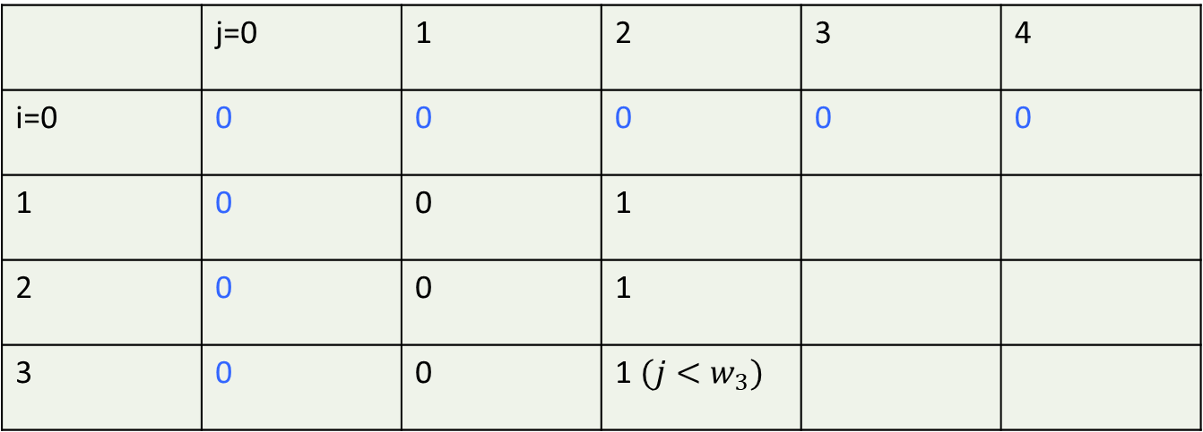
Case study II: 0/1 Knapsack
 | j=0 | 1 | 2 | 3 | 4
i=0 | 0 | 0 | 0 | 0 | 0
1 | 0 | 0 | 1
2 | 0 | 0 | 1
3 | 0 | 0 | 1 $(j<w_{3})$

Slide 51


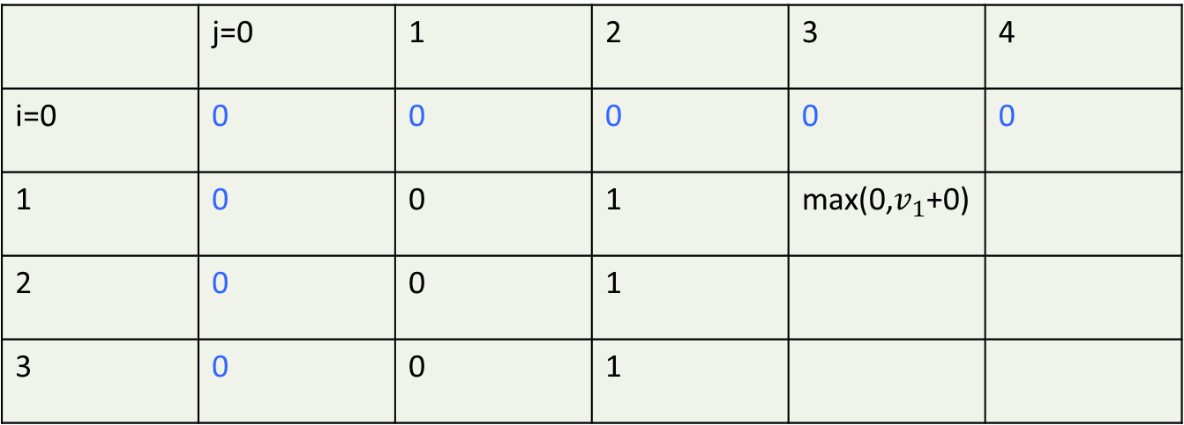
Case study II: 0/1 Knapsack
 | j=0 | 1 | 2 | 3 | 4
i=0 | 0 | 0 | 0 | 0 | 0
1 | 0 | 0 | 1 | max(0,$v_{1}$+0)
2 | 0 | 0 | 1
3 | 0 | 0 | 1

Slide 52
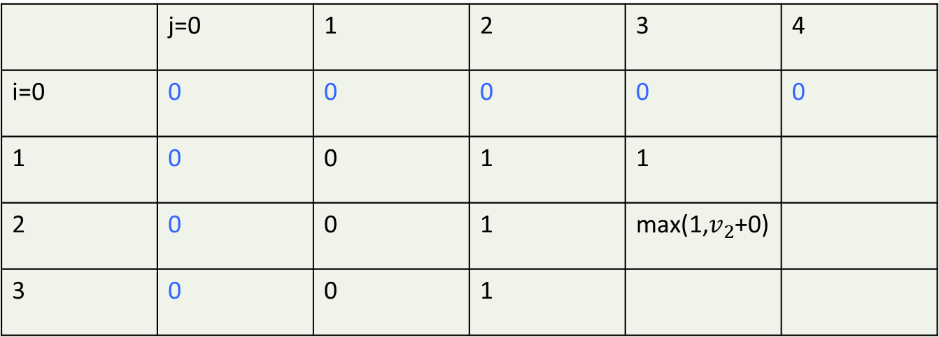
Case study II: 0/1 Knapsack
 | j=0 | 1 | 2 | 3 | 4
i=0 | 0 | 0 | 0 | 0 | 0
1 | 0 | 0 | 1 | 1
2 | 0 | 0 | 1 | max(1,$v_{2}$+0)
3 | 0 | 0 | 1

Slide 53
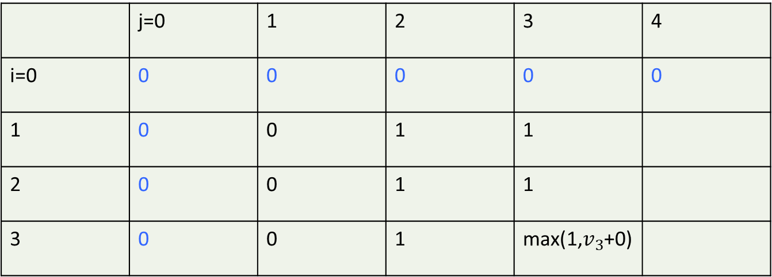
Case study II: 0/1 Knapsack
 | j=0 | 1 | 2 | 3 | 4
i=0 | 0 | 0 | 0 | 0 | 0
1 | 0 | 0 | 1 | 1
2 | 0 | 0 | 1 | 1
3 | 0 | 0 | 1 | max(1,$v_{3}$+0)

Slide 54
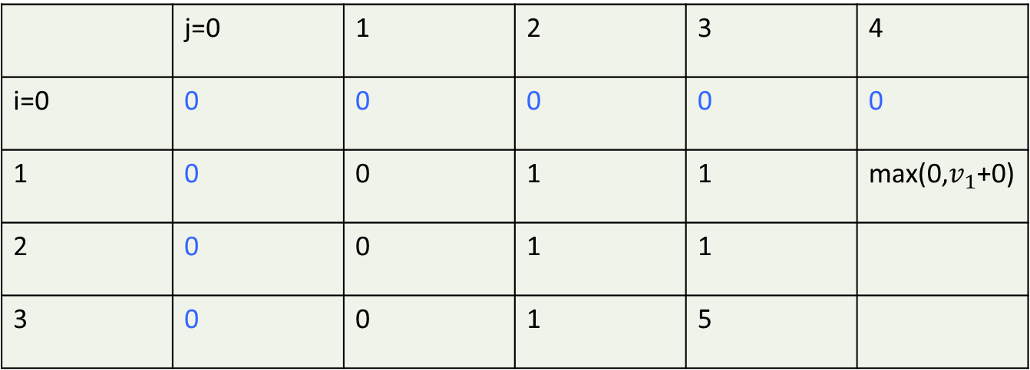
Case study II: 0/1 Knapsack
 | j=0 | 1 | 2 | 3 | 4
i=0 | 0 | 0 | 0 | 0 | 0
1 | 0 | 0 | 1 | 1 | max(0,$v_{1}$+0)
2 | 0 | 0 | 1 | 1
3 | 0 | 0 | 1 | 5

Slide 55
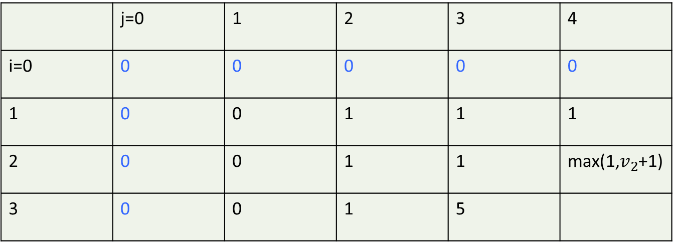
Case study II: 0/1 Knapsack
 | j=0 | 1 | 2 | 3 | 4
i=0 | 0 | 0 | 0 | 0 | 0
1 | 0 | 0 | 1 | 1 | 1
2 | 0 | 0 | 1 | 1 | max(1,$v_{2}$+1)
3 | 0 | 0 | 1 | 5

Slide 56
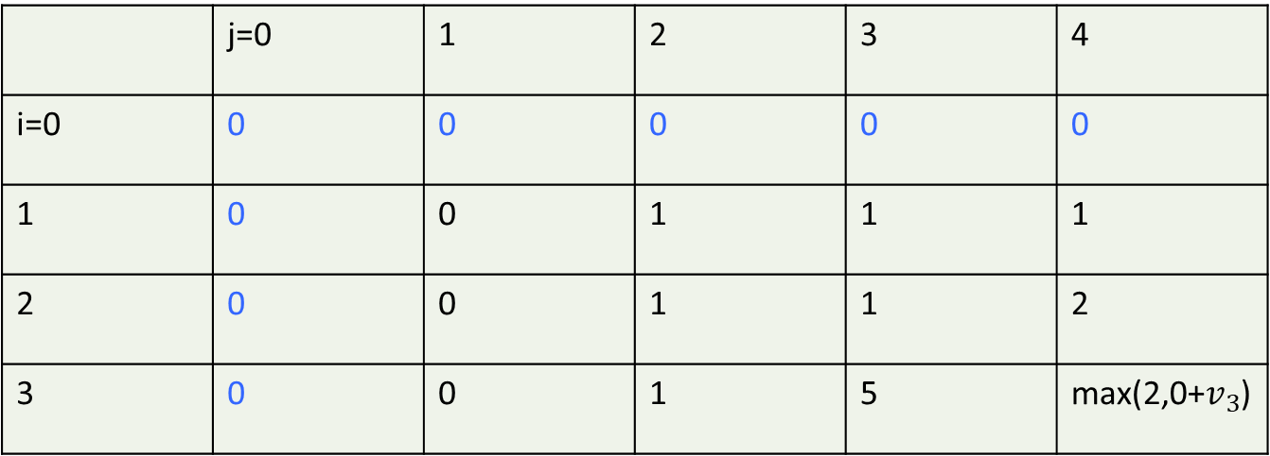
Case study II: 0/1 Knapsack
 | j=0 | 1 | 2 | 3 | 4
i=0 | 0 | 0 | 0 | 0 | 0
1 | 0 | 0 | 1 | 1 | 1
2 | 0 | 0 | 1 | 1 | 2
3 | 0 | 0 | 1 | 5 | max(2,0+$v_{3}$)

Slide 57
Case study II: 0/1 Knapsack
 | j=0 | 1 | 2 | 3 | 4
i=0 | 0 | 0 | 0 | 0 | 0
1 | 0 | 0 | 1 | 1 | 1
2 | 0 | 0 | 1 | 1 | 2
3 | 0 | 0 | 1 | 5 | 5

Slide 58

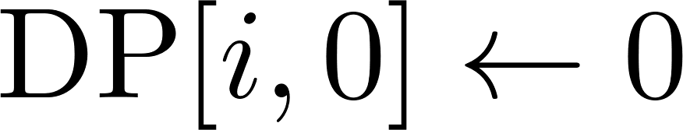

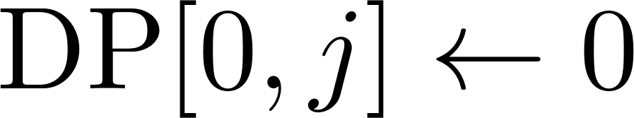



Case study II: 0/1 Knapsack
Pseudocode:
Initialization
Bottom up filliing DP
Goal
Design and Analysis of Algorithms

Slide 59

Case study II: 0/1 Knapsack
Pseudocode:
Initialization
Bottom up filliing DP
Goal
Design and Analysis of Algorithms

