Slide 1

Lecture 10 Dynamic Programming II: Bellman-Ford (cont), Interval Scheduling, Longest Common Subsequence
CS 161 Design and Analysis of Algorithms
Ioannis Panageas

Slide 2



Case study III: Bellman-Ford
In words: $d[s]=0, d[u]=+∞$ for $u≠s.$
For $n−1$ times, relax all the edges $(u,v)$.
Design and Analysis of Algorithms

Slide 3
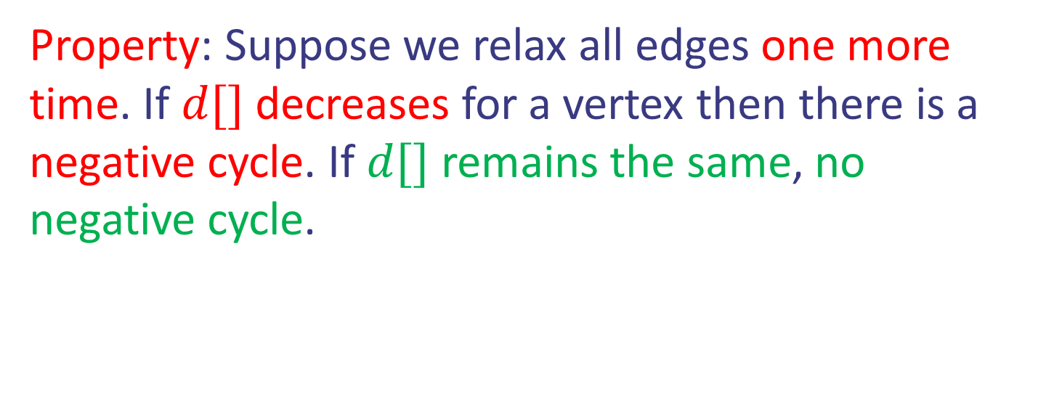
Case study III: Bellman-Ford
In words: $d[s]=0, d[u]=+∞$ for $u≠s.$
For $n−1$ times, relax all the edges $(u,v)$.
Property: Suppose we relax all edges one more time. If $d[]$decreases for a vertex then there is a negative cycle. If $d[]$ remains the same, no negative cycle.
Design and Analysis of Algorithms

Slide 4
Case study III: Bellman-Ford
Find the shortest weight path from node 0.
8
0
4
-2
∞
7
∞
1
∞
3
9
-2
∞
∞
5
Design and Analysis of Algorithms

Slide 5
Case study III: Bellman-Ford
8
0
4
8
0
4
-2
-2
7
1
8
7
-2
1
4
∞
∞
∞
∞
∞
∞
3
9
3
9
-2
∞
∞
5
-2
∞
∞
5
Design and Analysis of Algorithms

Slide 6
Case study III: Bellman-Ford
8
0
4
8
0
4
-2
-2
7
1
8
7
-2
1
4
∞
∞
∞
∞
∞
∞
3
9
3
9
-2
∞
∞
5
-2
∞
∞
5
8
0
4
-2
5
8
7
-2
1
4
-1
1
3
9
-2
6
9
5
∞
∞
Design and Analysis of Algorithms

Slide 7
Case study III: Bellman-Ford
8
0
4
8
0
4
-2
-2
7
1
8
7
-2
1
4
∞
∞
∞
∞
∞
∞
3
9
3
9
-2
∞
∞
5
-2
∞
∞
5
8
0
4
8
0
4
-2
-2
5
8
7
-2
1
4
-1
5
7
-2
1
-1
1
3
9
3
9
-2
6
9
5
-2
4
5
∞
∞
1
9
Design and Analysis of Algorithms

Slide 8

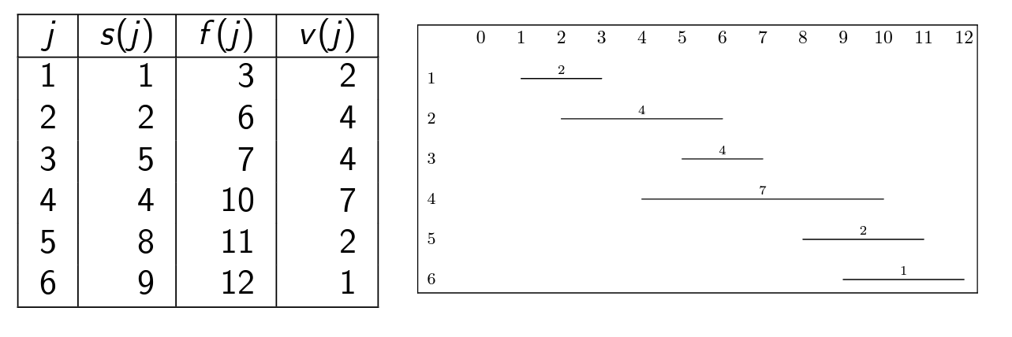
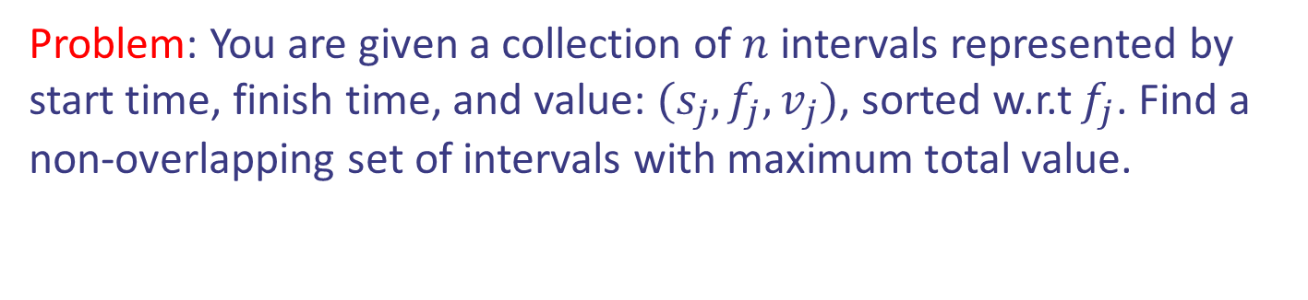
Case study IV: Interval Scheduling
Problem: You are given a collection of $n$ intervals represented by start time, finish time, and value: $(s_{j},f_{j},v_{j})$, sorted w.r.t $f_{j}$. Find a non-overlapping set of intervals with maximum total value.
Design and Analysis of Algorithms

Slide 9


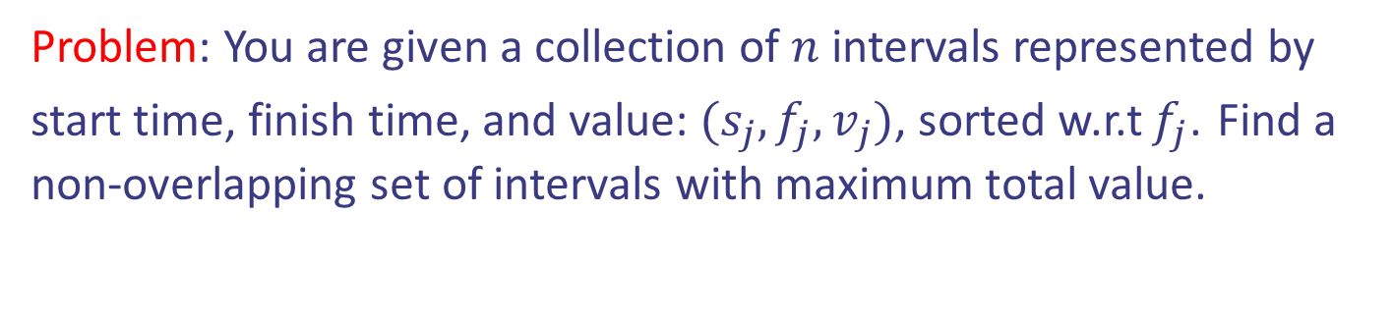
Case study IV: Interval Scheduling
Problem: You are given a collection of $n$ intervals represented by start time, finish time, and value: $(s_{j},f_{j},v_{j})$, sorted w.r.t $f_{j}$. Find a non-overlapping set of intervals with maximum total value.
Design and Analysis of Algorithms

Slide 10

Case study IV: Interval Scheduling
Step 1: Define the problem and subproblems.
Answer: Let $DP[j]$ be the maximum value that can be obtained from a set of non-overlapping intervals with indices in the range $\{1,…,j\}$
Design and Analysis of Algorithms

Slide 11
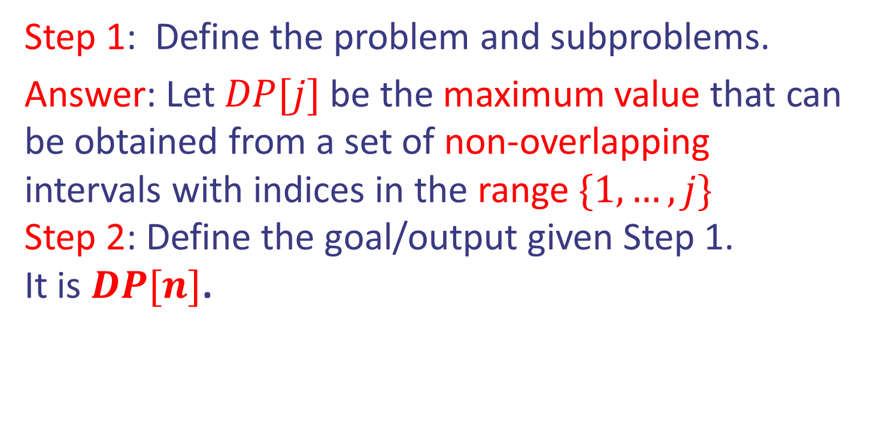
Case study IV: Interval Scheduling
Step 1: Define the problem and subproblems.
Answer: Let $DP[j]$ be the maximum value that can be obtained from a set of non-overlapping intervals with indices in the range $\{1,…,j\}$
Step 2: Define the goal/output given Step 1.
It is $DP[n]$.
Design and Analysis of Algorithms

Slide 12
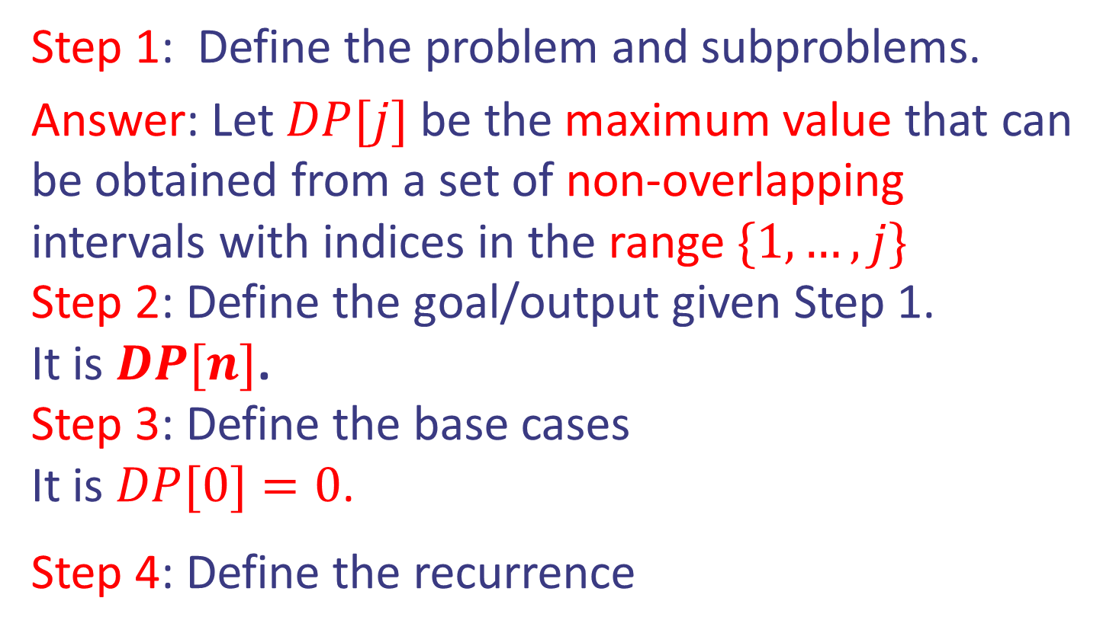
Case study IV: Interval Scheduling
Step 1: Define the problem and subproblems.
Answer: Let $DP[j]$ be the maximum value that can be obtained from a set of non-overlapping intervals with indices in the range $\{1,…,j\}$
Step 2: Define the goal/output given Step 1.
It is $DP[n]$.
Step 3: Define the base cases
It is $DP[0]=0$.
Step 4: Define the recurrence
Design and Analysis of Algorithms

Slide 13

Case study IV: Interval Scheduling
Step 4: Define the recurrence
Interval $j$ belongs to the optimal solution or not.
$DP[j] = max⁡(DP[\$]+v_{j},DP[j−1])$
What is $ ?
Design and Analysis of Algorithms

Slide 14
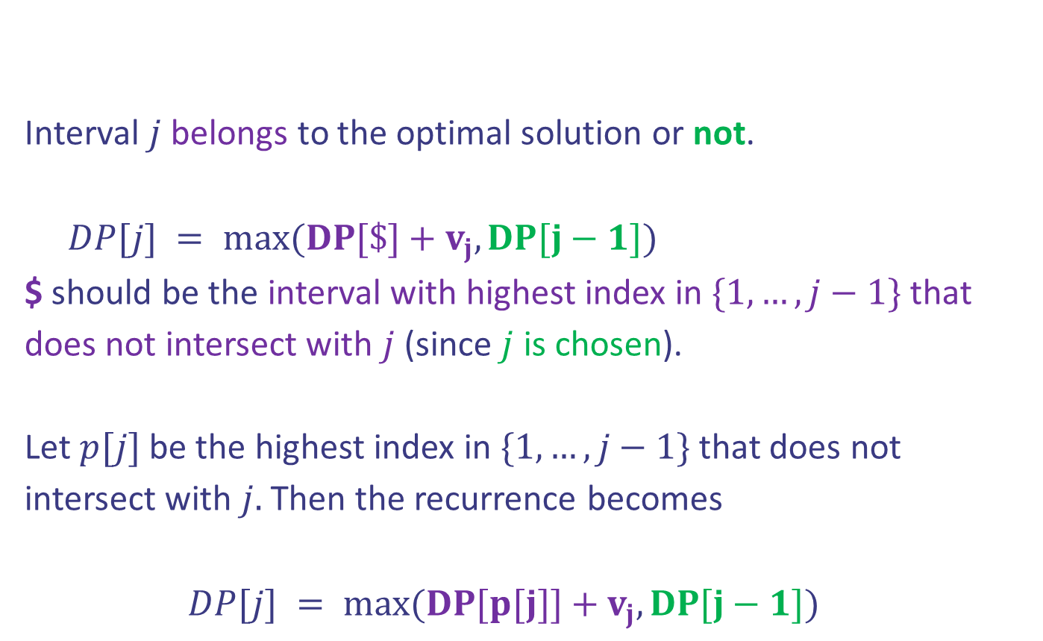
Case study IV: Interval Scheduling
Step 4: Define the recurrence
Interval $j$ belongs to the optimal solution or not.
$DP[j] = max⁡(DP[\$]+v_{j},DP[j−1])$
$ should be the interval with highest index in $\{1,…,j−1\}$ that does not intersect with $j$ (since $j$ is chosen).
Let $p[j]$ be the highest index in $\{1,…,j−1\}$ that does not intersect with $j.$ Then the recurrence becomes
$DP[j] = max⁡(DP[p[j]]+v_{j},DP[j−1])$
Design and Analysis of Algorithms

Slide 15

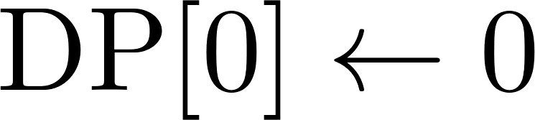

Case study IV: Interval Scheduling
Pseudocode:
Initialization
Bottom up filliing DP
Goal
Design and Analysis of Algorithms

Slide 16

Case study IV: Interval Scheduling
Pseudocode:
Initialization
Bottom up filliing DP
Goal
Question: How can we compute $p[j]$ for $1≤j≤n$
in $Θ(n\log{n)}$ time?
Design and Analysis of Algorithms

Slide 17
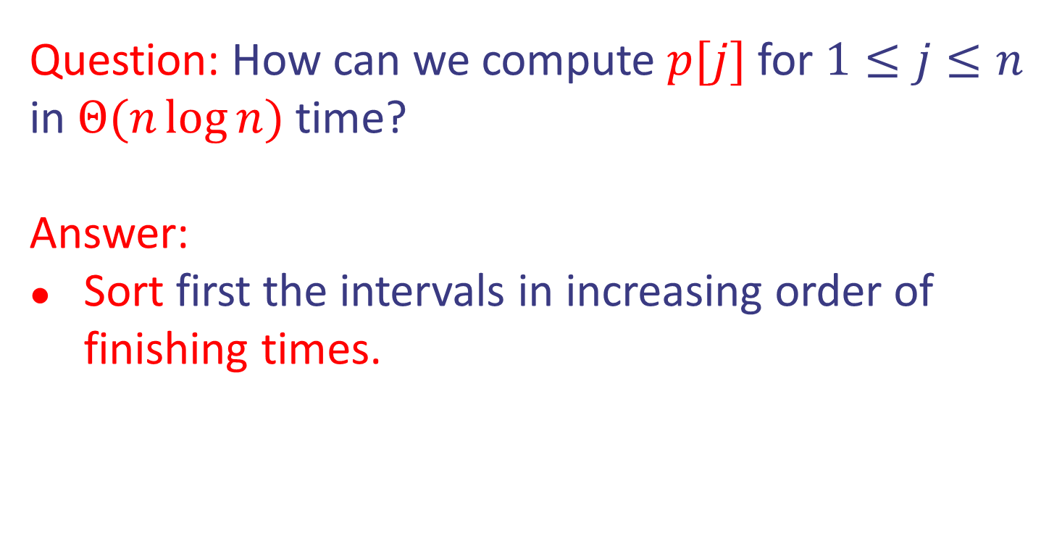
Case study IV: Interval Scheduling
Question: How can we compute $p[j]$ for $1≤j≤n$
in $Θ(n\log{n)}$ time?
Answer:
Sort first the intervals in increasing order of finishing times.
Design and Analysis of Algorithms

Slide 18
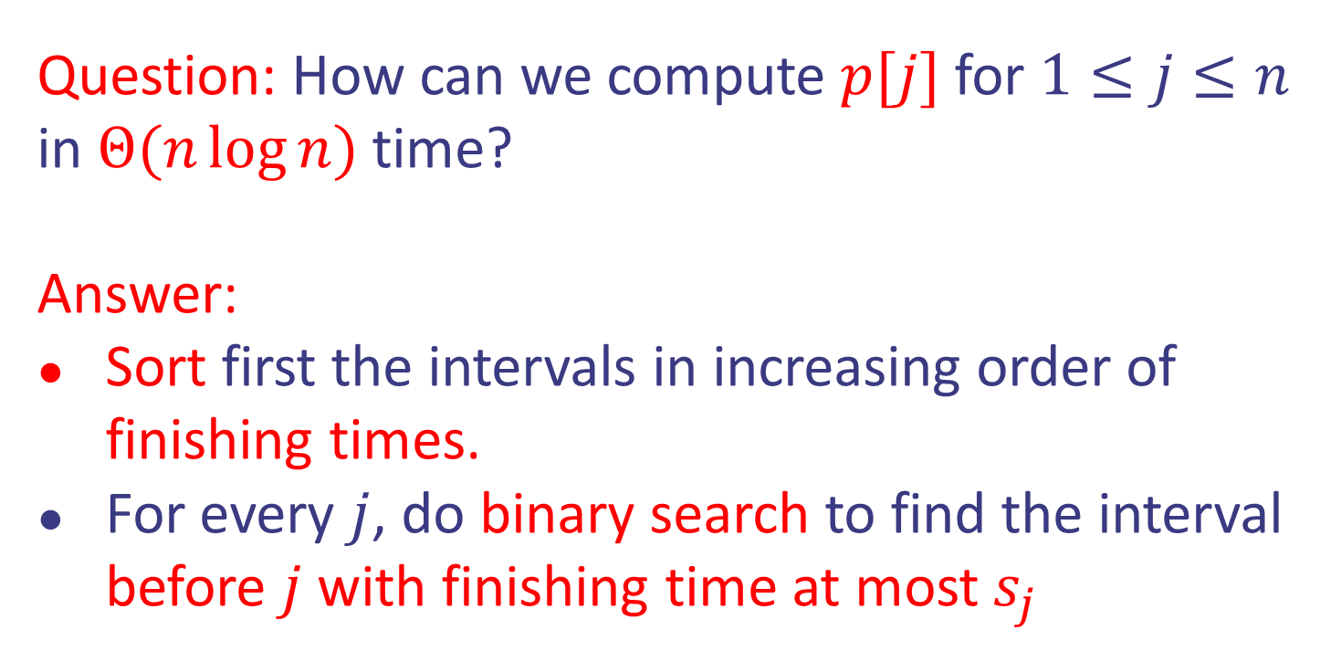
Case study IV: Interval Scheduling
Question: How can we compute $p[j]$ for $1≤j≤n$
in $Θ(n\log{n)}$ time?
Answer:
Sort first the intervals in increasing order of finishing times.
For every $j$, do binary search to find the interval before $j$ with finishing time at most $s_{j}$
Design and Analysis of Algorithms

Slide 19

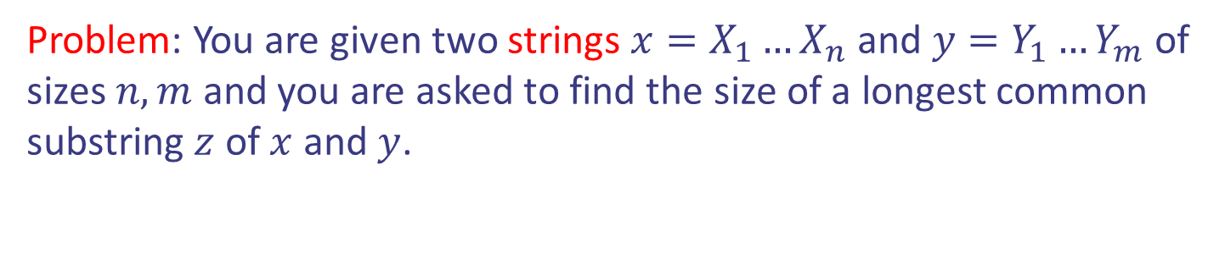
Case study V: Longest Common Subsequence
Problem: You are given two strings $x=X_{1}…X_{n}$ and $y=Y_{1}…Y_{m}$ of sizes $n,m$ and you are asked to find the size of a longest common substring $z$ of $x$ and $y$.
$x$ = H I E R O G L Y P H O L O G Y
$y$ = M I C H E L A N G E L O
Design and Analysis of Algorithms

Slide 20

Case study V: Longest Common Subsequence
Problem: You are given two strings $x=X_{1}…X_{n}$ and $y=Y_{1}…Y_{m}$ of sizes $n,m$ and you are asked to find the size of a longest common substring $z$ of $x$ and $y$.
$x$ = H I E R O G L Y P H O L O G Y
$y$ = M I C H E L A N G E L O
$z$ = H E G L O
Design and Analysis of Algorithms

Slide 21

Case study V: LCS
Step 1: Define the problem and subproblems.
Answer: Let $DP[i,j]$ be the longest common substring that can be obtained from substrings
$X_{1}X_{2}…X_{i}$ and $Y_{1}Y_{2}…Y_{j}.$
Design and Analysis of Algorithms

Slide 22
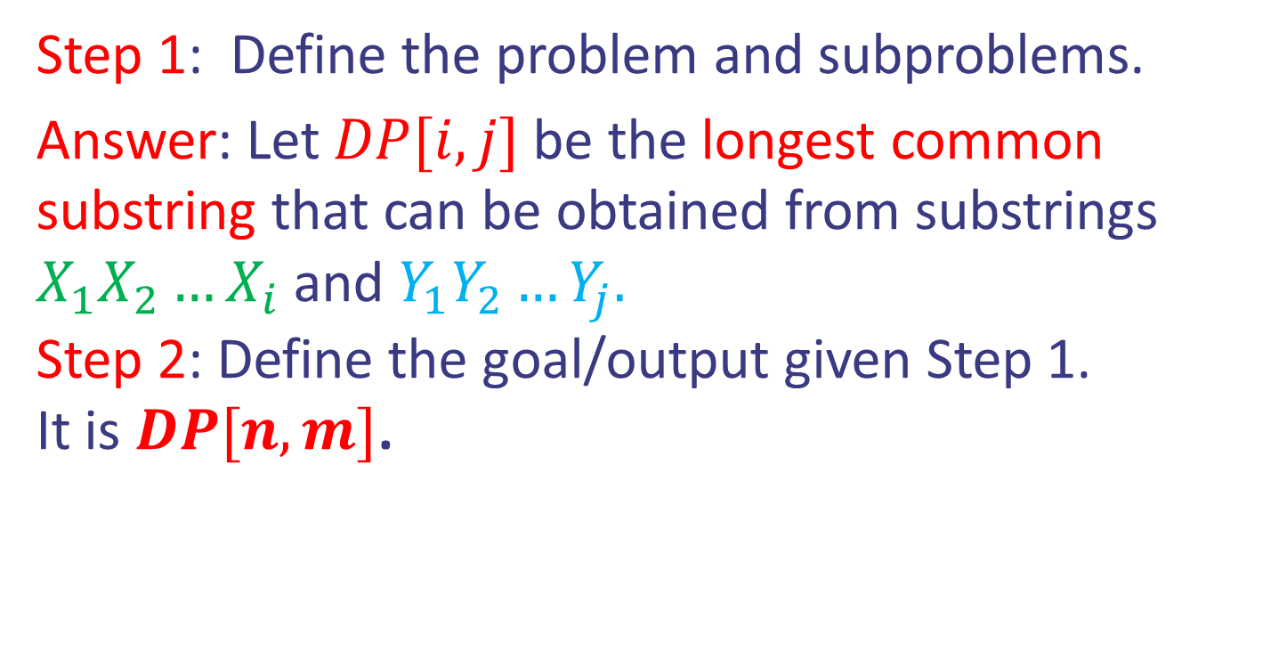
Case study V: LCS
Step 1: Define the problem and subproblems.
Answer: Let $DP[i,j]$ be the longest common substring that can be obtained from substrings
$X_{1}X_{2}…X_{i}$ and $Y_{1}Y_{2}…Y_{j}.$
Step 2: Define the goal/output given Step 1.
It is $DP[n,m]$.
Design and Analysis of Algorithms

Slide 23
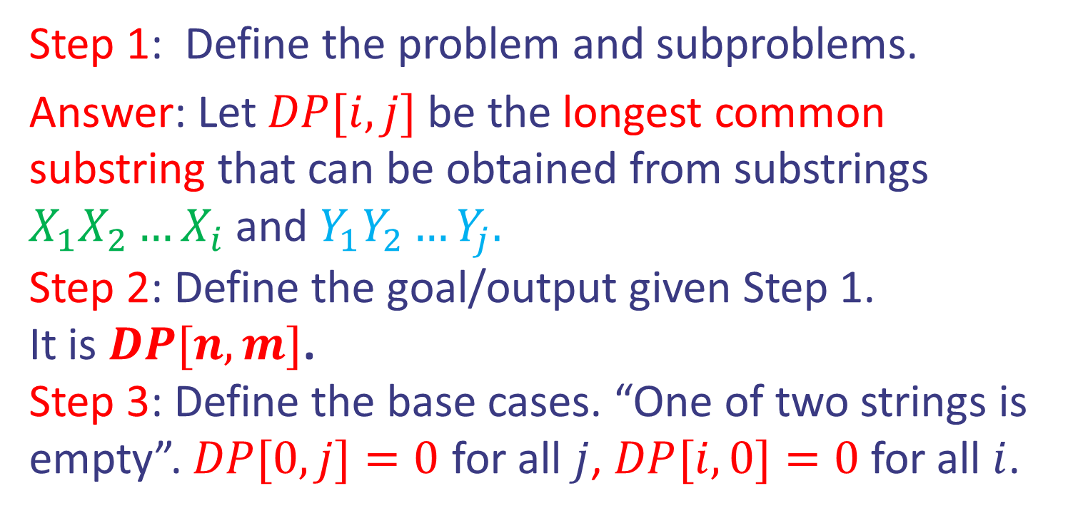
Case study V: LCS
Step 1: Define the problem and subproblems.
Answer: Let $DP[i,j]$ be the longest common substring that can be obtained from substrings
$X_{1}X_{2}…X_{i}$ and $Y_{1}Y_{2}…Y_{j}.$
Step 2: Define the goal/output given Step 1.
It is $DP[n,m]$.
Step 3: Define the base cases. “One of two strings is empty”. $DP[0,j]=0$ for all $j$, $DP[i,0]=0$ for all $i$.
Design and Analysis of Algorithms

Slide 24
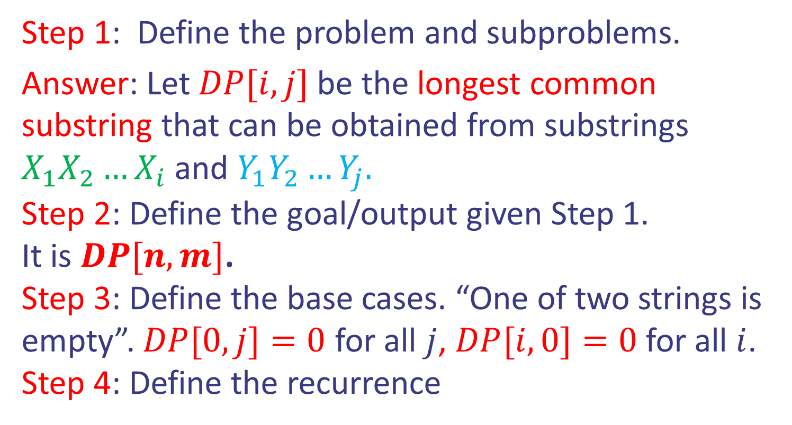
Case study V: LCS
Step 1: Define the problem and subproblems.
Answer: Let $DP[i,j]$ be the longest common substring that can be obtained from substrings
$X_{1}X_{2}…X_{i}$ and $Y_{1}Y_{2}…Y_{j}.$
Step 2: Define the goal/output given Step 1.
It is $DP[n,m]$.
Step 3: Define the base cases. “One of two strings is empty”. $DP[0,j]=0$ for all $j$, $DP[i,0]=0$ for all $i$.
Step 4: Define the recurrence
Design and Analysis of Algorithms

Slide 25
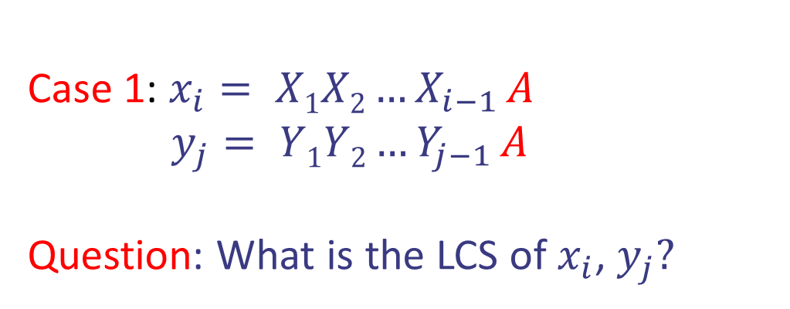
Case study V: LCS
Step 4: Define the recurrence
Case 1: $x_{i}= X1X2…X_{i−1} A$
$y_{j}= Y1Y2…Y_{j−1} A$
Question: What is the LCS of $x_{i}$, $y_{j}?$
Design and Analysis of Algorithms

Slide 26

Case study V: LCS
Step 4: Define the recurrence
Case 1: $x_{i}= X1X2…X_{i−1} A$
$y_{j}= Y1Y2…Y_{j−1} A$
Question: What is the LCS of $x_{i}$, $y_{j}?$
Answer: 1 + the LCS of $x_{i−1}, y_{j−1}$
Design and Analysis of Algorithms

Slide 27
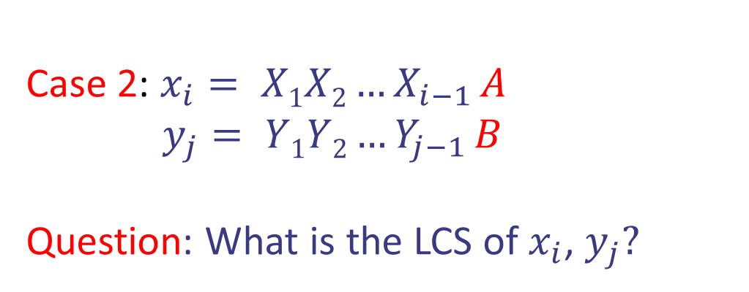
Case study V: LCS
Step 4: Define the recurrence
Case 2: $x_{i}= X1X2…X_{i−1} A$
$y_{j}= Y1Y2…Y_{j−1} B$
Question: What is the LCS of $x_{i}$, $y_{j}?$
Design and Analysis of Algorithms

Slide 28

Case study V: LCS
Step 4: Define the recurrence
Case 2: $x_{i}= X1X2…X_{i−1} A$
$y_{j}= Y1Y2…Y_{j−1} B$
Question: What is the LCS of $x_{i}$, $y_{j}?$
Answer: the maximum of the
LCS of $x_{i−1}, y_{j}$ and LCS of $x_{i}, y_{j−1}$
Design and Analysis of Algorithms

Slide 29

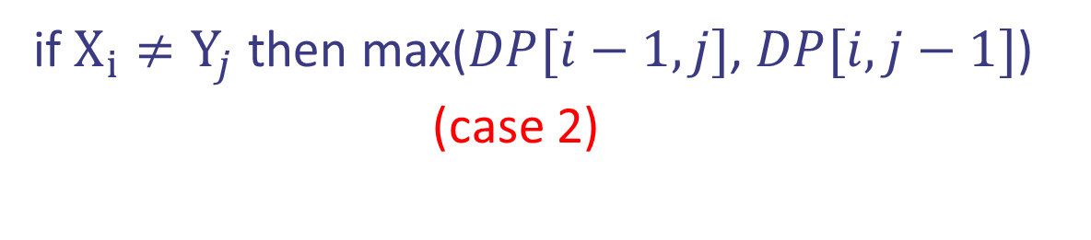

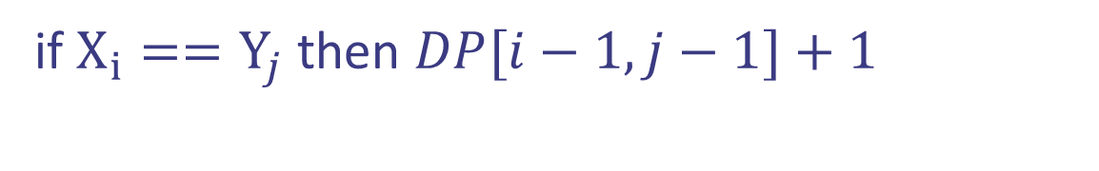
Case study V: LCS
Step 4: Define the recurrence
(case 1)
if $X_{i}==Y_{j}$ then $DP[i−1,j−1]+1$
$DP[i,j]$ =
if $X_{i}≠Y_{j}$ then max($DP[i−1,j]$, $DP[i,j−1]$) (case 2)
Design and Analysis of Algorithms

Slide 30

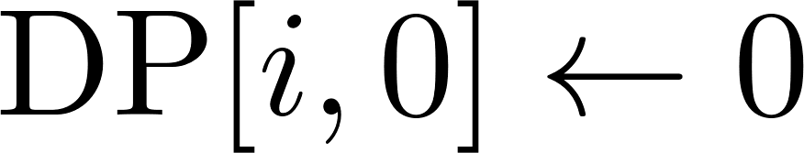

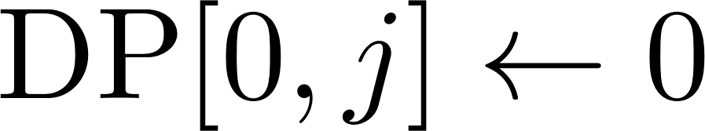


Case study V: LCS
Pseudocode:
Initialization
Bottom up filliing DP
Goal
Design and Analysis of Algorithms

Slide 31
Case study V: LCS
$x$ is the string "ABCBDAB" and $y$ is the string "BDCABA".
Design and Analysis of Algorithms

Slide 32
Case study V: LCS
$x$ is the string "ABCBDAB" and $y$ is the string "BDCABA".
 | j | 0 | 1 | 2 | 3 | 4 | 5 | 6
i |  | y_{j} | B | D | C | A | B | A
0 | x_{i} | 0 | 0 | 0 | 0 | 0 | 0 | 0
1 | A | 0
2 | B | 0
3 | C | 0
4 | B | 0
5 | D | 0
6 | A | 0
7 | B | 0
Design and Analysis of Algorithms

Slide 33
Case study V: LCS
$x$ is the string "ABCBDAB" and $y$ is the string "BDCABA".
 | j | 0 | 1 | 2 | 3 | 4 | 5 | 6
i |  | y_{j} | B | D | C | A | B | A
0 | x_{i} | 0 | 0 | 0 | 0 | 0 | 0 | 0
1 | A | 0 | 0 | 0 | 0
2 | B | 0
3 | C | 0
4 | B | 0
5 | D | 0
6 | A | 0
7 | B | 0
Design and Analysis of Algorithms

Slide 34
Case study V: LCS
$x$ is the string "ABCBDAB" and $y$ is the string "BDCABA".
 | j | 0 | 1 | 2 | 3 | 4 | 5 | 6
i |  | y_{j} | B | D | C | A | B | A
0 | x_{i} | 0 | 0 | 0 | 0 | 0 | 0 | 0
1 | A | 0 | 0 | 0 | 0 | 1
2 | B | 0
3 | C | 0
4 | B | 0
5 | D | 0
6 | A | 0
7 | B | 0
Design and Analysis of Algorithms

Slide 35
Case study V: LCS
$x$ is the string "ABCBDAB" and $y$ is the string "BDCABA".
 | j | 0 | 1 | 2 | 3 | 4 | 5 | 6
i |  | y_{j} | B | D | C | A | B | A
0 | x_{i} | 0 | 0 | 0 | 0 | 0 | 0 | 0
1 | A | 0 | 0 | 0 | 0 | 1 | 1
2 | B | 0
3 | C | 0
4 | B | 0
5 | D | 0
6 | A | 0
7 | B | 0
Design and Analysis of Algorithms

Slide 36
Case study V: LCS
$x$ is the string "ABCBDAB" and $y$ is the string "BDCABA".
 | j | 0 | 1 | 2 | 3 | 4 | 5 | 6
i |  | y_{j} | B | D | C | A | B | A
0 | x_{i} | 0 | 0 | 0 | 0 | 0 | 0 | 0
1 | A | 0 | 0 | 0 | 0 | 1 | 1 | 1
2 | B | 0
3 | C | 0
4 | B | 0
5 | D | 0
6 | A | 0
7 | B | 0
Design and Analysis of Algorithms

Slide 37
Case study V: LCS
$x$ is the string "ABCBDAB" and $y$ is the string "BDCABA".
 | j | 0 | 1 | 2 | 3 | 4 | 5 | 6
i |  | y_{j} | B | D | C | A | B | A
0 | x_{i} | 0 | 0 | 0 | 0 | 0 | 0 | 0
1 | A | 0 | 0 | 0 | 0 | 1 | 1 | 1
2 | B | 0 | 1
3 | C | 0
4 | B | 0
5 | D | 0
6 | A | 0
7 | B | 0
Design and Analysis of Algorithms

Slide 38
Case study V: LCS
$x$ is the string "ABCBDAB" and $y$ is the string "BDCABA".
 | j | 0 | 1 | 2 | 3 | 4 | 5 | 6
i |  | y_{j} | B | D | C | A | B | A
0 | x_{i} | 0 | 0 | 0 | 0 | 0 | 0 | 0
1 | A | 0 | 0 | 0 | 0 | 1 | 1 | 1
2 | B | 0 | 1 | 1
3 | C | 0
4 | B | 0
5 | D | 0
6 | A | 0
7 | B | 0
Design and Analysis of Algorithms

Slide 39
Case study V: LCS
$x$ is the string "ABCBDAB" and $y$ is the string "BDCABA".
 | j | 0 | 1 | 2 | 3 | 4 | 5 | 6
i |  | y_{j} | B | D | C | A | B | A
0 | x_{i} | 0 | 0 | 0 | 0 | 0 | 0 | 0
1 | A | 0 | 0 | 0 | 0 | 1 | 1 | 1
2 | B | 0 | 1 | 1 | 1
3 | C | 0
4 | B | 0
5 | D | 0
6 | A | 0
7 | B | 0
Design and Analysis of Algorithms

Slide 40
Case study V: LCS
$x$ is the string "ABCBDAB" and $y$ is the string "BDCABA".
 | j | 0 | 1 | 2 | 3 | 4 | 5 | 6
i |  | y_{j} | B | D | C | A | B | A
0 | x_{i} | 0 | 0 | 0 | 0 | 0 | 0 | 0
1 | A | 0 | 0 | 0 | 0 | 1 | 1 | 1
2 | B | 0 | 1 | 1 | 1 | 1
3 | C | 0
4 | B | 0
5 | D | 0
6 | A | 0
7 | B | 0
Design and Analysis of Algorithms

Slide 41
Case study V: LCS
$x$ is the string "ABCBDAB" and $y$ is the string "BDCABA".
 | j | 0 | 1 | 2 | 3 | 4 | 5 | 6
i |  | y_{j} | B | D | C | A | B | A
0 | x_{i} | 0 | 0 | 0 | 0 | 0 | 0 | 0
1 | A | 0 | 0 | 0 | 0 | 1 | 1 | 1
2 | B | 0 | 1 | 1 | 1 | 1 | 2
3 | C | 0
4 | B | 0
5 | D | 0
6 | A | 0
7 | B | 0
Design and Analysis of Algorithms

Slide 42
Case study V: LCS
$x$ is the string "ABCBDAB" and $y$ is the string "BDCABA".
 | j | 0 | 1 | 2 | 3 | 4 | 5 | 6
i |  | y_{j} | B | D | C | A | B | A
0 | x_{i} | 0 | 0 | 0 | 0 | 0 | 0 | 0
1 | A | 0 | 0 | 0 | 0 | 1 | 1 | 1
2 | B | 0 | 1 | 1 | 1 | 1 | 2 | 2
3 | C | 0
4 | B | 0
5 | D | 0
6 | A | 0
7 | B | 0
Design and Analysis of Algorithms

Slide 43
Case study V: LCS
$x$ is the string "ABCBDAB" and $y$ is the string "BDCABA".
 | j | 0 | 1 | 2 | 3 | 4 | 5 | 6
i |  | y_{j} | B | D | C | A | B | A
0 | x_{i} | 0 | 0 | 0 | 0 | 0 | 0 | 0
1 | A | 0 | 0 | 0 | 0 | 1 | 1 | 1
2 | B | 0 | 1 | 1 | 1 | 1 | 2 | 2
3 | C | 0 | 1 | 1 | 2 | 2 | 2 | 2
4 | B | 0 | 1 | 1 | 2 | 2 | 3 | 3
5 | D | 0 | 1 | 2 | 2 | 2 | 3 | 3
6 | A | 0 | 1 | 2 | 2 | 3 | 3 | 4
7 | B | 0 | 1 | 2 | 2 | 3 | 4 | 4
Design and Analysis of Algorithms

Slide 44
Case study V: LCS
$x$ is the string "ABCBDAB" and $y$ is the string "BDCABA".
 | j | 0 | 1 | 2 | 3 | 4 | 5 | 6
i |  | y_{j} | B | D | C | A | B | A
0 | x_{i} | 0 | 0 | 0 | 0 | 0 | 0 | 0
1 | A | 0 | 0 | 0 | 0 | 1 | 1 | 1
2 | B | 0 | 1 | 1 | 1 | 1 | 2 | 2
3 | C | 0 | 1 | 1 | 2 | 2 | 2 | 2
4 | B | 0 | 1 | 1 | 2 | 2 | 3 | 3
5 | D | 0 | 1 | 2 | 2 | 2 | 3 | 3
6 | A | 0 | 1 | 2 | 2 | 3 | 3 | 4
7 | B | 0 | 1 | 2 | 2 | 3 | 4 | 4
Design and Analysis of Algorithms

Slide 45


Case study V: LCS
$x$ is the string "ABCBDAB" and $y$ is the string "BDCABA".
 | j | 0 | 1 | 2 | 3 | 4 | 5 | 6
i |  | y_{j} | B | D | C | A | B | A
0 | x_{i} | 0 | 0 | 0 | 0 | 0 | 0 | 0
1 | A | 0 | 0 | 0 | 0 | 1 | 1 | 1
2 | B | 0 | 1 | 1 | 1 | 1 | 2 | 2
3 | C | 0 | 1 | 1 | 2 | 2 | 2 | 2
4 | B | 0 | 1 | 1 | 2 | 2 | 3 | 3
5 | D | 0 | 1 | 2 | 2 | 2 | 3 | 3
6 | A | 0 | 1 | 2 | 2 | 3 | 3 | 4
7 | B | 0 | 1 | 2 | 2 | 3 | 4 | 4
Design and Analysis of Algorithms

Slide 46
Case study V: LCS
$x$ is the string "ABCBDAB" and $y$ is the string "BDCABA".
 | j | 0 | 1 | 2 | 3 | 4 | 5 | 6
i |  | y_{j} | B | D | C | A | B | A
0 | x_{i} | 0 | 0 | 0 | 0 | 0 | 0 | 0
1 | A | 0 | 0 | 0 | 0 | 1 | 1 | 1
2 | B | 0 | 1 | 1 | 1 | 1 | 2 | 2
3 | C | 0 | 1 | 1 | 2 | 2 | 2 | 2
4 | B | 0 | 1 | 1 | 2 | 2 | 3 | 3
5 | D | 0 | 1 | 2 | 2 | 2 | 3 | 3
6 | A | 0 | 1 | 2 | 2 | 3 | 3 | 4
7 | B | 0 | 1 | 2 | 2 | 3 | 4 | 4
Design and Analysis of Algorithms

Slide 47







Case study V: LCS
$x$ is the string "ABCBDAB" and $y$ is the string "BDCABA".
 | j | 0 | 1 | 2 | 3 | 4 | 5 | 6
i |  | y_{j} | B | D | C | A | B | A
0 | x_{i} | 0 | 0 | 0 | 0 | 0 | 0 | 0
1 | A | 0 | 0 | 0 | 0 | 1 | 1 | 1
2 | B | 0 | 1 | 1 | 1 | 1 | 2 | 2
3 | C | 0 | 1 | 1 | 2 | 2 | 2 | 2
4 | B | 0 | 1 | 1 | 2 | 2 | 3 | 3
5 | D | 0 | 1 | 2 | 2 | 2 | 3 | 3
6 | A | 0 | 1 | 2 | 2 | 3 | 3 | 4
7 | B | 0 | 1 | 2 | 2 | 3 | 4 | 4
Design and Analysis of Algorithms

