Slide 1
Games, learning
& optimization
Ioannis Panageas
Computer Science, UC Irvine
01
Notes:
TIME 0:00–2:00 (2 minutes).
Opening: I work at the intersection of game theory, learning, and optimization. I study what happens when decision makers adapt while other decision makers are adapting too. The goal is both to design algorithms and to understand their limits. A learning system might optimize one loss, interact cooperatively with other agents, or face an opponent.
Tell the audience that they already know the first example: rock–paper–scissors. Ask them to choose a move silently, then play one round with you.
This is a research overview, not a list of all publications. The four selected results are joint work with the collaborators credited on the corresponding slides.
Profile and research interests: https://panageas.github.io/

Slide 2

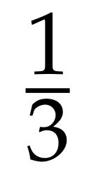
Rock–paper–scissors
Rock
Paper
Scissors
Nash equilibrium: no player gains by changing strategy alone.
02
Notes:
TIME 2:00–6:00 (4 minutes).
Ask: If your opponent knows your next move, can that move be optimal? Every fixed action loses to another, so there is no pure equilibrium. A strategy can instead be a probability distribution. If both players choose each move with probability one third, any fixed action earns zero, and therefore any mixture also earns zero. Neither player can improve alone.
Define Nash equilibrium carefully: each player is already playing a best response to the other player's strategy. It does not mean everyone receives their favorite outcome, or that a strategy beats every opponent.
Audience exercise: If I play rock half the time and never scissors, what would you do?
Before advancing, ask the next question without showing its answer: What if rock beating scissors were worth two points? Which move would appear more often in equilibrium? Take a vote.
The RPS calculation is exact. Illustration: AI-generated clay hand gestures, used only as illustrations.

Slide 3

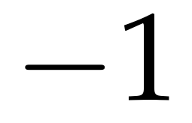
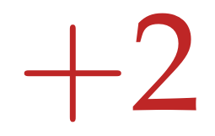
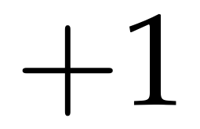
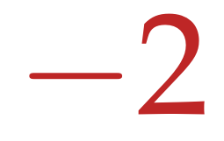
What if rock wins twice as much?
Your payoff
Equilibrium for both players
You / Other | Rock | Paper | Scissors
Rock
Paper
Scissors
Paper becomes more common.
03
Notes:
TIME 6:00–10:00 (4 minutes).
Pause on the audience's predictions. Against a uniform opponent, rock earns one third, paper zero, and scissors minus one third. So uniform play is no longer an equilibrium.
Let the opponent's probabilities be r, p, s. Your pure-action payoffs are −p+2s, r−s, and −2r+p. At equilibrium they are all zero. Thus r=s and p=2r. Since r+p+s=1, both players use (1/4,1/2,1/4). This can be checked directly using the displayed matrix.
Intuition: increasing rock's reward changes what is needed to keep rock indifferent. Paper must appear more often to offset the now larger gain against scissors. These are equilibrium comparisons, not a prediction about every person's immediate reaction.
Ask: How would we solve this if there were thousands of actions? That is an algorithmic question.
All payoffs, probabilities and the derivation are an original illustrative calculation, not a claimed new research result.

Slide 4
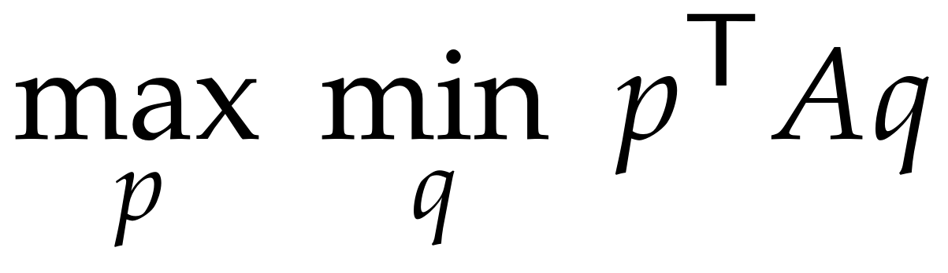
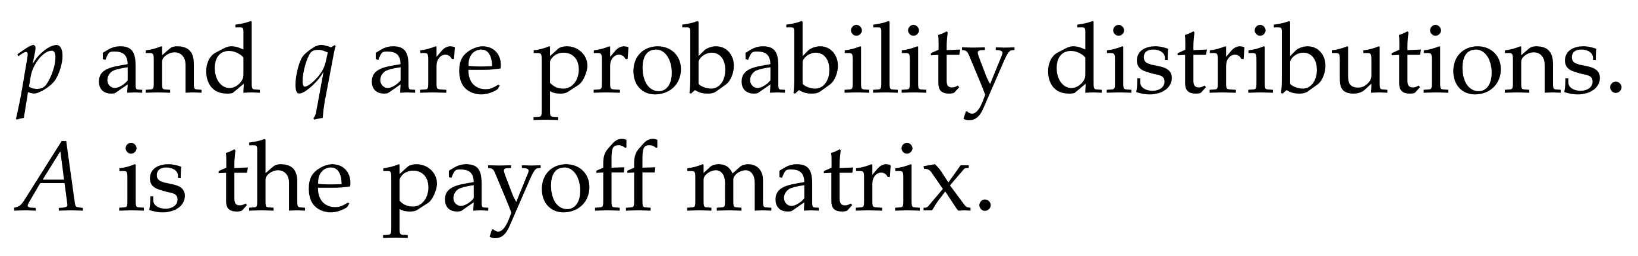
Optimization turns games into algorithms
Compute a strategy
Learn from repeated play
Choose probabilities to maximize
your worst-case payoff.
Two-player zero-sum games:
efficient linear programming.
Low-regret learners approach equilibrium
in their average strategies.
Illustrative learning run in the modified RPS game. Lower gap means closer to equilibrium.
04
Notes:
TIME 10:00–14:00 (4 minutes).
Optimization means choosing variables to make an objective as good as possible. Here the variables are probabilities. The inner minimum represents an adversary choosing a response. For a finite two-player zero-sum matrix game, linear programming computes an equilibrium in time polynomial in the explicit input length.
An alternative is to learn: increase the weight of actions that have performed well. Low regret means your average payoff is close to that of the best fixed action chosen in hindsight. If both players have sublinear external regret, the equilibrium gap of their average strategies tends to zero. Current strategies need not converge.
Chart: deterministic entropic FTRL in the exact matrix on slide 3. Start cumulative payoff vectors G=H=0. At round t, eta=sqrt(log(3)/t)/2, p=softmax(eta G), q=softmax(eta H), then G+=Aq and H+=−A^T p. Plot gap=max_i(A qbar)_i−min_j(pbar^T A)_j, sampled every 40 rounds through 4,000. This is a reproducible illustrative run, not a measured research benchmark.
Background: Freund and Schapire, Adaptive Game Playing Using Multiplicative Weights (1999), https://www.schapire.net/papers/FreundScYY.pdf
Transition: learning in machine learning often asks us to minimize a smooth loss instead. Can gradient descent get stuck?

Slide 5
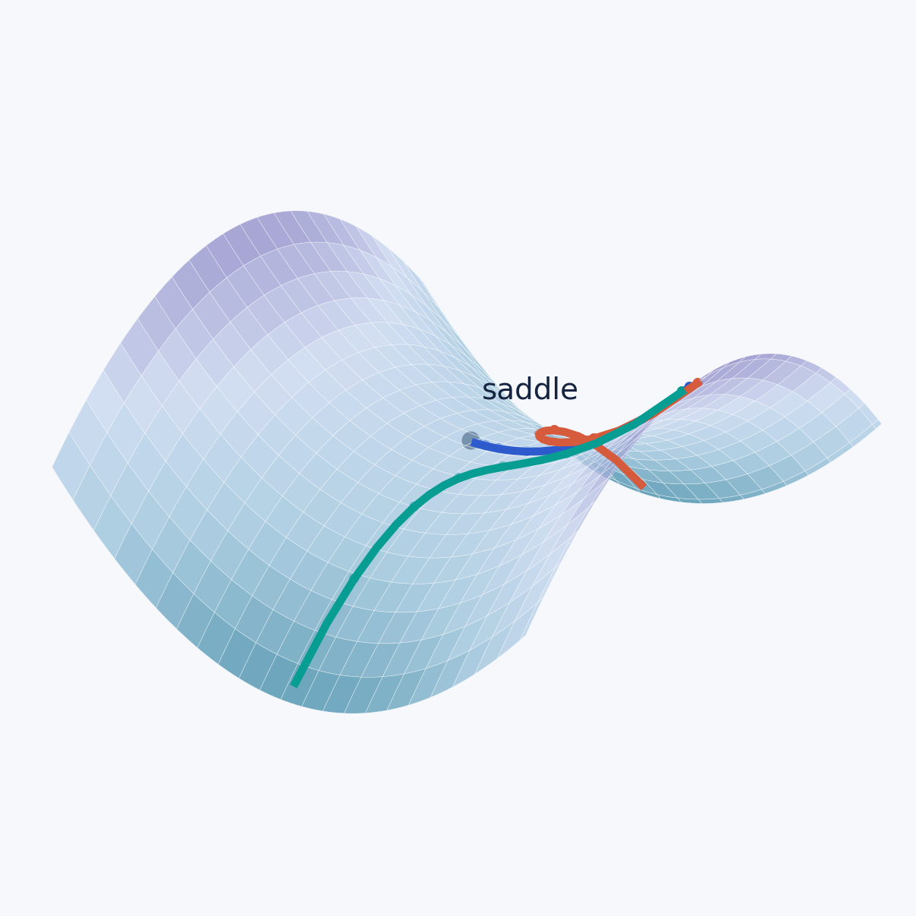
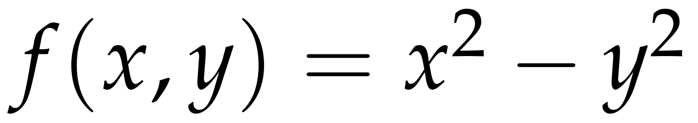
Why gradient descent avoids strict saddles
Optimization: minimize a loss by taking small downhill steps.
Our result
With a random start,
gradient descent almost
surely does not converge
to a strict saddle.
Smooth objective.
Small enough steps.
Avoidance does not imply fast escape
or finding the global minimum.
Panageas & Piliouras, ITCS 2017; Lee, Panageas, Piliouras, Simchowitz, Jordan & Recht, 2019
05
Notes:
TIME 14:00–18:00 (4 minutes).
At a saddle, the gradient can be zero even though a direction of improvement exists. On f(x,y)=x²−y² the x direction goes uphill and the y direction downhill. With step eta=0.1, gradient descent has x_next=0.8x and y_next=1.2y. Starting exactly on y=0 approaches the saddle; any nonzero y is amplified. The drawn paths use x0=1.35 and y0=0, +0.065, −0.065 for 17 steps.
Clean theorem: for C² functions with L-Lipschitz gradient, fixed 0<eta<1/L, and a random initialization with a density, convergence to any strict saddle has probability zero. Strict means a negative Hessian eigenvalue. The 2017 work handles non-isolated critical points; the broader 2019 framework covers several first-order methods under appropriate assumptions.
This is asymptotic avoidance. It does not give a polynomial escape time, global convergence, or a global minimum guarantee.
Primary sources: Panageas and Piliouras, Gradient Descent Only Converges to Minimizers: Non-Isolated Critical Points and Invariant Regions, ITCS 2017, https://drops.dagstuhl.de/entities/document/10.4230/LIPIcs.ITCS.2017.2
Lee, Panageas, Piliouras, Simchowitz, Jordan and Recht, First-order Methods Almost Always Avoid Saddle Points, Mathematical Programming (2019), https://arxiv.org/abs/1710.07406

Slide 6
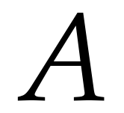
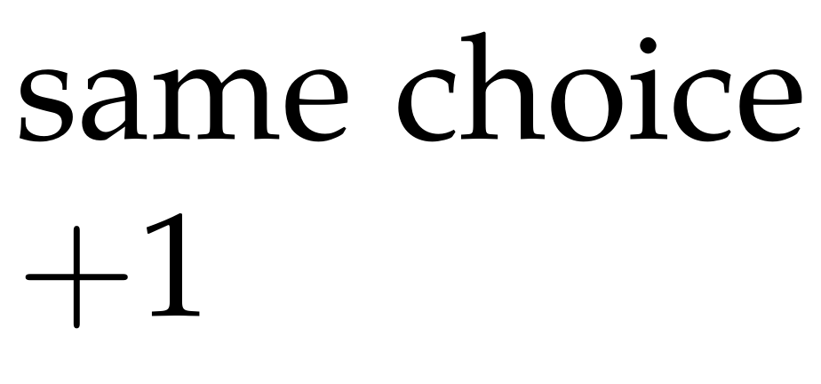
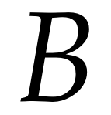
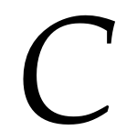
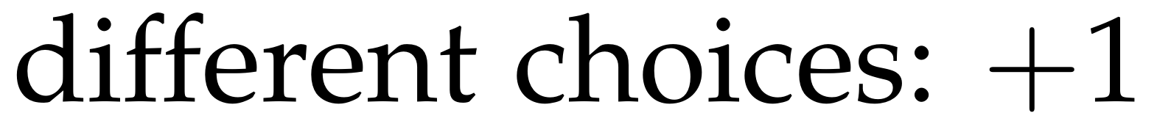
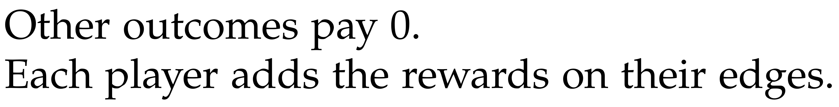
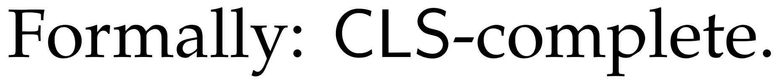
Cooperation on a network
Can everyone be satisfied?
Different relationships can pull
a player in different directions.
Our result
Finding an exact equilibrium
is computationally hard, even
with two choices per player.
Anagnostides, Panageas & Yan, 2026
06
Notes:
TIME 18:00–22:00 (4 minutes).
Use the triangle as a model example. A and B want to match, A and C want to match, while B and C want to differ. Both endpoints agree about the reward on each edge, but all edge goals cannot be met simultaneously. A player's payoff is the sum of incident rewards. This is local shared interest, not necessarily one identical global payoff.
Ask students to propose a stable assignment. All choosing 0 is a Nash equilibrium here: B or C can swap one satisfied edge for another, but cannot improve strictly. The tiny illustration is easy. It explains the model, not a hard instance.
Our general result: computing an exact Nash equilibrium is CLS-complete even for two actions per player and rational common edge payoffs in [0,1]. Randomization is allowed. CLS concerns continuous local search; the result classifies worst-case difficulty. It does not prove an unconditional exponential lower bound or hardness of inverse-polynomial approximation.
Ioannis Anagnostides, Ioannis Panageas, Jingming Yan, The Complexity of Nash Equilibrium in Network Congestion and Coordination Games (2026), Main Theorem 2, https://arxiv.org/html/2609.33225v1

Slide 7
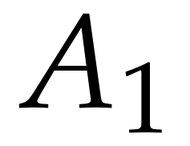
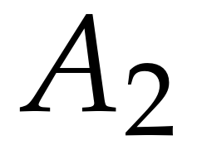
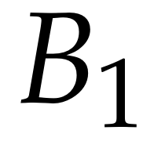
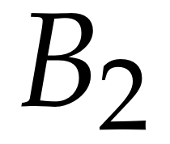
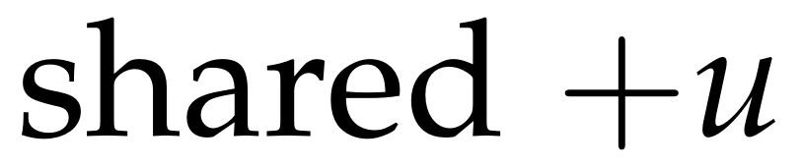
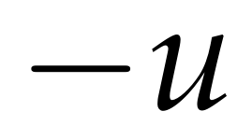
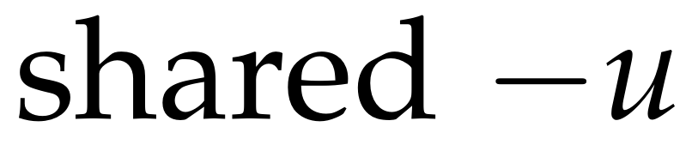
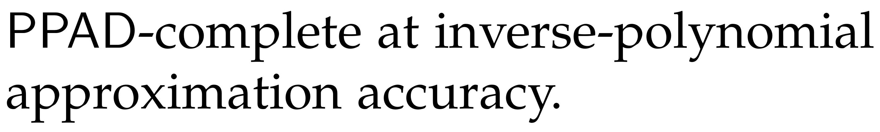
Teams combine cooperation and competition
Teammates share a payoff, but make independent decisions.
A team vs. one opponent
A team vs. another team
vs.
vs.
Efficient approximate
equilibrium algorithms
As hard as general games,
even two players vs. two
Also for games that evolve over time.
Kalogiannis et al., ICLR 2023; Anagnostides, Panageas, Sandholm & Yan, 2026
07
Notes:
TIME 22:00–27:00 (5 minutes).
Both settings mix cooperation within teams and competition across teams. Team A has utility u and Team B −u. Each player chooses an independent strategy. Nash equilibrium tests one player's deviation, not a joint change by the whole team.
Positive result: for finite discounted adversarial team Markov games against one adversary, we compute stationary epsilon-Nash in time polynomial in game parameters and 1/epsilon. The method combines independent team policy-gradient updates, adversary best responses, and an LP to recover the adversary policy. Do not claim arbitrary simultaneous gradient play converges or that exact equilibrium is efficiently solvable.
Negative result: with two opposing teams, epsilon-Nash is PPAD-complete already for two players per team and inverse-polynomial epsilon. This is a worst-case complexity classification and a barrier under P != PPAD.
Ask: Why not treat a whole team as a single player? That would allow a centralized joint action distribution. Independent teammates face product-distribution constraints, changing the problem. This is the key bridge to nonconvex min-max optimization.
Sources: Fivos Kalogiannis, Ioannis Anagnostides, Ioannis Panageas, Emmanouil-Vasileios Vlatakis-Gkaragkounis, Vaggos Chatziafratis, Stelios Stavroulakis, Efficiently Computing Nash Equilibria in Adversarial Team Markov Games, ICLR 2023, https://arxiv.org/abs/2208.02204
Ioannis Anagnostides, Ioannis Panageas, Tuomas Sandholm, Jingming Yan, The Computational Complexity of Team Zero-Sum Games (2026), https://arxiv.org/html/2606.16139v1

Slide 8
What I want to understand
Learning dynamics
A question to take away
When do repeated updates converge?
How long does it take?
What changes if
teammates can share
their random choices?
The limits of computation
Which game structures permit
efficient algorithms?
Questions and discussion
panageas.github.io
08
Notes:
TIME 27:00–30:00 (3 minutes, including discussion).
Close by connecting the four results: instability can help optimization avoid strict saddles; local cooperation still permits hard equilibrium problems; a team facing one opponent admits efficient approximation; two opposing teams can recover the difficulty of general games. These are examples of the larger project: understand which mathematical structure makes learning and optimization tractable.
The take-away question ties back to rock–paper–scissors: randomization matters, and constraints on who can coordinate random choices matter too. Explain that allowing a centralized correlated plan changes the strategy space and solution concept. Do not imply that all such settings automatically become efficiently solvable in a compact representation.
Invite questions. If time remains, ask for examples of cooperation and competition in multi-agent AI or everyday systems.
Research interests and contact: https://panageas.github.io/
Suggested total pacing: 2 + 4 + 4 + 4 + 4 + 4 + 5 + 3 = 30 minutes.

