Slide 1

Maternal mortality risks among Bangladeshi women
Panagiota Domestichou
Joanna Tolpanniemi

Slide 2

The aim of this project is to show the association between certain risk factors, like high blood pressure and high blood sugar level with maternal mortality in Bangladesh. Although the mortality ratio (deaths per 100 000 live births) is decreasing, it is still high. In 2017 there were 173 deaths, for example in Finland there were 3. Poverty, low socioeconomic status, and lack of access to healthcare facilities play a significant role but, in this project, we will be focusing strictly on health issues.
Introduction

Slide 3
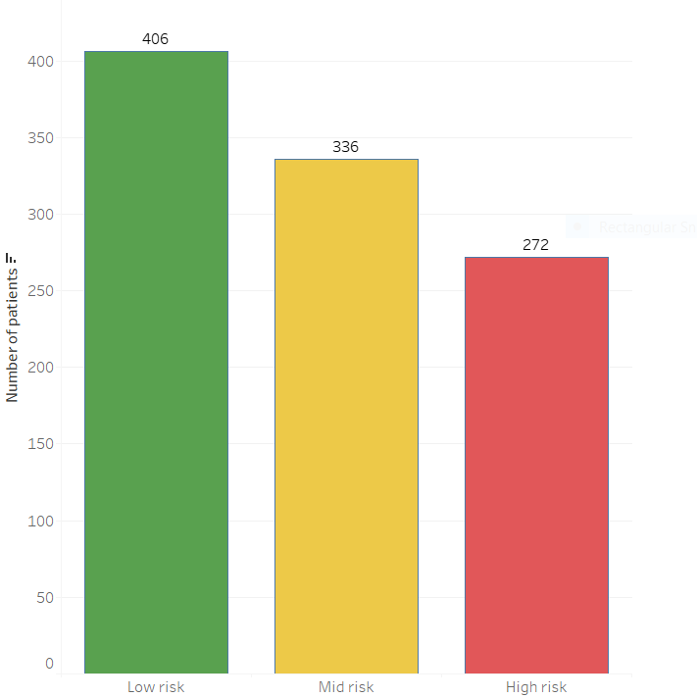
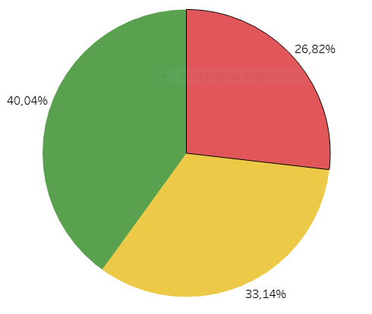

Risk of maternal death
In the dataset we have 1014 patients, 272 (26,82%) of them is at high risk of facing maternal death. 336 (33,14%) is at middle risk, so as you can see the numbers are high.
Risk in Numbers
Risk in Percentage

Slide 4
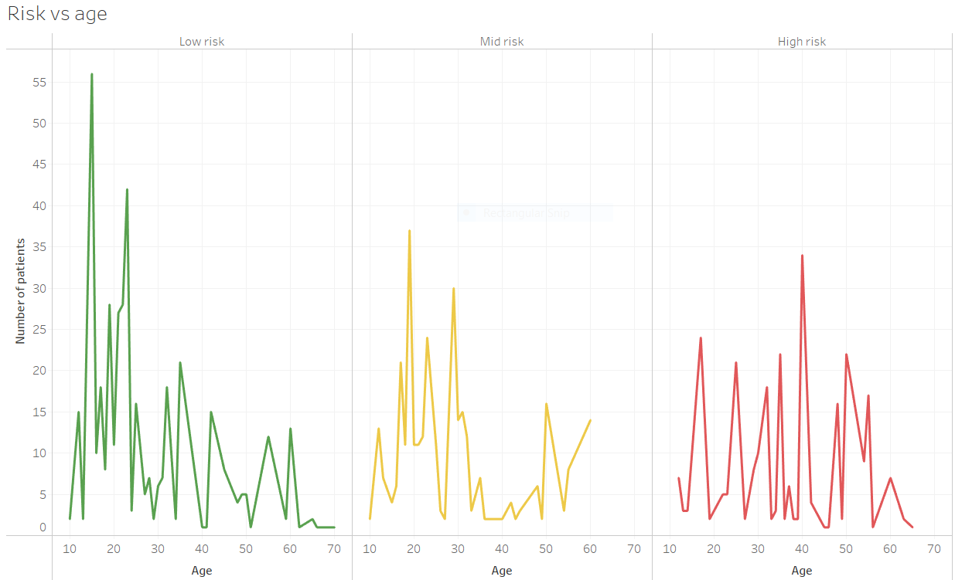
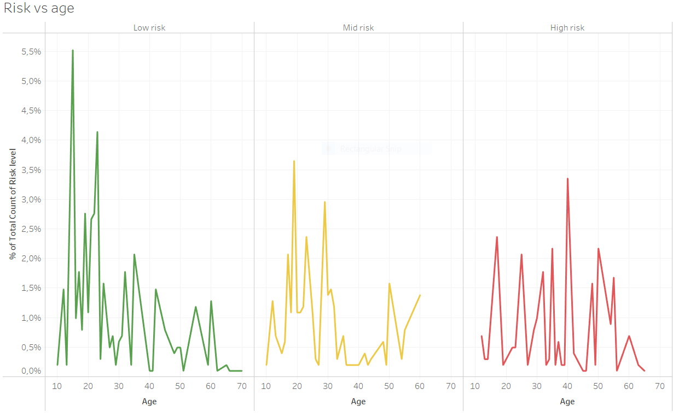
Risk vs age
The range of “Age” is 10-70. At the lowest risk are girls of age 15 (5,523%), at the highest risk are women at age of 40 (3,353%). Because the percentage difference is small, the “Age” doesn’t seem to be a relevant risk factor.

Slide 5
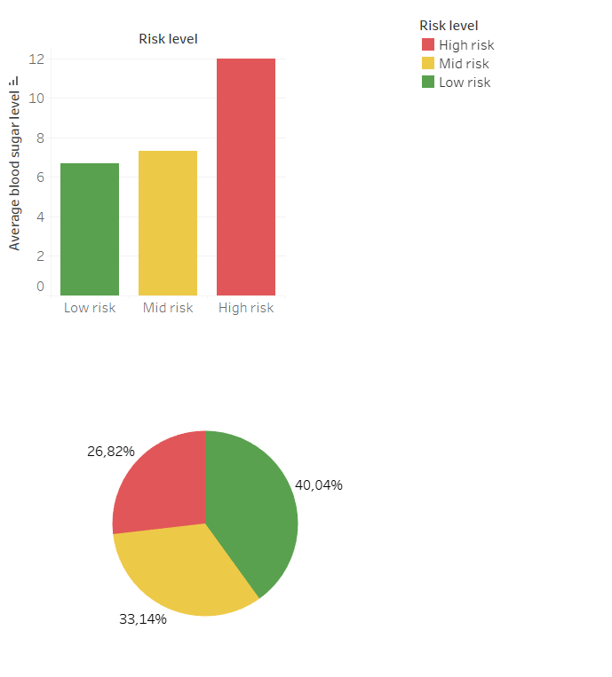
Risk vs blood sugar level
A fasting blood sugar level less than 100 mg/dL (5.6 mmol/L) is normal. A fasting blood sugar level from 100 to 125 mg/dL (5.6 to 6.9 mmol/L) is considered prediabetes. Sugar level over 126 mg/dL (7 mmol/L) is considered as a diabetes.
The dataset shows that patients with high blood sugar level are at a big risk of facing maternal death.
40,04% of patients with normal blood sugars are at low risk.
Blood sugar level seems to be a very important factor in predicting death of the mother.

Slide 6
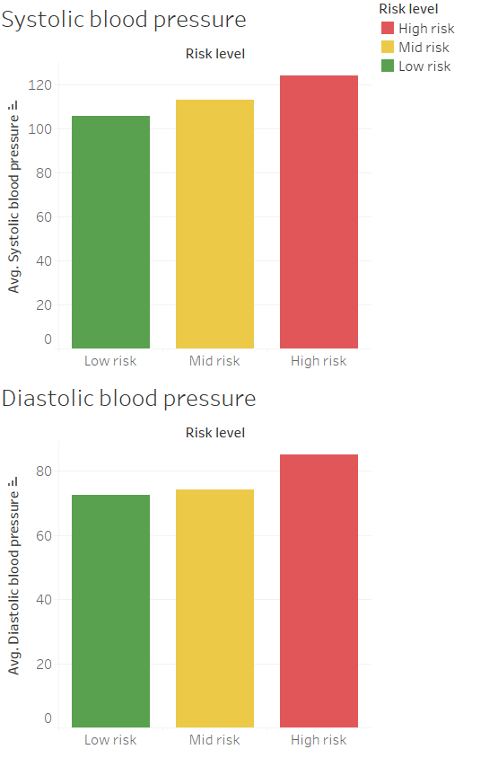
Risk vs blood pressure
Normal blood pressure for most adults is less or 120 mm Hg (systolic) and less or 80 mm Hg (diastolic).
High blood pressure is defined as 130 mm Hg or higher for the systolic pressure, and 90 mm Hg or higher for the diastolic pressure.
From the charts can be seen that the average systolic blood pressure around 105 and diastolic blood pressure around 72 are related to low risk of maternal death.
However, average blood pressures shown in the chart are almost within healthy range: high risk is associated here with average systolic blood pressure around 124 and diastolic bp around 85.

Slide 7
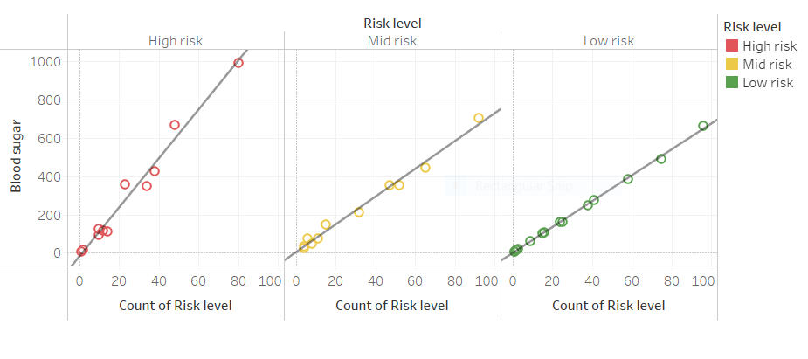
Risk vs blood sugar and diastolic blood pressure
The trend line in case of “low risk” shows strong correlation between low blood sugar level and low risk of maternal death.

Slide 8
Conclusions
From the data set it is pointed out that elevated risk of maternal death is related to high blood sugar levels and elevated blood pressure. Higher blood sugar level is the risk factor number one. These findings might be sufficient to predict survival rate of patients from medical records. The health care staff can use these results as a tool in their job when estimating the risk of maternal death.

Slide 9
Working with dataset
We have imagined that our client is one of the Bangladeshi hospitals and decided to represent the data in a relatively easy way. This helps the client to understand the data better. We have used mainly charts because this way the brain processes the information better. After all we are talking here about human’s life and health and there is no place for data’s misinterpretation.
After checking the dataset, we found out there were not any missing values. It was complete. The data set included 7 columns, 1014 instances. The data were in numerical form. We renamed columns to show better their meaning (e.g., BS renamed into Blood sugar, etc.). After that we could work with a clean and easy to understand dataset.

Slide 10


Thank You
Panagiota & Joanna

