Slide 1

Team Members:
Gourdouros Panagiotis
Karageorgi Tania
Vakouftsis Konstantinos
April 2021

Slide 2
Main Idea
Furnature is an online shopping platform made by a team of furniture designers that decided to contribute to the environment by taking old worn out furniture and use its whole, or parts, in order to design new ones.
The customers can browse freely through their catalogue of products, filtered by category, décor style, or material. In order to fill their carts and then make their purchase, they must first register.
The owners / employees of the furniture company with admin role, can also login into the platform and manipulate the company’s database by adding new products, updating existing ones, adding material / style / category fields or updating existing ones and updating the status of existing orders.
Only the owners of the company have a super-user role and can also add new employees(administrators) and delete or update existing ones.

Slide 3
Features
User register and login
Different views for customer & administrator & super user.
Administrators and super users also have the ability to switch views between customer – admin/super.
Forgot password functionality via e-mail
Customers:
Filter products by 3 main categories (Product category, Décor Style, Materials, each of those having its subcategories)
Add products to Cart and manipulate their quantities.
View their order history
View their address book – add / edit / delete their addresses.
Complete their purchase through PayPal
Chat in a public chat room

Slide 4
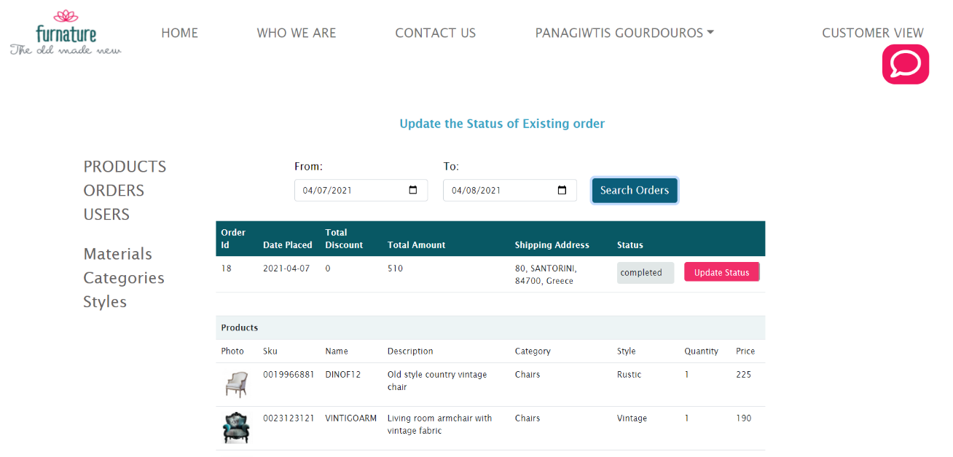
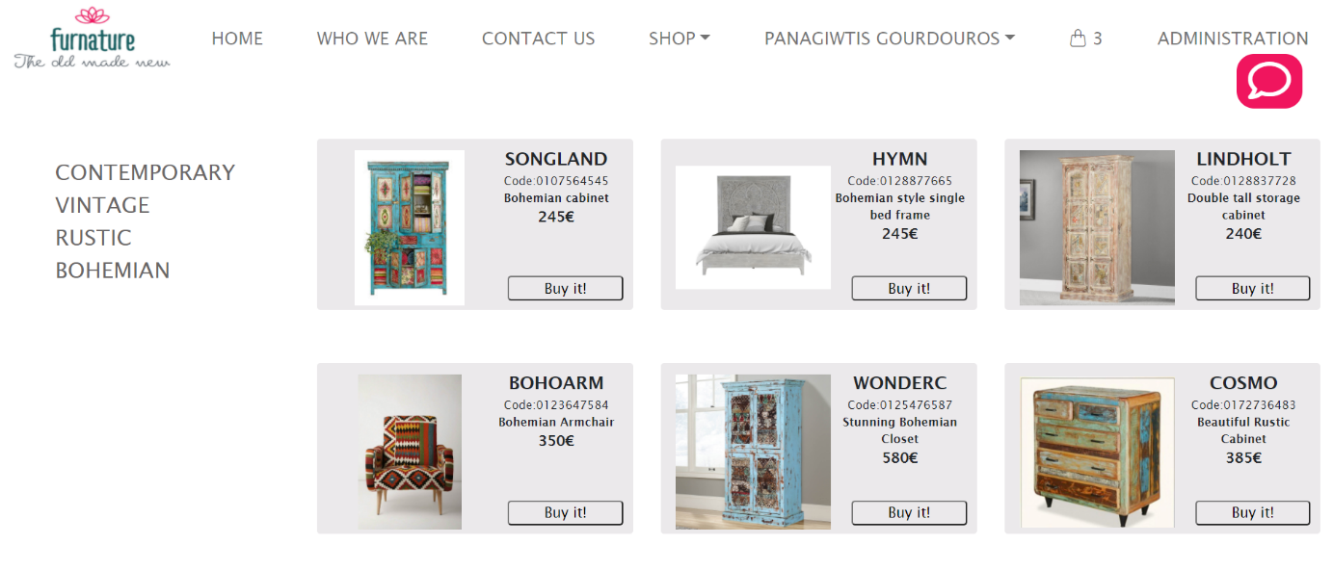
Administrators and super users also have the ability to switch views

Slide 5
Build Technologies
Database
SQL
My SQL Server
Back end
Java
Spring Boot, Spring MVC, Spring Data JPA, Hibernate, Spring Security, Spring WebSocket, Spring Boot DevTools, MySQL Driver
Front end
Html, CSS, JavaScript
Bootstrap, jQuery
Application server
Apache Tomcat
Tools & Protocols
Maven, JavaMailSender, Jbvalidator, SockJS, STOMP, JWT
API’s
WebSocket API, PayPal API

Slide 6
Technologies Not Taught
Login Authentication / Authorization: Json Web Tokens (JWT):
At each login request, Spring produces a special Jwt token and sends it back in the response body to the client.
At each subsequent request from the client: JWT token is sent along in the headers.
Spring Security filters each subsequent request, gets the JWT, checks its validity and allows authorization accordingly.
Front End Validation: jb-validator jquery plugin
Forgot Password Functionality: JavaMailSender Protocol
Customer Checkout: PayPal API (REST)
Public Chat Integration: SockJS, STOMP, WebSocket API

Slide 7
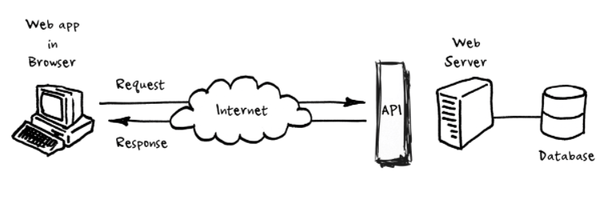
Rest API design
We implemented Rest API Design.
Our project is made of 2 independent Projects:
1. Our FRONT END (Client) project build exclusively with Html/Css/Javascript/ Bootstrap/jquery sending ajax requests to our:
2. BACK END Spring Boot Rest Api, which responds by sending json objects in the response body.

Slide 8
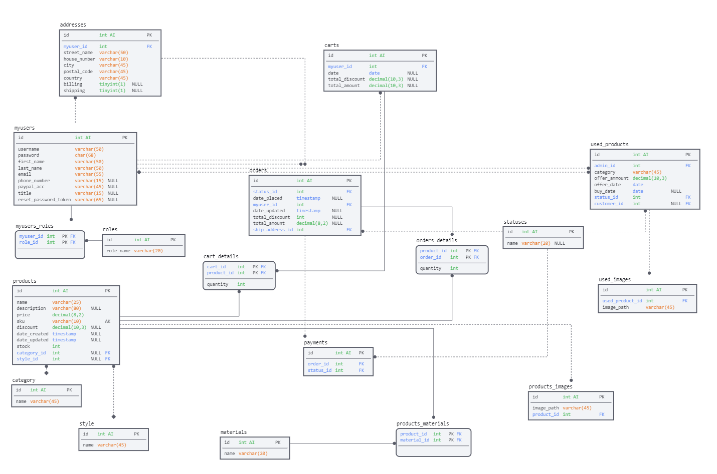
Database End-Schema

Slide 9
Back end Challenges
The main Challenge we faced was to implement everything we had learned so far in the course in a Restful way, making all our Controllers return json objects even when other API’s were involved(eg PayPal).
Another Challenge was to achieve the correct Mapping of our entities as the Database schema and entity relationships were much more complex that what we had learned so far.

Slide 10
Front end Challenges
JSON Responses from the Back End REST API had to be displayed by dynamically creating tables, forms or space elements (divs) that needed to also have dynamic functionality, exclusively done with jquery.
FORM VALIDATION:
Front End validation was done using the jb-validator jquery plugin offering a good user experience.
However this validator works on regular form submit (prevents submit if validation fails).
In our project we used ajax Post requests to submit form data - therefore invalid input was sent despite the front end validation -> back end validation errors
HOW WE HANDLED IT: Back end validation was done using JPA/Hibernate validation annotations above each entity field.
Errors in validation were handled using a specific @ExceptionHandler method in the GlobalExceptionHandler Class.
Specific validation error messages for each entity/input field were sent to the front end client through the response body and displayed under the form fields, thus combining the two validation sides, making sure that only valid input was entered in the database.

Slide 11
Overall, it was a very challenging task and an unforgettable experience, that we all enjoyed!
With Compliments,
The team

