Slide 1

Trust, but Verify Two-Phase Typing for Dynamic Languages
Panagiotis Vekris, Benjamin Cosman, Ranjit Jhala
University of California, San Diego

Slide 2
Scripting Languages – Then
“Perl is the duct tape of the Internet.”
Hassan Schroeder, Sun's first webmaster
“Scripting languages are designed for 'gluing' applications; they use typeless approaches to achieve a higher level of programming and more rapid application development than system programming languages.”
John K. Ousterhout
Notes:
Our main focus in this talk are scripting languages
Scripting languages, like Perl, were originally conceived as a means
of gluing together modules writen the so called system programming languages
One of their main properties was their lack of a static type system,
Which had its merits as it enabled quick prototyping and deployment.

Slide 3










Scripting Languages – Now
Front-end
Server-side
Tooling
Complex reasoning calls for stronger guarantees
Notes:
Nowadays, however, the trend has shifted towards deploying
Large scale applications and building the buiseness logic
Both for the front-end and the back end.
Thats’ why developers have welcomed attempts to provide some
Static guarantees, through type-systemic approaches.
However, the more complex the reasoning, the stronger the need for
Establishing static guarantees

Slide 4
Talk Outline
Goal: Static Verification of Scripting Languages
Notes:
This is the target of this work: static verification of scripting languages
To make this goal more concrete, let’s look at the following example

Slide 5
Program:
Compute index of smallest array element
Goal:
Verify that array accesses within bounds

Slide 6
Program #1: First-order
function minIndexFO(a) {
}

Slide 7
Program #1: First-order
function minIndexFO(a) {
var res = 0;
return res;
}

Slide 8
Program #1: First-order
function minIndexFO(a) {
var res = 0;
for (var i = 0; i < a.length; i++) {
}
return res;
}

Slide 9
Program #1: First-order
function minIndexFO(a) {
var res = 0;
for (var i = 0; i < a.length; i++) {
if (a[i] < a[res])
res = i;
}
return res;
}
Notes:
At the core of the loop, perform a check between the min element so far and the current element and update if necessary.

Slide 10
Program #1: First-order
function minIndexFO(a) {
if (a.length <= 0)
return -1;
var res = 0;
for (var i = 0; i < a.length; i++) {
if (a[i] < a[res])
res = i;
}
return res;
}

Slide 11
Program #1: First-order
function minIndexFO(a) {
if (a.length <= 0)
return -1;
var res = 0;
for (var i = 0; i < a.length; i++) {
if (a[i] < a[res])
res = i;
}
return res;
}
Array bound checks: easy
Dataflow Analysis: 0 ≤ res ≤ i < a.length
Notes:
It is easy for a DF analysis to establish an ordering that proves our goal.

Slide 12
Program #2: Higher-Order
function $reduce(a, f, x) {
var res = x;
for (var i = 0; i < a.length; i++) {
res = f(res, a[i], i);
}
return res;
}
Notes:
A common idiom among JS developers is to abstract the operation
In function like reduce, that takes a function f as an argument and
Calls it in the core of the loop.

Slide 13
Program #2: Higher-Order
function $reduce(a, f, x) {
var res = x;
for (var i = 0; i < a.length; i++) {
res = f(res, a[i], i);
}
return res;
}
function minIndexHO(a) {
if (a.length <= 0) return -1;
function step(min, cur, i) {
return (cur < a[min]) ? i : min;
}
return $reduce(a, step, 0);
}

Slide 14
Challenge: Verify array access
function $reduce(a, f, x) {
var res = x;
for (var i = 0; i < a.length; i++) {
res = f(res, a[i], i);
}
return res;
}
function minIndexHO(a) {
if (a.length <= 0) return -1;
function step(min, cur, i) {
return (cur < a[min]) ? i : min;
}
return $reduce(a, step, 0);
}
Hard to track relational facts among values and closures with DataFlow analyses
Notes:
Being presented with the same challenge in the HO setting
One needs to establish relational facts among values and closures.
And it’s not clear how to do this using data flow analyses

Slide 15
Easy to track relational facts among values and closures with Refinement Types
Notes:
Being presented with the same challenge in the HO setting
One needs to establish relational facts among values and closures.
And it’s not clear how to do this using data flow analyses

Slide 16
Talk Outline
Goal: Static Verification of Scripting Languages
Approach: Refinement Types

Slide 17
“Set of valid indices for array a”
type idx<a> = {v: number | 0 <= v && v < a.length}
type idx<a> = {v: number | 0 <= v && v < a.length}

Slide 18
“Set of valid indices for array a”
type idx<a> = {v: number | 0 <= v && v < a.length}
Base Type

Slide 19
“Set of valid indices for array a”
type idx<a> = {v: number | 0 <= v && v < a.length}
Logical Predicate

Slide 20
“Set of valid indices for array a”
type idx<a> = {v: number | 0 <= v && v < a.length}
Value Variable

Slide 21
“Set of valid indices for array a”
type idx<a> = {v: number | 0 <= v && v < a.length}

Slide 22
Higher-Order Example
function $reduce(a, f, x) {
var res = x;
for (var i = 0; i < a.length; i++)
res = f(res, a[i], i);
return res;
}
Notes:
Going bak to our $reduce example

Slide 23

Higher-Order Type Checking
function $reduce<A,B>(a: A[], f: (B,A,number) => B, x: B): B {
var res = x;
for (var i = 0; i < a.length; i++)
res = f(res, a[i], i);
return res;
}
Notes:
We first apply a typing that a type system like TS would provide

Slide 24
Higher-Order Value Checking
type idx<a> = { v: number | 0 <= v && v < a.length }
function $reduce<A,B>(a: A[], f: (B,A,idx<a>) => B, x: B): B {
var res = x;
for (var i = 0; i < a.length; i++)
res = f(res, a[i], i);
return res;
}
+ Refinements [Xi’99]
Notes:
Crucial prerequisite for refinements, namely that
the language possesses an unrefined static type system
that provides basic invariants about values
which can then be refined using logical predicates.

Slide 25
Type Analysis
Needs
Value Analysis
Notes:
Crucial prerequisite for refinements, namely that
the language possesses an unrefined static type system
that provides basic invariants about values
which can then be refined using logical predicates.

Slide 26
But there is a tricky problem ...

Slide 27
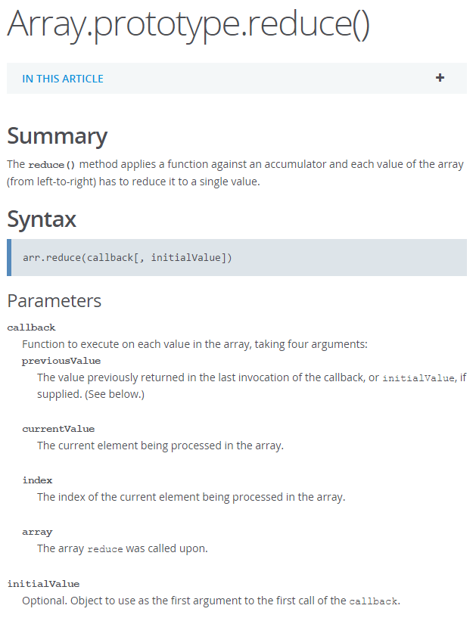

Problem: “Value Based” Overloading
https://developer.mozilla.org/en-US/docs/Web/JavaScript/Reference/Global_Objects/Array/reduce
Notes:
As we can see from the API for the JavaScript Array reduce method,
The second argument of reduce is OPTIONAL
Which lead to the function’s overloaded behavior.
We will address this notion of overloading as Value Based Overloading.

Slide 28
Talk Outline
Goal: Static Verification of Scripting Languages
Approach: Refinement Types
Problem: Value Based Overloading
Notes:
And this is the main problem we are trying to tackle in this work.

Slide 29
Value Based Overloading
function reduce(a, f, x) {
if (arguments.length === 3)
return $reduce(a, f, x);
else
return $reduce(a, f, a[0]);
}
Notes:
To shed more light on this notion,
Here is a potential implementation of reduce,
which dynamically reflects on the number of arguments passed to it
And proceeds differently in each case.

Slide 30
Value Based Overloading
function reduce(a, f, x) {
if (arguments.length === 3)
return $reduce(a, f, x);
else
return $reduce(a, f, a[0]);
}
Type when called with 3 values:
function reduce<A,B>(a: A[], f: (B,A,idx<a>) => B, x: B): B

Slide 31
Value Based Overloading
function reduce(a, f, x) {
if (arguments.length === 3)
return $reduce(a, f, x);
else
return $reduce(a, f, a[0]);
}
Type when called with 3 values:
function reduce<A,B>(a: A[], f: (B,A,idx<a>) => B, x: B): B
Type when called with 2 values:
function reduce<A>(a: A[]⁺, f: (A,A,idx<a>) => A): A

Slide 32
Type Analysis
Needs
Value Analysis

Slide 33
Type Analysis
Needs
Needs
Value Analysis
Notes:
To soundly establish basic typing
we must reason about the logical relationships between values,
which is exactly the problem we wished to solve via refinement typing.

Slide 34
Type Analysis
Needs
Circular Dependency
Needs
Value Analysis
Notes:
A circular dependency,
Which compicated reasoning about programs with Value Based Overloading.

Slide 35
Type Analysis
Needs
Two-Phased Typing
Needs
Value Analysis

Slide 36
Talk Outline
Goal: Static Verification of Scripting Languages
Approach: Refinement Types
Problem: Overloading
Solution: Two-Phased Typing

Slide 37
Two-Phased Typing – Goal
function negate(flag, x) {
if (flag) return 0 - x;
else return !x;
}
(1) If flag ≠ 0 then x: number
(2) If flag = 0 then x: boolean

Slide 38

Two-Phased Typing – Goal
function negate(flag, x) {
if (flag) return 0 - x;
else return !x;
}
(1) If flag ≠ 0 then x: number
(2) If flag = 0 then x: boolean
var ok1 = negate(1, 1);
var ok2 = negate(0, true);

Slide 39

Two-Phased Typing – Goal
function negate(flag, x) {
if (flag) return 0 - x;
else return !x;
}
(1) If flag ≠ 0 then x: number
(2) If flag = 0 then x: boolean
var ok1 = negate(1, 1);
var ok2 = negate(0, true);
var bad1 = negate(0, 1);
var bad2 = negate(1, true);

Slide 40
Two-Phased Typing – Goal
function negate(flag, x) {
if (flag) return 0 - x;
else return !x;
}
(1) If flag ≠ 0 then x: number
(2) If flag = 0 then x: boolean

Slide 41
Specification
type tt = {v: number | v ≠ 0} // "truthy" numbers
type ff = {v: number | v = 0} // "falsy" numbers
function negate(flag, x) {
if (flag) return 0 - x;
else return !x;
}
(1) If flag ≠ 0 then x: number
(2) If flag = 0 then x: boolean

Slide 42
Specification
type tt = {v: number | v ≠ 0} // "truthy" numbers
type ff = {v: number | v = 0} // "falsy" numbers
function negate(flag, x) {
if (flag) return 0 - x;
else return !x;
}
(1) If flag: tt then x: number
(2) If flag: ff then x: boolean

Slide 43
Specification
type tt = {v: number | v ≠ 0} // "truthy" numbers
type ff = {v: number | v = 0} // "falsy" numbers
function negate(flag: tt, x: number): number;
function negate(flag: ff, x: boolean): boolean;
function negate(flag, x) {
if (flag) return 0 - x;
else return !x;
}
Incorporate in negate’s type

Slide 44
Verification
type tt = {v: number | v ≠ 0} // "truthy" numbers
type ff = {v: number | v = 0} // "falsy" numbers
function negate(flag: tt, x: number): number;
function negate(flag: ff, x: boolean): boolean;
function negate(flag, x) {
if (flag) return 0 - x;
else return !x;
}
var ok1 = negate(1, 1);
var ok2 = negate(0, true);
var bad1 = negate(0, 1);
var bad2 = negate(1, true);
(A) Statically check negate’s body
(B) Statically check call-sites

Slide 45

Safe
Two-Phased Typing
Source Program
Unsafe
Notes:
TS + refs → Src
Add extra code box between Trust – Verify, called Target
Bring all the steps up front & number

Slide 46
Safe
Trust
Verify
Source Program
Clone
Cast
Resolve
Cons Gen
Check
Unsafe
Elaborated Program
Notes:
TS + refs → Src
Add extra code box between Trust – Verify, called Target
Bring all the steps up front & number

Slide 47
1st Phase (Trust) – Clone
function negate(flag: tt, x: number): number;
function negate(flag: ff, x: boolean): boolean;
function negate(flag, x) {
if (flag) return 0 - x;
else return !x;
}
Split overloaded functions

Slide 48
1st Phase (Trust) – Clone
function negate#1(flag: tt, x: number): number {
if (flag) return 0 - x;
else return !x;
}
function negate(flag: tt, x: number): number;
function negate(flag: ff, x: boolean): boolean;
function negate(flag, x) {
if (flag) return 0 - x;
else return !x;
}
function negate#2(flag: ff, x: boolean): boolean {
if (flag) return 0 - x;
else return !x;
}
One clone for each conjunct

Slide 49
Safe
Trust
Verify
Source Program
Clone
Cast
Resolve
Cons Gen
Check
Unsafe
Elaborated Program
Notes:
TS + refs → Src
Add extra code box between Trust – Verify, called Target
Bring all the steps up front & number

Slide 50
1st Phase (Trust) – Cast
function negate#1(flag: tt, x: number): number {
if (flag) return 0 - x;
else return !x;
}
function negate#2(flag: ff, x: boolean): boolean {
if (flag) return 0 - x;
else return !x;
}
Check each clone separately

Slide 51
1st Phase (Trust) – Cast
function negate#1(flag: number, x: number): number {
if (flag) return 0 - x;
else return !x;
}
This phase is agnostic to refinements

Slide 52
1st Phase (Trust) – Cast
function negate#1(flag: number, x: number): number {
if (flag) return 0 - x;
else return !x;
}
Path- and value-insensitive checking
Notes:
The trust phase should not have any refinements presentgonebut not forever

Slide 53



1st Phase (Trust) – Cast
function negate#1(flag: number, x: number): number {
if (flag) return 0 - x;
else return !x;
}
Argument of type 'number' is not assignable to parameter of type 'boolean'.
(parameter) x: number
We do not reject the program
Notes:
The trust phase should not have any refinements presentgonebut not forever

Slide 54
1st Phase (Trust) – Cast
function negate#1(flag: number, x: number): number {
if (flag) return 0 - x;
else return !DEAD(x);
}
Wrap erroneous expression in DEAD-cast
function negate#2(flag: number, x: boolean): boolean {
if (flag) return 0 – DEAD(x);
else return !x;
}
declare function DEAD<A,B>({v: A | false}): B;
Similar to assert(false)
Notes:
TODO: say it’s equivalent to assert(false) -- mention DEAD CODE

Slide 55
Safe
Trust
Verify
Source Program
Clone
Cast
Resolve
Cons Gen
Check
Unsafe
Elaborated Program

Slide 56
1st Phase (Trust) – Overload Resolution
function negate#1(flag: tt, x: number): number;
function negate#2(flag: ff, x: boolean): boolean;
var ok1 = negate(1, 1);
var ok2 = negate(0, true);
var bad1 = negate(0, 1);
var bad2 = negate(1, true);
Which overload should be used?

Slide 57
1st Phase (Trust) – Overload Resolution
function negate#1(flag: tt, x: number): number;
function negate#2(flag: ff, x: boolean): boolean;
var ok1 = negate(1, 1);
var ok2 = negate(0, true);
var bad1 = negate(0, 1);
var bad2 = negate(1, true);
Resolve based on base type

Slide 58
1st Phase (Trust) – Overload Resolution
function negate#1(flag: tt, x: number): number;
function negate#2(flag: ff, x: boolean): boolean;
var ok1 = negate#1(1, 1);
var ok2 = negate(0, true);
var bad1 = negate#1(0, 1);
var bad2 = negate(1, true);
Notes:
TODO: Add lines to the resolved overload

Slide 59
1st Phase (Trust) – Overload Resolution
function negate#1(flag: tt, x: number): number;
function negate#2(flag: ff, x: boolean): boolean;
var ok1 = negate#1(1, 1);
var ok2 = negate#2(0, true);
var bad1 = negate#1(0, 1);
var bad2 = negate#2(1, true);
Notes:
TODO: Add lines to the resolved overload

Slide 60
Safe
Trust
Verify
Source Program
Clone
Cast
Resolve
Cons Gen
Check
Unsafe
Elaborated Program

Slide 61
2nd Phase (Verify) – Constraint Generation
Goals:
CG for every clone of negate
CG for call-sites
Notes:
Is the checking of negate+1
Is the checking of call-sites
Remove infer

Slide 62
2nd Phase (Verify) – Constraint Generation
function negate#1(flag: tt, x: number): number {
if (flag) return 0 - x;
else return !DEAD(x);
}
Guards (g)
Environment (Γ)
Flow- and Path-sensitive

Slide 63
2nd Phase (Verify) – Constraint Generation
function negate#1(flag: tt, x: number): number {
if (flag) return 0 - x;
else return !DEAD(x);
}
Guards (g)
Environment (Γ)
flag : {v: number | v ≠ 0}
x : number

Slide 64
2nd Phase (Verify) – Constraint Generation
function negate#1(flag: tt, x: number): number {
if (flag) return 0 - x;
else return !DEAD(x);
}
Guards (g)
Environment (Γ)
flag ≠ 0
flag : {v: number | v ≠ 0}
x : number

Slide 65
2nd Phase (Verify) – Constraint Generation
function negate#1(flag: tt, x: number): number {
if (flag) return 0 - x;
else return !DEAD(x);
}
Guards (g)
Environment (Γ)
flag = 0
flag : {v: number | v ≠ 0}
x : number

Slide 66
2nd Phase (Verify) – Constraint Generation
function negate#1(flag: tt, x: number): number {
if (flag) return 0 - x;
else return !DEAD(x);
}
Guards (g)
Environment (Γ)
flag = 0
flag : {v: number | v ≠ 0}
x : number
declare function DEAD<A,B>({v: A | false}): B;

Slide 67
2nd Phase (Verify) – Constraint Generation
function negate#1(flag: tt, x: number): number {
if (flag) return 0 - x;
else return !DEAD(x);
}
Guards (g)
Environment (Γ)
flag = 0
flag : {v: number | v ≠ 0}
x : number
Γ, g ⊢ {v: number | v = x} ≤ {v: number | false}
declare function DEAD<A,B>({v: A | false}): B;

Slide 68
2nd Phase (Verify) – Constraint Generation
function negate#1(flag: tt, x: number): number {
if (flag) return 0 - x;
else return !DEAD(x);
}
Guards (g)
Environment (Γ)
flag = 0
flag : {v: number | v ≠ 0}
x : number
Γ, g ⊢ {v: number | v = x} ≤ {v: number | false}
To verification condition
Environment and Guards
⇒
LHS
⇒
RHS

Slide 69
2nd Phase (Verify) – Constraint Generation
function negate#1(flag: tt, x: number): number {
if (flag) return 0 - x;
else return !DEAD(x);
}
Guards (g)
Environment (Γ)
flag = 0
flag : {v: number | v ≠ 0}
x : number
Γ, g ⊢ {v: number | v = x} ≤ {v: number | false}
flag ≠ 0
⇒
LHS
⇒
RHS

Slide 70
2nd Phase (Verify) – Constraint Generation
function negate#1(flag: tt, x: number): number {
if (flag) return 0 - x;
else return !DEAD(x);
}
Guards (g)
Environment (Γ)
flag = 0
flag : {v: number | v ≠ 0}
x : number
Γ, g ⊢ {v: number | v = x} ≤ {v: number | false}
flag ≠ 0 ∧ true
⇒
LHS
⇒
RHS

Slide 71
2nd Phase (Verify) – Constraint Generation
function negate#1(flag: tt, x: number): number {
if (flag) return 0 - x;
else return !DEAD(x);
}
Guards (g)
Environment (Γ)
flag = 0
flag : {v: number | v ≠ 0}
x : number
Γ, g ⊢ {v: number | v = x} ≤ {v: number | false}
flag ≠ 0 ∧ true ∧ flag = 0
⇒
LHS
⇒
RHS

Slide 72
2nd Phase (Verify) – Constraint Generation
function negate#1(flag: tt, x: number): number {
if (flag) return 0 - x;
else return !DEAD(x);
}
Guards (g)
Environment (Γ)
flag = 0
flag : {v: number | v ≠ 0}
x : number
Γ, g ⊢ {v: number | v = x} ≤ {v: number | false}
flag ≠ 0 ∧ true ∧ flag = 0
⇒
LHS
⇒
RHS

Slide 73
2nd Phase (Verify) – Constraint Generation
function negate#1(flag: tt, x: number): number {
if (flag) return 0 - x;
else return !DEAD(x);
}
Guards (g)
Environment (Γ)
flag = 0
flag : {v: number | v ≠ 0}
x : number
Γ, g ⊢ {v: number | v = x} ≤ {v: number | false}
flag ≠ 0 ∧ true ∧ flag = 0
⇒
v = x
⇒
RHS

Slide 74
2nd Phase (Verify) – Constraint Generation
function negate#1(flag: tt, x: number): number {
if (flag) return 0 - x;
else return !DEAD(x);
}
Guards (g)
Environment (Γ)
flag = 0
flag : {v: number | v ≠ 0}
x : number
Γ, g ⊢ {v: number | v = x} ≤ {v: number | false}
flag ≠ 0 ∧ true ∧ flag = 0
⇒
v = x
⇒
false

Slide 75
2nd Phase (Verify) – Constraint Generation
Goals:
CG for every clone of negate
CG for call-sites
Notes:
Is the checking of negate+1
Is the checking of call-sites
Remove infer

Slide 76
2nd Phase (Verify) – Constraint Generation
function negate#1(flag: tt, x: number): number {
...
}
var ok1 = negate#1(1, 1);
var bad1 = negate#1(0, 1);

Slide 77
2nd Phase (Verify) – Constraint Generation
function negate#1(flag: tt, x: number): number {
...
}
var ok1 = negate#1(1, 1);
var bad1 = negate#1(0, 1);
⊢ {v: number | v = 1} ≤ {v: number | v ≠ 0}

Slide 78
2nd Phase (Verify) – Constraint Generation
function negate#1(flag: tt, x: number): number {
...
}
var ok1 = negate#1(1, 1);
var bad1 = negate#1(0, 1);
⊢ {v: number | v = 1} ≤ {v: number | v ≠ 0}
⊢ {v: number | v = 1} ≤ {v: number | true }

Slide 79
2nd Phase (Verify) – Constraint Generation
function negate#1(flag: tt, x: number): number {
...
}
var ok1 = negate#1(1, 1);
var bad1 = negate#1(0, 1);
⊢ {v: number | v = 1} ≤ {v: number | v ≠ 0}
⊢ {v: number | v = 1} ≤ {v: number | true }
⊢ {v: number | v = 0} ≤ {v: number | v ≠ 0}
⊢ {v: number | v = 1} ≤ {v: number | true }

Slide 80
2nd Phase (Verify) – Constraint Generation
function negate#1(flag: tt, x: number): number {
...
}
var ok1 = negate#1(1, 1);
var bad1 = negate#1(0, 1);
v = 1 ⇒ v ≠ 0
v = 1 ⇒ true
v = 0 ⇒ v ≠ 0
v = 1 ⇒ true
To logical implications

Slide 81
Safe
Trust
Verify
Source Program
Clone
Cast
Resolve
Cons Gen
Check
Unsafe
Elaborated Program

Slide 82

2nd Phase (Verify) – Check
negate’s body
flag ≠ 0 ∧ true ∧ flag = 0
⇒
v = x
⇒
false
v = 1
⇒
v ≠ 0
ok1
v = 1
⇒
true
v = 0
⇒
v ≠ 0
bad1
v = 1
⇒
true
SMT Solver

Slide 83
Benefits over previous work
Expressive Specification (Flow Typing, Typed Scheme) Refinements capture complex value relationships
Automated Verification (Dependent JavaScript) Compose simple type-checkers with program logics
End-To-End Soundness Semantics preserving elaboration
Notes:
Expressive Specification – compared to Flow typing, Typed Scheme
Fixed set of type-testing idoms, instead of general value based overloading
Automated Verification
Two-phase typing allows us to compose basic typing
with abstract interpretation,
which drastically lowers the annotation burden
for using refinement types

Slide 84
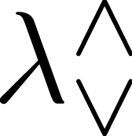
Source
Value-based overloading:
Intersections
Untagged unions

Slide 85
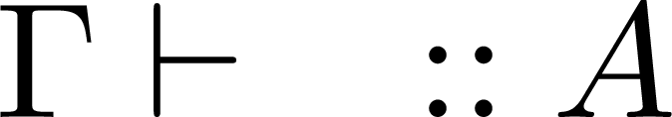

Source
Value-based overloading:
Intersections
Untagged unions
Base type-checking (Trust)

Slide 86
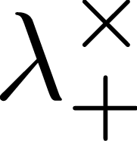
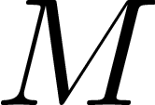

Source
Target
Value-based overloading:
Intersections
Untagged unions
Products
Tagged unions
DEAD-casts
Elaboration [Dunfield’12]
Notes:
The source expression e is elaborated to a target M
That belongs to a language witout value based overloading
Instead the language has products, tagged unions and DEAD-casts

Slide 87
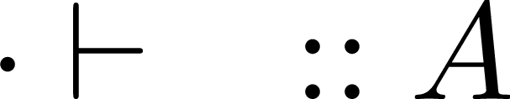



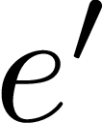
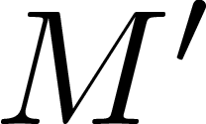
Notes:
TODO: simplify to single stepping op e → e’ and M → M’
Title: Elaboration preserves semantics

Slide 88
Elaboration Preserves Semantics
Notes:
TODO: simplify to single stepping op e → e’ and M → M’
Title: Elaboration preserves semantics

Slide 89
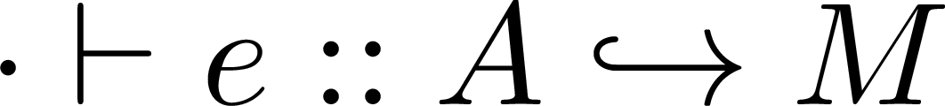
End-to-End Type Safety
Base type-checking (Trust)
Notes:
Before we introduce our soundness result, we make a definition

Slide 90
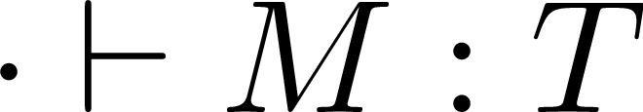
End-to-End Type Safety
Base type-checking (Trust)
Refinement type-checking (Verify)
Notes:
Before we introduce our soundness result, we make a definition

Slide 91
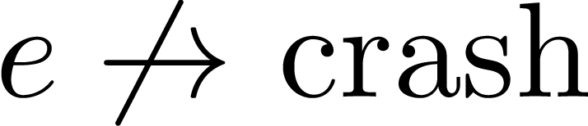
End-to-End Type Safety
Base type-checking (Trust)
Refinement type-checking (Verify)
Notes:
Before we introduce our soundness result, we make a definition

Slide 92
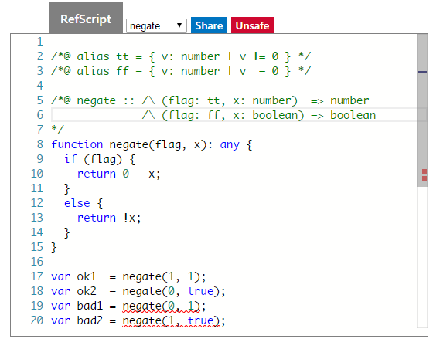
Future Work
Foundation of refinement type-checker for TypeScript
OO Features (imperative code, mutation etc)

Slide 93
Trust, but Verify
Goal: Static Verification of Scripting Languages
Approach: Refinement Types
Problem: Overloading
Solution: Two-Phased Typing
Results: Elaboration Equivalence & Soundness
Thank you! Questions?

