Slide 1
COMP791A: Statistical Language Processing
Collocations
Chap. 5

Slide 2
A collocation…
is an expression of 2 or more words that correspond to a conventional way of saying things.
  broad daylight
  Why not? ?bright daylight or ?narrow darkness
  Big mistake but not ?large mistake
overlap with the concepts of:
  terms, technical terms & terminological phrases
    Collocations extracted form technical domains
      Ex: hydraulic oil filter, file transfer protocol

Slide 3
Examples of Collocations
  strong tea
  weapons of mass destruction
  to make up
  to check in
  heard it through the grapevine
  he knocked at the door
  I made it all up

Slide 4
Definition of a collocation
(Choueka, 1988)
  [A collocation is defined as] “a sequence of two or more consecutive words, that has characteristics of a syntactic and semantic unit, and whose exact and unambiguous meaning or connotation cannot be derived directly from the meaning or connotation of its components."
Criteria:
  non-compositionality
  non-substitutability
  non-modifiability
  non-translatable word for word

Slide 5
Non-Compositionality
A phrase is compositional if its meaning can be predicted from the meaning of its parts
Collocations have limited compositionality
  there is usually an element of meaning added to the combination
  Ex: strong tea
Idioms are the most extreme examples of non-compositionality
  Ex: to hear it through the grapevine

Slide 6
Non-Substitutability
We cannot substitute near-synonyms for the components of a collocation.
  Strong is a near-synonym of powerful
    strong tea ?powerful tea
  yellow is as good a description of the color of white wines
    white wine ?yellow wine

Slide 7
Non-modifiability
Many collocations cannot be freely modified with additional lexical material or through grammatical transformations
  weapons of mass destruction --> ?weapons of massive destruction
  to be fed up to the back teeth --> ?to be fed up to the teeth in the back

Slide 8
Non-translatable (word for word)
English:
  make a decision ?take a decision
French:
  ?faire une décision prendre une décision
to test whether a group of words is a collocation:
  translate it into another language
  if we cannot translate it word by word
  then it probably is a collocation

Slide 9
Linguistic Subclasses of Collocations
Phrases with light verbs:
  Verbs with little semantic content in the collocation
  make, take, do…
Verb particle/phrasal verb constructions
  to go down, to check out,…
Proper nouns
  John Smith
Terminological expressions
  concepts and objects in technical domains
  hydraulic oil filter

Slide 10
Why study collocations?
In NLG
  The output should be natural
    make a decision ?take a decision
In lexicography
  Identify collocations to list them in a dictionary
  To distinguish the usage of synonyms or near-synonyms
In parsing
  To give preference to most natural attachments
    plastic (can opener) ? (plastic can) opener
In corpus linguistics and psycholinguists
  Ex: To study social attitudes towards different types of substances
    strong cigarettes/tea/coffee
    powerful drug

Slide 11
A note on (near-)synonymy
To determine if 2 words are synonyms-- Principle of substitutability:
  2 words are synonym if they can be substituted for one another in some?/any? sentence without changing the meaning or acceptability of the sentence
    How big/large is this plane?
    Would I be flying on a big/large or small plane?
    Miss Nelson became a kind of big / ?? large sister to Tom.
    I think I made a big / ?? large mistake.

Slide 12
A note on (near-)synonymy (con’t)
True synonyms are rare...
Depend on:
  shades of meaning:
    words may share central core meaning but have different sense accents
  register/social factors
    speaking to a 4-yr old VS to graduate students!
  collocations:
    conventional way of saying something / fixed expression

Slide 13
Approaches to finding collocations
Frequency
Mean and Variance
Hypothesis Testing
  t-test
  χ²-test
Mutual Information

Slide 14
Approaches to finding collocations
--> Frequency
Mean and Variance
Hypothesis Testing
  t-test
  χ²-test
Mutual Information

Slide 15
Frequency
(Justeson & Katz, 1995)
Hypothesis:
  if 2 words occur together very often, they must be interesting candidates for a collocation
Method:
  Select the most frequently occurring bigrams (sequence of 2 adjacent words)

Slide 16
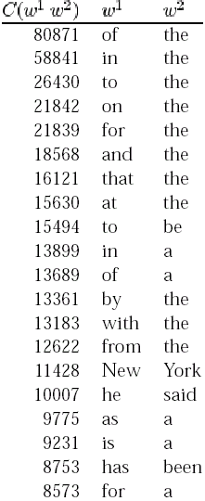
Results
Not very interesting…
Except for “New York”, all bigrams are pairs of function words
So, let’s pass the results through a part-of- speech filter
Tag Pattern
Example
A N
linear function
N N
regression coefficient
A A N
Gaussian random variable
A N N
cumulative distribution function
N A N
mean squared error
N N N
class probability function
N P N
degrees of freedom

Slide 17
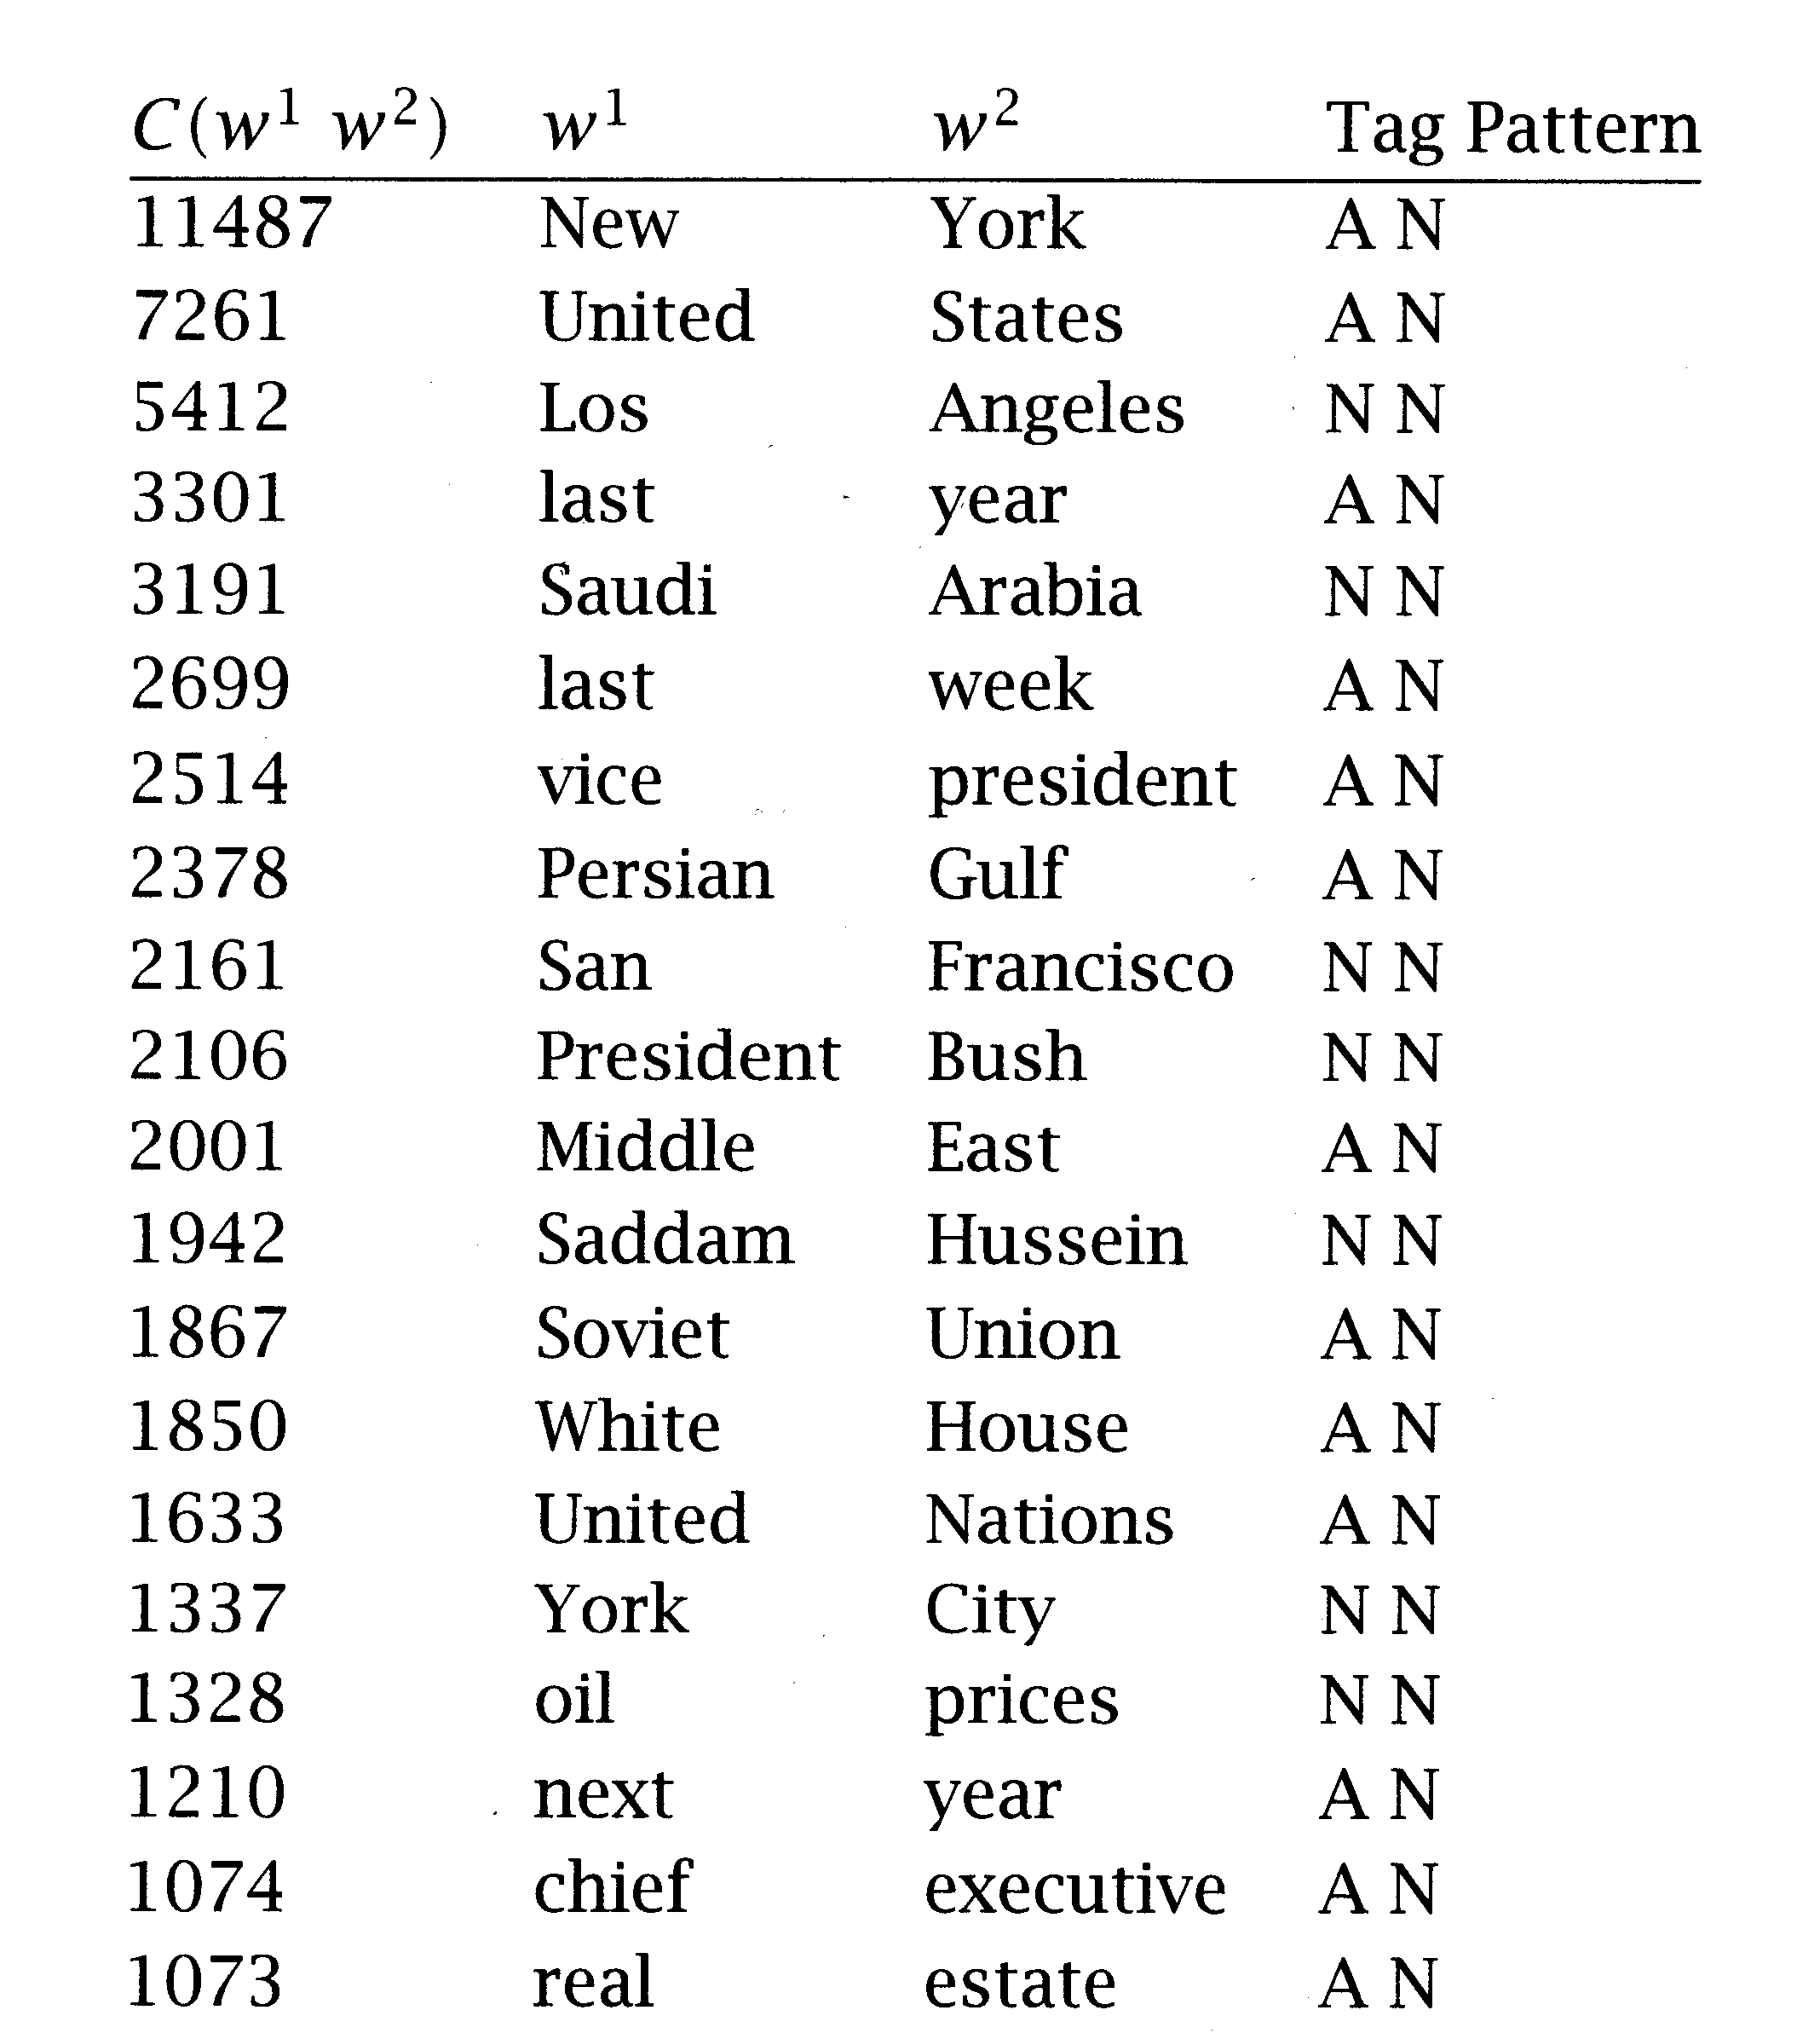
Frequency + POS filter
Simple method that works very well

Slide 18
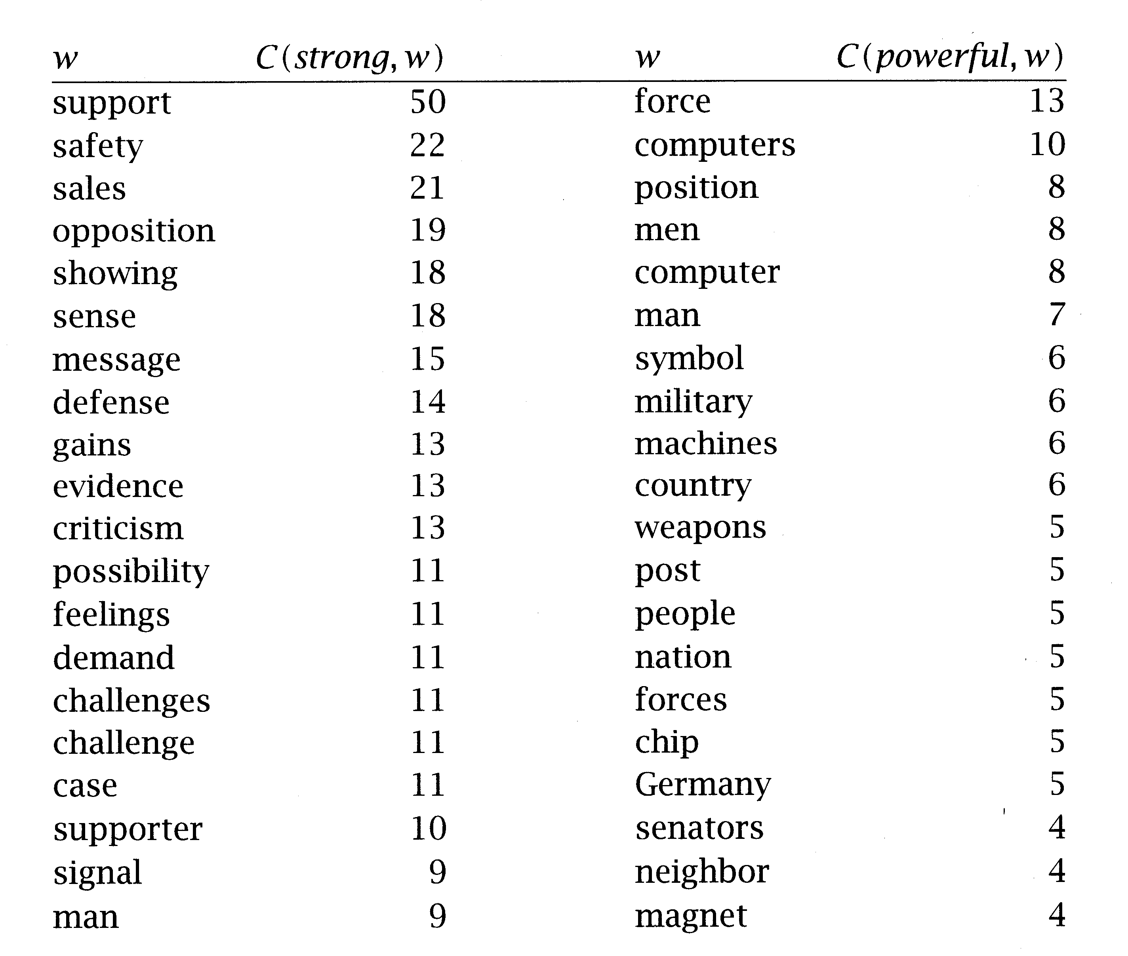
“Strong” versus “powerful”
On a 14 million word corpus from the New-York Times (Aug.-Nov. 1990)

Slide 19
Frequency: Conclusion
Advantages:
  works well for fixed phrases
  Simple method & accurate result
  Requires small linguistic knowledge
But: many collocations consist of two words in more flexible relationships
  she knocked on his door
  they knocked at the door
  100 women knocked on Donaldson’s door
  a man knocked on the metal front door

Slide 20
Approaches to finding collocations
Frequency
--> Mean and Variance
Hypothesis Testing
  t-test
  χ²-test
Mutual Information

Slide 21
Mean and Variance
(Smadja et al., 1993)
Looks at the distribution of distances between two words in a corpus
looking for pairs of words with low variance
  A low variance means that the two words usually occur at about the same distance
  A low variance --> good candidate for collocation
Need a Collocational Window to capture collocations of variable distances
knock
door
knock
door

Slide 22
Collocational Window
This is an example of a three word window.
To capture 2-word collocations
  this is this an
  is an is example
  an example an if
  example if example a
  of a of three
  a three a word
  three word three window
  word window

Slide 23
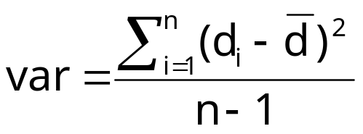

Mean and Variance (con’t)
The mean is the average offset (signed distance) between two words in a corpus
The variance measures how much the individual offsets deviate from the mean 
    n is the number of times the two words (two candidates) co-occur
    d_{i} is the offset of the i^{th} pair of candidates
    is the mean offset of all pairs of candidates
If offsets (d_{i}) are the same in all co-occurrences
  --> variance is zero
  --> definitely a collocation
If offsets (d_{i}) are randomly distributed
  --> variance is high
  --> not a collocation

Slide 24
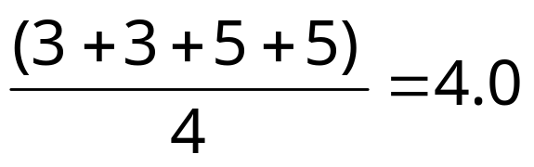
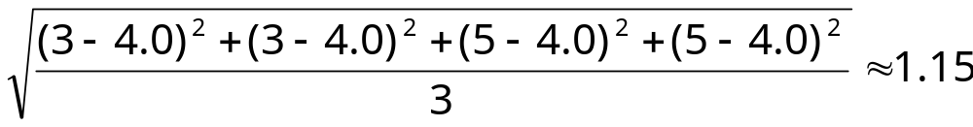
An Example
window size = 11 around knock (5 left, 5 right)
  she knocked on his door
  they knocked at the door
  100 women knocked on Donaldson’s door
  a man knocked on the metal front door
Mean d =
Std. deviation s =

Slide 25
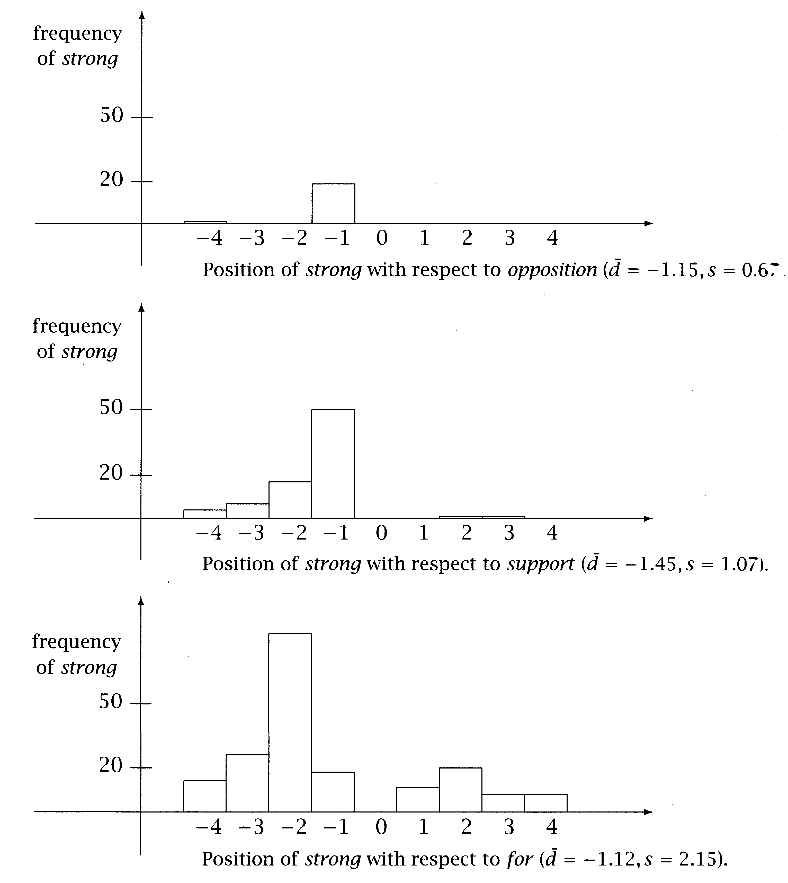
Position histograms
“strong…opposition”
  variance is low
  --> interesting collocation
“strong…support”
“strong…for”
  variance is high
  --> not interesting collocation

Slide 26
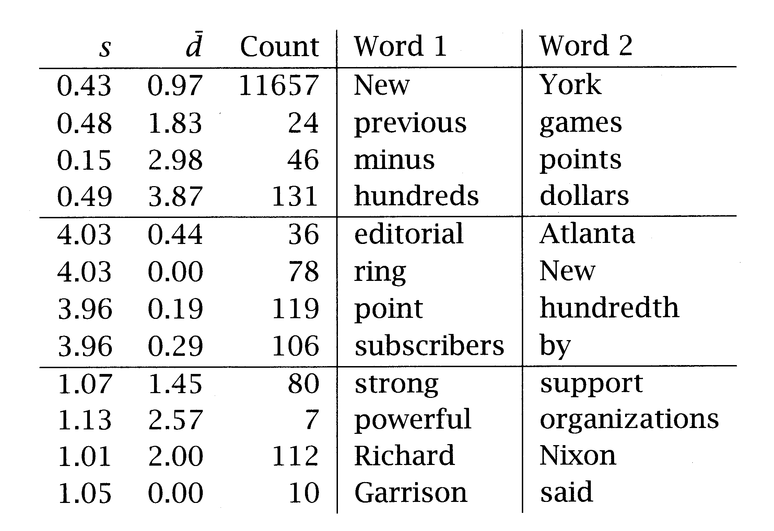
Mean and variance versus Frequency
std. dev. ~0 & mean offset ~1 --> would be found by frequency method
std. dev. ~0 & high mean offset --> very interesting, but would not be found by frequency method
high deviation --> not interesting

Slide 27
Mean & Variance: Conclusion
good for finding collocations that have:
  looser relationship between words
  intervening material and relative position

Slide 28
Approaches to finding collocations
Frequency
Mean and Variance
--> Hypothesis Testing
  t-test
  χ²-test
Mutual Information

Slide 29
Hypothesis Testing
If 2 words are frequent… they will frequently occur together…
Frequent bigrams and low variance can be accidental (two words can co-occur by chance)
We want to determine whether the co-occurrence is random or whether it occurs more often than chance
This is a classical problem in statistics called Hypothesis Testing
  When two words co-occur, Hypothesis Testing measures how confident we have that this was due to chance or not

Slide 30
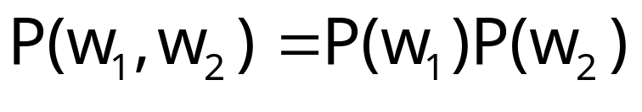
Hypothesis Testing (con’t)
We formulate a null hypothesis H₀
  H₀ : no real association (just chance…)
  H₀ states what should be true if two words do not form a collocation
  if 2 words w₁ and w₂ do not form a collocation, then w₁ and w₂ are independently of each other:
We need a statistical test that tells us how probable or improbable it is that a certain combination occurs
Statistical tests:
  t test
  χ² test

Slide 31
Approaches to finding collocations
Frequency
Mean and Variance
Hypothesis Testing
  --> t-test
  χ²-test
Mutual Information

Slide 32
Hypothesis Testing: the t-test
(or Student's t-test)
H₀ states that:
We calculate the probability p-value that a collocation would occur if H₀ was true
If p-value is too low, we reject H₀
  Typically if under a significant level of p < 0.05, 0.01, or 0.001
Otherwise, retain H₀ as possible

Slide 33
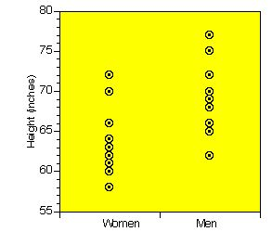
Some intuition
H_{o}: women and men are equally tall, on average
We gather data from 10 men and 10 women
Assume we want to compare the heights of men and women
we cannot measure the height of every adult…
so we take a sample of the population
and make inferences about the whole population
by comparing the sample means and the variation of each mean

Slide 34
Some intuition (con't)
t-test compares:
  the sample mean (computed from observed values)
  to a expected mean
determines the likelihood (p-value) that the difference between the 2 means occurs by chance.
  a p-value close to 1 --> it is very likely that the expected and sample means are the same
  a small p-value (ex: 0.01) --> it is unlikely (only a 1 in 100 chance) that such a difference would occur by chance
so the lower the p-value --> the more certain we are that there is a significant difference between the observed and expected mean, so we reject H₀

Slide 35
Some intuition (con’t)
t-test assigns a probability to describe the likelihood that the null hypothesis is true
high p-value --> Accept Ho
Accept Ho
low p-value --> Reject Ho
Reject Ho
Reject Ho
frequency
frequency
0
value of t
0
value of t
Critical value c (value of t where we decide to reject Ho)
Confidence level  = probability that t-score > critical value c
t distribution (1-tailed)
t distribution (2-tailed)

Slide 36
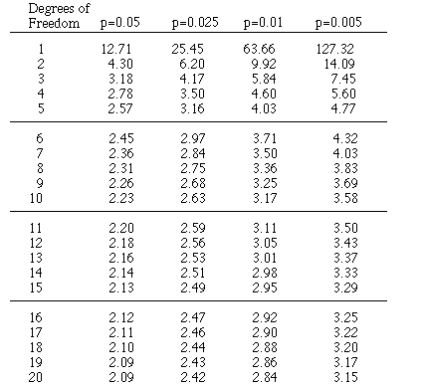
Some intuition (con’t)
Compute t score
Consult the table of critical values with df = 18 (10+10-2)
If t > critical value (value in table), then the 2 samples are significantly different at the probability level that is listed
Assume t=2.7
if there is no difference in height between women and men (H₀ is true) then the probability of finding t=2.7 is between 0.025 & 0.01
… that’s not much…
so we reject the null hypothesis H₀
and conclude that there is a difference in height between men and woman
Probability table based on the t distribution
(2-tailed test)

Slide 37
The t-Test
looks at the mean and variance of a sample of measurements
the null hypothesis is that the sample is drawn from a distribution with mean μ
The test :
  looks at the difference between the observed and expected means, scaled by the variance of the data
  tells us how likely one is to get a sample of that mean and variance
  assuming that the sample is drawn from a normal distribution with mean μ.

Slide 38
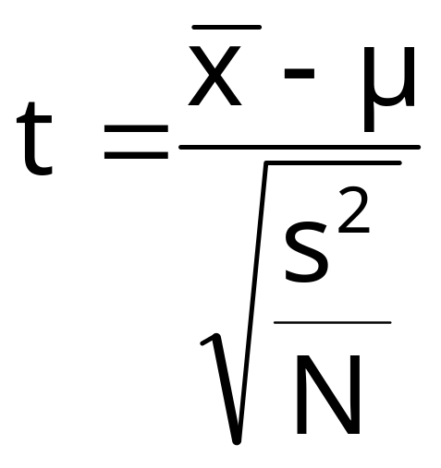

The t-Statistic
Difference between the observed mean and the expected mean
is the sample mean
μ is the expected mean of the distribution
s² is the sample variance
N is the sample size
the higher the value of t, the greater the confidence that:
  there is a significant difference
  it’s not due to chance
  the 2 words are not independent

Slide 39
t-Test for finding Collocations
We think of a corpus of N words as a long sequence of N bigrams
the samples are seen as random variables that:
  take the value 1 when the bigram of interest occurs
  take the value 0 otherwise

Slide 40
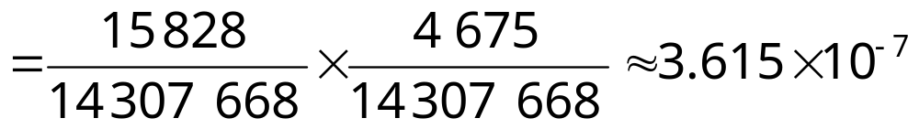
t-Test: Example with collocations
In a corpus:
  new occurs 15,828 times
  companies occurs 4,675 times
  new companies occurs 8 times
  there are 14,307,668 tokens overall
Is new companies a collocation?
Null hypothesis:
  Independence assumption
  P(new companies) = P(new) P(companies)

Slide 41
Example (Cont.)
If the null hypothesis is true, then:
  if we randomly generate bigrams of words
  assign 1 to the outcome new companies
  assign 0 to any other outcome
  …in effect a Bernoulli trial
  then the probability of having new companies is expected to be 3.615 x 10⁻⁷
  So the expected mean is μ = 3.615 x 10⁻⁷
  The variance s² = p(1-p) ≈ p since for most bigrams p is small
    in binomial distribution: s² = np(1-p) … but here, n=1

Slide 42
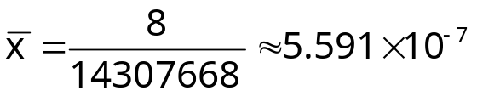
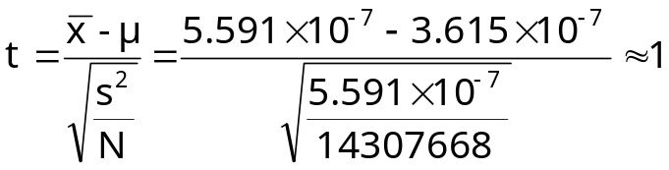
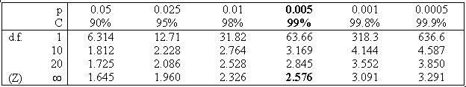
Example (Cont.)
But we counted 8 occurrences of the bigram new companies
So the observed mean is
By applying the t-test, we have:
With a confidence level =0.005, critical value is 2.576 (t should be at least 2.576)
Since t=1 < 2.576
  we cannot reject the H_{o}
  so we cannot claim that new and companies form a collocation

Slide 43
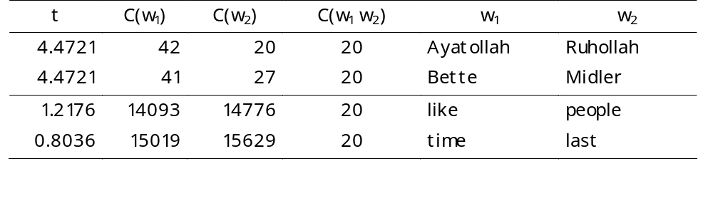
t test: Some results
t test applied to 10 bigrams that occur with frequency = 20
Notes:
  Frequency-based method could not have seen the difference in these bigrams, because they all have the same frequency
  the t test takes into account the frequency of a bigram relative to the frequencies of its component words
    If a high proportion of the occurrences of both words occurs in the bigram, then its t is high.
  The t test is mostly used to rank collocations
pass the t-test (t > 2.756) so:
we can reject the null hypothesis
  so they form collocation
fail the t-test (t < 2.756) so:
  we cannot reject the null hypothesis
  so they do not form a collocation

Slide 44
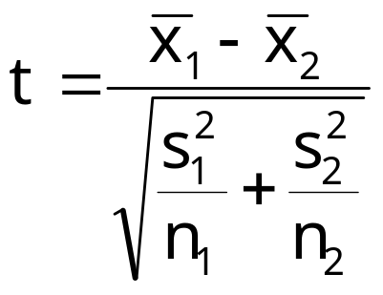


Hypothesis testing of differences
Used to see if 2 words (near-synonyms) are used in the same context or not
  “strong” vs “powerful”
can be useful in lexicography
we want to test:
  if there is a difference in 2 populations
    Ex: height of woman / height of man
  the null hypothesis is that there is no difference
  i.e. the average difference is 0 (μ =0)
is the sample mean of population 1
is the sample mean of population 2
s₁² is the sample variance of population 1
s₂² is the sample variance of population 2
n₁ is the sample size of population 1
n₂ is the sample size of population 2

Slide 45
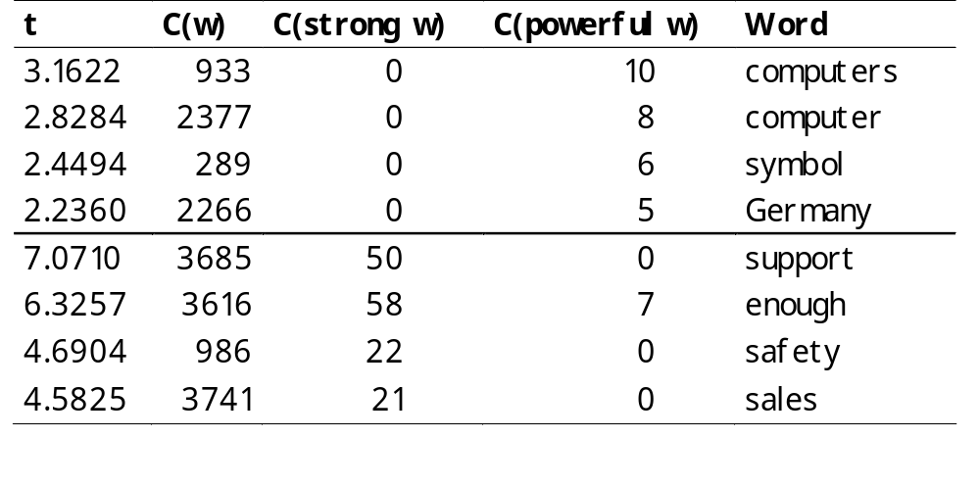
Difference test example
Is there a difference in how we use “powerful” and how we use “strong”?

Slide 46
Approaches to finding collocations
Frequency
Mean and Variance
Hypothesis Testing
  t-test
  --> χ²-test
Mutual Information

Slide 47
Hypothesis testing: the χ²-test
problem with the t test is that it assumes that probabilities are approximately normally distributed…
the χ²-test does not make this assumption
The essence of the χ²-test is the same as the t-test
  Compare observed frequencies and expected frequencies for independence
  if the difference is large
  then we can reject the null hypothesis of independence

Slide 48
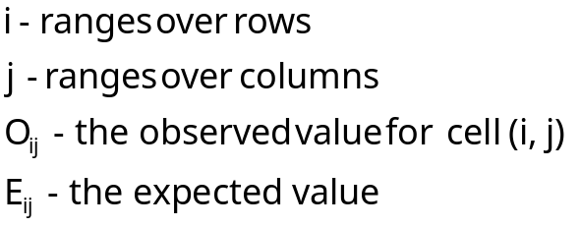
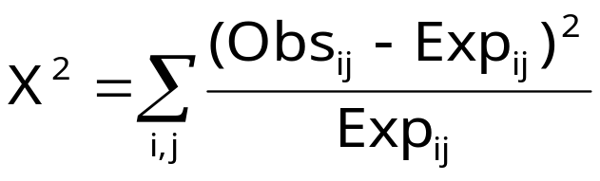
χ²-test
In its simplest form, it is applied to a 2x2 table of observed frequencies
The χ² statistic:
  sums the differences between observed frequencies (in the table)
  and expected values for independence
  scaled by the magnitude of the expected values:

Slide 49
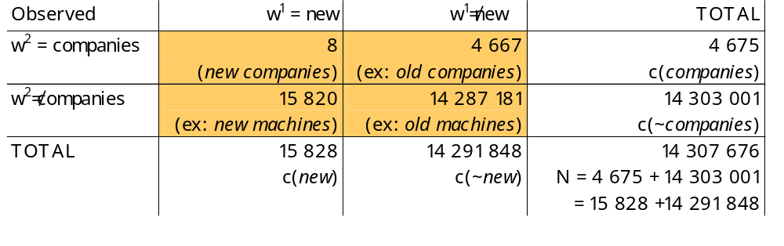
χ²-test- Example
Observed frequencies Obs_{ij}

Slide 50
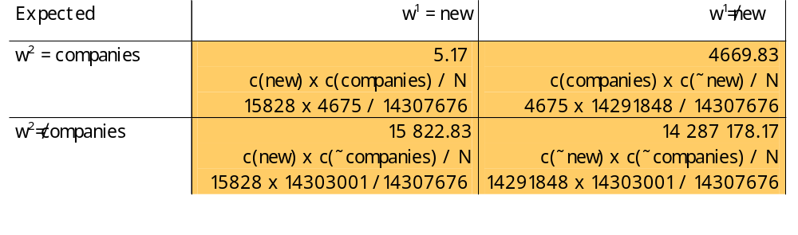
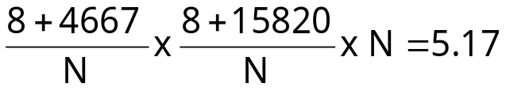
χ²-test- Example (con’t)
Expected frequencies Exp_{ij}
  If independence
  Computed from the marginal probabilities (the totals of the rows and columns converted into proportions)
  Ex: expected frequency for cell (1,1) (new companies)
    marginal probability of new occurring as the first part of a bigram times marginal probability of companies occurring as the second part of bigram:
  If “new” and “companies” occurred completely independent of each other
  we would expect 5.17 occurrences of “new companies” on average

Slide 51
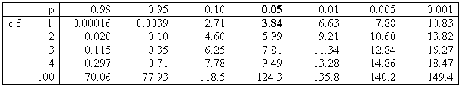
χ²-test- Example (con’t)
But is the difference significant?
  df in an nxc table = (n-1)(c-1) = (2-1)(2-1) =1 (degrees of freedom)
The probability level of α=0.05 the critical value is 3.84
Since 1.55 < 3.84:
  So we cannot reject H₀ (that new and companies occur independently of each other)
  So new companies is not a good candidate for a collocation

Slide 52
χ²-test: Conclusion
Differences between the t statistic and χ² statistic do not seem to be large
But:
  the χ² test is appropriate for large probabilities
    where t test fails because of the normality assumption
  the χ² is not appropriate with sparse data (if numbers in the 2 by 2 tables are small)
χ² test has been applied to a wider range of problems
  Machine translation
  Corpus similarity

Slide 53
χ²-test for machine translation
(Church & Gale, 1991)
To identify translation word pairs in aligned corpora
Ex:
χ² = 456 400 >> 3.84 (with α= 0.05)
So “vache” and “cow” are not independent… and so are translations of each other
Nb of aligned sentence pairs containing “cow” in English and “vache” in French
Observed frequency | “cow” | ~”cow” | TOTAL
“vache” | 59 | 6 | 65
~”vache” | 8 | 570 934 | 570 942
TOTAL | 67 | 570 940 | 571 007

Slide 54
χ²-test for corpus similarity
(Kilgarriff & Rose, 1998)
Ex:
Compute χ² for the 2 populations (corpus1 and corpus2)
H_{o}: the 2 corpora have the same word distribution
Observed frequency | Corpus 1 | Corpus 2 | Ratio
Word1 | 60 | 9 | 60/9 =6.7
Word2 | 500 | 76 | 6.6
Word3 | 124 | 20 | 6.2
… | … | … | …
Word500 | … | … | …

Slide 55
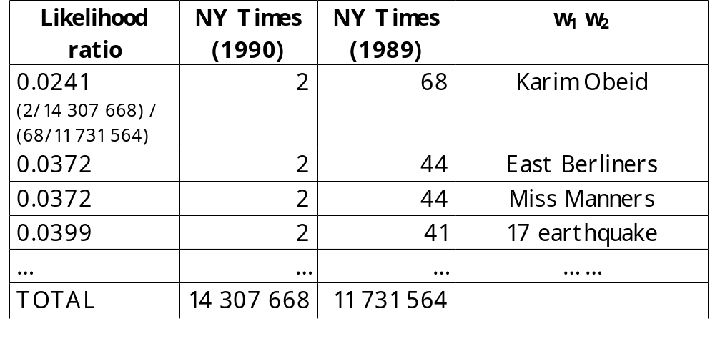
Collocations across corpora
Ratios of relative frequencies between two or more different corpora
can be used to discover collocations that are characteristic of a corpus when compared to other corpus

Slide 56
Collocations across corpora (con’t)
most useful for the discovery of subject-specific collocations
  Compare a general text with a subject-specific text
  words and phrases that (on a relative basis) occur most often in the subject-specific text are likely to be part of the vocabulary that is specific to the domain

Slide 57
Approaches to finding collocations
Frequency
Mean and Variance
Hypothesis Testing
  t-test
  χ²-test
--> Mutual Information

Slide 58
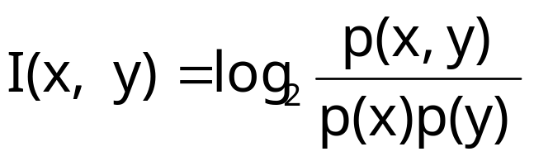
Pointwise Mutual Information
Uses a measure from information-theory
Pointwise mutual information between 2 events x and y (in our case the occurrence of 2 words) is roughly:
  a measure of how much one event (word) tells us about the other
  or a measure of the independence of 2 events (or 2 words)
    If 2 events x and y are independent, then I(x,y) = 0

Slide 59
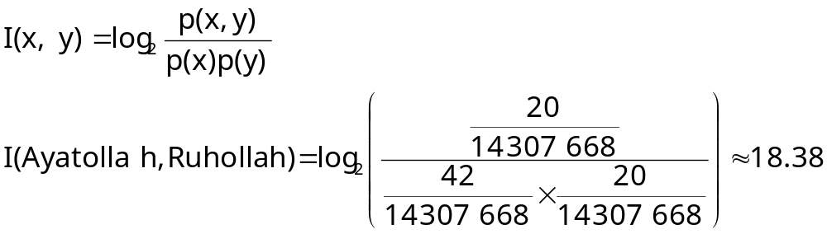
Example
Assume:
  c(Ayatollah) = 42
  c(Ruhollah) = 20
  c(Ayatollah, Ruhollah) = 20
  N = 143 076 668
Then:
So? The occurrence of “Ayatollah” at position i increases by 18.38bits if “Ruhollah” occurs at position i+1
works particularly badly with sparse data

Slide 60
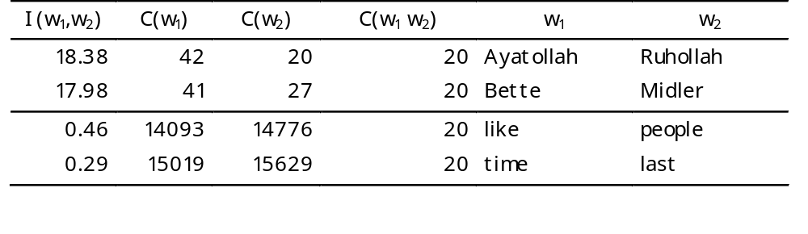
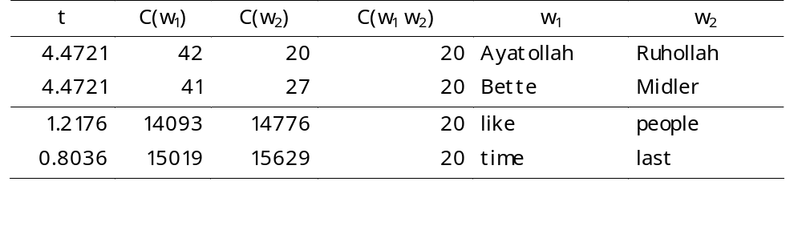
Pointwise Mutual Information (con’t)
With pointwise mutual information:
With t-test (see p.43 of slides)
Same ranking as t-test

Slide 61
Pointwise Mutual Information (con’t)
good measure of independence
  values close to 0 --> independence
bad measure of dependence
  because score depends on frequency
  all things being equal, bigrams of low frequency words will receive a higher score than bigrams of high frequency words
  so sometimes we take C(w₁ w₂) I(w₁ , w₂)

Slide 62
Automatic vs manual detection of collocations
Manual detection finds a wider variety of grammatical patterns
  Ex: in the BBI combinatory dictionary of English
Quality of collocations is better that computer-generated ones
But… long and requires expertise
strength | power
to build up ~ | to assume ~
to find ~ | emergency ~
to save ~ | discretionary ~
to sap somebody's ~ | fire ~
brute ~ | supernatural ~
tensile ~ | to turn off the ~
the ~ to [do X] | the ~ to [do X]

