Slide 1
Hidden Markov Models
David Meir Blei
November 1, 1999

Slide 2
What is an HMM?
Graphical Model
Circles indicate states
Arrows indicate probabilistic dependencies between states

Slide 3
What is an HMM?
Green circles are hidden states
Dependent only on the previous state
“The past is independent of the future given the present.”

Slide 4
What is an HMM?
Purple nodes are observed states
Dependent only on their corresponding hidden state

Slide 5
HMM Formalism
S
S
S
S
S
K
K
K
K
K
{S, K, Π, Α, Β}
S : {s₁…s_{N} } are the values for the hidden states
K : {k₁…k_{M} } are the values for the observations

Slide 6
HMM Formalism
A
A
A
A
S
S
S
S
S
B
B
B
K
K
K
K
K
{S, K, Π, Α, Β}
Π = {π_{ι}} are the initial state probabilities
A = {a_{ij}} are the state transition probabilities
B = {b_{ik}} are the observation state probabilities

Slide 7
Inference in an HMM
Compute the probability of a given observation sequence
Given an observation sequence, compute the most likely hidden state sequence
Given an observation sequence and set of possible models, which model most closely fits the data?

Slide 8
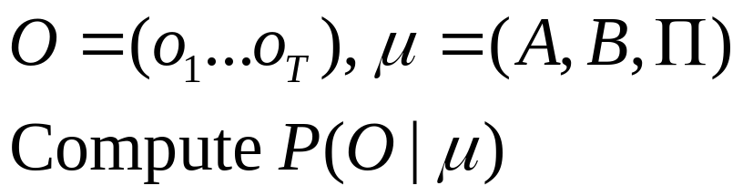
Decoding
o₁
o_{t-1}
o_{t}
o_{t+1}
o_{T}
Given an observation sequence and a model, compute the probability of the observation sequence

Slide 9
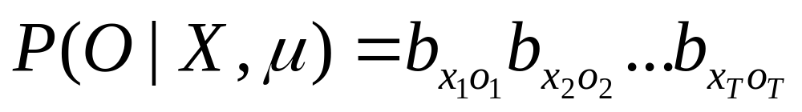
Decoding
x₁
x_{t-1}
x_{t}
x_{t+1}
x_{T}
o₁
o_{t-1}
o_{t}
o_{t+1}
o_{T}

Slide 10
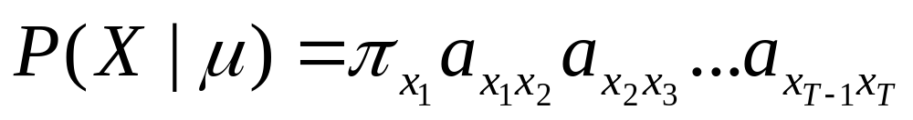
Decoding
x₁
x_{t-1}
x_{t}
x_{t+1}
x_{T}
o₁
o_{t-1}
o_{t}
o_{t+1}
o_{T}

Slide 11
Decoding
x₁
x_{t-1}
x_{t}
x_{t+1}
x_{T}
o₁
o_{t-1}
o_{t}
o_{t+1}
o_{T}

Slide 12
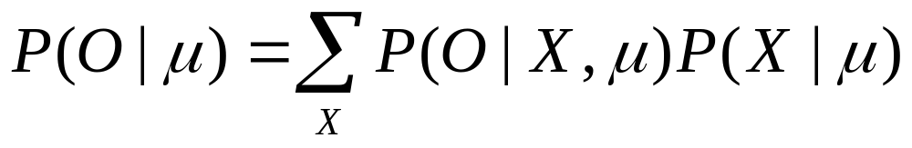
Decoding
x₁
x_{t-1}
x_{t}
x_{t+1}
x_{T}
o₁
o_{t-1}
o_{t}
o_{t+1}
o_{T}

Slide 13
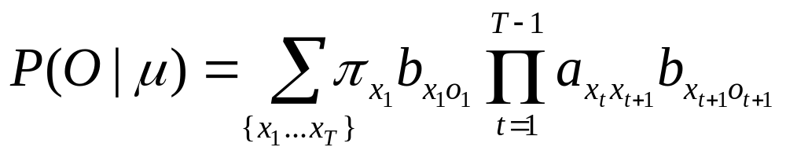
Decoding
x₁
x_{t-1}
x_{t}
x_{t+1}
x_{T}
o₁
o_{t-1}
o_{t}
o_{t+1}
o_{T}

Slide 14
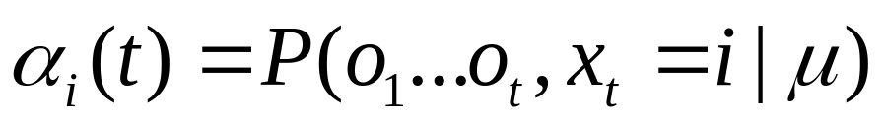
Forward Procedure
x₁
x_{t-1}
x_{t}
x_{t+1}
x_{T}
o₁
o_{t-1}
o_{t}
o_{t+1}
o_{T}
Special structure gives us an efficient solution using dynamic programming.
Intuition: Probability of the first t observations is the same for all possible t+1 length state sequences.
Define:

Slide 15
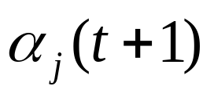
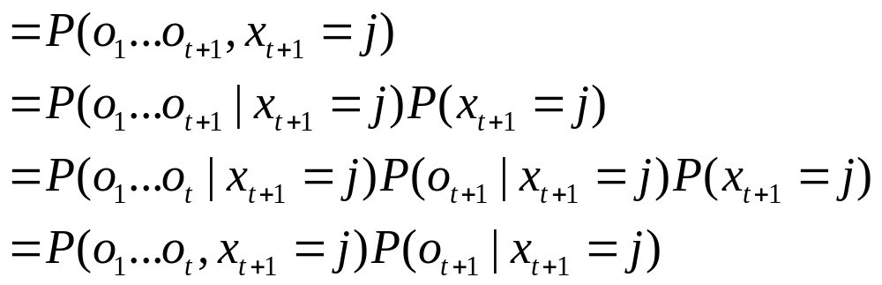
Forward Procedure
x₁
x_{t-1}
x_{t}
x_{t+1}
x_{T}
o₁
o_{t-1}
o_{t}
o_{t+1}
o_{T}

Slide 16
Forward Procedure
x₁
x_{t-1}
x_{t}
x_{t+1}
x_{T}
o₁
o_{t-1}
o_{t}
o_{t+1}
o_{T}

Slide 17
Forward Procedure
x₁
x_{t-1}
x_{t}
x_{t+1}
x_{T}
o₁
o_{t-1}
o_{t}
o_{t+1}
o_{T}

Slide 18
Forward Procedure
x₁
x_{t-1}
x_{t}
x_{t+1}
x_{T}
o₁
o_{t-1}
o_{t}
o_{t+1}
o_{T}

Slide 19
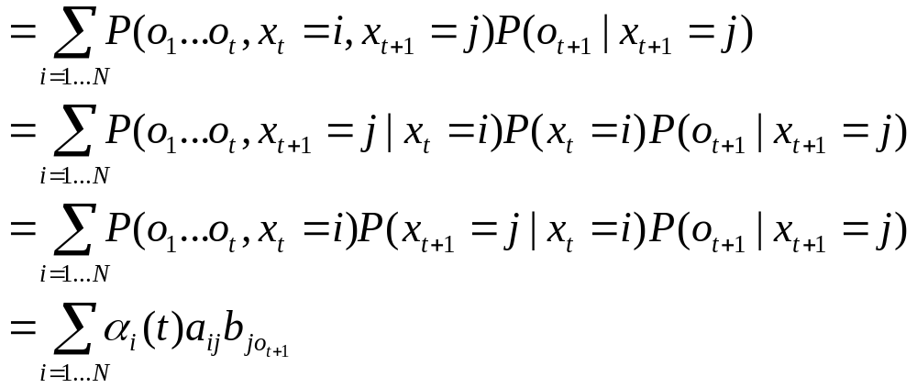
Forward Procedure
x₁
x_{t-1}
x_{t}
x_{t+1}
x_{T}
o₁
o_{t-1}
o_{t}
o_{t+1}
o_{T}

Slide 20
Forward Procedure
x₁
x_{t-1}
x_{t}
x_{t+1}
x_{T}
o₁
o_{t-1}
o_{t}
o_{t+1}
o_{T}

Slide 21
Forward Procedure
x₁
x_{t-1}
x_{t}
x_{t+1}
x_{T}
o₁
o_{t-1}
o_{t}
o_{t+1}
o_{T}

Slide 22
Forward Procedure
x₁
x_{t-1}
x_{t}
x_{t+1}
x_{T}
o₁
o_{t-1}
o_{t}
o_{t+1}
o_{T}

Slide 23
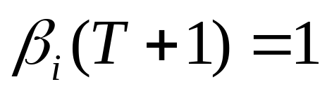
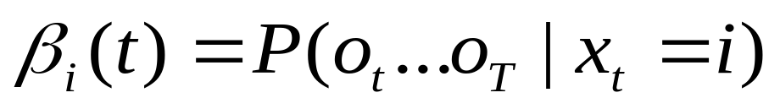
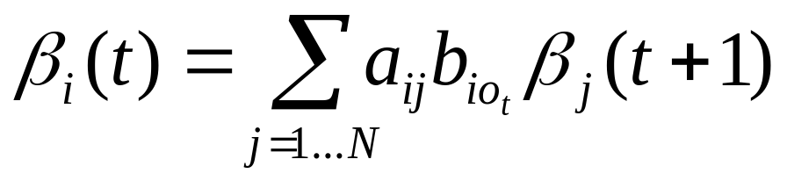
Backward Procedure
x₁
x_{t-1}
x_{t}
x_{t+1}
x_{T}
o₁
o_{t-1}
o_{t}
o_{t+1}
o_{T}
Probability of the rest of the states given the first state

Slide 24
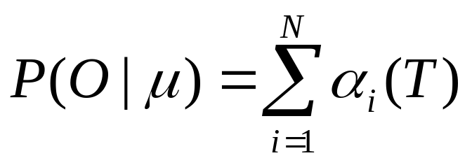
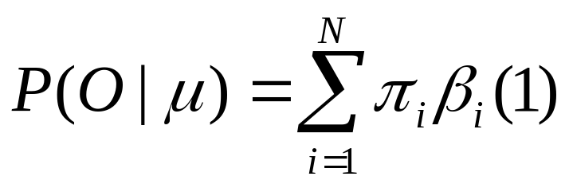
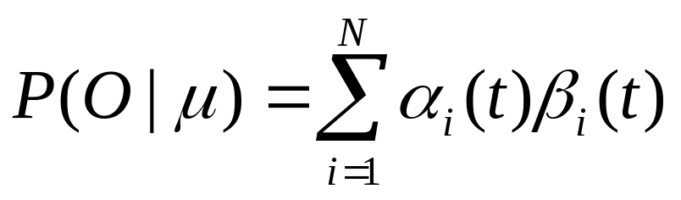
Decoding Solution
x₁
x_{t-1}
x_{t}
x_{t+1}
x_{T}
o₁
o_{t-1}
o_{t}
o_{t+1}
o_{T}
Forward Procedure
Backward Procedure
Combination

Slide 25
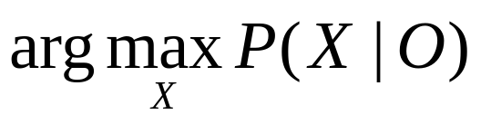
Best State Sequence
o₁
o_{t-1}
o_{t}
o_{t+1}
o_{T}
Find the state sequence that best explains the observations
Viterbi algorithm

Slide 26
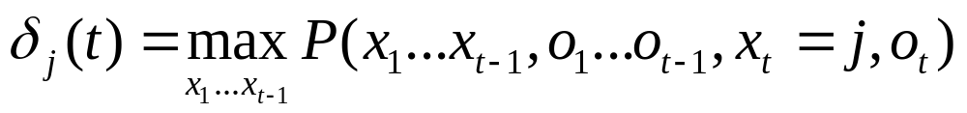
Viterbi Algorithm
x₁
x_{t-1}
j
o₁
o_{t-1}
o_{t}
o_{t+1}
o_{T}
The state sequence which maximizes the probability of seeing the observations to time t-1, landing in state j, and seeing the observation at time t

Slide 27
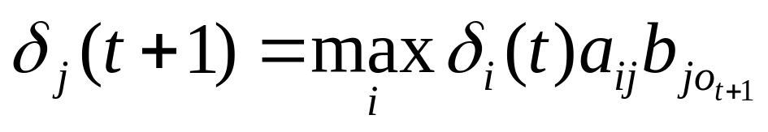
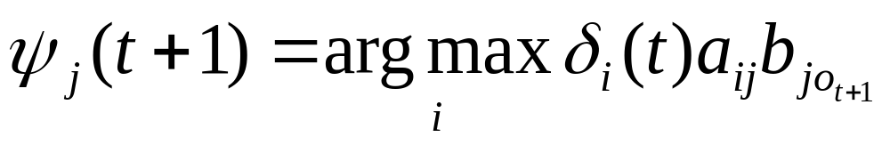
Viterbi Algorithm
x₁
x_{t-1}
x_{t}
x_{t+1}
o₁
o_{t-1}
o_{t}
o_{t+1}
o_{T}
Recursive Computation

Slide 28
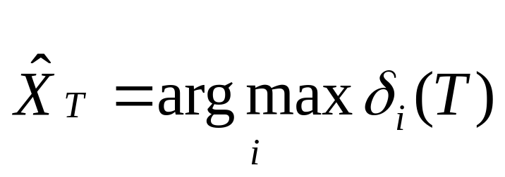
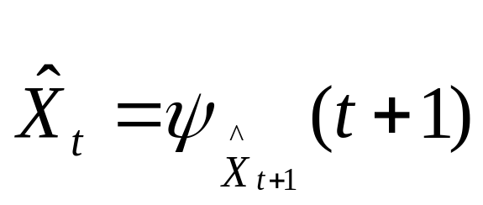
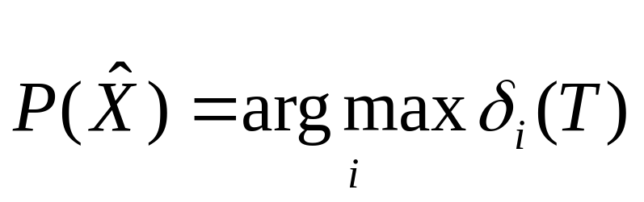
Viterbi Algorithm
x₁
x_{t-1}
x_{t}
x_{t+1}
x_{T}
o₁
o_{t-1}
o_{t}
o_{t+1}
o_{T}
Compute the most likely state sequence by working backwards

Slide 29
Parameter Estimation
A
A
A
A
B
B
B
B
B
o₁
o_{t-1}
o_{t}
o_{t+1}
o_{T}
Given an observation sequence, find the model that is most likely to produce that sequence.
No analytic method
Given a model and observation sequence, update the model parameters to better fit the observations.

Slide 30
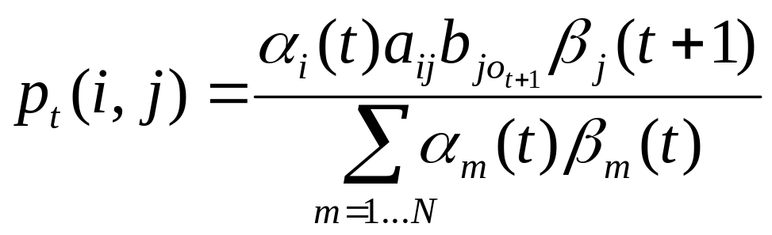
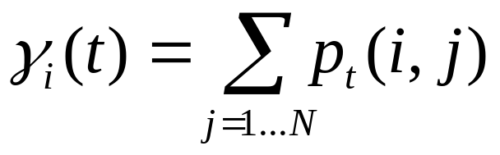
Parameter Estimation
A
A
A
A
B
B
B
B
B
o₁
o_{t-1}
o_{t}
o_{t+1}
o_{T}
Probability of traversing an arc
Probability of being in state i

Slide 31
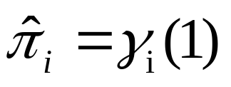
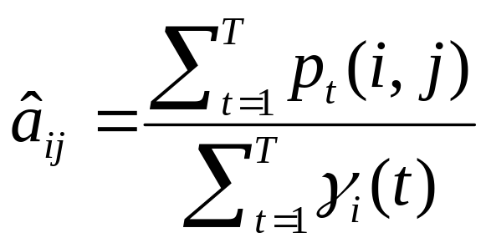
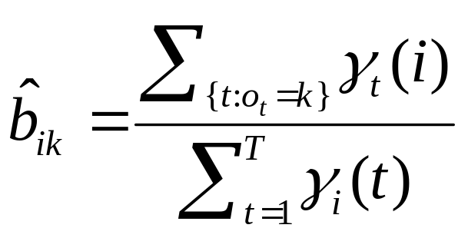
Parameter Estimation
A
A
A
A
B
B
B
B
B
o₁
o_{t-1}
o_{t}
o_{t+1}
o_{T}
Now we can compute the new estimates of the model parameters.

Slide 32
HMM Applications
Generating parameters for n-gram models
Tagging speech
Speech recognition

Slide 33
The Most Important Thing
A
A
A
A
B
B
B
B
B
o₁
o_{t-1}
o_{t}
o_{t+1}
o_{T}
We can use the special structure of this model to do a lot of neat math and solve problems that are otherwise not solvable.

