Slide 1
MNIST-PRO · ARC Race
Two games where a person and an AI face the same problem at the same time
panandi.github.io/mnistpro
Runs entirely in the browser · No server · No API key required to play

Slide 2
THE IDEA
Same problem, same moment, two players
A person and a model are given an identical task and race.
Not a benchmark chart in a paper - something you can actually sit down and play.
Two games, because the first one was too hard.
ARC Race asks you to infer a hidden rule. That turned out to be the wrong kind of hard for a five-minute game, so MNIST-PRO was added and became the front page.
MNIST-PRO needs no prior knowledge.
There is no rule to work out. Everyone already knows what a handwritten digit looks like - the difficulty is entirely in deciding where to look next.
You are expected to win.
That is the interesting part, not a defect. Active perception is a real weakness in current models.

Slide 3
MNIST-PRO
A digit behind a moving window
The canvas is 224x224. The window is 64x64 - about 8% of it.
A handwritten digit fills the canvas. Everything outside the window is masked grey.
The window moves up, down, left or right, 32px at a time.
Half the window's width, so consecutive views overlap. Each move is one sensing step.
Only the current window is visible. The rest is memory.
This is the point of the benchmark, not a limitation. A 'keep a trail' option relaxes it to the published unbounded-lookback condition.
One answer, 36 steps.
36 is exactly the number of distinct window positions - enough to visit every one once. A wrong answer ends the round.

Slide 4
SCORING
Fewest sensing steps wins - not fastest
Correctness gates first.
A lucky one-step guess never beats a careful correct answer.
Between two correct answers, fewer sensing steps wins. Equal counts tie.
Time is deliberately not scored.
The model answers over a network. Timing the race would measure API latency and my connection speed, not anyone's judgement.
This mirrors the benchmark's own reward.
-0.1 per move against +10 for a correct answer and -10 for a wrong one is already 'fewest steps wins'.

Slide 5
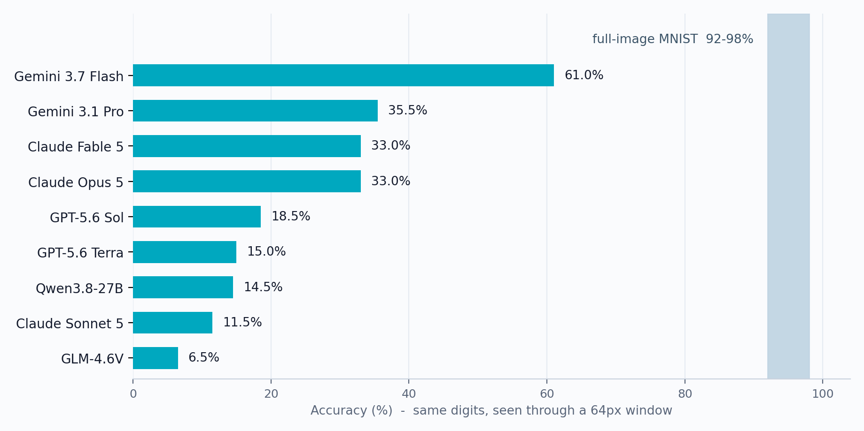
WHY YOU ARE THE FAVOURITE
Whole digits are easy. Exploring for one is not.
92-98%
on the whole digit
6.5-61%
through a window
Published results, MNIST-PRO (arXiv:2608.31022). The gap is active perception, not recognition.

Slide 6
HOW TO PLAY
MNIST-PRO, in four steps
1. Start a round.
You begin centred on part of the digit, never on blank canvas.
2. Move the window.
Arrow keys or the on-screen pad. Follow the ink.
3. Name the digit.
Press 0-9 when you are sure. You are asked to confirm, because you only get one answer.
4. Compare.
Your sensing steps against the model's.
Optional: race the AI.
Needs your own OpenRouter key, kept in your browser and sent only to openrouter.ai. Solo play needs nothing.

Slide 7
THE OTHER GAME
ARC Race - infer the rule
Worked examples show a grid before and after. One hidden rule explains them all.
Apply it to a test grid. Three attempts, five minutes, fastest correct answer wins.
Difficulty is measured, not guessed.
A classifier fits simple rules - rotations, mirrors, recolours, scaling, tiling - to all 400 ARC-AGI-1 training tasks. 19 are fully explained by one rule that also predicts the held-out answer. Those 19 are the Easy tier, and the game opens on them.
Every easy puzzle carries an opt-in hint naming its rule.
The answer itself is never shipped - only a SHA-256 of it.
The puzzle list shows the size of the answer, not the input.
109 of 386 need more than 150 cells painted and are flagged 'slow to paint'.

Slide 8
HOW IT IS BUILT
A static site that still keeps secrets
GitHub Pages serves files and cannot run code.
So the whole race runs in the browser. There is no server to attack and nothing to host.
ARC answers are never sent to the browser.
Each task ships a SHA-256 of its answer. A submission is graded by hashing it and comparing digests, so the solution is not readable in the page.
No API key is ever in the site.
Solo play needs no key at all. To race the AI, a visitor supplies their own, held in their browser and sent only to openrouter.ai. The project's own key has never been in the repository.
An optional FastAPI backend exists for a hosted AI lane.
There the key stays server-side and is never returned to a client.

Slide 9
FIDELITY
Built on the benchmark, and checked against it
Canvases come from the upstream generators, not a lookalike.
build_canvas and deterministic_start produce every canvas; episodes are sampled with their own sample_balanced at seed 42, so episode 0 here is episode 0 of the published runs.
Verified against their golden manifest.
Episode 0 starts at [130,130]; two 'up' moves give [130,98] then [130,66] - exactly the trajectory their recorded run produced.
The rendered canvas matches the shipped bitmap pixel for pixel.
Masking is measured by reading pixels back off the canvas, not eyeballed.
Both games are checked in a real browser on the live site.
Puzzle grading is tested in both directions: a wrong answer must be rejected and the right one accepted.

Slide 10
CREDITS
Standing on other people's work
MNIST-PRO - MIT
Toh, Majumder, Liu, Chen and Poria. DeCLaRe Lab, Nanyang Technological University, and A*STAR. arXiv:2608.31022 · github.com/declare-lab/MNIST-PRO
MNIST - CC BY-SA 3.0
LeCun, Cortes and Burges, derived from NIST Special Database 19.
ARC-AGI-1 - Apache 2.0
Francois Chollet. The public training set, used unmodified.
Licences are retained in the repository.
third_party/mnist-pro/LICENSE, and attribution files beside the generated data.

Slide 11
Try it
MNIST-PRO panandi.github.io/mnistpro
ARC Race panandi.github.io/mnistpro/arc.html
Player's guide panandi.github.io/mnistpro/guide.html
Source github.com/panandi/mnistpro
No install, no sign-up, no key needed to play solo.

