Slide 1
Spike Sorter Tutorial

Slide 2
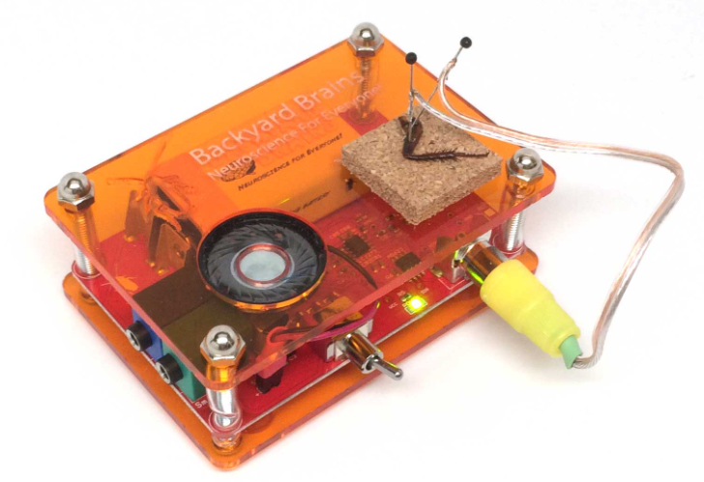
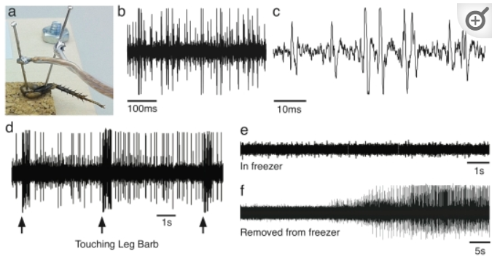

Introduction
Neuron SpikerBox
Electrophysiological recordings during cockroach leg stimulation experiment

Slide 3
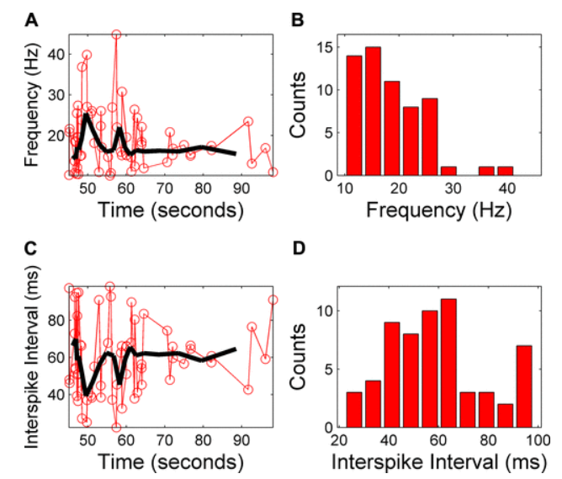
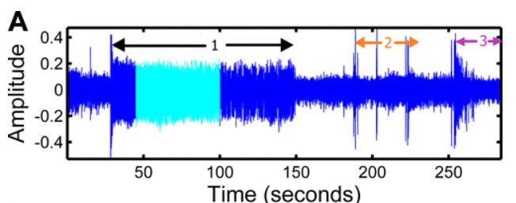
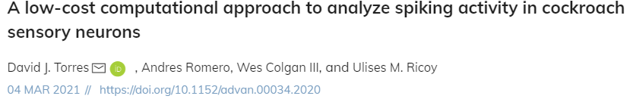
How do we analyze spike sorting data?
Figure 3A. From Torres et al. 2021
Figure 9 From Torres et al. 2021
Torres et al. 2021 builds a tool in Octave language to analyze spiking data(left figure) and obtain electrophysiological parameters (right figure)

Slide 4


Implementation in Python
Why Python?
https://github.com/panarnur/Spike-Sort-Python
Free
Open-source
Emphasis on code readability
Tools written in Python can be implemented in neuroscience outreach and curricula
URL containing the script

Slide 5

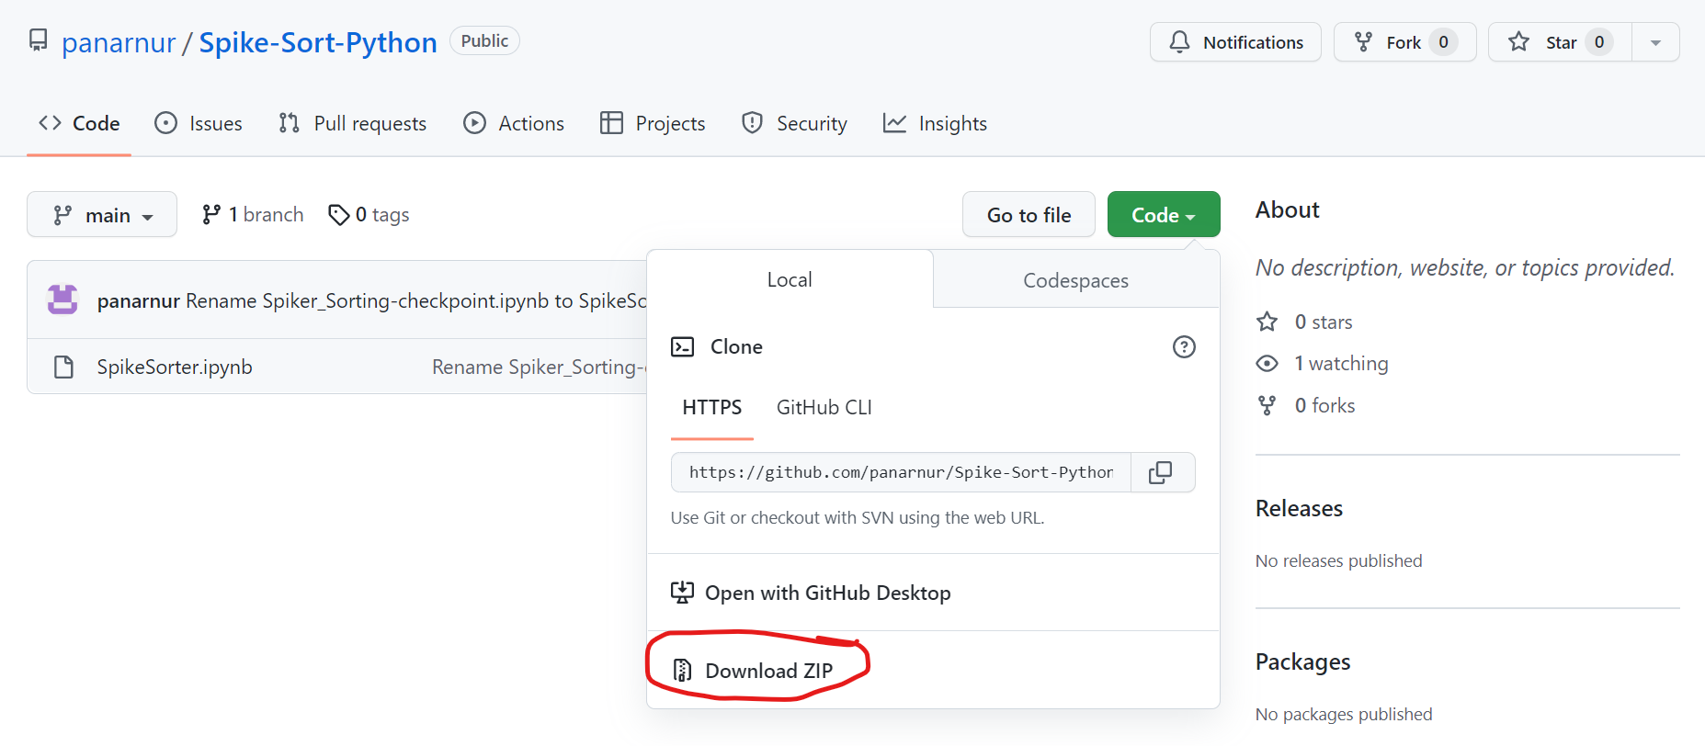
Step-by-Step Walkthrough
https://www.anaconda.com/products/distribution Click on the Download button.
Click on Anaconda.exe and let it install
Make a folder for the project. It is good to keep the script and audio files in one directory.
4. Go to the Github repository containing the script. Click on Code and Download Zip file.
5. Extract the zip folder to your project directory

Slide 6
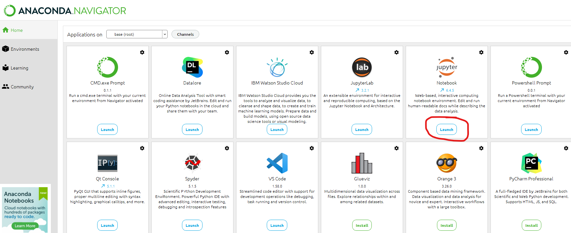
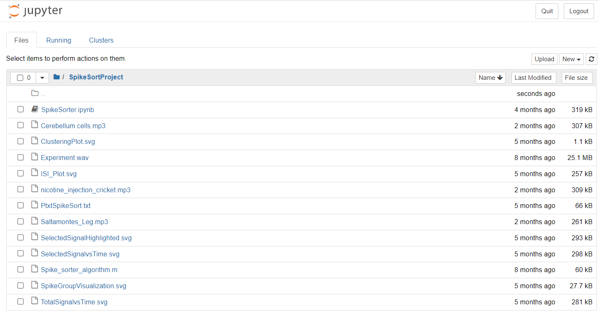
Opening Jupyter Notebook
Open the Anaconda Navigator program
Click on Jupyter Notebook to launch it.
Jupyter Notebook will open in your browser.
Go to your project directory
Click on the .ipynb file you downloaded from
Github (SpikeSorter.ipynb).

Slide 7
Breakdown of the Script
This script allows for significant user input.
The options you select will depend on your experiment.
Play around with the settings and observe how your findings vary.
The line numbers may not match. We continue to update and improve the script.

Slide 8
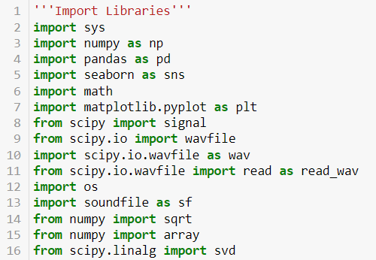
Importing Libraries
Programmers have written code and published them online into modules
We will import the ones that our script requires
These significantly reduce the amount of code our script needs
Python has powerful modules which contribute to its popularity!
Numpy has powerful tools for working with matrices and arrays
Scipy has broad tools for math, science, and computing

Slide 9
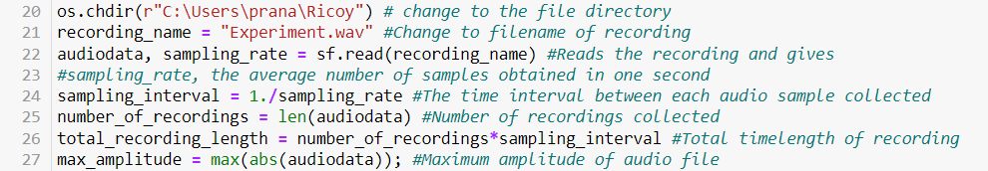
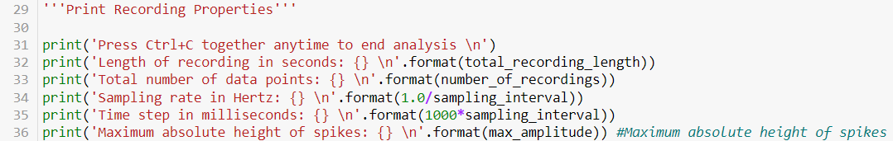
Reading the recording and extracting data
There are two user inputs
Line 20: os.chdir (r “ “ ) : Change the directory inside the quotations to your project directory
Line 21: recording_name = “ “ : Change the file name inside the quotations to the name of your audio recording
Recordings are often generated as .wav files
If your audio file is a different file format than .wav, you will have to convert it to .wav
The section titled “Print Recording Properties” gives audio properties the user may be interested in.

Slide 10
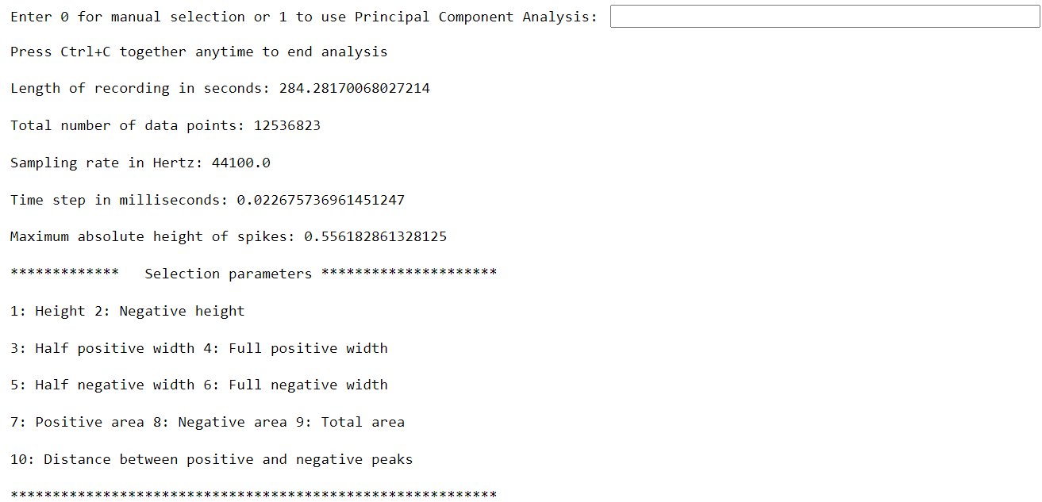
Manual Selection vs PCA
Manual selection sorts spikes based on two of the ten selection parameters.
See Figure 2 of https://journals.physiology.org/doi/full/10.1152/advan.00034.2020 for an explanation of these parameters
Principal component analysis spike sorts automatically. This option is recommended.
Press 1 to plot total signal

Slide 11
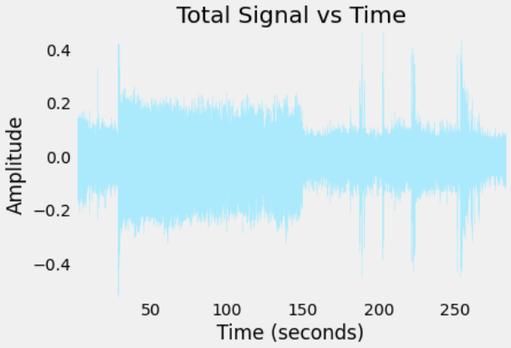
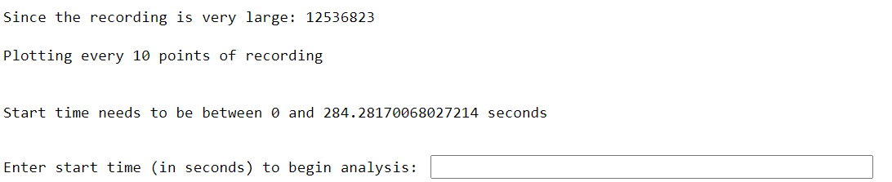
Selecting time range of interest
Examine your data in BYB Spike Recorder or other software you used to record data
Select a time range you are interested in analyzing in
Input start time in seconds
Input end time in seconds

Slide 12
Thresholding
All spikes below certain amplitude will be excluded
Select a threshold above the background noise you’d like to exclude, but below the experimental signal you want to keep. AKA somewhere in between noise and signal.
Looking at bottom right graph, amplitude at 0 seconds before stimulation is 0.1. Amplitude at 40 seconds to 150 seconds is around 0.2.
In the example data, a threshold of 0.15 can be used.

Slide 13
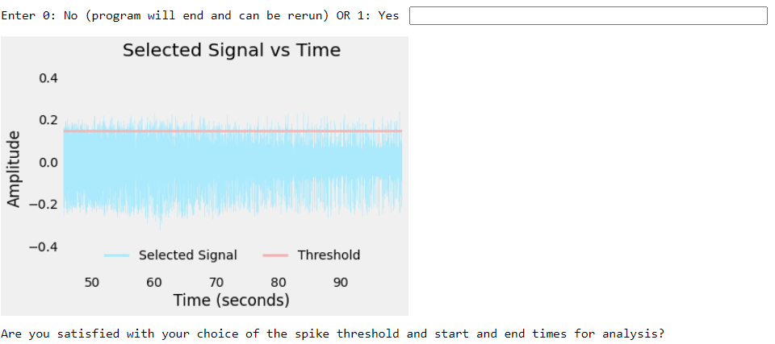
Visualizing selected data
A graph of selected signal and threshold appears.
Enter 0 here to stop the program, so you can rerun it.
Enter 1 to proceed

Slide 14
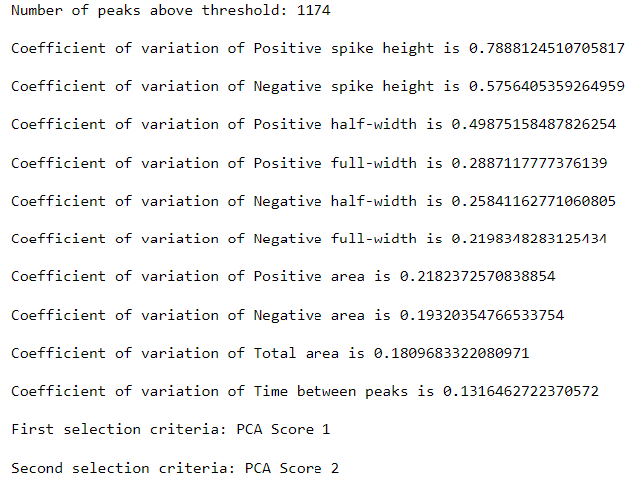
A few comments about resulting outputs before we continue…
A dataset of 1174 spikes is created and used for all further analyses
Positive spike height and negative spike height are the most variable features, if we were using manual selection of features
The First and selection criteria are the two variables that will be used to sort spikes
Since we used PCA instead of manual feature selection, we are using the first and second principal component
Great video on PCA

Slide 15
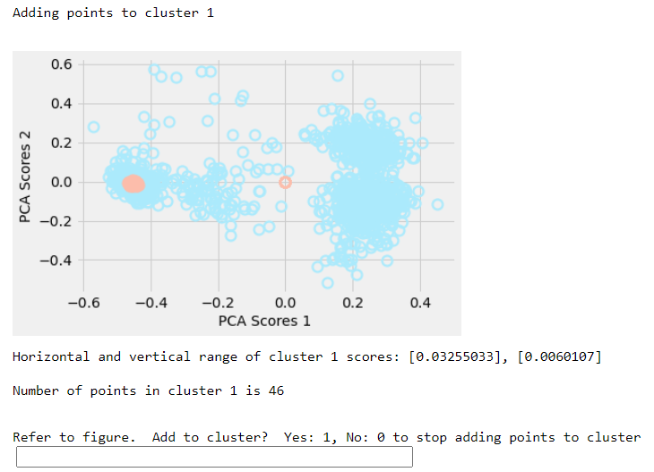
Evaluating PCA results
In our example data, two broad groups of spikes have emerged after PCA
If you expected broad spike groups to appear but they don’t:
A) Try selecting different range of timepoints and threshold
B) Go to section with ‘’’Set parameters for analysis’’’ and tweak those until better results appear
C) Think critically about your experiment and whether broad spike groups should even appear in the first place

Slide 16
Selecting distinct clusters for downstream analysis after PCA
In this example, cluster 1 is on the left.
1. In the section titled “Refer to figure. Add to cluster? Enter 1 to select more spikes within that cluster.

Slide 17
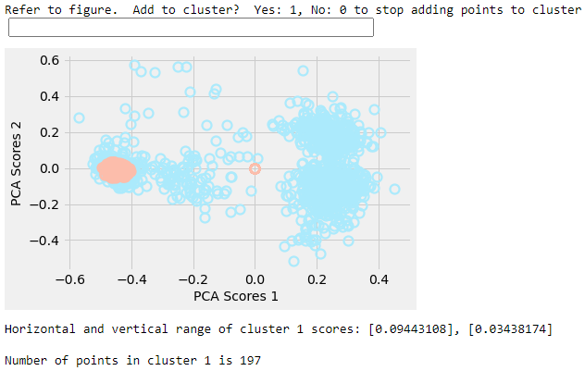
Selecting distinct clusters for downstream analysis after PCA (continued)
After entering 1 in the box, a new figure appears.
The orange-colored cluster corresponds to spike group 1. It has grown compared to the previous slide figure. This is because we selected more spikes.
Once cluster 1 (orange) covers a good portion of the separated spikes within your first broad group… press 0 to stop adding points to cluster.
In this example, we press 0.

Slide 18
Selecting distinct clusters for downstream analysis after PCA (continued)
After pressing 0 on “Refer to figure. Add to cluster? Yes: 1, No: 0 to stop adding points to cluster”, the program unselects cluster 1 and selects cluster 2.
Think critically. Was another broad cluster present after PCA? Sometimes there won’t be a second cluster.
In our example, YES! We saw two broad clusters, one on the left and one on the right in the PCA graph.
In this example, we type 1 to select cluster 2

Slide 19
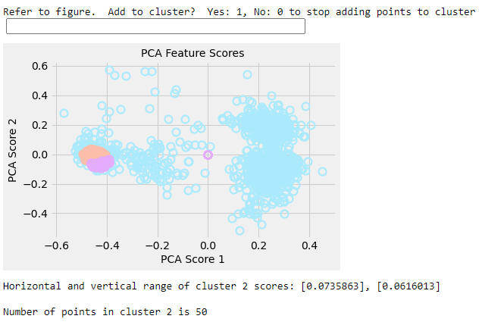
Selection of cluster 2 (purple)
Repeat the same process for cluster 2.
Enter 1 to select more points for cluster 2 as needed.
Once you are finished, enter 0 to stop adding points to cluster and enter 0 again to stop adding new clusters.
The rest of the program will generate various graphs. These graphs show various properties of your spike sorted groups.
Notes:
There’s a bug in the code which will be fixed immediately. The second spike group selects the same group as the first group. This didn’t happen w GITHUB so I will investigate.

Slide 20
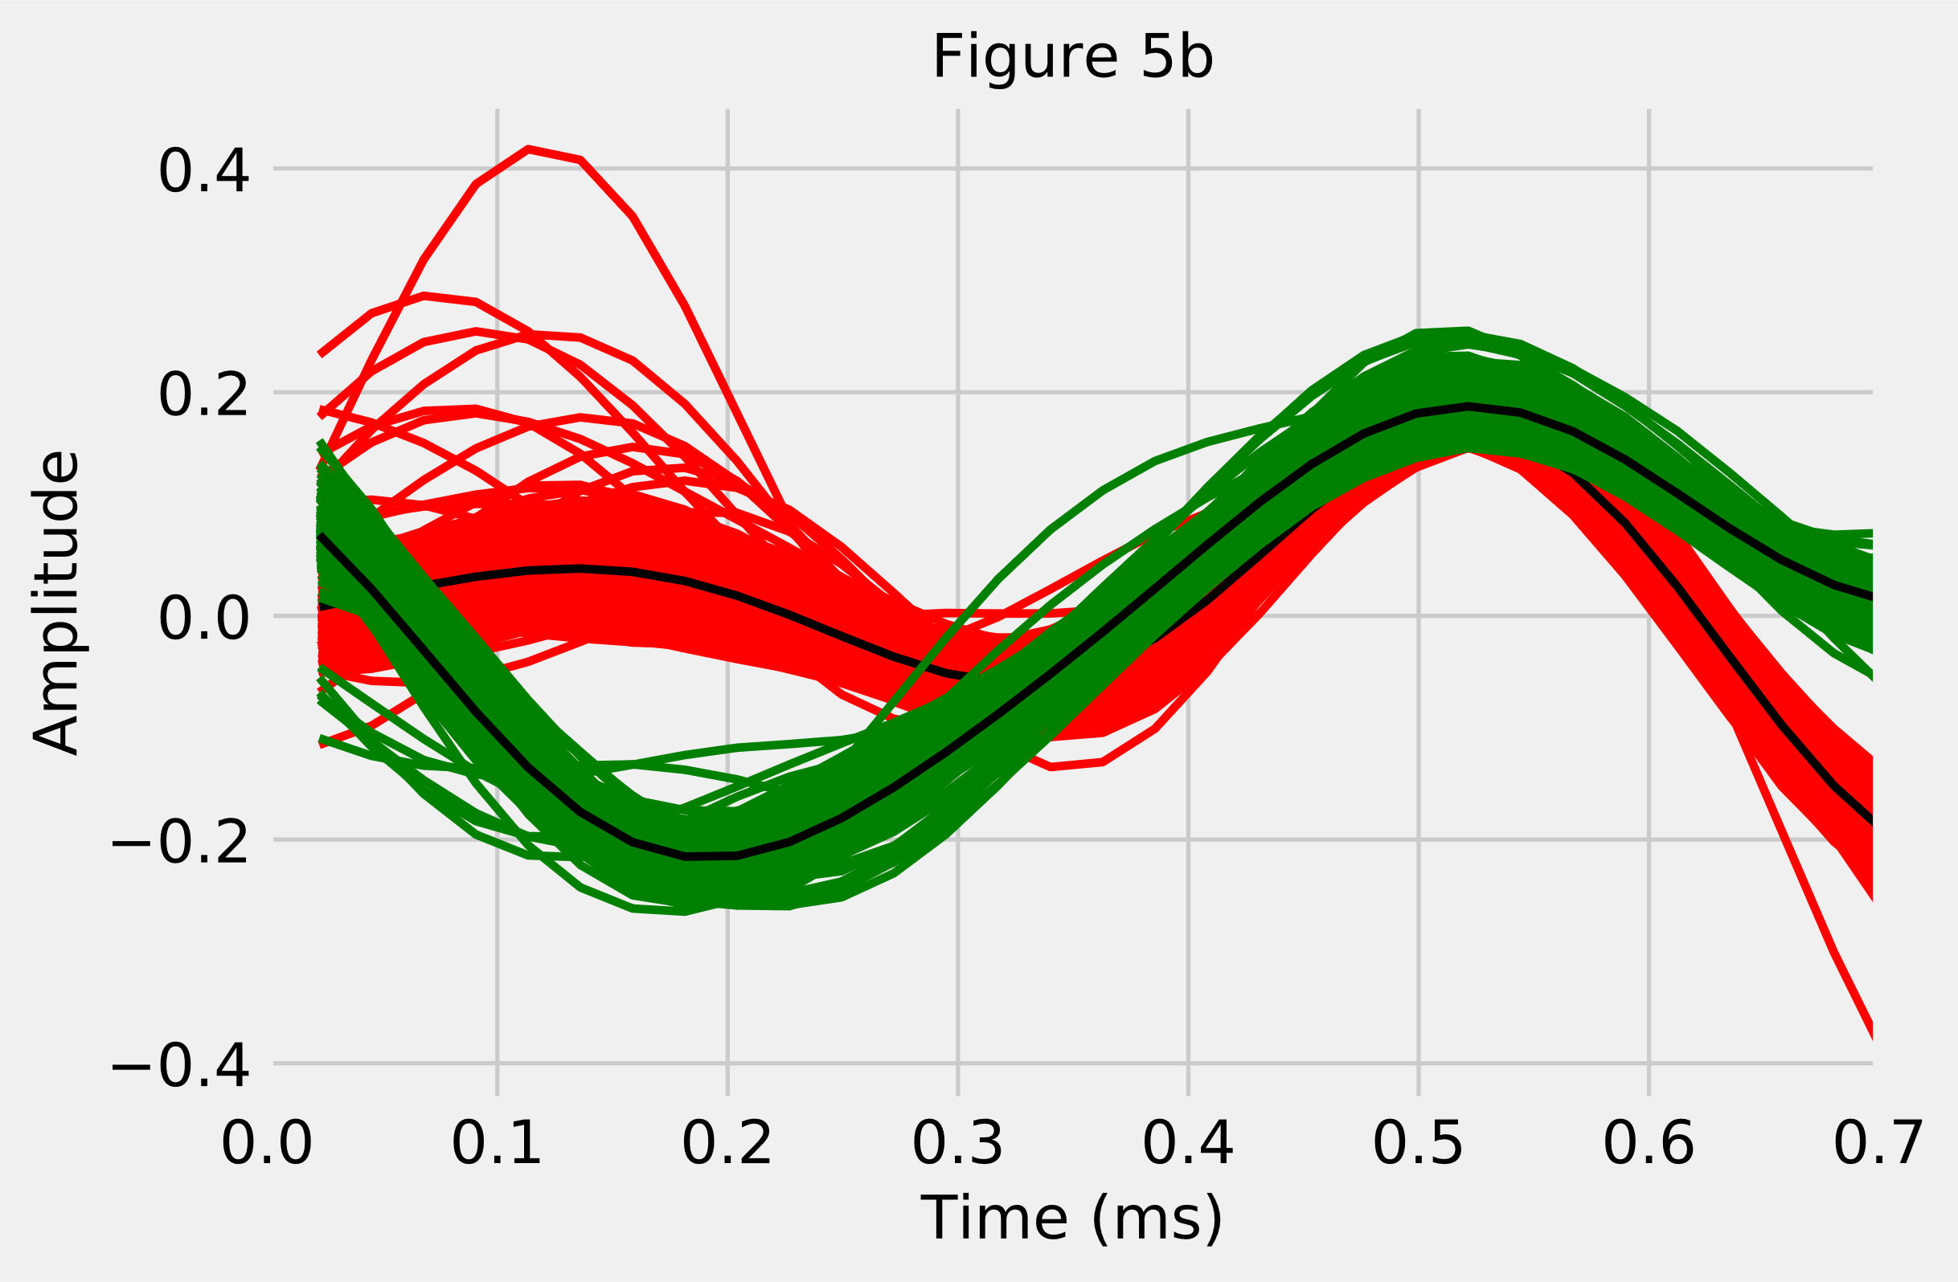
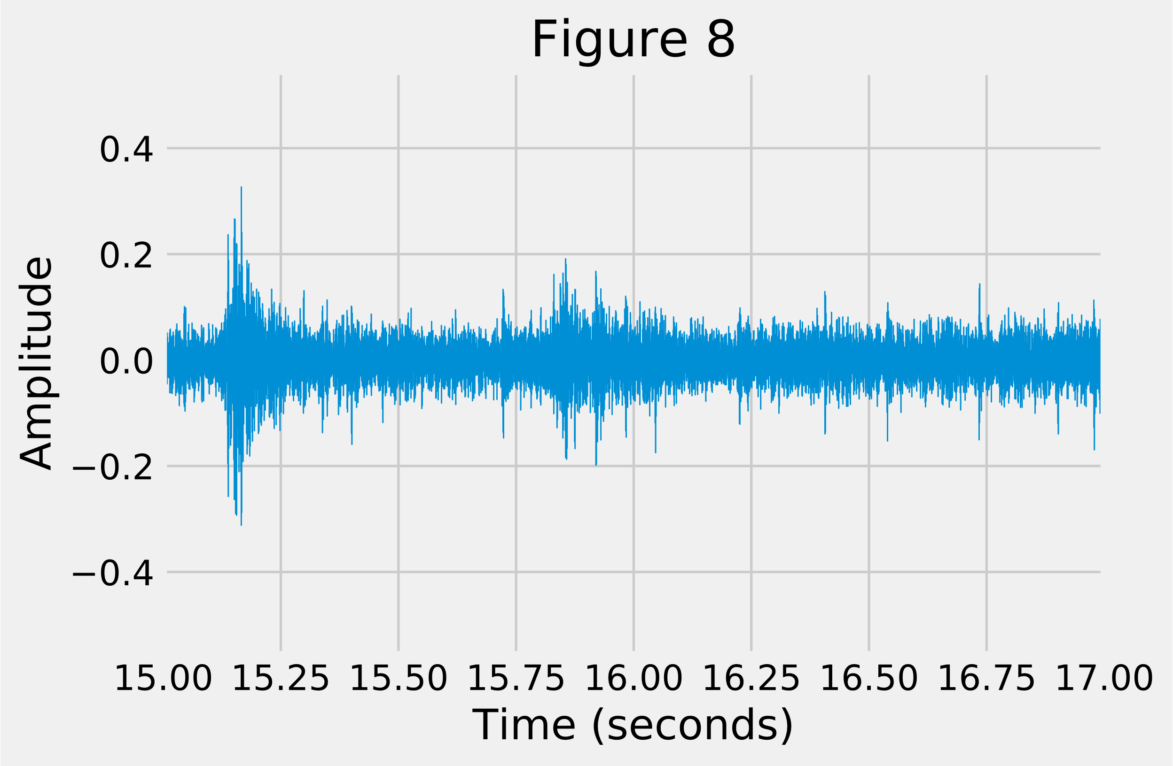

Slide 21
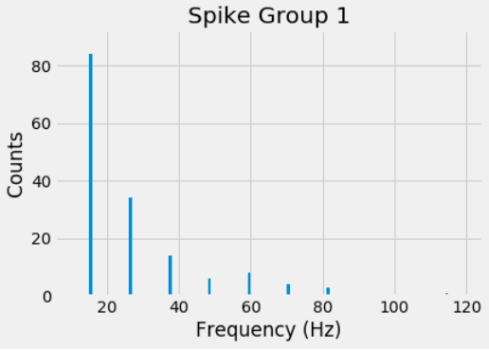
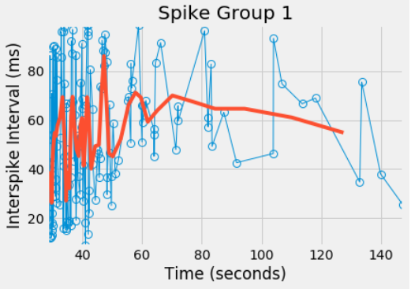
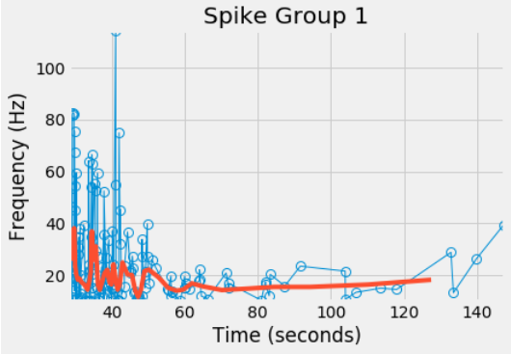
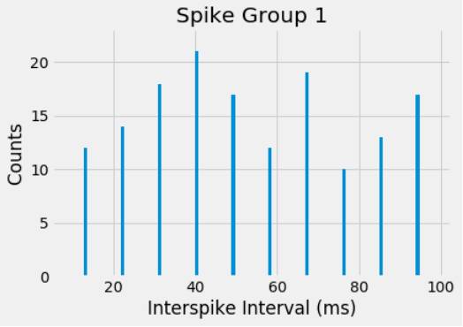

Slide 22
