Slide 1
Bonds
A bond is a promisory note whose holder is entitled to a stream of coupon payments (usually semi-annual), plus a par/face value payment at maturity.

Slide 2
Bond Characteristics
Face or par value
Coupon rate
  Zero coupon bond
payments
  Accrued Interest

Slide 3
Different Issuers of Bonds
U.S. Treasury
  Notes and Bonds
Corporations
Municipalities
International Governments and Corporations
Innovative Bonds
  Indexed Bonds
  Floaters

Slide 4
Provisions of Bonds
Secured or unsecured
Call provision
Convertible provision
Put provision (putable bonds)
Floating rate bonds
Sinking funds

Slide 5
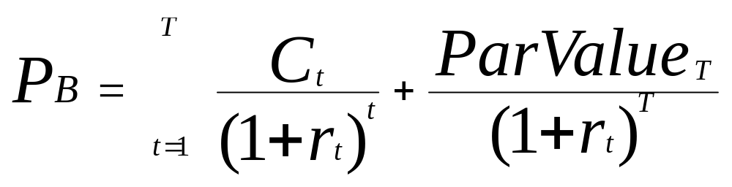
Bond Prices & Yields

P_{B} = Price of the bond
C_{t} = interest or coupon payments
T = number of periods to maturity
rt = semi-annual discount rate or the semi-annual yield to maturity

Slide 6
Example: pricing a bond
A 10-yr, 8% coupon bond, with face = $1,000
C_{t}= 40 (SA), P = 1000, T= 20 periods, rt= 3% (SA)
20
=

1
+
1
P
40
__________
1000
__________
B
(1+.03)
t
(1+.03)
20
t
=1
P_{B} = $1,148.77

Slide 7
Bond Prices and Discount Rates
Prices and discount rates (required rates of return) have an inverse relationship
When discount rates get very high the value of the bond will be very low
When discount rates approach zero, the value of the bond approaches the sum of the cash flows

Slide 8
Prices and Discount Rates
Price
Discount Rate

Slide 9
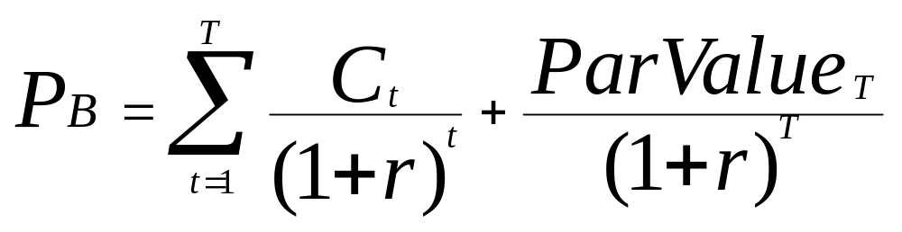
Yield to Maturity
Interest rate that makes the present value of the bond’s payments equal to its price
Solve the bond formula for r

Slide 10
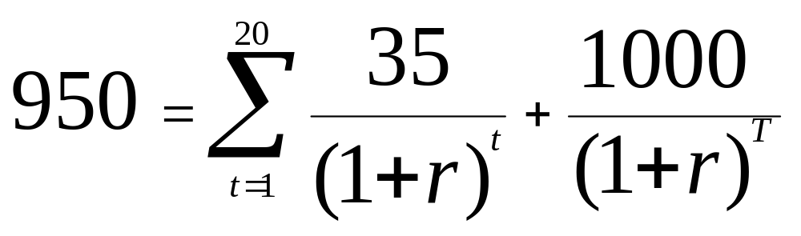
Yield to Maturity Example
10 yr Maturity, Coupon Rate = 7%, Price = $950
Solve for r = semiannual yield
r = 3.8635%

Slide 11
Yield Calculations
Bond Equivalent Yield
7.72% = 3.86% x 2
Effective Annual Yield
(1.0386)² - 1 = 7.88%
Current Yield
=Annual Coupons/ Market Price
= $70 / $950 = 7.37 %

Slide 12
Realized Return versus YTM
Holding Period Return
  Changes in rates affects returns
  Reinvestment of coupon payments
  Change in price of the bond

Slide 13
Holding-Period Return: Single Period
HPR = [ I + ( P₀ - P₁ )] / P₀
where
I = interest payment
P₁ = price in one period
P₀ = purchase price

Slide 14
Holding-Period Example
CR = 8% YTM = 8% N=10 years
Semiannual Compounding P₀ = $1000
In six months, the rate falls to 7%
P₁ = $1068.55
HPR = [40 + ( 1068.55 - 1000)] / 1000
HPR = 10.85% (semiannual)

Slide 15
Holding-Period Return: Multiperiod
Requires actual calculation of reinvestment income
Solve for the Internal Rate of Return using the following:
  Future Value: sales price + future value of coupons
  Investment: purchase price

