Slide 1
HOUSE PRICE PREDICTION SYSTEM
Predicting real estate prices from area, location, rooms, age & amenities
AIML Summer Internship 2026 | IIHMF, MNNIT Allahabad, Prayagraj
Capstone Project 2 • Regression

Slide 2
01 — THE PROBLEM
Why house price prediction is hard
Home buyers, sellers, and agents rely on gut feel and comparables to price property — a slow, inconsistent process that misses how many factors interact at once.
Multiple interacting factors
Area, rooms, age, location and amenities all move price together
Inconsistent manual estimates
Different agents price the same property differently
No fast, data-driven baseline
Buyers/sellers lack a quick, defensible reference price
House Price Prediction System
2

Slide 3
02 — GOALS
Project Objectives
1
Build a regression model that predicts house price from property features
2
Clean and explore a realistic housing dataset end-to-end
3
Engineer features that capture value drivers beyond raw inputs
4
Compare multiple ML models and select the best performer
5
Deploy the model as an interactive web app for live predictions
House Price Prediction System
3

Slide 4
03 — DATA
Dataset Description
1,400 property records • 11 raw features • regression target: Price
Area_SqFt
Numeric
Data quality realities built in
Bedrooms / Bathrooms
Numeric
• ~2-3% missing values across key columns
Age_Years
Numeric
• 25 duplicate rows
Location
Categorical (5 zones)
• Genuine outliers in price & area
Furnishing
Categorical
Garage / Garden / Pool / Near_School
Binary flags
Handled explicitly in the preprocessing phase (next).
House Price Prediction System
4

Slide 5
04 — APPROACH
Methodology — The ML Lifecycle
Problem
Understanding
→
Data
Collection
→
Preprocessing
→
EDA
→
Feature
Engineering
→
Model
Building
→
Evaluation
→
Deployment
Each phase produces a concrete artifact — cleaned data, plots, engineered features, a trained model, and a deployed app.
House Price Prediction System
5

Slide 6
05 — CLEANING
Data Preprocessing
Missing values
Filled numeric columns with median, categorical with mode
Duplicates
25 duplicate rows identified and removed
Outliers
IQR capping applied to Price and Area_SqFt
Encoding
One-hot encoding for Location and Furnishing
Scaling
StandardScaler applied to all numeric features
House Price Prediction System
6

Slide 7
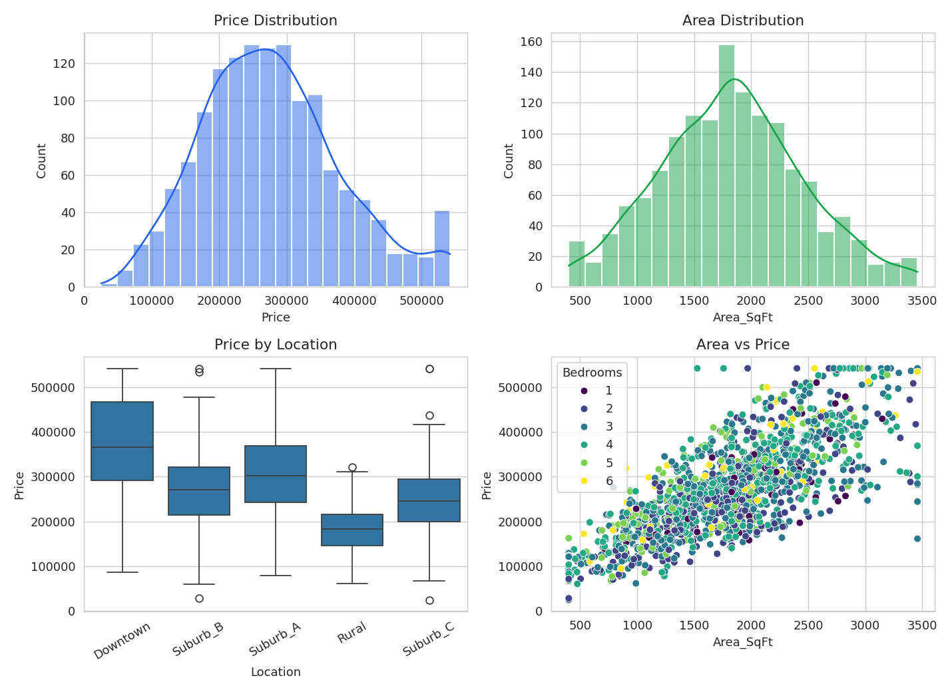
06 — EXPLORATION
Exploratory Data Analysis
Key observations
• Price is right-skewed — most homes cluster mid-range
• Downtown commands a clear premium over other zones
• Area is the single strongest price driver
House Price Prediction System
7

Slide 8
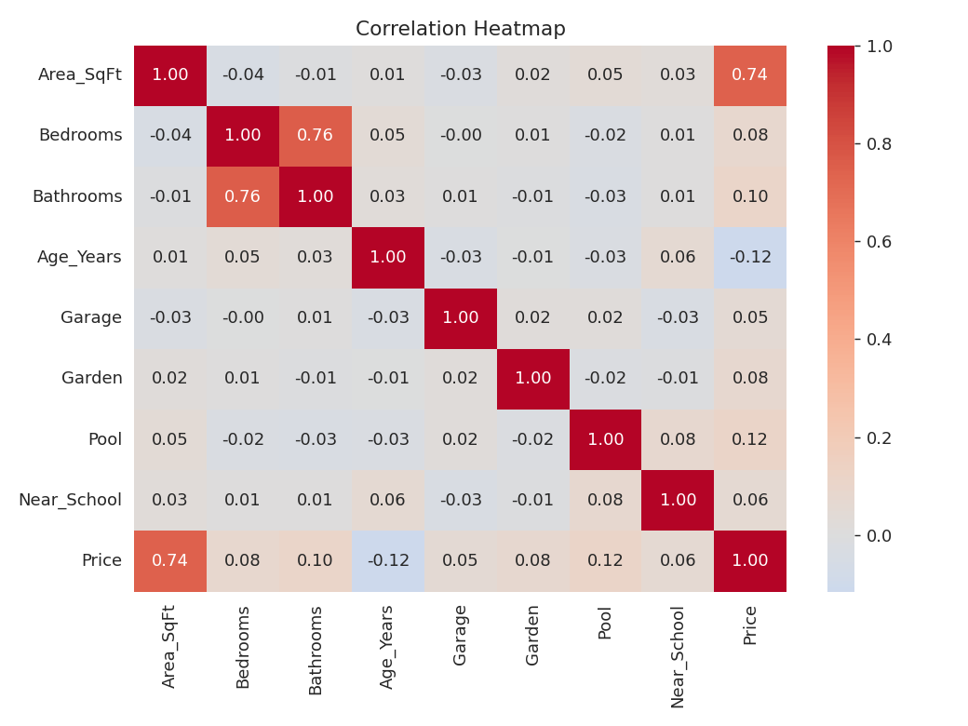
06 — EXPLORATION
Feature Correlations
Strongest correlations with Price
Area_SqFt
+0.74
Pool
+0.12
Bathrooms
+0.10
Age_Years
-0.12
House Price Prediction System
8

Slide 9
07 — MODELING
Models Trained
Linear Regression
Random Forest
Gradient Boosting
Baseline — interpretable linear relationship
Ensemble of decision trees, captures non-linearity
Sequential boosting — strongest performer here
Note: Gradient Boosting is used as an XGBoost-equivalent (same boosting family); swap in xgboost.XGBRegressor directly where internet access allows installing it.
House Price Prediction System
9

Slide 10
08 — EVALUATION
Model Results
Model | MAE | RMSE | R²
Linear Regression | 22,657 | 36,769 | 0.850
Random Forest | 22,546 | 34,167 | 0.870
Gradient Boosting | 20,449 | 32,602 | 0.882
Gradient Boosting wins on every metric — lowest error, highest R².
House Price Prediction System
10

Slide 11
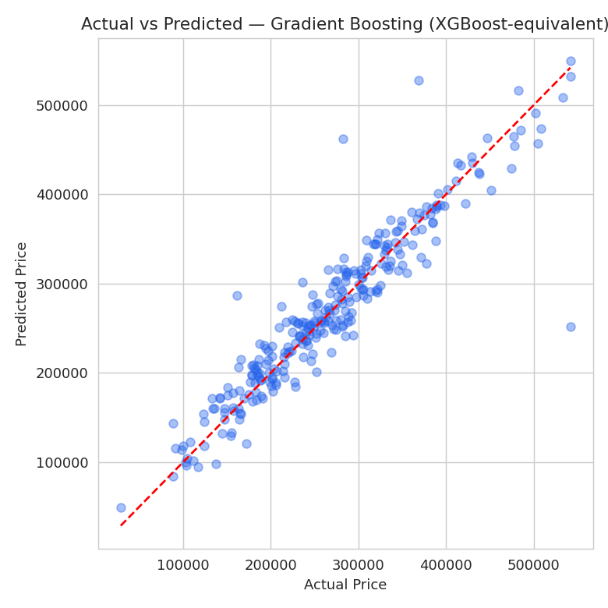
09 — LIVE DEMO
Prediction Accuracy & Deployment
Deployed as a Streamlit app
• User enters area, rooms, age, location & amenities
• App returns an instant price estimate
• Model performance table available inline
• Run locally: streamlit run app.py
House Price Prediction System
11

Slide 12
CONCLUSION & FUTURE SCOPE
A working, deployed model that turns property details into a defensible price estimate.
What we achieved
Future scope
• End-to-end ML lifecycle, phase by phase
• Train on a real, larger housing dataset (Kaggle/UCI)
• 3 models trained & fairly compared
• Add hyperparameter tuning (GridSearch/Optuna)
• Best model: Gradient Boosting, R² = 0.88
• Try real XGBoost / LightGBM / neural nets
• Deployed as an interactive app
• Host the app publicly (Streamlit Cloud)

