Slide 1
CAPGEN
Presented by
PANAV TYAGI (E17CSE184)
Submitted to
DEPARTMENT OF COMPUTER SCIENCE ENGINEERING
BENNETT UNIVERSITY, GREATER NOIDA, 201310, UTTAR PRADESH, INDIA

Slide 2
OUTLINE
Introduction & Background
Problem/Project Statement
Social Importance/Relevance of the Problem
Proposed Solution/ Idea/ Product/Contribution
Experiment and Implementation
Results Analysis and Validation
Conclusion and Future Work
References

Slide 3

INTRODUCTION
A caption can attract a watcher's eye to a significant part of your photo.
Captions are a powerful asset that can be helpful in gathering likes, comments, and can even get an online viewer to connect with you emotionally.
Most importantly, captions create an enormous opportunity to establish a more grounded relationship with your audience.
Therefore, I decided to create a software that can help people generate captions based on the mood displayed in their images.
My goal is to provide the users with AI-generated social media kits that are personalized just for them.
My goal is to minimize the extra effort any avid social media user has to put in finding a perfect caption for their image.
This project is basically a utility for people who like to post on social media and want a caption that perfectly captures the essence of their image.

Slide 4
PROBLEM STATEMENT
Avid social media users must go through the hassle of finding a perfect caption for their image every time they post anything.
They go through blogs, search multiple things on google just to find a perfect caption for their image.
what if there is a tool which can suggest a user some captions based on the emotion in their image?
This would, to an extent, reduce the hassle of brainstorming and finding a good caption.

Slide 5

Social Importance & Relevance
Captions create an enormous opportunity to establish a more grounded relationship with your audience.
Can be helpful in gathering likes, comments, and can even get an online viewer to connect with you emotionally.
Avid social media users must go through the hassle of finding a perfect caption
Saves the hassle of any netizen who must go through a lot of quotes, articles, and other social media accounts searching for the perfect caption
The major target group is basically anyone who uses social media and wants to create a great impact on their followers.

Slide 6
Proposed Solution
The solution that I proposed and implemented has 2 parts – emotion recognition and caption generation.
For the first part, I have created a CNN model which takes in the image that the user has to upload.
The model then identifies emotion from the faces present in the image.
The identifies emotion is then sent as an input for the caption generation model.
The caption generation model generates captions based on the emotion it receives.
I have created scrapers to create a dataset from online resources to train the models.

Slide 7
Implementation
The dataset that was used to create CNN model was obtained by scraping images from Instagram. I also used the FER-2013 dataset.
The resultant CNN model gave us an accuracy of 65%. I validated my model via the scraped images from social media.
The text generation model was created with the help of a python library for gpt-2, named gpt-2-simple.
The gpt-2-simple module was then trained on my corpus and the generated text was both grammatically and contextually correct.

Slide 8
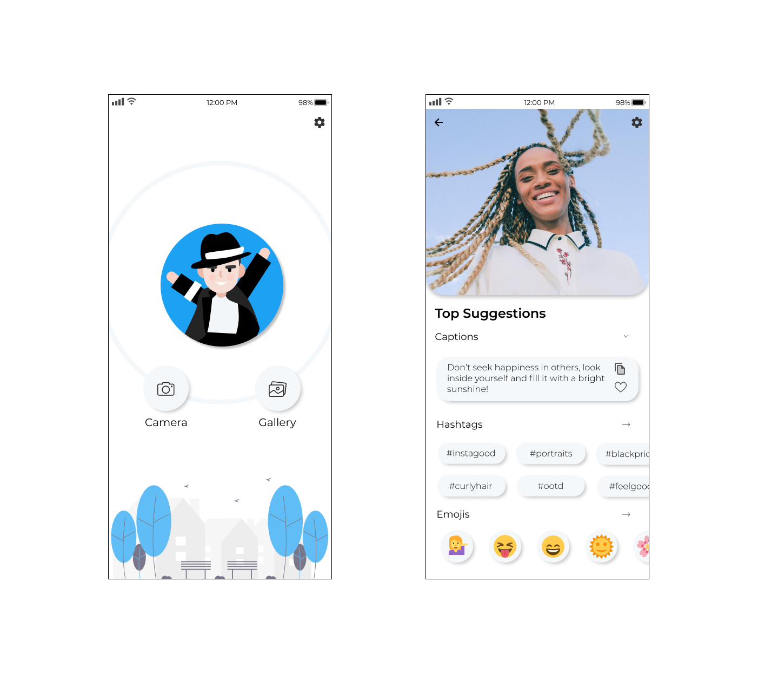
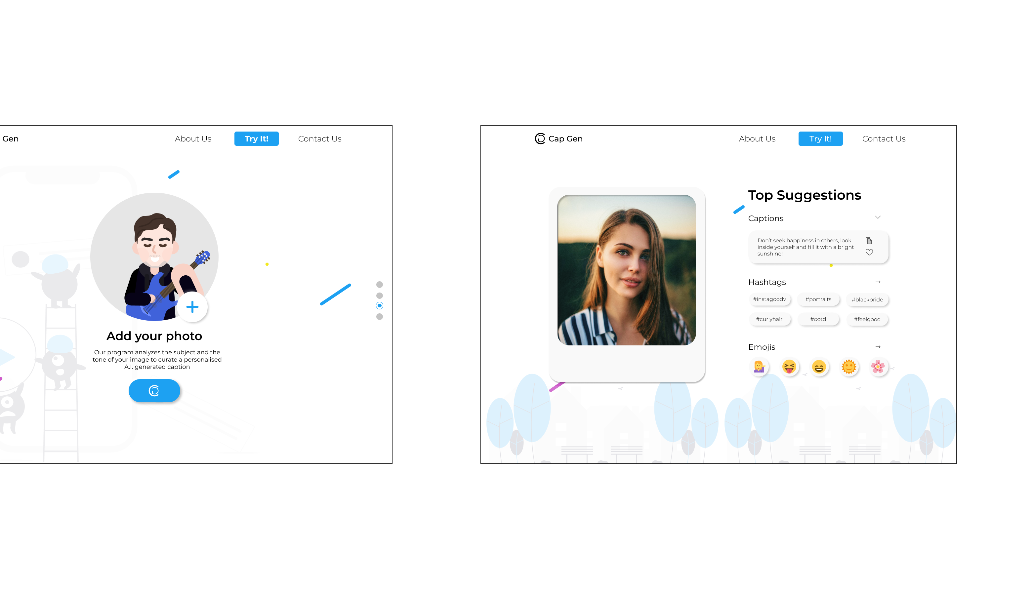
User Interface
The project is available on 2 interfaces – a web application and an android app.
Our application has straight forward U.I. implementations and concepts.
All the user needs to do is upload the photo of his/her choice that using the upload button.
After that, the photo will be analyzed, and captions will be displayed.
The web application has been developed using Flask.
The mobile application has been developed using Flutter.

Slide 9






Technologies Used

Slide 10
Results Analysis and Validation
The resultant model show great results.
The face emotion recognition model works with an accuracy of 65%.
The text generation model outputs text which is contextually and grammatically correct.
The results were verified by testing the CNN model on images scraped from Instagram using hashtags.

Slide 11


DEMO

Slide 12
Future Work
We can incorporate more emotions like sad, angry, surprise, etc. in the coming time.
Also, we can incorporate a feature where the user will be directly able to share the caption with the image on social media using the Instagram API.
a feature where even if there is no human face in the image, the model will be able to detect the mood of the image using properties like color, contrast, brightness, etc.

Slide 13
Conclusion
I created a caption generation software.
It generates captions based on the emotions visible in the image.
The project is available as a web and android application.
The project has been deployed on Heroku and can be seen at https://cap-gen.herokuapp.com

Slide 14
References
“Show, Attend And Tell: Neural Image Caption Generation With Visual Attention” Kelvin Xu, Jimmy Lei BA, Ryan Kiros, Kyunghyun Cho, Aaron Courville, Ruslan Salakhutdinov, Richard S. Zemel, Yoshua Bengio
“Guiding The Long-short Term Memory Model For Image Caption Generation” Xu Jia, Efstratios Gavves, Basura Fernando, Tinne Tuytelaars; Proceedings Of The Ieee International Conference On Computer Vision (Iccv), 2015, Pp. 2407-2415
Bahdanau, Dzmitry, Cho, Kyunghyun, And Bengio, Yoshua. “Neural Machine Translation By Jointly Learning To Align And Translate”. Arxiv:1409.0473, September 2014.
“Challenges In Representation Learning: A Report On Three Machine Learning Contests” I Goodfellow, D Erhan, Pl Carrier, A Courville, M Mirza, B Hamner, W Cukierski, Y Tang, Dh Lee, Y Zhou, C Ramaiah, F Feng, R Li, X Wang, D Athanasakis, J Shawe-taylor, M Milakov, J Park, R Ionescu, M Popescu, C Grozea, J Bergstra, J Xie, L Romaszko, B Xu, Z Chuang, And Y. Bengio. Arxiv 2013.
“Real Time Convolutional Neural Networks For Emotion And Gender Classification” Octavio Arriaga, Paul G. Plöger, And Matias Valdenegro. Arxiv:1710.07557 [Cs.Cv]

Slide 15
LINKS
TWITTER - https://twitter.com/panav_tyagi/status/1466491000726056963?s=20
BLOG - https://medium.com/@panavpratapsinghtyagi/captioned-28c68784da3a
GITHUB - https://github.com/panavtyagi/cap.git

Slide 16
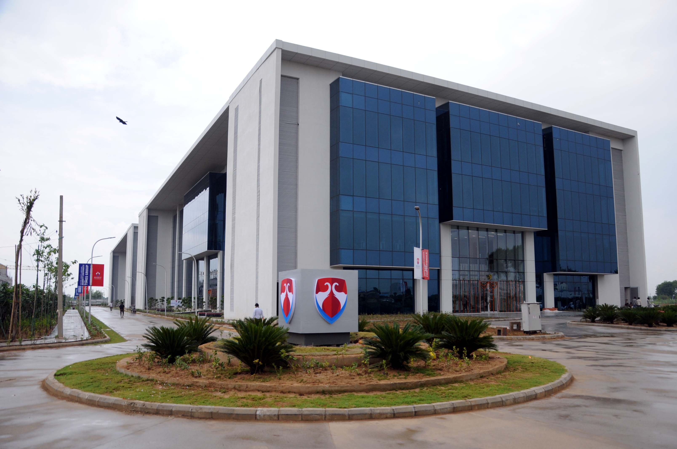
Questions Please Thank You

