Slide 1




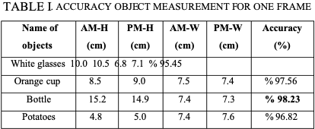
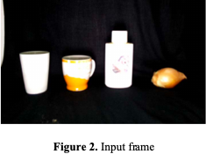
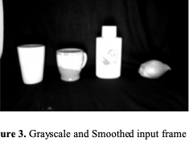
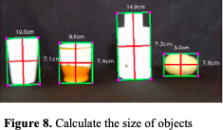
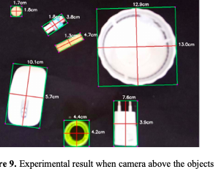
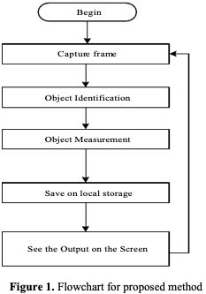
Size measuring of objects in an image
Third Year Project Poster, Fall 2019, Bennett University, Greater Noida, India
PANAV PRATAP SINGH TYAGI E17CSE184
Dept. of Computer Science Engineering, Bennett University, India
Introduction
Techniques Utilized
To briefly summarize object measurement, after edge detection and close any gaps between edges, we detect contours by using an OpenCV function that is cv2.findContours to find the shapes of the objects in the edge
In these days, object detection and
dimensioning of objects is an important issue from many areas of
industry. This is a vital topic of computer vision an image problems. This project presents an enhanced technique for detecting objects and computing their measurements
Problem
we need to pre-process our image. The camera will capture a frame and the frame will
convert to grayscale to increase quickness and accuracy.
Objects are detected via canny edge detector algorithm. It is used to detect only one object or multiple objects. By the help of canny edge detector, the converted image will be processed. The canny edge algorithm scans the entire image. After that, execute dilation and erosion algorithm to close holes among edges in the edge frame.
User Interface/Demo Snapshots
Solution
We suggested an object measurement technique for real-time video by utilizing OpenCV libraries and includesthe canny edge detection, dilation, and erosion algorithms. The suggested technique comprises of four stages: (1) identifying an object to be measured by using canny edge detection algorithm, (2) using morphological operators includes dilation and erosion algorithm to close gaps between edges, (3) find and sort contours, (4) measuring the dimensions of objects. In the implementation of the proposed technique, we designed a system that used OpenCV. The
proposed technique was nearly achieved 98% success in determines the size of the objects.
Conclusion
a powerful real time object measurement method is proposed for industrial systems. In the offered system, Computer Vision used to detect and measure objects. The system can detect and measure objects in a real time video. After the object has been detected by using canny edge detector, the size is obtained for each object by using OpenCV functions. We enhanced the canny edge detector algorithm through utilizing Morphological operations. This procedure benefits to eliminate extra noises. Furthermore, whereas eliminating the extra noises it likewise smoothens the shape and keeps the outline and size of each object. Thus, the outlines of the different objects in the scene were kept.
Future Work
I am planning to use raspberry pi and its on board camera for real time object detection and is measurement even a real time pre-recorded video.
Also using the ip camera and an internet connection for real time transmission of feed from a mobile camera and detection.

