Slide 1






Can Vibe Coding Beat Graduate CS Students?
An LLM vs. Human Coding Tournament on Market-driven Strategic Planning
Panayiotis Danassis¹, Naman Goel²
¹ University of Southampton
² University of Oxford and Alan Turing Institute
Notes:
Hello, my name is Panayiotis Danassis. I’m an Assistant Professor at the University of Southampton. This is joint work with my collaborator Naman Goel from the University of Oxford and the Alan Turing Institute.
So, the title asks: Can vibe coding beat graduate CS students? And the answer is…

Slide 2

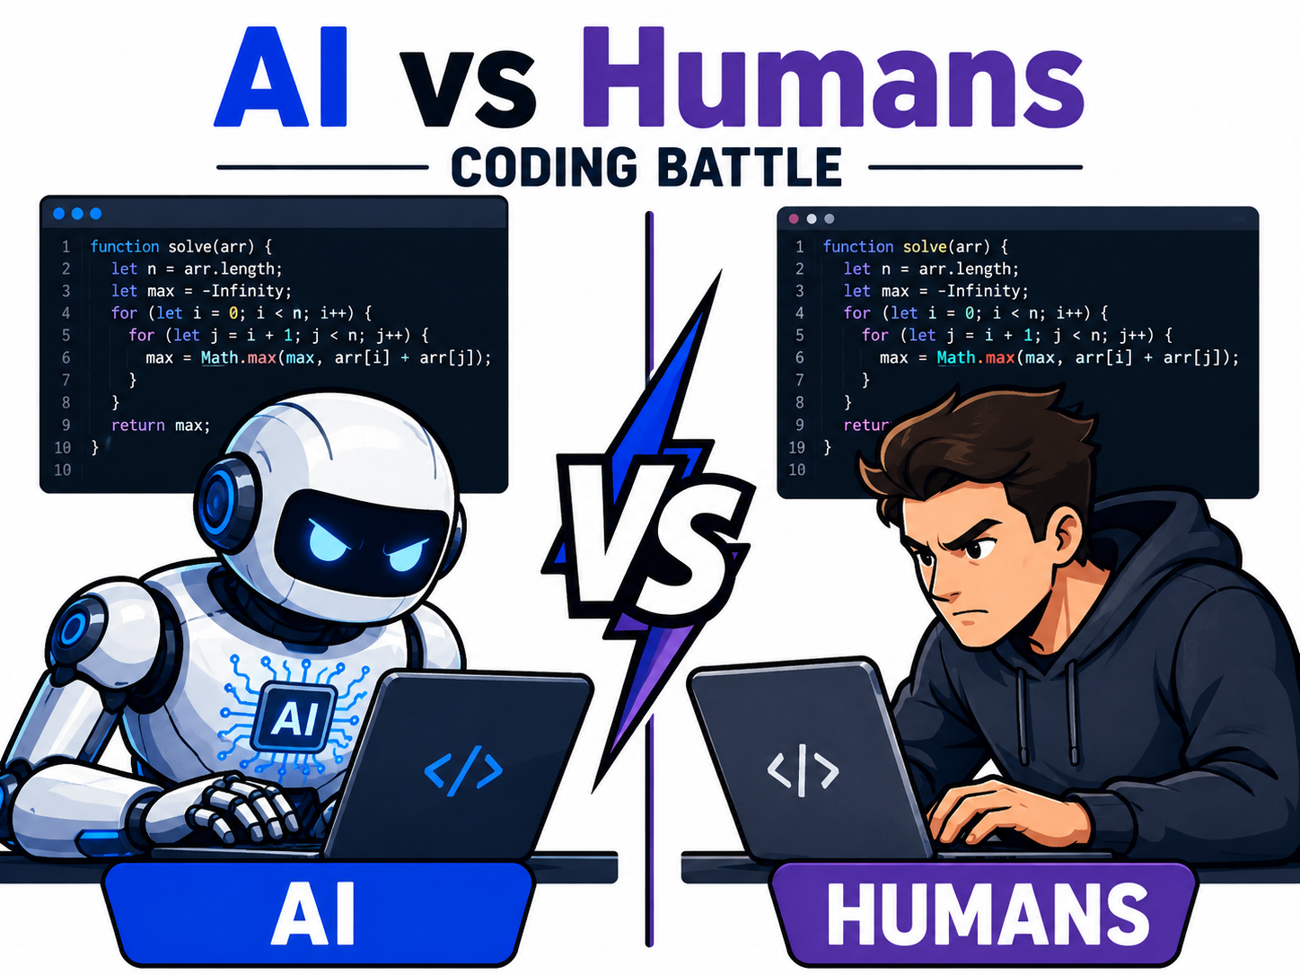



Paper:
Can Vibe Coding Beat Graduate CS Students?
No*
No*
Thank you for your attention!
Notes:
No.
That is the 10-second version of the paper. Of course, the 10-minute version has an asterisk -- and really, the whole paper is about what is hiding behind this asterisk.
But before we get to that, let me explain why this question matters right now.
===
So that concludes the talk; thank you very much. Am I on time?
Okay, of course, this is only the headline answer. There is an asterisk here -- and really, the whole paper is about what is hiding behind this asterisk.
But before we get to that, let me explain why this question matters right now.

Slide 3
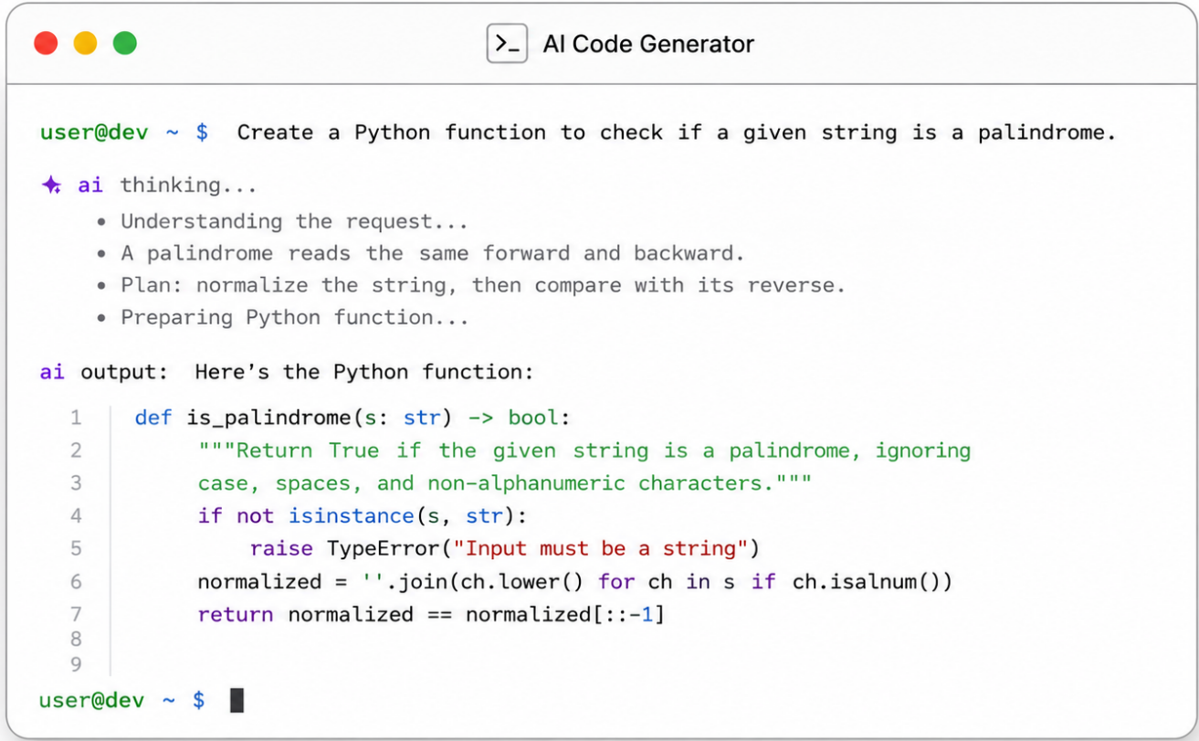
AI Code Generation
75% of all new code at Google is now AI-generated ¹
1. https://blog.google/innovation-and-ai/infrastructure-and-cloud/google-cloud/cloud-next-2026-sundar-pichai/
Notes:
AI-generated code is no longer a niche tool used by a few early adopters. It is becoming a normal part of software development.
In fact, Google recently reported that 75% of all new code at Google is now AI-generated.

Slide 4


The Vibe Coding Promise
Vibe Coding: Natural language → Code
Notes:
Now, I want to highlight a specific kind of AI-assisted coding that has received a lot of attention recently: vibe coding.
The idea is simple: you describe what you want in natural language, and the system turns that into working code.
For example, I was organizing a workshop here on Monday, I asked ChatGPT to build the website and a few minutes later, I had this beautiful and functional website!

Slide 5

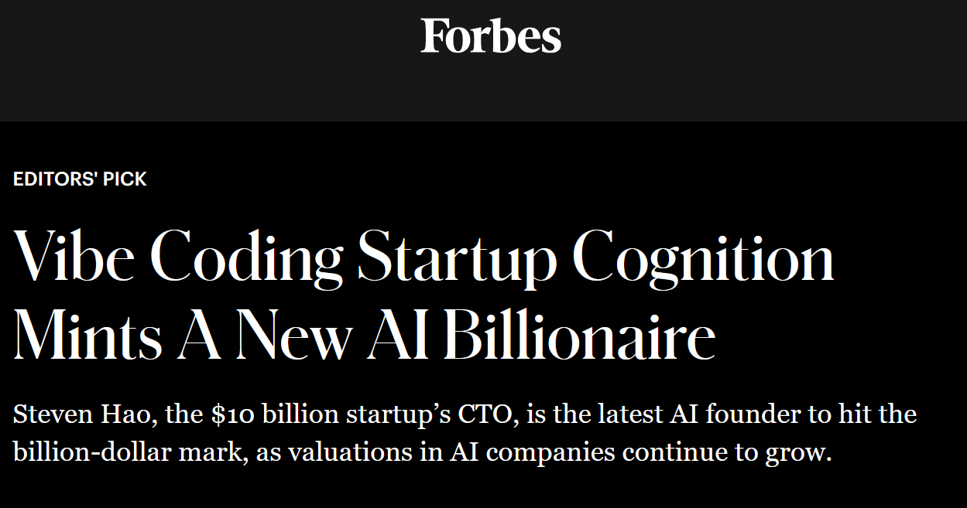
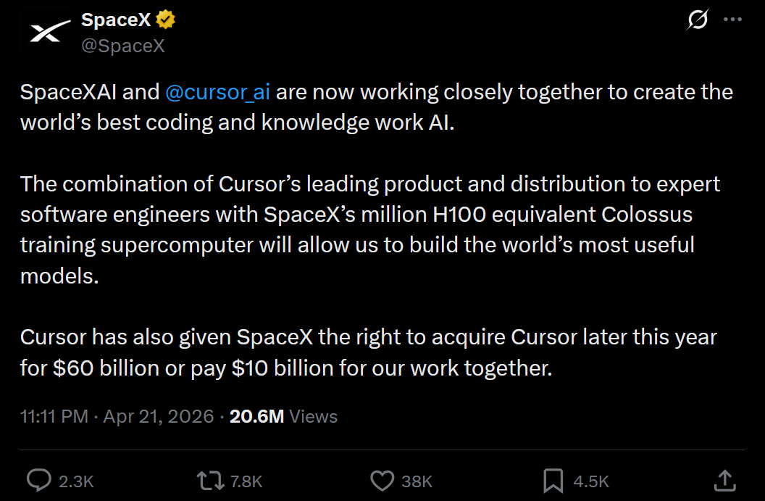
The Vibe Coding Promise
Vibe Coding: Natural language → Code
All people, irrespective of technical backgrounds can turn their ideas into code in seconds!
Notes:
The promise of vibe-coding is that anyone, regardless of technical background, can turn their ideas into code in seconds.
And this promise has now become not only a technical trend, but also a business narrative. You see this in startup valuations, headlines, and ads like this one on the right: “Build an app without knowing how to code.”
But how far does that promise go?

Slide 6
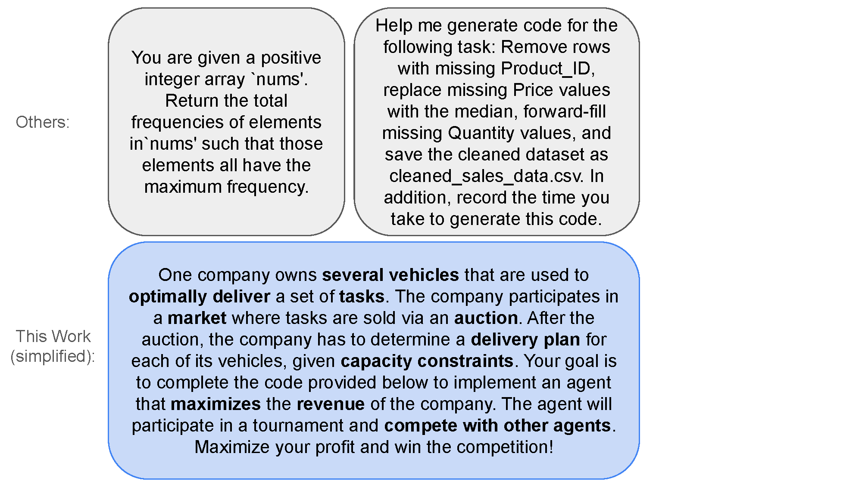
Putting Vibe Coding to the Test
Traditional benchmarks focus on problems with clearly defined correct or incorrect solutions, typically verified through unit tests.
Does benchmark success translate to the ability to compete in problems requiring multi-agent strategic interaction, planning, optimization, and advanced algorithm design?
① Benchmark
MAS, auctions, constraint optimization
💡 Logistics optimization
② Evaluation
No closed form solution
Pass/fail designations not feasible!
💡 Competition vs. human-coded agents
Notes:
So in this paper, we try to put the vibe coding promise to the test.
Most existing coding benchmarks focus on problems where there is a clearly defined correct or incorrect answer. For example, “Given an integer array, return X.”
But many real-world coding problems are not like this.
In the real world, we often care about code that has to make trade-offs. It has to plan under time limits. It has to optimize. It has to interact with other agents. It has to perform well, not just compile.
So the question is:
Does high performance on existing coding benchmarks translate to the ability to compete in these kind of settings?
To answer this, we need two things: a benchmark that contains these elements, and an evaluation method that is not just unit tests, because now we are dealing with problems that have no closed form solution!
For the former, in this work, we use a logistics optimization setting, while for the latter we compare against human coded agents. Let me elaborate on all this.
3:30 mins

Slide 7
Putting Vibe Coding to the Test
① Benchmark
② Evaluation
① Benchmark
MAS, auctions, constraint optimization?
② Evaluation
No closed form solution
Pass/fail designations not feasible!
Traditional benchmarks focus on problems with clearly defined correct or incorrect solutions, typically verified through unit tests.
Does benchmark success translate to the ability to compete in problems requiring multi-agent strategic interaction, planning, optimization, and advanced algorithm design?
7
Notes:
First, we need a benchmark that actually contains these ingredients. At the bottom right, you see the simplified version of the task we give to the model, which is building an agent to manage a delivery company. Like Amazon for example. The goal is to optimally bid for tasks, and delivery the won tasks, so that to maximize profit.

Slide 8

Putting Vibe Coding to the Test
① Benchmark
② Evaluation
Traditional benchmarks focus on problems with clearly defined correct or incorrect solutions, typically verified through unit tests.
Does benchmark success translate to the ability to compete in problems requiring multi-agent strategic interaction, planning, optimization, and advanced algorithm design?
17 human-coded agents, developed before the advent of LLMs (i.e., without any AI assisted programming)
12 agents, MSc CS students at EPFL
5 baselines, AI lab members
8
Notes:
Second, we need a different evaluation method. Because this is an open-ended optimization problem, we cannot simply ask whether the generated code is correct or incorrect. There is no simple closed-form optimal answer here, and a pass/fail unit test is not feasible.
So instead, we evaluate LLM-coded agents in a competition against agents coded by students, before the advent of LLMs. These students had to solve this as a course project. So the comparison is not against an unrealistic gold standard.
This allows us to ask a very concrete question: if we gave modern LLMs the same kind of task, would they produce agents that can compete with these students?

Slide 9
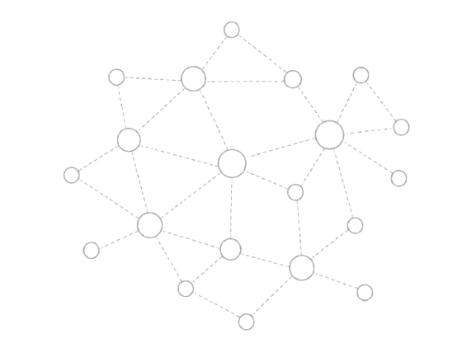










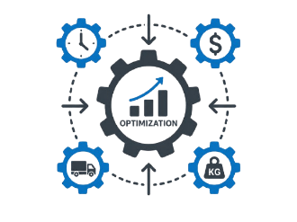
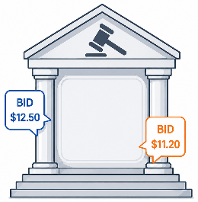
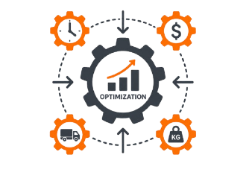
New Frontier in Automated Code Generation
① Benchmark
② Evaluation
The Auction, Pickup, and Delivery Problem (APDP)
Task: Logistic operations optimization
Goal: Maximize profit for a transportation company
Multiple transportation companies (agents)
Several vehicles: location, capacity
Multiple tasks (e.g., parcels): source, destination, weight
Auction
Marginal cost of adding the task
Marginal cost of the opponent
Other strategic decisions (e.g., incurring a loss at the start)
Notes:
Let’s start with the benchmark.
The benchmark is based on what we call the Auction, Pickup, and Delivery Problem. The goal is to maximize the profit of a transportation company.
We have multiple companies, represented by agents, competing in the same environment. Each company owns several vehicles.
Then tasks appear in the network and are auctioned one by one. To bid well, an agent has to reason about several things, for example: His marginal cost, his opponent’s likely marginal cost, and many other strategic considerations like for example having a loss early on to better position his vehicles.
Then, after the auction is over, each company has to compute a delivery plan for all tasks it won, while respecting constraints.

Slide 10
Why this is not just coding?
① Benchmark
② Evaluation
Non-cooperative MAS, Cooperative MAS, Constraint Opt
NP-hard: quality vs. time trade-off (real-time constraints)
Series of interconnected auctions, each affecting the next
Vehicles and their capacity are finite: marginal cost, opportunity cost
Cost of serving a set of tasks is subadditive: (A + B) < A + B
Future supply?
Opponent Actions?
Cannot simply employ an off-the-shelf or memorized algorithm as a competitive solution!
Notes:
So why is this not just another coding task?
Because of all the sources of difficulty.
The agent has to compete in sequential auctions, coordinate multiple vehicles, solve an NP-hard routing problem under time limits, reason about capacity and opportunity cost, and anticipate both future tasks and opponent behavior, and so on.
I won’t go through every item in detail, but the key point is this:
there is no single off-the-shelf or memorized algorithm you can drop in here and expect to win.

Slide 11
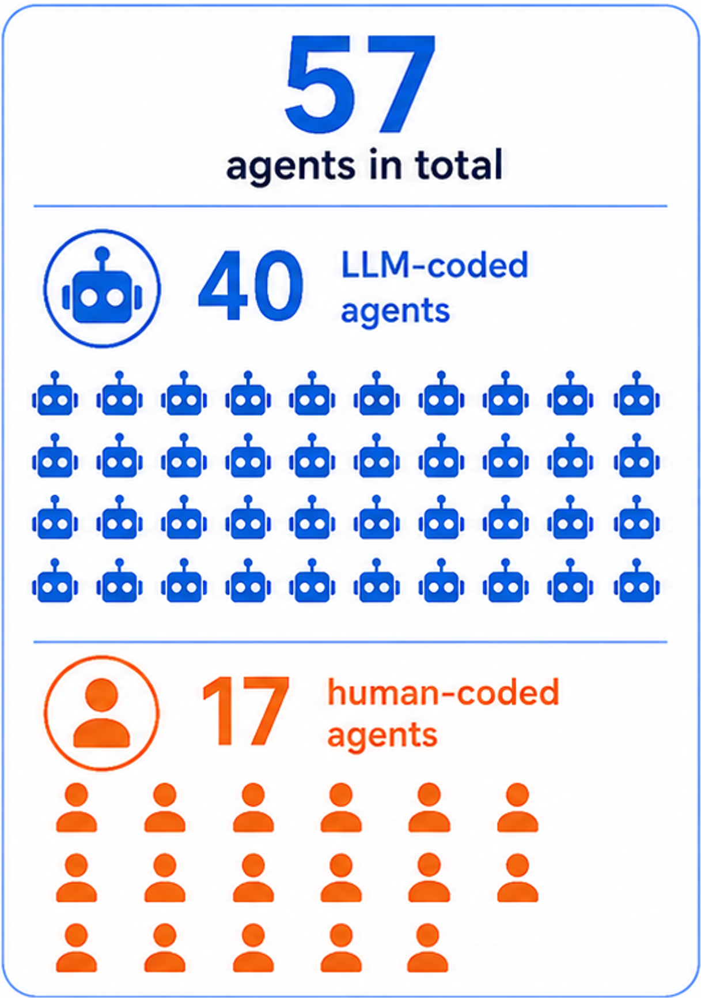
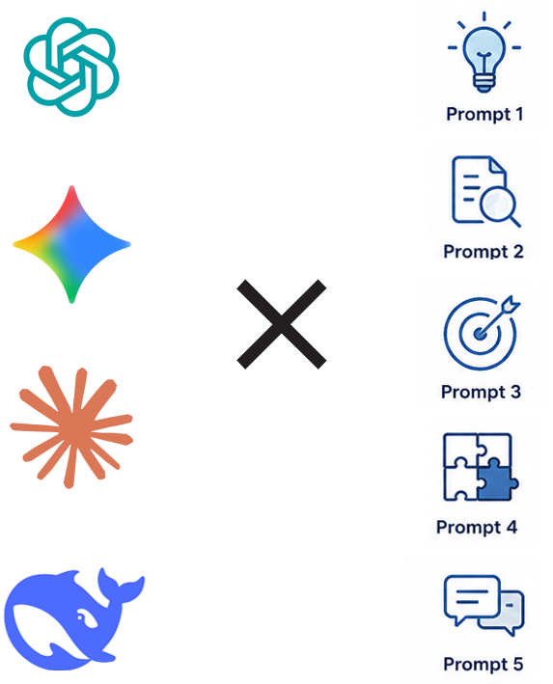
The Competitors: CS Students vs. SOTA LLMs
① Benchmark
② Evaluation
Human-coded Agents
12 agents developed by students
Part of their coursework for the Intelligent Agents course at EPFL
Not professional ML/software engineers
7 naive baselines developed by members of the AI Lab at EPFL
Fix bid
Bid distance × cost per km
Own marginal cost
Opponent marginal cost, etc.
LLM-coded Agents
4 SOTA LLMs: GPT-5 Thinking, Gemini 2.5 Pro, Claude Opus 4.1, and DeepSeek R1
5 different prompting strategies
Author Prompt #1 (A1)
Author Prompt #2 (A2)
Iterative Refinement (IR)
LLM as a Critic (CR)
GPT-5 generated (optimized) prompt (GEN)
Each LLM was prompted twice
Notes:
So who are the competitors?
On the human side, we have agents developed before the advent of LLMs.
Twelve of them were developed by students in the Intelligent Agents course at EPFL. These were Master’s students — not professional machine learning or software engineers. These students had to solve this as a course project. So the comparison is not against an unrealistic gold standard.
We also include simple baseline agents developed by members of the EPFL AI Lab. These baselines use simple strategies like bidding a fix number.
On the LLM side, we use four state-of-the-art models: GPT-5 Thinking, Gemini 2.5 Pro, Claude Opus 4.1, and DeepSeek R1. Importantly, we also test five prompting strategies.
Two are author-written prompts. These are prompts that we wrote to contain the information students received in the course. This allows us to ask a very concrete question: if we gave modern LLMs the same kind of information that students received, would they produce agents that can compete with these students?
Then we test iterative refinement: generate an agent, evaluate it, give the model feedback, and ask whether it wants to improve the agent before entering the tournament.
We also test an “LLM as critic” setup, where GPT-5 reviews the generated code and suggests improvements.
Finally, we test a GPT-5-generated optimized prompt.
For robustness, each model-prompt combination is run twice, giving us 40 LLM-coded agents in total.
7mins

Slide 12
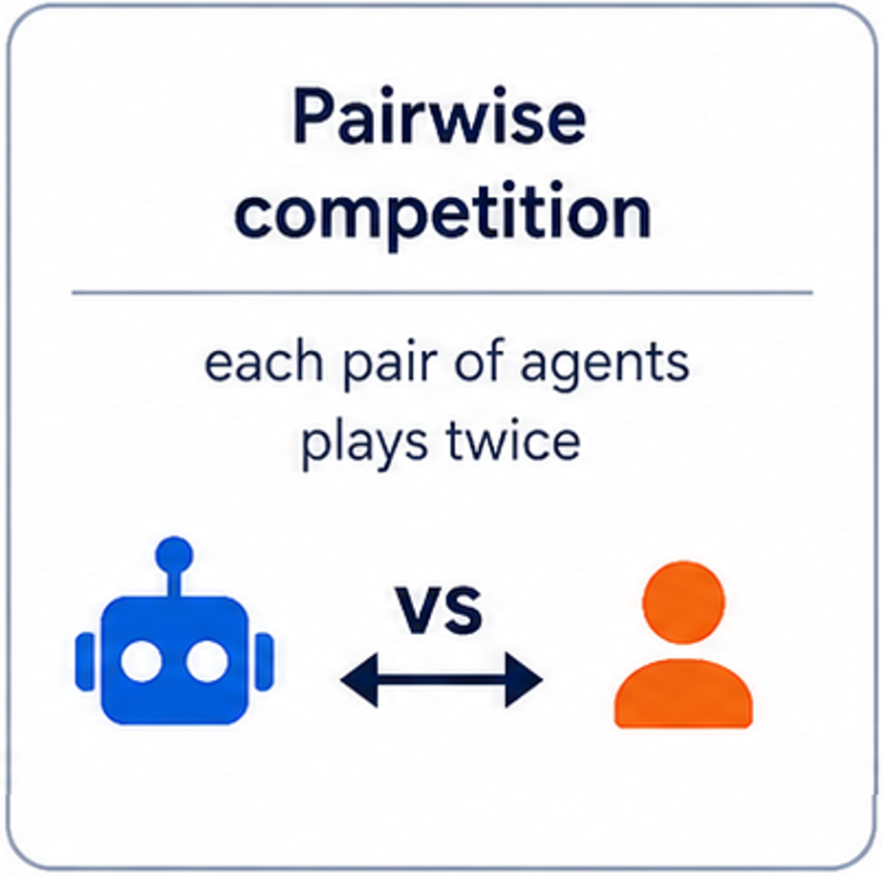
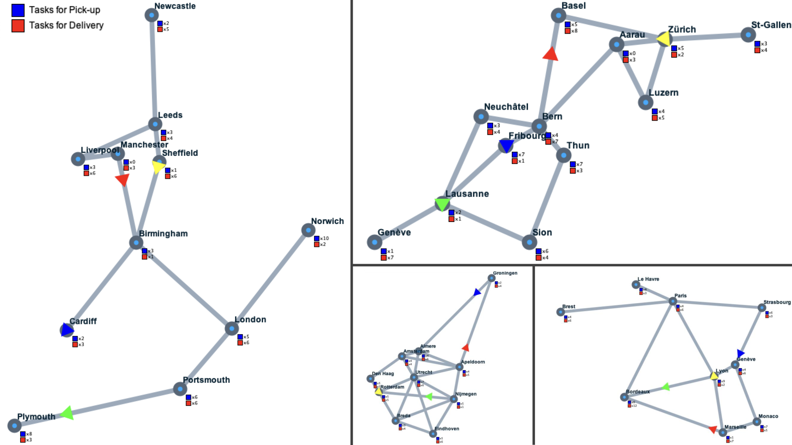
A Tournament, Not a Unit Test
① Benchmark
② Evaluation
Setup: 12 double all-play-all tournaments
4 network topologies; 3 tournaments with each topology
Each pair of agents plays twice for fairness, swapping companies
38304 matches in total
57 agents in total
40 LLM-coded agents
17 human-coded agents
12
Notes:
We evaluate the agents in a tournament, not with a unit test.
There are 57 agents, 4 network topologies, and 12 double all-play-all tournaments. Every agent plays every other agent twice, swapping company assignments for fairness.
In total, we run almost 40,000 matches!
We are not asking: “Does the code run?”
We are asking: “When this code faces another agent, does it make good enough decisions to win?”

Slide 13
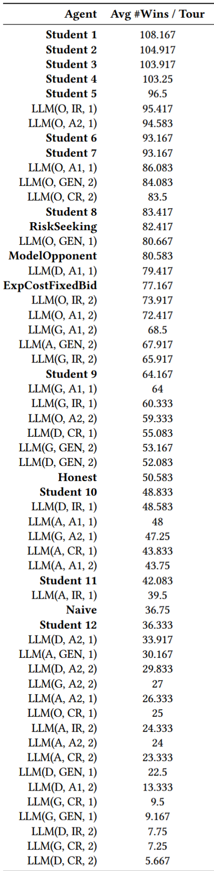



Results
🏆 Humans Dominated. The top 5 spots are consistently won by human-coded agents.
🤖 LLMs Fell Short. 33 of 40 LLM-coded agents lost to simple baseline strategies.
Given the best human solution as an input and prompted to improve upon, the best performing LLM makes the solution significantly worse instead of improving it.
📉Many Shortfalls During Testing.
LLMs often implemented an inadmissible heuristic for A*, while claiming it is admissible (not part of the tournament!).
13
Notes:
The headline result is very clear: humans dominated.
The top five spots are consistently won by human-coded agents.
The best LLM-coded agents are not terrible, but they do not beat the strongest student solutions. And again, these are students, not professional engineers!
Now, most of LLM-generated agents, specifically 33 out of 40, do not just lose to the best students. They also lose to relatively simple hand-written baselines.
We also tried giving the best human solution as input to the best-performing LLM, asking it to improve the code.
And instead of improving it, the model made the solution significantly worse.
This is a very important cautionary result. It suggests that unguided refactoring or “improvement” by an LLM can degrade strategic code, even when the original code is strong.
We also observed many shortfalls during testing. As an example, that is not part of the tournament, comes from A*. Several models implemented an inadmissible heuristic while claiming it was admissible. So, the question here is, does an LLM implementation actually satisfy the assumptions it claims to satisfy?

Slide 14
🎯 Takeaways
💡 Runnable ≠ Competitive: While LLMs can generate code that runs (i.e., free of syntax errors), the solution might not be competitive to human-designed ones on dimensions such as strategic planning, reasoning, optimization, or multi-agent competition.
💡 LLMs for Scaffolding, Humans in the Loop: For problems requiring optimization and planning, LLMs can accelerate implementation but humans should not be left out of the loop.
💡 Refactor with Caution: Code refactoring with no human guidance might degrade performance.
Need for a New Frontier of AI Evaluation: Novel scenarios emerge from strategic interactions between agents.
Notes:
So what should we take away from this?
First: runnable is not the same as competitive.
Second: LLMs are useful for scaffolding, but humans need to remain in the loop, especially for problems requiring optimization and planning and for mission critical applications.
Third: refactor with caution.
Finally, let me be clear about scope. This is not a leaderboard of LLMs, and we are not claiming to have found the optimal prompt or the best LLM performance. But this work points to a broader opportunity. Many AI evaluations are still static: prompt, answer, correctness check. In many real-world settings, difficulty comes from interaction — agents adapt, incentives matter, and decisions shape what happens next. Exactly the kind of setting the AAMAS community understands deeply. This is what this work is mainly about: defining the next frontier of AI Evaluation.

Slide 15
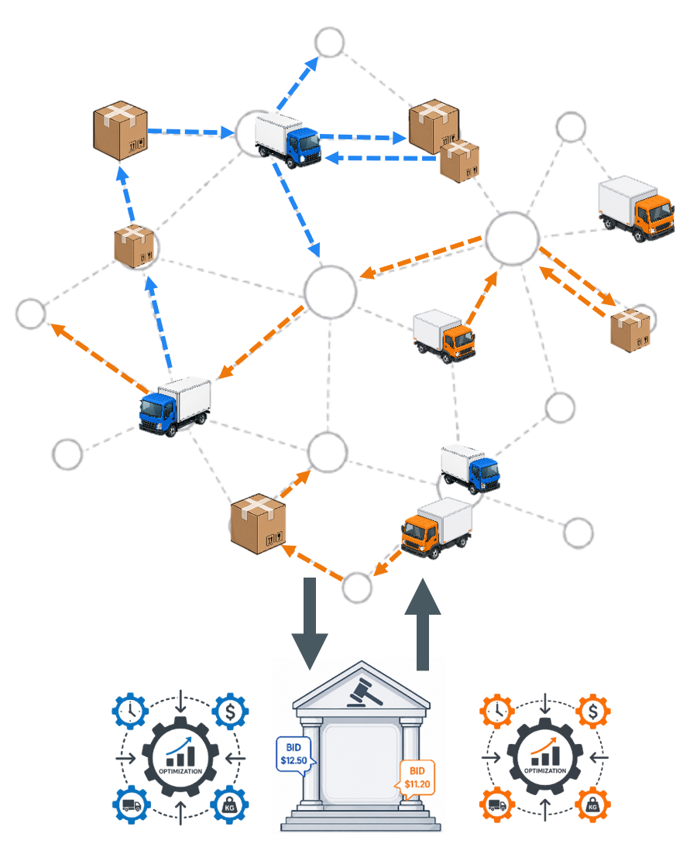


Summary: Vibe Coding Meets Reality
New Frontier of Benchmarks
Multi-agent, long-horizon planning, opponent reasoning, and strategic optimization.
The Vibe Coding Promise: All people, irrespective of technical backgrounds can turn their ideas into code in seconds
Passing the unit test is not the finish line when your code has to face another agent.
The top 5 spots are consistently won by human-coded agents.
Majority of the LLM-coded agents (33/40) lose to simple baselines
*
Thank you!
Paper:
Acknowledgements
Professor Emeritus Boi Faltings
Members of the Artificial Intelligence Laboratory at EPFL who contributed in the development of the Intelligent Agents course over the years
Students who contributed their code as baselines, specifically: Clement Burgelin, Jonas Ulbrich ("Student 3"), Lorenzo Jacqueroud, Alessandro Mari, Antoine Bourret, Samuel Dubuis, Oliver Facklam, Florian Singer, Manuel Leone, Stefano Huber, Wenuka Gunarathna, Sofia Dandjee, Karim Assi, Eugenie Demeure, Lorenzo Panchetti, Maxence Perret.
Website:
Notes:
To conclude,
We showed that producing code that compiles is not the finish line when your code has to face another agent. This should not be read as an argument against using LLMs for coding. On the contrary, they are remarkable engineering tools. But our results suggest that generating runnable code and designing competitive strategic behavior are still very different challenges.
Finally, I would like to sincerely thank Professor Emeritus Boi Faltings, the members of the Artificial Intelligence Laboratory at EPFL, and the students who contributed their code as baselines.
Thank you for attention. I’m happy to take questions.
10:00mins

Slide 17
Limitations & Scope
Not a leaderboard of LLMs We do not claim to find the best model, best prompt, or optimal LLM performance.
One rich domain Our conclusions are based on APDP: a logistics, auction, and planning benchmark.
Representative vibe-coding setting We evaluate broadly accessible LLMs and prompting strategies, not custom systems or highly specialized pipelines.
Main implication We need richer AI evaluations where difficulty emerges from planning, incentives, and interaction between agents.
Notes:
Let me be clear about scope. This is not a leaderboard of LLMs, and we are not claiming to find the optimal prompt or the best possible LLM performance.
The study is based on one domain, APDP, but a rich one: logistics, auctions, planning, and multi-agent interaction.
The broader point is that we need AI evaluations where difficulty comes not just from producing an answer, but from acting strategically in an interactive environment.

