Slide 1
Sonata Admin Bundle – CRUD generator for Back-end and Front-end
Symfony training at Levi9
Maksym Moskvychev
Mykola Labinskyi
Yurii Panaiotov

Slide 2
Agenda
General abilities
Usage
Automation testing
Customization
Handling uploads

Slide 3
What offers Sonata Admin?
Sorting
Support of all types of relations
Filters
Just CRUD
List of entities
Create/Update entity
File upload
Batch actions
Delete entity
Show (preview) mode
Pagination
Confirmation dialog
Export results
xml, json, csv
Breadcrumbs
Menu
Batch delete
Inline ajax actions
Translation for everything except entity fields
ACL by roles

Slide 4

Usage

Slide 5
How to create CRUD?
Services definition
CRUD
Entity
Admin class

Slide 6
Admin class
It is a PHP class where developer override some parent methods in order to:
Define structure of overview table
Define fields for edit form
Configure filters in overview
Set, what templates to use
Add some logic to saving flow
Customize almost everything..

Slide 7
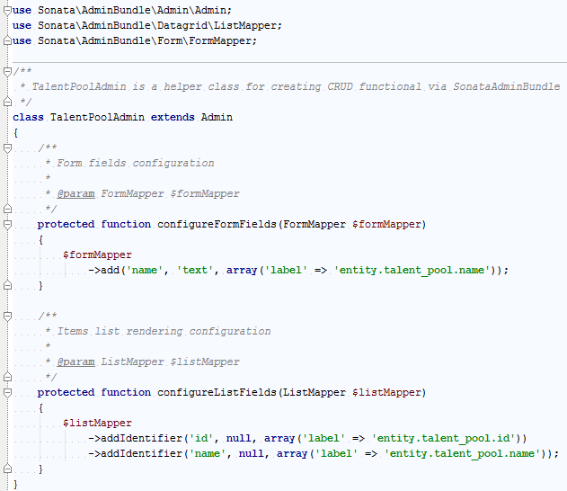
Example of Admin class
Class extends from Basic Admin
Configure fields for Create/Edit Form
Configure fields for overview

Slide 8
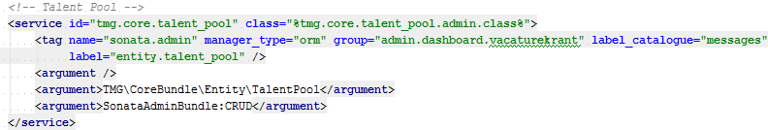
Example of service definition
Service id.
Should be just unique.
Define that this is Sonata Admin class
Class name of Admin class
(Real name is stored in parameters)
Name of menu item
(On dashboard)
What entity to use?
If you need custom controller, you could specify it here

Slide 9

Automation testing

Slide 10
Application design
Symfony Core
Custom Module
SonataAdminBundle
SMART Sonata Controller
Symfony
Kernel
Overridden methods in Admin class
Methods in parent Admin class
Doctrine
Entity
Sonata templates

Slide 11
If all custom code contains only..
Field list used in form
Field list used in overview
Overridden methods in Admin class
Simple getters and setters
Entity
.. then what to cover with
automation tests?

Slide 12
Target for automation tests
Symfony Core
Custom Module
SonataAdminBundle
Trusted code
Trusted code
Routing
SMART Sonata Controller
Kernel
Overridden methods in Admin class
Methods in parent Admin class
Doctrine
Entity
Sonata templates

Slide 13
Testing custom logic in Sonata Admin
Symfony Core
Custom Module
SonataAdminBundle
Trusted code
Trusted code
Routing
SMART Sonata Controller
Kernel
Overridden methods in Admin class
Methods in parent Admin class
Custom logic
Doctrine
Entity
Sonata templates
Custom logic

Slide 14
Covering logic with unit tests
Custom Module
Custom Module
Overridden methods in Admin class
Overridden methods in Admin class
Service class
Custom logic
Custom logic
Unit test
Entity
Entity
Custom logic
Custom logic
Unit test

Slide 15
When we might need functional test?
To check SonataAdmin configuration.
Functional test for only one CRUD, one test case. To check that SonataAdmin stuff is configured correctly.
For Asserts.
Easy way to make assert after another functional test.
To check redirects.
To check sequence of redirects inside some wizard.
To check SQL queries

Slide 16
Tests for custom logic in Sonata Admin
Functional tests
VS
Unit tests
Functional tests send request to a controller and test all workflow
Redirects
SQL Queries
Configuration
Assertions
Unit tests are testing logic of some class independently from the whole world
Everything, that can be separated into Service

Slide 17

Customization

Slide 18
Customization abilities
Templates
Access rights
Saving flow
Overview
Delete
Create
Edit

Slide 19
Creating one entity
Persisting flow
getNewInstance()
Form Submit
Access rights
isGranted()
prePersist()
Persist
$entityManager->flush()
Templates
Configure
postPersist()
setTemplate()

Slide 20
Update an entity
Updating flow
getObject()
Form Submit
Access rights
isGranted()
preUpdate()
Persist
$entityManager->flush()
Templates
Configure
postUpdate()
setTemplate()

Slide 21
Delete an entity
Delete flow
getObject()
Submit confirmation
Access rights
isGranted()
preRemove()
Remove
$entityManager->remove()
Templates
Configure
postRemove()
setTemplate()

Slide 22
Overview of entities
Query flow
createQuery()
Access rights
isGranted()
Templates
Configure
setTemplate()

Slide 23

Handling uploads with Sonata Media

Slide 24
Abilities in Image Uploading
Integration with Sonata Admin
Smart storage
in
user-defined folder
Upload file via form
Media
entity
Upload by direct link
Resizing into different formats
Relation to custom entities

Slide 25
to be continued next Wednesday

