Slide 1
High load projects on Symfony
Symfony training at Levi9
Maksym Moskvychev
Mykola Labinskyi
Yurii Panayotov

Slide 2
Agenda
Network design
Framework abilities to increase performance
Architecture principles & examples
Cache abilities
Tips to save memory

Slide 3

Network design

Slide 4
Network design of typical PHP application
Internet
Reverse proxy
Load balancer
Media storage
PHP node
PHP node
PHP node
PHP node
Session storage
Database cluster configuration
MySQL node
MySQL node
MySQL node

Slide 5
Master / slave DB connections in Symfony
Read/write connection
Define “slave” entity manager in Symfony. Connect slave entity manager with slave load balancer.
Inject default entity manager on regular basics
Inject slave entity manager into services which are loaded only with “read” traffic
Master node
Slave node
Read connection
Slave
node
Load balancer
Slave node

Slide 6
Session storage in Symfony
Symfony can be configured to store sessions in:
Database (SQL or NoSQL)
Memcache server
Then session data will be shared between all PHP nodes. And every PHP node would be able to process request with any session.

Slide 7
Media storage in Symfony
Design (theme) files could be stored in each PHP node.
Some of these files are committed into repository, some could be generated by console command. So, synchronization between nodes is hardly needed here.
Files, uploaded by users need fast synchronization.
A good option is to upload files via ready to use 3rd party libraries (e.g SonataMediaBundle or MoxieManager). A lot of them have build-in support of Amazon S3, simple FTP connectors, etc.
Also there are fast solutions like rsync or remote directory mount .

Slide 8
Build-in gateway proxy
A good choice for reverse proxy is Varnish.
Symfony also has build-in reverse proxy, written on PHP. This proxy is called AppCache. It stores cache data in local file system.
It is easy to use, but have some limitations in production environment:
It can host only current Symfony application
It is made on PHP, so it is not so fast as Varnish
It saves data on local file system
It’s hard to share cached data between PHP nodes.

Slide 9

Framework abilities to increase performance

Slide 10
Tuning performance in Symfony
The following methods increase performance of a Symfony application without side effects:
Enable OPcache in PHP settings.
Cache class autoloader with ApcClassLoader or XcacheClassLoader.
Doctrine query cache in any cache storage.
The total profit is rather significant.

Slide 11

Architecture principles & examples

Slide 12
Storing logic in SQL queries
Logic in PHP classes
VS
Logic in SQL queries
+ easy to implement
+ easy to maintain
+ complex logic could be
split into classes
+ could be covered with unit test
+ fast for batch operations

Slide 13
Storing logic in SQL queries
Publication logic
(method in repository)
->joinLeft(…
Query for Sonata Admin List
Overview of entities on Backend
Custom hydrator
Overview of entities on Frontend
Query for Frontend
Service class
Display one entity on Frontend

Slide 14
Pre-loading data in Doctrine
By default Doctrine loads data from related entities at the moment getter is used.
There is a possibility to download all relations’ data in one query.
$query->joinLeft(‘product.category’);

Slide 15
Personalization & full page cache
Full page cache adds some limitations, because most requests never reach real server
There is no user sessions
There is JavaScript (Ajax, web sockets)
There are headers, cookies
There are ESI tags

Slide 16
Personalization & full page cache
Page itself.
Cached by public cache
User menu in block loaded by JS.
Cached by private cache
Some page
ESI tag.
Cached by public cache
Recently seen pages.
Data stored in Cookies
JavaScript
Google analytics
&
another tracking systems

Slide 17

Cache abilities

Slide 18
Caching in web application
Http cache
Full page cache
Query result cache
Memcached
Memory
Other methods
Gateway cache
PHP accelerator
ESI tags
File system

Slide 19
Http cache
Unified standard for full page cache
Defined in HTTP protocol
Cache communicates with application via HTTP headers and status codes
Available for private and public cache
Expiration and validation caching models
Fully supported by Symfony HTTP Foundation component

Slide 20
Expiration model in HTTP cache
1. Request to “/contacts” page
Internet
Reverse proxy
PHP node
Hey, this response would
be OK for next 2 hours
2. Request to “/contacts” page within 2 hours
Internet
Reverse proxy
Some requests are fetched from cache and do not reach the application
Expiration time can be different for private and public requests

Slide 21
Validation model in HTTP cache
1. Request to “/article1” page
Fetch only hash of article
Fetch all data for article
Internet
Reverse proxy
PHP node
MySQL node
Hey, this response has ETag d54sd65yf6cytfrtfg7w4fgy
Give me “/article1”
FYI: I know response for ETag d54sd65yf6cytfrtfg7w4fgy
2. Request to “/article1” page
Fetch only hash of article
Internet
Reverse proxy
PHP node
MySQL node
Yes, this is exactly d54sd65yf6cytfrtfg7w4fgy

Slide 22
Caching query results in Symfony
Choose one of existing caching providers: APCu, memory (memcache/arrays), file system, etc..
Set ‘result query cache provider’ during building a query
Choose and set cache lifetime during building a query.

Slide 23
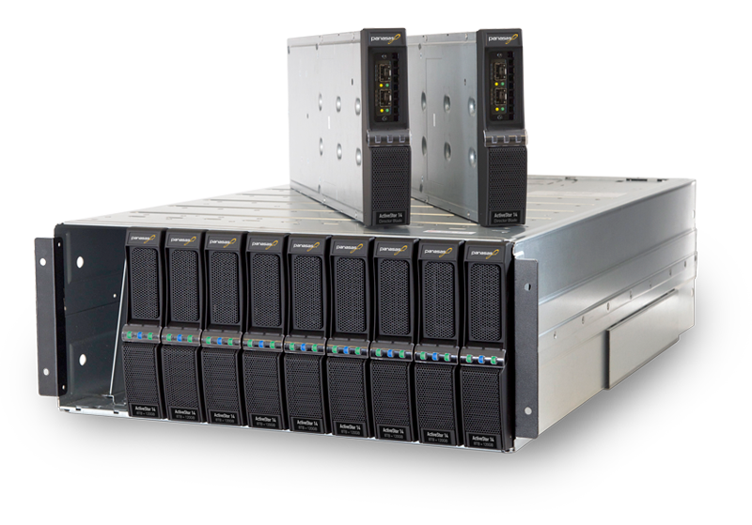
Tips to save memory

Slide 24
Saving memory in Symfony
Turn off SQL logger.
In debug mode it stores in memory information about all executed queries.
Clear entity manager from time to time
$entityManager->clear()
Flush garbage collector from time to time
gc_collect_cycles()
Use pagination to foreach huge amount of data.
Use few queries with limit/offset instead of one query for all data.
Use batch processing for bulk operations with a lot of data.
Well-suited for mass inserts, updates or deletions.

Slide 25
Typical scheme of console command in Symfony
Turn off SQL logger
Fetch batch of data
Apply some logic
to each data row
Clear entity manager
Flush garbage collector

Slide 26
The End

