Slide 1
Architecture of a web project on Symfony
Symfony training at Levi9
Maksym Moskvychev
Mykola Labinskyi
Yurii Panaiotov

Slide 2

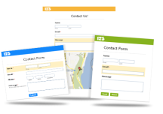




Agenda
Bundles in Symfony
Page with a Form in Symfony
Page with a List in Symfony
Multilingual support in Symfony
Functional tests in Symfony
Web application security and Symfony

Slide 3

Bundles in Symfony

Slide 4
Symfony Bundle structure
Presentation layer
Service layer
Database layer
Commands
Services
Entities
Controllers
Form Types
Entity Repositories
Listeners
Templates
Pictures
CSS
Unit tests
JavaScript
Functional tests

Slide 5
Purpose of multiple bundles in Symfony project
One application hosts few sites – each site could be represented via bundle
Project needs integration with some external service, this integration could be represented as a bridge bundle.
New presentation layer is added to project (i.e. some API), this could be implemented as separate bundle

Slide 6
Example of multiple bundle architecture
All custom bundles
Bundles in Vendors
Group of custom bundles
Symfony
Framework
Bundle
SiteA Bundle
Core Bundle
Symfony Components
SiteB Bundle
Doctrine
Twig
Facebook Bundle
External service
Facebook API

Slide 7
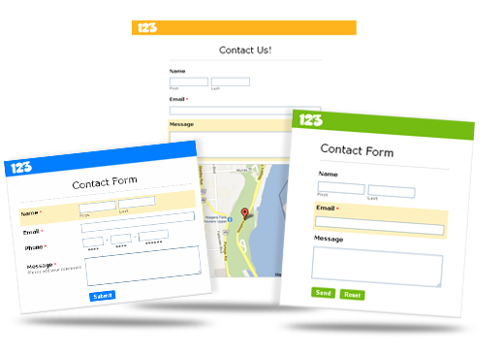
Page with a Form in Symfony

Slide 8
Application design for a page with a form
Symfony 2 Core
Controller
Form instance
HTTP
Request
Form
Request
Is Form Valid ?
If Form is valid
It contains Entity
Controller asks
to save Entity
Entity
Doctrine
Validation rules
Set success message
Session
Response
Template
HTTP
Response

Slide 9
Application design for a page with a form
Controller action is responsible for 3 types of requests:
Form is rendered first time
Handle success form submission
There was error in form validation. Render a form with errors.
Get form instance
Handle Request by the form
Check if Form is Valid
+
Form is submitted
2
+
Save entity to DB.
Add success message to session.
3
1
Add error message to session.
Redirect to some page
Render a template

Slide 10
Page with a form and custom logic
For example, this is a registration form.
After user is registered we have to send him “welcome” email, then notify moderator to check this user, and authenticate.
send “welcome” email
User Mailer Service
Registration
service
notify moderator
Moderator Mailer Service
authenticate
Authentication Service
persist in database
Doctrine

Slide 11
Page with a form and custom logic
Get form instance
If you have any custom logic – keep it all in a service classes.
Handle Request by the form
Check if Form is Valid
+
2
Form is submitted
Registration
service
+
3
1
Add error message to session.
Redirect to some page
Render a template

Slide 12
Unit testing the Service class
All relations are replaced by mocks
Tested class is the only one real class in the test. Only it can be created via “new”
send “welcome” email
User Mailer Service
The test itself checks that when user is registered – all needed services will be called.
Registration
service
notify moderator
Moderator Mailer Service
Unit test
authenticate
Authentication Service
persist in database
Doctrine

Slide 13

Page with a List in Symfony

Slide 14
Application design for a page with a list
Symfony 2 Core
Controller
HTTP
Request
Request
Controller fetch entity repository
Doctrine
Entity repository
->findBy()
data
Response
Template
HTTP
Response

Slide 15
Introduction of service layer
Symfony 2 Core
Controller
HTTP
Request
Request
Fetch entity repository
Doctrine
Service class
getListData
data
Entity repository
->findBy()
data
Response
Template
HTTP
Response

Slide 16
Advantages of service layer on a page with a list
Less logic and dependencies in controller.
Ability to reuse data for the list from another place.
Ability to cover fetching logic by Unit test.

Slide 17
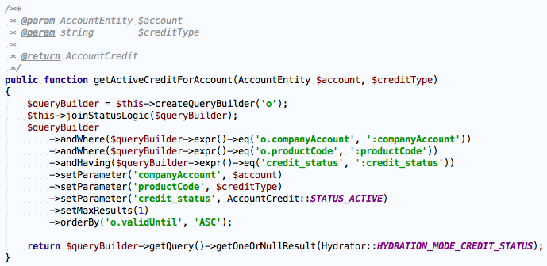
When you need a custom SQL query
Create method in entity repository
Define your logic in object-oriented way

Slide 18
Build-in abilities of entity repositories
->find($id)
Search by Id
->findAll()
Return all entities
->findOneBy($criteria)
Search for one entity by criteria
->findBy($criteria)
Search for entities by criteria
->findOneName($name)
Search for one entity by name. Magic method.
->findName($name)
Search for entities by name. Magic method.

Slide 19
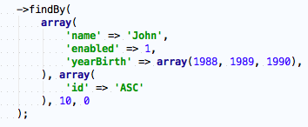

Build-in abilities of entity repositories
findBy(
array $criteria,
array $orderBy = null,
$limit = null,
$offset = null
)

Slide 20

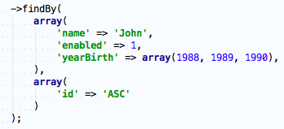
Multilingual support in Symfony

Slide 21
Purpose of multilingual support
Even if your site is only in English now, you should take care of its multilingual abilities.
Nobody knows what will be with the project in 5 years. But if the project is success, it will go to another countries.
Static text on pages
Form fields
Menus
Messages to user
Translation of user interface
Localized versions of content from DB
Translation of content
How to determine User locale?
Switching between locales
Switching between locales

Slide 22
Translation of user interface
Use “keys” instead of strings. And translate these “keys” via Symfony translation component. With this rule you must not have strings in your code, even in templates.
Create translation files for each supported language. Define real text for each “key” in translation files.

Slide 23
Translation of user interface
Symfony 2 Core
Controller
Form instance
HTTP
Request
Form
Request
Is Form Valid ?
If Form is valid
It contains Entity
Controller asks
to save Entity
Entity
Doctrine
Validation rules
Set success message
Session
Translation files
Response
Template
HTTP
Response

Slide 24
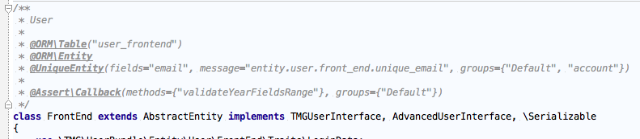
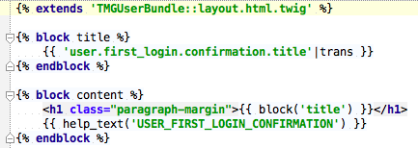
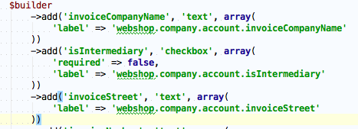
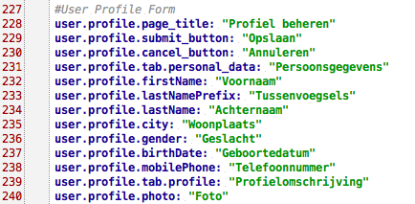
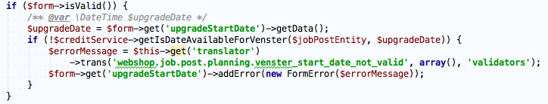
Translation of user interface
Entity
Twig template
Form
Controller
Translation file in yml format

Slide 25
Translation of content
Create custom DB structure to support localized entities.
It’s a complex task.
Doctrine ODM supports localized documents out of the box.
Its easy to use, but hard to combine requests to ORM & ODM systems

Slide 26
Switching between locales
Set default locale in configuration.
Set default locale for each route.
Determine locale from request URI
Determine locale from domain

Slide 27

Functional tests in Symfony

Slide 28
Tips about Functional tests
Functional tests make requests to controllers, and check HTTP response from them.
Functional tests are good in checking that all modules, used in a request, are integrated in a right way.
Functional tests work much slower then Unit tests. Their amount should be under control.

Slide 29
Functional and Unit tests in Symfony
Test suite for Unit tests
Run test
Test suite for Functional tests
Clear database
Create database schema
Run migrations
Run fixtures
Run test

Slide 30
How to set up environment for Functional tests
Option 1. Bootstrap file.
You could create bootstrap file, which will refresh database before whole test suite. Path to bootstrap file could be defined in phpunit.xml file.
Option 2. Set up method.
If all tests are extended from one parent – you could define setUp method in it, which will refresh database after each test.

Slide 31

Web application security and Symfony

Slide 32
Symfony resolves some vulnerabilities
Cross Site Scripting
Authorization policy
SQL Injection
Information Disclosure
Cross Site Request Forgery

Slide 33
Cross Site Scripting
Policy: save as it is, escape on output
When using Twig templates, all values printed in template are automatically escaped.

Slide 34
SQL Injection
Policy: pass to database raw data, but use Prepared Statements
Write SQL queries via Doctrine Query Builder, pass all parameters via setParameter() methods, and you’ll be safe.

Slide 35
Cross Site Request Forgery
Policy: all not-safe requests include protection by CSRF token
By default, all forms in Symfony have _token field, responsible for CSRF protection. Token is validated automatically, while form validation.
If some unsafe action is performed without a form – you should include one or do CSRF check manually.

Slide 36
Information Disclosure & Authorization policy
Policy: white-list access to resources
Security component in Symfony allows to configure:
Firewalls to set up Authentication policy.
User providers to get list of users for Authentication.
Access rules to match a resource and a role.
Role hierarchy to define dependencies between roles.
Encoders to define algorithm to encode passwords.
In addition, there is ACL system that allows to store access rules in unified database structure.

Slide 37
to be continued next Tuesday

