Slide 1
Personal Profile
PAN, Fan (Peter)

Slide 2

About
Education
Master of Logistics Engineering, Shanghai Jiao Tong University
Bachelor of Industrial Engineering, China University of Mining and Technology
Strength
Proficient in SCM workflow & practice;
Drive result through firm actions;
Collaborative & team-oriented attitude.
Supporting Skill
Good database development (SQL), coding (VBA) skills;
Strong data analysis skill, with capability of modeling with R;
Fundamental financial knowledge: FMCM (CPA, module passed), Accounting Professional.
Professional Experience
SCM Management Trainee
Logistics Analyst (MT, 1st year) - APAC Corporate SCM
Materials Planner (MT, 2nd year) - Ningbo Hydraulics
Supplier Development Engineer (MT, 3rd year) - VG China SCM
Senior Materials & Planning Analyst - APAC Filtration

Slide 3
Professional Experience Senior Materials & Planning Analyst - APAC Filtration
Scope
Regional Role: Lead freight cost control, inventory optimization, OTD improvement, excess & obsolete reduction in APAC region;
RDC Role: Own RDC’s (regional distribution center in Shanghai) planning, purchasing, freight forwarding, trade compliance.
Accomplishments
Total regional inventory was reduced by 15%, in which Shanghai RDC was reduced by 30%;
Overall RDC readiness Lead-time was improved by 25%, key products (A items) readiness LT was improved by 70%.
Drive regional logistics saving from $10 to $100K, P&L logistics cost effectiveness was improved by 30% ($400K).
Developed a database based on ACCESS for APAC Regional Distribution Center logistics management;

Slide 4
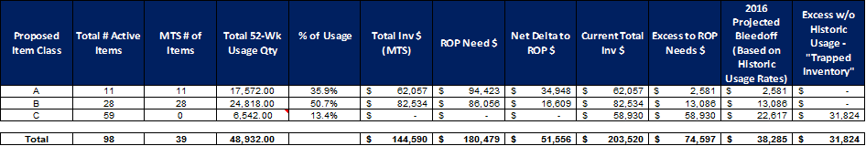
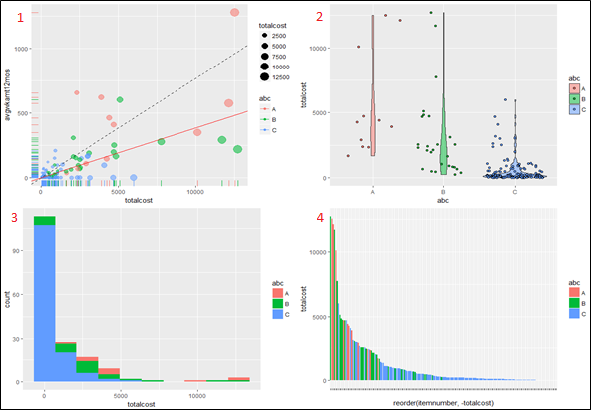
Quarterly Inventory Review
Questions to be answered in review
What’s the inventory profile of current level?
Does the existing ABC coding correctly reflect customers’ (historical) demand?
Any “A” & “B” parts have risk with decreasing demand, and to be moved to “C” taking out safety stock?
What’s the new reasonable ROP (re-order point) level for each stock item?
Any disturbance factors to be considered?

Slide 5
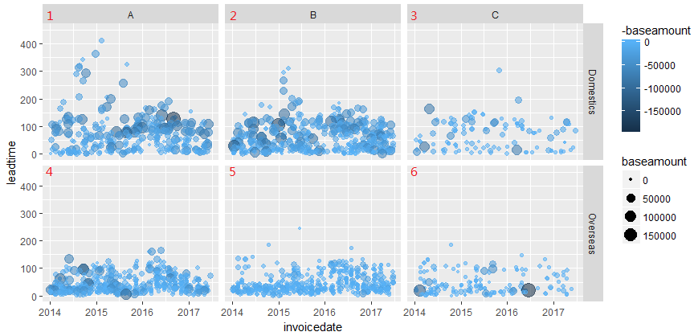
Leadtime Improvement
Less extreme-LT occasions to ensure stable supply to customer
0-day-leadtime is becoming more and more possible for MTS (make to stock items, namely A & B items)
* Leadtime = invoice date – order date

Slide 6
Professional Experience Logistics Analyst (MT, 1st year) - APAC Corporate SCM
Scope
Commodity management: Inland small parcel
Regional logistics data warehouse management
Cargo Claim Program
Support the Regional Freight RFQ, Freight Audit Program
Accomplishments
Led China Road Mode Optimization project (Phase III), delivering about 10% savings from $600K addressable spending;
Supported Supply Chain Optimization by Utilizing Reusable Packaging Project, the project delivered $200K savings

Slide 7
Professional Experience Materials Planner (MT, 2nd year) - Ningbo Hydraulics, Logistics Department
Scope
Daily PR creation, PO releasing, orders tracking. Also responsible on past-due shipment, issue escalation to improve OTD performance.
Work on logistics cost savings, inventory control, ERP system health.
Process Improvement / Continues improvements.
Accomplishments
Importing shipping mode optimization.
Purchasing lead-time was reduced from 75 days to 55 days resetting the benchmark,
Small parcel shipments decreased by 70%
FCL TEU increased by 150%.
Past due amount was reduced by 80%, from $55K/month to $10K/month and less.

Slide 8
Importing shipping mode optimization Observations & Approach
Observations
High past due amount
Long purchasing lead-time
Shipments are very disperse
Lots of FedEx shipments
Many light-weight ocean shipments
Improvement Approach
FedEx Reduction, transferring FedEx shipments into air shipping
Shipment density improvement, consolidating LCL shipments to FCL, and combine several air shipments into one air shipment.
Transfer sea shipments below 220kg to air shipping.
10 TEU
6 TEU
7 TEU
4 TEU
5 TEU
5 TEU
4 TEU
4 TEU
1 TEU
Count of shipments Total

Slide 9
Importing shipping mode optimization Total freight spending was well controlled
Remarks:
Total shipping spending is controlled well, even air spending is higher than before, as a result of FedEx reduction and shipments combination which avoid lots of shipping spending and clearance fee.
Shipping Spending Total
Freight as % of purchased amount

Slide 10
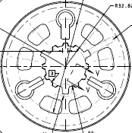
Professional Experience Supplier Development Engineer (MT, 3rd year) - VG China SCM
Scope:
Project: Localization project
Part No./Name: 2770441 Plate-Clutch
Sourcing Reason: Localization
Supplier: Shiyan Tongchuang (New Supplier)
Investment:
Capex:
Forging Die: $0.23K
Cutter: $10K
Gauge: $2.3K
2016 Saving: $3K
MY Saving: $8.4K
Saving Rate: 20%
Timing/Milestones
Sourcing decision _ Sept 22, 2015
Process development _ Nov 11 2015
Tooling approval _ Jan 16, 216
PAPP Submission _ Feb 28, 2016
PPAP approval _ Mar 15, 2016
SOP _ Apr 2016
Current Risks:
Milling on grooves may miss the requirement of print
KEY PROGRESS In last (30) days:
2770441 Broaching cutter, gauge design approval
Supplier Tooling order released to the cutter vendor
PTC reviewed with the supplier and engineering
PLANNED ACTIONS In next 30 days: (Focused Area)
PTC sign-off
Tooling procurement in position
Post-broaching process validation
Item | Issue | Mitigation Plans | Resp. | Target Date
1
2

Slide 11
Thanks for your time

