Slide 1
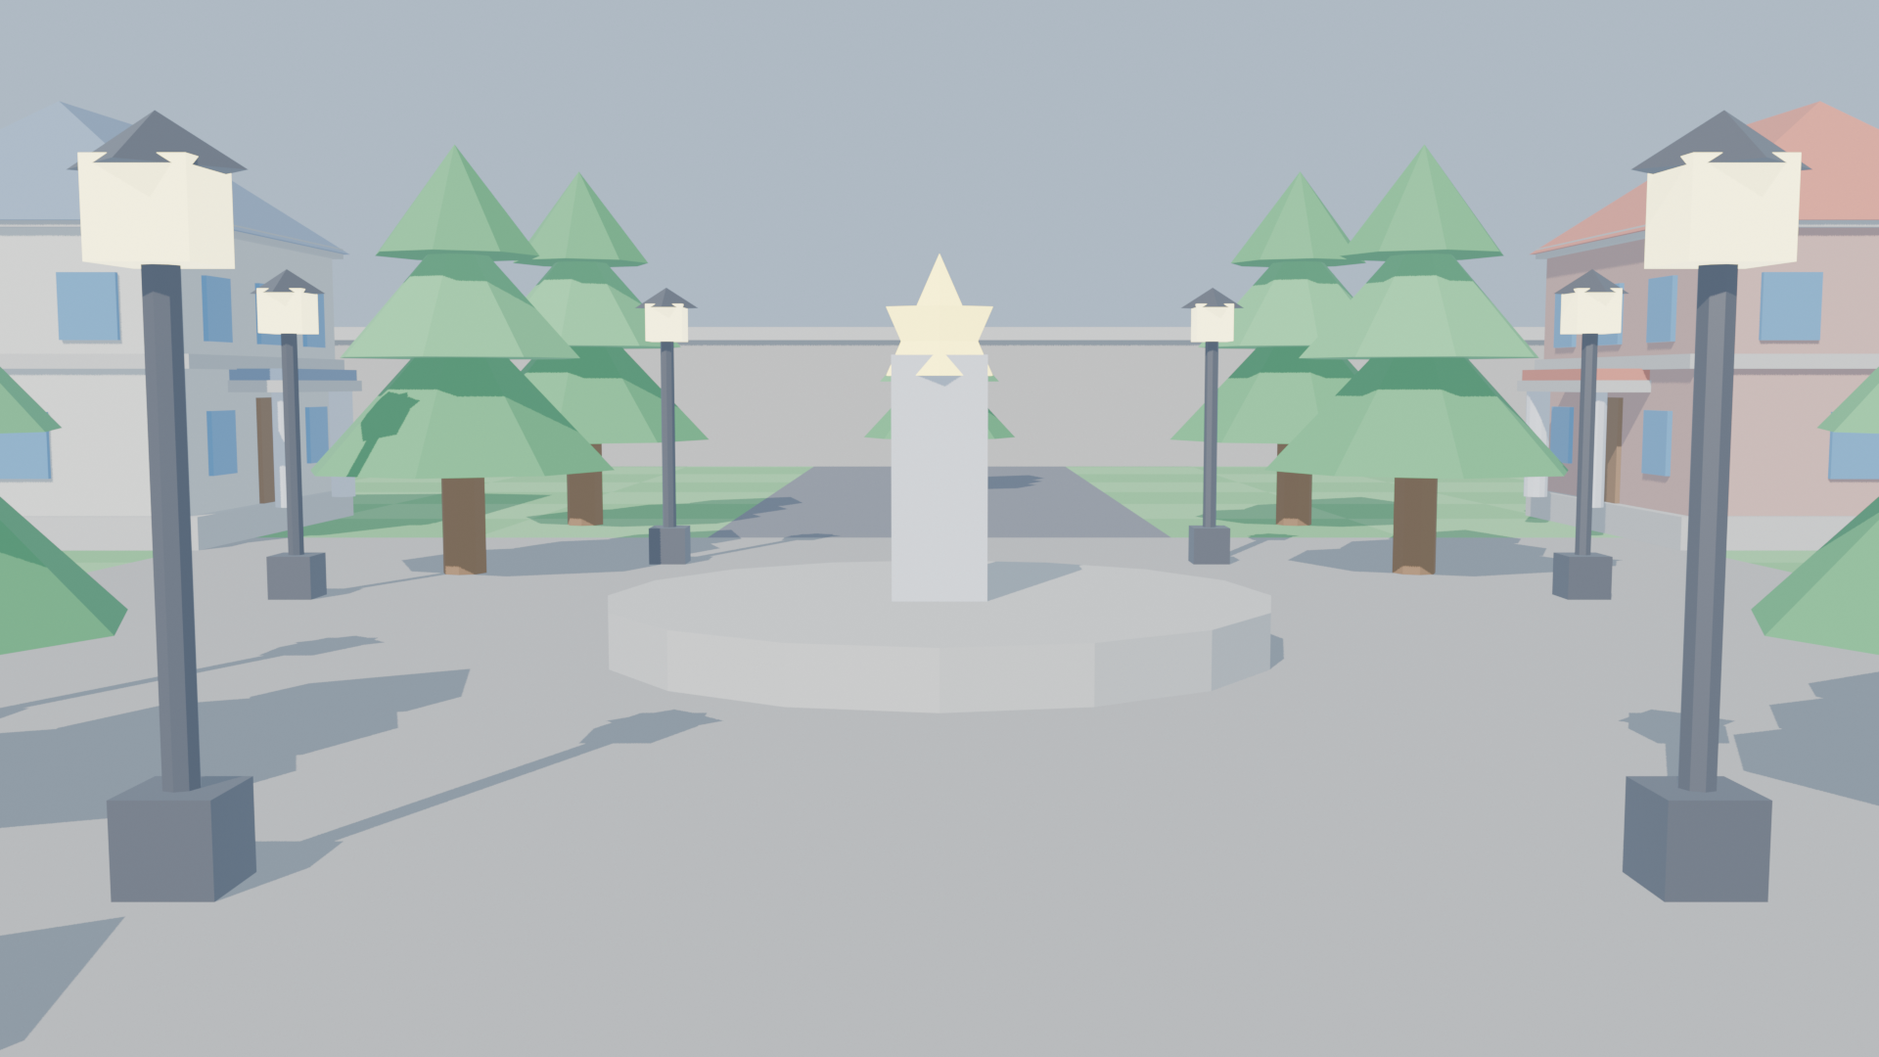
COMPUTER GRAPHICS & GAME ENGINE OPTIMIZATION
Real-Time 3D Game Environment Optimization Using Back-Face Culling
A hardware-accelerated 3D environment that proves how culling hidden polygons cuts GPU work and frame latency.
Python 3.x | OpenGL 4.6 | Pygame | Blender 5.0
RENDERED
CULLED

Slide 2
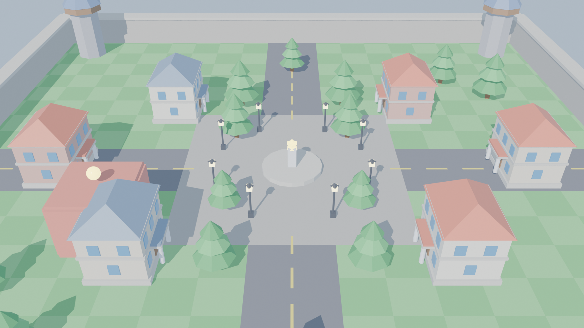



The Problem: Invisible Polygon Waste
16.6 ms
Frame budget for 60+ FPS with millions of triangles.
~50%
Of a closed mesh faces away from the camera and is never seen.
Every building hides faces the camera can never see
Culled early
WITHOUT
100% drawn
WITH
~50% skipped
Back-facing triangles are dropped before rasterization, with no visual change.

Slide 3
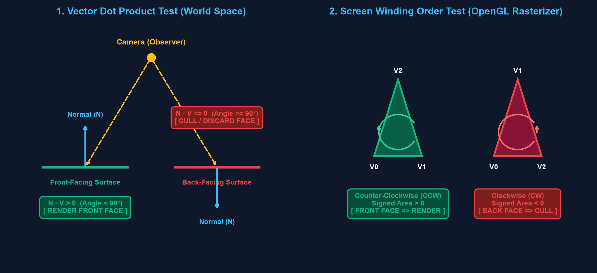
How Culling Works: Two Simple Tests
Object space
N · V > 0 => Render
N · V <= 0 => Cull
Screen space
Area > 0 => CCW (Render)
Area < 0 => CW (Cull)
Vertex Shader
›
Primitive Assembly
CULLING HERE
›
Rasterizer
›
Fragment Shader

Slide 4
Implementation: Python + OpenGL + Blender
main.py
culling_manager.py
scene.py
Pipeline coordinator & game loop
GL_CULL_FACE, GL_BACK, GL_CCW
Buildings, towers, trees, stress grid
camera.py
obj_loader.py
hud.py
6-DOF first-person flight
OBJ parser into Display Lists
Live FPS, ms & discard counter
Blender Face Orientation Rule
Live Demo Keys
BLUE = front-facing CCW (correct)
[C]
[M]
[T]
[U]
RED = inward normals (wrongly culled)
Culling
Wireframe
Stress Grid
Uncapped FPS

Slide 5
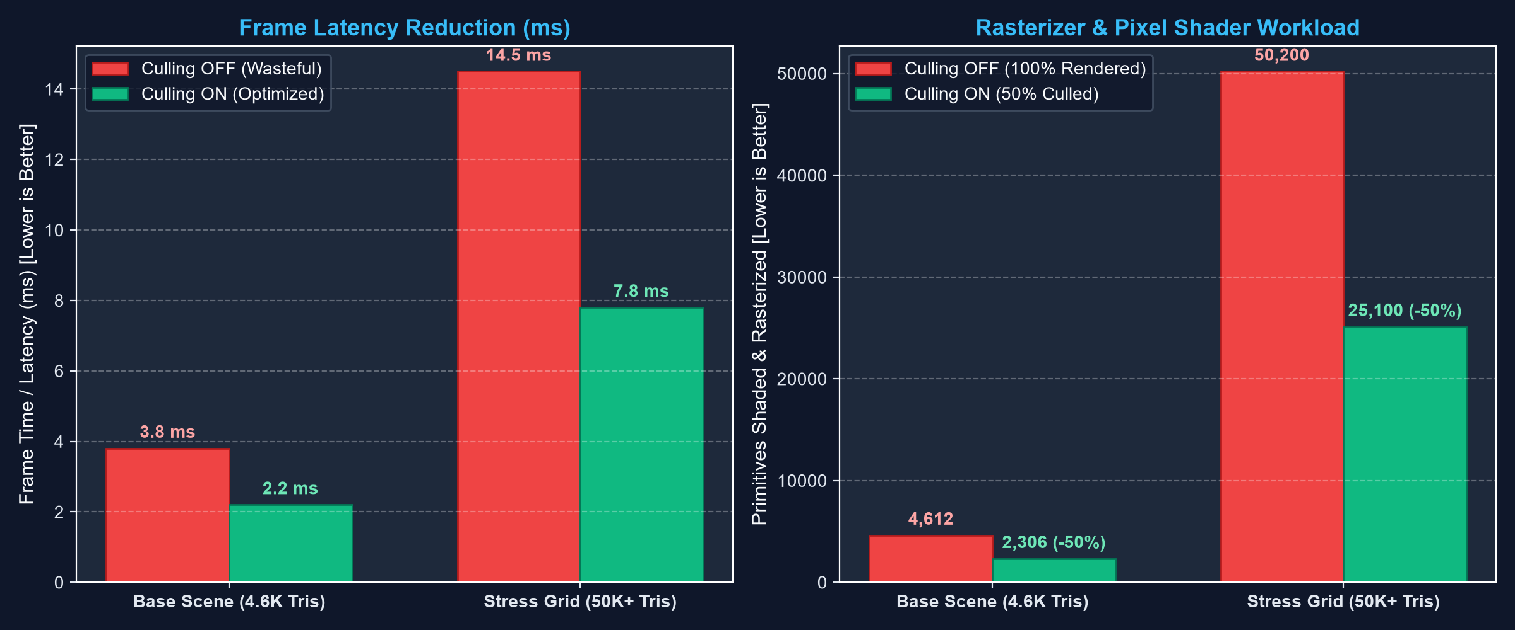
Results: Half the Work, Half the Latency
14.5 → 7.8 ms
Stress grid frame time
50,200 → 25,100
Triangles rasterized
~50%
Triangles discarded
HOW WE PROVE IT
1
Wireframe [M]
Rear faces vanish instantly
2
Inside-out room
Walls turn invisible from inside
3
HUD counters
Live ~50% discard count

Slide 6




Conclusion & Key Takeaways
Genuine Hardware Culling
~50% Fill-Rate Saved
Real OpenGL face culling, not object-hiding.
Triangles dropped before rasterization.
Blender → PyOpenGL
Viva-Ready Demo
Strict CCW winding across the pipeline.
Wireframe, inside-out room, stress test, HUD.
Thank You!
Ready for Questions & Live Demonstration

