Slide 1
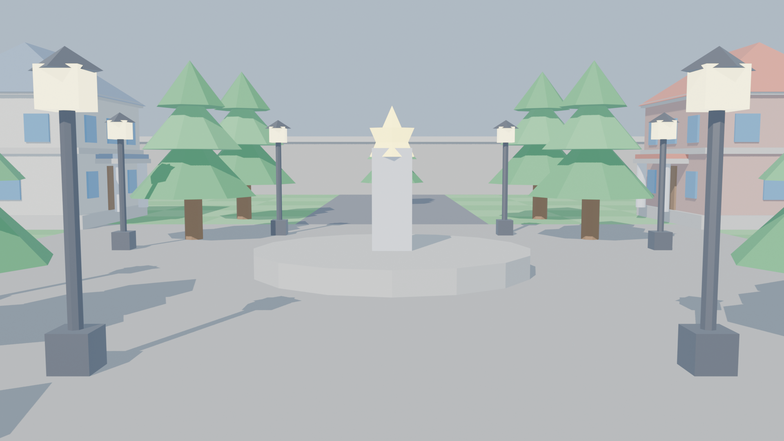
COMPUTER GRAPHICS & GAME ENGINE OPTIMIZATION
Real-Time 3D Game Environment
Optimization Using Back-Face Culling
An interactive hardware-accelerated 3D environment analyzing polygon culling algorithms, vector normal mathematics, screen winding determinants, and real-time GPU frame latency.
Tech Stack: Python 3.x | OpenGL 4.6 (PyOpenGL) | Pygame | Blender 5.0

Slide 2
REAL-TIME 3D GRAPHICS OPTIMIZATION
The 3D Graphics Bottleneck: Invisible Polygon Waste
1. The Polygon Explosion
• Modern 3D games render millions of triangles per second (buildings, terrain, props, characters).
• Achieving 60+ FPS requires a frame budget under 16.6 milliseconds.
• Processing non-visible geometry wastes GPU transform bandwidth and fill rate.
2. The ~50% Redundancy
• In any closed 3D polyhedral mesh (building, tower, tree, cube), roughly 50% of surfaces face AWAY from the camera.
• The observer can never see the rear walls of a closed structure from the outside.
• Rendering back faces wastes rasterizer setup and pixel shading.
3. The Solution: Face Culling
• Back-Face Culling detects surface orientation before rasterization.
• Hardware discards back-facing primitives in the Primitive Assembly stage.
• Eliminates ~50% of triangle setup and fragment shading without altering visual output.

Slide 3
REAL-TIME 3D GRAPHICS OPTIMIZATION
What is Back-Face Culling? Fundamental Concepts
Core Definition
Back-Face Culling is an essential visibility determination algorithm implemented in GPU graphics hardware.
It evaluates each polygon's orientation relative to the camera viewpoint. Polygons facing away from the camera are discarded BEFORE pixel interpolation and fragment shading.
Key Operational Rules:
✔ Front-Facing Polygon: Normal points toward camera (Rendered).
✔ Back-Facing Polygon: Normal points away from camera (Culled).
✔ Zero Visual Loss: Discarded faces are occluded by front surfaces on solid meshes.
WITHOUT Culling (glDisable(GL_CULL_FACE))
• 100% of triangles pass through rasterization and pixel shading.
• GPU renders back surfaces, only for them to be overwritten by the Z-Buffer.
• Wastes fill-rate, memory bandwidth, and power.
WITH Culling (glEnable(GL_CULL_FACE))
• Hardware discards ~50% of triangles before rasterization.
• Zero fragment shader overhead for back-facing surfaces.
• Results in lower frame latency (ms) and higher frame rates (FPS).

Slide 4
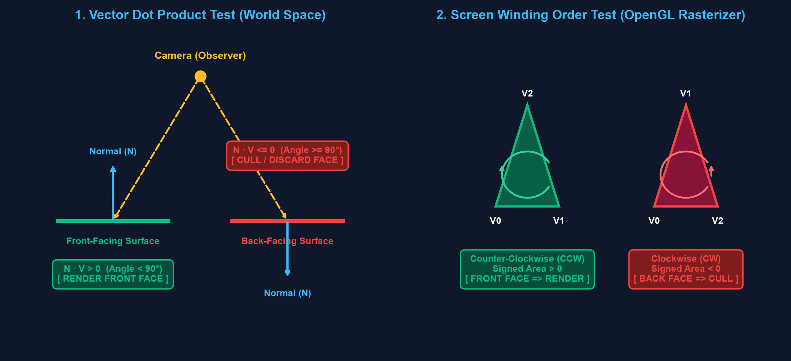
REAL-TIME 3D GRAPHICS OPTIMIZATION
Mathematical Foundation: Vectors & Winding Determinants
The Mathematical Tests
1. Object Space (Dot Product):
• Surface Normal: N = (V1 - V0) x (V2 - V0)
• View Vector: V = CameraPos - Centroid
• Facing Test:
N · V > 0 => Front Face (Render)
N · V <= 0 => Back Face (Cull)
2. Screen Space (OpenGL Hardware):
• After 2D projection, OpenGL tests signed area:
Area = 1/2 [(x1-x0)(y2-y0) - (y1-y0)(x2-x0)]
• Area > 0 => Counter-Clockwise (CCW)
• Area < 0 => Clockwise (CW) [Culled!]

Slide 5
REAL-TIME 3D GRAPHICS OPTIMIZATION
Graphics Pipeline: Where Back-Face Culling Occurs
1. Vertex Spec
Vertex Arrays & VBOs
(v, vn, vt indices)
2. Vertex Shader
ModelView & Projection
Transform to Clip Space
3. Primitive Assembly
FACE CULLING STAGE!
glCullFace(GL_BACK)
Drops CW triangles!
4. Rasterizer
Scan-conversion of
FRONT triangles only
5. Fragment Shader
Lighting, texturing,
shading visible pixels
6. Per-Sample Tests
Depth Buffer (Z-Buffer)
& Framebuffer blend
💡 CRITICAL ARCHITECTURAL POINT: Back-face culling drops triangles at Step 3, saving 100% of rasterization and pixel shading work at Steps 4 & 5!

Slide 6
REAL-TIME 3D GRAPHICS OPTIMIZATION
Software Architecture: Modular Python & OpenGL Engine
main.py
Core Pipeline Coordinator
• High-precision delta time clock
• Viewport & OpenGL state initialization
• Input event dispatcher & camera loop
culling_manager.py
Culling & Rasterizer State
• Controls glEnable/glDisable(GL_CULL_FACE)
• glCullFace(GL_BACK) & glFrontFace(GL_CCW)
• glPolygonMode() wireframe switching
scene.py
3D Game Environment
• Classical buildings, towers, trees, lamps
• Inside-Out Inspection Chamber
• Heavy-Poly Stress Grid (100K+ tris)
camera.py
6-DOF First-Person Camera
• Smooth WASD flight & sprint boost
• Mouse pitch/yaw look with angle clamping
• gluLookAt view matrix update
obj_loader.py
Wavefront OBJ Parser
• Parses vertices, normals, CCW faces
• Compiles into OpenGL Display Lists
• Zero runtime CPU parsing overhead
hud.py
2D Telemetry & UI Overlay
• Real-time smoothed FPS & frame time (ms)
• Live triangle discard counter (~50%)
• Antialiased Pygame-to-OpenGL overlay

Slide 7
REAL-TIME 3D GRAPHICS OPTIMIZATION
3D Environment Design & Blender 5.0 Asset Pipeline
Asset Pipeline & Face Orientation
1. Blender 5.0 Integration:
• Automated headless script builds and exports all modular assets.
• Saved complete scene to `game_environment.blend`.
2. The Face Orientation Rule:
• In Blender's Viewport Overlays, Face Orientation must be BLUE (front-facing CCW normals).
• Inward RED normals cause OpenGL to cull front faces mistakenly!
3. Architectural Elements:
• Hip roof townhouses with marble pillars and entrance porticos.
• Medieval corner watchtowers with crenellated observation rims.
• Upright coniferous pine trees with brown trunks & layered foliage.
• Street lamps with point lights and central plaza fountain.

Slide 8
REAL-TIME 3D GRAPHICS OPTIMIZATION
Interactive Controls & Demonstration Modes
Interactive Keyboard Shortcuts
Key / Input | Action | Demonstration Purpose
W, A, S, D + Mouse | 6-DOF First Person Flight | Freely inspect buildings, plaza, and fly inside demo rooms
[C] Key | Toggle Back-Face Culling | Instantly compare ENABLED (Optimized) vs DISABLED (Wasteful)
[M] Key | Toggle Mesh Mode (Solid / Wireframe) | Wireframe mode exposes back surfaces for visual proof
[T] Key | Toggle Heavy-Poly Stress Grid | Spawns 50,000+ triangles to show real frame latency differences
[U] Key | Toggle Uncapped FPS Benchmark | Removes 60 FPS cap to benchmark raw hardware throughput
[F] Key | Toggle Cull Target (GL_BACK / GL_FRONT) | Educational test showing inverted inside-out geometry
[Tab] / [Esc] | Lock / Unlock Mouse Cursor | Frees mouse cursor to point on screen during presentation

Slide 9
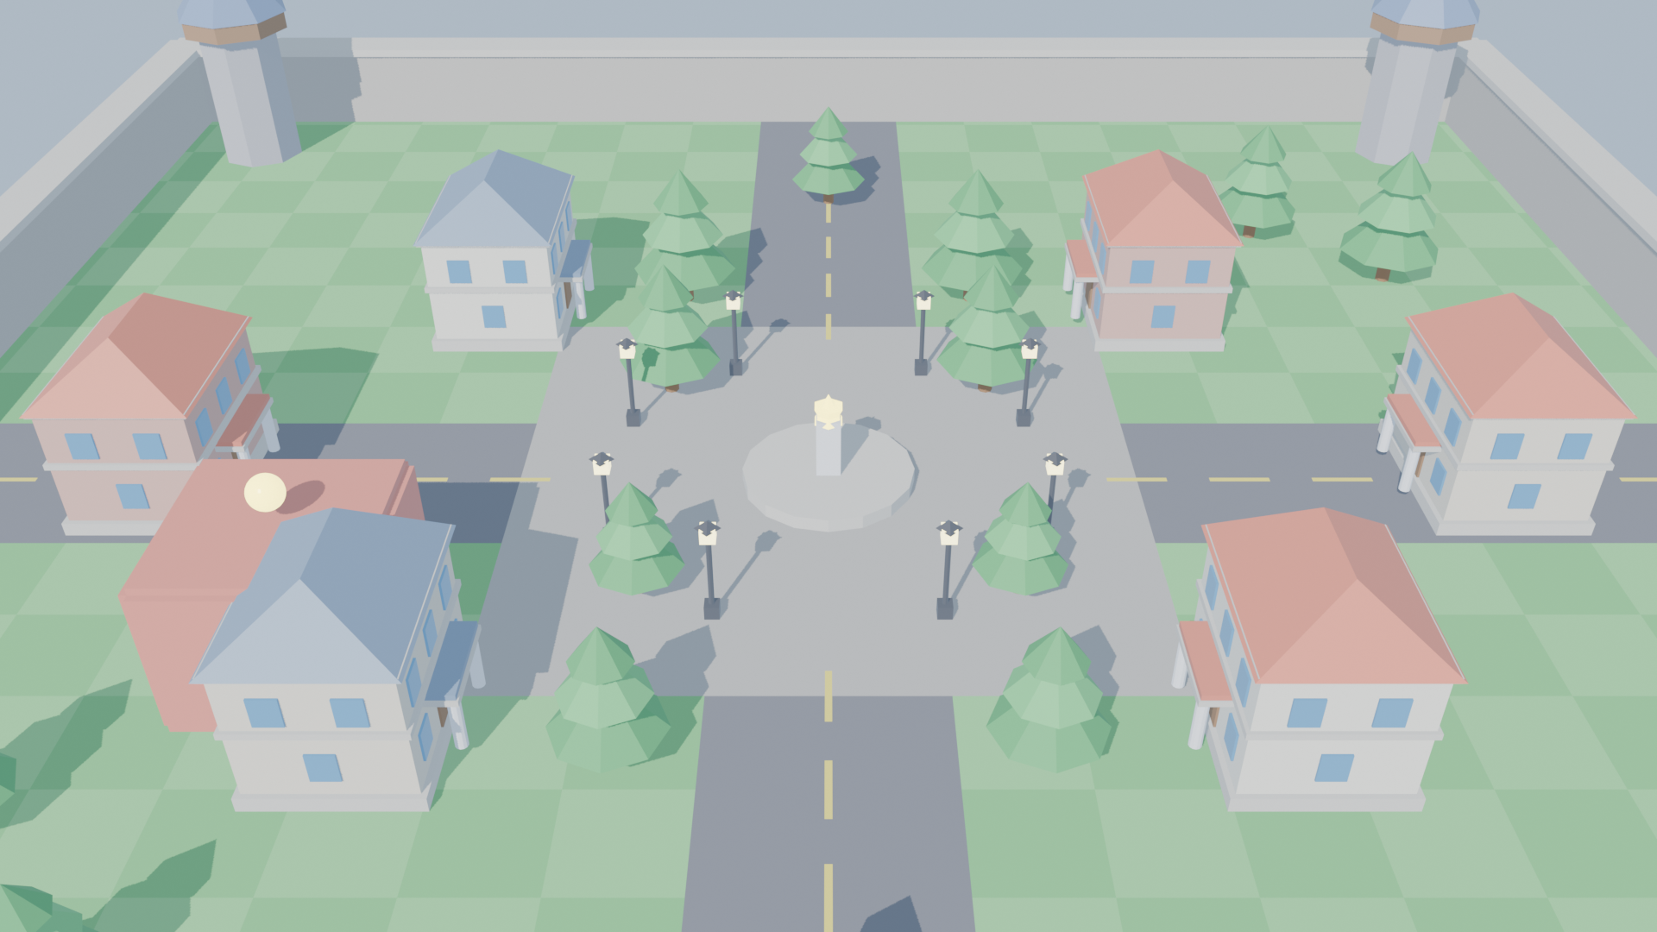
REAL-TIME 3D GRAPHICS OPTIMIZATION
Examiner Verification: 3 Indisputable Proofs
How to Prove Culling Is Real
Proof 1: Wireframe Mode Test ([M] Key):
• Solid mode masks back faces behind the Z-Buffer.
• Wireframe mode removes surface occlusion!
• Culling OFF: All rear wireframes visible (cluttered mesh).
• Culling ON: Rear wireframes vanish instantly!
Proof 2: Inside-Out Chamber ([C] Inside Room):
• Walk inside the red building at X: -25, Z: -15.
• Walls were built with outward normals.
• From inside, all walls face AWAY from camera.
• Culling ON: Walls turn invisible (see through to outside)!
• Culling OFF: Walls reappear immediately.
Proof 3: Hardware Geometry Counters:
• Real-time HUD proves ~50% triangles discarded.

Slide 10
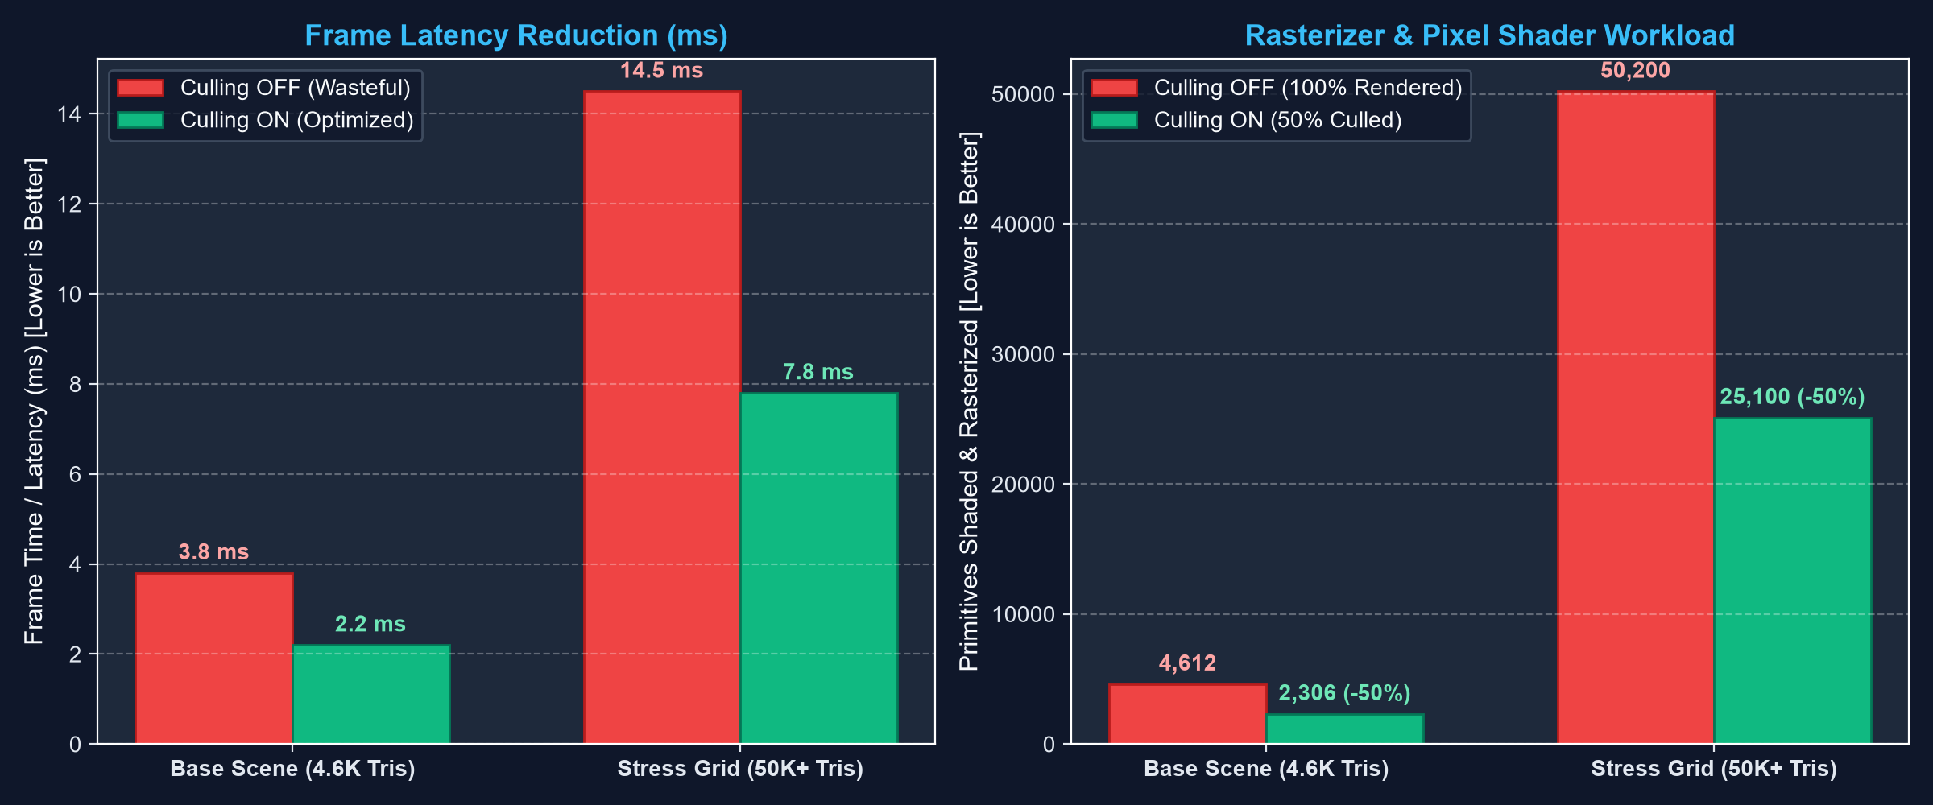
REAL-TIME 3D GRAPHICS OPTIMIZATION
Performance Benchmarks & Experimental Results

Slide 11
REAL-TIME 3D GRAPHICS OPTIMIZATION
Comparative Visibility Analysis: Culling Techniques
Culling Technique | Granularity | Pipeline Stage | Algorithmic Mechanism | What It Removes
Back-Face Culling (Our Project) | Polygon-level (Individual Triangles) | Primitive Assembly (Hardware Rasterizer) | Normal · View Vector <= 0 Screen Winding Det < 0 | Surfaces pointing away on visible objects (~50%)
View Frustum Culling | Object / Bounding Box level (AABB/Sphere) | CPU Pre-Pass / Compute Shader | 6 Frustum Plane clipping equations | Entire objects outside the camera FOV
Occlusion Culling | Object or Fragment level | Early-Z / Hardware Occlusion Queries | Hierarchical Z-Buffer (HZB) / Depth bounding | Front-facing objects hidden behind large walls

Slide 12
REAL-TIME 3D GRAPHICS OPTIMIZATION
Conclusion & Key Takeaways
Summary of Project Achievements
✔ Genuine Hardware Culling: Implemented authentic OpenGL pipeline face culling (`glEnable(GL_CULL_FACE)`, `glCullFace(GL_BACK)`, `glFrontFace(GL_CCW)`), not superficial object-hiding.
✔ ~50% Fill-Rate Protection: Confirmed that closed polyhedral meshes achieve a consistent ~50% primitive drop before rasterization, directly lowering frame latency under heavy polygon loads.
✔ Multi-Disciplinary Pipeline: Successfully bridged 3D digital content creation (Blender 5.0) with real-time rendering code (Python/PyOpenGL) enforcing strict Counter-Clockwise vertex winding.
✔ Complete Viva-Ready Suite: Equipped with live wireframe inspection, inside-out chamber demonstration, high-density stress tests, and automated telemetry overlays.

Slide 13
THANK YOU!
Real-Time 3D Game Environment Optimization Using Back-Face Culling
Ready for Questions & Live Demonstration
Interactive Demo Controls: [M] Wireframe | [C] Toggle Culling | [T] Stress Grid | [U] Uncapped FPS

