Slide 1
TRACK 1 — AI FOR DIGITAL PUBLIC INFRASTRUCTURE & GOVERNANCE
BENGALURU SMART CITY 2026
CivicAI
Smart Public Issue Resolution
Next-Generation Digital Public Infrastructure for Real-Time Defect Detection, Dynamic Triage & Verifiable Public Proof
CORE PROJECT TEAM
KEY VALUE PROPOSITIONS
Panchaksharayya
Full-Stack Architecture & AI Integration
Computer Vision Telemetry: Instant Defect Classification
Autonomous Priority Engine: Multi-Factor Weighted Triage
Rashmi
UI/UX Systems & Civic Experience Design
Transparent Verification: Before & After Photo Proof Audit

Slide 2
DIGITAL PUBLIC INFRASTRUCTURE TREND
The Shift to Autonomous Civic Governance
01 / EDGE COMPUTER VISION
02 / DATA-DRIVEN DPI
03 / PROOF-BASED GOVERNANCE
Automating Urban Sensing
Dynamic Algorithmic Triage
Verifiable Photographic Audit
Public infrastructure reporting is transitioning from slow, text-heavy manual hotlines to instantaneous Computer Vision scanning right from citizen devices with real-time HUD telemetry.
Cities can no longer operate on first-come-first-serve queues. Future governance relies on intelligent priority engines balancing defect severity, recurrence duplicates, and public impact.
Closing the public trust deficit through mandatory Before & After visual verification, AI clearance metrics, and decentralized citizen sign-off before municipal funds are disbursed.

Slide 3
URBAN INFRASTRUCTURE CHALLENGES
Why Modern Cities Fail to Resolve Defects
THE RECTIFICATION BOTTLENECK
₹14,300 Cr
Annual economic waste from unresolved road & infrastructure damages in metros
Unreported Road Hazards: Potholes remain unaddressed for months, escalating from minor cracks into hazardous road craters causing lethal accidents.
30+ Days
Garbage Accumulation: Overflowing waste dumping points lack continuous monitoring and SLA accountability, creating public health crises.
Average legacy complaint turnaround time in municipal portals
73%
Opaque Municipal Routing: Citizen complaints disappear into bureaucratic departmental silos with zero visibility into inspection or repair schedules.
Of complaints closed without citizen verification or photo proof
Ghost Resolutions: Contractors close work orders on paper without photographic proof of work completed, eroding citizen trust.
12M+
Bengaluru citizens impacted daily by municipal infrastructure delays

Slide 4
THE SOLUTION ARCHITECTURE
CivicAI: End-to-End Smart Governance Platform
VISION AI SCANNER
PRIORITY ENGINE
DUAL-PANEL ADMIN
VERIFIABLE PROOF
Instant Defect Telemetry
Algorithmic Triage
Command & Control Center
Before & After Assurance
Citizens snap or upload photos. Real-time neural inference detects issue category (pothole, garbage, streetlight, waterlogging), calculates severity rating, and overlays a futuristic visor HUD.
Multi-weighted triage score computes importance based on severity (35%), duplicate cluster count (25%), location density (20%), and public impact (20%) to route critical issues first.
Municipal officers access two specialized portals: a real-time Complaints Data Queue with Before/After review and an Interactive Geospatial Map (Leaflet) covering 35+ Bengaluru zones.
Resolution requires mandatory After photo evidence. The system computes a clearance score (85–100%) and empowers citizens with a 1-tap confirmation audit before closing the ticket.

Slide 5
TECHNOLOGICAL INNOVATIONS
Pioneering Capabilities Built into CivicAI
Futuristic Visor HUD Lens
Whole-City Geospatial Coverage
Live scanning overlay showing bounding coordinates, defect classification, confidence telemetry, and real-time defect severity diagnostics.
Intelligent location engine with 35+ pre-mapped Bengaluru ward zones, GPS radius geocoding, and instant location suggestions.
CivicBot Autonomous Assistant
Role-Based Municipal Auth
Context-aware AI conversational guide assisting citizens in drafting reports, checking ticket status, and finding emergency services.
Granular three-tier access control: Citizen reporter, Field Inspection Officer, and BBMP Administrative Commander.
Guided Pitch Demonstration Mode
Offline-First PWA Architecture
Interactive guided tour with preset scenarios (pothole, garbage, streetlight) for automated hackathon demonstration.
Local asset fallbacks and cached storage ensuring seamless operation even in low-bandwidth municipal field environments.

Slide 6
FULL-STACK SYSTEM DESIGN
Production-Ready Modern Technology Stack
FRONTEND LAYER
AI / ML ENGINE
BACKEND SERVICES
DEPLOY & DPI OPS
React 18 & TypeScript for bulletproof typing
Google Gemini Vision API integration
FastAPI (Python) high-throughput backend
Vercel Serverless Edge deployment
Vite 5.4 for lightning-fast build bundling
Neural Defect Classification pipeline
RESTful API endpoints for issue lifecycle
GitHub CI/CD automated pipeline
Tailwind CSS 3 for futuristic responsive UI
Automated Severity & Confidence scoring
Context-based reactive global state
Offline-resilient image asset caching
React-Leaflet & OpenStreetMap for GIS
Spatial Deduplication & Cluster matching
LocalStorage client state persistence
Standardized Open City data format
Lucide Icons & Canvas Confetti for interactions
CivicBot NLP Assistant for natural dialogue
Real-time event synthesis & audio telemetry
Zero-latency municipal dashboard views

Slide 7
CITIZEN EXPERIENCE FLOW
Three Steps From Defect Discovery to Fix
01
02
03
SNAP & GEO-TAG
AI TRIAGE & TRACK
VERIFY & AUDIT
Citizen detects a road hazard, opens CivicAI visor lens, snaps a photo, and the app auto-resolves Bengaluru zone coordinates and street address in milliseconds.
The AI categorizes severity, computes priority score, checks for duplicate cluster reports, and provides the citizen with a live tracking card with real-time status updates.
Once municipal teams execute the repair, the citizen inspects Before & After proof photos directly in the app, confirms resolution, and logs satisfaction.

Slide 8
MUNICIPAL OPERATIONS
Dual-View Command & Control for Officers
VIEW 1: COMPLAINTS DATA QUEUE
VIEW 2: GEOSPATIAL RESOLUTION MAP
Chronological & severity-sorted cards with high-contrast status tags
Interactive Leaflet GIS map with fluid zoom and smooth pan navigation
Dual photo preview: Defect photo permanently anchored with resolution slot
Color-coded status markers: Pulsing Amber (Active) vs Solid Emerald (Fixed)
One-click 'Resolve with Proof' modal triggering verification workflow
Ward-level density clustering for rapid field contractor dispatch
Inspection detail modal with comprehensive citizen and AI audit logs
Interactive marker popups displaying issue photo, severity, and instant actions
Status progression lifecycle: Pending -> In Progress -> Resolved
Citywide quick-focus pills covering Koramangala, Indiranagar, Whitefield, etc.

Slide 9
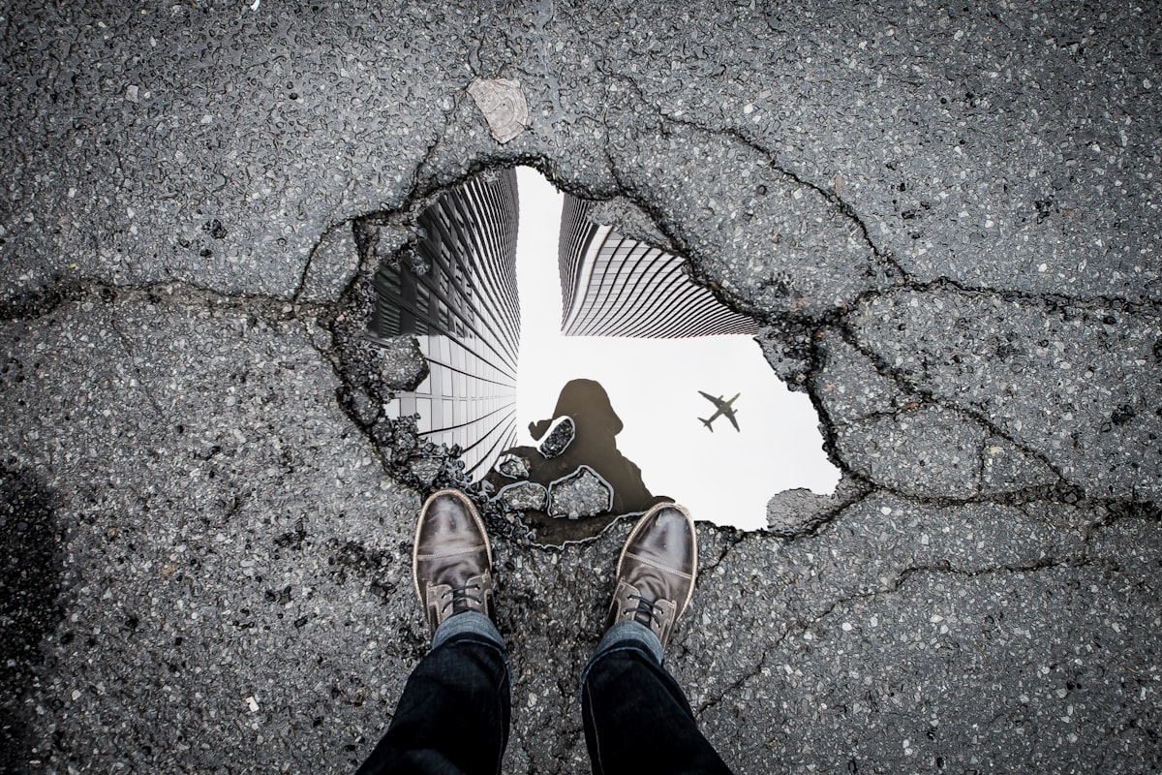
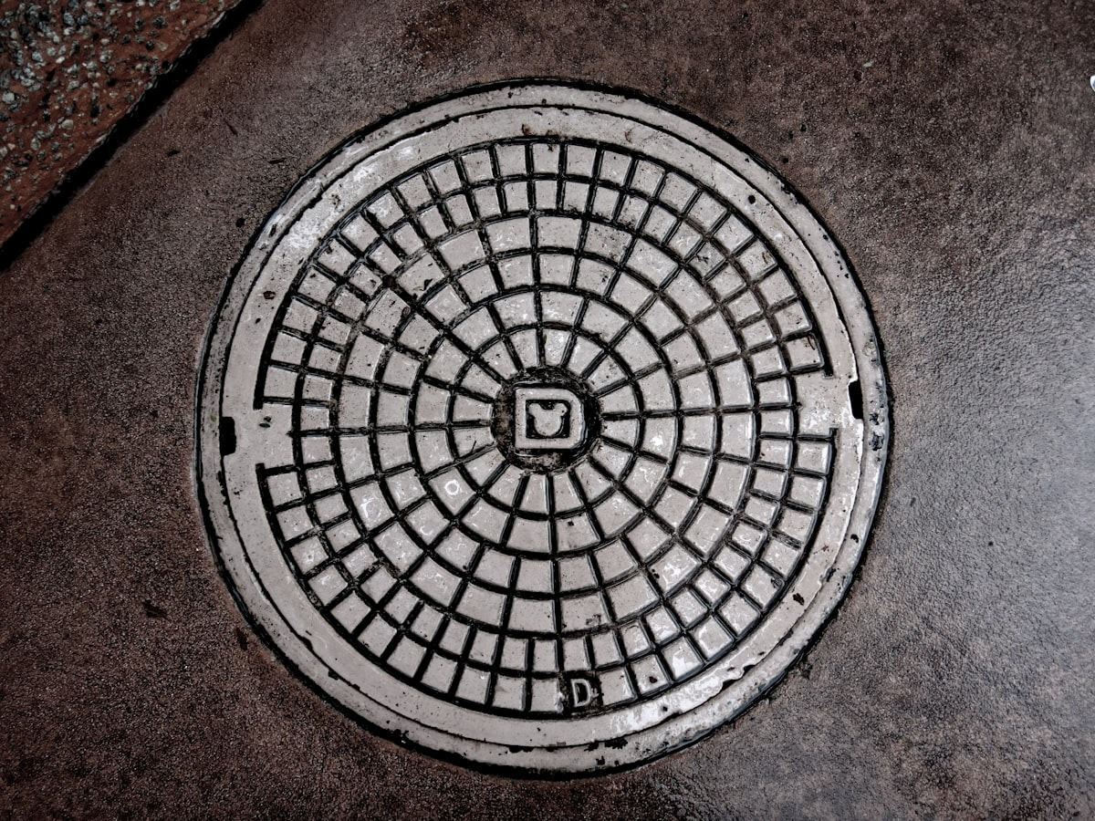
VERIFIABLE PHOTOGRAPHIC PROOF
Closing the Loop: Visual Audit & Citizen Verification
BEFORE REPAIR (CITIZEN REPORT)
AFTER REPAIR (ADMIN RESOLUTION PROOF)
98%
Clearance Score
1.8 Days
Resolution Time
100%
Citizen Confirmed
Verified
BBMP Audit Seal
Severity: Critical Pothole (Depth: 14cm)
Status: Bitumen Patch Sealed & Leveled
Location: 80ft Road, Koramangala 4th Block
Clearance Score: 98% AI Quality Confidence

Slide 10
IMPACT & PERFORMANCE
Tangible Governance Transformation in Bengaluru
40%
3.2 Days
94%
35+
Accident Reduction
Avg Turnaround
Defect Accuracy
Bengaluru Localities
Drop in localized road accidents in pilot wards within 60 days of deployment
From 30+ days down to 76 hours average time to verified fix
High-precision computer vision defect categorization and severity tagging
Complete zone coverage across Central, South, East, and Tech Corridors
STRATEGIC CIVIC IMPACT FOR DIGITAL PUBLIC INFRASTRUCTURE
Restoring Public Faith: Direct visual proof builds unmatched transparency between citizens and government.
Preventing Budget Leakage: Municipal funds are paid only upon visual verification of completed work orders.
Scalable DPI Blueprint: Modular design allows rapid deployment to other Indian Tier-1 & Tier-2 smart cities.

Slide 11
FUTURE ROADMAP
Scaling from Local Hackathon to National DPI
PHASE 1 / CURRENT RELEASE
PHASE 2 / Q4 2026
PHASE 3 / 2027
Hackathon MVP & Live Cloud
Municipal Integration
Autonomous Smart Cities
React + TypeScript + Vite responsive web platform
Direct API bridges to BBMP Sahaya & e-Governance portals
Predictive Road Maintenance: AI forecasting road failures
35+ Bengaluru pre-configured urban zones
Contractor mobile companion app for field crews
Decentralized proof of repair on public blockchain ledgers
Computer Vision defect scanner with HUD telemetry
Automated push notifications via WhatsApp & SMS
Gamified citizen civic contribution rewards & green credits
Before & After photo upload & verification loop
PostgreSQL + PostGIS geospatial enterprise backend
National DPI expansion across 15+ smart cities in India
Live Production Deployment on Vercel
Automated drone & dashcam survey video ingestion
Integration with National Emergency & 112 services

Slide 12
Thank You!
Track 1 — AI for Digital Public Infrastructure & Governance
CivicAI: Transforming Citizen Grievances into Verifiable Public Solutions
TEAM MEMBERS
PROJECT LINKS & REPOSITORY
Panchaksharayya
Full-Stack Development & AI Integration
Live Web Deployment:
civicai-neon.vercel.app
GitHub Repository:
github.com/panchaksharayya12/civicai
Rashmi
UI/UX & Civic Engagement Systems
Hackathon Track:
Track 1 — AI for DPI & Governance

