Slide 1
Money Lending Management System
By: Parth Panchal
Rutvik Panchal

Slide 2

Project Definition:
This software system will be a Money Lending Management System for Money Lenders who are doing business on individual or large scale through multiple branches in multiple cities.
This system is designed to maximize Money Lenders productivity by efficient management of customer in digital way which reduce time and efforts. Which would otherwise have to record manually on hardcopy .
Mainly system covers stock management for items taken as Mortgage and print formatted GST based Invoice.
Software System is mainly designed for users interface to manages customer account for mortgage and customer transection and prepare date wise report for customer transection and mortgage items information.

Slide 3
Major Functionality:
System Provide facility of add /edit/delete customer account to user .
Manages customer accounts with mortgage details .
Also provide resultant mortgage amount with interest rate calculation.
System Provide feature of dashboard which show recently created/closed customer account , total mortgage ,credit and debit amount which help user for better estimation of business.
System also provide feature to print GST INVOICE for customers.
System Manage users and enable admin to perform CRUD operation.

Slide 4
Database Design:

Slide 5
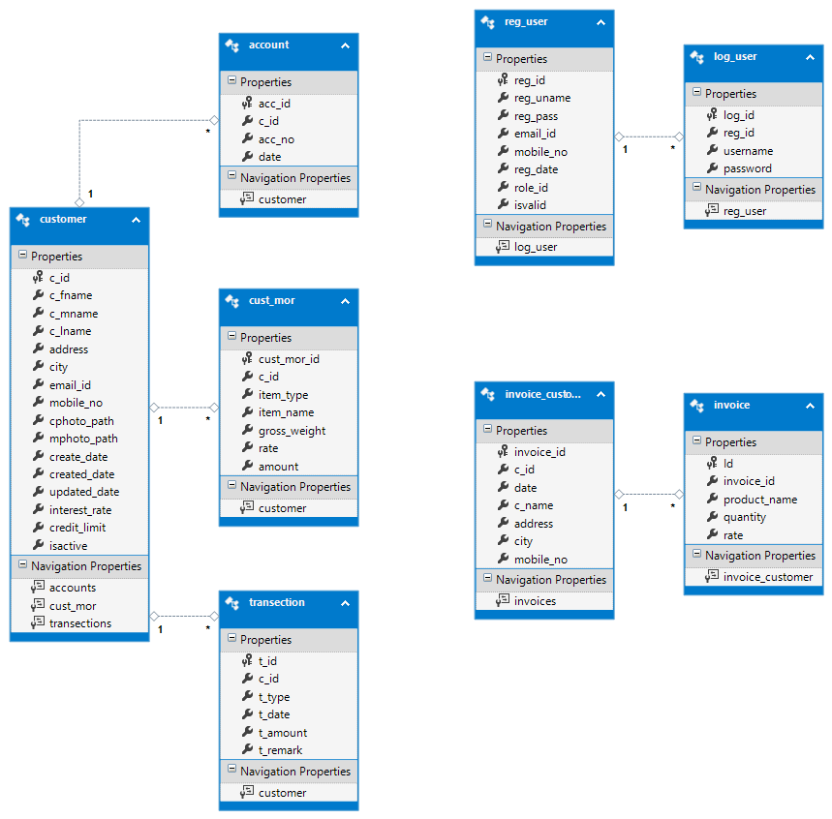

Slide 6
Trigger: login trigger (insert username and password into login table if registered user is validated by admin
CREATE TRIGGER [log_Trigger]
ON [dbo].[reg_user]
AFTER UPDATE
AS
BEGIN
SET NOCOUNT ON
DECLARE @regid INT
DECLARE @user VARCHAR (25)
DECLARE @pass VARCHAR (20)
DECLARE @valid BIT
SELECT @regid = INSERTED.reg_id FROM INSERTED ;
SELECT @user = INSERTED.reg_uname FROM INSERTED ;
SELECT @pass = INSERTED.reg_pass FROM INSERTED ;
IF UPDATE(isvalid)
BEGIN
INSERT INTO log_user(reg_id,username,password)
VALUES(@regid, @user,@pass)
END
END

Slide 7
Trigger: customer trigger: Genrate Account Id in formate: yy-mm-c-c_id(179c5)
CREATE TRIGGER [cust_trg]
ON [dbo].[customer]
FOR INSERT
AS
BEGIN
declare @cid int
declare @dy int
declare @dm int
declare @dt DateTime
select @cid=c_id from inserted
select @dy= ( YEAR( GETDATE() ) % 100 )
SELECT @dt=GETDATE()
SELECT @dm= RIGHT('0'+CAST(MONTH(GETDATE()) AS varchar(2)),2)
insert into account values (@cid,cast(@dy as nvarchar(2))+cast(@dm as nvarchar(2))+'c'+cast(@cid as nvarchar(7)),@dt)
END

Slide 8
Procedure: for search customer Account
CREATE PROCEDURE [dbo].[searchp]
@scust varchar(30)=null
AS
Begin
SELECT
CONCAT(c_fname,' ',c_mname,' ',c_lname) as c_name from customer
WHERE(c_fname LIKE '%' + @scust + '%' OR c_mname LIKE '%' + @scust + '%' OR c_lname LIKE '%' + @scust + '%') or @scust is null
END

Slide 9
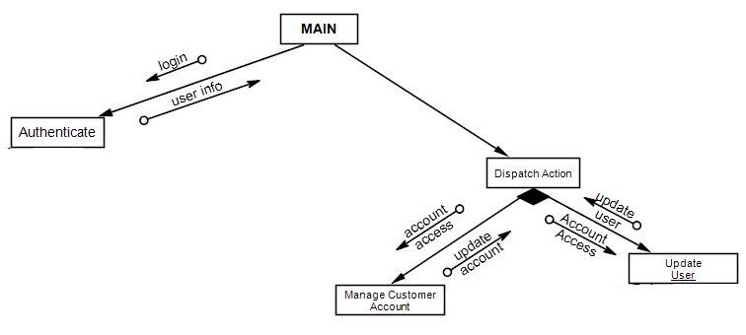
Module Design:
MAIN
Authenticate
Manage Customer Account
Update User

Slide 10
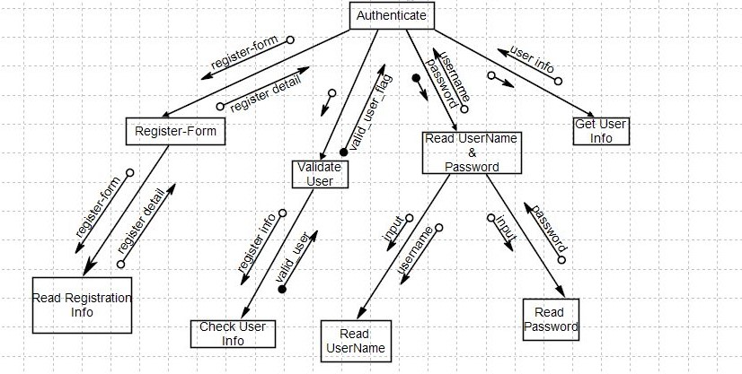
Authentication:

Slide 11
Code pages:
For Registration of User:
register.aspx
register.aspx.cs
For Authentication:
login.aspx
login.aspx.cs

Slide 12
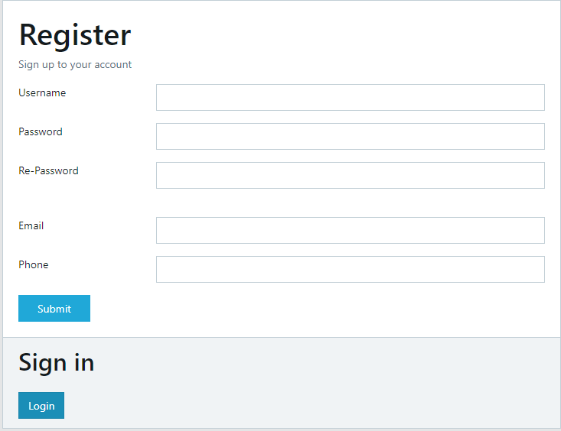
register.aspx

Slide 13
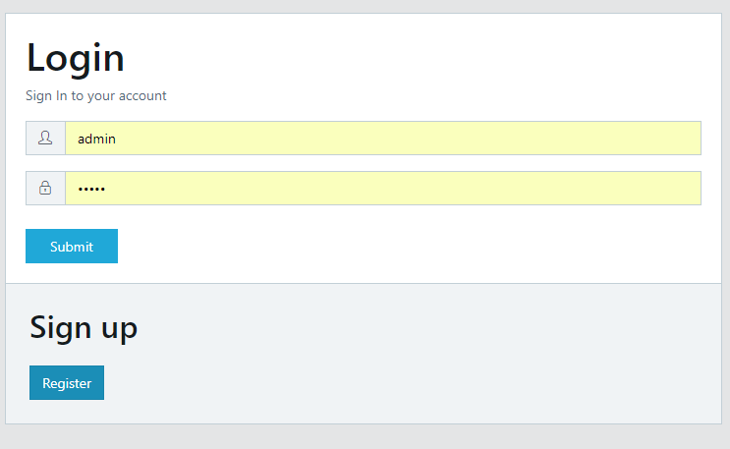
login.aspx

Slide 14
Master Page
Site1.Master:
design layout of application
Site1.Master.cs:
Authorization for different role of user login

Slide 15
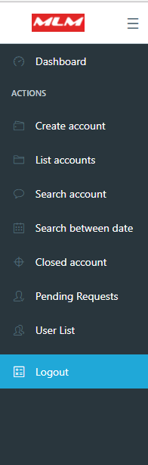
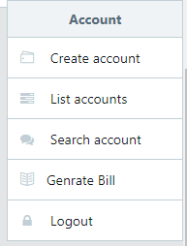
Admin User:

Slide 16
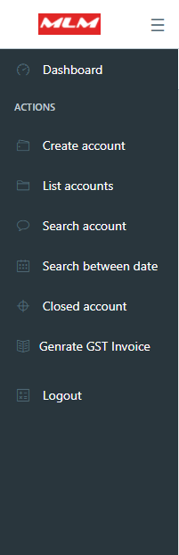
Normal User:

Slide 17
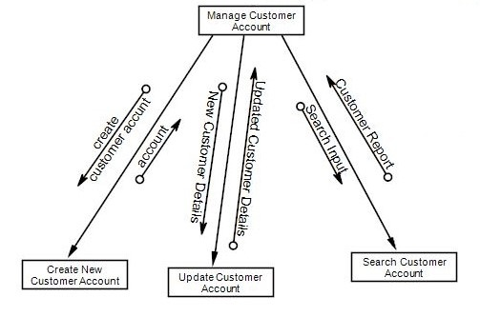
Manage Customer Account:
Create Customer Account:
customer.aspx
customer.aspx.cs
Search Customer Account:
search.aspx
search.aspx.cs
Update Customer Account:
view.aspx
view.aspx.cs

Slide 18
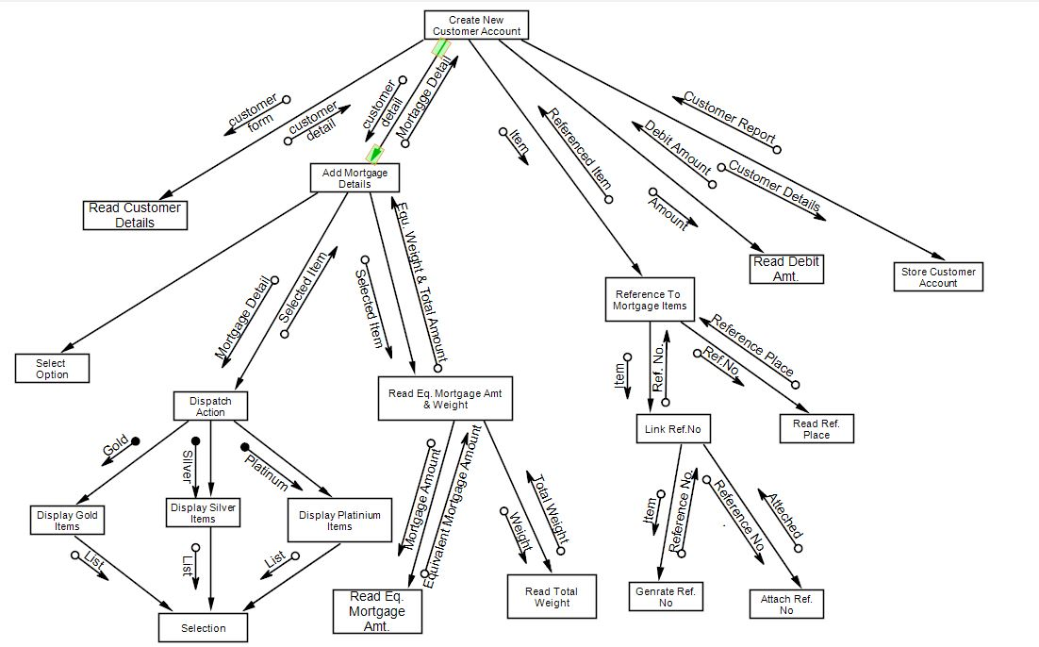
Module-1: Create Customer Account:
Create Customer Account:
customer.aspx
customer.aspx.cs
Show Created Customer Account
cust_list.aspx
cust_list.aspx.cs

Slide 19
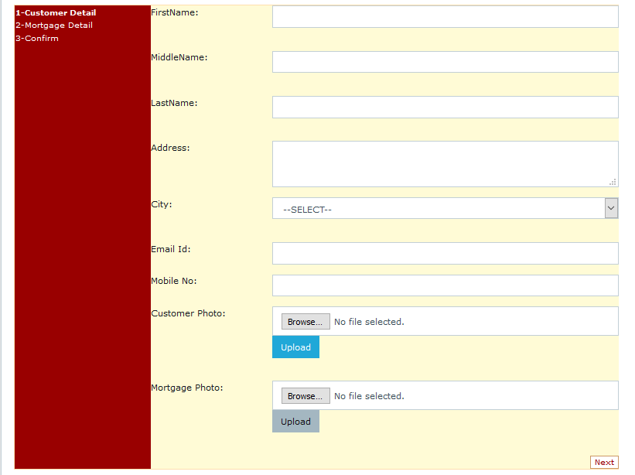
customer.aspx :
Wizard step1 :

Slide 20
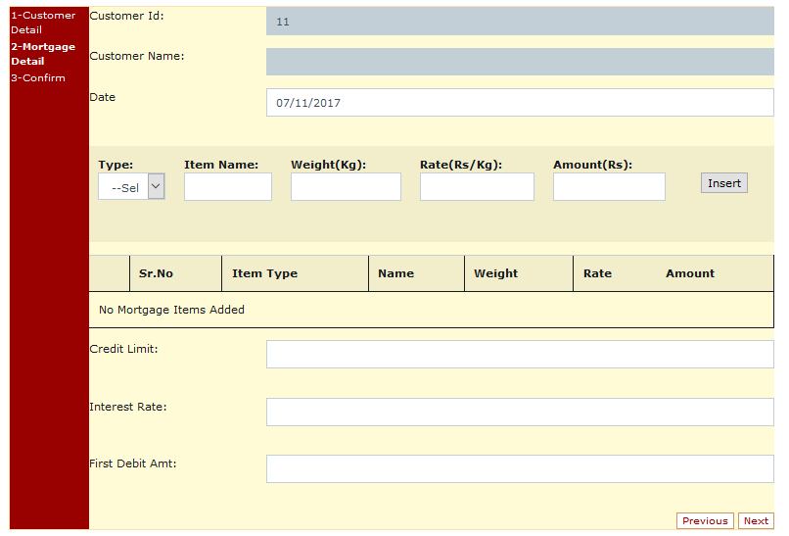
customer.aspx :
Wizard step2 :

Slide 21
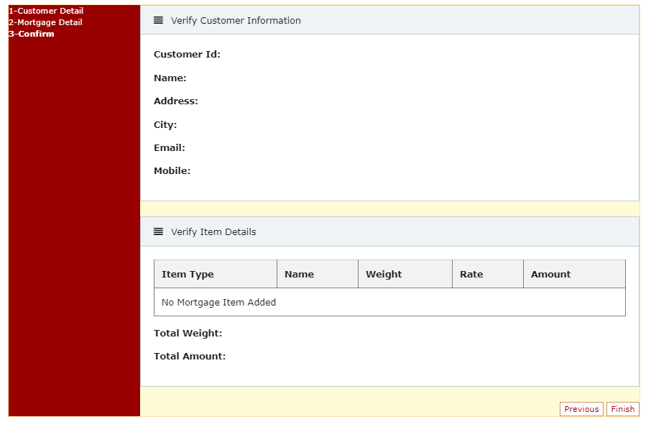
customer.aspx :
Wizard step3 :

Slide 22
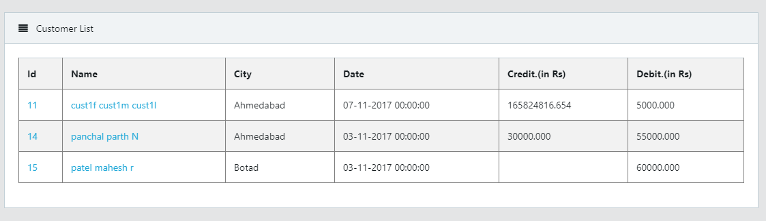
cust_list.aspx :

Slide 23
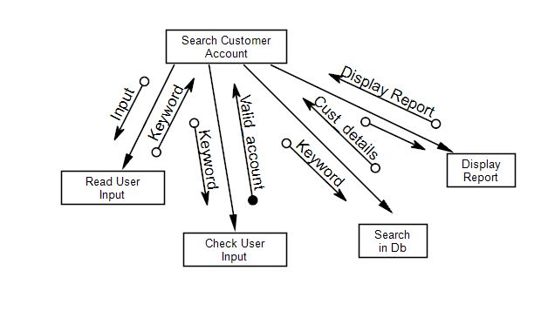
Module-2: Search Customer Account:
Search Customer Account:
search.aspx
search.aspx.cs

Slide 24
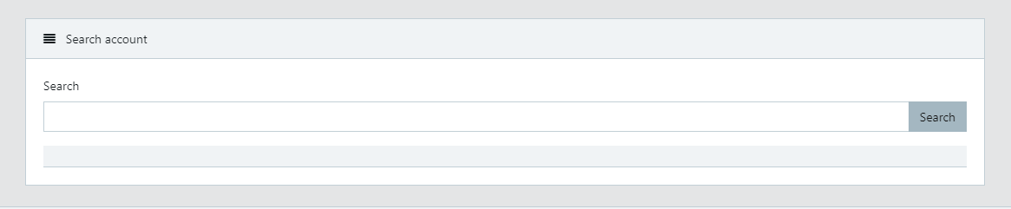
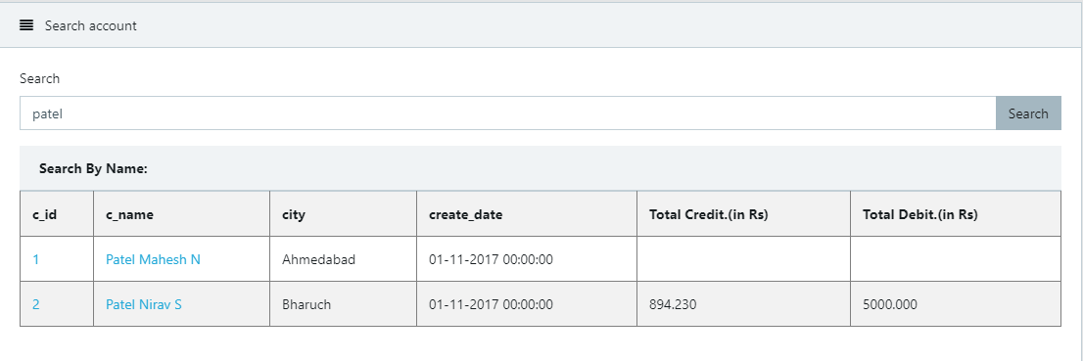
search.aspx :
Demo:

Slide 25
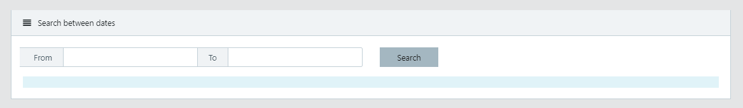
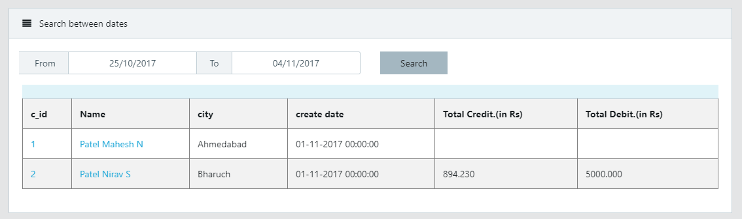
search_datewise.aspx :
Demo:

Slide 26
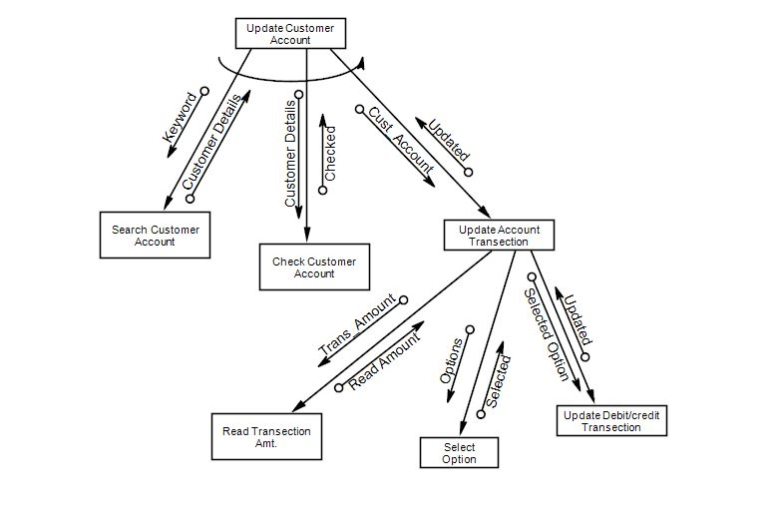
Module-3: Update Customer Account:
Update Customer Account:
view.aspx
view.aspx.cs

Slide 27
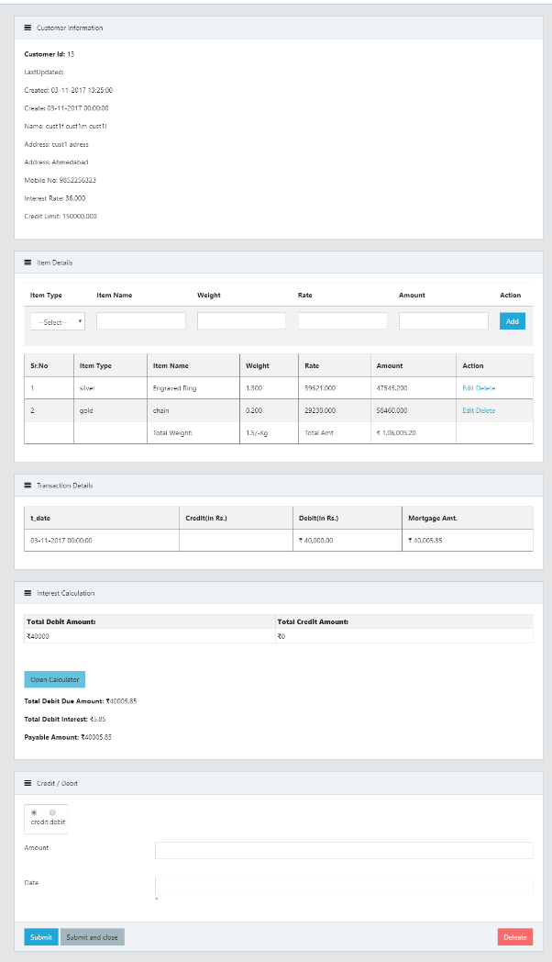
view.aspx :
Customer Info
Mortgage Detail
transection Info
Mortgage calculation based on interest rate
Update customer Account

Slide 28
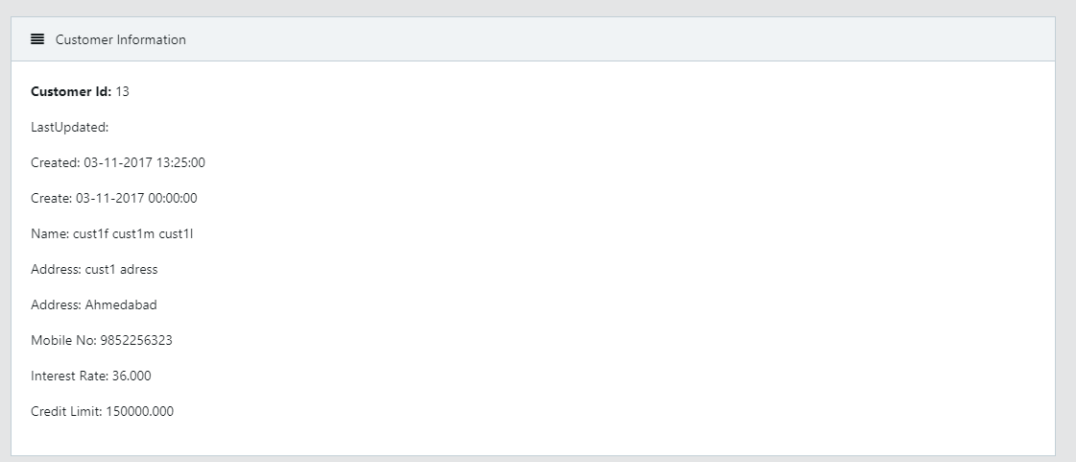
view.aspx :
Part-1:Customer Info

Slide 29
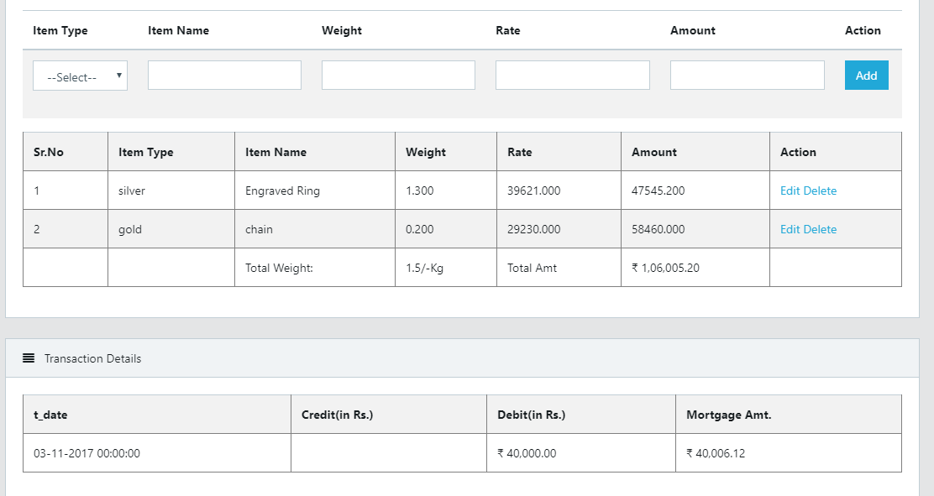
view.aspx :
Part-2: Add/Update/Delete/View Mortgage Detail

Slide 30
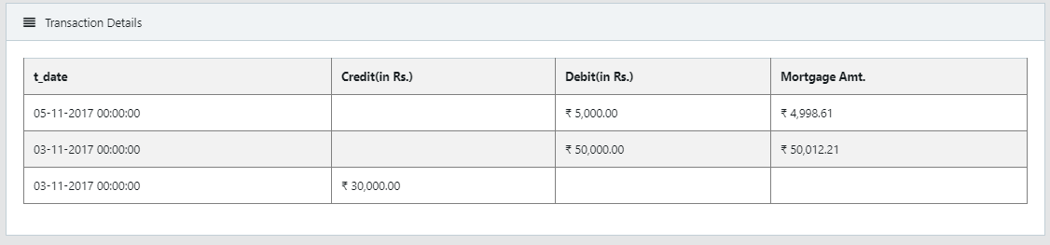
view.aspx :
Part-3: View Transection Detail

Slide 31
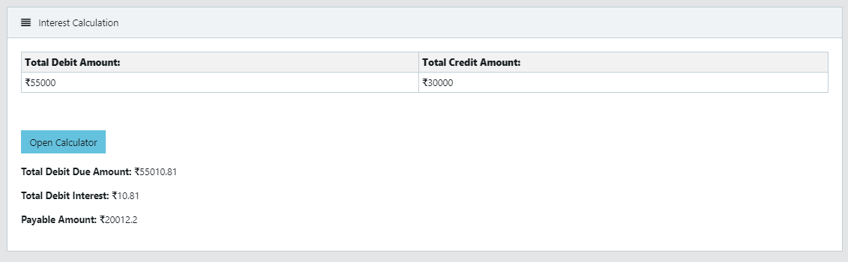
view.aspx :
Part-4: View Transection Detail AND Calculate Payable amount with Interest Rate

Slide 32
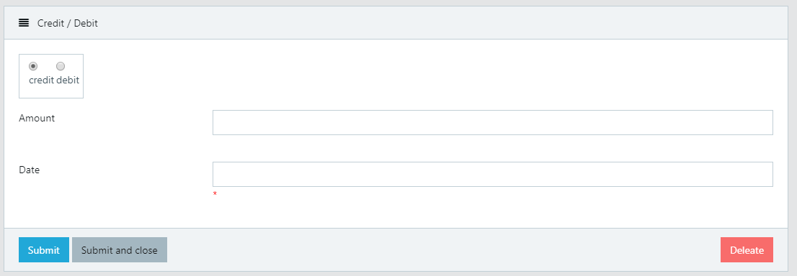
view.aspx :Update/Delete Customer Account
Part-5:Add Customer Account Transection

Slide 33
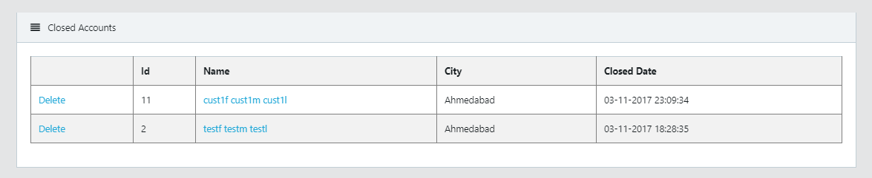
closed_acc.aspx : show closed/submitted customer Account List

Slide 34
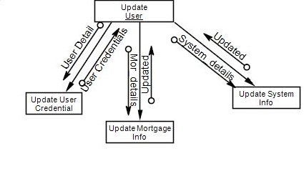
Module: Update User(For Admin Only):
Add/Update/Delete Pending Approval :
verify_user.aspx
verify_user.aspx.cs
Add/Update/Delete Active User :
approved.aspx
approved.aspx.cs

Slide 35
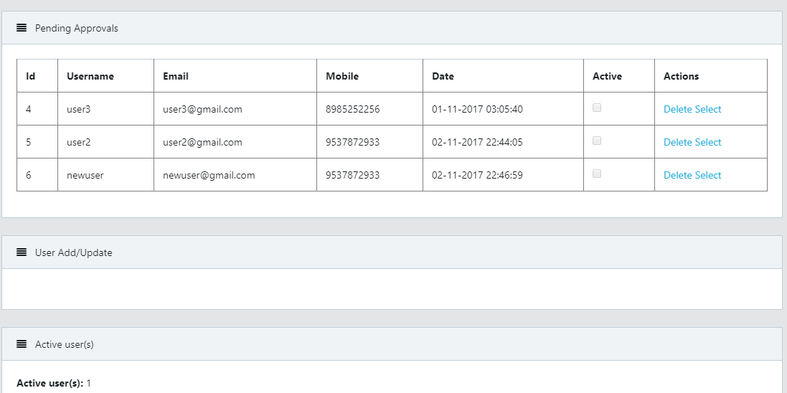
verify_user.aspx

Slide 36
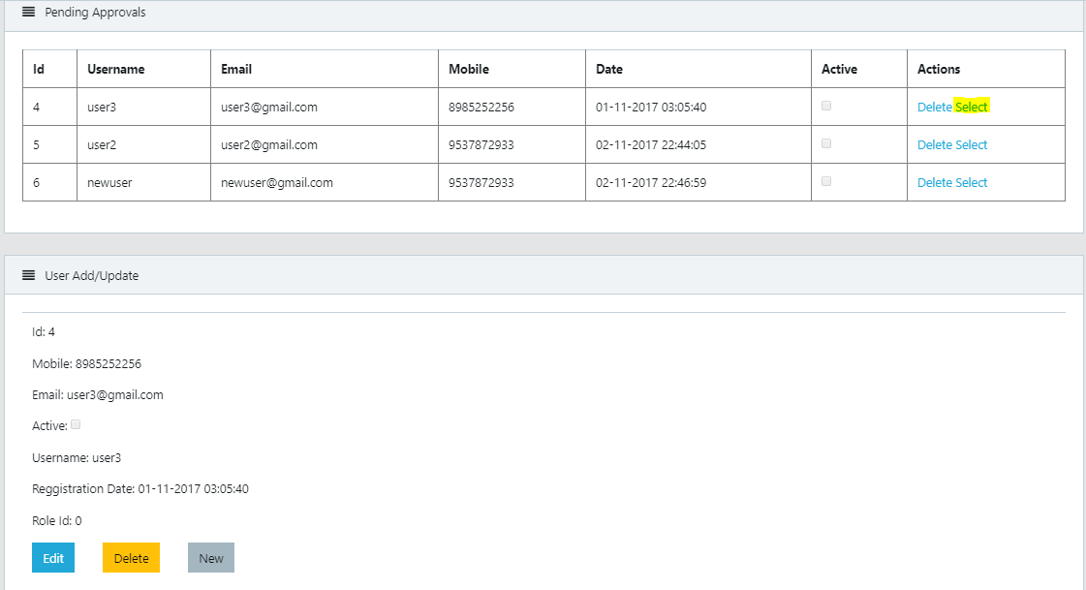
verify_user.aspx Demo

Slide 37
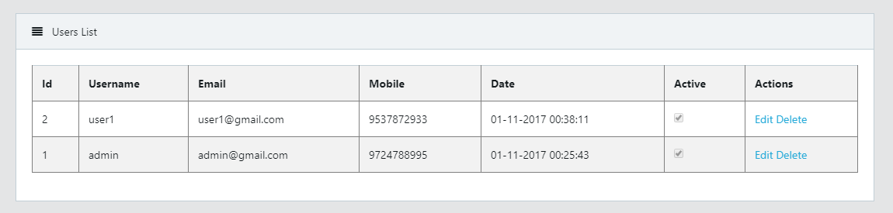
approved.aspx

Slide 38
DASHBOARD: For Better Estimation Of Business
dashboard.aspx
dashboard.aspx.cs
Based on Role of User Authorization user is redirected to dashboard after login.
Global.asax is used to count Active user.(for admin only)

Slide 39
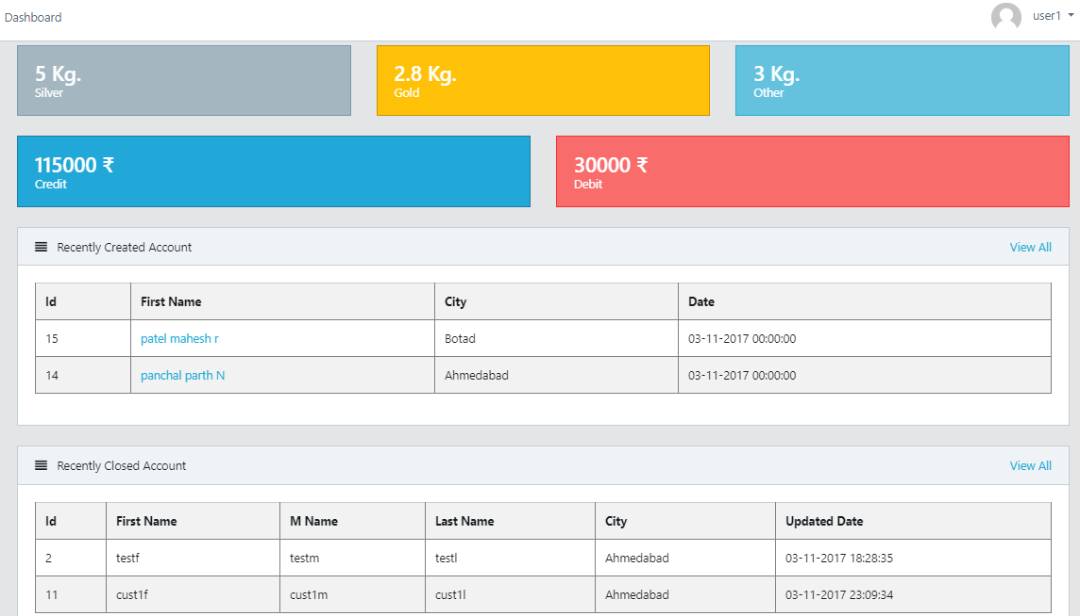
Dashboard for normal user:
dashboard.aspx

Slide 40
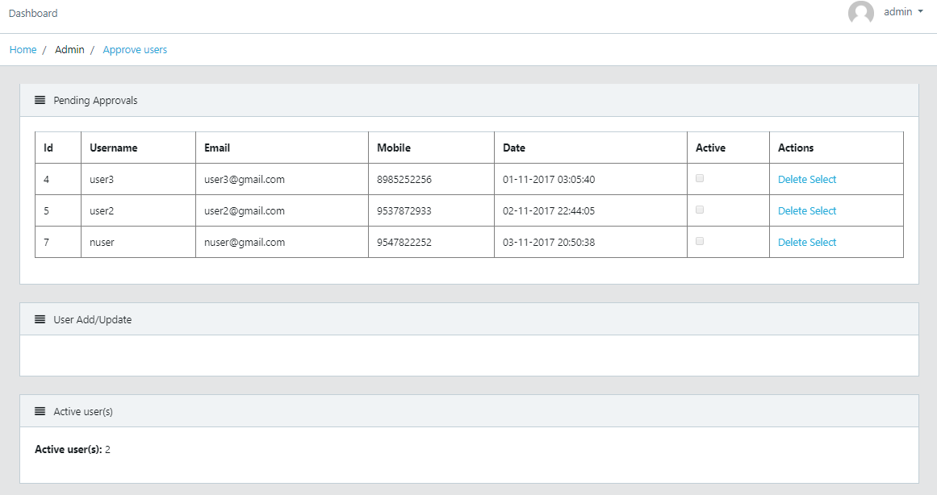
Dashboard for Admin:
verify_user.aspx

Slide 41
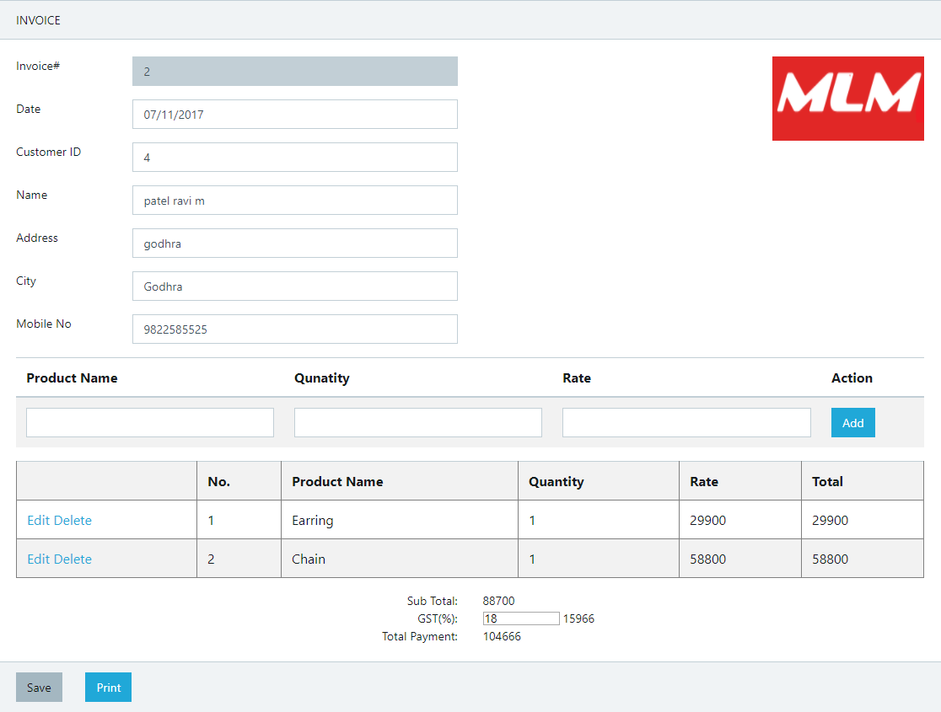
Generate GST Invoice:
Invoice.aspx

Slide 42
Auto-Complete Textbox Using Jquery:
customerserv.asmx
customerserv.asmx.cs
Web service is used to get customer names autocomplete textbox for search customer account operation.
Web service is linked with stored procedure ‘searchp‘ for Auto-Complete.
Source File Used:
<script src="Scripts/jquery.js"></script>
<script src="Scripts/jquery-ui.min.js"></script>
<link href="Styles/jquery-ui.min.css" rel="stylesheet" />
<link href="Styles/jquery-ui.structure.min.css" rel="stylesheet" />
<link href="Styles/jquery-ui.theme.min.css" rel="stylesheet" />

Slide 43
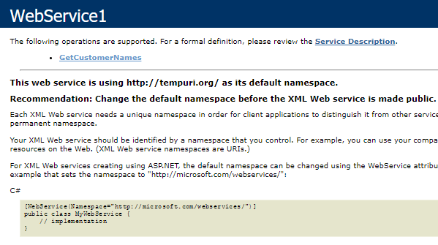
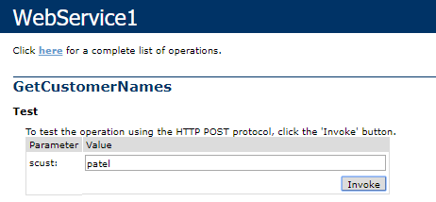

Slide 44
Security Aspects
Register user page is provided to Users(Money Lenders).
After registration user is able to login to system after admin approval.
Admin is only allow to perform crud operations on users.
Only Admin is allow to delete customer account on users requirement.
Guest user are not allow to use System

Slide 45
Output :

Slide 46
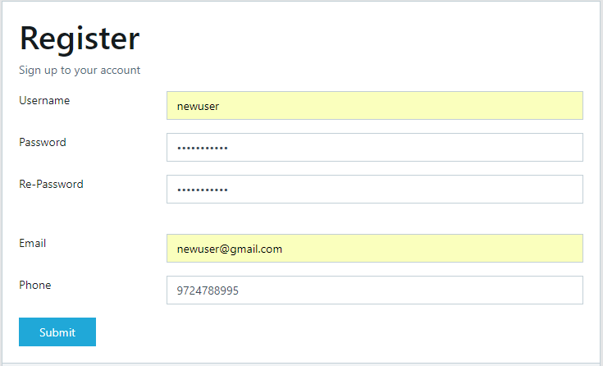
Registration:

Slide 47
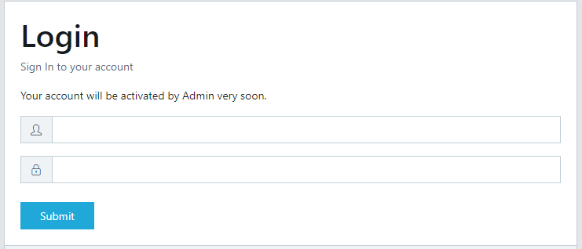

Slide 48
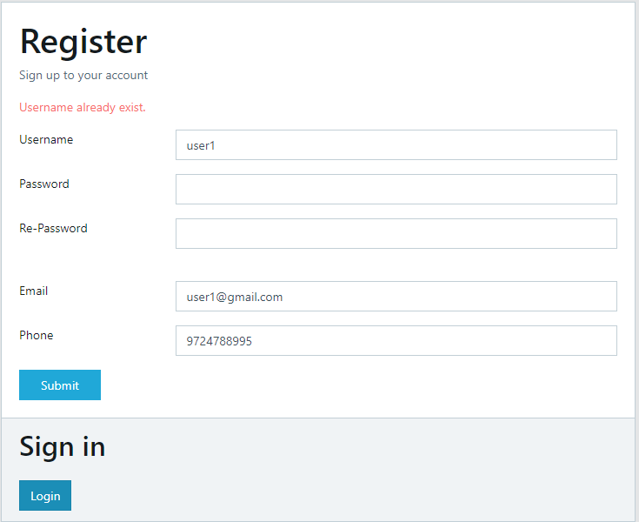

Slide 49
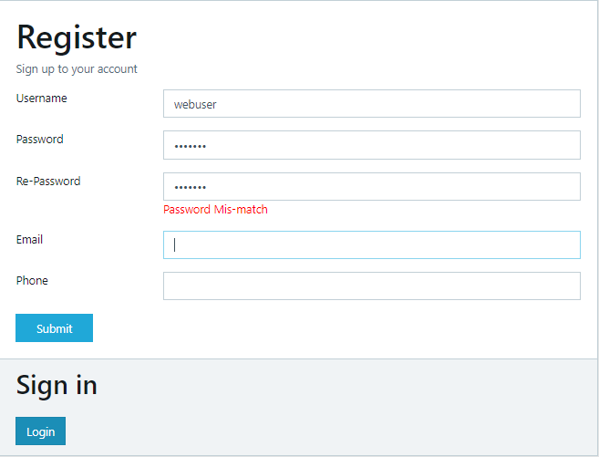

Slide 50
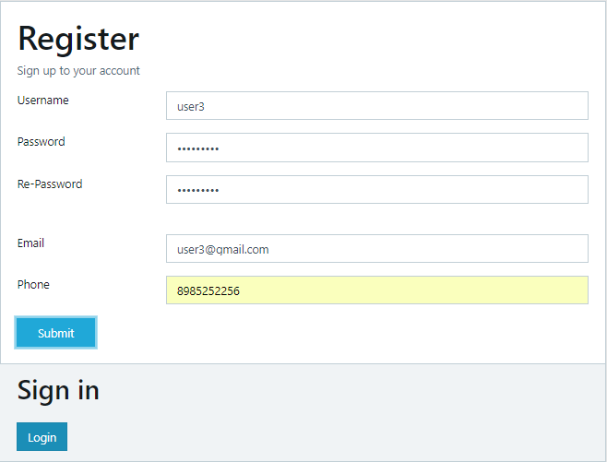

Slide 51
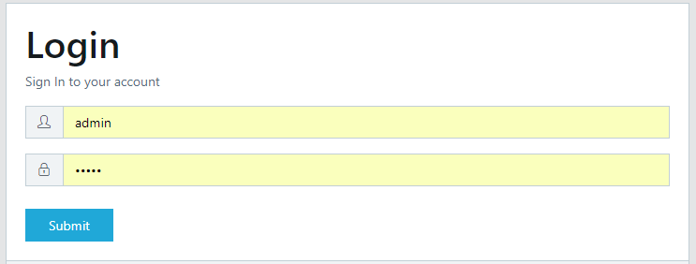

Slide 52
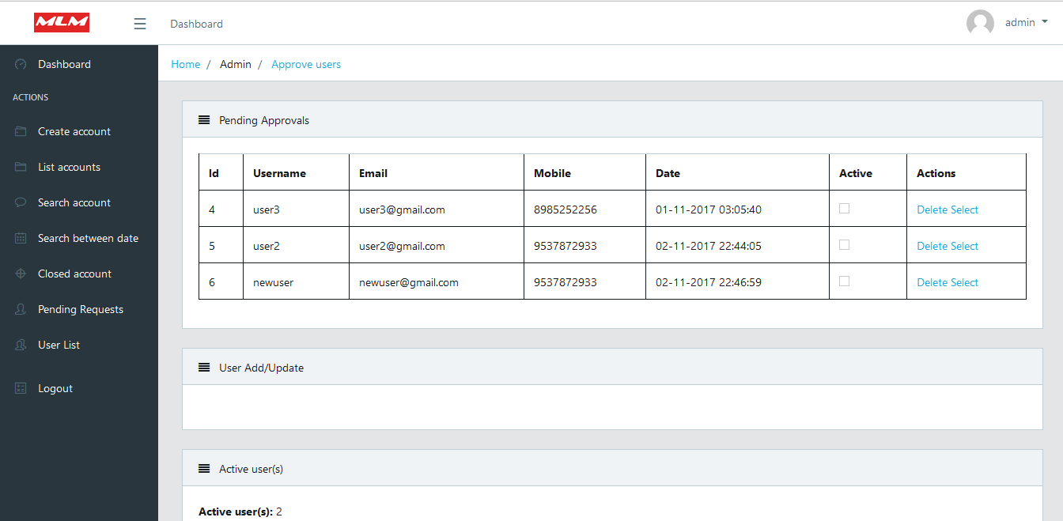
For Admin Credential:

Slide 53
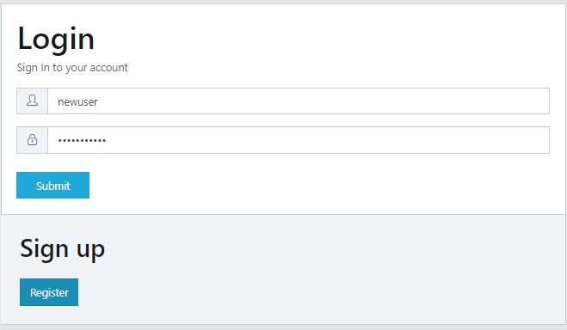

Slide 54
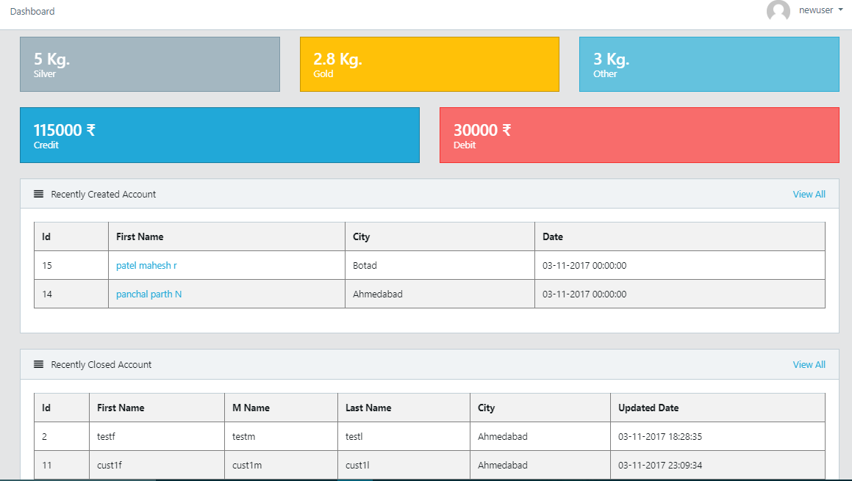
For User Credential:

Slide 55
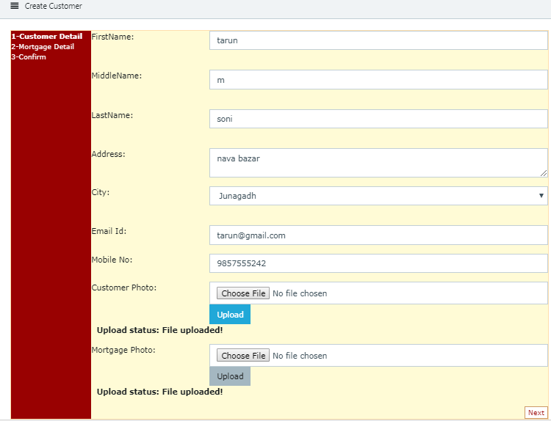

Slide 56
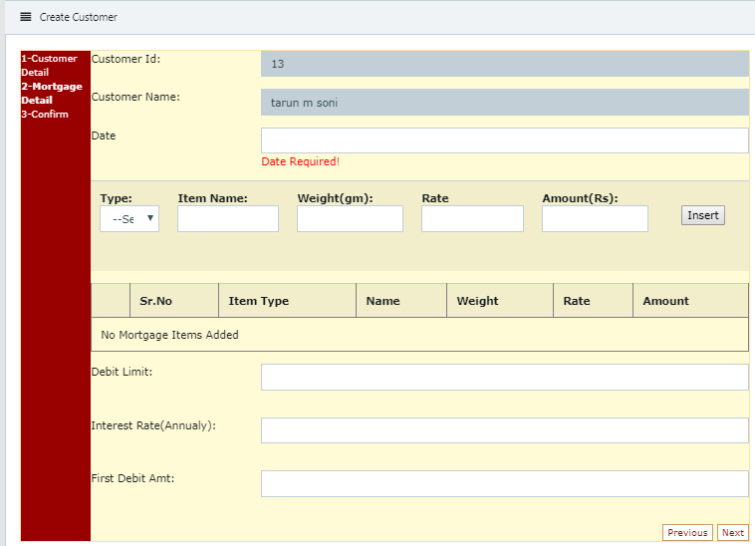

Slide 57
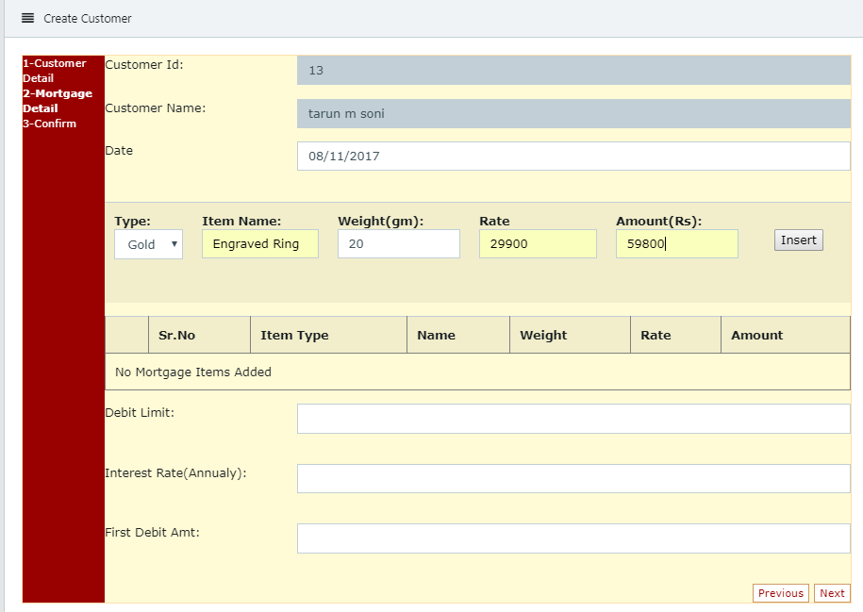

Slide 58
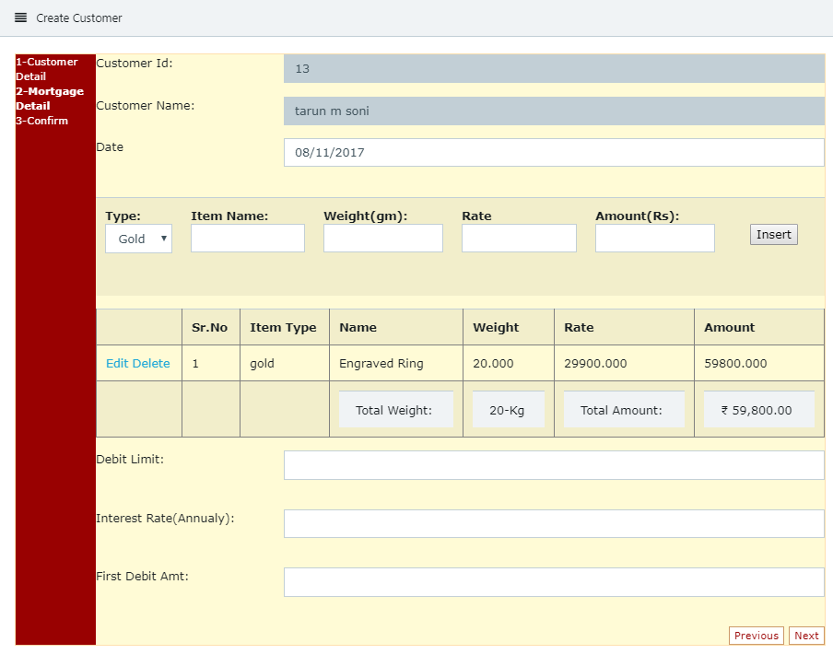

Slide 59
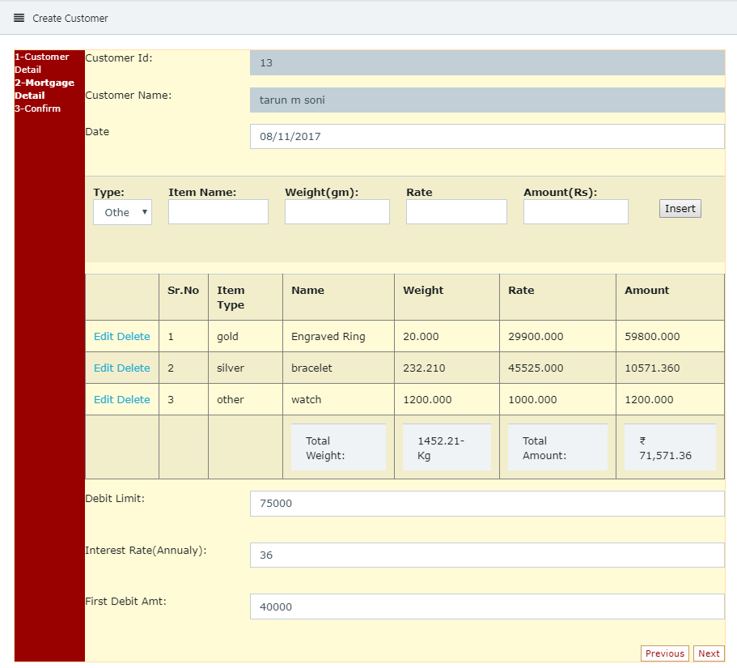

Slide 60


Slide 61

Customer list order by create date

Slide 62

Customer Info
Mortgage Detail
transection Info
Mortgage calculation based on interest rate
Update customer Account

Slide 63

Customer Info:

Slide 64

Mortgage Detail:

Slide 65

transection Info:

Slide 66


Slide 67

Update customer Account Transection:

Slide 68

Search account
Order by create date
Hyperlink to customer account

Slide 69



Slide 70


Slide 72


Slide 73


Slide 74


Slide 75


Slide 77

Search By customer Id:

Slide 78


Slide 81


Slide 83


Slide 84


Slide 85


Slide 86


Slide 87


Slide 88


Slide 89

All Text field and Add button are disable

Slide 90

disable

Slide 91

For Admin Only

Slide 92

For Normal User

Slide 93


Slide 94


Slide 95


Slide 96



Slide 97


Slide 98


Slide 99

onclick="window.print();"
Web Hosting On: somee.com
URL:http://www.smlm.somee.com

Slide 100

Validation:

Slide 101




Slide 102


Only jpeg/jpg /png extension are valid

Slide 103


Slide 104


Slide 105

Finish Button is
Enable Only On
Next Step Index=2

Slide 106



