Slide 1

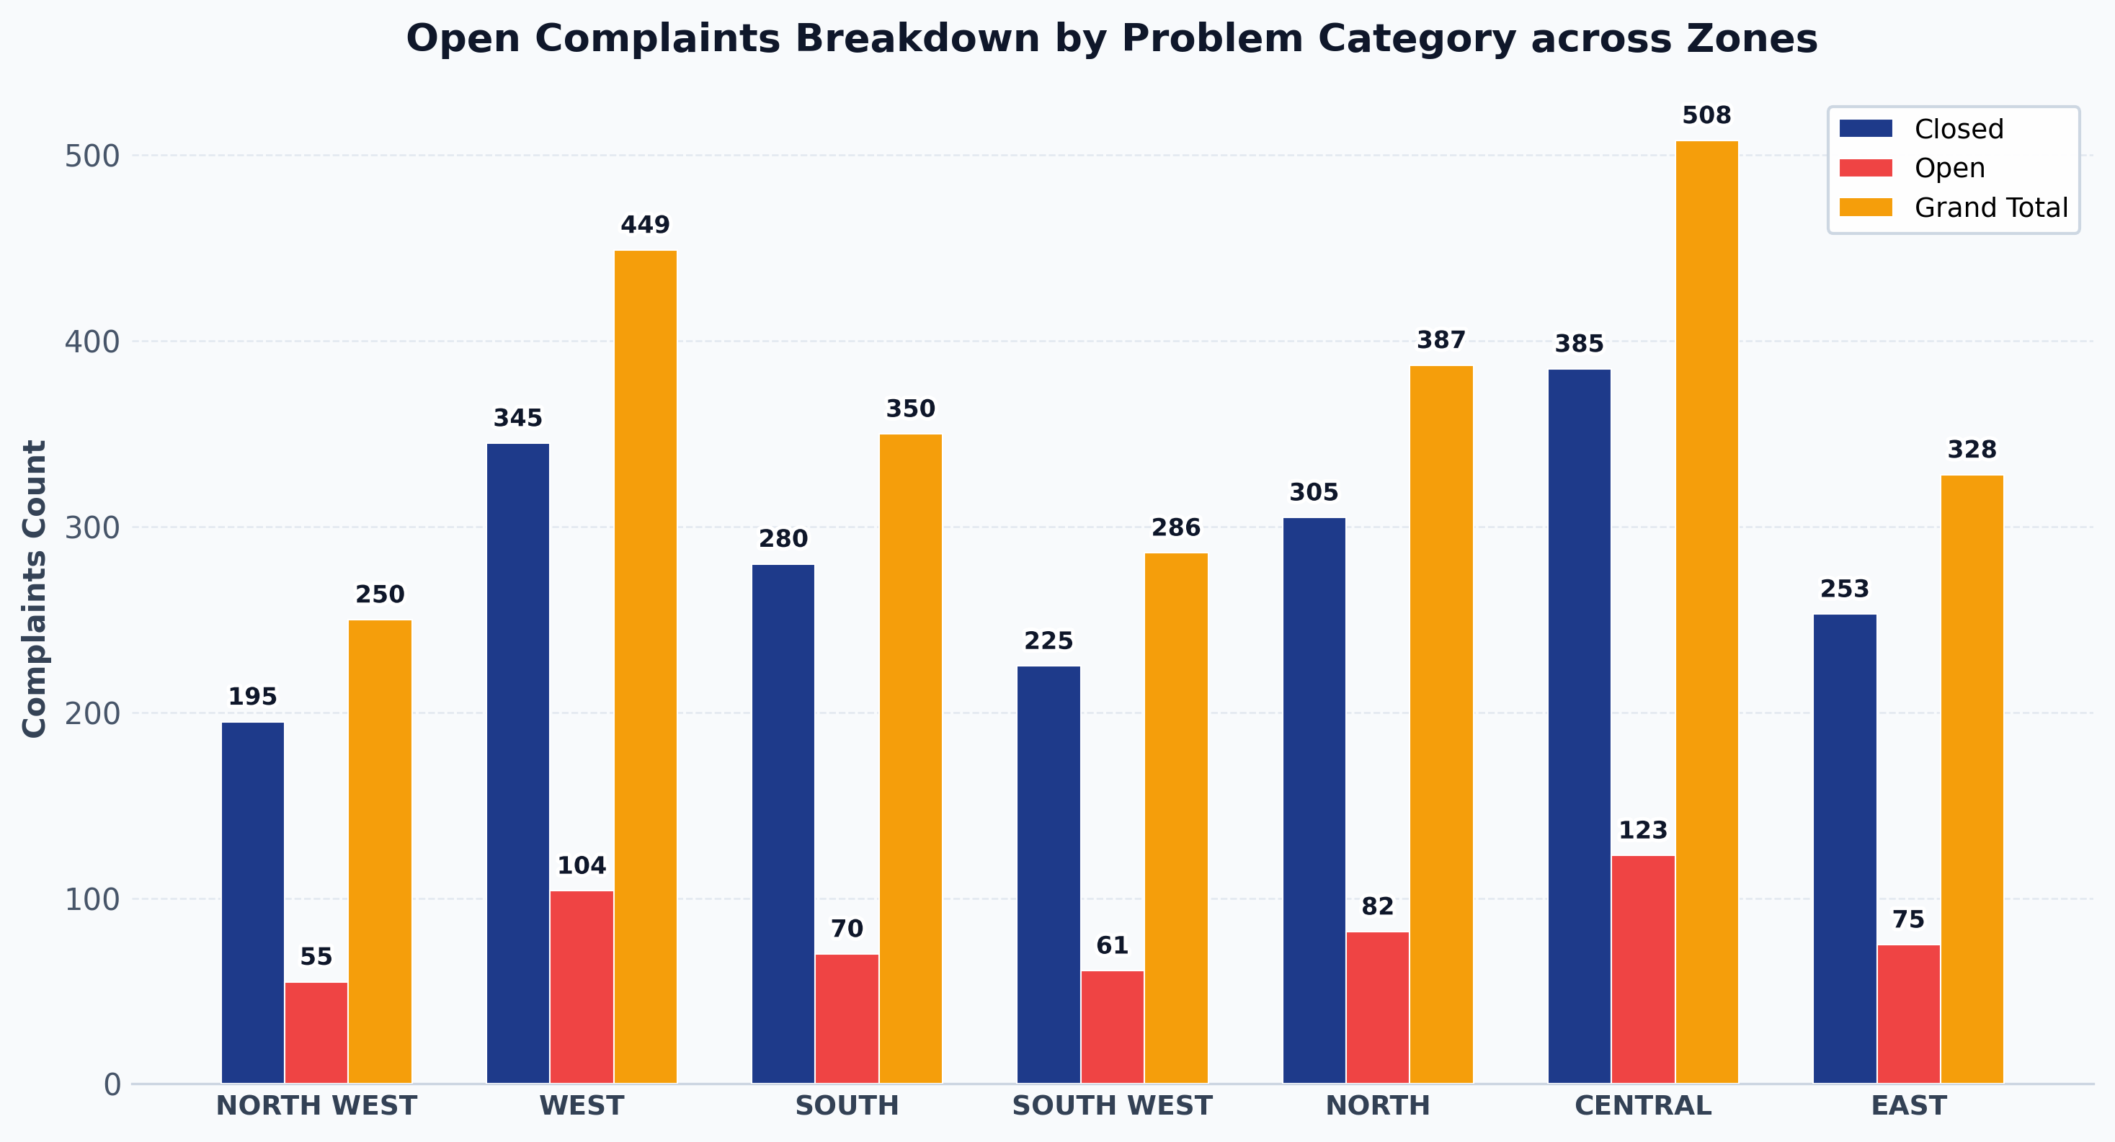
Zone wise Road CCRS Complaints Report
Open Complaints Breakdown by Problem Category across Zones • Reporting Period: August 2026
TOTAL COMPLAINTS
2558
22.28% Open Rate
CLOSED COMPLAINTS
1988
77.72% Resolution Rate
OPEN COMPLAINTS
570
Requires Field Maintenance
KEY INSIGHTS & EXECUTIVE SUMMARY
• Overall Road Status: 2558 total complaints registered — 1988 resolved (77.72% resolution rate) and 570 open (22.28% pending field maintenance action.
• Zone Backlog Severity: Top 3 zones with highest open road complaints — CENTRAL (123), WEST (104), NORTH (82).
• Critical Problem Category: 'Road-Repair Require' is the leading road issue with 353 open cases (61.93% of total road backlog) — requiring priority material & crew deployment.
• Highest Pending Ratio: Zone 'CENTRAL' has 24.21% of its complaints still open (123 cases) — immediate supervisory intervention required.

Slide 2
Zone wise Road CCRS Complaints - Detailed Data Table
Zone & Problem Category Breakdown • August 2026
ZONE | PROBLEM CATEGORY | CLOSED | OPEN | GRAND TOTAL
NORTH WEST | Road-Repair Require | 120 | 35 | 155
NORTH WEST | Road-Bhuva On Road | 45 | 12 | 57
NORTH WEST | Road-Footpath Repairing | 30 | 8 | 38
NORTH WEST — Subtotal |  | 195 | 55 | 250
WEST | Road-Repair Require | 210 | 65 | 275
WEST | Road-Bhuva On Road | 80 | 24 | 104
WEST | Road-Footpath Repairing | 55 | 15 | 70
WEST — Subtotal |  | 345 | 104 | 449
SOUTH | Road-Repair Require | 180 | 42 | 222
SOUTH | Road-Bhuva On Road | 60 | 18 | 78
SOUTH | Road-Footpath Repairing | 40 | 10 | 50
SOUTH — Subtotal |  | 280 | 70 | 350
SOUTH WEST | Road-Repair Require | 140 | 38 | 178
SOUTH WEST | Road-Bhuva On Road | 50 | 14 | 64
SOUTH WEST | Road-Footpath Repairing | 35 | 9 | 44
SOUTH WEST — Subtotal |  | 225 | 61 | 286
NORTH | Road-Repair Require | 190 | 50 | 240
NORTH | Road-Bhuva On Road | 70 | 20 | 90
NORTH | Road-Footpath Repairing | 45 | 12 | 57
NORTH — Subtotal |  | 305 | 82 | 387
CENTRAL | Road-Repair Require | 230 | 75 | 305
CENTRAL | Road-Bhuva On Road | 95 | 30 | 125
CENTRAL | Road-Footpath Repairing | 60 | 18 | 78
CENTRAL — Subtotal |  | 385 | 123 | 508
EAST | Road-Repair Require | 160 | 48 | 208
EAST | Road-Bhuva On Road | 55 | 16 | 71
EAST | Road-Footpath Repairing | 38 | 11 | 49
EAST — Subtotal |  | 253 | 75 | 328
GRAND TOTAL |  | 1988 | 570 | 2558

Slide 3
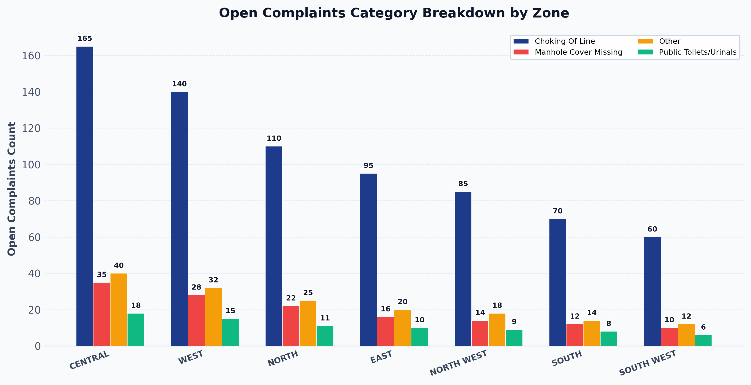
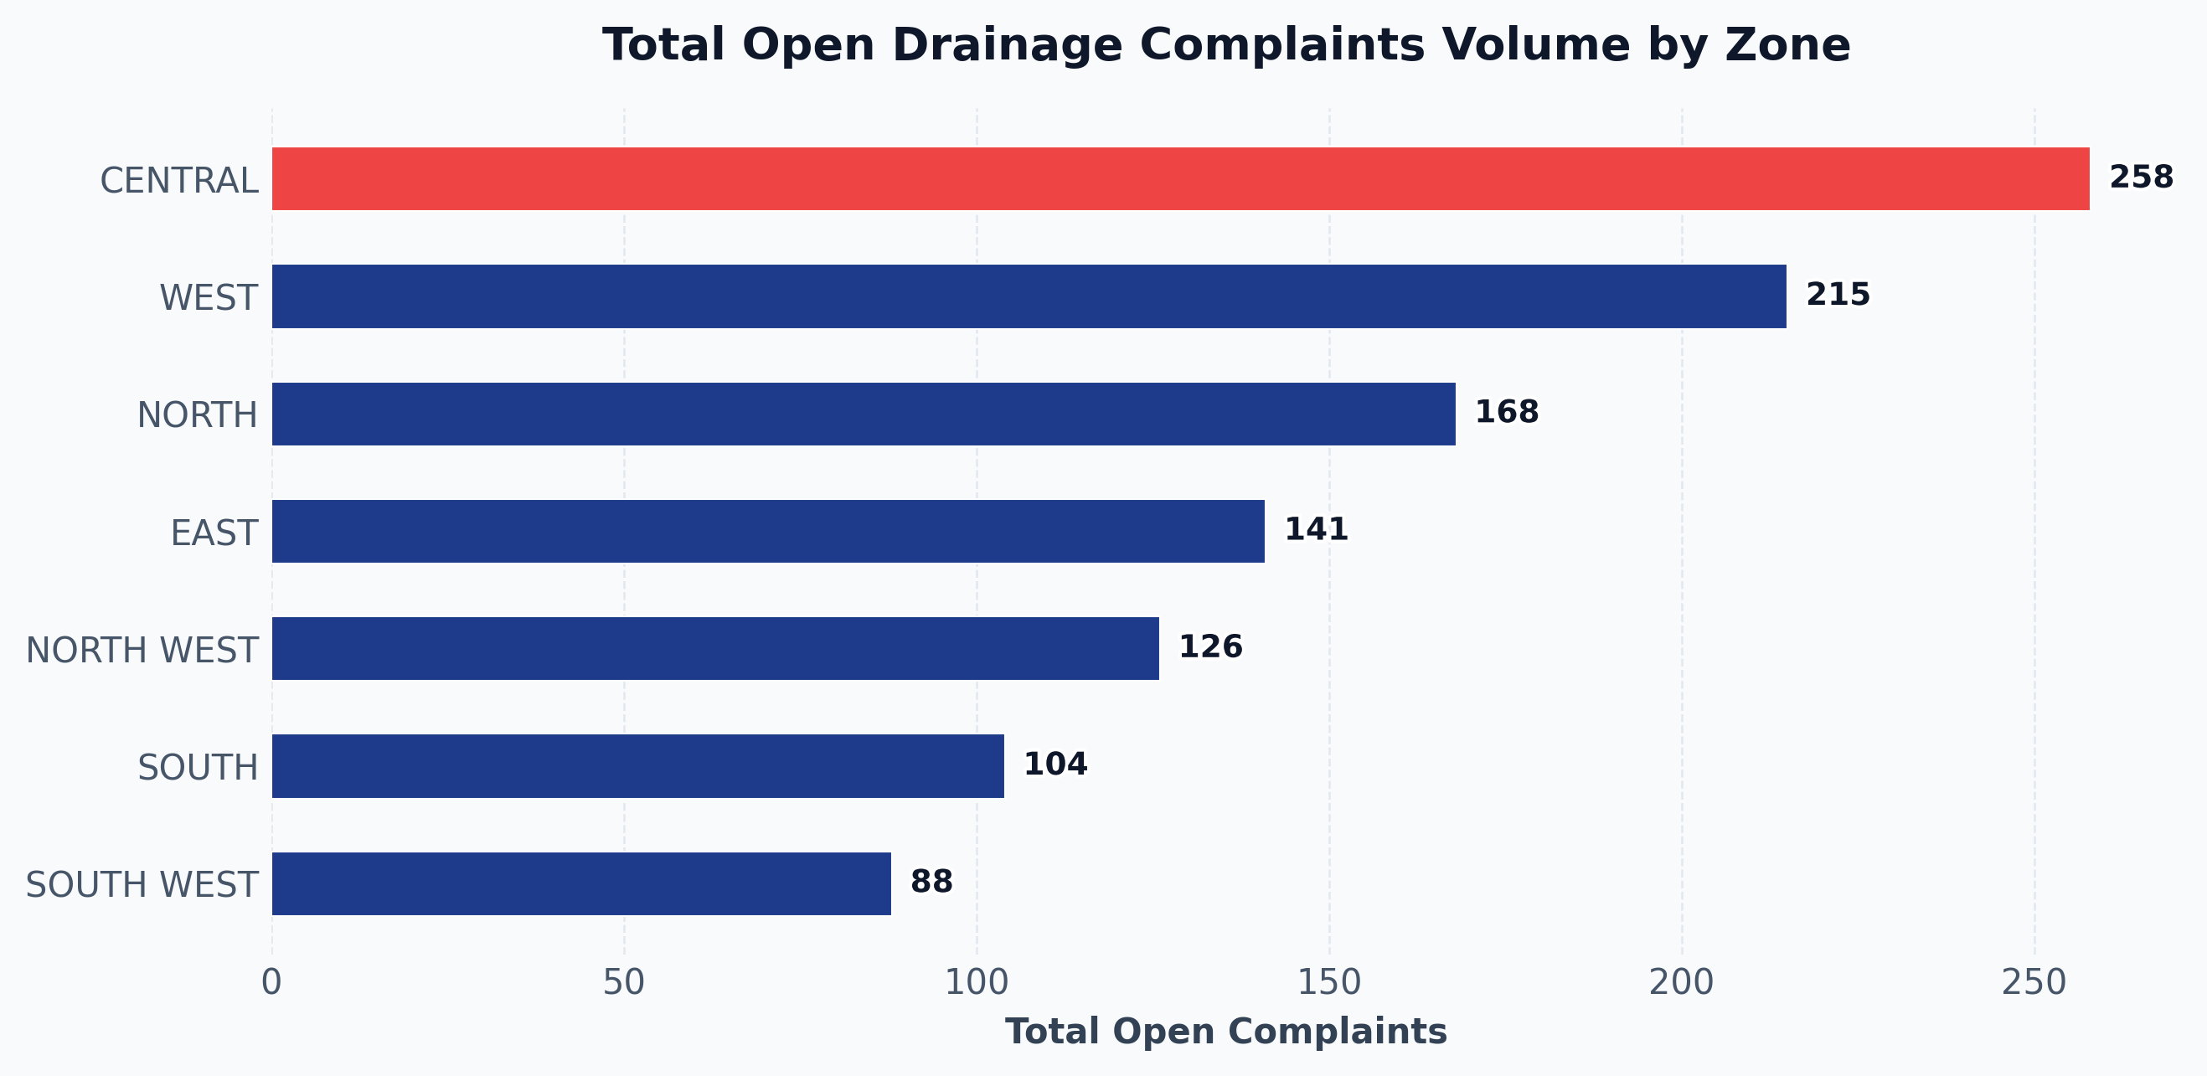
CCRS Drainage Complaints Summary Report
Comprehensive Zone-Wise Open Complaints Analysis • Period: August 2026
TOTAL COMPLAINTS
4750
CLOSED COMPLAINTS
3650
76.84% Res. Rate
OPEN COMPLAINTS
1100
23.16% Pending
HIGHEST OPEN ZONE
CENTRAL
258 Open Cases

Slide 4
Zone-Wise CCRS Drainage Complaints Detailed Data Table
Zone Matrix with Category Open Counts & Resolution Rates • August 2026
Zone | Choking Of Line | Manhole Cover Missing | Other | Public Toilets/Urinals | Total Open | Total Closed | Grand Total | % Open
CENTRAL | 165 | 35 | 40 | 18 | 258 | 745 | 1003 | 25.72%
WEST | 140 | 28 | 32 | 15 | 215 | 660 | 875 | 24.57%
NORTH | 110 | 22 | 25 | 11 | 168 | 555 | 723 | 23.24%
EAST | 95 | 16 | 20 | 10 | 141 | 477 | 618 | 22.82%
NORTH WEST | 85 | 14 | 18 | 9 | 126 | 448 | 574 | 21.95%
SOUTH | 70 | 12 | 14 | 8 | 104 | 415 | 519 | 20.04%
SOUTH WEST | 60 | 10 | 12 | 6 | 88 | 350 | 438 | 20.09%
ALL ZONES | 725 | 137 | 161 | 77 | 1100 | 3650 | 4750 | 23.16%
KEY INSIGHTS & EXECUTIVE SUMMARY
• Primary cause of backlog: 'Choking Of Line' with 725 open complaints (65.91% of total citywide open backlog).
• Zone backlog severity ranking: Top 3 affected zones are CENTRAL (258), WEST (215), NORTH (168).
• Highest pending ratio: Zone 'CENTRAL' has the highest pending ratio at 25.72% open.
• Safety Critical Action: 'Manhole Cover Missing' has 137 pending cases. Top priority zones requiring immediate replacement: CENTRAL (35), WEST (28), NORTH (22).

Slide 5
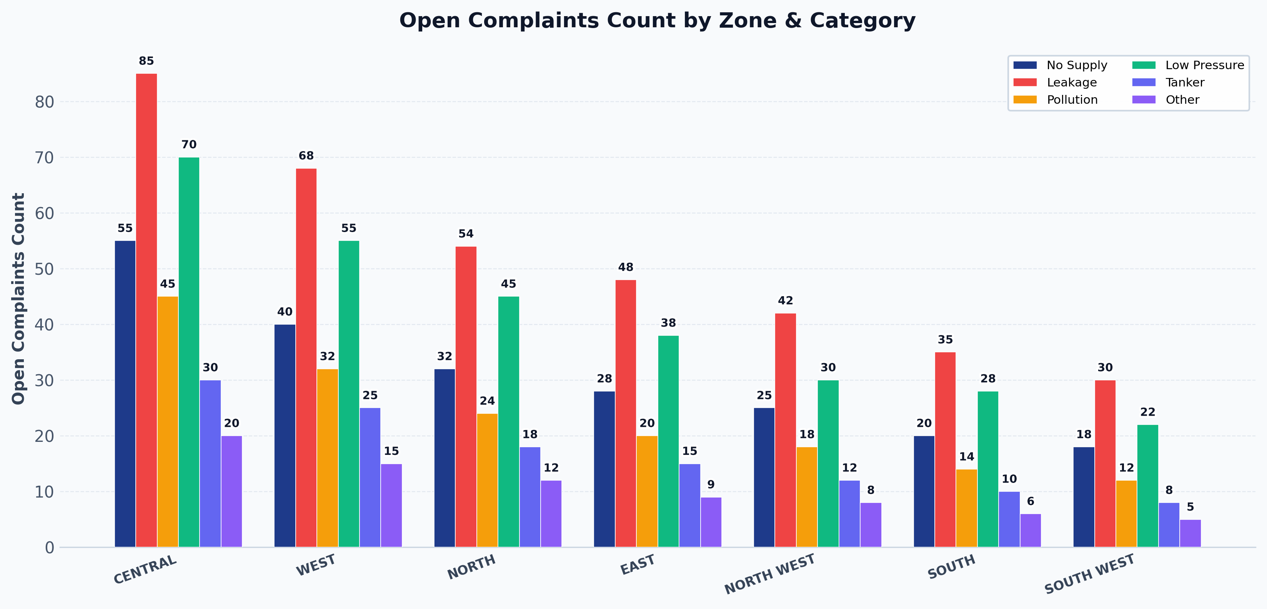
CCRS Water Complaints: Zone & Category Open Summary
Reporting Period: August 2026
TOTAL OPEN COMPLAINTS
1226
Citywide Water Backlog
TOP OPEN ZONE
CENTRAL
305 Open Cases
TOP OPEN CATEGORY
Leakage
362 Cases (29.53%)
CATEGORIES TRACKED
6
Active Water Issue Types
Zone Name | No Supply | Leakage | Pollution | Low Pressure | Tanker | Other | Total Open
CENTRAL | 55 | 85 | 45 | 70 | 30 | 20 | 305
WEST | 40 | 68 | 32 | 55 | 25 | 15 | 235
NORTH | 32 | 54 | 24 | 45 | 18 | 12 | 185
EAST | 28 | 48 | 20 | 38 | 15 | 9 | 158
NORTH WEST | 25 | 42 | 18 | 30 | 12 | 8 | 135
SOUTH | 20 | 35 | 14 | 28 | 10 | 6 | 113
SOUTH WEST | 18 | 30 | 12 | 22 | 8 | 5 | 95
Total Open | 218 | 362 | 165 | 288 | 118 | 75 | 1226
KEY INSIGHTS
• Highest Pendency Category: 'Leakage' accounts for 362 open complaints (29.53% of total citywide water backlog).
• Top 3 High-Pressure Zones: CENTRAL (305), WEST (235), NORTH (185) represent 59.14% of total citywide water complaints.
• Zone-Specific Key Challenges: CENTRAL: Leakage (85); WEST: Leakage (68); NORTH: Leakage (54); EAST: Leakage (48); NORTH WEST: Leakage (42); SOUTH: Leakage (35); SOUTH WEST: Leakage (30).

Slide 6
CCRS Water Complaints - Strategic Focus & Executive Summary
Actionable Insights Based on Zone x Category Analysis • August 2026
KEY INSIGHTS & STRATEGIC FOCUS AREAS
• Highest Pendency Category: 'Leakage' accounts for 362 open complaints (29.53% of total citywide water backlog).
• Top 3 High-Pressure Zones: CENTRAL (305), WEST (235), NORTH (185) represent 59.14% of total citywide water complaints.
• Zone-Specific Key Challenges: CENTRAL: Leakage (85); WEST: Leakage (68); NORTH: Leakage (54); EAST: Leakage (48); NORTH WEST: Leakage (42); SOUTH: Leakage (35); SOUTH WEST: Leakage (30).
• Targeted Intervention Required: Zone 'CENTRAL' alone accounts for 305 open cases (24.88% of citywide water backlog) — dedicated water supply teams and SCADA monitoring recommended.

