Slide 1
MedicLoan
By: Kiran Panchal (001826692)
Komal Suthar (001278113)

Slide 2
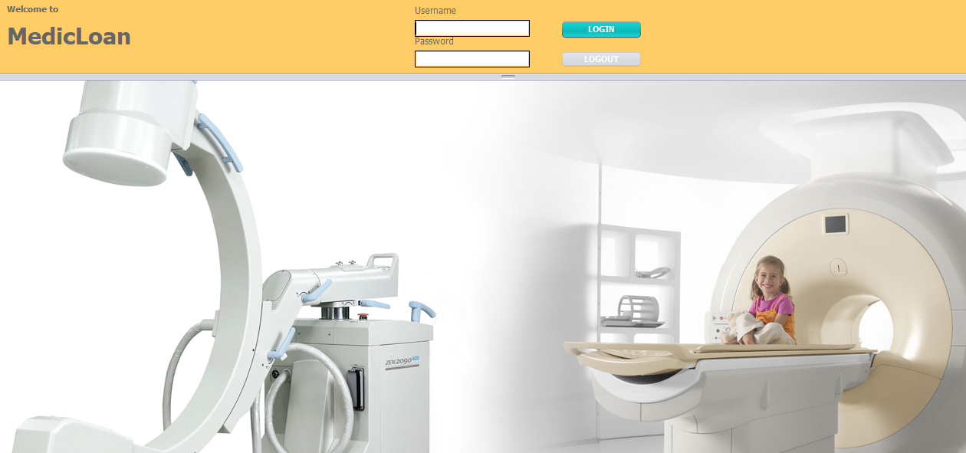

Slide 3
Purpose
Insufficient funds to be able to afford latest health equipment is one of the major problems faced by hospitals today.
Due to this inconvenience hospitals are unable to perform proper diagnosis for any disease to the patient.
To overcome this issue, we help such hospitals by providing machines on rent or loan basis. These are provided by companies who manufacture them or those, who trade them at low pricing.

Slide 4
Overview
MedicLoan is a System that provides Hospitals, Doctors, University healthcare Research , NGOs and other users to rent medical equipment on loan basis.
We are connecting Suppliers and Users with our System. Suppliers can promote their machines and Users can be aware of newly available equipment in the market.
System provides recommendations based on the frequently brought equipment analysis.
We are integrating a platform that facilitates maintenance and guidelines for the use of machine.

Slide 5
Features
The User can rent equipment by paying monthly installments instead of spending whole amount at one time.
System will generate Invoice and email reminders would be sent to users regarding the payment due.
System provides recommendations to the users by analyzing the frequently bought equipment.

Slide 6
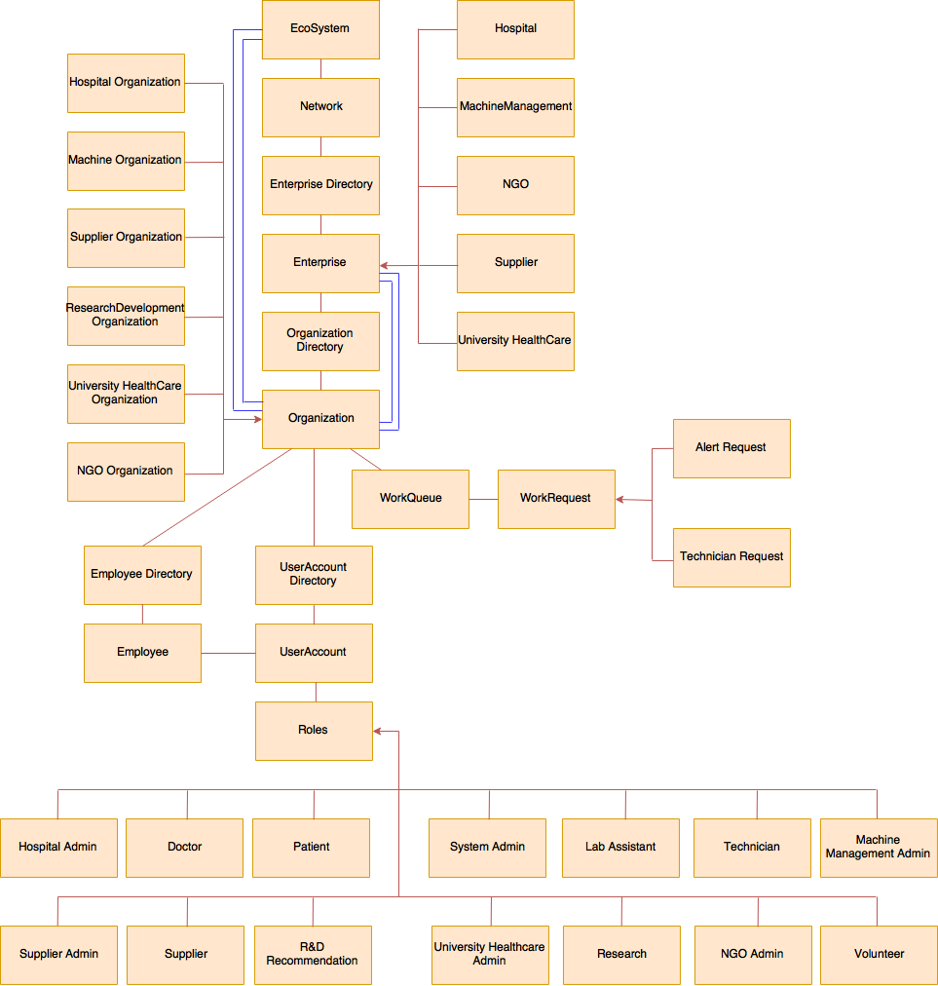

Slide 7
Users
System Admin
Hospital Admin
Supplier
Doctor
Technician
Volunteer
Lab Assistant
Patient
Research & Development

Slide 8
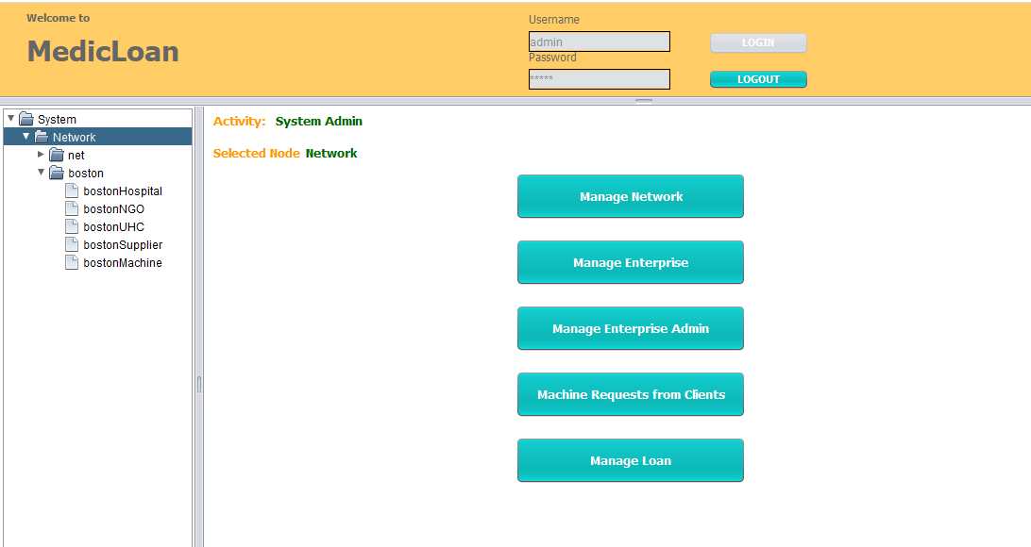
System Admin

Slide 9
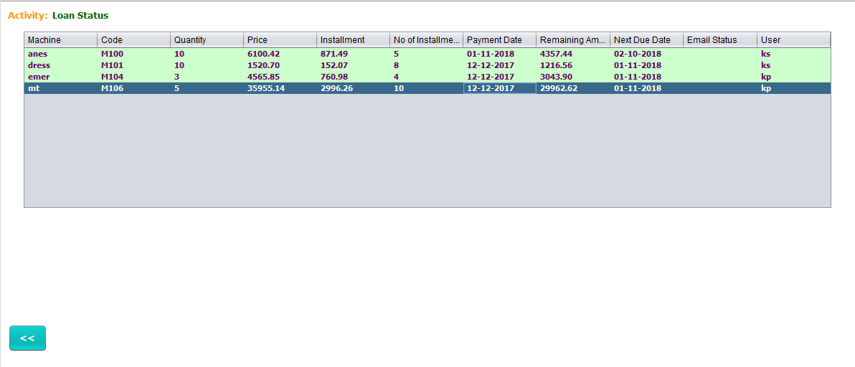
Manage Loan

Slide 10
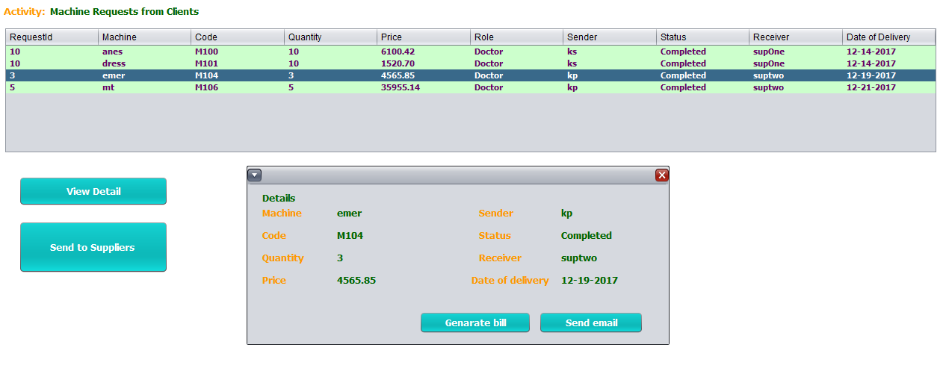
Machine Requests

Slide 11
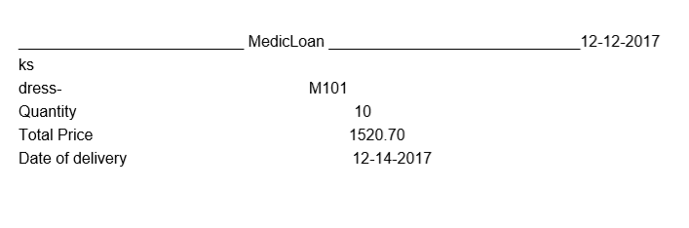
Bill Generation

Slide 12
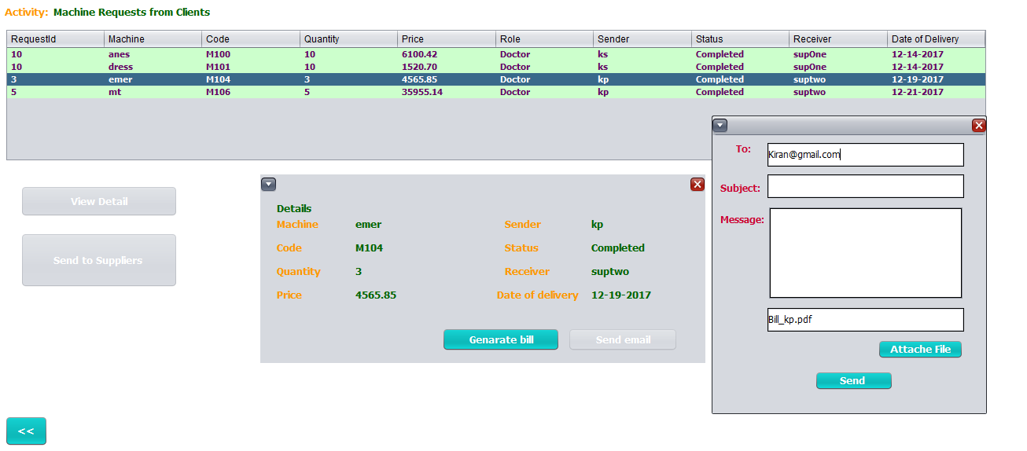
Email to User

Slide 13
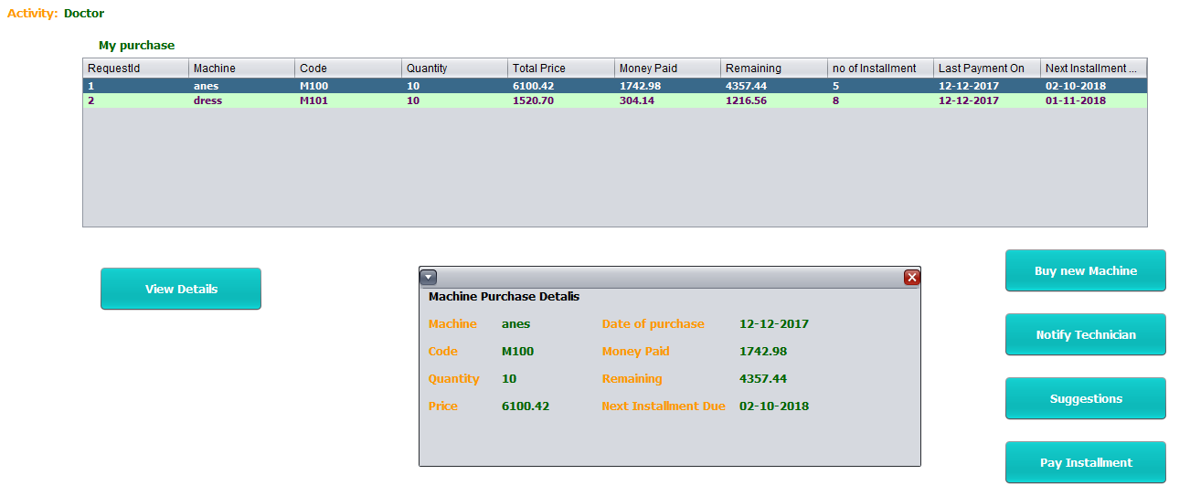
Doctor Work Area

Slide 14
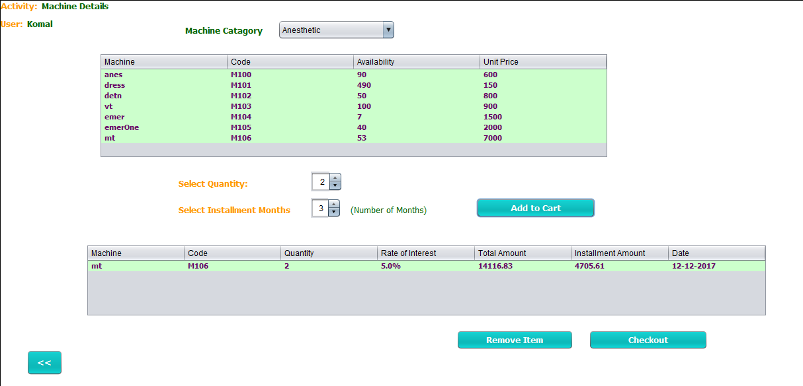
Buy a Machine

Slide 15
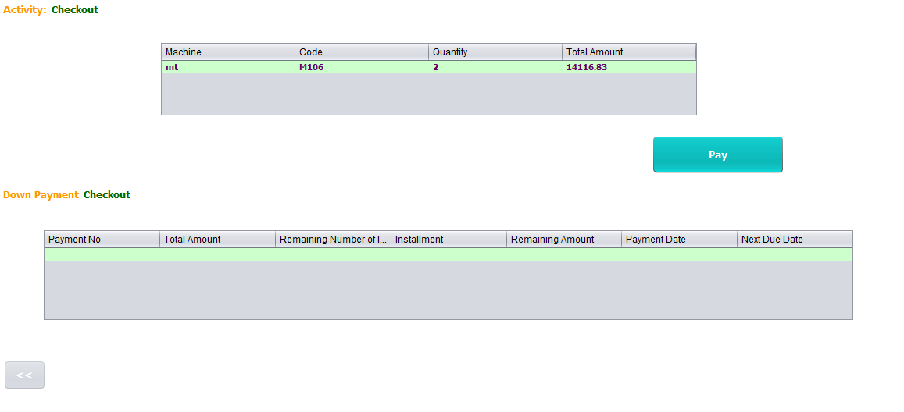
Checkout

Slide 16
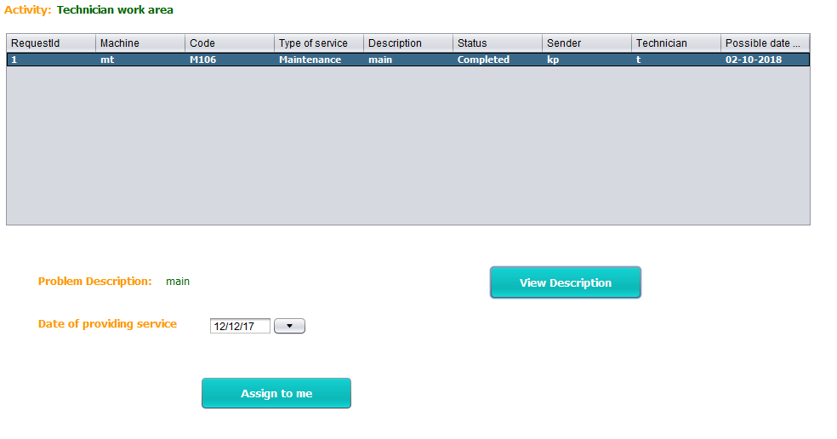
Notify Technician

Slide 17
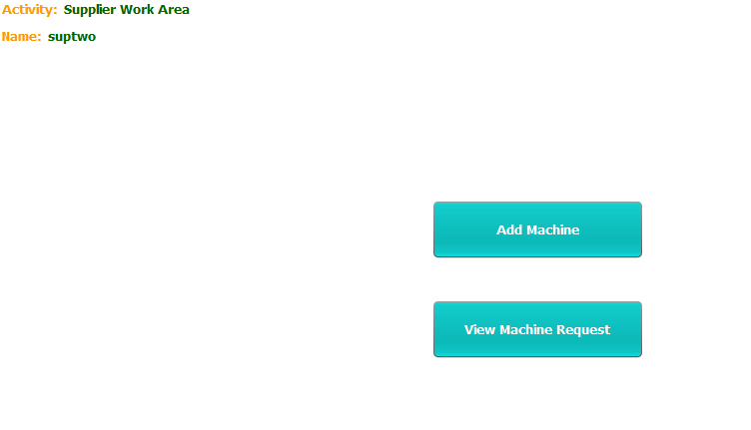
Supplier Work Area

Slide 18
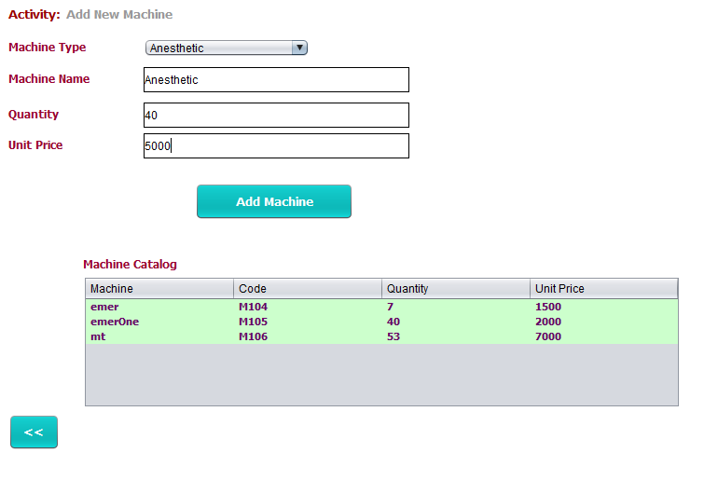
Add Machine

Slide 19
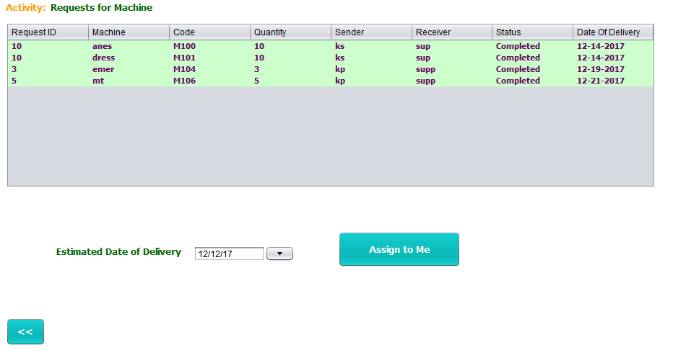
View Machine Requests

Slide 20
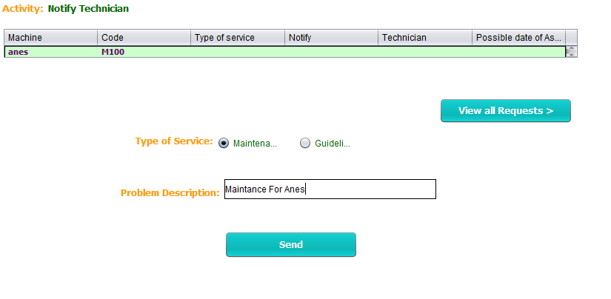
Technician Work Area

Slide 21
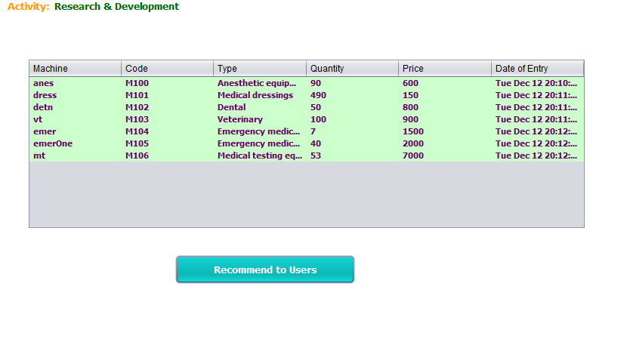
Recommendation

Slide 22
Thank You!!

