Slide 1
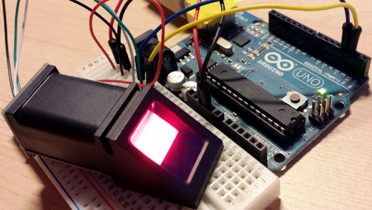
FINGERPRINT ATTENDANCE SYSTEM
STUDENT NAME:-
PANCHAL MEET BHARATBHAI -146400307554
NAREKAR RUSHABH BIPINBHAI -146400307549
PATEL MRUNAL RAMESHBHAI -146400307548
Guided By
J.B Baria Sir

Slide 2
PROJECT PROFILE
Project Title : | Fingerprint attendance system
Project Aim : | To provide automatic attendance
Project Objective : | To motive of this fingerprint attendance system provides a satisfaction attendance report of students for faculties
Project Duration : | Approximately 8 months
Internal Guide : | J. B. Baria sir
Mentored By : | V. A. Vyas sir
Front End : | Python , VB.net
Back End : | ARDUINO , MS Access
Technology : | I.O.T
Developed By : | Narekar Rushabh B.(146400307549) Panchal Meet B.(146400307554) Patel Mrunal R.(146400307548)

Slide 3
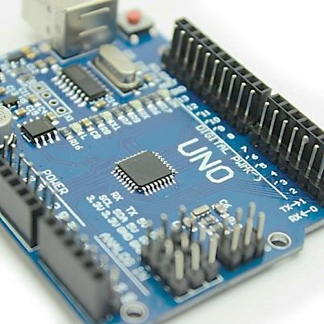
ABOUT HARDWARE
CIRCUIT DESCRIPTION:-
ARDUINO /Genuino Rev 3 (Clone)
ARDUINO/genuino uno is a microcontroller board based on the atmega328p . It has 14 digital input/output pins (of which 6 can be used as pwm-pulse width modulation outputs), 6 analog inputs, a 16 MHZ quartz crystal, a USB connection, a power jack, an ICSP header and a reset button. It contains everything needed to support the microcontroller; simply connect it to a computer with a USB cable or power it with a ac-to-dc adapter or battery to get started.

Slide 4
TECHNICAL SPECIFICATION
Microcontroller | Atmega328p
Operating voltage | 5v
Input voltage(recommended) | 7-12v
Input voltage (limit) | 6-20v
Digital i/o pins | 14 (of which 6 provide pwm output)
PWM digital i/o pins | 6
Analog input pins | 6
Dc current per i/o pin | 20ma
Dc current for 3.3v pin | 50ma
Flash memory | 32 kb (atmega328p)
SRAM | 2 kb (atmega328p)
EPROM | 1 kb (atmega328p)
Length | 68.6 mm
Width | 53.4 mm
Weight | 25 g

Slide 5
SENSOR DESCRIPTION FINGERPRINT MODULE R305_V1.6
Fingerprint sensor type: | Optical
Sensor life: | 100 million times
Static indicators: | 15kvbacklight: bright green
Interface: | USB1.1/uart(TTL logical level)
Rs232 communication baud rate: | 4800bps~115200bps changeable
Dimension: | 55*32*21.5mm
Image capture surface : | 15—18(mm)
Verification speed: | 0.3 sec
Scanning speed: | 0.5 sec
Character file size: | 256 bytes
Template size: | 512 bytes
Storage capacity: | 250
Security level: | 5 (1,2,3,4,5(highest))
False acceptance rate (far) : | 0.0001%
False rejection rate (frr): | 0.1%
Resolution: | 500 dpi
Voltage : | 3.6-6.0 vdc
Working current: | Typical 90 ma, peak 150ma
Matching method: | 1: n
Operating environment temperature: | -20 to 45° centigrade’s

Slide 6
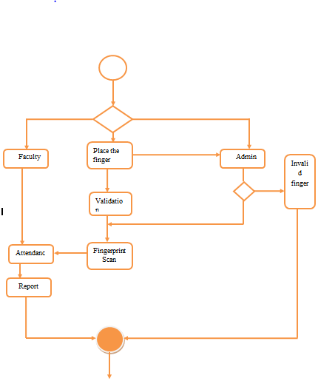
ACTIVITY DIAGRAM

Slide 7
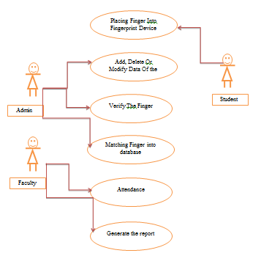
USECASE DIAGRAM

Slide 8
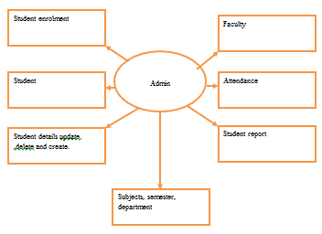
SEQUENCE DIAGRAM

Slide 9
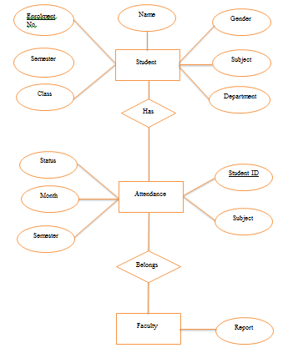
ER Diagram

Slide 10
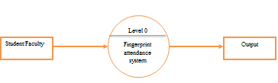
DATA FLOW DIAGRAM
Level 0 data flow diagram

Slide 11
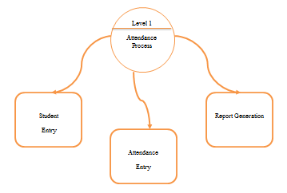
Level 0 data flow diagram

Slide 12
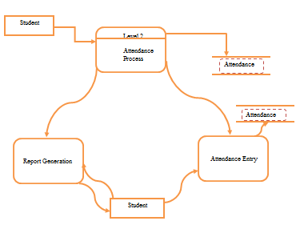
Level 0 data flow diagram

Slide 13
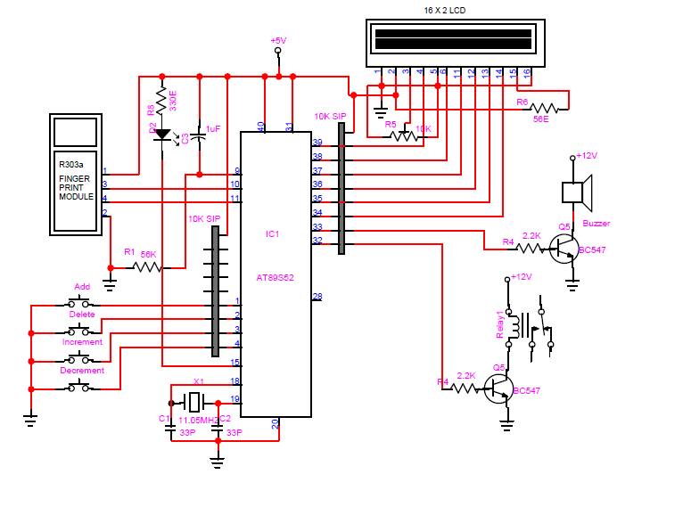
PIN DIAGRAM OF FINGERPRINT SENSOR(R305)

Slide 14
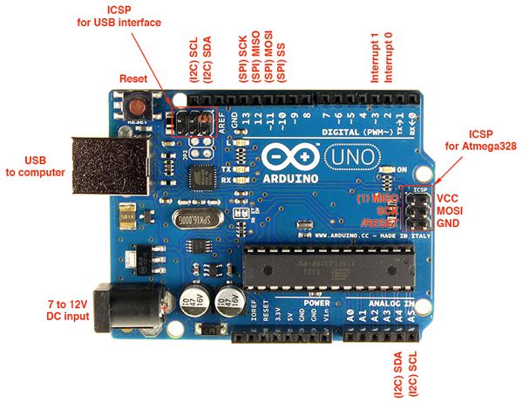
PIN DIAGRAM OF ARDUINO

Slide 15
Hardware & Software Requirements
Software Requirement
User Side
Front End : PYTHON
Back End :MS-ACCESS,ARDUINO
Operating System : Windows XP or above
Hardware Requirement
User Side
Pentium4 Processor
80 GB hard disk
512 MB RAM

Slide 16
Roles and responsibilities
Activities | Responsibilities
Information Gathering | Patel Mrunal & Narekar Rushabh
Requirement Analysis | Panchal Meet & Narekar Rushabh
Project Planning | Patel Mrunal & Narekar Rushabh &Panchal Meet
Documentation | Patel Mrunal & Narekar Rushabh &Panchal Meet
Designing | Patel Mrunal
Coding | Patel Mrunal & Narekar Rushabh &Panchal Meet
Implementation | Narekar Rushabh &Panchal Meet
Testing | Narekar Rushabh &Panchal Meet

Slide 17
ABOUT SOFTWARE
SOFTWARE TOOLS USED:
Microsoft visual basic .net(2013) for GUI
MS Access for database
WHY MS-ACCESS:
It's easy to use: MS-ACCESS is very easy to use. With only a few simple sql statements, you can build and interact with MS-ACCESS .
It's secure: MS-ACCESS includes solid data security layers that protect sensitive data from intruders. Passwords are encrypted.
It's scalable: MS-ACCESS can handle almost any amount of data, up to as much as 50 million rows or more. The default file size limit is about 4 GB.
It runs on many operating systems: MS-ACCESS runs on many operating systems, including windows, linux, many varieties of unix, and others.

Slide 18
WHY .NET
OOP language :it is object oriented programming language. It support 18+ languages such as c/c#/j#/java/vb etc.
It’s easy to use :it makes form easier with use of different controls simply drag and drop.
CLR(common language runtime):features
Deployment makes easier
Common language supported
Security mechanism secured
Software isolatio
It runs on many operating systems:.net runs on many operating systems, including windows, linux, many varieties of unix, and others.

