Slide 1


RAP Learning Solutions Private Limited

Slide 2
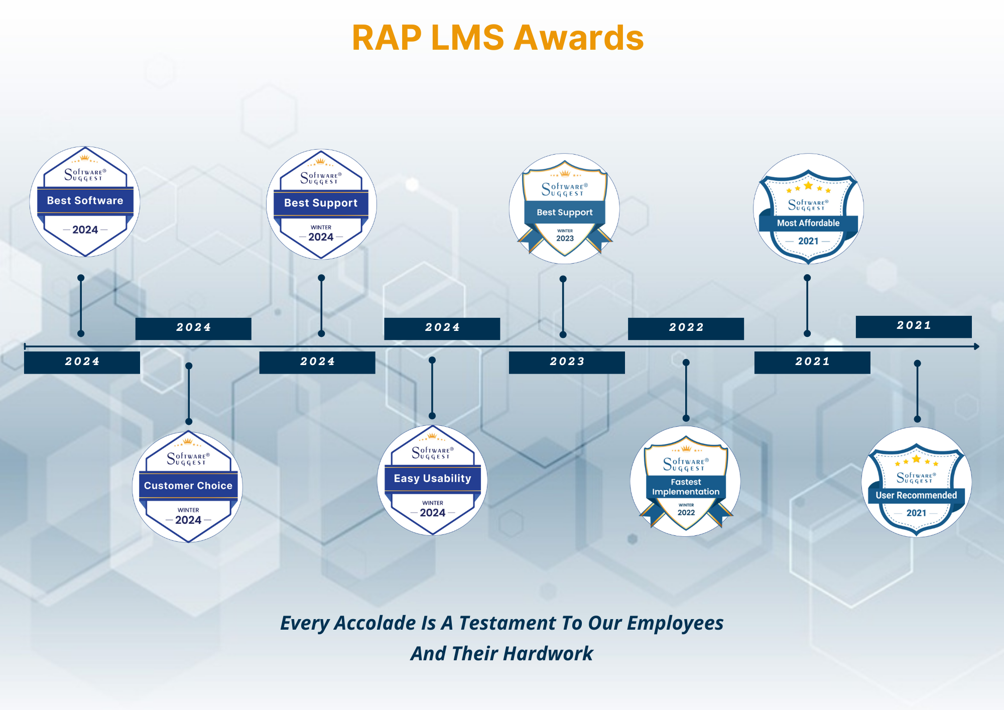

Slide 3

















Our Esteemed Clients

Slide 4


RAP LMS History
Headquartered in India, Pune
RAP Tech Solutions is a leading provider of complete e-learning technologies and solutions to small and large enterprises and educational institutes
RAP has been delivering eLearning services for past 6 years to a variety of industries (BFSI, Oil & Gas, Mfg., Educational and many more..)
RAP Tech Solutions understands the unique needs and requirements of international clients offering LMS implementation, consulting, support, hosting, training and course creation
RAP LMS has over 100 integrations with different applications such as Salesforce, Peoplesoft, WebEx, SIS etc.
We are driven by SPEED and EFFICIENCY to produce
Superior quality SOLUTIONS for our customers

Slide 5
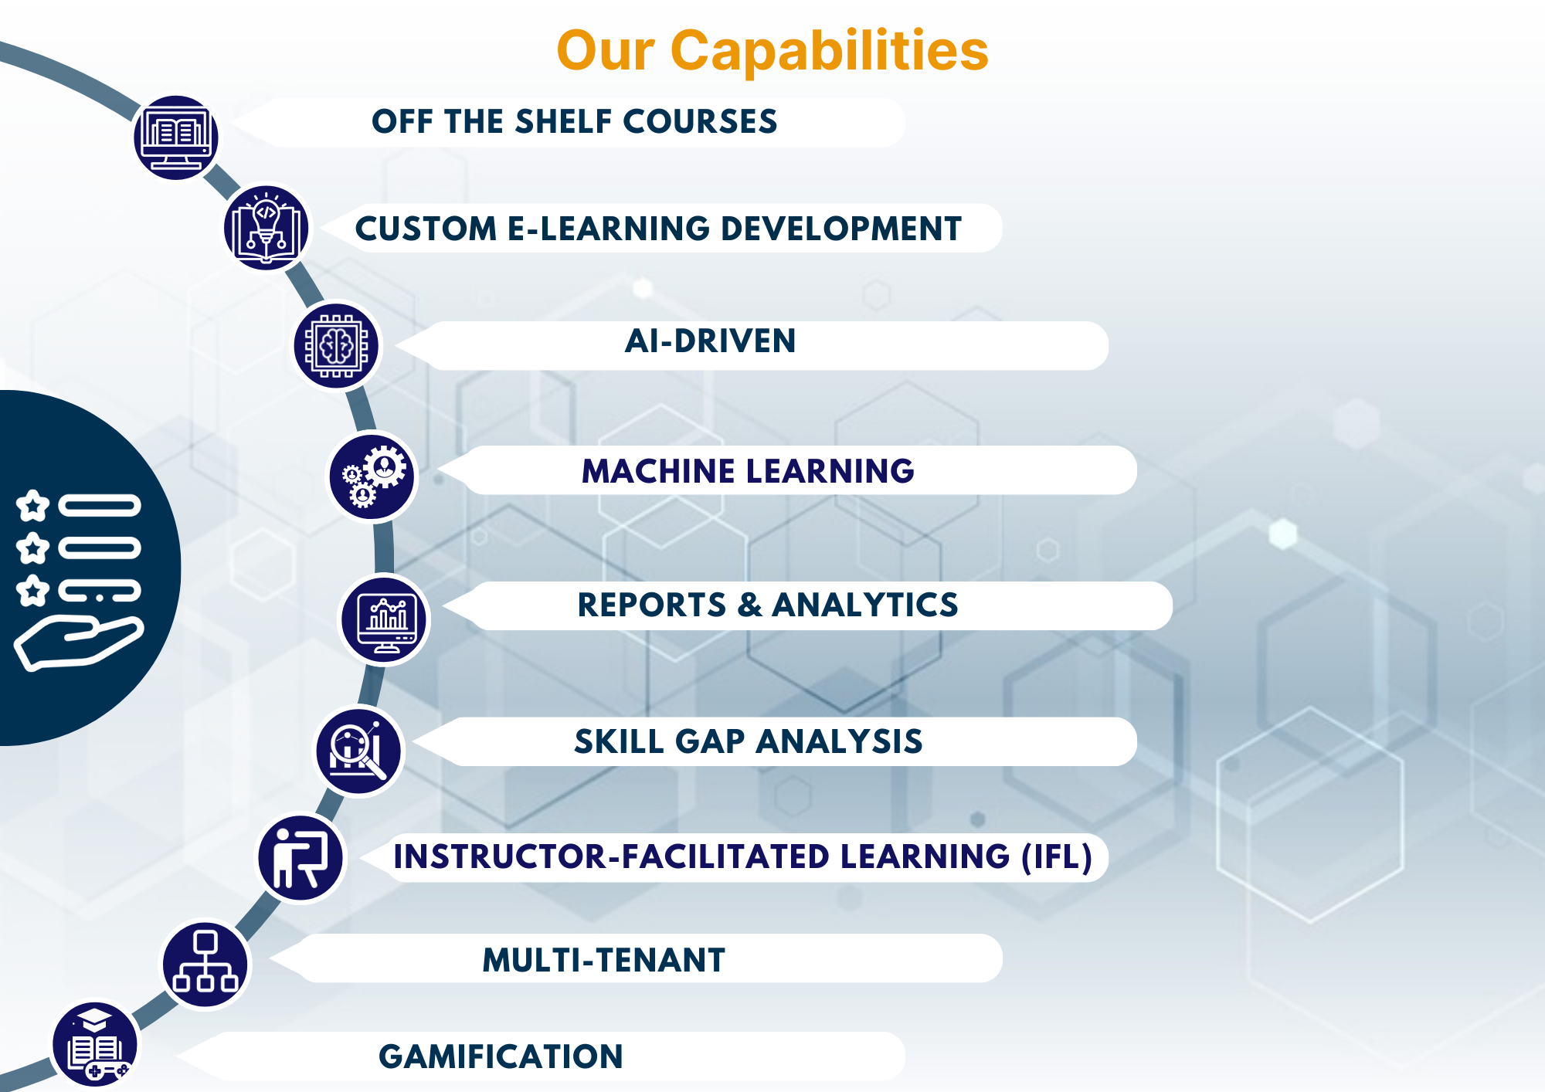

Slide 6
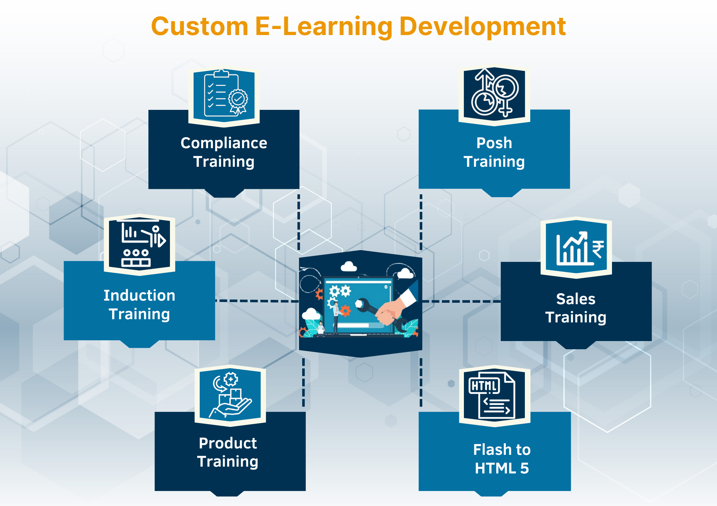

Slide 7
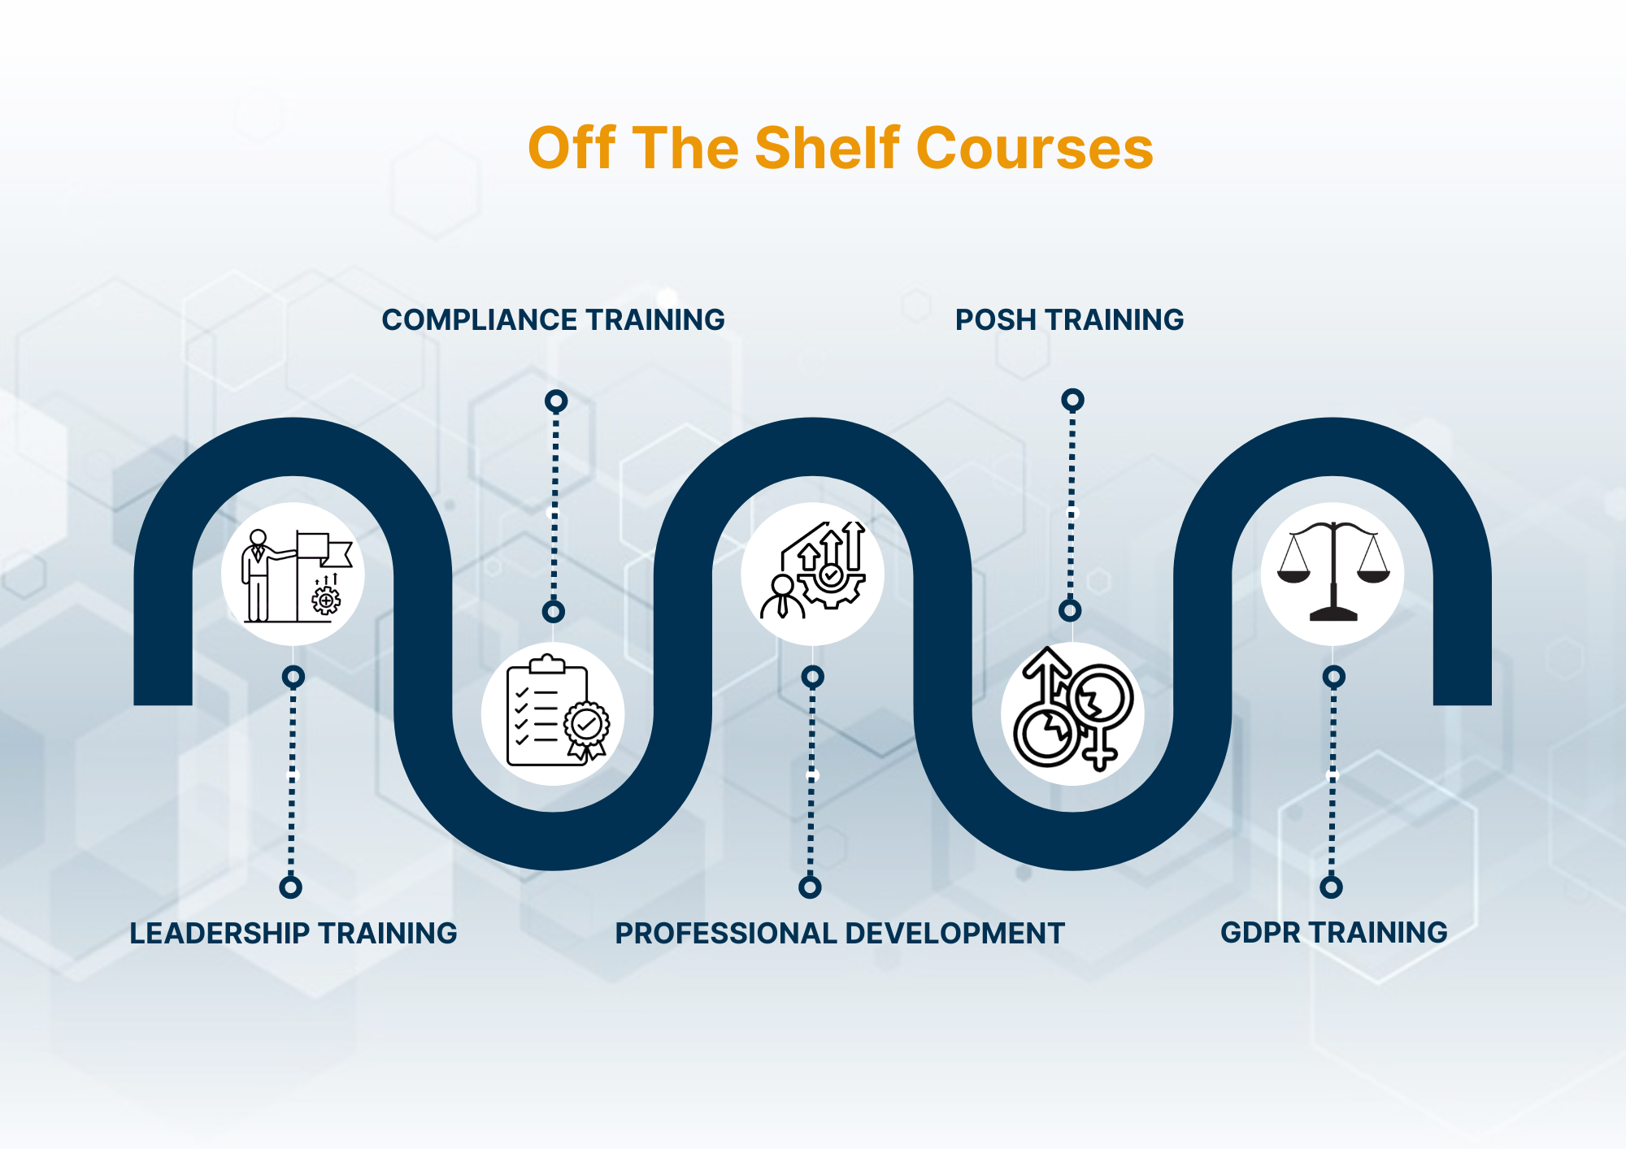

Slide 8
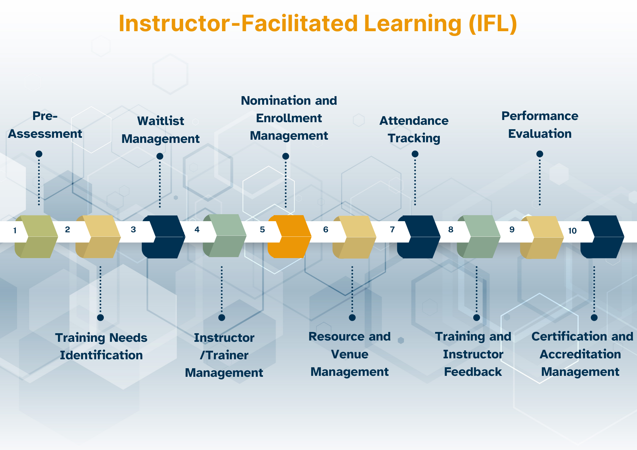

Slide 9
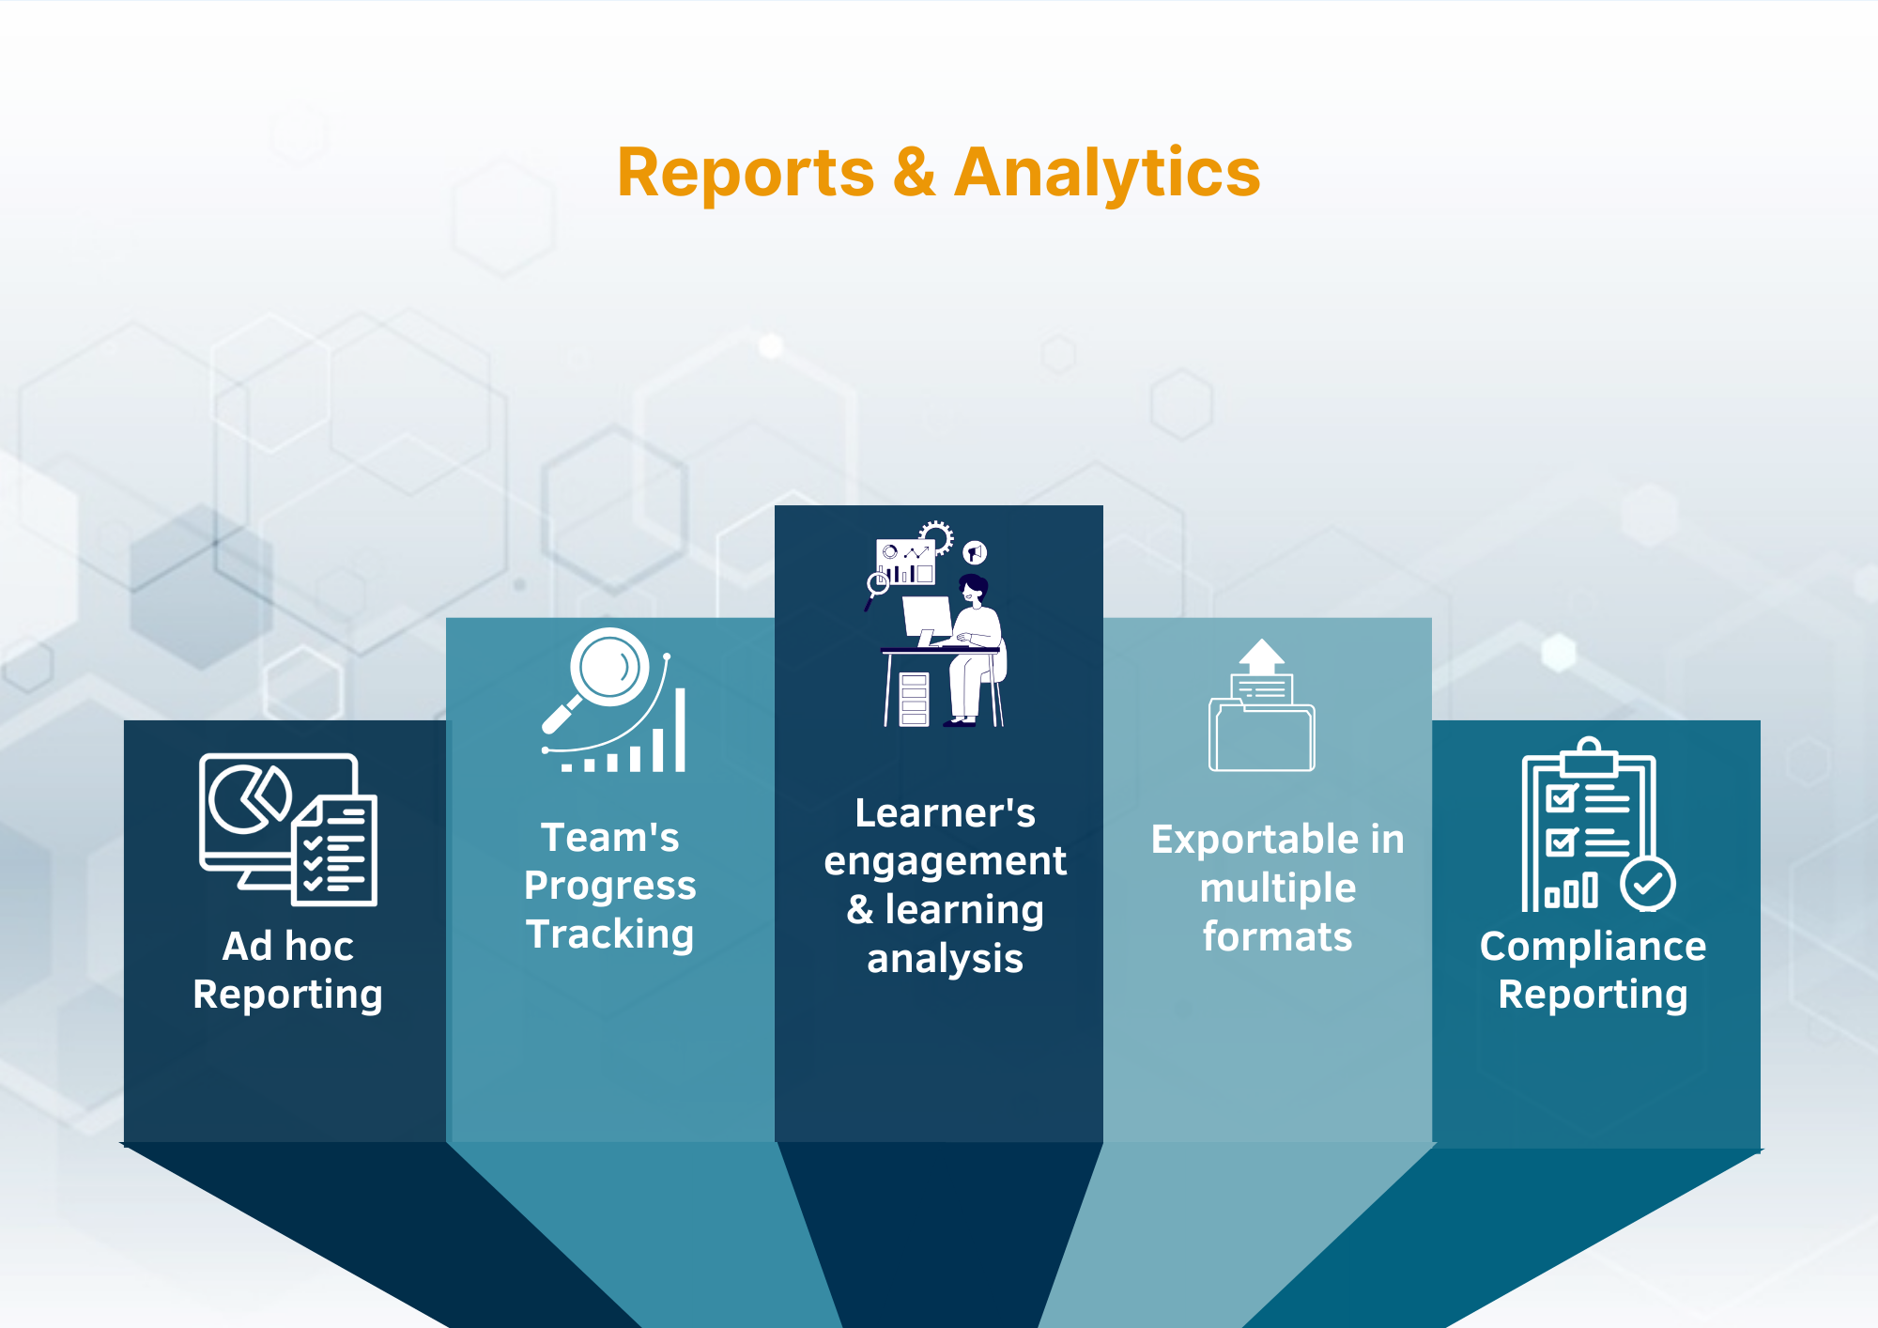

Slide 10
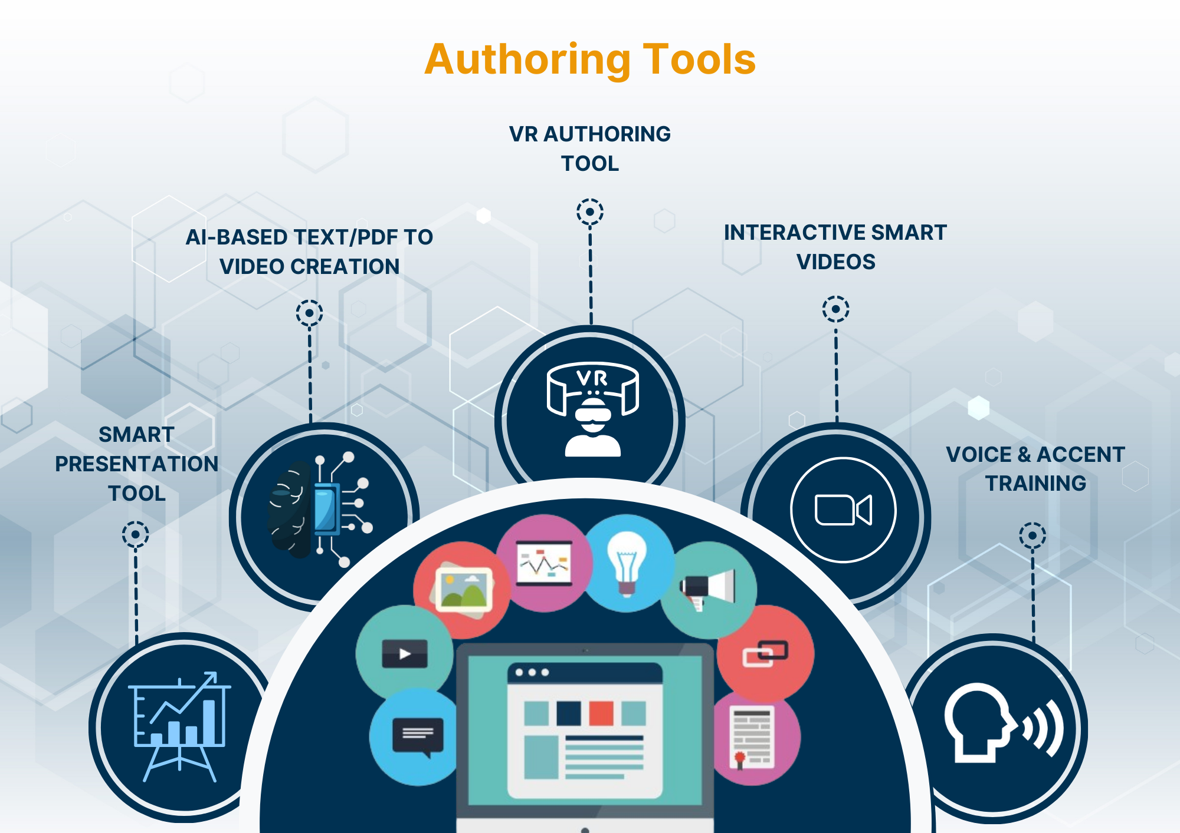

Slide 11

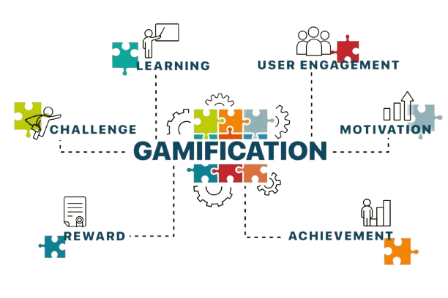



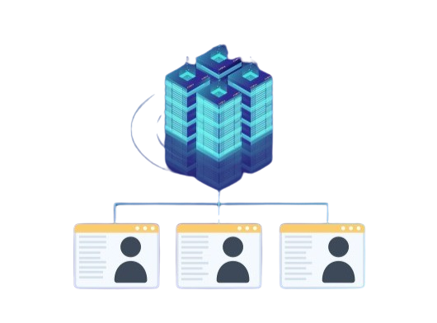




Why RAP LMS?
Advance Gamification
End user Ease of Use
Ease of Administration
VR Authoring
Why
RAP LMS?
Multi-Tenant
Smart Video Authoring
E-Commerce
Integrations
E- COMMERCE
Educational Games & Flash Card based Assessment

Slide 12
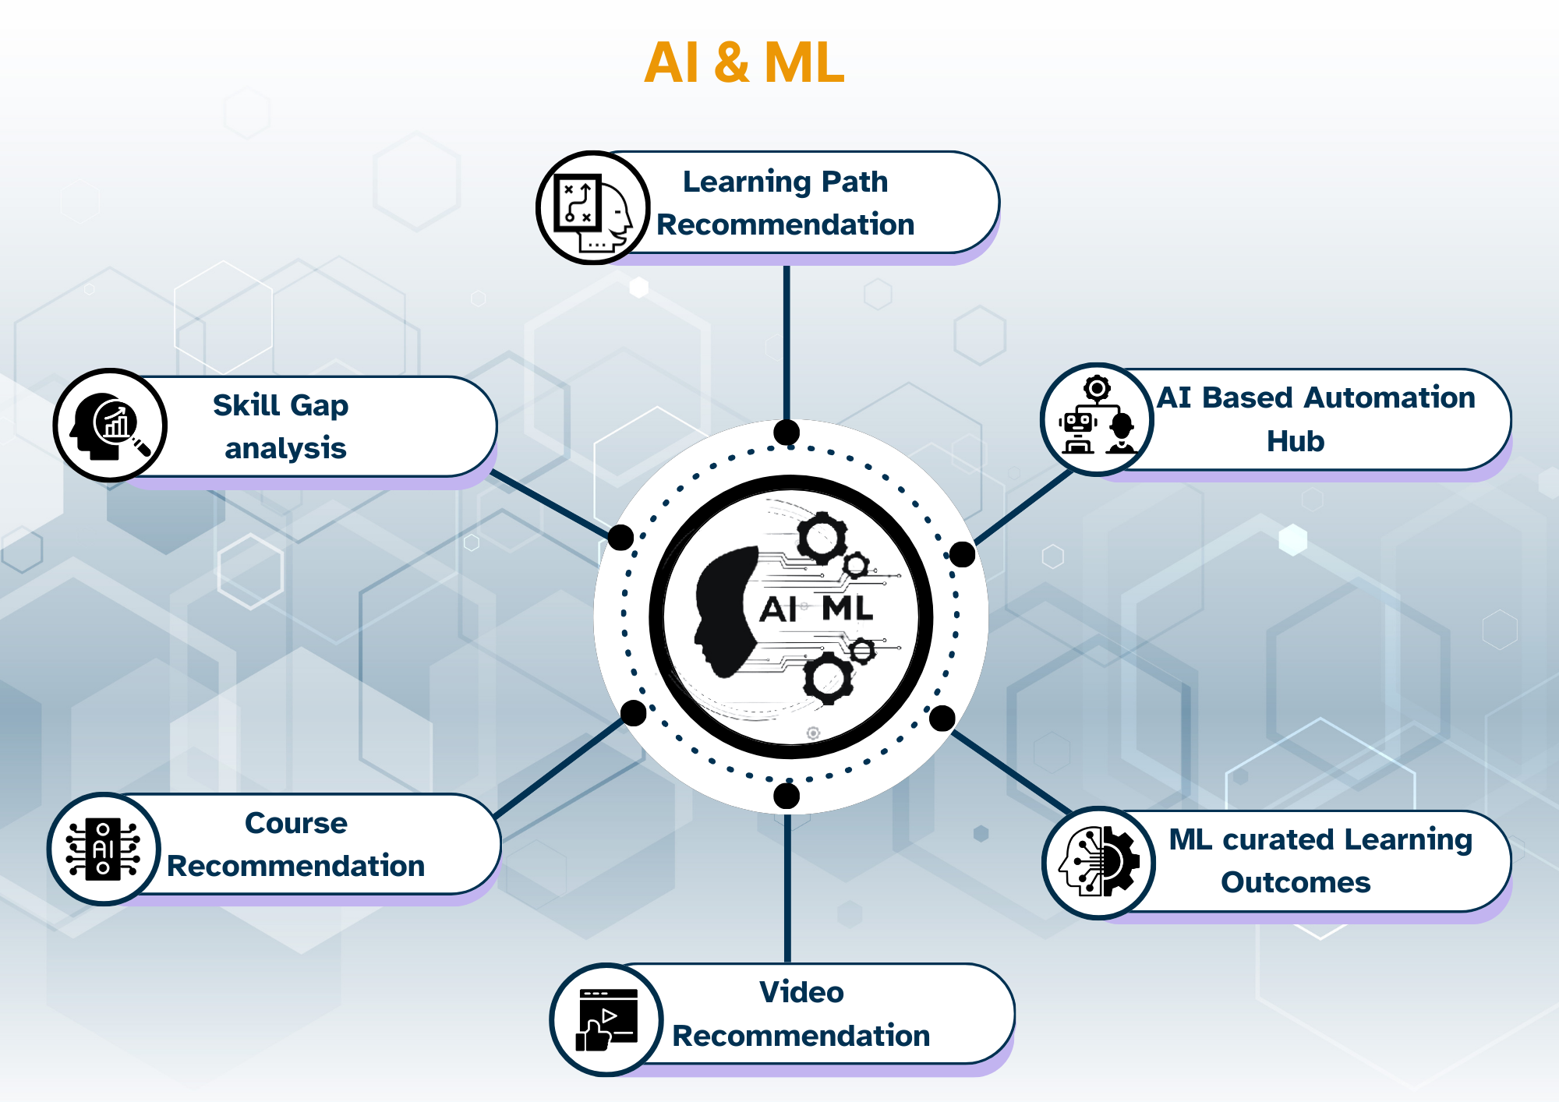

Slide 13
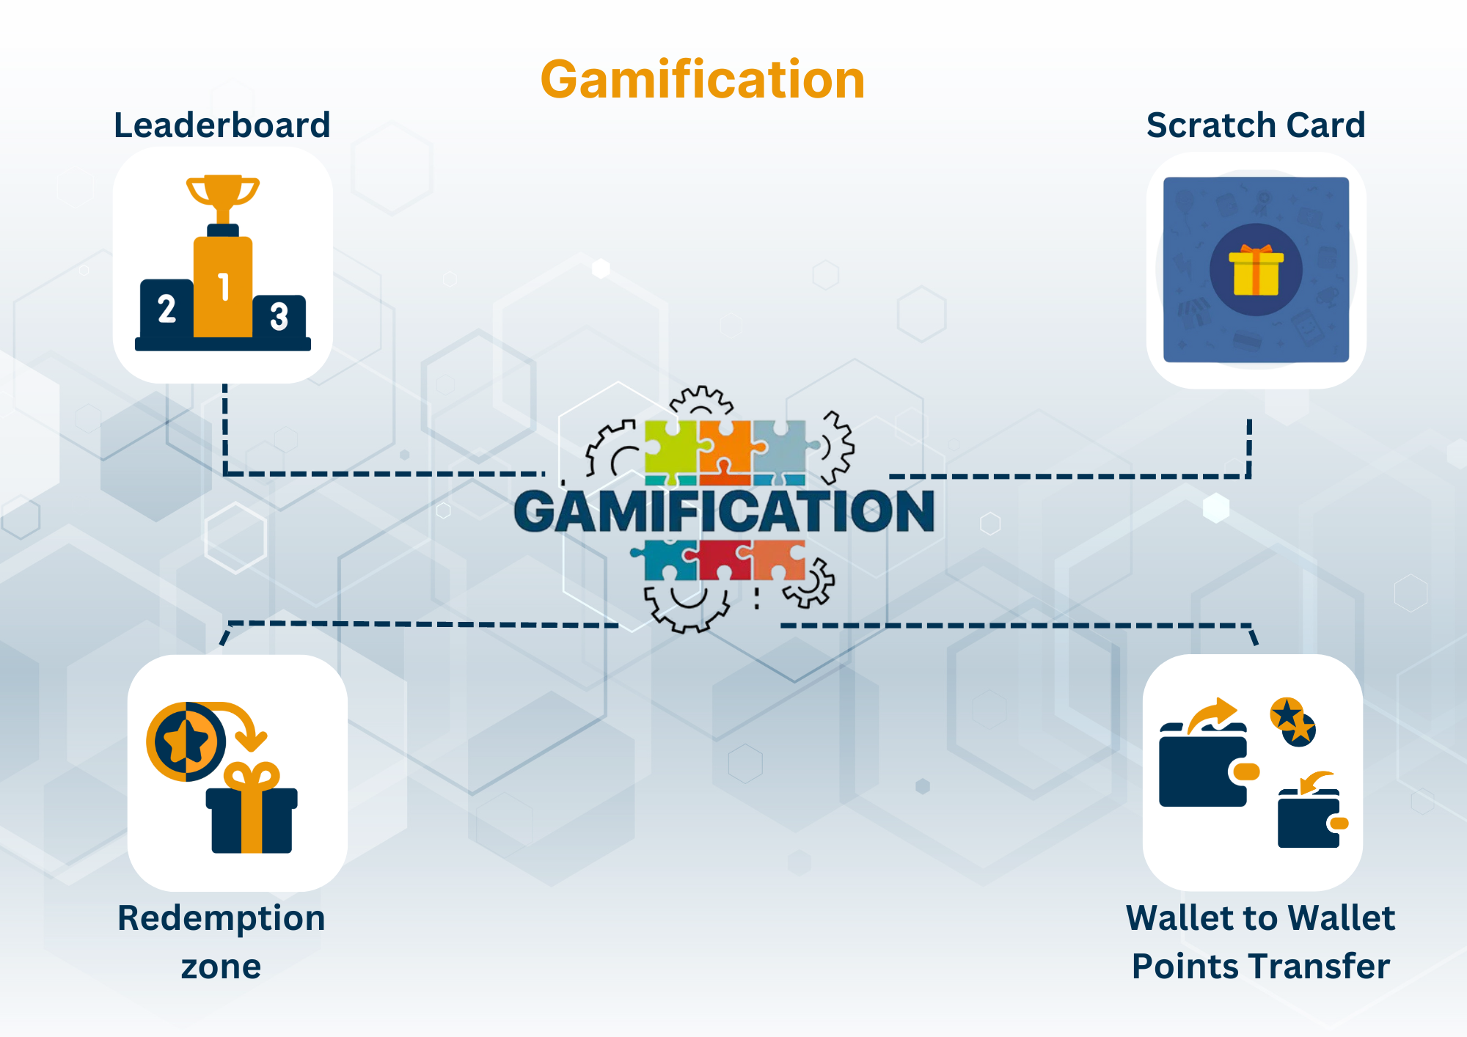

Slide 14
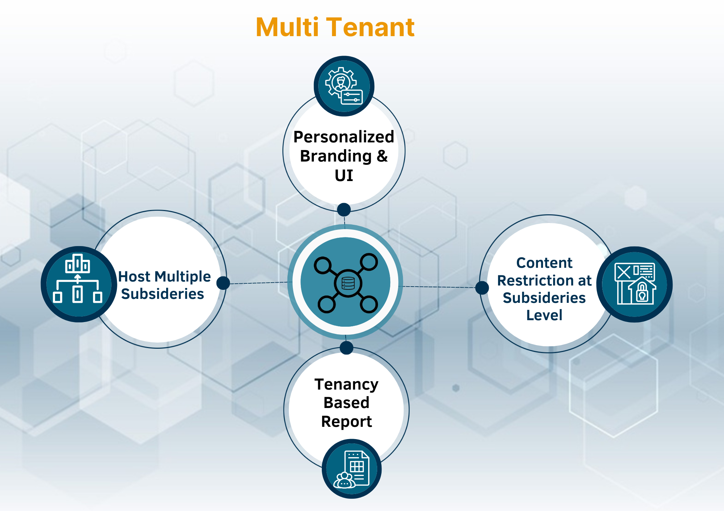

Slide 15




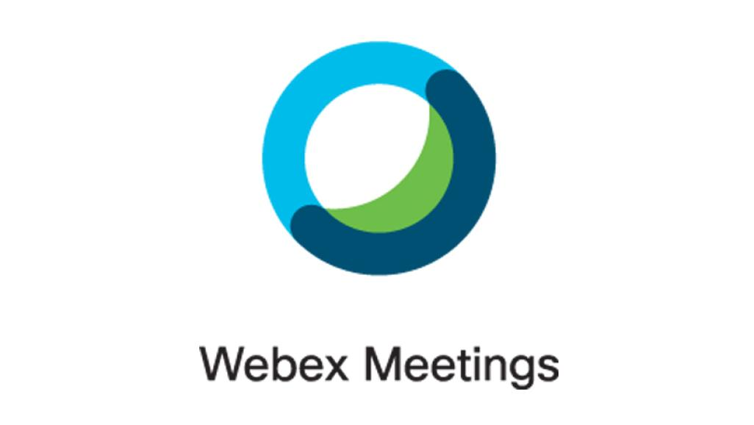







Integration
Many more ...

Slide 16


