Slide 1
MINI PROJECT PRESENTATION
Third Year Computer Engineering
AI-Powered Python Error Detection and Explanation System
Jadhav Kalyani 39
Kanjawane Anjali 46
Gavhane Rushikesh 30
Akolkar Pancham 05
GUIDE
Prof. M. S. Kale
Department Of Computer Engineering
Academic Year 2026--27

Slide 2
Contents
1 Title of Project
2 Purpose of the Presentation
3 Title of Project
4 Abstract
5 Introduction
6 Scope
7 Specific Requirements
8 Theory of Software Used
9 ER Diagram
10 Output Screen (GUI)
11 Conclusion
12 References

Slide 3
Purpose of the Presentation
BEFORE YOU START
Your presentation should explain the problem, your proposed solution, how the system works, and what you have implemented.
Problem
Design
Beginner programmers often struggle to understand Python error messages and identify the causes of errors. Finding solutions manually can be time-consuming and confusing.
Develop a web-based application using Python and Streamlit. Use AST for basic code analysis and Scikit-learn with TF-IDF and Naive Bayes for error classification.
Demonstrate
Conclude
Show how the system analyzes Python code, detects supported errors, classifies pasted error messages, explains the causes, and provides suggested fixes with corrected code examples.
Present CodeSense AI as a beginner-friendly debugging assistant that helps users understand common Python errors, learn suitable corrections, and improve their programming skills.
02

Slide 4
AI-Powered Python Error Detection and Explanation System
Project details
Include these details
Project Aim
• AI-Powered Python Error Detection and Explanation System
Team:Jadhav Kalyani (39),Kanjawane Anjali (46),Gavhane Rushikesh (30),Akolkar Pancham (05)
• Department of Computer Engineering
• Guide: Prof. M. S. Kale
• Academic Year: 2026–27
To develop CodeSense AI, an AI-powered web application that detects and classifies common Python programming errors, explains their causes in simple language, and provides suggested fixes with corrected code examples to help beginners understand errors and improve their debugging skills.
Institution: Dr. Vithalrao Vikhe Patil College of Engineering, Ahilyanagar
03

Slide 5
2. Abstract
PROJECT SUMMARY IN BRIEF
A concise overview of the implemented application.
Problem
Objective
Beginners often struggle to understand Python error messages and identify the correct solutions, making debugging difficult and time-consuming.
Develop a web application that detects common Python errors, classifies error messages, explains their causes, and suggests suitable fixes.
Method
Outcome
A user-friendly web application that provides basic code analysis, error classification, simple explanations, and corrected code examples to support beginner programmers
Python, Streamlit, Scikit-learn, TF-IDF Vectorizer, Multinomial Naive Bayes, and Abstract Syntax Tree (AST).
04

Slide 6
3. Introduction
BACKGROUND & GOALS
Background
Problem statement
Python is widely used in programming, AI, and software development. Beginners often face errors while writing code and may find error messages difficult to understand.
Understanding error messages and finding solutions can be time-consuming.
Objectives
Proposed solution
Detect common Python errors.
Classify error messages using Machine Learning.
Explain errors in simple language.
CodeSense AI is a Streamlit web application that analyzes Python code and helps beginners understand and fix common errors.
Output accuracy depends on source-file layout and the user reviewing extracted records
05

Slide 7
4. Scope
SYSTEM BOUNDARIES
What is included?
Analyze Python code for common errors.
Detect syntax errors and basic code issues.
Classify error messages using Machine Learning.
Explain errors in simple language.
Suggest fixes and corrected code examples.
Intended users: teachers, academic staff, and authorized users processing student marks.
06

Slide 8
5. Specific Requirements
HARDWARE AND SOFTWARE
Hardware Requirements
Software Requirements
Dual-core processor or better
Minimum 4 GB RAM
500 MB free storage
Keyboard, mouse, and display
Internet connection for package installation
Windows 10/11 or compatible OS
Python 3
VS Code or any Python editor
Streamlit
Scikit-learn
NumPy and Pandas (if used)
AST module for code analysis
Install only the libraries needed for the file formats used by the final application.
No separate database is required for the current file-processing workflow
07

Slide 9
6. Theory of Software Used
TOOLS AND THEIR ROLES
Each tool supports one part of the file-analysis workflow
Programming language
Streamlit
Used as the main programming language for code analysis, error detection, and machine learning logic.
Creates the web-based interface for entering Python code, displaying errors, and showing suggested fixes.
Pandas
Plotly and Document libraries
Stores and organizes data in DataFrames and supports data cleaning, sorting, and calculations.
Plotly visualizes error analysis results, while document libraries process supported Word, PDF, and image files when required.
CSV export provides a portable output format. A database is not part of the current workflow.
08

Slide 10
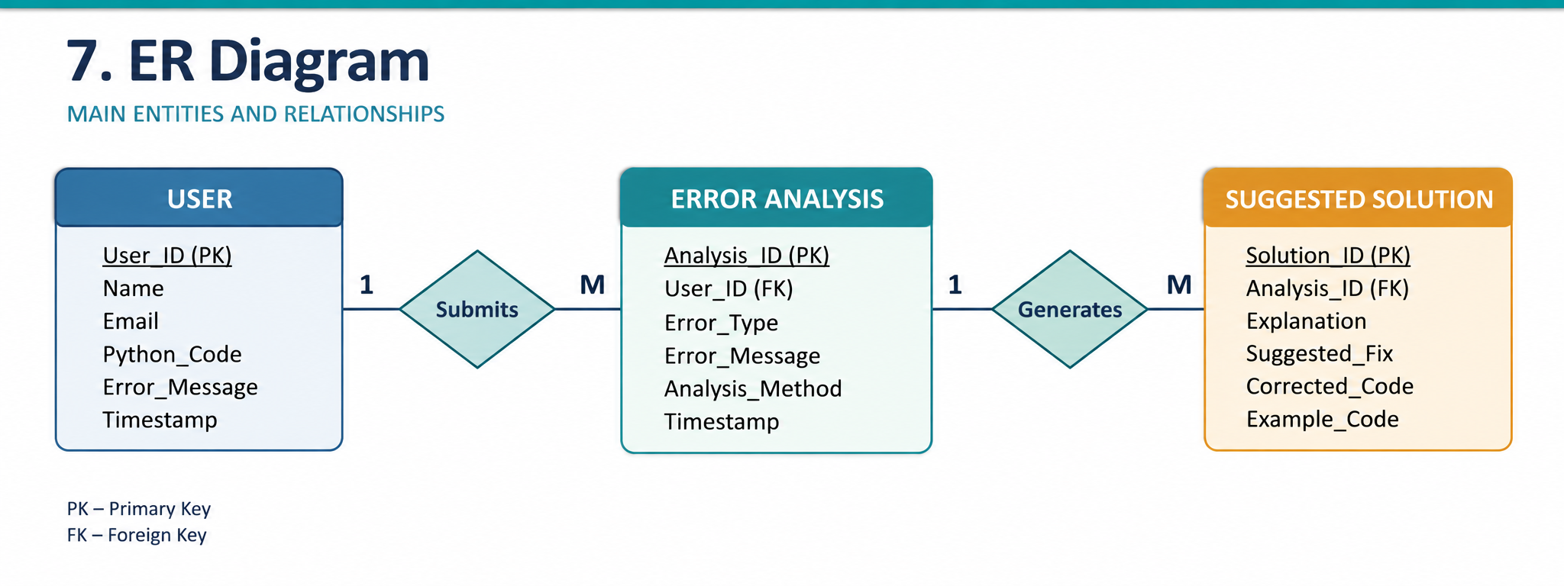
7. ER Diagram
FROM FILE TO RESULTS
The current application is file-based, so an ER diagram is not applicable unless a database is added.
Reviewed student table
Metrics, charts, CSV download
.
09

Slide 11
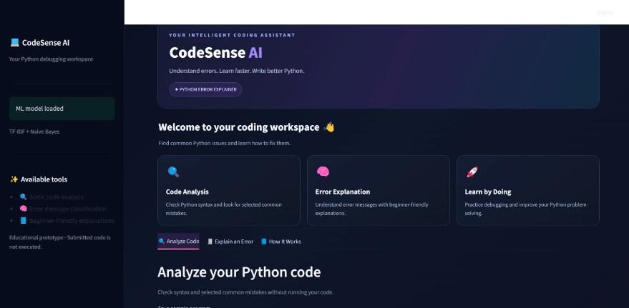
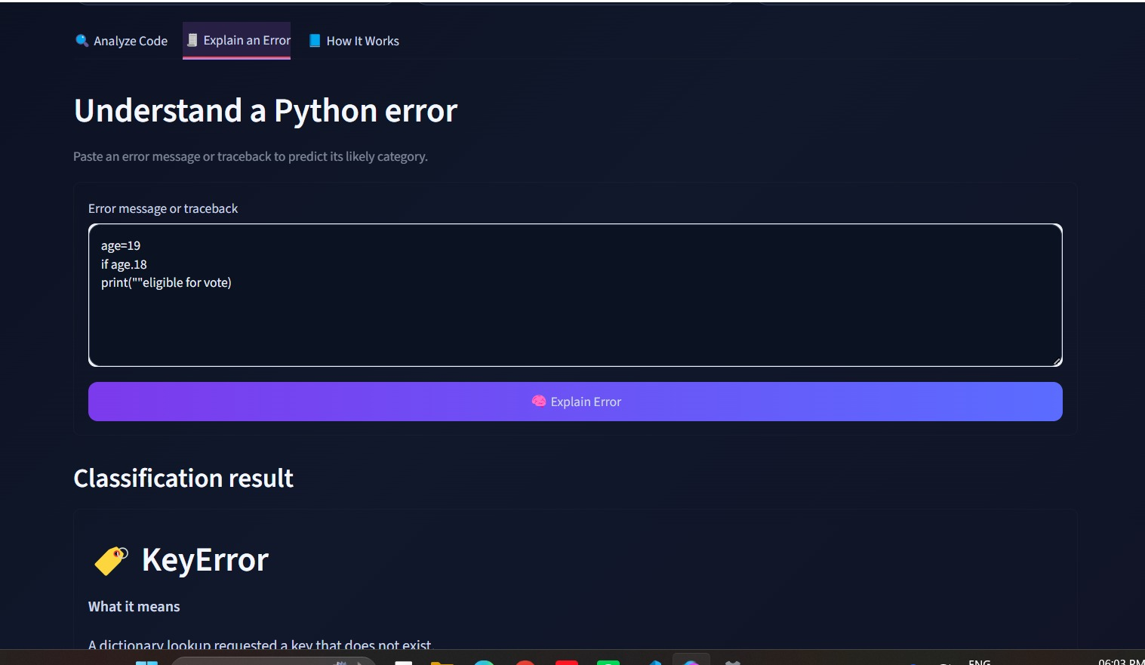
8. Output Screen (GUI)
ACTUAL APPLICATION EVIDENCE
.
SCREEN 1
SCREEN 2
PASTEOUR SCREENSHOT HERE
Caption: state the feature shown and expected result.
.
10

Slide 12
9. Conclusion
RESULTS & LIMITATIONS
What the system provide
Limitation and Learning
Detects common Python programming errors.
Analyzes code using AST.
Classifies pasted error messages using Machine Learning.
Provides simple explanations and suggested fixes.
Displays corrected code examples.
Detects only selected common errors.
ML predictions may not always be accurate.
Code is analyzed without execution.
Future improvements can include advanced error detection, better model accuracy, and support for more error types.
11

Slide 13
10. References
OFFICIAL DOCUMENTATION
Technical sources
File processing
Python Documentation — https://docs.python.org/3/
Streamlit Documentation — https://docs.streamlit.io/
Scikit-learn Documentation — https://scikit-learn.org/stable/
NumPy Documentation — https://numpy.org/doc/
• python-docx — https://python-docx.readthedocs.io/
• pdfplumber — https://github.com/jsvine/pdfplumber
• PyMuPDF — https://pymupdf.readthedocs.io/
• Tesseract OCR — https://tesseract-ocr.github.io/
The project demonstrates practical Python data processing and interactive web-app development.
12

