Slide 1
IBM University Engagement Project Submission
“Exploring the Power of Agentic AI with IBM Granite and IBM Bob”

Slide 2
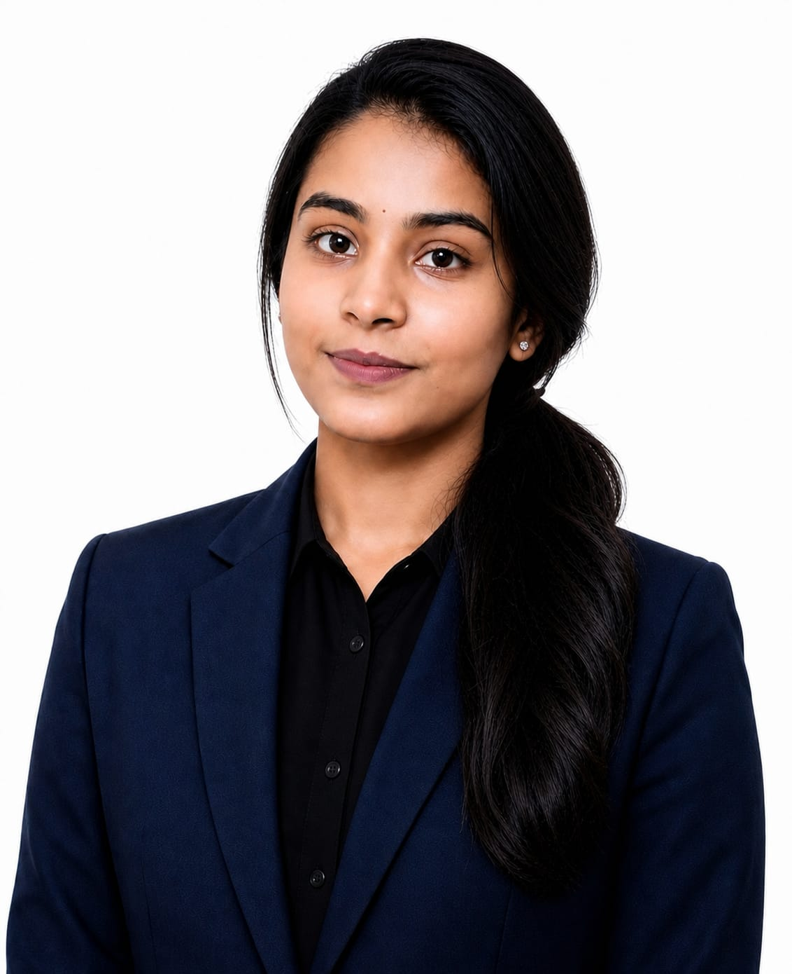
Project Tile – IoT Doctor – Smart IoT Device Troubleshooting Chatbot
Domain of Project – Internet of Things (IoT) / Artificial Intelligence
Student Name | Recent Passport Photo | Email ID | Mobile number [WhatsApp]
PANCHAMI S |  | panchamigowda641@gmail.com | 9113671957
Recommended font style and size:
Font Style: Arial
Font Size (Heading): 28
Font Size (Content): 20

Slide 3
Problem Statement -
Problem Statement : Smart IoT Device Troubleshooting Chatbot
The Challenge
Users face Wi-Fi connectivity, configuration, firmware, sensor and device malfunction issues and often need technical documentation or support.
The Objective
Build an AI-powered Smart IoT Device Troubleshooting Chatbot that helps users identify and resolve common IoT device issues through natural-language interaction.
The system aims to:
Understand IoT Issues – Interpret problems related to connectivity, configuration, sensors, firmware, and device malfunctions.
Retrieve Relevant Knowledge – Use RAG to find relevant information from an IoT troubleshooting knowledge base.
Provide Step-by-Step Solutions – Generate simple and practical troubleshooting instructions for users.
Use a Multi-Agent System – Coordinate three specialized agents for issue understanding, knowledge retrieval, and troubleshooting.
Enable Conversational Support – Allow users to describe their problems naturally and receive interactive guidance.
Support Common IoT Problems – Handle issues such as ESP32 Wi-Fi connectivity, sensor readings, device detection, and code-upload errors.

Slide 4
Proposed Solution -
Proposed Solution: IoT Doctor
IoT Doctor is an AI-powered, multi-agent troubleshooting chatbot designed to help users identify and resolve common IoT device problems through natural-language interaction. Instead of requiring users to search through technical manuals or forums, the system provides relevant troubleshooting guidance through a single conversational interface.
The solution consists of three specialized AI agents working together. The Issue Understanding Agent analyzes the user's description and identifies the device, symptoms, and possible category of the problem. The IoT Knowledge/RAG Agent retrieves relevant information from the IoT troubleshooting knowledge base, providing the system with supporting technical information. The Troubleshooting Agent then uses the identified issue and retrieved knowledge to generate a clear, structured, and step-by-step solution.
The system is implemented as a web-based application with a simple chatbot interface. It can assist with common scenarios such as ESP32 Wi-Fi connectivity problems, sensor reading failures, Arduino detection issues, configuration problems, and code-upload errors.
The overall workflow is:
User Problem → Issue Understanding → RAG Knowledge Retrieval → Troubleshooting Analysis → Step-by-Step Solution
This approach combines Agentic AI, RAG, and conversational interaction to make IoT troubleshooting more accessible and systematic. The solution directly addresses the problem statement's requirements for issue understanding, knowledge retrieval, step-by-step solutions, and conversational support.

Slide 5
Technology Used
Python – Used as the main programming language for developing the chatbot and implementing the AI workflow.
Flask – Used to develop the web application and connect the chatbot interface with the backend.
Groq API – Used to access the Large Language Model for understanding user queries and generating troubleshooting responses.
RAG (Retrieval-Augmented Generation) – Used to retrieve relevant IoT troubleshooting information from the knowledge base before generating answers.
Multi-Agent Architecture – Three specialized agents handle issue understanding, knowledge retrieval, and troubleshooting.
HTML, CSS & JavaScript – Used to create the chatbot interface and provide interactive user interaction.
Bootstrap 5 – Used for responsive UI components and layout.
dotenv – Used to securely load the Groq API key and other configuration values from the .env file.
IBM Bob – Used as the AI-assisted development environment for designing and generating the project.

Slide 6
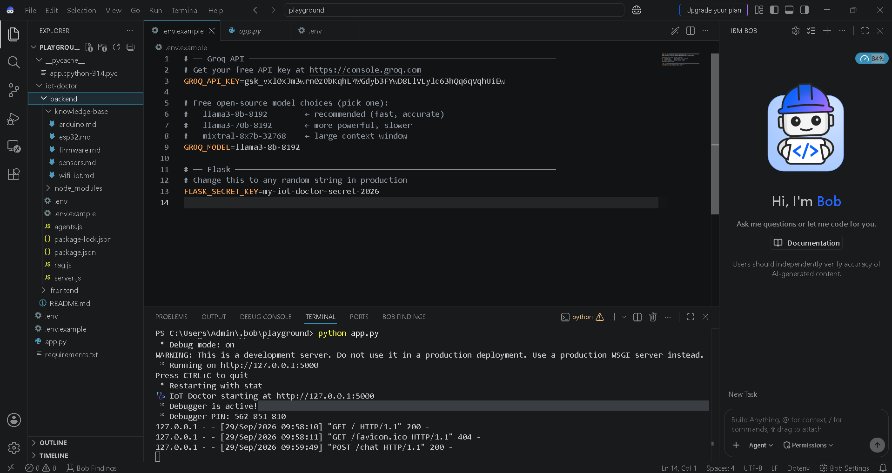
Required Files created using IBM bob -
App.py
Requirements.txt
Style.css
.env
Index.html

Slide 7
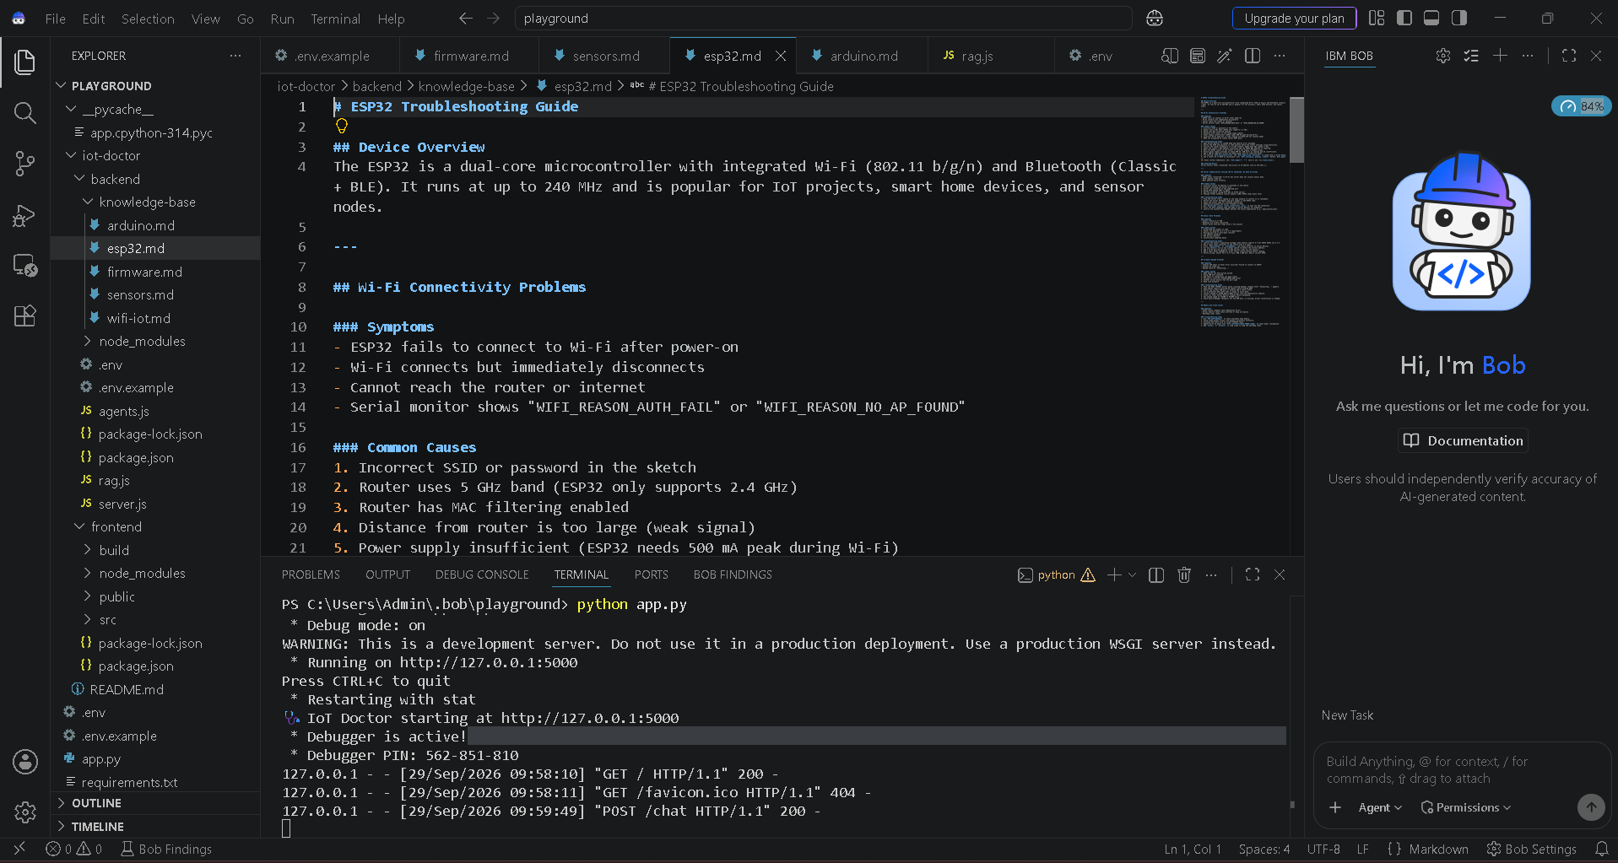
IBM Bob Screenshots:

Slide 8
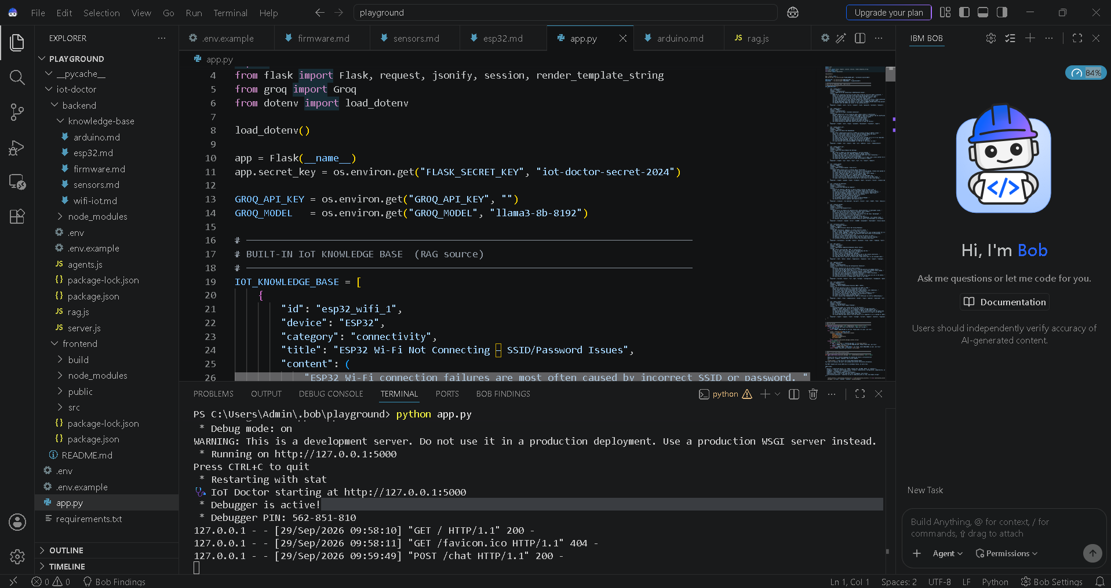

Slide 9
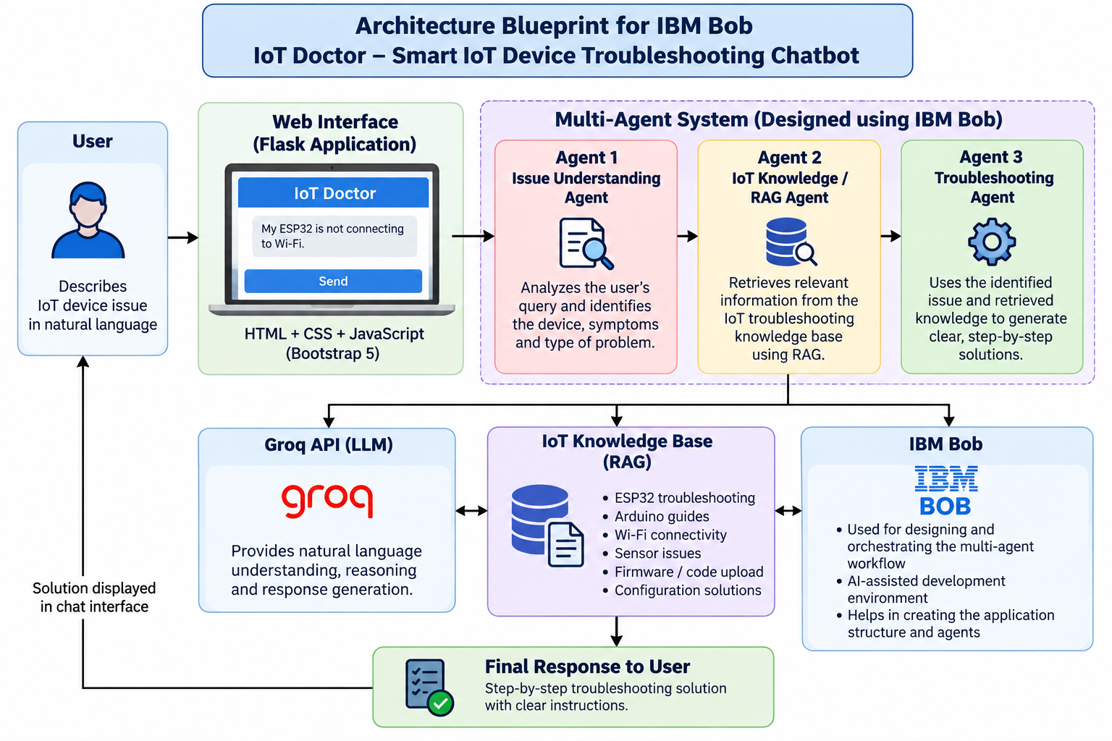
Architecture blueprint for IBM bob:

Slide 10

Role of Agentic AI in the solution
Agentic AI enables IoT Doctor to work as an intelligent troubleshooting system rather than a basic question-and-answer chatbot. It divides the troubleshooting process into specialized tasks and allows multiple AI agents to work together to understand the user's problem, retrieve relevant knowledge, and generate an appropriate solution.
Autonomous Issue Analysis – The Issue Understanding Agent analyzes the user's natural-language description and identifies the device, symptoms, and problem category.
Knowledge Retrieval – The IoT Knowledge/RAG Agent retrieves relevant troubleshooting information from the IoT knowledge base before the final response is generated.
Collaborative Agent Workflow – The three specialized agents work sequentially, passing relevant information from one stage to the next.
Context-Aware Responses – The Troubleshooting Agent uses the user's problem and retrieved knowledge to generate solutions relevant to the specific IoT issue.
Step-by-Step Decision Support – Instead of giving a generic answer, the system produces structured troubleshooting steps that users can follow.
Adaptability – The system can be extended with additional IoT devices, troubleshooting documents, and specialized agents in the future.
Overall, Agentic AI makes IoT Doctor more structured, knowledge-driven, and capable of handling IoT troubleshooting through coordinated AI agents.

Slide 11
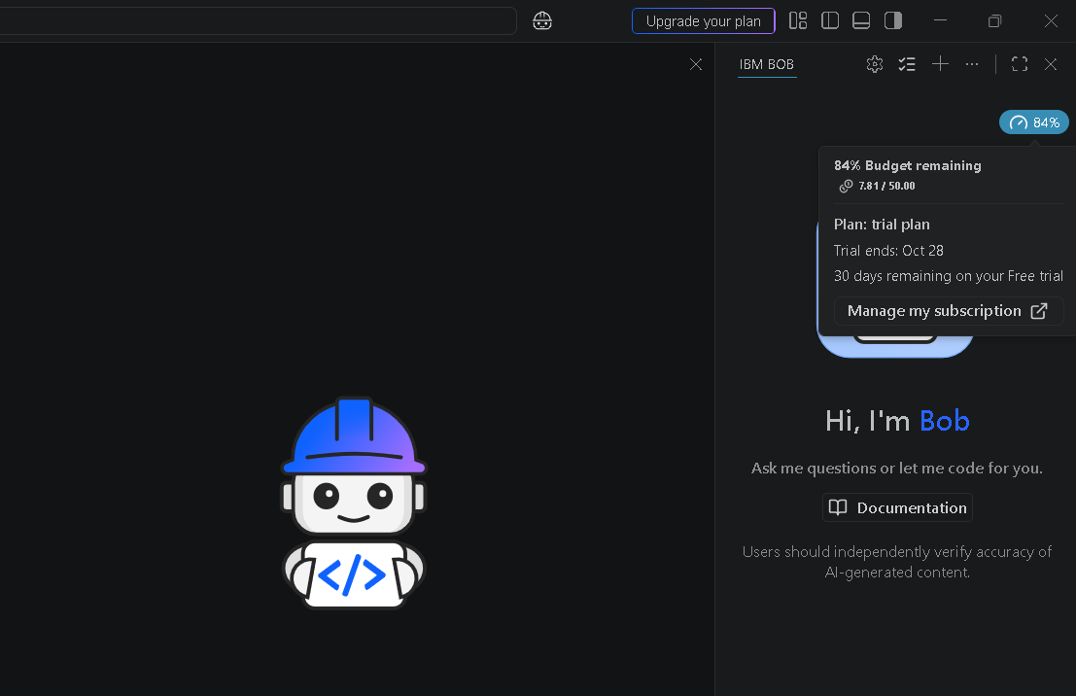
Token Usage
7.81 / 50.00
After the Prompt
·
·
·

Slide 12
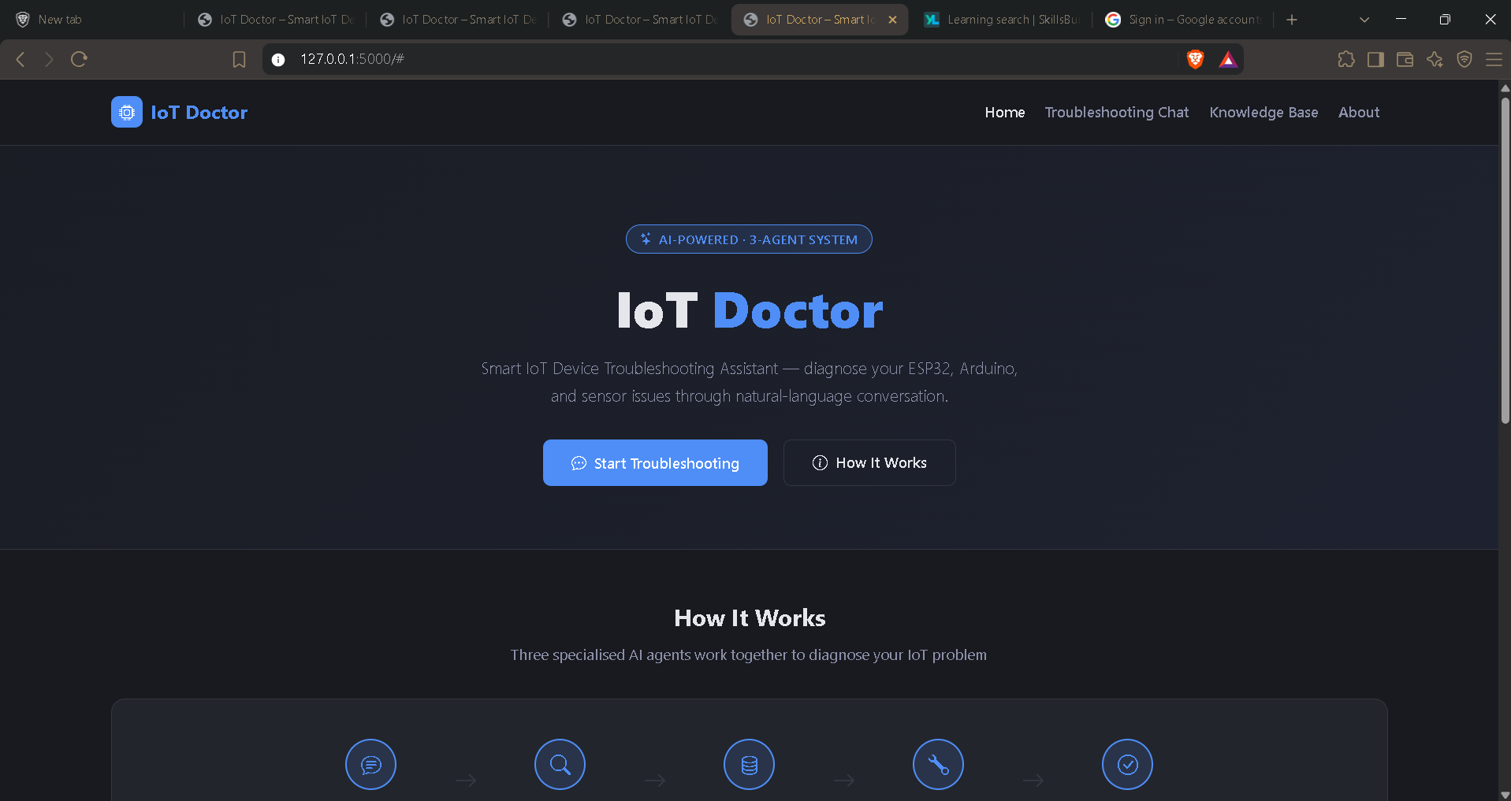
Project Output Screenshot
·
·
·

Slide 13
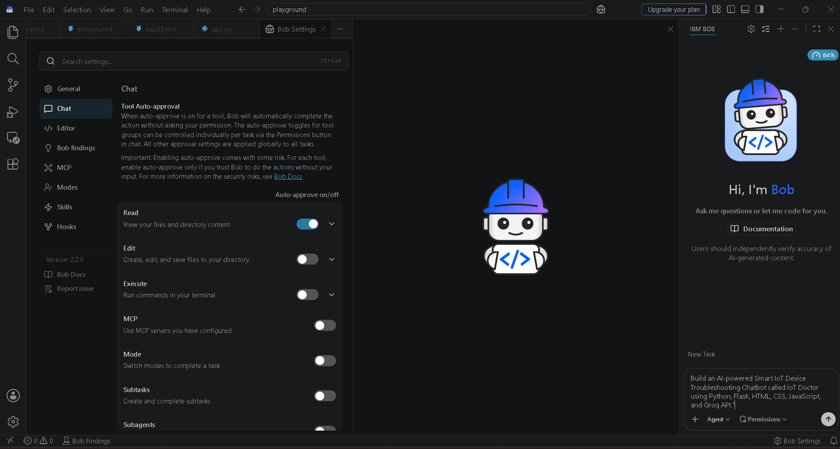

Slide 14
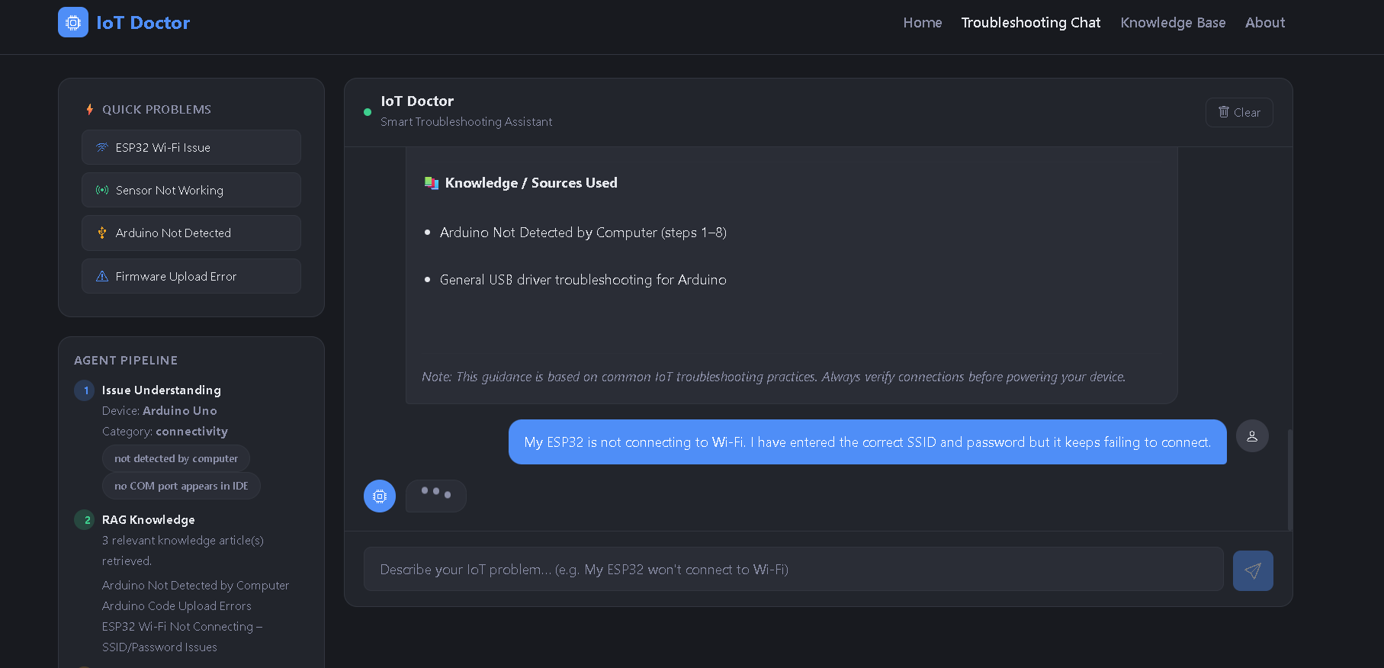
Project Output Screenshot
·
·
·

Slide 15
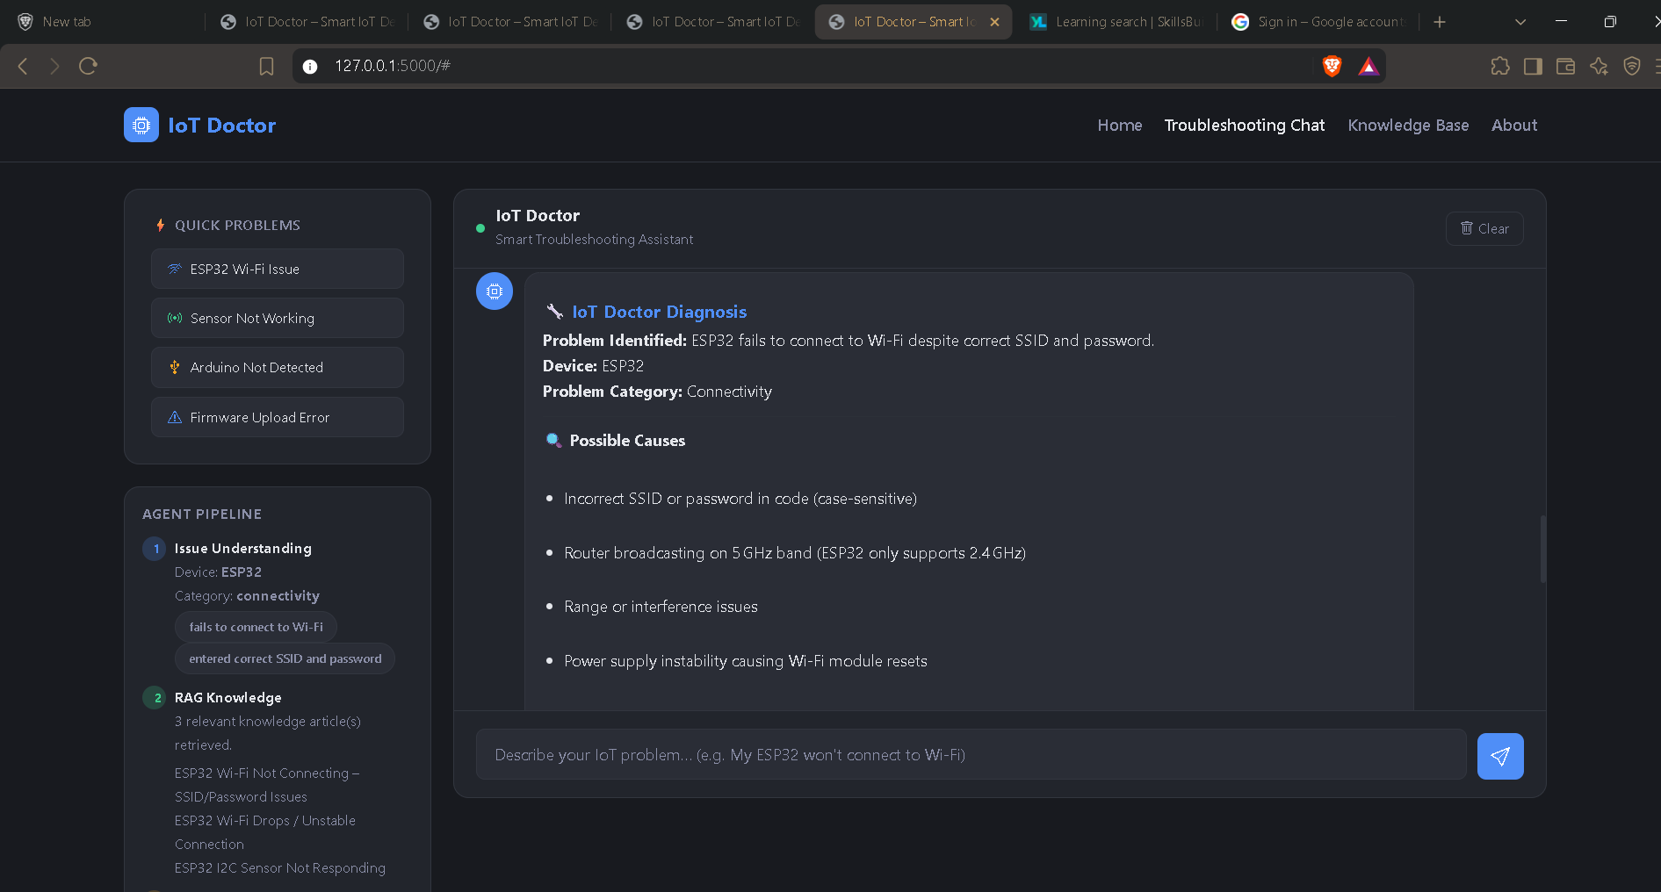
Project Output Screenshot

Slide 16
Novelty and Uniqueness
The proposed IoT Doctor stands out by combining Agentic AI, RAG, and conversational troubleshooting into a single IoT support system.
Multi-Agent Troubleshooting – Uses three specialized agents that collaboratively understand, retrieve, and solve IoT problems.
RAG-Based Knowledge Retrieval – Retrieves relevant troubleshooting information from an IoT knowledge base before generating the solution.
Natural-Language Problem Understanding – Users can describe technical problems in simple language without needing to know specific technical terminology.
Step-by-Step Guidance – Converts technical troubleshooting information into clear and practical instructions.
IoT-Specific Knowledge Base – Focuses on common issues involving devices such as ESP32, Arduino, sensors, Wi-Fi connectivity, and firmware.
Conversational Support – Allows users to interact with the system instead of manually searching through multiple documentation sources.
Expandable Architecture – The knowledge base and agent workflow can be extended to support additional IoT devices, sensors, and troubleshooting scenarios.
Overall, IoT Doctor combines specialized AI agents with IoT-focused RAG to provide a structured and user-friendly approach to device troubleshooting.

Slide 17
Git Hub Link
· Please create public github repository (Enable Add README button while creating repository) with format –
Please test and Paste the working Github URL –
Make sure you have Uploaded following three files into your github repository
1) All Agent relevant files of IBM Cloud , 2) yourproblemstatement.pdf file 3) your projectpresntation.pptx file 4)any other files
·
·
·

Slide 18
Future Scope
1.Integration with Wearables & Health Devices –
The system can be integrated with smartwatches and fitness trackers to collect real-time data such as steps, calories burned, heart rate, and sleep patterns. This will enable the Nutrition Agent to provide more accurate and dynamic diet recommendations based on actual user activity and health metrics.
2.AI-Powered Voice Assistant & Multilingual Support –
Enhancing the system with a voice-enabled assistant and support for multiple languages will improve accessibility. Users can interact naturally in their preferred language, making the solution more inclusive and suitable for diverse populations, especially in regions with varied linguistic backgrounds.
·
·
·

Slide 19
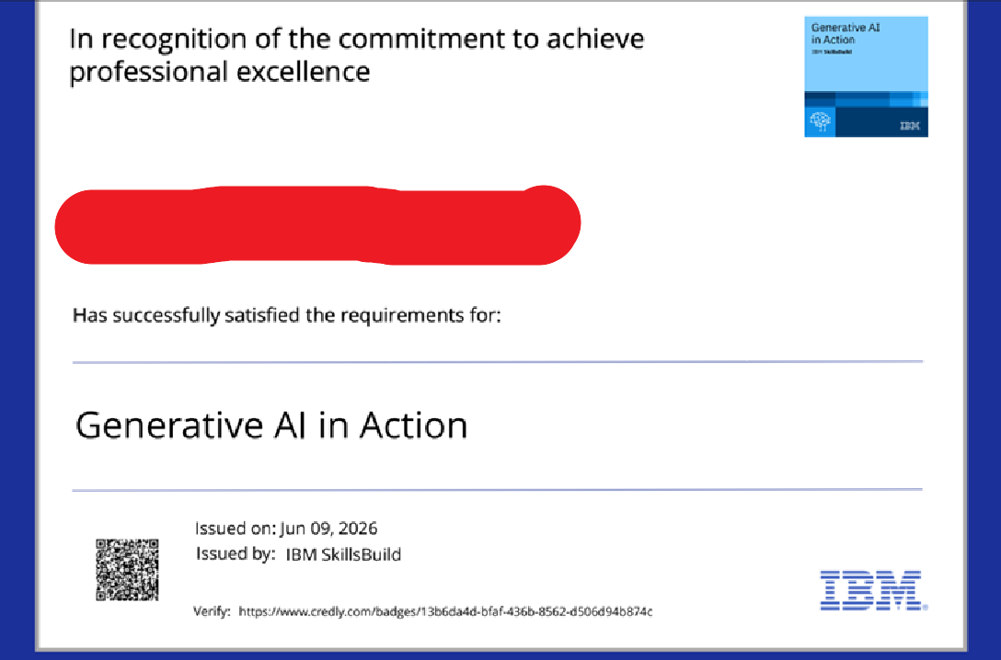
Certificates Earned:
Please add your credly certificate

Slide 20

Certificates Earned:​
Add your IBM BOB Certificate

Slide 21


