Slide 1

ONLINE SHOPPING MANAGEMENT SYSTEM
Panchami M
USN: 1VE21CA031
CSE-AI, 5TH SEM
SVCE, BANGALORE

Slide 2
CONTENTS
INTRODUCTION
PROBLEM STATEMENT
OBJECTIVE
SOFTWARE AND HARDWARE REQUIREMENTS
ADVANTAGES AND DISADVANTAGES
APPLICATION
ER DIAGRAM
SNAPSHOTS OF MINI PROJECT
CONCLUSION
REFERENCES

Slide 3

INTRODUCTION
This project entails the development of an Online Shopping Management System, a crucial platform in the realm of e-commerce.
It serves as a centralized hub for both customers and administrators, facilitating seamless transactions and efficient inventory management.
By leveraging technology, this system enhances the shopping experience, offering convenience, accessibility, and a wide array of products.
In an increasingly digital world, such systems play a pivotal role in modern retail, and preferences of consumers while empowering businesses to thrive in the competitive online marketplace.

Slide 4

PROBLEM STATEMENT
Online shopping activities present challenges for both users and administrators alike.
Users often encounter issues such as difficulty in finding desired products, navigating through complex interfaces, and concerns regarding payment security.
Administrators face challenges related to inventory management, order processing inefficiencies, and ensuring seamless customer experiences.
This project aims to address these specific issues by developing a user-friendly interface for customers, implementing robust inventory management systems for administrators, and integrating secure payment processing mechanisms.
Through targeted solutions, the project seeks to streamline online shopping activities, enhancing satisfaction for both users and administrators.

Slide 5
OBJECTIVE
The primary objectives of this project are to:
Develop a user-friendly interface that simplifies the browsing and purchasing process for customers, enhancing their overall shopping experience.
Streamline inventory management processes for administrators, enabling efficient tracking, updating, and restocking of products to meet customer demand.
Implement secure payment processing mechanisms to safeguard user financial information and ensure smooth and trustworthy transactions.
Generate comprehensive reports for sales analysis, enabling administrators to gain insights into customer preferences, trends, and overall business performance.
By achieving these objectives, the project aims to optimize the online shopping management system for enhanced usability, efficiency, and profitability.

Slide 6

SOFTWARE AND HARDWARE REQUIREMENTS
For the Online Shopping Management System, the software requirements include a robust Database Management System (DBMS) such as MySQL for efficient data storage and retrieval.
Additionally, web development tools like HTML, CSS, JavaScript, and a server-side scripting language like PHP or Python are essential for creating the user interface and implementing backend functionalities.
Hardware requirements encompass server specifications with ample processing power, memory, and storage capacity to handle concurrent user requests and store large volumes of product data securely.
Client devices, such as desktops, laptops, tablets, and smartphones, must have internet connectivity and support modern web browsers for accessing the system's online interface.

Slide 7
ADVANTAGES AND DISADVANTAGES
The Online Shopping Management System offers numerous advantages.
Firstly, it provides unparalleled convenience for customers, allowing them to shop anytime, anywhere, with access to a wide range of products.
Secondly, it facilitates efficient inventory management, enabling administrators to track stock levels, forecast demand, and optimize supply chain operations.
Additionally, the system has the potential to boost sales through targeted marketing strategies and personalized recommendations.
However, it's important to acknowledge the disadvantages and limitations.
Security concerns surrounding online transactions, such as data breaches and identity theft, pose significant risks to both customers and businesses.
Furthermore, technical challenges may arise in system maintenance and updates, requiring continuous monitoring and resource allocation to ensure smooth operation.

Slide 8
APPLICATION
In this section, we present visual representations of the Online Shopping Management System's user interface and functionalities.
These screenshots showcase various pages and features, including product listings, shopping cart, and checkout processes.
Users can see the intuitive layout and design, making it easy to browse products, add items to the cart, and complete purchases seamlessly.
Additionally, snapshots highlight additional functionalities such as user account management, order tracking, and secure payment processing.
These visuals provide a glimpse into the user experience and the system's capabilities, enhancing understanding and engagement with the project.

Slide 9
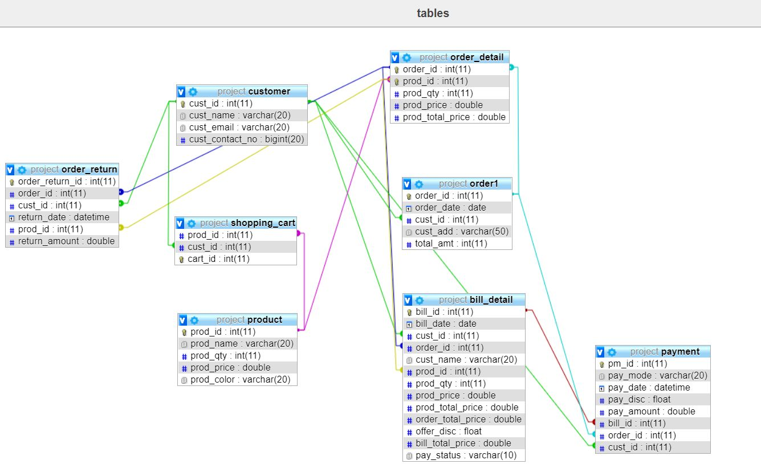
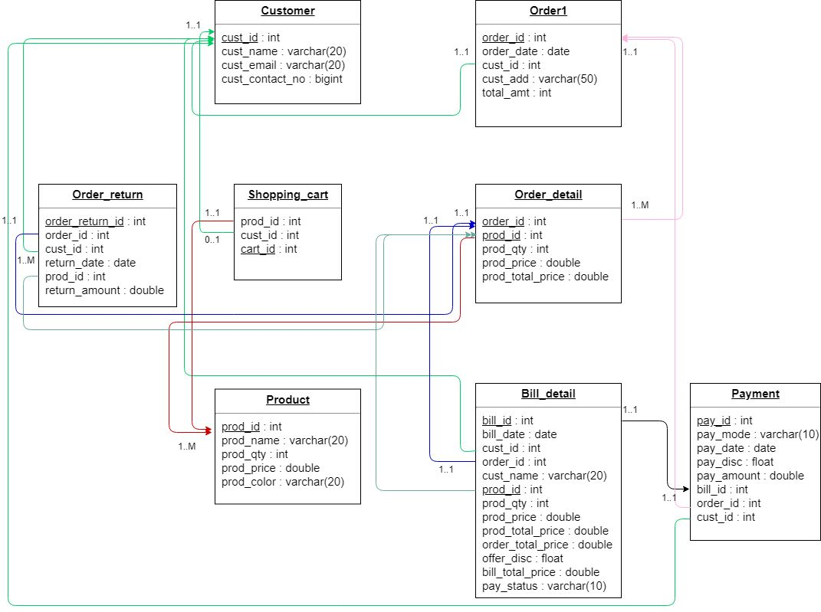
ER DIAGRAM

Slide 10
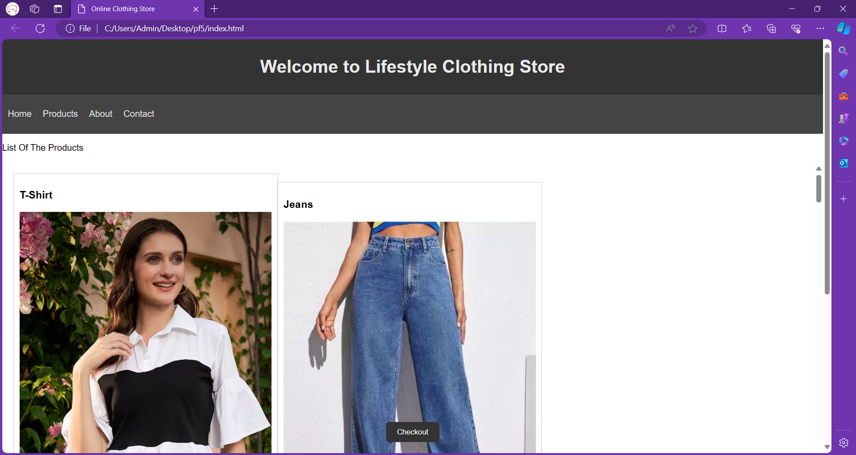
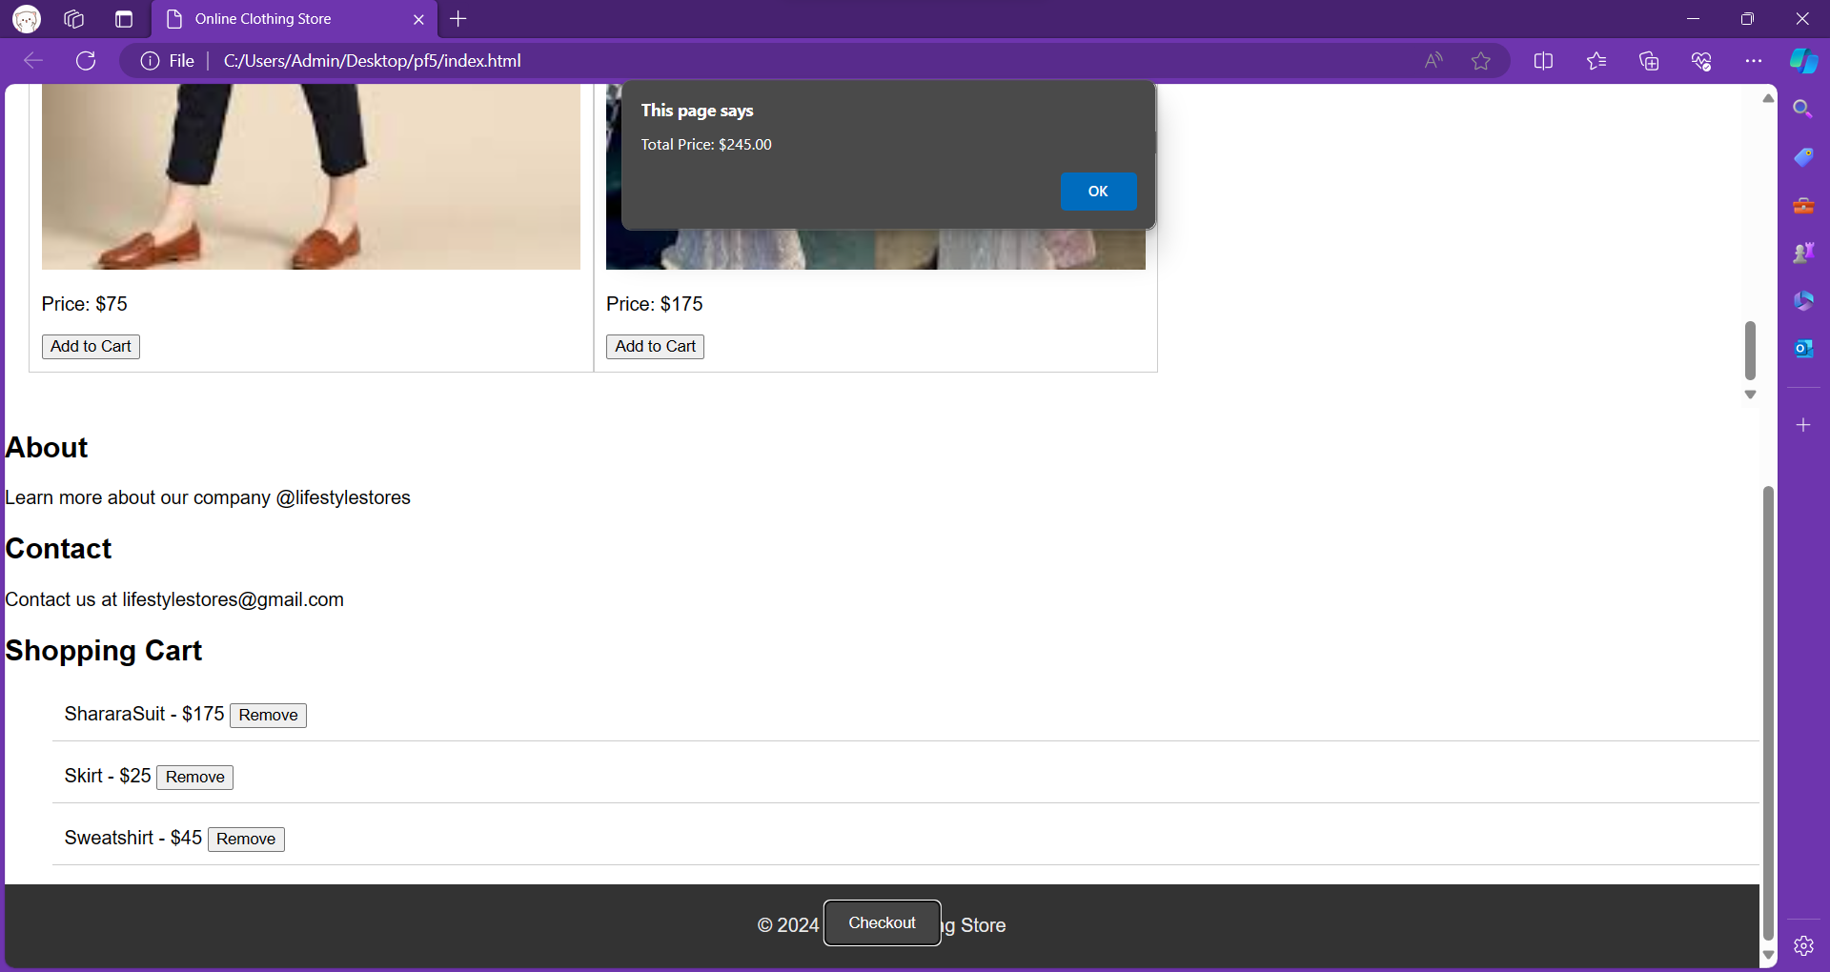
SNAPSHOTS OF MINI PROJECT
In this section, we present visual representations of the Online Shopping Management System's user interface and functionalities.

Slide 11
CONCLUSION
In conclusion, the Online Shopping Management System presents a comprehensive solution to the challenges faced in the e-commerce realm.
Throughout this presentation, we've highlighted its objectives, software and hardware requirements, advantages, and disadvantages.
Efficient online shopping management is crucial for businesses to thrive and for consumers to enjoy seamless shopping experiences.
By leveraging technology to streamline processes, enhance security, and improve user experience.
This system not only benefits businesses by increasing sales and optimizing operations but also enhances convenience and satisfaction for consumers.
It underscores the significance of adapting to digital innovations in modern retail practices.

Slide 12
REFERENCES
During the development of the Online Shopping Management System, the following sources were consulted:
Books:
"Database Management Systems" by Raghu Ramakrishnan and Johannes Gehrke
"E-commerce 2018: Business, Technology, and Society" by Kenneth C. Laudon and Carol Guercio Traver
Online Articles:
"Best Practices for Secure E-commerce Websites" - TechTarget
"Inventory Management Techniques in E-commerce" - Shopify Blog
Documentation:
HTML/CSS Documentation - Official HTML/CSS website.
JS Manual – Official JS website.
These resources provided valuable insights and guidance on database management, e-commerce best practices, and the implementation of tools and technologies.

