Slide 1
Extracting and Analyzing Social Media Data
Panchami Rudrakshi
Lahari Ganesha
Kavyashree AnanthA Raman

Slide 2
INTRODUCTION
Social networking sites are websites designed for human interaction.
Major platform for communication and interaction between users.
Means of information extraction and analysis.
Suitable for Opinion Mining and Sentiment Analysis activities.
Our Project: Twitter and Facebook data extraction and analysis.
Tweets and status updates range from discussions of important political issues to inane comments. Several Twitter studies have demonstrated that aggregating millions of messages can provide valuable insights into a population based on several aspects like their geographic locations.

Slide 3
TWITTER
To showcase two frequent analyses that rely on Twitter data:
A map of geo-located tweets to examine the geographic distribution of human activity.
An estimation of the favorability of a popular personality based on tweets that mention the person using sentiment analysis.

Slide 4
FACEBOOK
Collect general information about the users and different public pages to build a word cloud to analyze popularity of a person/page.
Gender distribution analysis to find most popular names.

Slide 5
Approach/Analysis- TWITTER
REST API
Queries for specific information about users and tweets. Examples: user profile, list of followers and friends, tweets generated by a given user, user lists, follower lists, etc.
Library used: twitteR

Slide 6
Streaming API
To connect to the “stream” of tweets as they are being published (NOTE: tweets can only be downloaded in real time)
Three of them that were mainly used are – Filter stream (tweets filtered by keywords), Geo stream (tweets filtered by location and thereby examine the geographic distribution of human activity) and Sample stream (1% random sample of tweets)
Library used: streamR

Slide 7
Data extraction:
Extract access token and authorize.
Analyzing geo-located tweets to study the map distribution of tweets in the US (giving an outline on the number of tweets from each state).
Measure opinions on Twitter i.e., perform supervised sentiment analysis using a dictionary of positive and negative words and counting the number of times they appear (the Dictionary method).
Predict sentiment of unseen posts.

Slide 8
Packages used for Facebook:
Rfacebook:
Collect the data that belongs to a particular page on Facebook.
It extracts top posts, profiles of the people who liked and commented on those top posts.
Tm and wordcloud
Print the most popular posts/words in the form of a cloud.
Most used word/post is printed in the highest font and in Bold and decreases thereafter.
Least used post/word is printed in least font.

Slide 9
Data extraction for Facebook:
Extract information about one or more Facebook users using getUsers().
Collect top 5 list of posts from a public Facebook page with most likes and comments, not users with public profiles using getPage().
Print the posts in the form of a word cloud by printing the most popular post in the biggest font and least popular in the least font using tm and word cloud Package. This is done by creating a corpus of the text data, removing all the punctuation, stop words and converting it into a text document matrix to print the word cloud.
Collect the list of the users who liked a specific post, so that we can analyze “what” kind of people are interested in a particular post using getPost() by collecting list of users associated with a particular page.

Slide 10
Analyze the number of likes, average likes, number of comments, number of shares for a given public page.
Gender distribution analyses by getting top N most common names of the users.
Collect the comments on a particular post and analyze the most popular post based on no of likes for that comment. This also tells us about the opinions of people on a particular post.

Slide 11
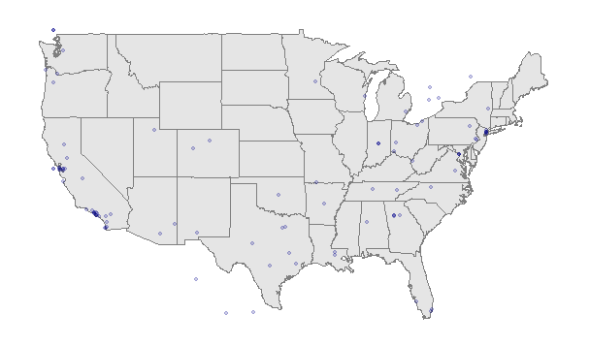
RESULTS
Geo Location Tweets

Slide 12
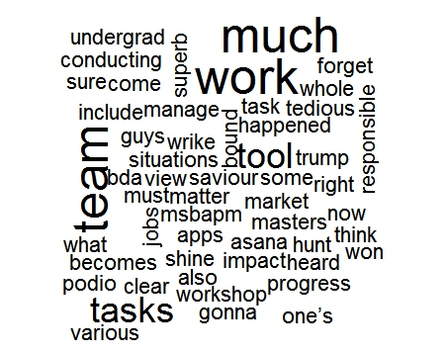
Facebook
Word cloud

Slide 13
FUTURE WORK
Analyze sample Streaming over different phases of time, at different locations.
Predict if the person can be re-elected based on Sentiment analysis done through geo-located twitter tweet .
Gender distribution analyses in Facebook can be extended to predict most commonly occurring names that will be kept for babies.
Based on most popular Facebook post, sentiment analyses over a period of time can be done.
Further, what new information can be learned by studying Twitter and Facebook, potentially supporting political and health informatics hypotheses can be analyzed.
We plan to consider more specific applications with the goal of learning new things using web mining from Twitter and Facebook in future to get better accuracy.
Try to understand more social data sources which are useful for including in the system and our future research.

Slide 14
CONCLUSION
The data extracted from Facebook and Twitter is believed to have shed more light on the structure and activities of social network.
We were successfully able to perform sentiment analysis on the tweets extracted based on a popular personality (“Obama” in our case) and find the favorability of the person considered.
Cluster analysis showing distribution of human activity for geo-located tweets extracted over a period of time, collect a random sample of tweets, analyze most common hashtags right now, find most re-tweeted tweets.
We also captured tweets mentioning multiple keywords.
General information about the users and page was collected to build a word cloud to analyze popularity.
Gender distribution analysis was performed using user’s information list.

Slide 15
REFERENCES
Michael J. Paul and Mark Dredze. 2011. You Are What You Tweet: Analyzing Twitter for Public Health
Bing Liu, 2012. Sentiment Analysis and Opinion Mining, Synthesis Lectures on Human Language Technologies.
Mariam Adedoyin-Olowe etal. A Survey of Data Mining Techniques for Social Network Analysis
Ting etal. Analysing Multi-Source social data for extraction and Mining Social Networks

Slide 16
THANK YOU

