Slide 1
Google+ Recommendation System and Analysis
Harsha Deep Reddy (vdr140330)
Rahul Pinjani (rkp140230)
Namrata Singh (nxs142830)
Nivesh Naramsetti (nxn132030)
Priyadarshini Rajendran(pxr143830)
Vivek Kumandan Kothakota (vxk142530)
Mohan Sai Ghattamaneni (mxg141530)
Aravinder Reddy Bandi (axb144730)

Slide 2
Introduction :
We are creating a recommendation system and data analysis of various features using the Google Plus dataset provided here ‘https://snap.stanford.edu/data/egonets-Gplus.html’. The recommendation mechanism is aiming at providing the user with suggestions for friends based on various criteria like ego networks and common features.

Slide 3
Background :
A computer system that makes suggestions is called a . As background, there are two general approaches: collaborative filtering and content-based filtering.
Collaborative filtering says that, if your past behavior/preferences were similar to some other user's, then your future behavior may be as well. As a concrete example, suppose that you like John, Paul, and George, and other people like John, Paul, George, and Ringo. Then it stands to reason that you will like Ringo as well, even if you had never previously heard of him. The recommender system does not have to understand anything about what “John”, “Paul”, “George”, and “Ringo” are they could even be brands of toilet paper, and the algorithm would work identically.
Content-based filtering considers the characteristics of the things you like, and it recommends similar sorts of things. For instance, if you like “Billie Jean”, “Crazy Train”, and “Don't Stop the Music”, then you might like other songs in the key of F-sharp minor, such as Rachmaninoff's “Piano Concerto No. 1”, even if no one else has ever had that particular set of favorite songs before.

Slide 4
More about Recommending People:
We implemented mechanisms for recommending people in a social network. A simple way to state this question is, “For user X, who are the best people to recommend?”
We implemented LinkedIn Style shortest path recommendations to suggest friends and also used PageRank algorithm to pick out the most famous users in the dataset provided.

Slide 5
Dataset Description:
Our goal is to evaluate our unsupervised method on ground-truth data. We expended significant time, effort, and resources to obtain high quality hand-labeled data.2 We were able to obtain ego-networks and ground-truth from Google+.
snap.stanford.edu/data/egonets-Gplus.html
Datasets we were provided are:
A circles file
A feature names file
An Edges file
An User’s Features file
All features of a user’s network
Followers files
A combined massive dataset containing all items

Slide 6
Recommendation and Analysis :
Suggest people based on Jaccard Similarity and Cosine Similarity.
User pairs with most number of common Friends → Top 10.
Recommending friends based on the shortest path between the Users along the Graph. (Friend of Friend)
Page Rank to pick the most famous people.
Suggesting Friends based on common interests from the features dataset.
Similar users with identical interests using cosine similarity.
Segregate people in a user’s ego network by gender.
Segregate people in the user’s network by place/University or any other Filter.
Find the top 5 users with most number of followers in the complete dataset.

Slide 7
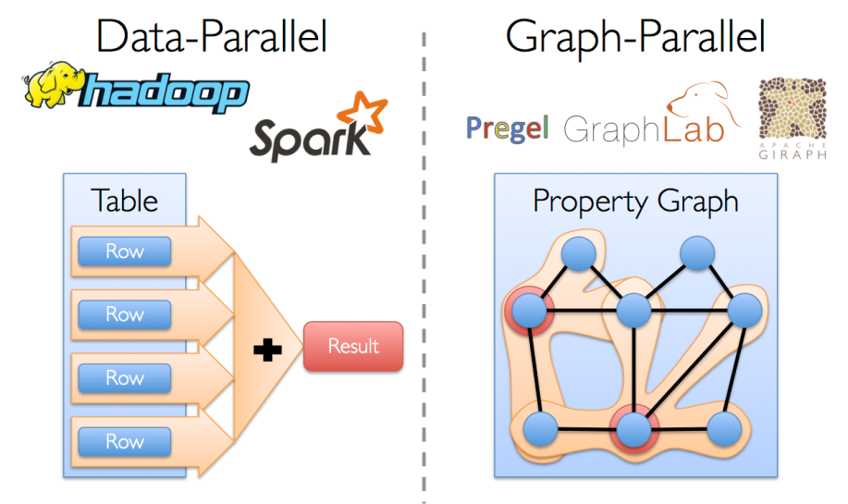
Technologies used:
Apache Graph-X
Apache Spark
Scala
Graph-X example Implementation :
From social networks to language modeling, the growing scale and importance of graph data has driven the development of numerous newgraph-parallel systems (e.g., Giraph and GraphLab). By restricting the types of computation that can be expressed and introducing new techniques to partition and distribute graphs, these systems can efficiently execute sophisticated graph algorithms orders of magnitude faster than more general data-parallel systems

Slide 8
Challenges Faced:
Getting well acquainted with Graph-x and Spark Technologies.
Implementing the recommendations based on mutual interests in the features data set.
We learnt having many nodes in a cluster is very important even for data with a few million rows as the processing would have been much faster and without memory errors.

Slide 9
Conclusion:
Social networks provide an important source of information regarding users and their interactions. This is especially valuable to recommender systems. In this paper we presented a social network-based recommender system (SNRS) which makes recommendations by considering a user's own preference, an item's general acceptance and influence from friends.
Using the results we have obtained we can improve suggestion based on various features like places common and same university attended. We can also recommend based on mixture of these to find the best suitable people.

