Slide 1
Presentation On Disease Prediction
Introduction
On a population-wide level, predictive analytics can help greatly cut costs by predicting which patients are at higher risk for disease and arrange early intervention, before problems develop. This involves aggregating data that are related to a variety of factors. It can identify patients at risk of disease or health conditions.
What is disease prediction?
In this Project, Disease Prediction using Machine Learning is the system that is used to predict the diseases from the symptoms which are given by the patients or any user. The system processes the symptoms provided by the user as input and gives the output as the probability of the disease
Presenting By: Shivani Panchiwala
UTA ID: 1001982478

Slide 2
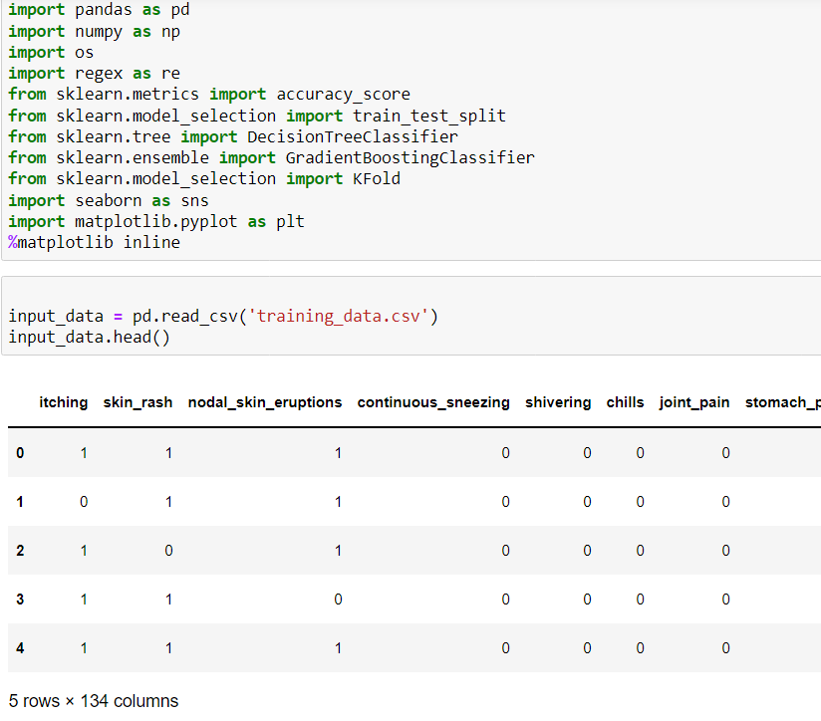
Getting the data
I used Symptom Prediction dataset from Kaggle. There are columns containing diseases, their symptoms , precautions to be taken, and their weights.
https://www.kaggle.com/datasets/rabisingh/symptom-checker?select=Training.csv
Read the Dataset
Import some libraries

Slide 3
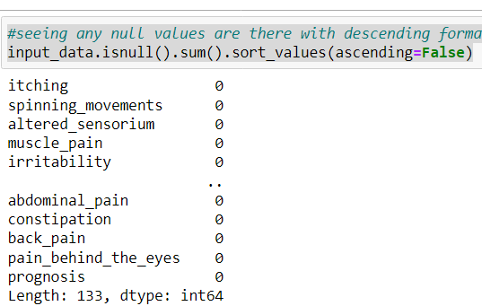
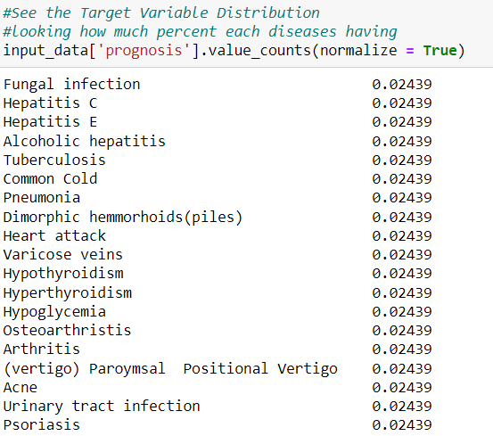
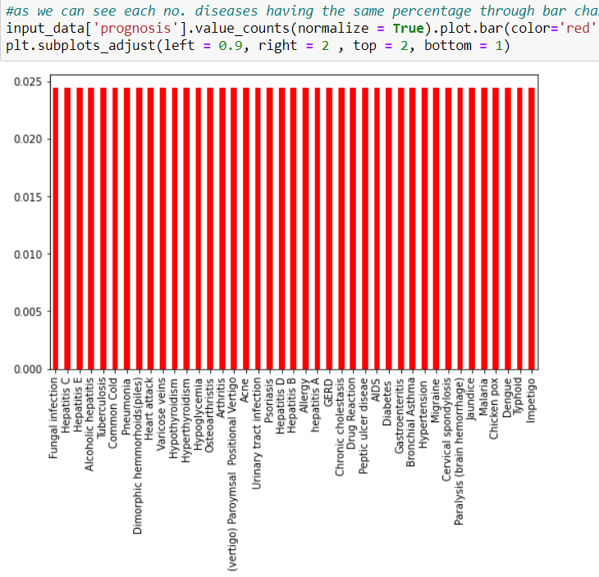
Cleaning Dataset
Percentage of each diseases in bar chart and Target variable distribution

Slide 4
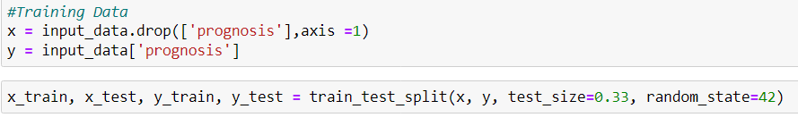
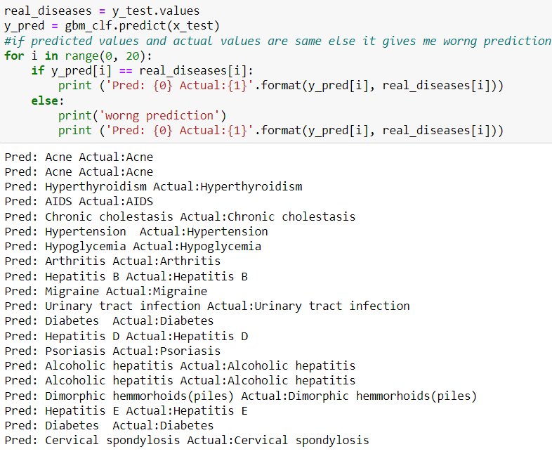
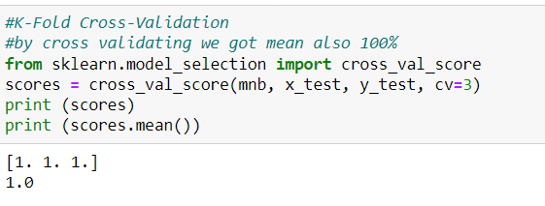
Train the Data
K-Fold Cross-Validation
Check predicted and actual values are same else give wrong prediction

Slide 5
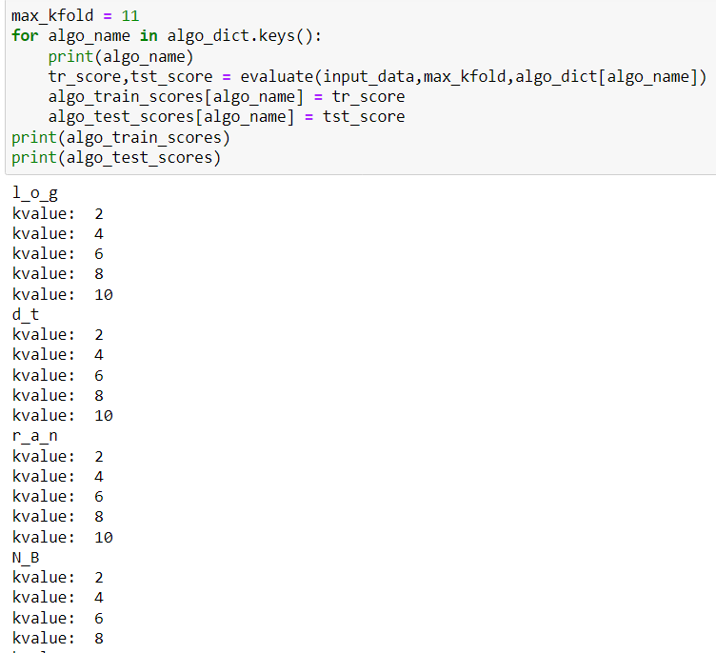
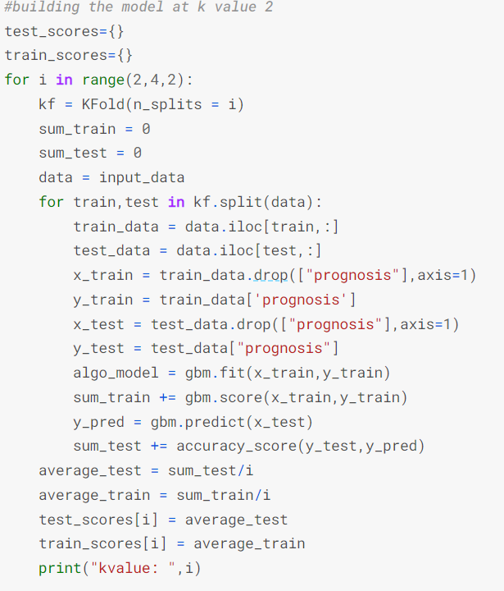
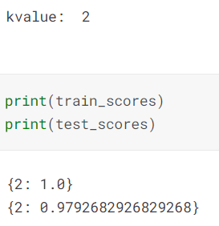
K-fold cross-validation
Divide data set into K-folds. K represents the number of folds into which you want to split your data. If we use 5-folds, the data set divides into five sections. In different iterations, one part becomes the validation set.

Slide 6
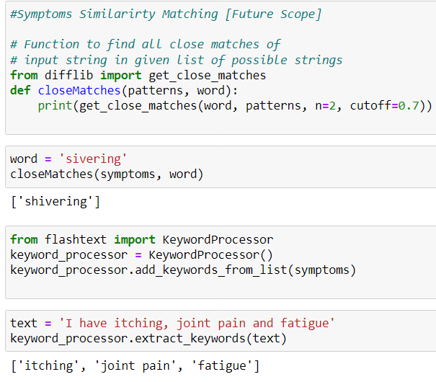
Symptoms Similarirty Matching [Future Scope] and extract keywords

Slide 7
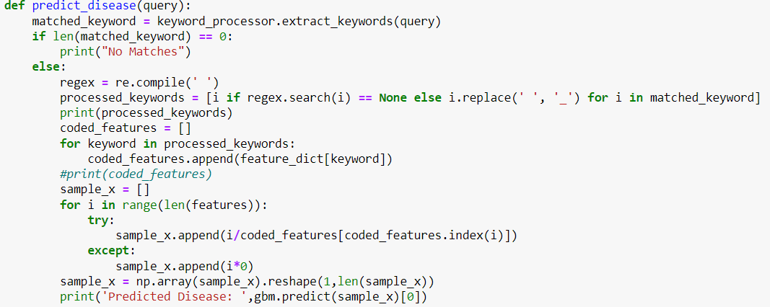
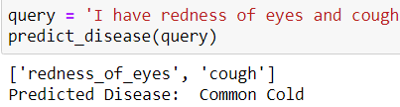
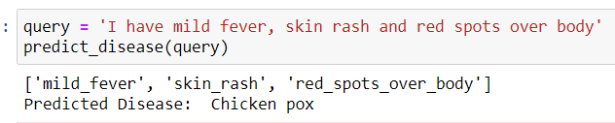
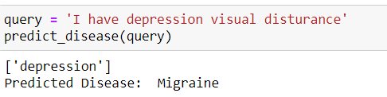

Slide 8
References
https://www.kaggle.com/code/soumya044/disease-prediction
https://github.com/anujdutt9/Disease-Prediction-from-Symptoms/blob/master/dataset/test_data.csv

