Slide 1


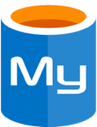

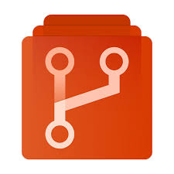
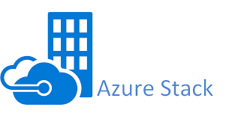
Public Azure
Azure Stack (on-premises)
seattle.azurestack.corp.humongousinsurance.com
External
data stores
Azure AD
Azure Monitor
Ingress
Front end
Back-end services
Client Apps
Azure
Traffic Manager
Azure (Stack)
Load Balancer
Ingress
Utility services
helm upgrade
Kubernetes
Cluster
Monitoring
Logging
docker push
docker pull
Kubernetes
AKS-engine
Azure
Container Registry
Azure Stack
Azure Repos
Node
Node
Node
Node

Slide 2
Public Azure
Azure Stack (on-premises)
seattle.azurestack.corp.humongousinsurance.com
External
data stores
Azure AD
Azure Monitor
Ingress
Front end
Back-end services
Client Apps
Azure
Traffic Manager
Azure (Stack)
Load Balancer
Ingress
Utility services
docker push
docker pull
Kubernetes
Cluster
Azure
Container Registry
Monitoring
Logging
helm upgrade
Build
Agent
Kubernetes
AKS-engine
kubectl
git clone
Azure Stack
ARM
Azure Repos
Node
Node
Node
Node

Slide 3
Docker & Helm push
Azure Container Registry
push configuration
pull images and charts
push configuration
pull images and charts
Azure
Traffic Manager
Azure Repos
Azure Monitor
Kubernetes Cluster
Kubernetes Cluster
AKS-engine
AKS-engine
Azure Stack
Azure Stack
Node
Node
Node
Node
Node
Node
Node
Node
orlando.azurestack.corp.humongousinsurance.com
seattle.azurestack.corp.humongousinsurance.com

Slide 4
AKS-engine
Azure Stack
Node
Node
Node
Node

Slide 5



K8s Cluster Contributor
Azure AD
K8s Cluster Contributor
AKS Engine Contributor
Subscription Owner
Seattle K8s Cluster Contributor
Orlando K8s Cluster Contributor
Subscription “Seattle K8s”
Subscription “Orlando K8s”
Resource Group “Kubernetes”
Resource Group “Kubernetes”
seattle.azurestack.corp.humongousinsurance.com
orlando.azurestack.corp.humongousinsurance.com

Slide 6
Scalability Considerations
Architecture Level | Affects | How?
Application | Application | Number of Pods; Horizontal Pod Autoscaler (HPA)
Cluster | Kubernetes Cluster | Number of Nodes and Node Pools, aks-engine scale (manual)
Infrastructure | Azure Stack Hub | Number of Nodes and Scale Units

Slide 7



Availability considerations
Recursive
DNS Service
Azure
Traffic Manager
Users connect to their local site based on DNS response
On-premises
On-premises

Slide 8

Deployment (CI/CD) considerations
Internet-facing Management Endpoints?
No
self-hosted Build Agents
Azure Stack Hub
Azure Pipelines
Yes
Public IP Addresses
No
Yes
Microsoft-hosted Build Agents
Azure Repos
Kubernetes Cluster

Slide 9
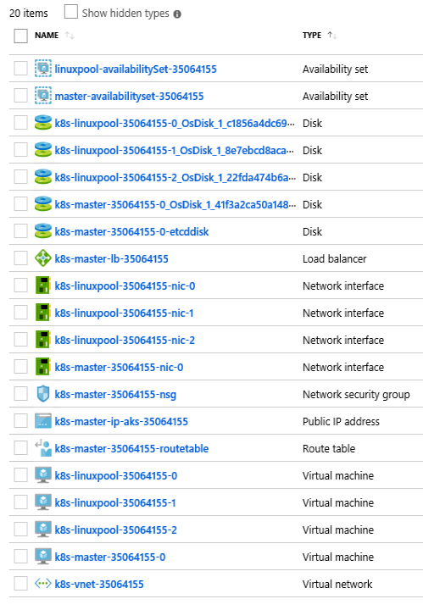
1
2
3

Slide 10
Public Azure
Azure Stack (on-premises)
Azure Repos
Azure Monitor
Azure AD
docker push
docker pull
outbound TCP/80,443
Kubernetes Cluster
Azure
Container Registry
Kubernetes API TCP/443
Kubernetes
AKS-engine
Build Agent
outbound TCP/443
Azure Stack
ARM Endpoints TCP/443
Node
Node
Node
Node
seattle.azurestack.corp.humongousinsurance.com

Slide 11
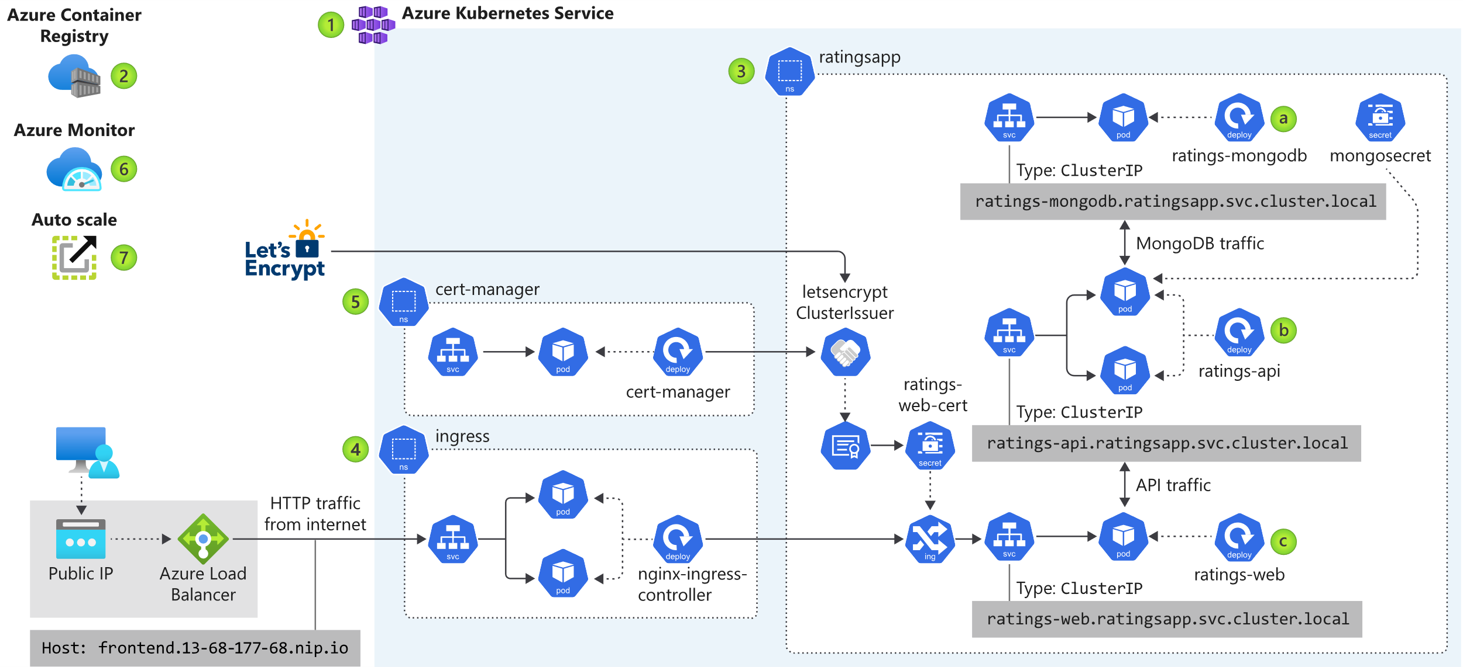

Azure Kubernetes Service Engine

Slide 12
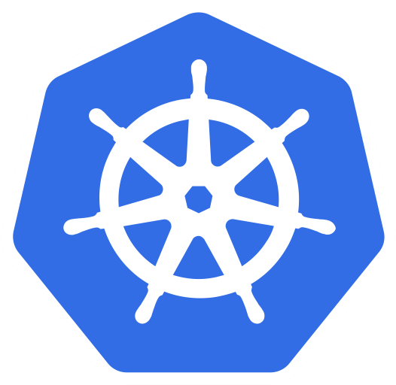
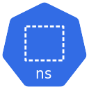
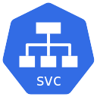

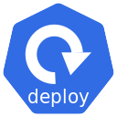
seattle.azurestack.corp.humongousinsurance.com
Azure
Load Balancer
ratingsapp
Type: LoadBalancer
ratings-mongodb.ratingsapp.svc.cluster.local
MongoDB traffic (cluster)
ratingsapp
Azure
Load Balancer
Type: LoadBalancer
ratings-mongodb.ratingsapp.svc.cluster.local
MongoDB traffic (cluster)
orlando.azurestack.corp.humongousinsurance.com

Slide 13
Azure Container Registry
Azure Repos
(or GitHub)
Docker, Helm push
Configuration push (GitOps)
pull configuration
pull images and charts
pull configuration
pull images and charts
Azure
Traffic Manager
Azure Monitor
Kubernetes Cluster
Kubernetes Cluster
AKS-engine
AKS-engine
Azure Stack
Azure Stack
Node
Node
Node
Node
Node
Node
Node
Node

Slide 14




Site A
Azure Stack Hub “Logistics Site A”
(on-premises)
Azure Stack Hub “Logistics Site A”
(on-premises)
Azure
Event Hubs
Azure
Event Hubs
Log Analytics
Log Analytics
Frontend writes to Event Hub
Frontend writes to Event Hub
API Endpoint
API Frontend
API Frontend
backend
backend
CosmosDB
Backend writes to CosmosDB
CosmosDB
Backend writes to CosmosDB
Frontend reads from CosmosDB
Frontend reads from CosmosDB
Notes:
2 Azure Stack Hubs per Site (HA using 2 Stacks)
On-prem data/storage options
TM/DNS etc. Azure and non-Azure options

Slide 15
Site A
Azure Stack Hub “Logistics Site A”
(on-premises)
Event Hubs
Azure
Log Analytics
Frontend writes to Event Hub
API Endpoint
API Frontend
backend
Backend writes to CosmosDB
CosmosDB
Frontend reads from CosmosDB
Failover
to API Cloud Deployment (in Azure)
API Cloud Deployment

