Slide 1

Rhizome Data and Westbridge Capital

Slide 2
About Time Someone Built Intelligence into Grid Resilience
80% of Outages are Weather-Related
$150B Annual Economic Impact
Massive Investment Gap
Regulatory Pressure Mounting
Weather causes 80% of major outages (1,755 events from 2000-2023). Outages doubled in the last decade vs. 2000-2009. Most utilities still use backward-looking historical data.
Power outages cost U.S. businesses $150B annually. Storm-related outages alone: $20-55B per year. Critical facilities lose thousands per minute during blackouts.
$1.4 trillion needed from 2025-2030 for grid modernization. Duke spending $75B over 10 years but lacks precision in targeting investments.
14 states mandate resilience plans with quantified cost-benefit analyses. Utilities struggle to justify investments without data-driven resilience metrics.
AI platform predicts 50-year climate impacts and quantifies $ value of resilience per investment, combining climate, asset, and equity data. Enterprise-proven yet simple enough for municipal utilities with one-click GIS upload. Transforms reactive planning into predictive, optimized capital with justifications.
Sources: MarketsandMarkets, Grand View Research, Lighthouse Global

Slide 3

Rhizome's Intelligence Layer
Traditional
Planning
Historical Bias: Utilities rely on past weather patterns that no longer predict future risks Siloed Analysis: Climate, asset, and social vulnerability data analyzed separately
Forward-Looking Intelligence: By leveraging AI against climate risk data and digital representations of the physical grid, Rhizome's platform identifies vulnerabilities and prioritizes resilience investments and upgrades.
Manual Processes: Weeks of engineering time for each investment scenario Regulatory Friction: Difficulty quantifying resilience benefits for rate cases
Multi-Modal Analysis: Combines utility system data, climate projections, and social vulnerability in one platform
Overall difficult process for each scenario, no truly predictive methods, reliance on only the past.
Rapid Deployment: gridCAVA (an affordable climate vulnerability assessment tool designed specifically for municipal and cooperative utilities) enables quick vulnerability assessments

Slide 4
Some Key Observations about Market Structure
Climate impacts accelerating utility investment needs. The U.S. has already been hit with 24 billion-dollar extreme weather-related events this year, the most in a year since records have been kept, driving unprecedented grid hardening requirements.
Energy resilience market experiencing rapid growth. Energy Resilience Market size is growing with a CAGR of 9.7% in the prediction period & it crosses USD 95.64 Bn by 2032 from USD 49.99 Bn in 2025.
Regulatory frameworks creating tailwinds. more than $65 billion in funding from the bipartisan infrastructure law is beginning to flow into the grid while states mandate resilience planning.
AI/ML becoming the differentiator. Rhizome, which just announced a $6.5 million seed round, uses AI to help assess and prevent climate change-induced grid infrastructure vulnerabilities. Moving from reactive to predictive planning.

Slide 5
Sub-Verticals Market Maps
Vertical | Legacy/Build Your Own | Modern Embedded
Climate Risk Assessment | Historical weather data, Excel models, Consulting studies | Rhizome (Aspen platform), Jupiter Intelligence, One Concern, Climate AI
Grid Planning Software | CYME, ETAP, PowerWorld, Manual processes | Rhizome (gridADAPT), Kevala, Pearl Street, Copperleaf
Wildfire Risk Management | Technosylva, Utility self-assessment, Manual vegetation management | Rhizome (gridFIRM), Overstory, AiDash, Pano AI
Vulnerability Assessment | Engineering consultants, One-off studies, Spreadsheet analysis | Rhizome (gridCAVA), Grid Subject Matter, Xendee
Resilience Investment Optimization | Cost-of-service models, Engineering judgment, Traditional BCA | Rhizome, E Source, Guidehouse, 1898 & Co.

Slide 6
WestBridge Partnership

Slide 7
WestBridge Capital At-a-Glance
US-India Fund
~$8b
150+
$1B+
Crossover, Evergreen Fund
Investments
New Tech Investments
60+
40
9
6
Tech Portfolio Companies
Tech Investments
Last 3 Years
Unicorns
IPOs

Slide 8
Best-in-class Cross-Border Team
Patient Capital
10-20 year holding period, leading rounds across multiple stages to save time and bandwidth for founders
Truly Cross-Border
Full-fledged teams in both US and India to support cross-border founders
Operational Expertise
Comprehensive portfolio support teams across talent acquisition, GTM strategy, and customer introductions

Slide 9


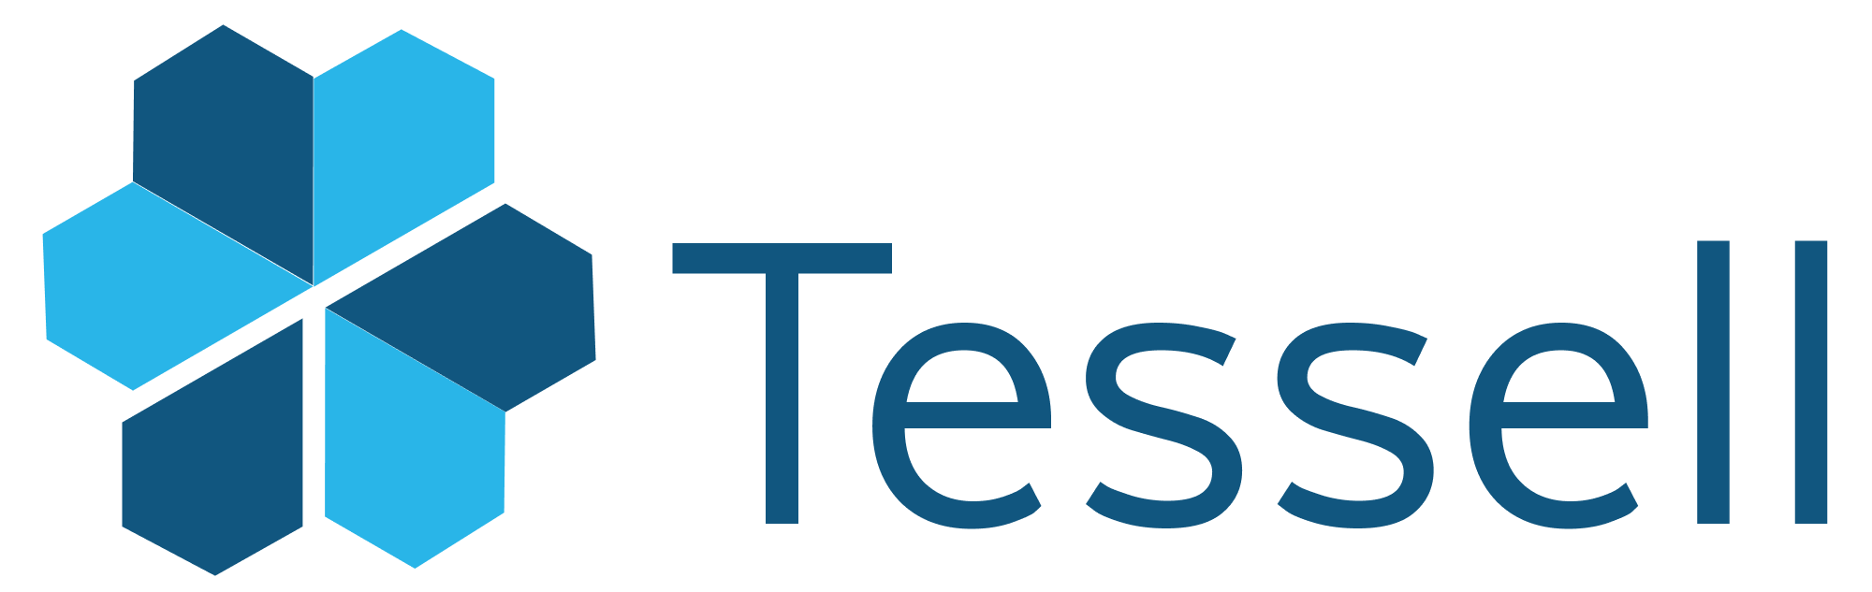
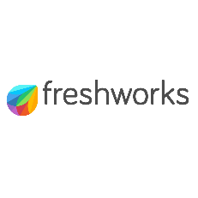


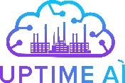

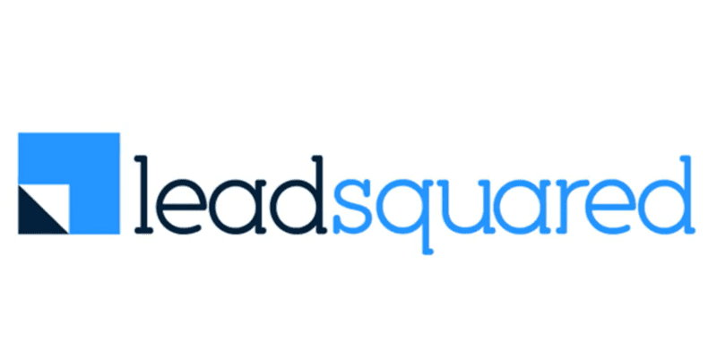













Investments across Sectors and Stages
New
2020 and Prior
2021
2022
2023
2024
2025

Slide 10



Portfolio Acceleration Services
1
2
3
Talent Recruitment
Scaling GTM
Advisory Board
Spearheaded by:
Girish Mirchandani, ex-Pure Storage, HFA
Karan Gurunathan, ex-Google, Flipkart
Initiatives include customer intros to enterprises, channel partners across US/India, competitive research, M&A targets, sales playbook, customer feedback, cost benchmarking
Spearheaded by Peter Kim, ex-LinkedIn, Relativity
Members like:
Patrick Wendell, co-founder Databricks
Manoj Apte, ex-CSO Zscaler
Bill Macaitis, ex-CMO, CRO Slack, Zendesk
Sid Malik, ex-CRO Freshworks
Silicon Valley and Bangalore

Slide 11
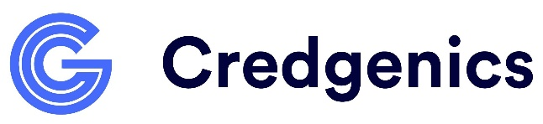
Investment Case Study: Credgenics
AI Debt Resolution & Loan Collection Platform
Our Thesis
Partnership for Growth
Strong Value Proposition
Best in Class Product
Significant Early Traction
Robust Unit Economics
Strong Founding Team
From $1M to $10M ARR
Strategically shifted customer mix from SMB to Enterprises; Built channel partnerships
Series B
Invested $50M
Lead investor
IPO ready
Helped turn company profitable and ready for IPO
2021
2022
2023
2024
2025
2026
Series A
Invested $25M
Added intelligence across vetting and matching process
International Entry
Helped identify new markets to enter for TAM expansion
Sales Org Restructure
Helping company re-org sales teams and incentives
We have operationally supported Credgenics’ growth journey by leveraging our domain expertise
from previous investments in HDFC Bank, ICICI Bank, B2Credit, and Axis Bank

Slide 12
Disclaimer
QUALIFICATIONS:
This presentation contains information about WestBridge Crossover Fund, LLC and its subsidiaries as determined for purposes of US GAAP (the “Fund”) and some of its select portfolio companies and has been prepared solely for your information purposes only. This is not a solicitation or an offer to buy any security or instrument or to participate in any trading strategy of any WestBridge Fund.
The contents of this presentation shall be maintained in strict confidence by all recipients. Any reproduction or distribution of this presentation, in whole or in part, or the disclosure of its contents, without the prior written consent of the Fund is strictly prohibited. Any reproduction or distribution of this presentation, in whole or in part, or the disclosure of its contents, without the prior written consent of WestBridge is strictly prohibited.
The information set forth herein does not purport to be complete and no obligation to update or otherwise revise such information is being assumed. Moreover, certain information contained herein has been obtained from published and non-published sources prepared by other parties and intermediaries, which in certain cases has not been updated through the date hereof. While such sources are believed to be reliable for the purposes used herein, WestBridge does not assume any responsibility for the accuracy or completeness of such information. Further, no third party has assumed responsibility for independently verifying the information contained herein and accordingly, no such persons make any representation with respect to the accuracy, completeness or reasonableness of the information provided herein. Unless otherwise indicated, market analyses and conclusions are based upon opinions or assumptions that WestBridge considers to be reasonable.
Multiple slides show WestBridge’s investment thesis, opinions and beliefs as of the date of this presentation. Any use of adjectives such as “best in class”, “massive”, “robust”, “superior”, “strong”, “dominant” etc. only reflect WestBridge’s belief and view of a particular aspect of the portfolio company as shown in such slides.
There is no guarantee that any investment will perform as projected. Further, the information contained herein does not take into account the particular investment objectives or financial circumstances of any particular investor.
Certain statements, projections or other estimates herein (including estimates of value, returns or performance) are forward looking statements and are based upon certain assumptions. Other events that were not taken into account may occur and may significantly affect the analysis. Any assumptions should not be construed to be indicative of the actual events that will occur. Past performance is not indicative of future performance or results.
No person may treat this presentation as constituting either an offer to sell, or as solicitation of an offer to buy, any interest in the Fund nor does this constitute investment advice or as an offer to participate in the trading strategy of any WestBridge Fund.
Please note that the WestBridge Funds are high-risk investment vehicles and investments therein are available only to qualified individuals or entities that are willing to assume above-average risk and have limited liquidity with a portion of their net-worth. There can be no guarantee that the investment objectives of any WestBridge Fund will be achieved, and an entire loss of principal may occur. Please do refer to the relevant WestBridge Fund’s final confidential offering memorandum, shareholders’ agreement, Form ADV of WestBridge Capital and other related documents for additional information regarding risks and conflicts of interests. No guarantee of investment performance is being provided and no inference to the contrary should be made.

