Slide 1

Cogent Security and Westbridge Capital
Confidential — July 2025

Slide 2
About Time Someone Built Intelligence into Vulnerability Management
5X Growth in Annual CVEs
<5 Days to Exploit
50% Critical Vulnerabilities Unresolved
2X Faster Remediation
Attackers now weaponize AI to exploit new vulnerabilities in under 5 days, accelerated by LLM-powered toolkits that automate vulnerability discovery and exploitation.
CVE publications have grown 5x over the last decade, creating an overwhelming flood of new vulnerabilities that traditional tools can't effectively manage at scale.
Half of all critical vulnerabilities remain unresolved after 2 months due to process bottlenecks and resource constraints, leaving organizations exposed to active threats.
Cogent customers achieve 2x faster mean time to remediate critical vulnerabilities with 50% less manual effort through autonomous AI-driven vulnerability lifecycle management.
Cogent's AI taskforce autonomously drives the entire vulnerability management lifecycle, surfacing top risks, accelerating remediation, and keeping AI-equipped attackers out with minimal human intervention.
Sources: MarketsandMarkets, Grand View Research, Lighthouse Global

Slide 3

Cogent's AI Taskforce
Traditional Vulnerability Management
Overwhelming vulnerability backlogs with no intelligent prioritization, making it impossible to focus resources on findings that pose real business risk
Dynamic risk prioritization using live threat intelligence, asset exposure analysis, and business impact assessment to focus on what matters most
Siloed, outdated asset inventories that leave security teams blind to the full picture of what's vulnerable and why it matters to the business
Enriched asset inventory with 90% accuracy in inferring system ownership, business criticality, and sensitive data presence through deep context extraction
Manual vulnerability scanning and assessment processes that require extensive human intervention and create significant operational overhead
Autonomous AI agents that continuously monitor, assess, and prioritize vulnerabilities 24x7 at machine speed with minimal human oversight required

Slide 4
Some Key Observations about Market Structure
1. 1. <cite index="3-6,5-6"Vulnerability management market valued at $14.94 billion in 2024, expected to reach $24.08 billion by 2030</cite with <cite index="3-8,5-8"8% CAGR driven by expanding attack surfaces and regulatory requirements</cite
2. 2. <cite index="3-9,5-9"Market highly concentrated with top 3 players holding over 60% share</cite, creating opportunity for innovative AI-native solutions to disrupt established vendors
3. 3. <cite index="5-16"Growing adoption of IoT and cloud trends, plus integration of AI and machine learning technologies</cite are reshaping vulnerability management requirements and capabilities
4. 4. <cite index="3-12,5-12"Rapid expansion of modern attack surface has resulted in significant increase in security weaknesses</cite, overwhelming traditional manual approaches and creating demand for autonomous solutions
5. 5. <cite index="6-28,6-30"Organizations using AI-driven tools for 24/7 network monitoring and real-time threat intelligence</cite to stay ahead of evolving cyber threats and reduce response times

Slide 5
Competitive Landscape - Vulnerability Management Market
Vertical | Legacy/Build Your Own | Modern Embedded
Traditional VM Tools | Tenable, Qualys, Rapid7 | Cogent, Hackuity, Wiz
Asset Discovery | Manual inventory and CMDB | AI-powered context extraction
Risk Prioritization | CVSS scoring and basic filters | Dynamic risk scoring with business context
Remediation Guidance | Generic patch recommendations | Contextual, tailored fix instructions
Workflow Automation | Manual ticketing and assignment | Autonomous orchestration and escalation

Slide 6
WestBridge Partnership

Slide 7
WestBridge Capital At-a-Glance
US-India Fund
~$8b
150+
$1B+
Crossover, Evergreen Fund
Investments
New Tech Investments
60+
40
9
6
Tech Portfolio Companies
Tech Investments
Last 3 Years
Unicorns
IPOs

Slide 8
Best-in-class Cross-Border Team
Patient Capital
10-20 year holding period, leading rounds across multiple stages to save time and bandwidth for founders
Truly Cross-Border
Full-fledged teams in both US and India to support cross-border founders
Operational Expertise
Comprehensive portfolio support teams across talent acquisition, GTM strategy, and customer introductions

Slide 9



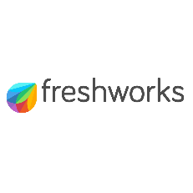




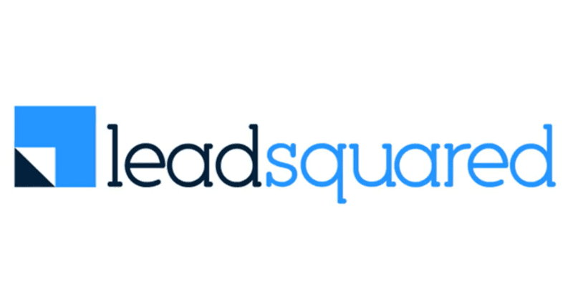













Investments across Sectors and Stages
New
2020 and Prior
2021
2022
2023
2024
2025

Slide 10



Portfolio Acceleration Services
1
2
3
Talent Recruitment
Scaling GTM
Advisory Board
Spearheaded by:
Girish Mirchandani, ex-Pure Storage, HFA
Karan Gurunathan, ex-Google, Flipkart
Initiatives include customer intros to enterprises, channel partners across US/India, competitive research, M&A targets, sales playbook, customer feedback, cost benchmarking
Spearheaded by Peter Kim, ex-LinkedIn, Relativity
Members like:
Patrick Wendell, co-founder Databricks
Manoj Apte, ex-CSO Zscaler
Bill Macaitis, ex-CMO, CRO Slack, Zendesk
Sid Malik, ex-CRO Freshworks
Silicon Valley and Bangalore

Slide 11

Investment Case Study: Turing
AI-enabled Software Services
Our Thesis
Partnership for Growth
Massive Services Market
Best in Class Product
High Customer Traction
Robust Unit Economics
Strong Founding Team
From $10M to $50M ARR
Strategically shifted customer mix from SMB to Enterprises; Built channel partnerships
From $50M to $100M ARR
Restructured GTM to win
$10M+ contracts
IPO ready
Helped turn company profitable and ready for IPO
2020
2021
2022
2023
2024-25
2026
Series B
Invested $28M
Added intelligence across vetting and matching process
Series C
Invested $72M
Lead investor
From $100M to $300M ARR
Expanded focus to LLM data services
We have operationally supported Turing’s growth journey by leveraging our domain expertise
from previous lead investments in Cognizant, GlobalLogic and marketRx

Slide 12
Disclaimer
QUALIFICATIONS:
This presentation contains information about WestBridge Crossover Fund, LLC and its subsidiaries as determined for purposes of US GAAP (the “Fund”) and some of its select portfolio companies and has been prepared solely for your information purposes only. This is not a solicitation or an offer to buy any security or instrument or to participate in any trading strategy of any WestBridge Fund.
The contents of this presentation shall be maintained in strict confidence by all recipients. Any reproduction or distribution of this presentation, in whole or in part, or the disclosure of its contents, without the prior written consent of the Fund is strictly prohibited. Any reproduction or distribution of this presentation, in whole or in part, or the disclosure of its contents, without the prior written consent of WestBridge is strictly prohibited.
The information set forth herein does not purport to be complete and no obligation to update or otherwise revise such information is being assumed. Moreover, certain information contained herein has been obtained from published and non-published sources prepared by other parties and intermediaries, which in certain cases has not been updated through the date hereof. While such sources are believed to be reliable for the purposes used herein, WestBridge does not assume any responsibility for the accuracy or completeness of such information. Further, no third party has assumed responsibility for independently verifying the information contained herein and accordingly, no such persons make any representation with respect to the accuracy, completeness or reasonableness of the information provided herein. Unless otherwise indicated, market analyses and conclusions are based upon opinions or assumptions that WestBridge considers to be reasonable.
Multiple slides show WestBridge’s investment thesis, opinions and beliefs as of the date of this presentation. Any use of adjectives such as “best in class”, “massive”, “robust”, “superior”, “strong”, “dominant” etc. only reflect WestBridge’s belief and view of a particular aspect of the portfolio company as shown in such slides.
There is no guarantee that any investment will perform as projected. Further, the information contained herein does not take into account the particular investment objectives or financial circumstances of any particular investor.
Certain statements, projections or other estimates herein (including estimates of value, returns or performance) are forward looking statements and are based upon certain assumptions. Other events that were not taken into account may occur and may significantly affect the analysis. Any assumptions should not be construed to be indicative of the actual events that will occur. Past performance is not indicative of future performance or results.
No person may treat this presentation as constituting either an offer to sell, or as solicitation of an offer to buy, any interest in the Fund nor does this constitute investment advice or as an offer to participate in the trading strategy of any WestBridge Fund.
Please note that the WestBridge Funds are high-risk investment vehicles and investments therein are available only to qualified individuals or entities that are willing to assume above-average risk and have limited liquidity with a portion of their net-worth. There can be no guarantee that the investment objectives of any WestBridge Fund will be achieved, and an entire loss of principal may occur. Please do refer to the relevant WestBridge Fund’s final confidential offering memorandum, shareholders’ agreement, Form ADV of WestBridge Capital and other related documents for additional information regarding risks and conflicts of interests. No guarantee of investment performance is being provided and no inference to the contrary should be made.

