Slide 1

Backslash Security and Westbridge Capital
Confidential — July 2025

Slide 2
Finally, A Platform to Secure the AI Coding Revolution
Google: 25% of Code is AI-Generated
90% of AI-Generated Code is Insecure
70% of Companies Are Deploying Daily
85% Believe Security Must Modernize
Backslash research shows that popular LLMs like GPT-4o produce insecure code vulnerable to 4-8 out of 10 common CWEs when using naive prompts.
Google reports that 25% of its code is now written by AI, with organizations rapidly adopting vibe coding tools like Cursor and Windsurf to accelerate development.
The percentage of large organizations deploying code to production daily is expected to increase from 5% in 2021 to 70% in 2025, driven by AI acceleration.
85% of organizations believe modernizing security is very important to their cloud-native deployment, yet manual security processes can't keep pace with AI-generated code.
Backslash's App Graph creates a digital twin of applications, analyzing both human and AI-generated code to identify triggerable vulnerabilities and provide context-aware security without slowing development velocity.
Sources: MarketsandMarkets, Grand View Research, Lighthouse Global

Slide 3

Backslash's Unified Intelligence
Legacy SAST/SCA Tools
Manual correlation between code vulnerabilities and cloud deployment context slows remediation
Built-in governance for AI coding environments with MCP server integration and security rules
High false positive rates overwhelm security teams with 75% of applications having at least one flaw
Focuses on triggerable vulnerabilities with actual exploitation potential rather than theoretical risks
Separate tools for code and dependencies create artificial boundaries that miss real-world attack vectors
App Graph digital twin models entire application ecosystem - custom code, OSS dependencies, and cloud context

Slide 4
Market Dynamics Driving the Security Transformation
1. Application security market growing from $11.27B in 2024 to $30.41B by 2030 at 17.4% CAGR, driven by AI coding adoption
2. The emergence of 'vibe coding' creates silent killer vulnerabilities that evade traditional security tools but survive CI/CD pipelines
3. 42% of companies attribute external attacks to software vulnerabilities, with average breach costs reaching $4.35M
4. EU AI Act now classifies vibe coding implementations as high-risk AI systems requiring conformity assessments in critical sectors
5. Developer productivity demands are forcing security teams to abandon manual processes or get pushed out entirely

Slide 5
Competitive Landscape - Application Security Evolution
Vertical | Legacy/Build Your Own | Modern Embedded
Static Analysis (SAST) | Veracode, Checkmarx, Fortify | Backslash, Snyk Code, Semgrep
Composition Analysis (SCA) | Black Duck, WhiteSource, Sonatype | Snyk Open Source, FOSSA, Backslash
AI Code Security | No dedicated solutions | Backslash, Aikido, GitGuardian
Cloud Context Integration | Separate cloud security tools | Backslash, Contrast Security, Bridgecrew
Developer Experience | Noisy scanners with high false positives | Backslash, Codacy, DeepCode

Slide 6
WestBridge Partnership

Slide 7
WestBridge Capital At-a-Glance
US-India Fund
~$8b
150+
$1B+
Crossover, Evergreen Fund
Investments
New Tech Investments
60+
40
9
6
Tech Portfolio Companies
Tech Investments
Last 3 Years
Unicorns
IPOs

Slide 8
Best-in-class Cross-Border Team
Patient Capital
10-20 year holding period, leading rounds across multiple stages to save time and bandwidth for founders
Truly Cross-Border
Full-fledged teams in both US and India to support cross-border founders
Operational Expertise
Comprehensive portfolio support teams across talent acquisition, GTM strategy, and customer introductions

Slide 9



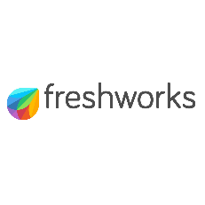




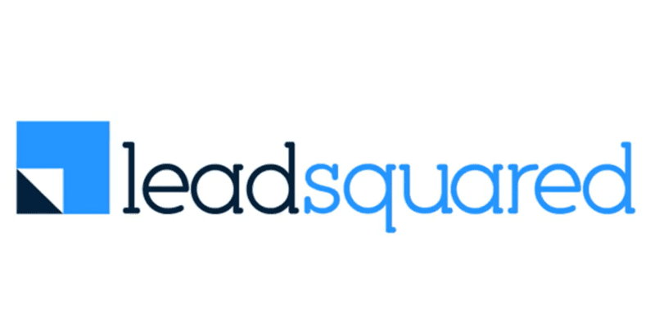













Investments across Sectors and Stages
New
2020 and Prior
2021
2022
2023
2024
2025

Slide 10



Portfolio Acceleration Services
1
2
3
Talent Recruitment
Scaling GTM
Advisory Board
Spearheaded by:
Girish Mirchandani, ex-Pure Storage, HFA
Karan Gurunathan, ex-Google, Flipkart
Initiatives include customer intros to enterprises, channel partners across US/India, competitive research, M&A targets, sales playbook, customer feedback, cost benchmarking
Spearheaded by Peter Kim, ex-LinkedIn, Relativity
Members like:
Patrick Wendell, co-founder Databricks
Manoj Apte, ex-CSO Zscaler
Bill Macaitis, ex-CMO, CRO Slack, Zendesk
Sid Malik, ex-CRO Freshworks
Silicon Valley and Bangalore

Slide 11

Investment Case Study: Turing
AI-enabled Software Services
Our Thesis
Partnership for Growth
Massive Services Market
Best in Class Product
High Customer Traction
Robust Unit Economics
Strong Founding Team
From $10M to $50M ARR
Strategically shifted customer mix from SMB to Enterprises; Built channel partnerships
From $50M to $100M ARR
Restructured GTM to win
$10M+ contracts
IPO ready
Helped turn company profitable and ready for IPO
2020
2021
2022
2023
2024-25
2026
Series B
Invested $28M
Added intelligence across vetting and matching process
Series C
Invested $72M
Lead investor
From $100M to $300M ARR
Expanded focus to LLM data services
We have operationally supported Turing’s growth journey by leveraging our domain expertise
from previous lead investments in Cognizant, GlobalLogic and marketRx

Slide 12
Disclaimer
QUALIFICATIONS:
This presentation contains information about WestBridge Crossover Fund, LLC and its subsidiaries as determined for purposes of US GAAP (the “Fund”) and some of its select portfolio companies and has been prepared solely for your information purposes only. This is not a solicitation or an offer to buy any security or instrument or to participate in any trading strategy of any WestBridge Fund.
The contents of this presentation shall be maintained in strict confidence by all recipients. Any reproduction or distribution of this presentation, in whole or in part, or the disclosure of its contents, without the prior written consent of the Fund is strictly prohibited. Any reproduction or distribution of this presentation, in whole or in part, or the disclosure of its contents, without the prior written consent of WestBridge is strictly prohibited.
The information set forth herein does not purport to be complete and no obligation to update or otherwise revise such information is being assumed. Moreover, certain information contained herein has been obtained from published and non-published sources prepared by other parties and intermediaries, which in certain cases has not been updated through the date hereof. While such sources are believed to be reliable for the purposes used herein, WestBridge does not assume any responsibility for the accuracy or completeness of such information. Further, no third party has assumed responsibility for independently verifying the information contained herein and accordingly, no such persons make any representation with respect to the accuracy, completeness or reasonableness of the information provided herein. Unless otherwise indicated, market analyses and conclusions are based upon opinions or assumptions that WestBridge considers to be reasonable.
Multiple slides show WestBridge’s investment thesis, opinions and beliefs as of the date of this presentation. Any use of adjectives such as “best in class”, “massive”, “robust”, “superior”, “strong”, “dominant” etc. only reflect WestBridge’s belief and view of a particular aspect of the portfolio company as shown in such slides.
There is no guarantee that any investment will perform as projected. Further, the information contained herein does not take into account the particular investment objectives or financial circumstances of any particular investor.
Certain statements, projections or other estimates herein (including estimates of value, returns or performance) are forward looking statements and are based upon certain assumptions. Other events that were not taken into account may occur and may significantly affect the analysis. Any assumptions should not be construed to be indicative of the actual events that will occur. Past performance is not indicative of future performance or results.
No person may treat this presentation as constituting either an offer to sell, or as solicitation of an offer to buy, any interest in the Fund nor does this constitute investment advice or as an offer to participate in the trading strategy of any WestBridge Fund.
Please note that the WestBridge Funds are high-risk investment vehicles and investments therein are available only to qualified individuals or entities that are willing to assume above-average risk and have limited liquidity with a portion of their net-worth. There can be no guarantee that the investment objectives of any WestBridge Fund will be achieved, and an entire loss of principal may occur. Please do refer to the relevant WestBridge Fund’s final confidential offering memorandum, shareholders’ agreement, Form ADV of WestBridge Capital and other related documents for additional information regarding risks and conflicts of interests. No guarantee of investment performance is being provided and no inference to the contrary should be made.

