Slide 1

Mitsogo and Westbridge Capital
Confidential — July 2025

Slide 2
About Time Someone Built Intelligence into Endpoint Security
$4.88M Average Data Breach Cost
82% of Organizations Use BYOD
277 Days to Identify Breaches
$111.6B UEM Market by 2029
82% of organizations currently use BYOD policies, with 90% of employees using a mix of personal and company devices, creating massive endpoint management complexity across diverse device ecosystems.
The average cost of a data breach reached an all-time high of $4.88 million in 2024, representing a 10% increase from 2023, with endpoint security failures being a primary contributor to these costly incidents.
Security teams take an average of 277 days to identify and contain a data breach, with breaches involving lost or stolen credentials taking 328 days - highlighting the critical need for proactive endpoint management.
The global Unified Endpoint Management market is projected to reach $111.6 billion by 2029, growing at a 58% CAGR as organizations desperately seek unified solutions to manage their expanding device ecosystems.
Mitsogo's Hexnode UEM delivers 360-degree digital security for enterprises of all sizes, protecting internet-enabled work devices from malpractices and data loss while improving work quality through intelligent automation and centralized management.
Sources: MarketsandMarkets, Grand View Research, Lighthouse Global

Slide 3

Mitsogo's Hexnode UEM Intelligence
Traditional Endpoint Management
Complex device provisioning and configuration processes that require significant IT resources and technical expertise to manage diverse endpoints
Zero-touch device provisioning and intelligent automation reducing IT workload while ensuring consistent security configurations
Reactive security approach with lengthy breach detection times averaging 277 days and manual incident response procedures
Proactive threat detection and automated security enforcement with real-time policy compliance across all managed endpoints
Fragmented point solutions requiring separate tools for mobile device management, endpoint protection, and access management across different platforms
Unified platform delivering comprehensive endpoint management from mobile devices to IoT, providing single-pane-of-glass visibility and control

Slide 4
Some Key Observations about Market Structure
1. UEM market experiencing explosive 58% CAGR growth as organizations struggle with endpoint complexity - from $4.49B in 2024 to projected $111.6B by 2029
2. 82% of organizations already using BYOD with 90% of employees mixing personal and company devices, creating unprecedented endpoint management challenges
3. Healthcare and finance sectors face highest breach costs at $9.77M and $5.9M respectively, driving urgent need for specialized endpoint security solutions
4. SMEs driving 64.5% of UEM market adoption as smaller organizations seek cost-effective solutions to manage distributed workforces
5. Cloud deployment commanding 60.9% market share with 26.1% CAGR as organizations prioritize scalable, remotely-manageable endpoint solutions

Slide 5
Competitive Landscape - Unified Endpoint Management Market
Vertical | Legacy/Build Your Own | Modern Embedded
Mobile Device Management | MobileIron, AirWatch, Good Technology | Hexnode, Microsoft Intune, Jamf
Enterprise Mobility Management | BlackBerry Enterprise Server, Citrix XenMobile | VMware Workspace ONE, IBM MaaS360
IoT & Kiosk Management | Manual configuration, custom scripts | Hexnode Kiosk, 42Gears SureMDM
BYOD Security | VPN-based access, perimeter security | Zero-trust architecture, identity-based access
Healthcare Compliance | Point solutions, manual audit trails | Integrated HIPAA compliance, automated reporting

Slide 6
WestBridge Partnership

Slide 7
WestBridge Capital At-a-Glance
US-India Fund
~$8b
150+
$1B+
Crossover, Evergreen Fund
Investments
New Tech Investments
60+
40
9
6
Tech Portfolio Companies
Tech Investments
Last 3 Years
Unicorns
IPOs

Slide 8
Best-in-class Cross-Border Team
Patient Capital
10-20 year holding period, leading rounds across multiple stages to save time and bandwidth for founders
Truly Cross-Border
Full-fledged teams in both US and India to support cross-border founders
Operational Expertise
Comprehensive portfolio support teams across talent acquisition, GTM strategy, and customer introductions

Slide 9








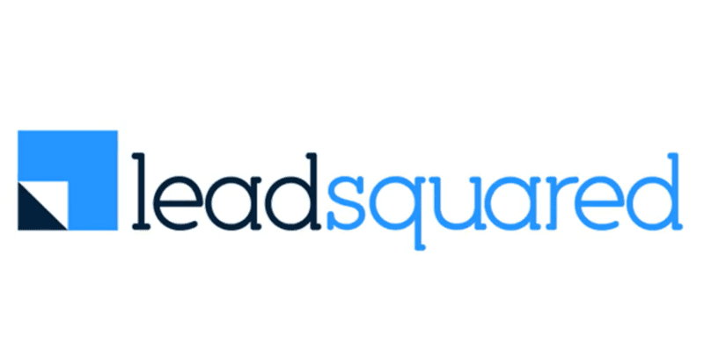













Investments across Sectors and Stages
New
2020 and Prior
2021
2022
2023
2024
2025

Slide 10



Portfolio Acceleration Services
1
2
3
Talent Recruitment
Scaling GTM
Advisory Board
Spearheaded by:
Girish Mirchandani, ex-Pure Storage, HFA
Karan Gurunathan, ex-Google, Flipkart
Initiatives include customer intros to enterprises, channel partners across US/India, competitive research, M&A targets, sales playbook, customer feedback, cost benchmarking
Spearheaded by Peter Kim, ex-LinkedIn, Relativity
Members like:
Patrick Wendell, co-founder Databricks
Manoj Apte, ex-CSO Zscaler
Bill Macaitis, ex-CMO, CRO Slack, Zendesk
Sid Malik, ex-CRO Freshworks
Silicon Valley and Bangalore

Slide 11

Investment Case Study: Turing
AI-enabled Software Services
Our Thesis
Partnership for Growth
Massive Services Market
Best in Class Product
High Customer Traction
Robust Unit Economics
Strong Founding Team
From $10M to $50M ARR
Strategically shifted customer mix from SMB to Enterprises; Built channel partnerships
From $50M to $100M ARR
Restructured GTM to win
$10M+ contracts
IPO ready
Helped turn company profitable and ready for IPO
2020
2021
2022
2023
2024-25
2026
Series B
Invested $28M
Added intelligence across vetting and matching process
Series C
Invested $72M
Lead investor
From $100M to $300M ARR
Expanded focus to LLM data services
We have operationally supported Turing’s growth journey by leveraging our domain expertise
from previous lead investments in Cognizant, GlobalLogic and marketRx

Slide 12
Disclaimer
QUALIFICATIONS:
This presentation contains information about WestBridge Crossover Fund, LLC and its subsidiaries as determined for purposes of US GAAP (the “Fund”) and some of its select portfolio companies and has been prepared solely for your information purposes only. This is not a solicitation or an offer to buy any security or instrument or to participate in any trading strategy of any WestBridge Fund.
The contents of this presentation shall be maintained in strict confidence by all recipients. Any reproduction or distribution of this presentation, in whole or in part, or the disclosure of its contents, without the prior written consent of the Fund is strictly prohibited. Any reproduction or distribution of this presentation, in whole or in part, or the disclosure of its contents, without the prior written consent of WestBridge is strictly prohibited.
The information set forth herein does not purport to be complete and no obligation to update or otherwise revise such information is being assumed. Moreover, certain information contained herein has been obtained from published and non-published sources prepared by other parties and intermediaries, which in certain cases has not been updated through the date hereof. While such sources are believed to be reliable for the purposes used herein, WestBridge does not assume any responsibility for the accuracy or completeness of such information. Further, no third party has assumed responsibility for independently verifying the information contained herein and accordingly, no such persons make any representation with respect to the accuracy, completeness or reasonableness of the information provided herein. Unless otherwise indicated, market analyses and conclusions are based upon opinions or assumptions that WestBridge considers to be reasonable.
Multiple slides show WestBridge’s investment thesis, opinions and beliefs as of the date of this presentation. Any use of adjectives such as “best in class”, “massive”, “robust”, “superior”, “strong”, “dominant” etc. only reflect WestBridge’s belief and view of a particular aspect of the portfolio company as shown in such slides.
There is no guarantee that any investment will perform as projected. Further, the information contained herein does not take into account the particular investment objectives or financial circumstances of any particular investor.
Certain statements, projections or other estimates herein (including estimates of value, returns or performance) are forward looking statements and are based upon certain assumptions. Other events that were not taken into account may occur and may significantly affect the analysis. Any assumptions should not be construed to be indicative of the actual events that will occur. Past performance is not indicative of future performance or results.
No person may treat this presentation as constituting either an offer to sell, or as solicitation of an offer to buy, any interest in the Fund nor does this constitute investment advice or as an offer to participate in the trading strategy of any WestBridge Fund.
Please note that the WestBridge Funds are high-risk investment vehicles and investments therein are available only to qualified individuals or entities that are willing to assume above-average risk and have limited liquidity with a portion of their net-worth. There can be no guarantee that the investment objectives of any WestBridge Fund will be achieved, and an entire loss of principal may occur. Please do refer to the relevant WestBridge Fund’s final confidential offering memorandum, shareholders’ agreement, Form ADV of WestBridge Capital and other related documents for additional information regarding risks and conflicts of interests. No guarantee of investment performance is being provided and no inference to the contrary should be made.

