Slide 1

Menlo Security and Westbridge Capital
Confidential — July 2025

Slide 2
About Time Someone Built Intelligence into Browser Security
62% Cite Data Loss as Top BYOD Concern
72% of Applications Have Unauthorized Access
66% of Apps Vulnerable to Code Injection
Over 800 Global Customers Trust Menlo
Nearly three-quarters of applications provide access to unauthorized features, creating massive attack surfaces that traditional network security cannot address.
Cybersecurity professionals identify data loss and leaks as their primary concern with bring-your-own-device policies, highlighting the critical gap in browser-based security for unmanaged devices.
Two-thirds of applications can be compromised by injecting malicious code in HTTP headers or payloads, demonstrating the browser's role as the primary attack vector.
Leading enterprises across almost 250 countries have deployed Menlo Security, processing over 400 billion isolated browsing sessions annually to protect against browser-based threats.
Menlo Security's Secure Enterprise Browser creates a hardened digital twin of users' local browsers, providing complete protection against evasive threats while maintaining the familiar browsing experience users demand.
Sources: MarketsandMarkets, Grand View Research, Lighthouse Global

Slide 3

Menlo's AI-Native Browser Protection
Traditional Browser Security
VPN and VDI solutions are costly, complex, provide poor user experience, and still lack adequate browser security
Clientless architecture works with any browser on any device without requiring endpoint software or configuration changes
Signature-based detection can only identify known threats, failing against zero-hour phishing attacks and adaptive malware
Secure Cloud Browser creates isolated digital twins for every session, preventing malware from ever reaching user endpoints
Network and endpoint defenses have no visibility into browser traffic due to encryption, leaving security teams blind to actual threats
HEAT Shield AI uses computer vision and neural networks to detect zero-hour phishing attempts up to 6 days before other vendors

Slide 4
Key Market Observations About Browser Security
1. Remote browser isolation market growing at 20.12% CAGR, reaching $15.31B by 2033, driven by increasing cyber threats and cloud adoption
2. Browser has become central to enterprise workspace, involved in virtually every cyberattack today as the least protected attack surface
3. Traditional security tools are blind to browser-based threats due to encryption, creating massive visibility gaps for security teams
4. Rise of BYOD policies and hybrid work has made browser security critical - 62% of professionals cite data loss as top BYOD concern
5. Attackers now use AI to create evasive threats that adapt based on environment and delay execution to avoid detection

Slide 5
Competitive Landscape - Browser Security Market
Vertical | Legacy/Build Your Own | Modern Embedded
Remote Browser Isolation | Symantec, Citrix, Ericom | Menlo Security, Light Point, Authentic8
Zero Trust Network Access | VPN, VDI, Citrix Virtual Apps | Menlo SAA, Zscaler, Palo Alto Prisma
Phishing Protection | Email security, URL filtering | Menlo HEAT Shield AI, Proofpoint, Ironscales
Browser Management | Manual policy configuration | Menlo Browser Posture Manager, LayerX
Data Loss Prevention | Network-based DLP, endpoint agents | Menlo last-mile DLP, Forcepoint, Microsoft Purview

Slide 6
WestBridge Partnership

Slide 7
WestBridge Capital At-a-Glance
US-India Fund
~$8b
150+
$1B+
Crossover, Evergreen Fund
Investments
New Tech Investments
60+
40
9
6
Tech Portfolio Companies
Tech Investments
Last 3 Years
Unicorns
IPOs

Slide 8
Best-in-class Cross-Border Team
Patient Capital
10-20 year holding period, leading rounds across multiple stages to save time and bandwidth for founders
Truly Cross-Border
Full-fledged teams in both US and India to support cross-border founders
Operational Expertise
Comprehensive portfolio support teams across talent acquisition, GTM strategy, and customer introductions

Slide 9



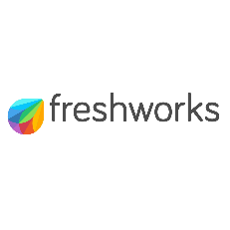




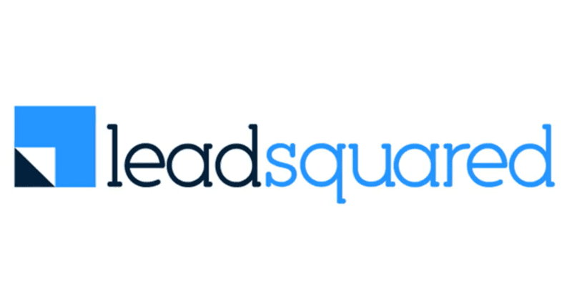













Investments across Sectors and Stages
New
2020 and Prior
2021
2022
2023
2024
2025

Slide 10



Portfolio Acceleration Services
1
2
3
Talent Recruitment
Scaling GTM
Advisory Board
Spearheaded by:
Girish Mirchandani, ex-Pure Storage, HFA
Karan Gurunathan, ex-Google, Flipkart
Initiatives include customer intros to enterprises, channel partners across US/India, competitive research, M&A targets, sales playbook, customer feedback, cost benchmarking
Spearheaded by Peter Kim, ex-LinkedIn, Relativity
Members like:
Patrick Wendell, co-founder Databricks
Manoj Apte, ex-CSO Zscaler
Bill Macaitis, ex-CMO, CRO Slack, Zendesk
Sid Malik, ex-CRO Freshworks
Silicon Valley and Bangalore

Slide 11

Investment Case Study: Turing
AI-enabled Software Services
Our Thesis
Partnership for Growth
Massive Services Market
Best in Class Product
High Customer Traction
Robust Unit Economics
Strong Founding Team
From $10M to $50M ARR
Strategically shifted customer mix from SMB to Enterprises; Built channel partnerships
From $50M to $100M ARR
Restructured GTM to win
$10M+ contracts
IPO ready
Helped turn company profitable and ready for IPO
2020
2021
2022
2023
2024-25
2026
Series B
Invested $28M
Added intelligence across vetting and matching process
Series C
Invested $72M
Lead investor
From $100M to $300M ARR
Expanded focus to LLM data services
We have operationally supported Turing’s growth journey by leveraging our domain expertise
from previous lead investments in Cognizant, GlobalLogic and marketRx

Slide 12
Disclaimer
QUALIFICATIONS:
This presentation contains information about WestBridge Crossover Fund, LLC and its subsidiaries as determined for purposes of US GAAP (the “Fund”) and some of its select portfolio companies and has been prepared solely for your information purposes only. This is not a solicitation or an offer to buy any security or instrument or to participate in any trading strategy of any WestBridge Fund.
The contents of this presentation shall be maintained in strict confidence by all recipients. Any reproduction or distribution of this presentation, in whole or in part, or the disclosure of its contents, without the prior written consent of the Fund is strictly prohibited. Any reproduction or distribution of this presentation, in whole or in part, or the disclosure of its contents, without the prior written consent of WestBridge is strictly prohibited.
The information set forth herein does not purport to be complete and no obligation to update or otherwise revise such information is being assumed. Moreover, certain information contained herein has been obtained from published and non-published sources prepared by other parties and intermediaries, which in certain cases has not been updated through the date hereof. While such sources are believed to be reliable for the purposes used herein, WestBridge does not assume any responsibility for the accuracy or completeness of such information. Further, no third party has assumed responsibility for independently verifying the information contained herein and accordingly, no such persons make any representation with respect to the accuracy, completeness or reasonableness of the information provided herein. Unless otherwise indicated, market analyses and conclusions are based upon opinions or assumptions that WestBridge considers to be reasonable.
Multiple slides show WestBridge’s investment thesis, opinions and beliefs as of the date of this presentation. Any use of adjectives such as “best in class”, “massive”, “robust”, “superior”, “strong”, “dominant” etc. only reflect WestBridge’s belief and view of a particular aspect of the portfolio company as shown in such slides.
There is no guarantee that any investment will perform as projected. Further, the information contained herein does not take into account the particular investment objectives or financial circumstances of any particular investor.
Certain statements, projections or other estimates herein (including estimates of value, returns or performance) are forward looking statements and are based upon certain assumptions. Other events that were not taken into account may occur and may significantly affect the analysis. Any assumptions should not be construed to be indicative of the actual events that will occur. Past performance is not indicative of future performance or results.
No person may treat this presentation as constituting either an offer to sell, or as solicitation of an offer to buy, any interest in the Fund nor does this constitute investment advice or as an offer to participate in the trading strategy of any WestBridge Fund.
Please note that the WestBridge Funds are high-risk investment vehicles and investments therein are available only to qualified individuals or entities that are willing to assume above-average risk and have limited liquidity with a portion of their net-worth. There can be no guarantee that the investment objectives of any WestBridge Fund will be achieved, and an entire loss of principal may occur. Please do refer to the relevant WestBridge Fund’s final confidential offering memorandum, shareholders’ agreement, Form ADV of WestBridge Capital and other related documents for additional information regarding risks and conflicts of interests. No guarantee of investment performance is being provided and no inference to the contrary should be made.

