Slide 1

Neurable and Westbridge Capital
Confidential — July 2025

Slide 2
About Time Someone Built Intelligence into Brain Health
52% of Workers Experience Burnout
$190B Annual Economic Impact
28% Show High Emotional Exhaustion
BCI Market Growing 15% CAGR
Workplace burnout costs the U.S. economy $190 billion annually through health-related expenses, absenteeism, reduced productivity, and occupational injuries.
Over half of survey respondents report experiencing burnout, with rates increasing post-pandemic from 43% to 52%, creating a massive market opportunity for cognitive health solutions.
28% of workers score high in emotional exhaustion, with multivariable analysis showing this is the only burnout dimension significantly associated with productivity loss.
The brain-computer interface market is projected to reach $8.73 billion by 2033, growing at 15.13% CAGR, with non-invasive solutions dominating 76.5% of the market.
Neurable's MW75 Neuro headphones represent the first consumer-grade brain-computer interface that seamlessly integrates EEG monitoring with premium audio, enabling real-time focus tracking and personalized brain break recommendations to combat the epidemic of workplace burnout.
Sources: MarketsandMarkets, Grand View Research, Lighthouse Global

Slide 3

Neurable's Direct Brain Monitoring
Traditional Wellness & Productivity Tools
Offer generic productivity tips and break schedules that don't account for individual brain activity patterns
Delivers personalized brain break recommendations based on individual neural activity patterns and optimal cognitive performance windows
Require manual input and self-reporting for focus tracking, leading to inconsistent and subjective data collection
Uses proprietary AI to automatically detect focus patterns and cognitive load without any manual input required
Rely on external behavioral metrics like heart rate, sleep patterns, and step counts that provide indirect indicators of cognitive state
Captures real-time EEG brain signals through soft fabric neural sensors, providing direct measurement of cognitive states and focus levels

Slide 4
Some Key Observations about Market Structure
1. The brain-computer interface market is experiencing explosive growth, projected to reach $8.73 billion by 2033 with 15.13% CAGR, driven by advances in AI and non-invasive technologies
2. North America dominates with 48% market share, led by companies like Neurable, Neuralink, and Synchron, supported by substantial R&D investments and clinical trials
3. Non-invasive BCI solutions represent 76.5% of the market, with consumer headsets enabling everyday usage scenarios like productivity tracking and neurofeedback
4. Healthcare applications currently hold 45-57% market share, but entertainment, gaming, and workplace productivity segments are showing the highest growth rates
5. The shift from medical-only to consumer applications is creating new market categories, with focus tracking and cognitive enhancement emerging as key use cases

Slide 5
Competitive Landscape - Brain-Computer Interface Market
Vertical | Legacy/Build Your Own | Modern Embedded
EEG Monitoring | Clinical-grade caps, gel electrodes, lab-only | Neurable MW75, Emotiv EPOC+, everyday wearables
Focus Tracking | Manual logging, time-tracking apps, self-reporting | Real-time brain signal analysis, AI-powered insights
Productivity Tools | Generic break reminders, Pomodoro timers | Personalized brain break recommendations
Audio + Health | Separate headphones and fitness trackers | Integrated audio-neurotechnology devices
Burnout Prevention | Post-symptom wellness programs, HR interventions | Proactive cognitive health monitoring

Slide 6
WestBridge Partnership

Slide 7
WestBridge Capital At-a-Glance
US-India Fund
~$8b
150+
$1B+
Crossover, Evergreen Fund
Investments
New Tech Investments
60+
40
9
6
Tech Portfolio Companies
Tech Investments
Last 3 Years
Unicorns
IPOs

Slide 8
Best-in-class Cross-Border Team
Patient Capital
10-20 year holding period, leading rounds across multiple stages to save time and bandwidth for founders
Truly Cross-Border
Full-fledged teams in both US and India to support cross-border founders
Operational Expertise
Comprehensive portfolio support teams across talent acquisition, GTM strategy, and customer introductions

Slide 9



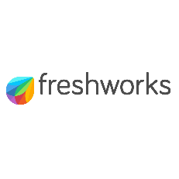


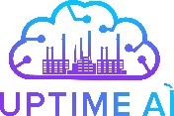

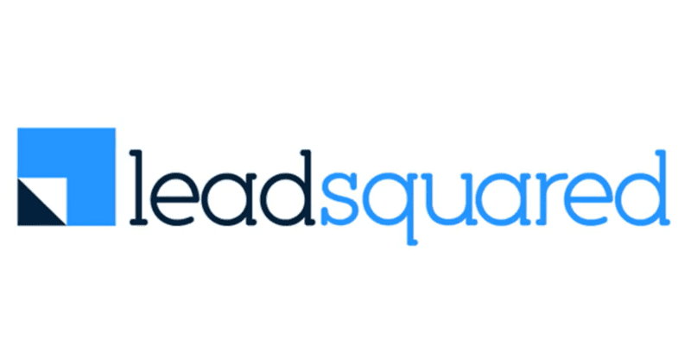





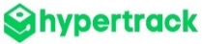
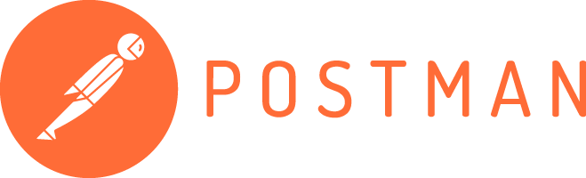
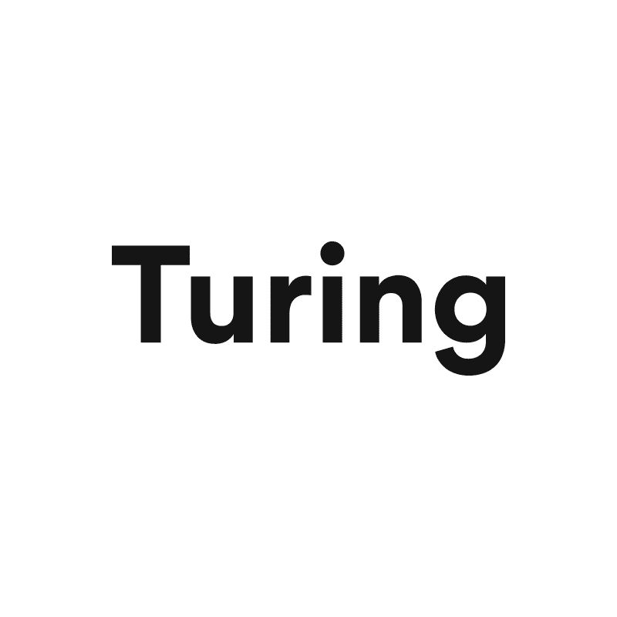

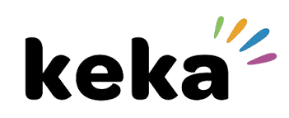

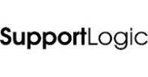

Investments across Sectors and Stages
New
2020 and Prior
2021
2022
2023
2024
2025

Slide 10



Portfolio Acceleration Services
1
2
3
Talent Recruitment
Scaling GTM
Advisory Board
Spearheaded by:
Girish Mirchandani, ex-Pure Storage, HFA
Karan Gurunathan, ex-Google, Flipkart
Initiatives include customer intros to enterprises, channel partners across US/India, competitive research, M&A targets, sales playbook, customer feedback, cost benchmarking
Spearheaded by Peter Kim, ex-LinkedIn, Relativity
Members like:
Patrick Wendell, co-founder Databricks
Manoj Apte, ex-CSO Zscaler
Bill Macaitis, ex-CMO, CRO Slack, Zendesk
Sid Malik, ex-CRO Freshworks
Silicon Valley and Bangalore

Slide 11

Investment Case Study: Turing
AI-enabled Software Services
Our Thesis
Partnership for Growth
Massive Services Market
Best in Class Product
High Customer Traction
Robust Unit Economics
Strong Founding Team
From $10M to $50M ARR
Strategically shifted customer mix from SMB to Enterprises; Built channel partnerships
From $50M to $100M ARR
Restructured GTM to win
$10M+ contracts
IPO ready
Helped turn company profitable and ready for IPO
2020
2021
2022
2023
2024-25
2026
Series B
Invested $28M
Added intelligence across vetting and matching process
Series C
Invested $72M
Lead investor
From $100M to $300M ARR
Expanded focus to LLM data services
We have operationally supported Turing’s growth journey by leveraging our domain expertise
from previous lead investments in Cognizant, GlobalLogic and marketRx

Slide 12
Disclaimer
QUALIFICATIONS:
This presentation contains information about WestBridge Crossover Fund, LLC and its subsidiaries as determined for purposes of US GAAP (the “Fund”) and some of its select portfolio companies and has been prepared solely for your information purposes only. This is not a solicitation or an offer to buy any security or instrument or to participate in any trading strategy of any WestBridge Fund.
The contents of this presentation shall be maintained in strict confidence by all recipients. Any reproduction or distribution of this presentation, in whole or in part, or the disclosure of its contents, without the prior written consent of the Fund is strictly prohibited. Any reproduction or distribution of this presentation, in whole or in part, or the disclosure of its contents, without the prior written consent of WestBridge is strictly prohibited.
The information set forth herein does not purport to be complete and no obligation to update or otherwise revise such information is being assumed. Moreover, certain information contained herein has been obtained from published and non-published sources prepared by other parties and intermediaries, which in certain cases has not been updated through the date hereof. While such sources are believed to be reliable for the purposes used herein, WestBridge does not assume any responsibility for the accuracy or completeness of such information. Further, no third party has assumed responsibility for independently verifying the information contained herein and accordingly, no such persons make any representation with respect to the accuracy, completeness or reasonableness of the information provided herein. Unless otherwise indicated, market analyses and conclusions are based upon opinions or assumptions that WestBridge considers to be reasonable.
Multiple slides show WestBridge’s investment thesis, opinions and beliefs as of the date of this presentation. Any use of adjectives such as “best in class”, “massive”, “robust”, “superior”, “strong”, “dominant” etc. only reflect WestBridge’s belief and view of a particular aspect of the portfolio company as shown in such slides.
There is no guarantee that any investment will perform as projected. Further, the information contained herein does not take into account the particular investment objectives or financial circumstances of any particular investor.
Certain statements, projections or other estimates herein (including estimates of value, returns or performance) are forward looking statements and are based upon certain assumptions. Other events that were not taken into account may occur and may significantly affect the analysis. Any assumptions should not be construed to be indicative of the actual events that will occur. Past performance is not indicative of future performance or results.
No person may treat this presentation as constituting either an offer to sell, or as solicitation of an offer to buy, any interest in the Fund nor does this constitute investment advice or as an offer to participate in the trading strategy of any WestBridge Fund.
Please note that the WestBridge Funds are high-risk investment vehicles and investments therein are available only to qualified individuals or entities that are willing to assume above-average risk and have limited liquidity with a portion of their net-worth. There can be no guarantee that the investment objectives of any WestBridge Fund will be achieved, and an entire loss of principal may occur. Please do refer to the relevant WestBridge Fund’s final confidential offering memorandum, shareholders’ agreement, Form ADV of WestBridge Capital and other related documents for additional information regarding risks and conflicts of interests. No guarantee of investment performance is being provided and no inference to the contrary should be made.

