Slide 1
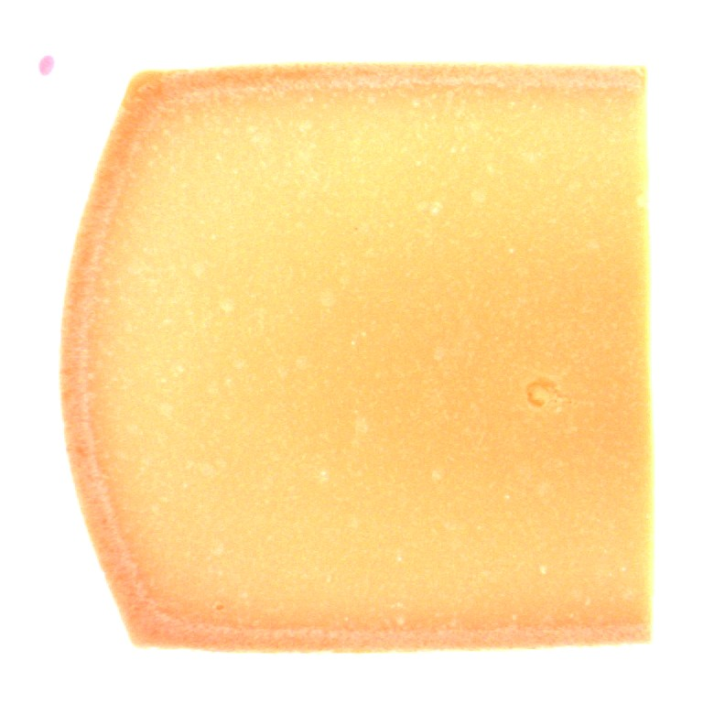
AI4FQC · PROJECT 07
Sensory captioning
of Trentingrana cheese
From dataset construction to comparing three encoder–decoder methods
Technical report · 38,437 image–caption pairs · 3 models · 7 attributes
Notes:
Good morning everyone, and welcome. Today I'm presenting our project on the sensory captioning of Trentingrana cheese.
The starting idea was to automatically generate sensory descriptions, in Italian, from images of grana cheese cross-sections.
In other words, teach a model to "describe" a cheese by looking at a slice of it.
We'll look at concrete numbers: 38 thousand image-caption pairs, three models, seven sensory attributes, and above all a clear scientific result about what truly drives a model to actually use the image.
Let's start with the context.

Slide 2
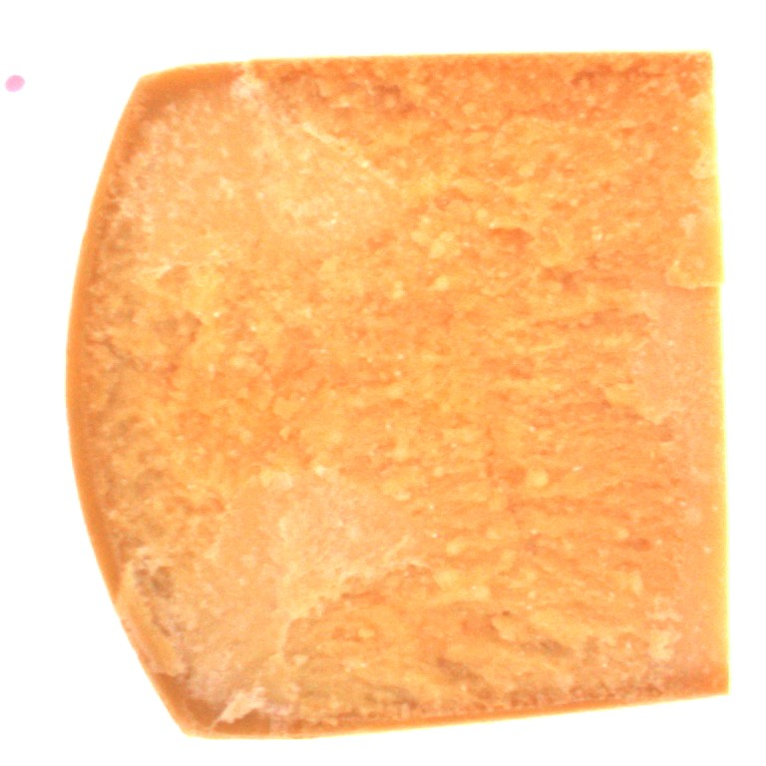
THE CONTEXT
Why an AI that describes cheese
Sensory quality control
Every wheel of grana is assessed by a panel of expert tasters. It is precious work, but it is slow, subjective and hard to scale across thousands of wheels.
The idea
● Input: IRIS images of cross-sections (controlled lighting)
● Output: a sensory description in Italian, per attribute
● Value: objective, reproducible support to the human panel
Close-up of the grain - IRIS electronic visual analyzer
AI4FQC · Project 07: GRANA Captioning
02
Notes:
Let's begin with the real problem.
Grana quality is certified by tasting panels which are experts who smell, taste and observe each wheel, describing aroma, flavor, structure and so on.
This approach has three limits: it is slow, it is subjective, two panelists describe the same wheel with different words, and it is hard to scale when there are thousands of wheels.
The project's idea is to support this work with an automatic system.
We feed the model an image captured with the IRIS electronic visual analyzer, like the one you see on the right, and we ask it to produce a sensory description in Italian for each attribute

Slide 3
THE SUBJECT
Seven sensory attributes
For each wheel the panel describes seven dimensions. Three are visible in the image, four are not, a distinction that returns in the results.
Colore della pasta
VISUAL
Texture
VISUAL
Struttura della pasta
VISUAL
Spessore della crosta
VISUAL*
Odore
OLFACTORY
Aroma
OLFACTORY
Sapore
GUSTATIVE
* visible but small
The rind is a small area: CLIP weights it little.
AI4FQC · Project 07: GRANA Captioning
03
Notes:
These are the seven sensory dimensions the panel rates for each wheel: paste colour, texture, paste structure, rind thickness, smell, aroma and taste.
Please keep in mind a distinction that will become central in the second part.
Three attributes, paste colour, texture and paste structure, are intrinsically visual: they can be read from the image.
Smell, aroma and taste, belong to olfaction and gustation: no photograph can reveal a taste.
And then there is an instructive case, rind thickness: it is physically visible, yet the rind occupies a small portion of the slice, and we'll see that the model struggles to "weight" it.
This taxonomy is not decorative: when we measure whether the model truly uses the image, we’ll find it succeeds exactly on the visible attributes and fails on the olfactory and gustatory ones.
It is a sanity check that validates the whole approach.

Slide 4
THE BRIEF
Two steps, one comparison goal
Step 1 · Text pre-processing
● Clean and normalize telegraphic, dialectal, inconsistent descriptions
● Replace quantitative measures (mm/cm) with qualitative descriptions
● Produce captions as complete Italian sentences
● ≈ 70% of the project's overall effort
Step 2 · Three captioning methods
● Apply three «as conceptually different as possible» encoder–decoders
● Focus on comparing methods, not on the single «best» model
● Multi-metric evaluation beyond BLEU alone
● ≈ 30% of the project's overall effort
AI4FQC · Project 07: GRANA Captioning
04
Notes:
The first step is text pre-processing: take the tasters' descriptions, often telegraphic, sometimes in dialect, occasionally inconsistent , and turn them into clean, normalised captions in the form of Italian sentences.
A specific, recurring requirement is to replace quantitative measures, the rind's millimetres and centimetres, with qualitative descriptions.
This step, as you see, accounts for about 70% of the work: it is the most original part.
The second step is to apply and compare three encoder-decoder methods that are "as conceptually different as possible".
Consistently with these weights, I'll devote the first and larger part of the talk to building the dataset, and the second to the models.
Let's start with the data.

Slide 5
PART I
Building the dataset
From 51,988 raw, dialectal rows to 38,437 clean image–caption pairs
Notes:
Let's start with Part One: building the dataset.
Here's the whole story in one line. We start with almost 52 thousand raw, messy rows. We end with 38 thousand clean image-caption pairs, written as real sentences.
Let me show you how we got there.

Slide 6
THE STARTING POINT
Rich data, but misaligned
What we had
2,745 BMP photos of sections (Slice / Grain)
4 Excel workbooks (2018-2021), one sheet per attribute
1 codebook: dairy ↔ product ↔ letter (16 dairies)
The join problem
Images and comments «spoke different languages». The filename identifies the single wheel; the comment only the taster's tray. No row-level join, only a dairy-level join, via the codebook.
Invisible obstacles
Triple dairy indexing: TN_306 / TN306 / 306
Inconsistent headers across years
Italian decimal comma ('7,48')
Provenance propagated downstream → traceability
AI4FQC · Project 07: GRANA Captioning
06
Notes:
At first the data looked rich. We had almost 2,750 photos of cheese sections, in two views: the full slice, and a close-up of the grain.
We had four Excel files, one per year, from 2018 to 2021.
And we had a codebook for the sixteen dairies.
So the problem was not how much data we had. The problem was alignment.
The images and the comments spoke different languages. The photo filename points to one single wheel. The taster's comment points only to the tray. So we could not match a photo to its comment row by row. We could only match them at the dairy level, through the codebook.
And on top of that, three small headaches. The same dairy is written three different ways. The Excel headers change every year. And the numbers use the Italian comma instead of the dot.
One good thing: we carry every detail about where each row comes from. So every final row can be traced back to the original comment.

Slide 7
THE JOIN SOLUTION
Dairy-level broadcast
Each comment is propagated to all coherent images of that dairy in that session: up to 4 rows from a single comment.
P3a - Slice
P3a - Grain
Panel comment
«Sauerkraut»
(Smell · TN_306)
4 image-caption rows
(same caption)
P3b - Slice
P3b - Grain
Net effect: 51,988 rows (image × panelist × attribute) · 39,510 with a comment · pairing rate ≈ 76%
AI4FQC · Project 07: GRANA Captioning
07
Notes:
So how do we fix the missing link between photo and comment?
We use something we call a dairy-level broadcast. The idea is simple. We take each taster's comment, and we copy it onto every matching image from that dairy, in that session.
Look at the example. One comment about smell, the word "Sauerkraut", for dairy TN_306. It becomes the caption for four different images: replica a and replica b, each in two views, slice and grain.
So one comment gives us up to four image-caption rows.
In total this gives almost 52 thousand rows. About 39 and a half thousand of them have a real comment. That's a pairing rate around 76 percent.
And from here, the pipeline begins.

Slide 8
THE ARCHITECTURE
An eleven-stage pipeline
Guiding principle: deterministic-before-the-LLM, everything that can be done with reproducible, free code is done before calling the model.
0
Unified table
51,988
1
Deterministic prep
39,356
2–3
Vocabulary + audit
7 attr.
4
Cleanup + qualitative
7,705 unique
5
Noise drop
7,689
6–7
Prompt + pilot
105
8
LLM batch
7,689
9
Manual salvage
+916
10
Broadcast + sentence
38,437
■ deterministic (free) ■ with LLM ■ final assembly
AI4FQC · Project 07: GRANA Captioning
08
Notes:
Here's the full pipeline. Eleven stages, numbered zero to ten.
There's one idea behind all of it, and it's the most important decision in Part One. We call it "deterministic before the LLM".
It means that anything we can do with plain code, free and repeatable, we do first. We only call the language model for the things that really need it.
In blue you see the code stages: preparing the text, building the vocabulary, cleaning, deduplicating. In gold, the stages that use the LLM: the prompt, the pilot, the full batch. In green, the final assembly.
Let me walk you through the key stages.

Slide 9
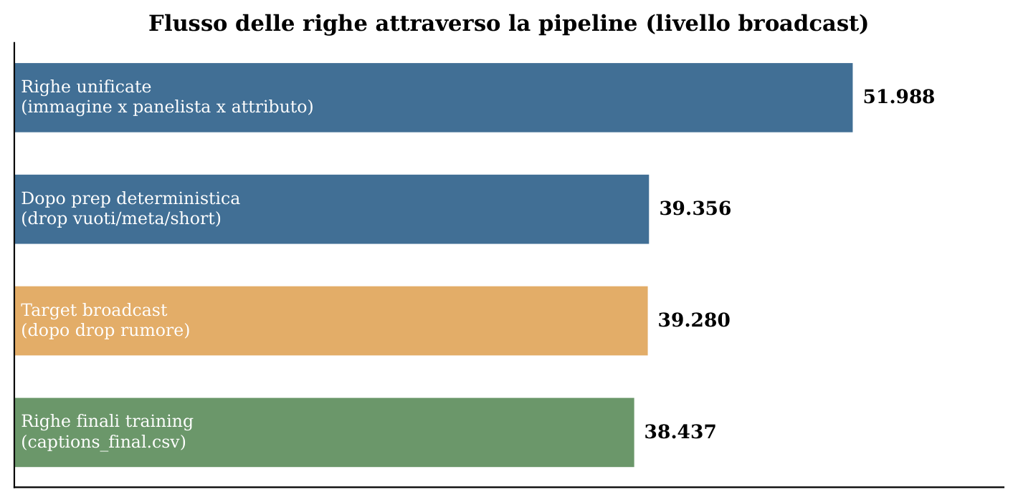
THE DATA FLOW
The funnel: where rows are lost (and kept)
Reading
● -12,632 rows in deterministic prep
● 12,478 empty / null
● 86 meta-comments · 68 near-empty
● 75.7% retention after stage 1
AI4FQC · Project 07: GRANA Captioning
09
Notes:
This is the same story, seen as a funnel. The bars show how many rows we have as we move through the pipeline.
The biggest drop is at the start, in stage one. Over 12,600 rows.
But almost all of it is empty or null. Only 86 are meta-comments. Only 68 are tiny fragments.
So we are not throwing away sensory content. We are only removing certain, obvious noise.
But how do we know it's safe to drop? That's the rule of stage one.

Slide 10
STAGE 1
Deterministic prep: clean without rewriting
Operations
● Filter empties/N-A + Unicode normalization (NFC)
● Remove non-breaking spaces, zero-width, tabs, newlines
● Drop meta-comments (small, conservative blacklist)
● Drop near-empty noise (< 2 alphanumeric characters)
● Dual column raw / norm → reversibility and audit
Philosophy
«Drops must be certain». The LLM will handle ambiguity better: a negation with a descriptor: «I don't penalize it, but it smells of barn» carries real information and is kept. Result: 39,356 rows (75.7% retention), 12,632 drops, of which 12,478 empty, 86 meta, 68 near-empty.
AI4FQC · Project 07: GRANA Captioning
10
Notes:
This is stage one: the deterministic prep.
The golden rule here is: clean, don't rewrite. We never change the taster's words. We only tidy them up.
Everything we do is mechanical and checkable. We remove empties. We fix the character encoding. We strip out hidden, broken characters. We drop meta-comments, using a very short
blacklist. And we drop tiny fragments, the ones with almost no letters left after cleaning.
We always keep two columns: the raw text, and the cleaned text. So every change can be undone and checked.
The rule on the right is the heart of it: a drop has to be certain. If something is unclear, we keep it, because the LLM will handle it better than any fixed rule.
The result is about 39 thousand rows. And remember, 99 percent of what we dropped was simply empty.

Slide 11
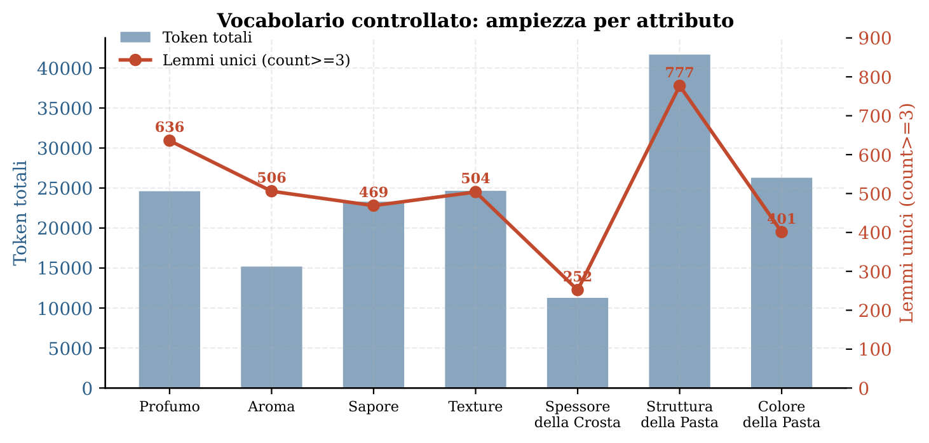
STAGES 2–3
A controlled vocabulary, tailor-made
Why custom
● Italian NLP tools err: panna→panno, latte→latto. Our stoplist keeps the intensifiers that matter: «molto», «poco», «leggermente»
● Deterministic normalization: abbreviation + typo maps, accent restoration, measurement units dropped
● Singular↔plural merge only when both forms are attested → antonyms stay split (carico ≠ scarico)
● Top-200 lemmas + top-80 bigrams per attribute (freq ≥ 3): audit basis + style anchor in the prompt, never a closed dictionary
AI4FQC · Project 07: GRANA Captioning
11
Notes:
In stages two and three we build a controlled vocabulary, one for each of the seven attributes. The most common words, and the most common word pairs. And we do it with our own Italian lemmatiser.
Why not just use a standard NLP library? Because on this kind of vocabulary, they get it wrong. "Panna", cream, becomes "panno", cloth. "Latte", milk, becomes "latto", which isn't even a word.
And worse, they throw away the little intensifier words, like "very" or "slightly", that actually carry the meaning here.
So we built our own, fully deterministic. It expands abbreviations, fixes the typos we found in the audit, and restores accents only when the accented word already exists in the data.
We also avoid blind suffix-cutting. A small handcrafted dictionary deals with the tricky cases. And we merge singular and plural only when both forms really appear, keeping the more common one.
The chart shows how rich each vocabulary is. Paste structure is the richest, around 780 words. Rind thickness is the smallest, around 250. That makes sense: there's just less to say about rind thickness.
We keep the top words and word pairs. They do two jobs: they're the basis for our audit, and later they guide the LLM's style, without ever being a closed list. The model already speaks Italian.
We just remind it how the panel talks.

Slide 12
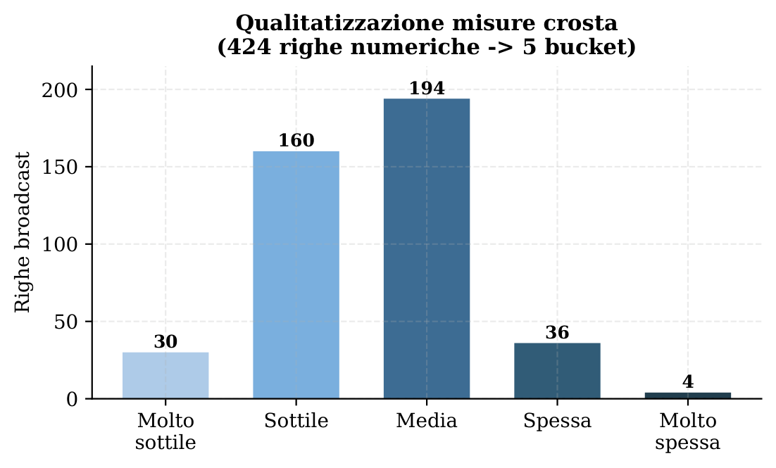
STAGE 4 · KEY REQUIREMENT
From numbers to quality: the rind
Hundreds of captions were just measures («10», «1 cm», «8-10 mm»). A deterministic function converts everything to mm and assigns a bucket.
Threshold (mm) | Bucket
< 8 | Molto sottile
8 ≤ x < 10 | Sottile
10 ≤ x < 14 | Medio
14 ≤ x < 18 | Spessa
≥ 18 | Molto spessa
AI4FQC · Project 07: GRANA Captioning
12
Notes:
Stage four deals with something the brief asked for directly: turning numbers into words.
The clearest case is rind thickness. Hundreds of captions were just numbers. "10". "1 cm". "around 9 mm". "8 to 10 mm".
So we wrote a function that spots these pure numbers, converts everything to millimetres, and sorts them into named buckets. Below 8, very thin. Up to 10, thin. And so on, up to very thick above 18.
Why do this with code, and not the LLM? Because it kills the model's biggest source of confusion. The LLM would read "1 cm" and "10 mm" as different things, even though they're the exact same size.
On the right you see the result: 424 numeric rows, sorted cleanly into five buckets.
The mixed captions, the ones with both a number and a description, we leave to the LLM, because those need real judgement.

Slide 13
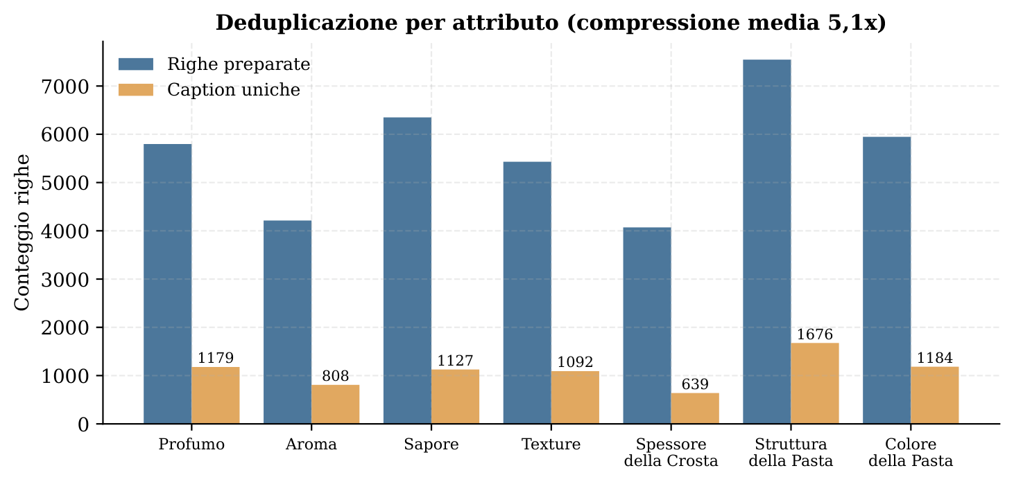
STAGE 5
Deduplication: 5.1× compression
Why it matters
● The broadcast replicates the same text many times
● 39,356 rows → 7,705 unique captions
● 5.1× compression by (caption, attribute) key
● Dominant 4× pattern: 6,595 captions exactly 4 times
● → cuts the LLM cost ~5×
AI4FQC · Project 07: GRANA Captioning
13
Notes:
This is the single trick that made the project cheap: deduplication.
Remember the broadcast? We copied each comment across four images. That means the exact same text would be sent to the LLM over and over, and we'd pay every time. That makes no sense.
So before we call the model, we remove the duplicates. We group by caption and attribute.
The result is sharp. Over 39 thousand rows shrink to about 7,700 unique captions. That's a 5-fold cut. The chart shows it per attribute: prepared rows on one side, unique captions on the other.
And you can see the broadcast's fingerprint: almost 6,600 captions appear exactly four times.
So we only send the LLM the unique captions. That cuts the cost by about five times.
It's the perfect example of "deterministic before the LLM". One free, simple step. Five times less to pay.

Slide 14
STAGES 6–8
LLM rewriting: the genuinely hard work
6 · Prompt design
● Per-attribute system prompt
● 11 rules :
Faithfulness: zero invention
Normalization: numbers→quality, synonyms→controlled lexicon
Cleanup: remove pure meta comments
Safety: NON_DESCRITTO escape when no descriptor is present
● Top-60 lemmas as a style anchor
● 6 real few-shot examples
7 · Pilot run
● 105 captions (15 per attribute)
● Found 2 failure modes: 1cm vs 10mm; empty format
● Both fixed in the prompt
● 3 workers = optimal; 8 → storms of 429s
8 · Full batch
● 7,689 / 7,689 completed, 0 errors
● ~25-30 minutes
● Haiku 4.5 · Anthropic Batch API
● ~$4.50 for the batch
AI4FQC · Project 07: GRANA Captioning
14
Notes:
Now we reach the smart part: the LLM rewriting. Stages six, seven and eight.
Here the model does the work no fixed rule could do well. It turns "Sauerkraut" into "Smell of sauerkraut". It cleans up dialect. It removes the meta-comments but keeps the real description. It turns questions into statements.
Stage six is the prompt. One prompt per attribute, with eleven rules. One of them is "invent nothing". Another is an escape word, NON_DESCRITTO, for inputs with no real content. We also give
it the sixty most common words as a style guide, and six real examples.
Stage seven is the pilot, on 105 captions. This is where we caught two problems before spending money: the centimetre-millimetre mix-up, and some formatting errors. We fixed both in the prompt. One practical lesson: three workers at a time was the sweet spot. Eight workers, and we hit rate-limit storms.
Stage eight is the full batch. All 7,689 captions, in one job. The result: all of them done, zero errors, in about half an hour, for around four and a half dollars.
Which brings us to one question: why Haiku?

Slide 15
MODEL CHOICE
Why Haiku 4.5: same job, a fraction of the cost
The pilot's verdict
● 2.4× cheaper than Sonnet
● 12× cheaper than Opus
● On the verified task, bigger models gave no measurable extra quality
● $5.60 total LLM cost of the project
AI4FQC · Project 07: GRANA Captioning
15
Notes:
So how do we actually know Step One is done? Not by feeling. By checking, automatically, all 7,689 outputs.
The table shows the checks. Every output starts with the right prefix, with one "violation" that's really just a valid alternative.
But look at the numbers that matter. Zero outputs with digits. Zero with units like millimetres. Zero too long. Zero empty. Zero with markup. All zeros.
So the job the brief asked for, turning numbers into words, is done one hundred percent. No numbers left, no units left, in the final captions.
And when a reviewer asks "are you sure you removed all the measures?", the answer is a table, not an opinion.

Slide 16
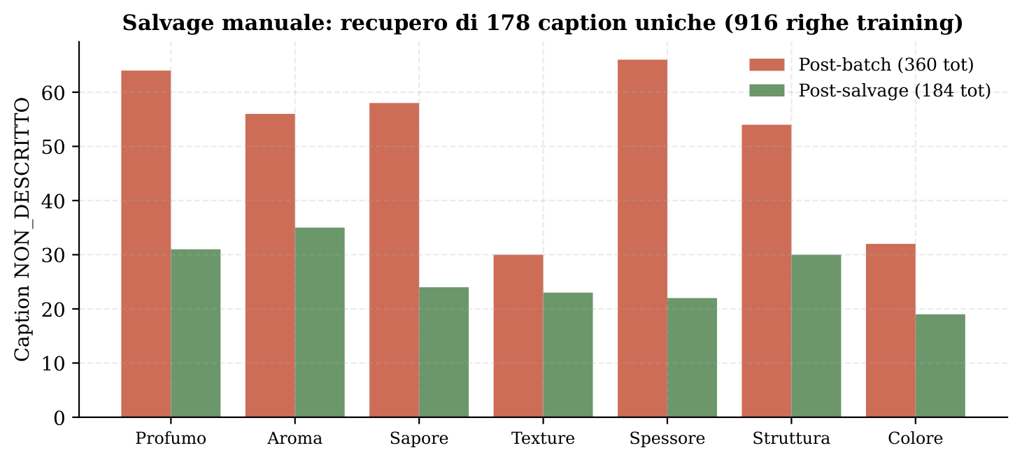
STAGE 9
Manual salvage: cleaning ≠ throwing away
Hand-curation
● 291/362 NON_DESCRITTO had a vocabulary lemma → LLM too cautious
● 178 captions salvaged by hand
● «marcio, putrido,» → «Smell of rot and putridity.»
● 362 → 184 unique NON_DESCRITTO
● +916 training rows recovered
AI4FQC · Project 07: GRANA Captioning
17
Notes:
Stage nine is one of those steps that separate a truly curated dataset from one that's just "cleaned".
After the batch, we found something interesting. Of the 362 captions the model marked as "no description here", 291 actually had a real vocabulary word in them. The model had just been too cautious on the borderline cases, the ones mixing a judgement with a description.
So we went in by hand and rescued 178 of them, where the description was real.
A couple of examples. "marcio, putrido" becomes "Smell of rot and putridity". "Sangue" becomes "Aroma of blood".
The result, in the chart: the unmarked ones drop from 362 to 184. And that brings back 916 training rows we would have lost.
The message is simple. Cleaning data is not the same as throwing it away. A bit of careful work by hand, on a small set, cost less than another LLM run, and gave us back almost a thousand good examples.

Slide 17
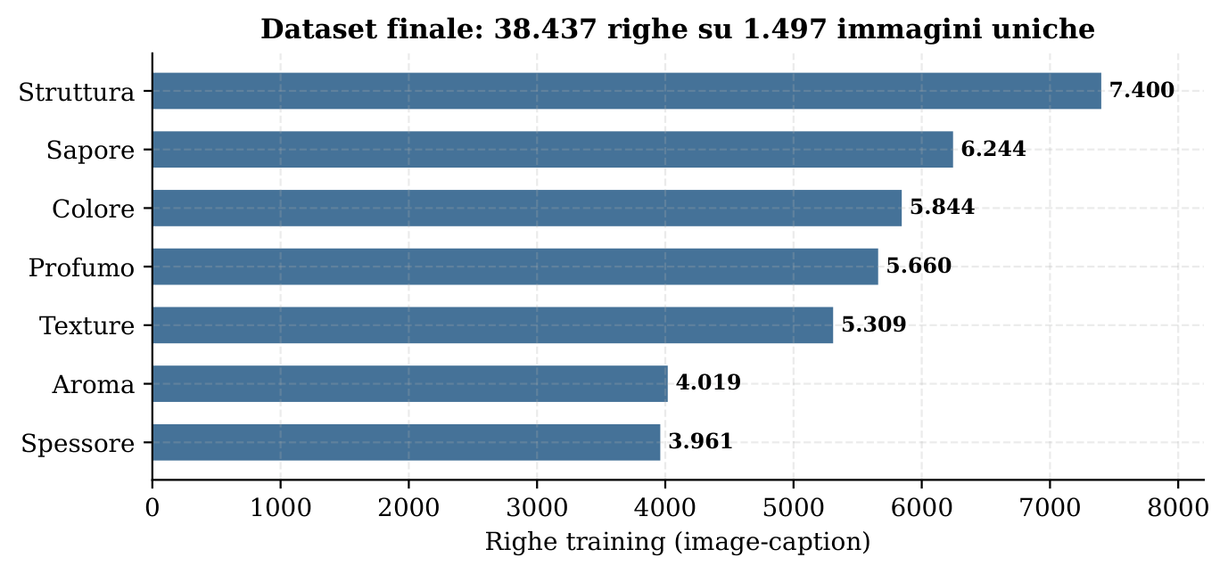
STAGE 10 · THE DELIVERABLE
The final dataset
Delivered schema
● captions_final.csv — 38,437 × 18 col. (provenance)
● image_caption_attribute.csv — 4-column view
● by_attribute/<Attr>.csv — 7 per-attribute splits
● caption (compact, ~4–8 words)
● caption_sentence (Italian sentence, ~7–15 words)
● Deterministic sentence form: 100% template, 0 extra LLM round-trips
38,437
final rows
1,497
unique images
2
caption forms
AI4FQC · Project 07: GRANA Captioning
18
Notes:
And here's the deliverable for Part One. Stage ten joins the clean captions back to the broadcast table, and gives us the final dataset: 38,437 rows, over 1,497 unique images.
The chart shows the rows per attribute, and notice there's a real imbalance. Paste structure has almost double the rows of rind thickness. That gap will matter later, in Part Two.
On the format side, we made a flexible choice. Every row carries two versions of the caption. A short one, four to eight words, like "Smell of cream". And a full Italian sentence, "The cheese has a
smell of cream", which works better for the models and the metrics. And that sentence step is fully deterministic, no extra LLM call.
We deliver the dataset in a few shapes: the full table with all the provenance, a simple four-column view, and seven splits, one per attribute, so any model can use it.
And with that, we close the data part, and move on to the models.

Slide 18
PART II
Model selection and training
Three encoder–decoder methods, one determinant: the visual encoder
Notes:
Second part: the models.
Here the brief's goal is the comparison of methods, and let me give you the conclusion upfront, so
you can follow the data with the right key. Among everything we could change — the decoder, the
amount of data, the hyperparameters — the single factor that decides whether the model truly uses
the image is one: the visual encoder.
We'll build this conclusion step by step, and verify it with two independent tools: the shuffle test
and the CLIPScore. Let's start with the three architectures.

Slide 19
THE ARCHITECTURES
Three methods, two axes of variation
m1
m3
m6
ENCODER
ResNet-50
(CNN, frozen)
ENCODER
ViT-B/16
(frozen)
ENCODER
ViT-B/16
(frozen)
DECODER
LSTM
from scratch
DECODER
Transformer
from scratch
DECODER
GePpeTto
pretrained Italian GPT-2
↔ m1 vs m3 isolates the ENCODER ↔ m3 vs m6 isolates the DECODER
All encoders are frozen: only decoder and cross-attention projection are trained → fair comparison.
AI4FQC · Project 07: GRANA Captioning
20
Notes:
The brief asks for three methods "as conceptually different as possible". We chose them to isolate
the three main axes of variation in captioning.
m1 is the classic: a convolutional encoder, ResNet-50, with an LSTM decoder trained from scratch.
m3 changes the encoder: a Vision Transformer, ViT-B/16, with a Transformer decoder, still from
scratch. m6 changes the decoder: the same ViT, but the decoder is GePpeTto, an already-pretrained
Italian GPT-2.
The beauty of this design is in the axes, at the bottom. Comparing m1 with m3 isolates the encoder's
effect, because the decoder stays the same "from scratch" type. Comparing m3 with m6 isolates the
decoder's effect, because the encoder is identical. It's a small controlled experiment.
A crucial choice for fairness: all encoders are frozen. We train only the decoder and the
cross-attention projection. So each decoder receives exactly the same visual features, and the
differences we observe are attributable to architecture, not to a lucky encoder. This, we'll see,
is also the main limitation, and the main pointer to future work.

Slide 20
EXPERIMENTAL SETUP
Training on Kaggle, fair comparison
Model | epochs | batch | lr | scheduler | patience
m1 · CNN+LSTM | 50 | 32 | 3e-4 | StepLR | 7
m3 · ViT+Transf. | 30 | 16 | 1e-4 | cosine | 5
m6 · ViT+GePpeTto | 20 | 8 | 5e-5 | cosine | 5
AI4FQC · Project 07: GRANA Captioning
21
Notes:
The experimental setup, briefly. All training ran on Kaggle's free GPU tier, with T4 or P100. The
hyperparameters in the table are reasonable defaults for each architecture, not the fruit of an
exhaustive search: m1 more epochs and a higher learning rate, m6 few epochs and a small learning
rate, as is natural for a pretrained model that only needs fine-tuning.
Two choices ensure a fair comparison. First, the split is sample-disjoint: the same cheese never
appears both in training and in test, so we avoid leakage. Second, at inference we use nucleus
sampling instead of beam search, because on small datasets beam collapses to the most frequent
caption, artificially inflating BLEU but reducing diversity.
The training curves are healthy across all three models, no overfitting, no NaN, no collapse, so
the differences in results are not due to training pathologies.
On the right, a Kaggle lesson learned the hard way, for anyone wanting to reproduce: the enable_gpu
flag in the metadata is not enough, and the preinstalled PyTorch on P100s must be reinstalled.
Details, but the kind that cost you an afternoon.

Slide 21
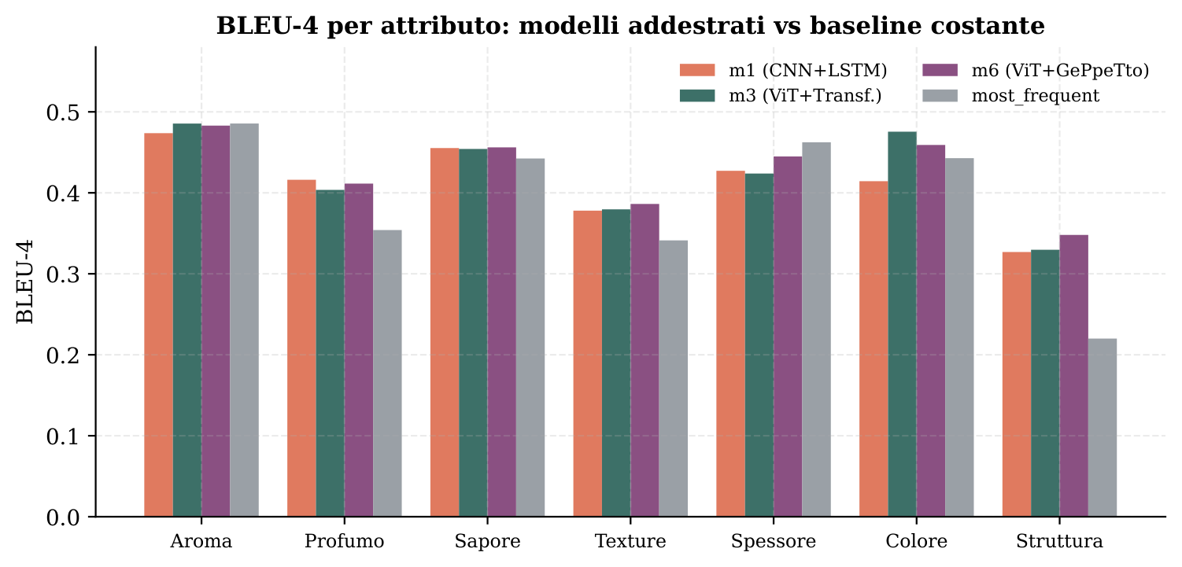
RESULTS · PER-ATTRIBUTE
BLEU-4: models win where captions are diverse
Reading
● Win: Struttura (+0.128), Profumo, Texture, Colore
● Tie/lose: Aroma, Sapore, Spessore
● Not from weakness: BLEU rewards the modal predictor on low-diversity captions
● 4 / 7 attributes beat the constant baseline
AI4FQC · Project 07: GRANA Captioning
22
Notes:
Let's see the first results, in the per-attribute regime: seven separate models, one per sensory
dimension. The chart shows BLEU-4 per attribute, compared with the most_frequent baseline, the one
that always emits the most frequent caption.
The picture is sharp and two-sided. The trained models clearly beat the constant baseline on four
attributes: paste structure, with a notable margin of over 0.12 points, then smell, texture and
colour. On the other three, aroma, taste and rind thickness, they tie or lose.
Be careful not to misread this "lose". It does not mean the models are poor on those attributes. It
means that there the reference captions are not very diverse, very template-heavy, and under those
conditions BLEU rewards whoever always predicts the majority. It's a flaw of the metric, not of the
model, and we'll prove it shortly with the shuffle test, which on thickness confirms m3 and m6 do
use the image.
In short: 4 of 7 attributes beat the baseline, and the 3 "lost" ones are a BLEU artifact.

Slide 22
RESULTS · GLOBAL MODEL
A single model across all attributes
m6 wins narrowly
● m6 first on BLEU-1/4, ROUGE-L, METEOR≈
● m3 first on CIDEr
● 0.007 BLEU-4 spread: a very tight cluster
● ⚠ most_frequent has the highest BLEU-1 but worst BLEU-4: degenerate
AI4FQC · Project 07: GRANA Captioning
23
Notes:
Let's move to the global regime: a single model trained across all attributes together. It's an
intrinsically harder task, because the model must also choose which sensory dimension to describe,
and it works with a much larger vocabulary.
The chart compares the three models on five metrics. Two observations. First, m6, the ViT with
GePpeTto, wins narrowly almost everywhere: it's first on BLEU-1, BLEU-4 and ROUGE-L, and
essentially tied on METEOR; m3 only beats it on CIDEr. Second, and equally important, the three
models are in a very tight cluster: the BLEU-4 spread is just seven thousandths. They are very close.
A note on the baseline, which I left out of the chart for readability but is crucial: most_frequent,
the constant sentence, would have the highest BLEU-1 of all but the worst BLEU-4. It's the
degenerate behaviour of "always predict the majority": you guess many single words, but you never
compose a correct four-word sequence different from the template. Keep this anomaly in mind: it's
the first clue that BLEU, on its own, is misleading us.

Slide 23
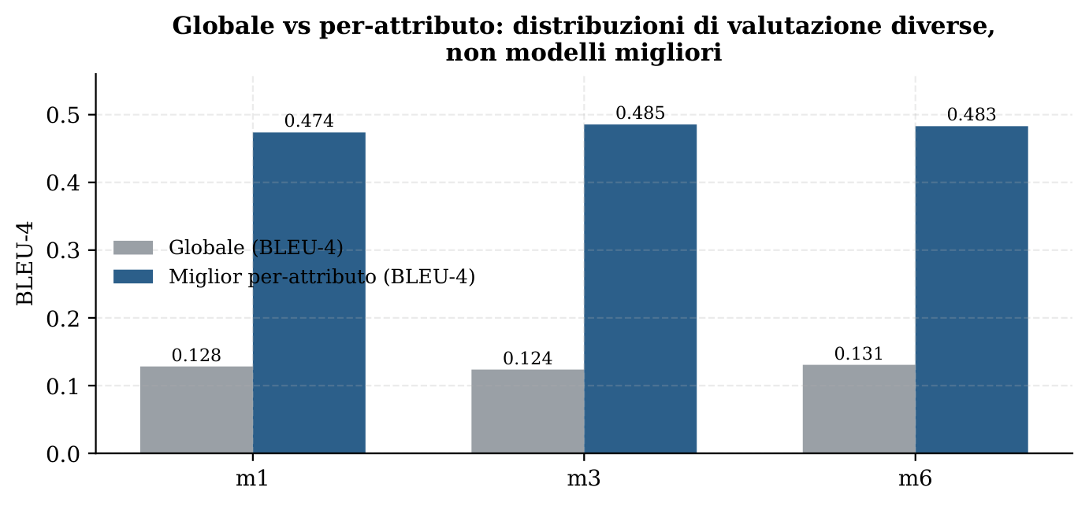
MIND THE INTERPRETATION
Per-attribute vs global: two different rulers
Why the 3–4× jump
● Does NOT mean per-attribute models learn better
● Per-attribute evaluation runs on a narrower distribution
● ~80-140 vocabulary words vs ~600+
● Shared scaffolding: ~5 words of constant 4-gram
● → they measure performance on different distributions
AI4FQC · Project 07: GRANA Captioning
24
Notes:
A slide of methodological caution, because it's easy to draw the wrong conclusion.
You'll have noticed that the per-attribute numbers, BLEU-4 from 0.33 to 0.47, are much higher than
the global BLEU-4, around 0.13. A three- or four-fold jump. The temptation is to say: "so the
per-attribute models are much better". Wrong.
That jump doesn't reflect better learning, but the fact that per-attribute evaluation runs on a much
narrower distribution. When you focus on a single attribute, the vocabulary collapses from over 600
words to about 80-140, and the shared scaffolding — "the cheese has a such-and-such attribute of..."
— alone contributes five words of constant 4-gram that send BLEU soaring.
They are two different rulers measuring performance on different distributions. The global model is
intrinsically harder because it must also choose which dimension to describe. Comparing the two
numbers as if on the same scale would be a mistake, and it's the kind of subtlety that separates an
honest analysis from one that fools itself.

Slide 24
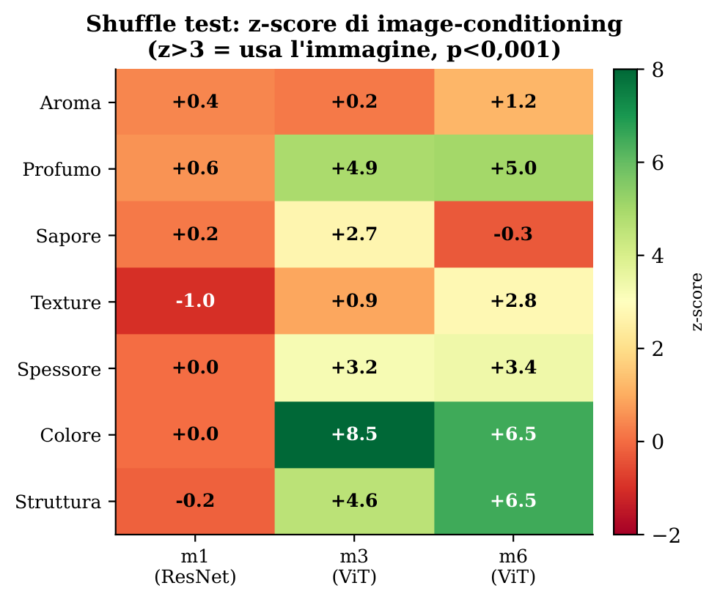
THE KEY RESULT
The shuffle test: does the model use the image?
How it works
Predictions are shuffled across test rows, breaking the prediction ↔ image alignment.
Recompute 100 times → null distribution → z-score. z > 3 ⟺ p < 0.001: strong evidence of image-conditioning.
What it says
● m1 (ResNet): z≈0 everywhere → pure language model
● m3 / m6 (ViT): use the image on 4/7 attributes
● Odore, Spessore, Colore, Struttura → succeed
● Aroma → no model uses the image
AI4FQC · Project 07: GRANA Captioning
25
Notes:
We're at the most important result of the whole project. The question is as simple as it is
fundamental: is the model actually using the image, or just mimicking the caption distribution?
The tool is the shuffle test. The idea: if a model is truly conditioned on the image, its prediction
for image i must match the reference of i better than a randomly picked prediction. So we shuffle the
predictions across test rows, breaking the alignment, recompute the overlap a hundred times to get a
null distribution, and measure the z-score. A z above 3 corresponds to p below 0.001: strong
evidence.
The verdict, in the chart, is crystal clear. m1, the ResNet model, has z near zero everywhere: it
never uses the image, it's effectively a pure language model guessing from the distribution. m3 and
m6, the ViT models, clearly use the image on four attributes out of seven: smell, thickness, colour
and structure. The only one where no model uses the image is aroma.
Keep this chart in mind: the next slide draws the architectural conclusion.

Slide 25
CIDER
Discriminates where BLEU flattens
Reading
● Orders the models: random < freq < m1 < m3 < m6
● Trained models clearly beat the random baselines
● m6 is the best among the models
● most_frequent (0.79) leads only because the reference IS often the frequent sentence: artifact, not quality
AI4FQC · Project 07: GRANA Captioning
28
Notes:
Let's start with CIDEr, the metric designed specifically for captioning. Unlike BLEU, which
flattened the models onto close values, CIDEr weights rare terms with TF-IDF and so separates them.
Look at the ordering in the chart, on the seven-attribute means: random 0.23, then freq_weighted
0.37, then the trained models rising clearly: m1 at 0.59, m3 at 0.65, m6 at 0.70. CIDEr orders the
models correctly, and confirms m6 is the best. It's exactly the information BLEU couldn't give us: a
clean ranking.
There's one column taller than all, in gold: most_frequent, at 0.79. Don't be fooled: the constant
baseline leads only because, on this dataset, the panel reference is often the frequent sentence
itself. It's an artifact of the single reference, not real quality. On an extreme case like rind
thickness, where BLEU gave 0.39 for everyone, CIDEr ranges from 1.04 to 2.29: a rich ordering BLEU
simply did not see.
Conclusion: CIDEr adds real information and separates the trained models from the noise.

Slide 26
CLIPSCORE
Independent confirmation of the shuffle test
By MODEL → all equal (gap < 0.004)
By ATTRIBUTE → visual high, smell/taste low
With a frozen encoder the image isn't exploited: the models do language modeling. The real variation is per attribute.
AI4FQC · Project 07: GRANA Captioning
29
Notes:
Now CLIPScore, the only metric that looks at the image, and the independent confirmation of the
shuffle test. Two charts, two messages.
On the left, mean CLIPScore by model. Note the axis: I deliberately zoomed in, and despite the zoom
the bars are practically identical. The trained models m1, m3, m6 do not beat the constant baseline
most_frequent, the one that always fires the same sentence ignoring the image. The gap is below
0.004, within the noise. It's the quantitative, independent confirmation of what the shuffle test
already told us: with a frozen encoder, the models don't anchor the caption to the visual content,
they do language modeling on the caption distribution.
On the right, the real variation: it's per attribute, not per model. CLIP "sees" that texture,
colour and structure, the visual attributes, get higher scores, while aroma, taste and smell stay
low for everyone, because no image can reveal a taste. It's a sanity check that validates the metric.
And remember the exception: rind thickness is visible but low, because the rind is a small portion
of the slice and CLIP weights it little. Everything fits.

Slide 27
QUALITATIVE EXAMPLES
What m6 actually generates
Attributo | Predizione (m6) | Riferimento (panel)
Aroma | Il formaggio ha un aroma di panna. | Il formaggio ha un aroma di panna. ✓
Sapore | …sapore leggermente salato e piccante. | Il formaggio ha un sapore salato.
Spessore | La crosta è mediamente spessa. | La crosta è mediamente spessa. ✓
Colore | …colore giallo carico omogeneo. | …colore giallo troppo carico.
Struttura | …frattura irregolare e grana fine. | …stirata e poca grana a tratti.
Four recurring patterns: (1) the scaffolding is always correct and worth ~50% of BLEU-4; (2) the language is fluent thanks to the pretrained LM; (3) the descriptor is often valid but for another cheese; (4) references vary enormously across tasters → a ceiling on BLEU.
AI4FQC · Project 07: GRANA Captioning
31
Notes:
The numbers tell half the story; the generated captions tell the other half. Here you see real
predictions from m6 alongside the panel reference, on test-set samples.
Sometimes it's an exact match: on the aroma of cream, prediction and reference coincide word for
word. On thickness, "the rind is medium-thick", again perfect. But look at the other cases: on taste
the model says "slightly salty and spicy" where the panel said just "salty"; on structure it
proposes "irregular fracture and fine grain" while the reference talks about stretched paste.
From these examples four patterns emerge, summarised at the bottom. First: the scaffolding, "the
cheese has a...", is always correct and alone worth about half the BLEU-4, which is why the numbers
aren't tiny. Second: the language is fluent and grammatical, thanks to the pretrained model. Third,
and most telling: the descriptor is often plausible but refers to another cheese, exactly what we
expect from a model only partially conditioned on the image. Fourth: the variability across tasters
is enormous and puts a ceiling on what any model can achieve with a single-reference BLEU.

Slide 28
Conclusions & future work
Scientific result
● The encoder matters: ResNet ignores the image, ViT uses it on 4/7
● Confirmed by shuffle test + CLIPScore
Practical result
● 4/7 attributes beat the baseline (max Structure +0.128)
● m6 (ViT+GePpeTto) wins narrowly almost everywhere
● $5.60 data cost · 38,437 pairs delivered
Future work
● Fine-tune the encoder and re-measure CLIPScore
● k-NN retrieval baseline as an image-aware «floor»
● If models pull away from the baseline → image exploited
Honest framing: no model would replace a taster. They learned the vocabulary and a partial image → descriptor map, consistent with the data scale and the noise of multi-taster annotation.
Thank you. Questions?
Notes:
Let's wrap up. The project delivers two results and one promise for the future.
The scientific result is the most solid: on this dataset, the determinant of image use is the visual
encoder. ResNet ignores the image on all seven attributes, ViT uses it on four out of seven,
independent of the decoder, the data scale and the hyperparameters. And it's not an isolated claim:
two independent tools, the shuffle test and CLIPScore, converge on the same conclusion.
The practical result: the trained models beat the constant baseline on four attributes out of seven,
with the maximum on structure. m6, the ViT with GePpeTto, wins narrowly almost everywhere. And all
this rests on a 38-thousand-pair dataset built with just 5 dollars and 60 cents of LLM cost.
Future work follows directly from the diagnosis: since the bottleneck is the frozen encoder, the
natural next experiment is fine-tuning the encoder and re-measuring CLIPScore. If the models start
pulling away from the constant baseline, we'll have direct proof that the image is finally being
exploited.
I'll close with an honest framing: none of these models would replace a taster today. They learned
the sensory vocabulary and a partial map from image to descriptor, a result consistent with the
data scale and the intrinsic noise of multi-taster annotation. But the path is mapped, and we know
exactly where to act.
Thank you for your attention. I'm happy to take questions.

Slide 29
HONEST EVALUATION
Beyond BLEU: seven complementary metrics
Metric | What it measures | Family
BLEU-1/4 | n-gram precision (words / exact phrasing) | text
METEOR | overlap with stemming and synonyms | text
ROUGE-L | longest common subsequence (order) | text
CIDEr | TF-IDF weighted n-grams: rewards rare salient terms | text
BERTScore | semantic similarity via embeddings (BERT it) | semantic
Vocab. conformity | % words in the attested sensory lexicon | domain
CLIPScore | caption–image appropriateness (CLIP cosine) | image
AI4FQC · Project 07: GRANA Captioning
27
Notes:
We've seen that BLEU, on its own, misleads: it rewards template repetition and never looks at the
image. To read the models more honestly, we paired BLEU with six complementary metrics, groupable
into three families.
The text metrics compare the prediction with the textual reference: besides BLEU, METEOR, which is
more lenient because it aligns with stemming and synonyms, ROUGE-L, which rewards word order, and
CIDEr, designed specifically for captioning, which weights n-grams with TF-IDF and so rewards rare,
informative sensory terms like "eyes" (occhiatura) over common words.
Then a semantic metric, BERTScore, measuring meaning similarity via embeddings. A domain metric,
vocabulary conformity, which asks: does the model "speak cheese" in the certified register?
And finally, highlighted at the bottom, the most important for captioning: CLIPScore, the only one
that truly looks at the image. It compares the caption with the slice in CLIP space, ignoring the
panel reference. The next two slides show what CIDEr and CLIPScore add.

Slide 30
THE INTERPRETATION
The encoder matters, not the decoder
m1 vs m3: isolates the encoder
m1 (ResNet) NEVER conditions on the image. m3 (ViT) does on most attributes.
→ A frozen ResNet-50's features aren't enough at this data scale; a frozen ViT-B/16's are.
m3 vs m6: isolates the decoder
They produce different outputs (never the same caption), but have the SAME image-conditioning profile: the same attributes succeed, the same fail. → The decoder changes the style, not whether the image is used.
The «binary gate» of image-conditioning is the visual encoder — not the decoder, not data scale, not hyperparameters.
AI4FQC · Project 07: GRANA Captioning
26
Notes:
Put the shuffle test together with the two-axis design from the architectures slide, and the
conclusion writes itself.
Comparing m1 with m3, which isolates the encoder: m1 with ResNet never conditions on the image, m3
with ViT does on most attributes. By changing only the encoder, image use switches on. The reading
is that a frozen ResNet-50's features aren't informative enough at this data scale, while a frozen
ViT-B/16's are.
Comparing m3 with m6, which isolates the decoder: they produce different outputs, they never give
the same caption for the same image, yet they have exactly the same image-conditioning profile. The
same attributes succeed, the same fail. Changing the decoder changes the sentence's style, not
whether the image is used.
The synthesis is at the bottom: the binary gate of image-conditioning, on this dataset, is the
visual encoder. Not the decoder, not the amount of data, not the hyperparameters. It's a clean
result, and it also tells us where to act in future: on the encoder. Now let's reinforce this
conclusion with the complementary metrics.

Slide 31
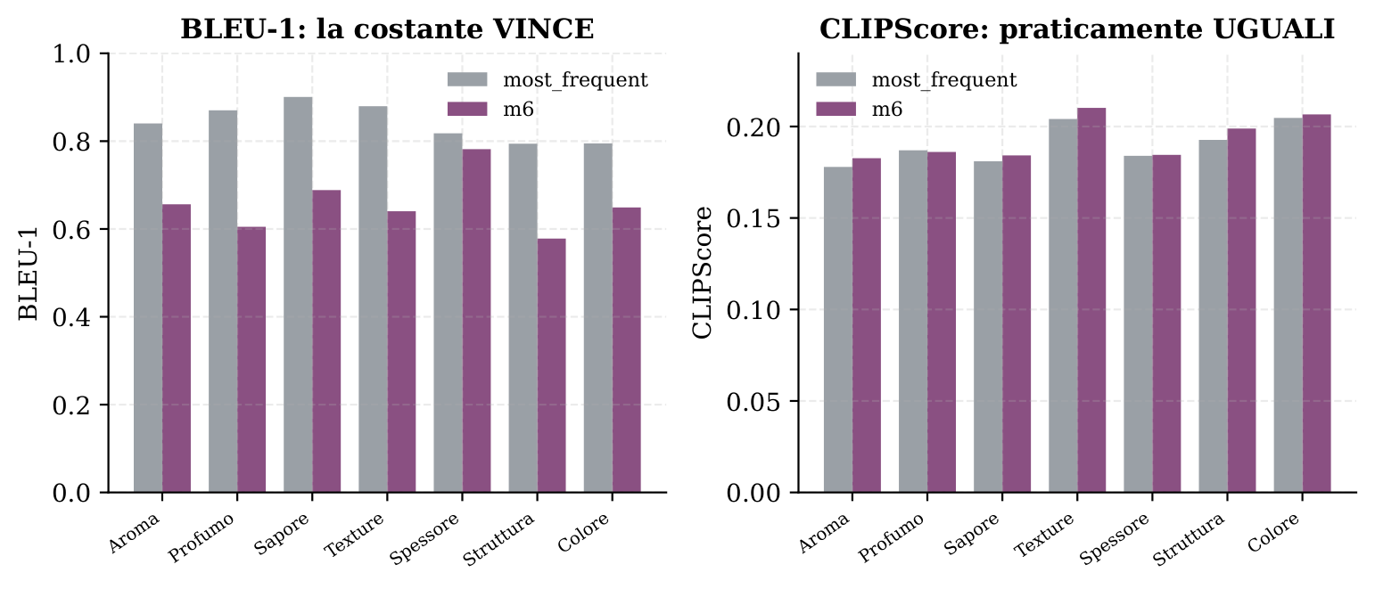
THE METHODOLOGICAL MORAL
The BLEU trap, visualized
A metric lies
Left, BLEU-1: the constant caption most_frequent WINS. Right, CLIPScore: the two models are practically equal. → BLEU-1 alone is misleading. Metrics must be read together.
AI4FQC · Project 07: GRANA Captioning
30
Notes:
This slide is the methodological moral of the whole evaluation, condensed into one image.
Look at the same pair of models, the constant baseline most_frequent against m6, seen by two
different metrics. On the left, with BLEU-1, the constant caption wins: it always emits the same
sentence and matches on the prefix. On the right, with CLIPScore, the two are practically
indistinguishable.
The exact same comparison, two opposite verdicts. This vividly demonstrates that a single metric, on
its own, can lie. Had we looked only at BLEU-1, we'd have concluded that a constant sentence beats a
trained model: an absurd conclusion. This is exactly why we built a battery of metrics and read
them together: BLEU for phrasing, CIDEr for salient terms, BERTScore for meaning, and CLIPScore for
image grounding.
BERTScore, for completeness, is poorly discriminating here: all values fall between 0.83 and 0.92,
because all sentences talk about cheese with the same structure. It's useful as a sanity check, not
for ranking. The lesson stands: never trust a single metric.

