Slide 1
Week 4 Deployment on Flask Abida Bhatti Batch Code: LISUM01 July 3,2021 submitted to Github
Data Source
https://www.kaggle.com/adityakadiwal/water-potability
Data file name
water_potability.csv

Slide 2
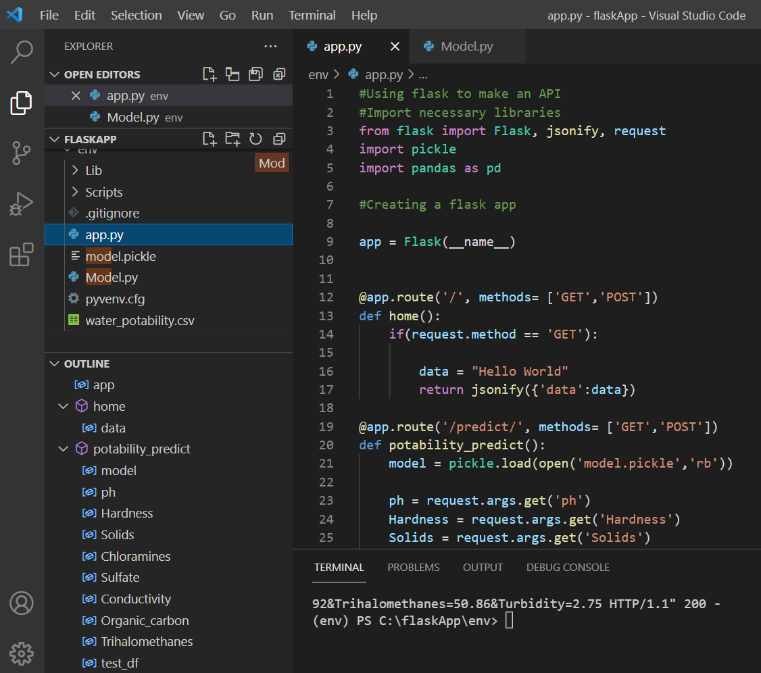

Slide 3
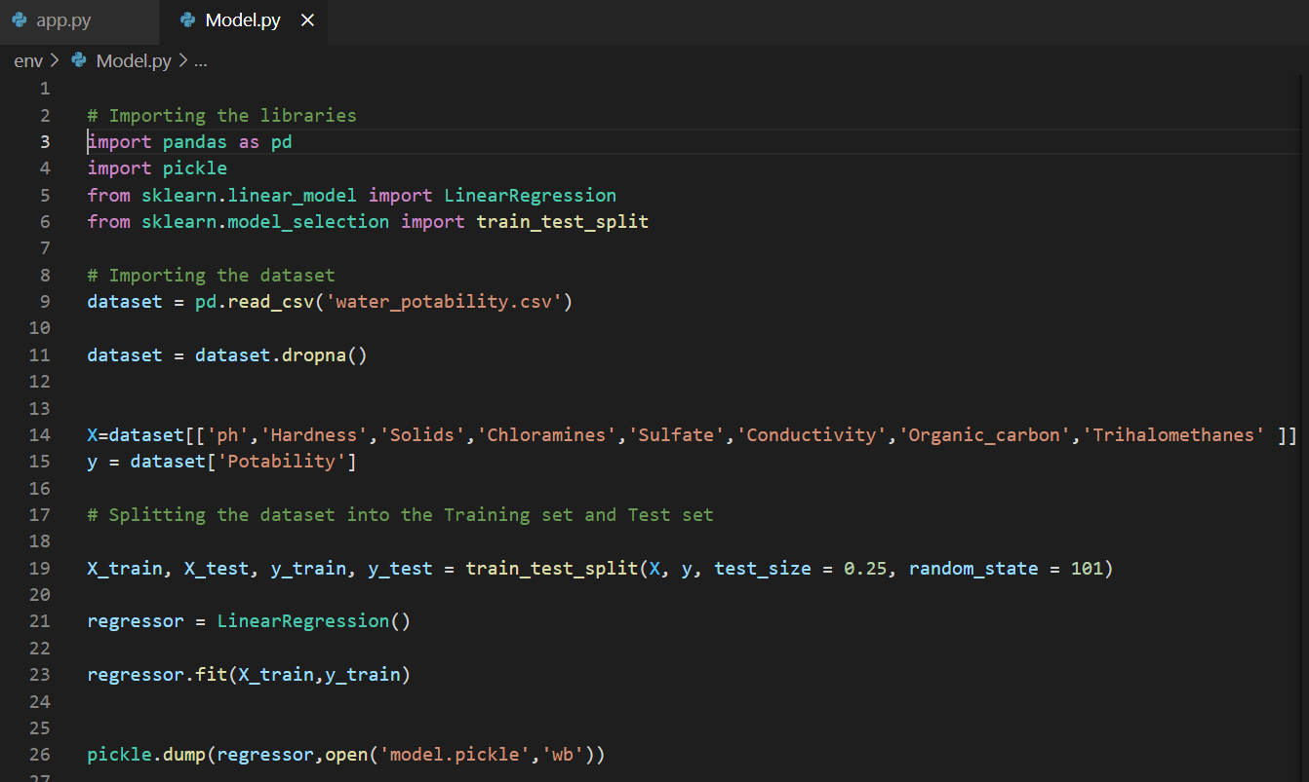

Slide 4
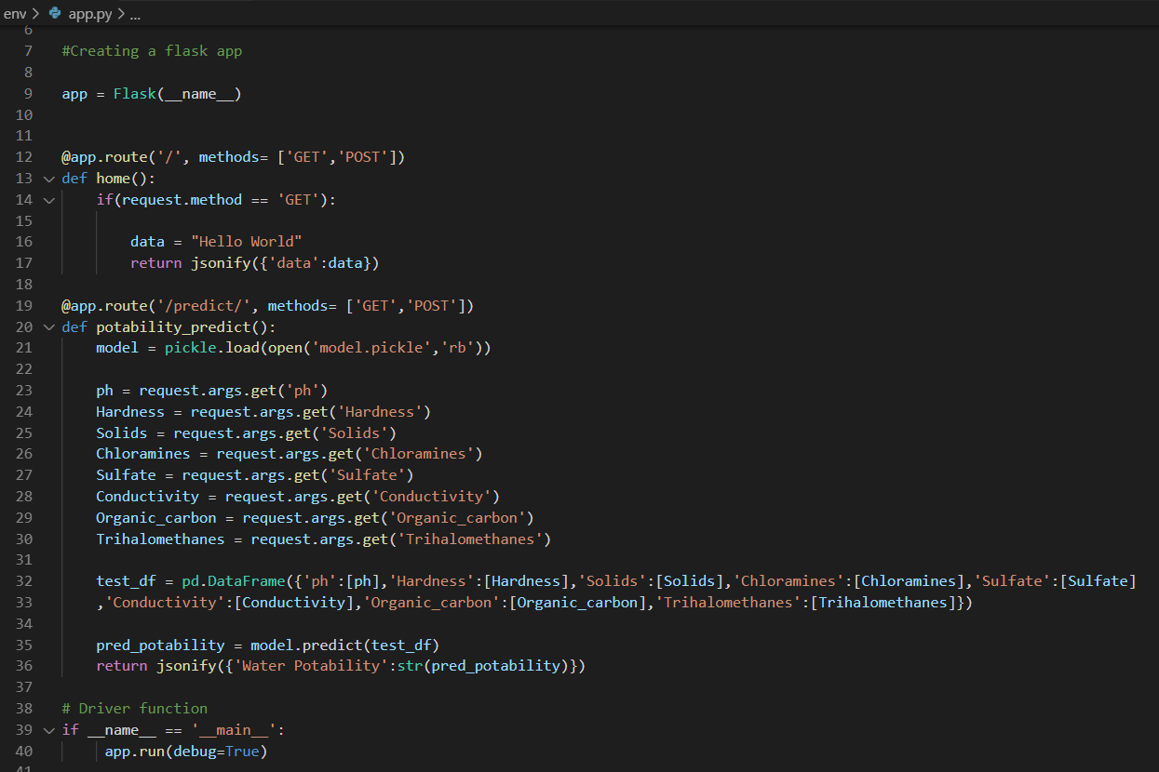

Slide 5
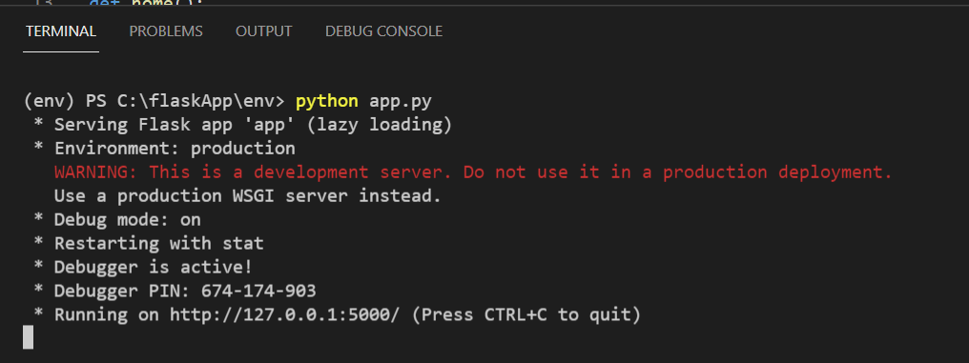
Application Deployment

Slide 6
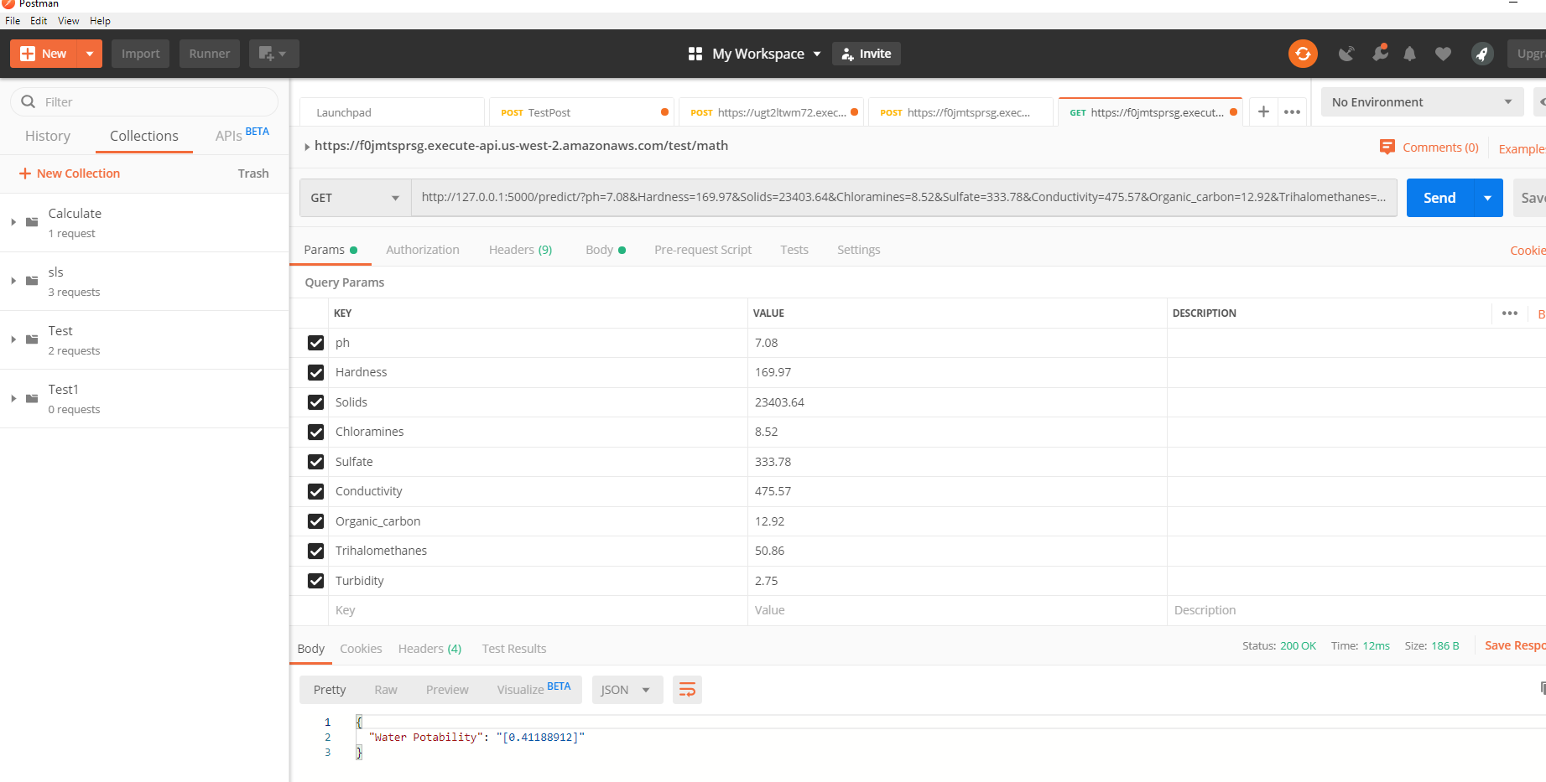
Testing using postman

Slide 7
Postman access test to waterpotability application deployed on Heroku
postman link https://waterpotability.herokuapp.com/predict/?ph=7.08&Hardness=169.97&Solids=23403.64
&Chloramines=8.52&Sulfate=333.78&Conductivity=475.57
&Organic_carbon=12.92&Trihalomethanes=50.86&Turbidity=2.75

