Slide 1
Masterfoods Asia Pacific
Business Data Store (BDS) Project Overview

Slide 2
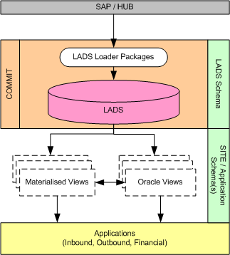
Today
Current Situation
Complex LADS table structure
Meaningless column/table names (SAP technical names)
Iterative View/Snapshots to achieve data access
(views on views)
Repetition of common logic/processing
Inconsistent approaches/logic to common data access
Issues
Unable to complete Oracle “Fast Refreshes” to factories
Slow LADS data access for site applications
Batched availability of LADS data based on snapshot timings
Large maintenance overhead for logic changes
Incorrect and inconsistent use of LADS data
Decentralised approach to common logic/processing
CURRENT : SAP to Site Application data flow

Slide 3
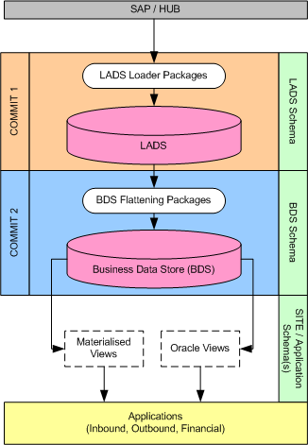
The Future
Proposed Solution - Business Data Store (BDS)
Introduce a flattened LADS data environment (BDS)
BDS to be loaded immediately after LADS (live feed)
BDS to be structured for fast data access
BDS to be structured to accommodate future requirements
Applications to utilise BDS data via single view layer
Materialised Views (snapshots) only for factory data transfer
Benefits
Single point of business data logic/processing
Simplified data structure optimised for access speed
Meaningful and logical naming conventions/structure
Ability to “Fast Refresh” to factory databases
PRPOSED : SAP to Site Application data flow

Slide 4
Project Outline
Prioritised Approach (by data set)
Phase 1 : Material / Classification Data - P1W4
Phase 2 : Material Determination - P2W4
Phase 3 : Factory Bill of Material - P3W4
Phase 4 : Customer - P4W4
Phase 5 : Orders / Delivery / Shipment - to be determined
note : timings are for the installation of the BDS processing in Production, not Application upgrade
Phase Tasks (required tasks per phase) :
1. Data Analysis (LADS/SAP) - LG / SAP Process Analyst(s)
2. BDS Design - LG / SITE
3. BDS Development/Testing - LG / SITE
4. Site Application Upgrades - SITE
Resources : GRD/IB/OB/Finance Process Analyst(s), Site Team analyst(s), DWT Analyst(LG),
Steve Gregan (Architect Consultant - as required)

