Slide 1


AP GSM – Information Delivery
ANZ ICS/LADS Overview & Support
October, 2007

Slide 2
Agenda
  ICS/LADS/BDS Overview
  ICS Website Overview
  ICS Support Examples
  ICS Support Escalation Process

Slide 3
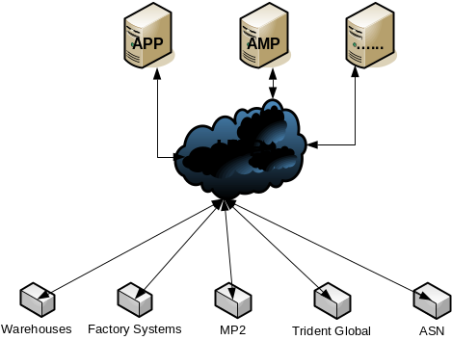
ICS/LADS Overview : Background
SAP going live for Australia & NZ – located in MTO
Local applications/systems would remain
Data flow via the HUB – didn’t guarantee sequencing
Also located in MTO
Connection to the HUB required server licensing ($$$)
What we didn’t want:
Each application/system connecting to HUB/SAP via WAN
Have to create/maintain/support duplicated interfaces
Decentralisation of HUB connections/control
Decentralisation of configuration/logging/alerting/etc.

Slide 4
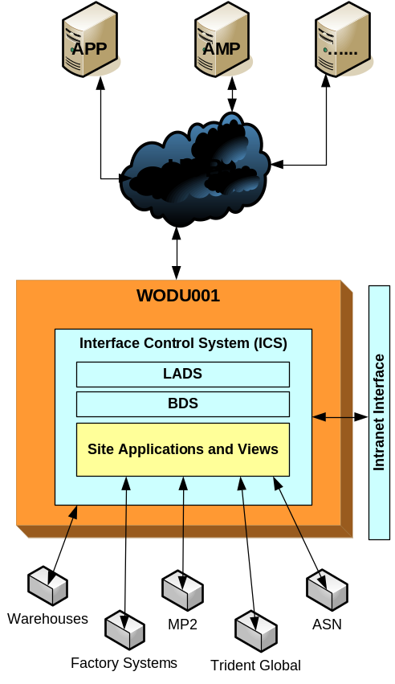
ICS/LADS Overview : A Star Is Born
Provide centralised, once only development
Provide centralised notification/alerts
Minimise WAN network & HUB traffic (MTO <-> AP)
Address HUB sequencing issues
Centralised application support
Service sites servers without Maestro and Data Junction
4 Core Components:
ICS (Interface Control System)
LADS (Local Application Data Store)
BDS (Business Data Store)
Intranet interface (web site)

Slide 5
ICS/LADS Overview : What is ICS?
It’s the set of Oracle Packages that make everything run
Provides:
  Logging features
  Schedule control
  Alerting features
  Job and Interface monitoring features
  Centralised configuration & control of interfaces
  Controls Inbound, Outbound & Passthru interfaces
Supported by AP GSM Information Delivery
Is not specific to one site or application (generic)
Is independent of LADS, SITE APPS, BDS, etc…

Slide 6
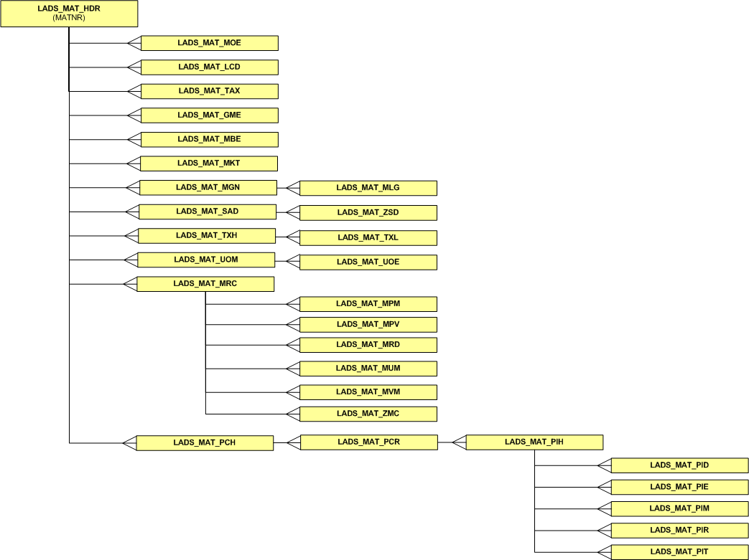
ICS/LADS Overview: What is LADS?
It’s the set of Oracle tables that represent the raw data received from SAP through IDOCS.
Data is only updated through IDOCS – NEVER manually!
IDOCS are complete sends (not change documents)
AP GSM DO NOT support data
Transaction data is purged after 90 days, GRD never
Currently there are 30 LADS interfaces, examples of these are:
  Material, Customer, Invoice, Sales Order, Delivery, etc.
SAP Technical names used – ie. Abbreviated German!
Data is in a loosely relational structure (as per SAP)

Slide 7
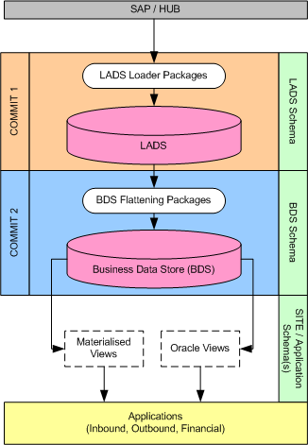
ICS/LADS Overview: What is BDS?
It’s the set of Oracle tables & views that provides the LADS data in a simplified, relational & meaningful structure.
Data is fed instantly from LADS -> BDS
AP GSM DO NOT support BDS data

Slide 8
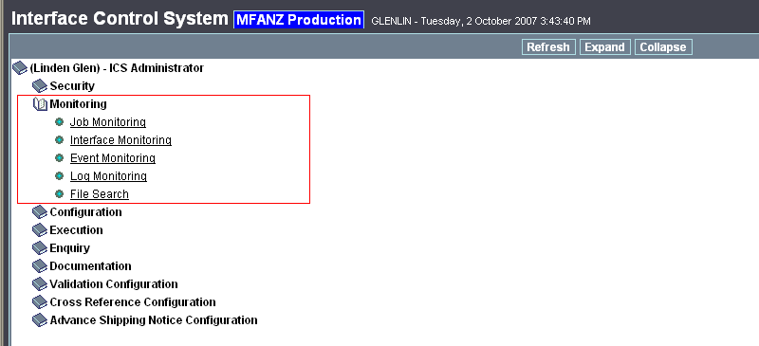
ICS Website Overview: Core Functions
Monitor & Review Interfaces Status
Review Exceptions & Errors
Review Interface Data
File Search
Interface/Job Configuration (GSM ONLY)
Job Control (GSM ONLY)

Slide 9
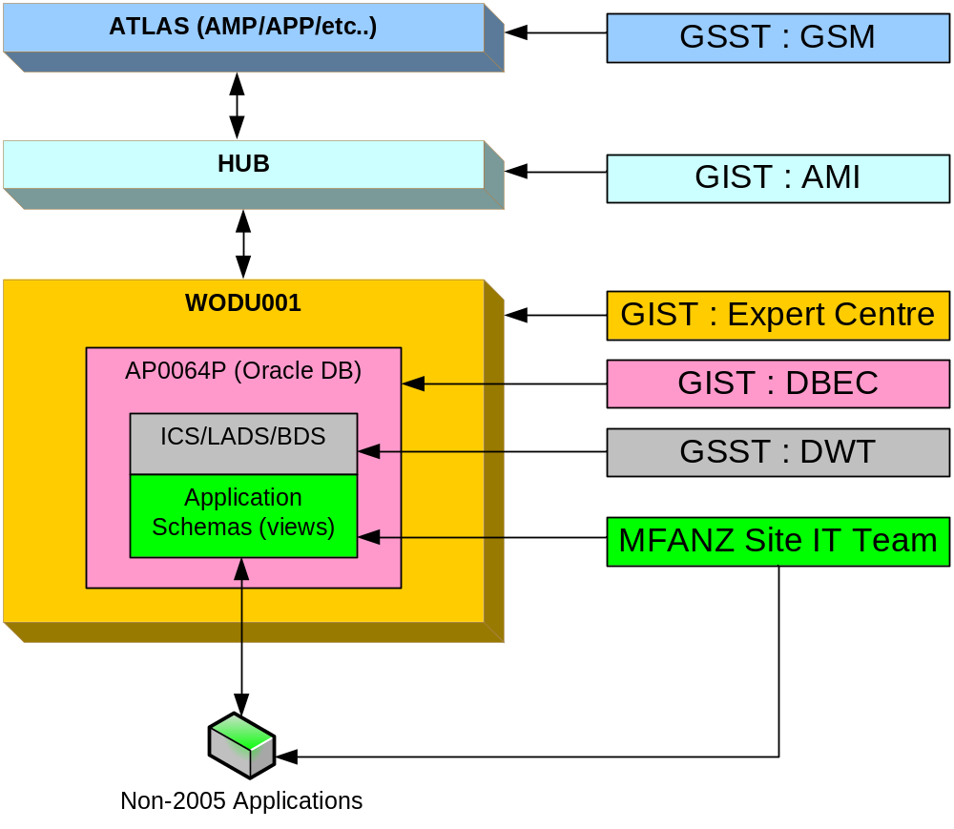
ICS Support Structure

Slide 10
ICS Website: Hands On
http://icsbrowser.mars

Slide 11
BDS Overview: Hands On
AP0064P : ics_reader

