Slide 1


GSM RBS Team
Callout Procedures
July, 2009

Slide 2
Agenda
Environment Overview
Solution – Missing Invoices
Solution – Missing Invoice Summary
Solution – Unexpected Server Outage
Solution – Other
Callout Detail – What you need to know
Documents / Useful Links

Slide 3
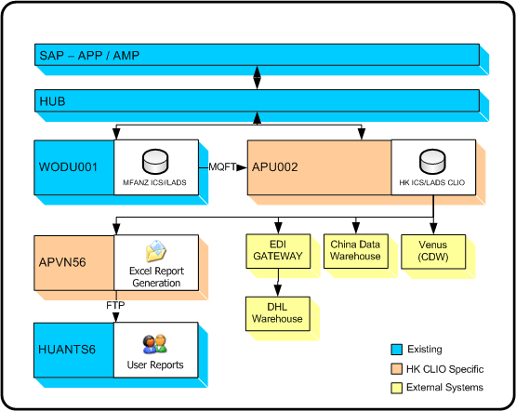
Environment Overview - CLIO

Slide 4
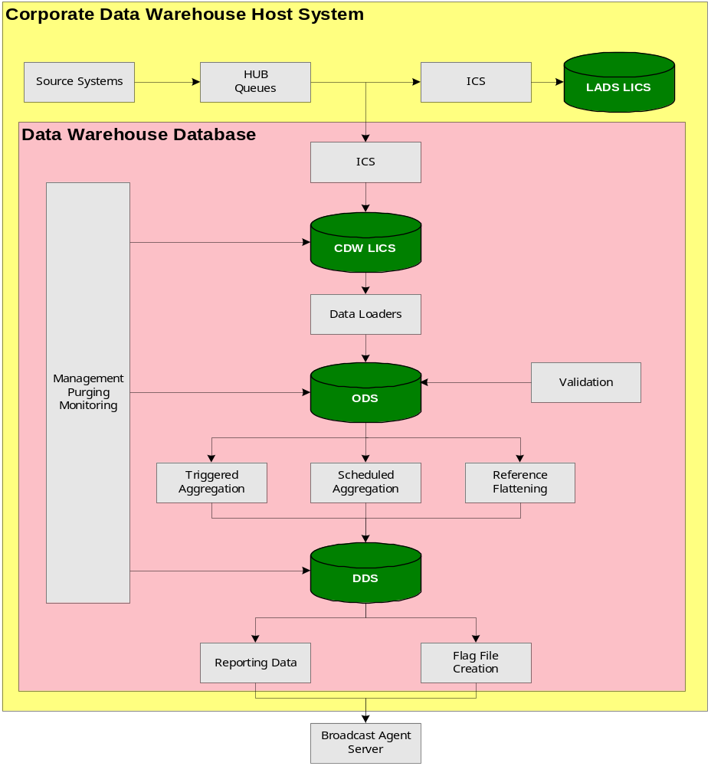
Environment Overview - VENUS

Slide 5
Solution – Troubleshooting Steps
1 - find which problem we are dealing with (missing invoice summary or missing invoices)
2 - run relevant query from cheatsheet (check invoices / check invoice summary)
3 - contact ATLAS Outbound AP team to get them to resend missing data (ATLAS Team information)
4 - run same query (from step 2) once again to ensure all data has been received
5 - redo steps 3 & 4 if data still missing
6 - if data exists run query to check invoice reconciliation
7 - rerun the interface (unless invoice summary was missing)
Please refer to cheatsheet in Document page for more information.

Slide 6
Solution – Missing Invoices
Re-execute DW_RECONCILIATION in case invoices have arrived since callout:
Connect to database.
Execute the code to get the reconciliation result.
If the reconciliation result balances, then continue.
If the reconciliation result does not balance then the cause needs to be identified and resolved before continuing. Possible causes are:
Invoices not sent from SAP
Delays in sending from HUB/SAP
Issue with link between WODU001 and WODU002 (Venus ONLY)
Callout Atlas if invoices have not arrived and send them the list of invoices currently in the database.

Slide 7
Solution – Missing Invoices cont’d
Re-run Invoice Summary Processing
Connect to the ICS Webpage -> Select relevant environment
Under the Configuration menu, select Interface Processing
Filter the view by (ATLLAD12) Atlas to LADS – Invoice Summary
At the top of the list will be an entry for the most recently received Invoice Summary. Click the blue Interface number in the left column for this interface.
On the next screen, click Accept. This will initiate the reprocessing of the Invoice Summary, and hence aggregation if reconciliation is successful.

Slide 8
Solution – Missing Invoice Summary
Connect to ICS webpage -> Select relevant environment
Go to interface monitoring
Filter the view by ATLLAD12 or ATLODS12
Check the item at the top of the list to see if it is the correct invoice summary. Note that in some environments (HK CLIO and VENUS) there is an invoice summary for each company code, so you need to ensure your checking for the correct one
If the invoice summary exists, ensure processing runs correctly
Otherwise contact Atlas Outbound to get them to resend
Once the data arrives successfully, monitor processing to ensure it runs successfully

Slide 9
Solution – Unexpected Server Outage
Connect to ICS for the impacted site (Venus, ICS/LADS, HK CLIO, etc)
If connection fails, contact the ART to see what the status of the server is
Once the ICS webpage can be accessed, go to Configuration -> Job Control
Click the “Stop Jobs” button and wait until all jobs status is “Stopped”. Note the page doesn’t refresh automatically, so use the “Refresh” button to reload the status of the jobs.
Once all jobs are “Stopped”, click the “Start” button
Click the “Backlog” button and check the backlog is being processed correctly (again use the “Refresh” button to reload the page)

Slide 10
Solution – Other
Callout either Jonathan Girling or Trevor Keon, depending who is second in the Support Contact Directory.

Slide 11
Callout Detail – What you need to know
Read the “Call Out Policy”, located on Mpower (Policies -> Pay and Benefits -> Call Out Policy).
The cheat sheet is a quick reference guide to handle most issues. It will be all you need to refer to in most cases.
Keep track of the tasks you complete for each callout. For example (from file Callout_20080724.txt):
  - took call at 1:00AM.
  - spoke to Angela Han about the issue, claimed CISATL17 not processing
  - checked ICS jobs which where running, but not processing anything
  - checked uptime on APU002, which was 3hrs
  - restarted ICS jobs
  - restarted APVN60 server
  - checked filesystem for any unprocessed files
  - found 2 files not processed in the inbound directory. Could not process them due to their permissions. Contacted AMI op to set the correct permissions.
  - disconnected at 1:45AM.

Slide 12
Callout Detail – What you need to know cont’d
Ensure emails are sent once callout is completed detailing the issue and what was done (can use the points from the callout file)
Remember to log your callout in the On Call Hours database

Slide 13
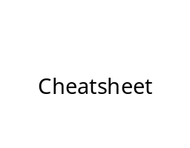

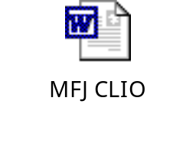
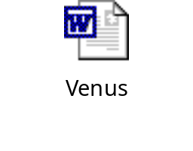
Documents
The below document is also available in the Tortoise SVN repository. The repository will always have the most recent version of the document available, while the one below may not be current. The location is:
DOCUMENTATION\ICS\ON_CALL

Slide 14
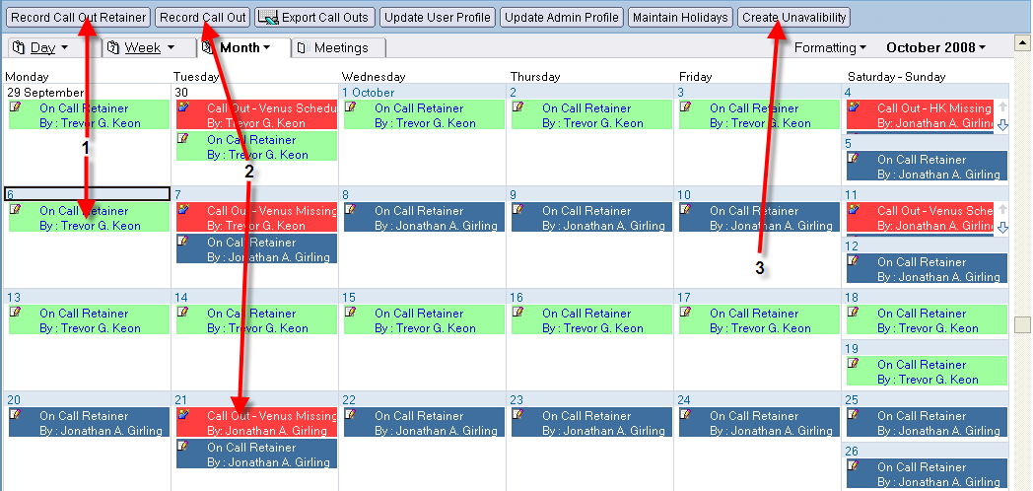
On Call Hours Database
notes://ISASN1/ISA/oncall.nsf
1. Record the days you where on call for.
2. Record the time, type and length of a call out. Note the standard format for the call out type.
3. Create unavailability should be used when you are on leave for auditing purposes.

Slide 15
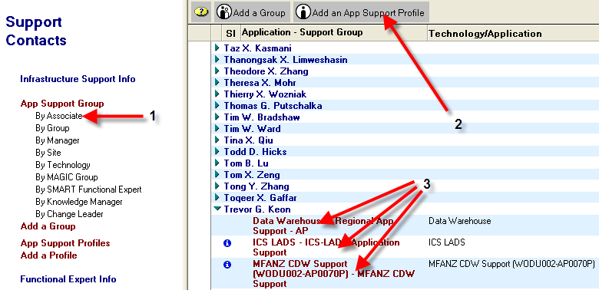
Support Contact Directory Database
notes://APSN4/MSC/supinfo1.nsf
1. Display by Associate to find your name and supported applications .
2. Use this to create an application support profile to be available to go on call. Please fill in the details with as much information as possible.
3. The list of supported applications you are responsible for.

Slide 16
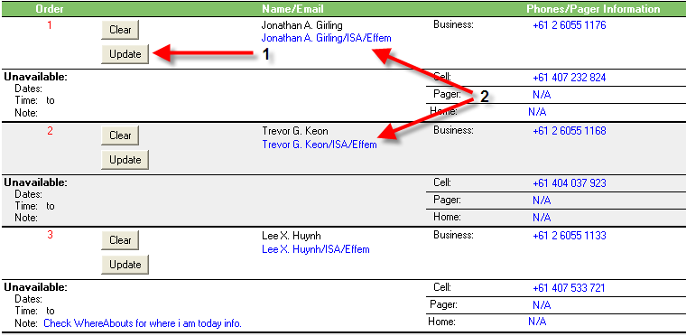
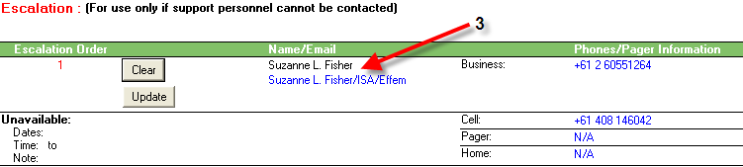
Support Contact Directory Database cont’d
1. Use the update button to set the new contact person for the specified level (ie 1st contact, 2nd contact, etc)
2. The names of the person on call at the specified level
3. Don’t let it get that far.

Slide 17
ICS Webpage
http://webappdev11.ap.mars/ics_browser.asp

Slide 18
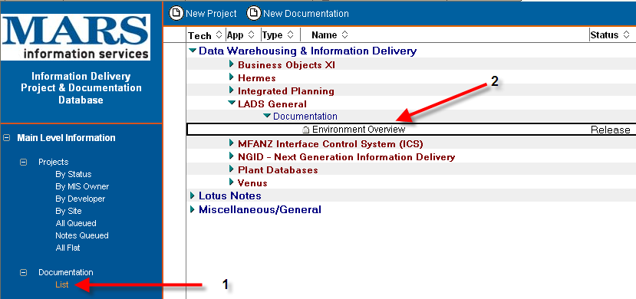
Info Delivery Project Database
1. Select the Documentation -> List option to display documentation information
2. Select the environment overview to get access to database connection information
This database also contains helpful documentation about other information delivery systems. Feel free to have a look around and see if there is anything of use for you.
notes://APSN36/dev/ISA/InfoDelApp.nsf

Slide 19
Access
WODU001
WODU002
APU002
TOKU006
HUAU003
APVN56
APVN60
SCD (Support Contact Directory)
On Call Hours
Tortoise SVN
Access to ICS as Admin

